Slide 1



SPEEDING UP "WINDOWS 11"
1

Slide 2
Web location for this presentation:
http://aztcs.apcug.org
Click on "Meeting Notes"

Slide 3
SUMMARY
Microsoft's defaults and background processes can massively slow down your "Windows 11.." computer.
You can get into the hidden settings screens of your "Windows 11.." computer to speed it up !

Slide 4
BASIC STRATEGY
No direct editing of the “registry”
Make reversible changes to the "Windows.." operating system

Slide 5
BASIC STRATEGY (continued)
To speed up a Windows 11.. computer, you have to be logged into the computer with an "account" that has an "Account type" of "Administrator", not an "Account" that has an "Account type" of "Standard user".

Slide 6
PROCEDURE & TOPICS
Big Step 100: Run "System File Checker"
Big Step 200: Uncheck Most "Visual Effects"
Big Step 300: Check and Set "Advanced Performance Options"
Big Step 400: Disable most "Startup apps"
Big Step 500: Provide Windows.. With More "Virtual Memory"

Slide 7
SPEEDING UP WINDOWS 11 --BIG STEP 100: RUN "SYSTEM FILE CHECKER"

Slide 8
SPEEDING UP WINDOWS 11--BIG STEP 100: RUN "SYSTEM FILE CHECKER"
Step 101: Use the RIGHT mouse button to click on the "Start button" (or using the keyboard, press Windows key + x key).

Slide 9


Slide 10
SPEEDING UP WINDOWS 11--BIG STEP 100: RUN SYSTEM FILE CHECKER (continued()
Step 102: A "Power Users" menu will be displayed.

Slide 11
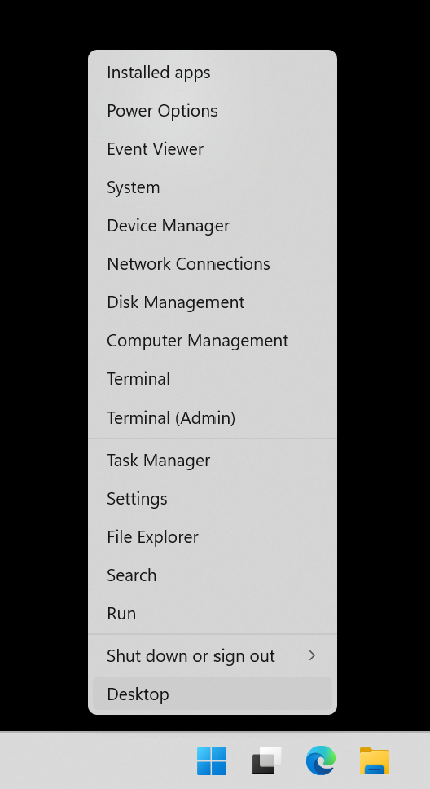

Slide 12
SPEEDING UP WINDOWS 11--BIG STEP 100: RUN SYSTEM FILE CHECKER (continued()
Step 103: Use the LEFT mouse button to click on Terminal (Admin)

Slide 13
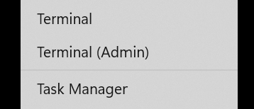

Slide 14
SPEEDING UP WINDOWS 11--BIG STEP 100: RUN SYSTEM FILE CHECKER (continued()
Step 104: A "User Account Control" box will be displayed

Slide 15
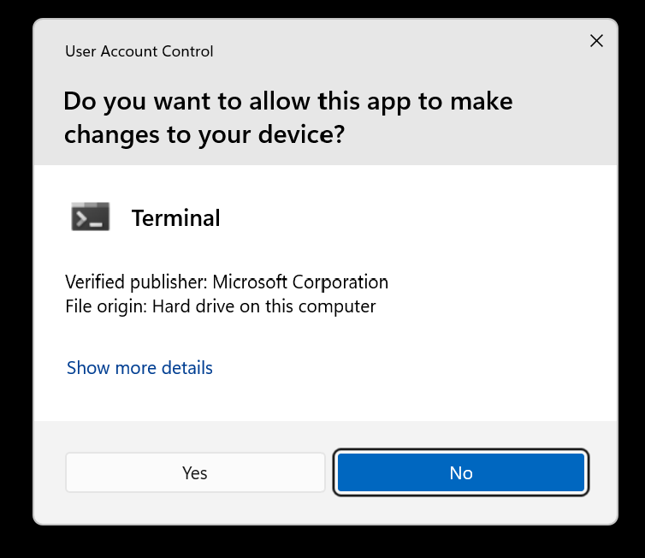

Slide 16
SPEEDING UP WINDOWS 11--BIG STEP 100: RUN SYSTEM FILE CHECKER (continued()
Step 105: Use the LEFT mouse button to click on the "Yes" button in the "User Account Control" box:

Slide 18
SPEEDING UP WINDOWS 11--BIG STEP 100: RUN SYSTEM FILE CHECKER (continued()
Step 106: An "Administrator: Windows Powershell" window will be displayed:

Slide 19
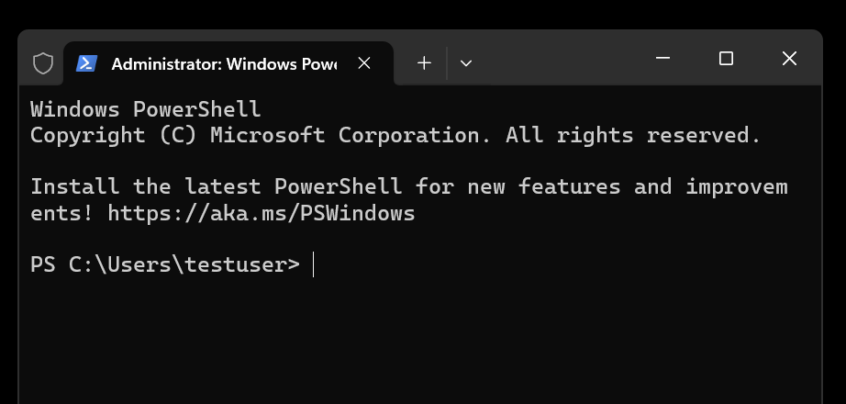

Slide 20
SPEEDING UP WINDOWS 11--BIG STEP 100: RUN SYSTEM FILE CHECKER (continued()
Step 107: At the "Command Prompt" of the "Administrator: Windows Powershell" window, type in sfc /scannow
Be sure that there is at least one space between the "c" and the "/".

Slide 21
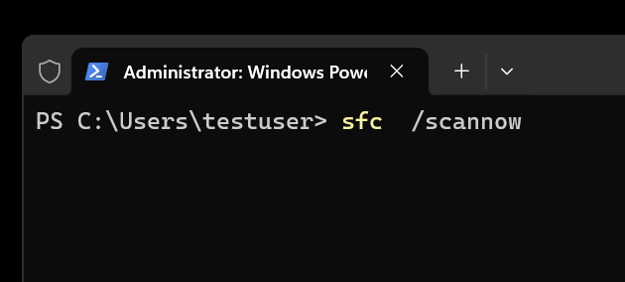

Slide 22
SPEEDING UP WINDOWS 11--BIG STEP 100: RUN SYSTEM FILE CHECKER (continued()
Step 108: Press the Enter key of the keyboard of the computer.

Slide 23
SPEEDING UP WINDOWS 11--BIG STEP 100: RUN SYSTEM FILE CHECKER (continued)
Step 109: The "System File Checker" app will run for a while.

Slide 24
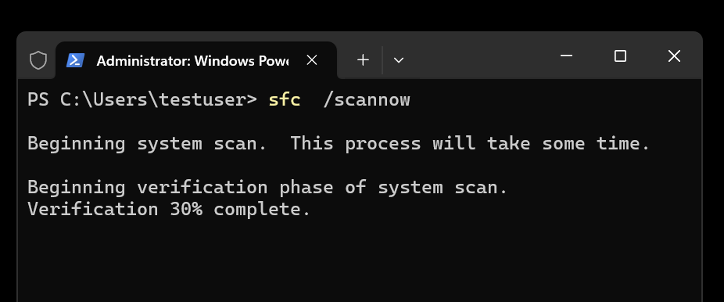

Slide 25
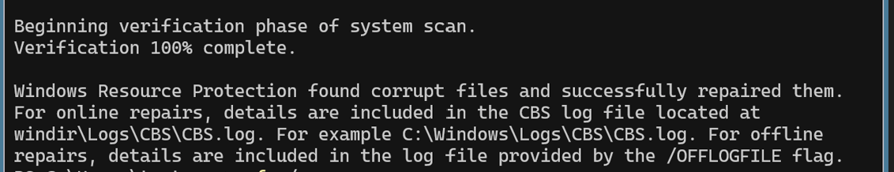

Slide 26
SPEEDING UP WINDOWS 11--BIG STEP 100: RUN "SYSTEM FILE CHECKER" (continued)
If the "System File Checker" tells you that it is unable to complete it's process, run the DISM.. command that is described at https://support.microsoft.com/en-us/topic/use-the-system-file-checker-tool-to-repair-missing-or-corrupted-system-files-79aa86cb-ca52-166a-92a3-966e85d4094e
Then perform Steps 101 through 109 again.

Slide 27
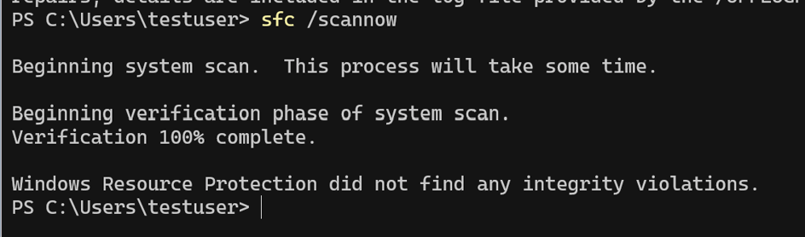

Slide 28
SPEEDING UP WINDOWS 11 --BIG STEP 200: UNCHECK ALL "VISUAL EFFECTS"

Slide 29
SPEEDING UP WINDOWS 11--BIG STEP 200: UNCHECK ALL "VISUAL EFFECTS"
Step 201: Use the RIGHT mouse button to click on the "Start button"

Slide 31
SPEEDING UP WINDOWS 11--BIG STEP 200: UNCHECK ALL "VISUAL EFFECTS"
Step 202: A "Power Users Menu" will be displayed:

Slide 33
SPEEDING UP WINDOWS 11--BIG STEP 200: UNCHECK ALL "VISUAL EFFECTS" (continued)
Step 203: Use the LEFT mouse button to click on Terminal (Admin)

Slide 35
SPEEDING UP WINDOWS 11--BIG STEP 200: UNCHECK ALL "VISUAL EFFECTS" (continued)
Step 204: A "User Account Control" box will be displayed

Slide 37
SPEEDING UP WINDOWS 11--BIG STEP 200: UNCHECK ALL "VISUAL EFFECTS" (continued)
Step 205: Use the LEFT mouse button to click on the "Yes" button in the "User Account Control" box:

Slide 39
SPEEDING UP WINDOWS 11--BIG STEP 200: UNCHECK ALL "VISUAL EFFECTS" (continued)
Step 206: An "Administrator: Windows Powershell" window will be displayed:

Slide 41
SPEEDING UP WINDOWS 11--BIG STEP 200: UNCHECK ALL "VISUAL EFFECTS" (continued)
Step 207: Type the following into the "Command Prompt" of the Administrator: Windows Powershell window: systempropertiesadvanced Do not type in any spaces.

Slide 42
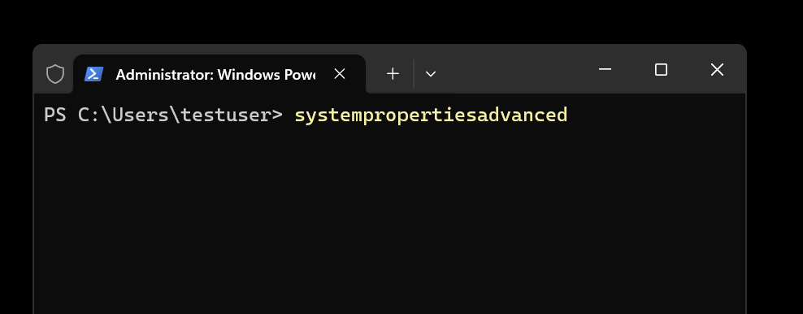

Slide 43
SPEEDING UP WINDOWS 11--BIG STEP 200: UNCHECK ALL "VISUAL EFFECTS" (continued)
Step 208: Press the Enter key of the keyboard:

Slide 44
SPEEDING UP WINDOWS 11--BIG STEP 200: UNCHECK ALL "VISUAL EFFECTS" (continued)
Step 209: A "System Properties" box will be displayed.

Slide 45
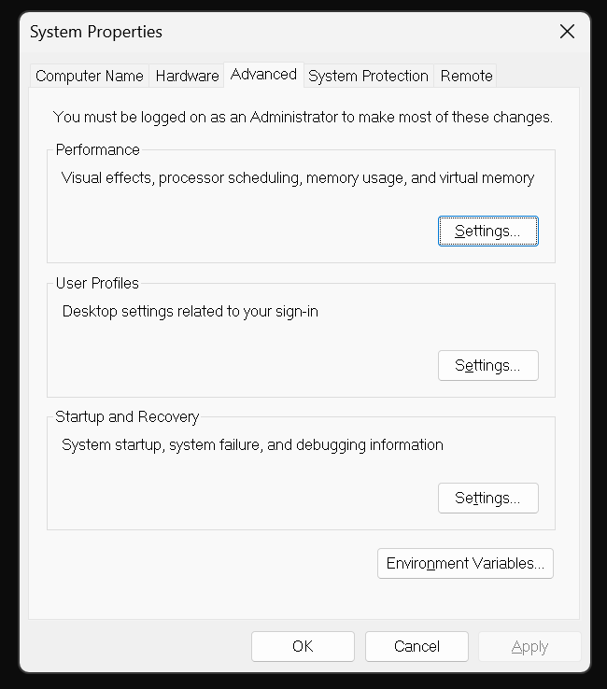

Slide 46
SPEEDING UP WINDOWS 11--BIG STEP 200: UNCHECK ALL "VISUAL EFFECTS" (continued)
Step 210: Make sure that the "Advanced" tab is selected by using the LEFT mouse button to click on it.

Slide 48
SPEEDING UP WINDOWS 11--BIG STEP 200: UNCHECK ALL "VISUAL EFFECTS" (continued)
Step 211: Locate the "Performance" section and use the LEFT mouse button to click on the "Settings" button of the "Performance" section:

Slide 50
SPEEDING UP WINDOWS 11--BIG STEP 200: UNCHECK ALL "VISUAL EFFECTS" (continued)
Step 212: A "Performance Options" box will be displayed.

Slide 51
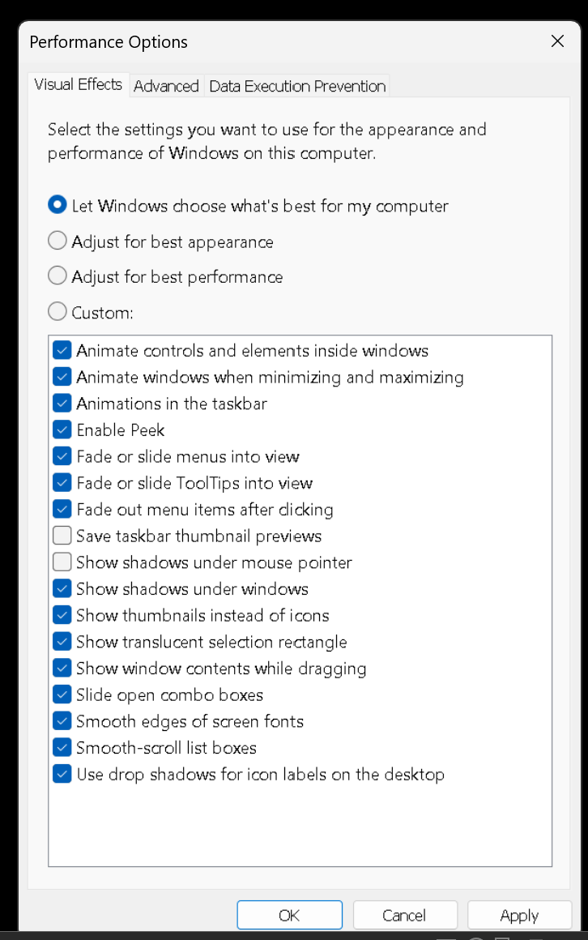

Slide 52
SPEEDING UP WINDOWS 11--BIG STEP 200: UNCHECK ALL "VISUAL EFFECTS" (continued)
Step 213: Make sure that the "Visual Effects" tab is selected by using the LEFT mouse button to click on it.

Slide 54
SPEEDING UP WINDOWS 11--BIG STEP 200: UNCHECK ALL "VISUAL EFFECTS" (continued)
Step 214: Select the "Adjust for best performance" option, if it is not already selected.

Slide 55
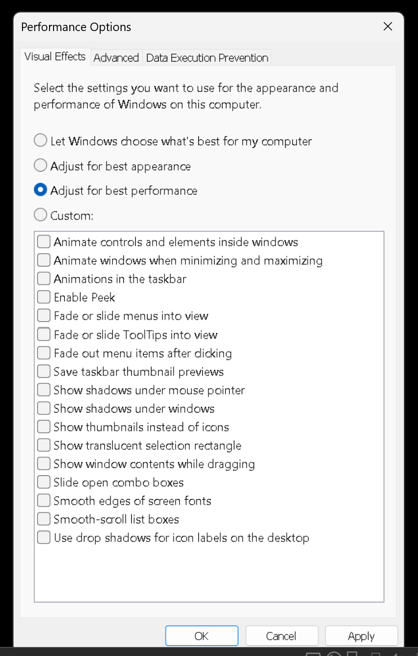

Slide 56
SPEEDING UP WINDOWS 11--BIG STEP 200: UNCHECK ALL "VISUAL EFFECTS" (continued)
Step 215: Use the LEFT mouse button to click on the "Apply" button of the "Performance Options" box.

Slide 58
SPEEDING UP WINDOWS 11--BIG STEP 200: UNCHECK ALL "VISUAL EFFECTS" (continued)
Step 216: Use the LEFT mouse button to click on the "OK" button of the "Performance Options" box

Slide 60
SPEEDING UP WINDOWS 11--BIG STEP 200: UNCHECK ALL "VISUAL EFFECTS" (continued)
Step 217: Use the LEFT mouse button to click on the "OK" button of the "System Properties" box

Slide 61
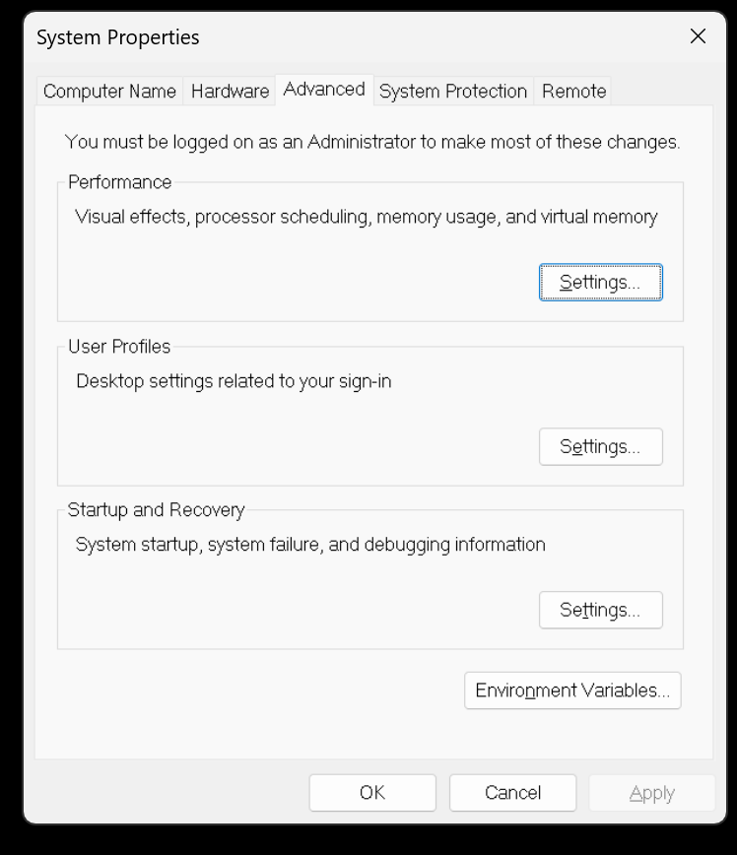

Slide 62
SPEEDING UP WINDOWS 11 --BIG STEP 300: CHECK AND SET "ADVANCED PERFORMANCE OPTIONS"

Slide 63
SPEEDING UP WINDOWS 11--BIG STEP 300: CHECK AND SET "ADVANCED PERFORMANCE OPTIONS"
Step 301: Use the RIGHT mouse button to click on the "Start button"

Slide 65
SPEEDING WINDOWS 11--BIG STEP 300: CHECK AND SET "ADVANCED PERFORMANCE OPTIONS" (continued)
Step 302: A "Power Users Menu" will be displayed:

Slide 67
SPEEDING WINDOWS 11--BIG STEP 300: CHECK AND SET "ADVANCED PERFORMANCE OPTIONS" (continued)
Step 303: Use the LEFT mouse button to click on Task Manager

Slide 69
SPEEDING WINDOWS 11--BIG STEP 300: CHECK AND SET "ADVANCED PERFORMANCE OPTIONS" (continued)
Step 304: A "User Account Control" box will be displayed

Slide 71
SPEEDING WINDOWS 11--BIG STEP 300: CHECK AND SET "ADVANCED PERFORMANCE OPTIONS" (continued)
Step 305: Use the LEFT mouse button to click on the "Yes" button in the "User Account Control" box:

Slide 73
SPEEDING WINDOWS 11--BIG STEP 300: CHECK AND SET "ADVANCED PERFORMANCE OPTIONS" (continued)
Step 306: An "Administrator: Windows Powershell" window will be displayed:

Slide 75
SPEEDING WINDOWS 11--BIG STEP 300: CHECK AND SET "ADVANCED PERFORMANCE OPTIONS" (continued)
Step 307: Type the following into the "Command Prompt" of the "Administrator: Windows Powershell" window: systempropertiesadvanced Do not type in any spaces.

Slide 77
SPEEDING WINDOWS 11--BIG STEP 300: CHECK AND SET "ADVANCED PERFORMANCE OPTIONS" (continued)
Step 308: Press the Enter key of the keyboard.

Slide 78
SPEEDING WINDOWS 11--BIG STEP 300: CHECK AND SET "ADVANCED PERFORMANCE OPTIONS" (continued)
Step 309: A "System Properties" box will be displayed.

Slide 80
SPEEDING WINDOWS 11--BIG STEP 300: CHECK AND SET "ADVANCED PERFORMANCE OPTIONS" (continued)
Step 309: Make sure that the "Advanced" tab is selected by using the LEFT mouse button to click on it.

Slide 82
SPEEDING WINDOWS 11--BIG STEP 300: CHECK AND SET "ADVANCED PERFORMANCE OPTIONS" (continued)
Step 310: Locate the "Performance" section and use the LEFT mouse button to click on the "Settings" button of the "Performance" section.

Slide 84
SPEEDING WINDOWS 11--BIG STEP 300: CHECK AND SET "ADVANCED PERFORMANCE OPTIONS" (continued)
Step 311: A "Performance Options" box will be displayed.

Slide 85
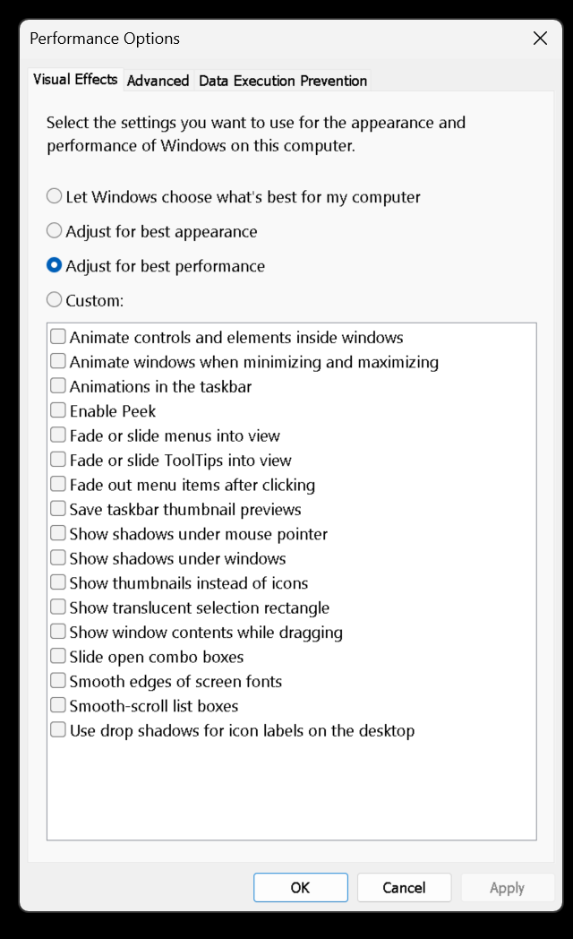

Slide 87
SPEEDING WINDOWS 11--BIG STEP 300: CHECK AND SET "ADVANCED PERFORMANCE OPTIONS" (continued)
Step 312: Use the LEFT mouse button to click on the "Advanced" tab of the "Performance Options" box

Slide 89
SPEEDING WINDOWS 11--BIG STEP 300: CHECK AND SET "ADVANCED PERFORMANCE OPTIONS" (continued)
Step 313: Use the LEFT mouse button to select the "Programs" option of the "Performance Options" box, if it is not already selected.

Slide 90
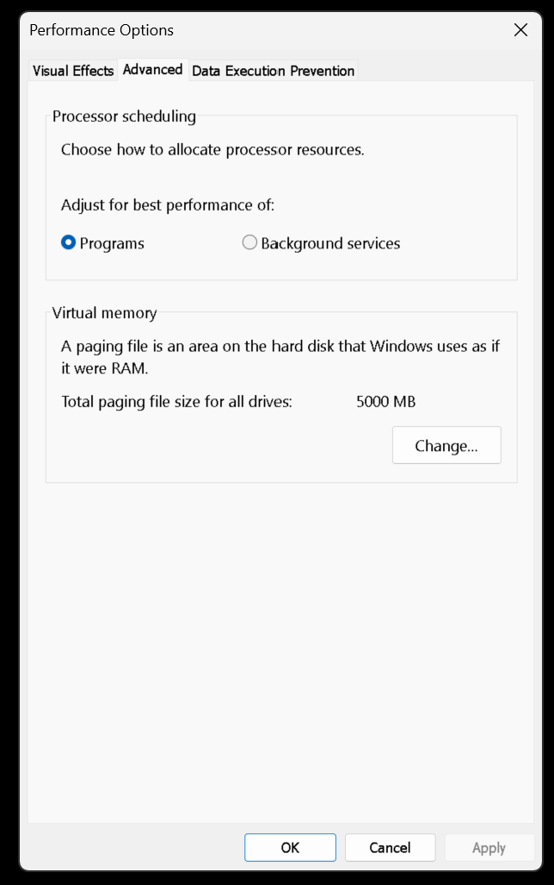

Slide 92
SPEEDING WINDOWS 11--BIG STEP 300: CHECK AND SET "ADVANCED PERFORMANCE OPTIONS" (continued)
Step 314: Use the LEFT mouse button to click on the "OK" button of the "Performance Options" box.

Slide 94
SPEEDING WINDOWS 11--BIG STEP 300: CHECK AND SET "ADVANCED PERFORMANCE OPTIONS" (continued)
Step 315: Use the LEFT mouse button to click on the "OK" button of the "System Properties" box

Slide 95
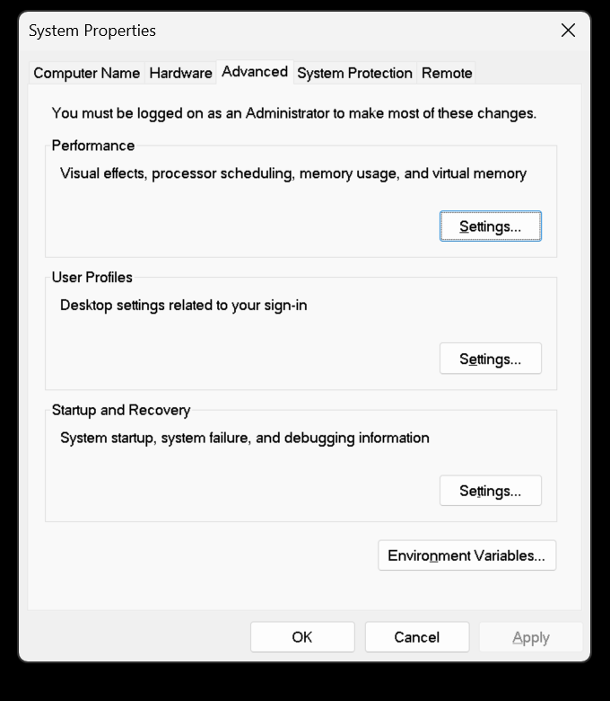

Slide 96
SPEEDING UP WINDOWS 11--BIG STEP 400: DISABLE MOST STARTUP APPS

Slide 97
SPEEDING UP WINDOWS 11--BIG STEP 400: DISABLE MOST STARTUP APPS
Step 401: Use the RIGHT mouse button to click on the "Start button"

Slide 99
SPEEDING WINDOWS 11--BIG STEP 400: DISABLE MOST STARTUP APPS (continued)
Step 402: A "Power Users Menu" will be displayed:

Slide 101
SPEEDING WINDOWS 11--BIG STEP 400: DISABLE MOST STARTUP APPS (continued)
Step 403: Use the LEFT mouse button to click on Task Manager

Slide 102


Slide 103
SPEEDING WINDOWS 11--BIG STEP 400: DISABLE MOST STARTUP APPS (continued)
Step 405: A "Task Manager" window will be displayed:

Slide 104
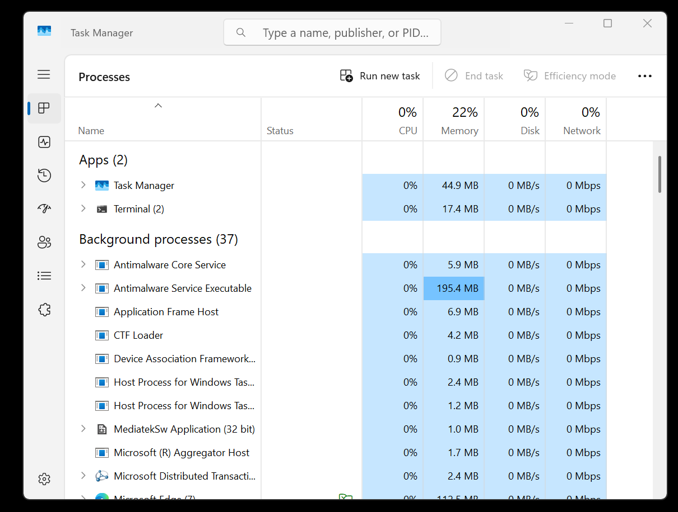

Slide 105
SPEEDING WINDOWS 11--BIG STEP 400: DISABLE MOST STARTUP APPS (continued)
Step 406: Use the LEFT mouse button to click on "Startup apps"

Slide 106
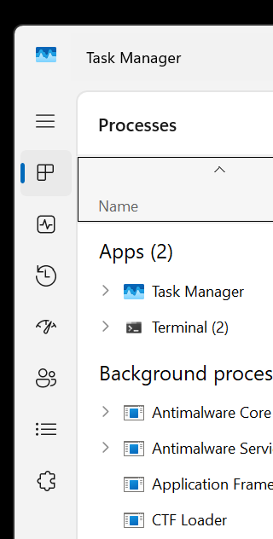

Slide 107


Slide 108
SPEEDING WINDOWS 11--BIG STEP 400: DISABLE MOST STARTUP APPS (continued)
Step 407: Unless they are part of antivirus/antimalware software apps such as "Microsoft Defender" or "SecurityHealthSystem.exe" or servers such as "VNC" that you have installed into your, computer, most of the "enabled" Startup Apps can be safely disabled with a click of the RIGHT mouse button.
If you disable a startup app that you need, you can turn it back on at a future time from this screen.

Slide 109
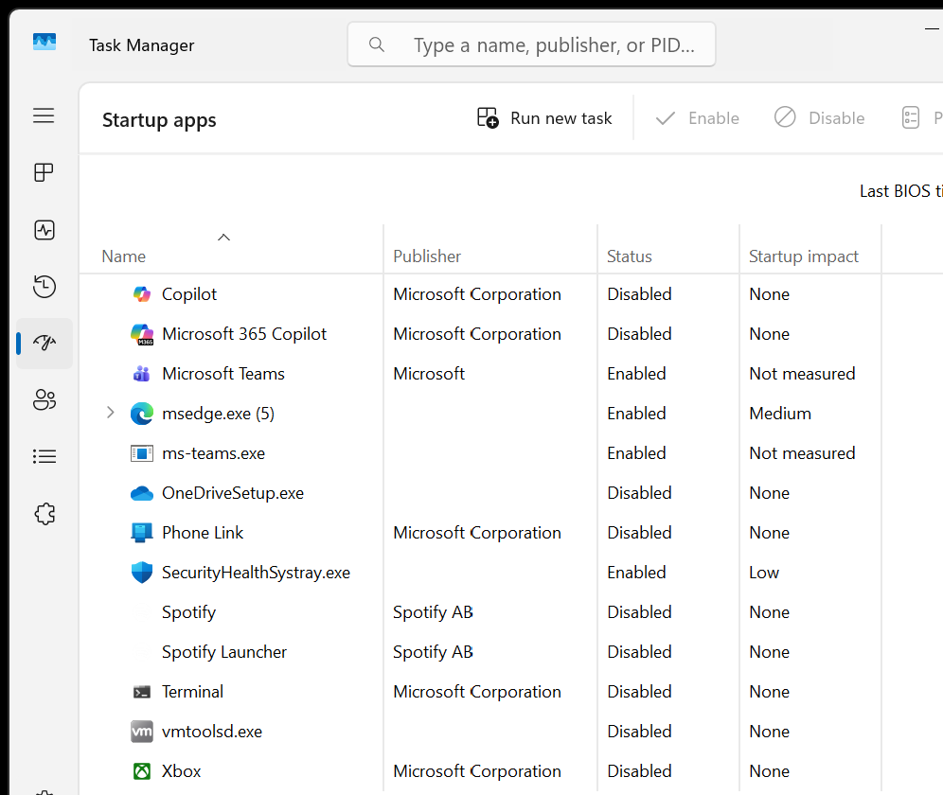

Slide 110
SPEEDING UP WINDOWS 11 --BIG STEP 500: PROVIDE WINDOWS WITH MORE VIRTUAL MEMORY

Slide 112
SPEEDING UP WINDOWS 11--BIG STEP 500: PROVIDE WINDOWS WITH MORE VIRTUAL MEMORY
Step 501: Use the RIGHT mouse button to click on the "Start button"

Slide 113
113

Slide 114
SPEEDING UP WINDOWS 11--BIG STEP 500: PROVIDE WINDOWS WITH MORE VIRTUAL MEMORY ( continued)
Step 502: A "Power Users Menu" will be displayed:

Slide 116
SPEEDING UP WINDOWS 11--BIG STEP 500: PROVIDE WINDOWS WITH MORE VIRTUAL MEMORY ( continued)
Step 503: Use the LEFT mouse button to click on Terminal (Admin)

Slide 117


Slide 118
SPEEDING UP WINDOWS 11--BIG STEP 500: PROVIDE WINDOWS WITH MORE VIRTUAL MEMORY ( continued)
Step 504: A "User Account Control" box will be displayed

Slide 120
SPEEDING UP WINDOWS 11--BIG STEP 500: PROVIDE WINDOWS WITH MORE VIRTUAL MEMORY ( continued)
Step 505: Use the LEFT mouse button to click on the "Yes" button in the "User Account Control" box:

Slide 122
SPEEDING UP WINDOWS 11--BIG STEP 500: PROVIDE WINDOWS WITH MORE VIRTUAL MEMORY ( continued)
Step 506: An "Administrator: Windows Powershell" window will be displayed:

Slide 124
SPEEDING UP WINDOWS 11--BIG STEP 500: PROVIDE WINDOWS WITH MORE VIRTUAL MEMORY ( continued)
Step 507: Type the following into the "Command Prompt" of the "Administrator: Windows Powershell" window: systempropertiesadvanced Do not type in any spaces.

Slide 126
SPEEDING UP WINDOWS 11--BIG STEP 500: PROVIDE WINDOWS WITH MORE VIRTUAL MEMORY ( continued)
Step 507: Press the Enter key of the keyboard of the computer.

Slide 127
SPEEDING UP WINDOWS 11--BIG STEP 500: PROVIDE WINDOWS WITH MORE VIRTUAL MEMORY ( continued)
Step 508: A "System Properties" box will be displayed.

Slide 129
SPEEDING UP WINDOWS 11--BIG STEP 500: PROVIDE WINDOWS WITH MORE VIRTUAL MEMORY ( continued)
Step 509: Make sure that the "Advanced" tab is selected by using the LEFT mouse button to click on it.

Slide 131
SPEEDING UP WINDOWS 11--BIG STEP 500: PROVIDE WINDOWS WITH MORE VIRTUAL MEMORY ( continued)
Step 510: Locate the "Performance" section and click on the "Settings" button of the "Performance" section of the "System Properties" box

Slide 133
SPEEDING UP WINDOWS 11--BIG STEP 500: PROVIDE WINDOWS WITH MORE VIRTUAL MEMORY ( continued)
Step 511: A "Performance Options" box will be displayed.

Slide 135
SPEEDING UP WINDOWS 11--BIG STEP 500: PROVIDE WINDOWS WITH MORE VIRTUAL MEMORY ( continued)
Step 512: Use the LEFT mouse button to click on the "Advanced" tab of the "Performance Options" box:

Slide 137
SPEEDING UP WINDOWS 11--BIG STEP 500: PROVIDE WINDOWS WITH MORE VIRTUAL MEMORY ( continued)
Step 513: Use the LEFT mouse button to click on the "Change" button in the "Virtual Memory" section of the "Performance Options" box

Slide 138
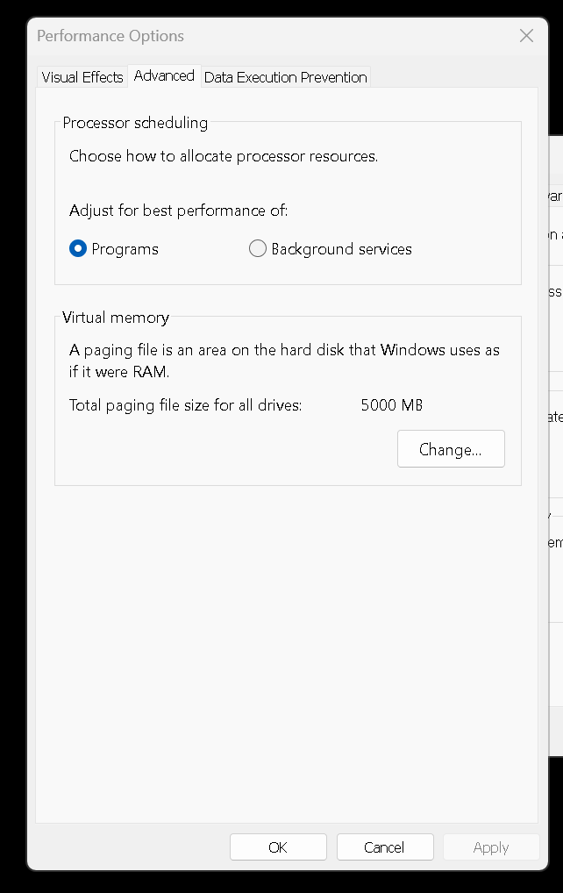

Slide 140
SPEEDING UP WINDOWS 11--BIG STEP 500: PROVIDE WINDOWS WITH MORE VIRTUAL MEMORY ( continued)
Step 514: If there is a checkmark for "Automatically manage paging file size for all drives, use the LEFT mouse button to remove it

Slide 141
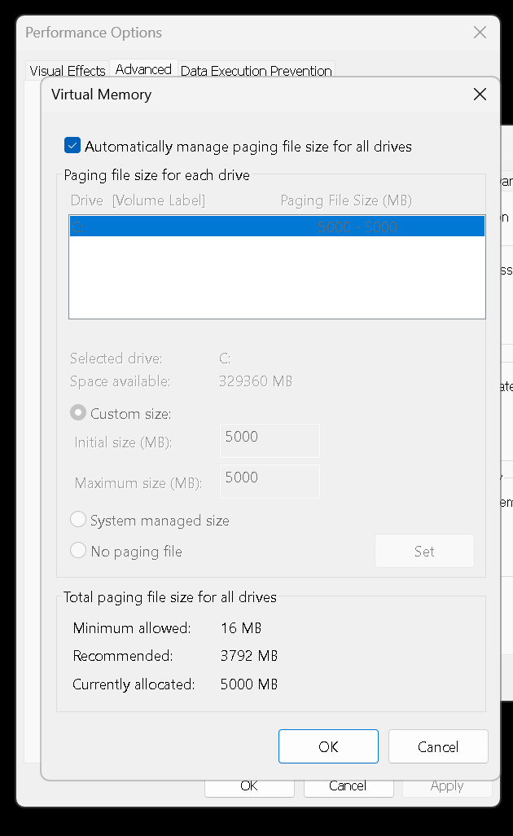

Slide 142
SPEEDING UP WINDOWS 11--BIG STEP 500: PROVIDE WINDOWS WITH MORE VIRTUAL MEMORY ( continued)
Step 515: Use the LEFT mouse button to select the "Custom size" option

Slide 144
SPEEDING UP WINDOWS 11--BIG STEP 500: PROVIDE WINDOWS WITH MORE VIRTUAL MEMORY ( continued)
Step 516: Set both the "Initial size MB" and the "Maximum size MB" to the "Recommended" value but do not exceed the amount of free space that you have on the C: drive.

Slide 146
SPEEDING UP WINDOWS 11--BIG STEP 500: PROVIDE WINDOWS WITH MORE VIRTUAL MEMORY ( continued)
Step 517: Click on the "OK" button of the "Virtual memory" box

Slide 148
SPEEDING UP WINDOWS 11--BIG STEP 500: PROVIDE WINDOWS WITH MORE VIRTUAL MEMORY ( continued)
Step 518: Use the LEFT mouse button to click on the "OK" button of the "System Properties" box

Slide 150
SPEEDING UP WINDOWS 11--BIG STEP 500: PROVIDE WINDOWS WITH MORE VIRTUAL MEMORY ( continued)
Step 519: Reboot the computer and see if it is running faster.

Slide 151
