Slide 1



WINDOWS 10 AND 11 ACTIVATION

Slide 2
Web location for this presentation:
http://aztcs.org
Click on “Meeting Notes”
2

Slide 3
SUMMARY
If you take an existing "Windows 7" or "Windows 8" or "Windows 8.1" computer and upgrade it for free, your copy of Windows 10 or 11 will be activated with a "Digital License". If you purchase a retail copy of Windows 10 or 11 and use it to install or upgrade a computer, you will be activating with a 25-character Windows 10 or 11 Product Key.
3

Slide 4
TOPICS
Microsoft's Activation Servers
Do Not Comply With All Initial Requests For A Product Key (For Windows 10 and 11)
Two Ways to Activate "Windows 10"
Which Method of Activation Was Used in My "Windows 10" Computer?
4

Slide 5
TOPICS (continued)
Details of "Digital License" Activation
Details of "Product Key" Activation
Difference Between "Digital License" Activation and "Product Key" Activation
Linking Your "Microsoft Account" to a "Digital License" Activation
5

Slide 6

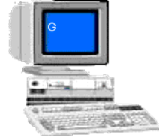
Server Farms Operated by Microsoft:
Activation Servers
Other servers for Outlook.com, OneDrive, Bing, etc.
Internet Connection
Activated "Windows 10"
6

Slide 7
Microsoft's Activation Servers DIGITAL LICENSE DATABASE:
UUID of your motherboard, edition ("Win10 Home", "Windows 10 Pro", "Windows 11 Home, or "Windows 11 Pro) and optionally, your Microsoft account's email address or username if you have "linked" the "Digital License to a Microsoft Account
Internet Connection
Activated "Windows 10"
7

Slide 8
MICROSOFT'S ACTIVATION SERVERS (continued)
Two separate databases inside Microsoft's activation servers: "Digital Licenses" database and "Product Keys" database
8

Slide 9
Microsoft's Activation Servers
"DIGITAL LICENSE" DATABASE
"PRODUCT KEYS" DATABASE
9

Slide 10
Microsoft's Activation Servers
DIGITAL LICENSE DATABASE: UUID of your motherboard,
edition ("Windows 10 Home", "Windows 10 Pro", "Windows 11 Home", or "Windows 11 Pro),
optionally, your Microsoft account's email address if you linked it to your Microsoft Account
PRODUCT KEY DATABASE: "Product Key",
edition (Windows 10 Home, Windows 10 Pro, Windows 11 Home, or Windows 11 Pro), Number of remaining activations for THE key
10

Slide 11
DO NOT COMPLY WITH ALL INITIAL REQUESTS FOR A PRODUCT KEY IN "WINDOWS 10.."
When installing or upgrading to Windows 10 or 11, do not comply with all initial requests for a product key.
11

Slide 12
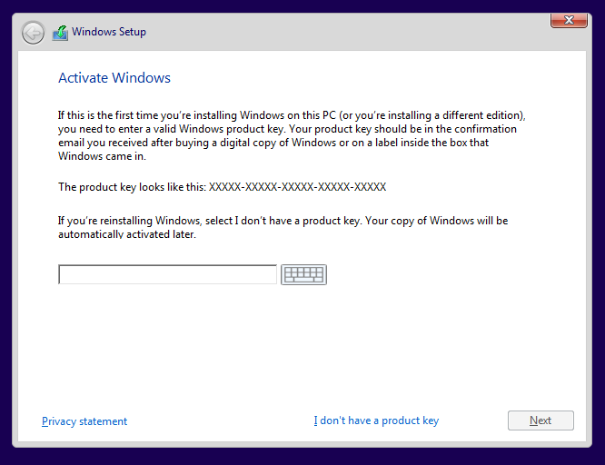
12

Slide 13
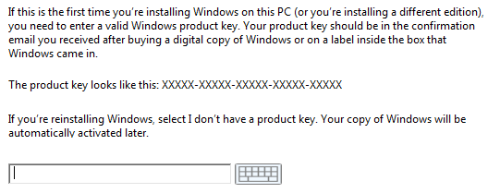
13

Slide 14

14

Slide 15
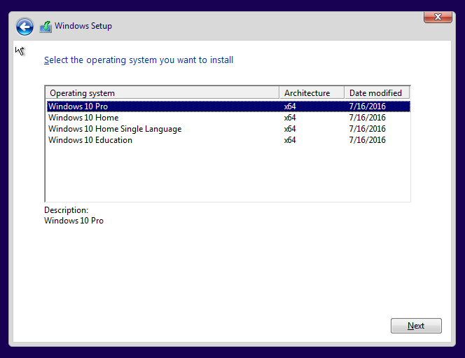
15

Slide 16
DO NOT COMPLY WITH ALL INITIAL REQUESTS FOR A PRODUCT KEY IN WINDOWS 10 OR 11 (continued)
Unlike previous "Windows.." products, "Windows 10" is kinder and gentler, even if you do not activate it.
16

Slide 17
DO NOT COMPLY WITH ALL INITIAL REQUESTS FOR A PRODUCT KEY IN WINDOWS 10 OR 11 (continued)
Unlike previous "Windows.." products, Windows 10 or 11 will let you complete an upgrade or installation, even if you do not comply with all initial requests for a product key.
17

Slide 18
DO NOT COMPLY WITH ALL INITIAL REQUESTS FOR A PRODUCT KEY FOR WINDOWS 10 OR 11 (continued)
After installing or upgrading to Windows 10 or 11, if you need to activate it with a 25-character "Windows 10 Product Key" you have an indefinite amount of time to do so.
18

Slide 19
DO NOT COMPLY WITH ALL INITIAL REQUESTS FOR A PRODUCT KEY IN WINDOWS 10 OR 11 (continued)
Unlike previous "Windows.." products, Windows 10 or 11 will not turn your Desktop black, delete what you are working on, and shut your computer down every 60 minutes, even if it is Windows 10 or 11 is not activated. Unactivated copies of Windows 10 or 11 are now kinder and gentler!
19

Slide 20
DO NOT COMPLY WITH ALL INITIAL REQUESTS FOR A PRODUCT KEY (continued)
Reason 1: A digital license may already be stored up in Microsoft's activation servers but the installation wizard will not notify you of this situation.
20

Slide 21
DO NOT COMPLY WITH ALL INITIAL REQUESTS FOR A PRODUCT KEY (continued)
Reason 1 (continued): If you enter in a newly-purchased Retail key at this point and Microsoft already has a "Digital License" stored up in their activation server system, your computer will now have two "Digital Licenses" and you will have to jump thorough hoops to re-use the newly-entered Retail key on another computer some day.
21

Slide 22
DO NOT COMPLY WITH ALL INITIAL REQUESTS FOR A PRODUCT KEY (continued)
Reason 2: If you use a newly-purchased Retail key for "Windows 10" and something goes wrong during the rest of the installation process: and IF you have an "OEM System Builder" channel key you might need to buy another key (since OEM System Builders have zero "support from Microsoft
22

Slide 23
DO NOT COMPLY WITH ALL INITIAL REQUESTS FOR A PRODUCT KEY (continued)
Reason 2 (continued): If you use a newly-purchased Retail key for Windows 10 or 11 and something goes wrong during the rest of the installation process and you have purchased a "Retail" channel key, you will have to phone or text Microsoft support to reuse the "Retail" key
23

Slide 24
DO NOT COMPLY WITH ALL INITIAL REQUESTS FOR A PRODUCT KEY (continued)
If you install Windows 10 or 11 into a blank hard drive or if you upgrade a copy of "Windows 7", "Windows 8", or "Windows 8.1", ignore the following request to enter in a 25-character activation key:
24

Slide 25
25

Slide 26
26

Slide 27
TWO WAYS TO ACTIVATE WINDOWS 10 or 11
Method 1: "Digital License" Method (No "Windows 10 or 11 product key is used to activate "Windows 10 or 11.)
Method 2: "Product Key" Method (A 25-character "Product Key" is used.)
27

Slide 28
TWO WAYS TO ACTIVATE WINDOWS 10 OR 11 (continued)
Microsoft's confusing description of the differences between the two activation methods is located at https://support.microsoft.com/en-us/help/12440/windows-10-activation
28

Slide 29
WHICH METHOD OF ACTIVATION WAS USED IN MY WINDOWS 10 OR 11 COMPUTER?
Step 1: Click on the "Start" button.
29

Slide 30
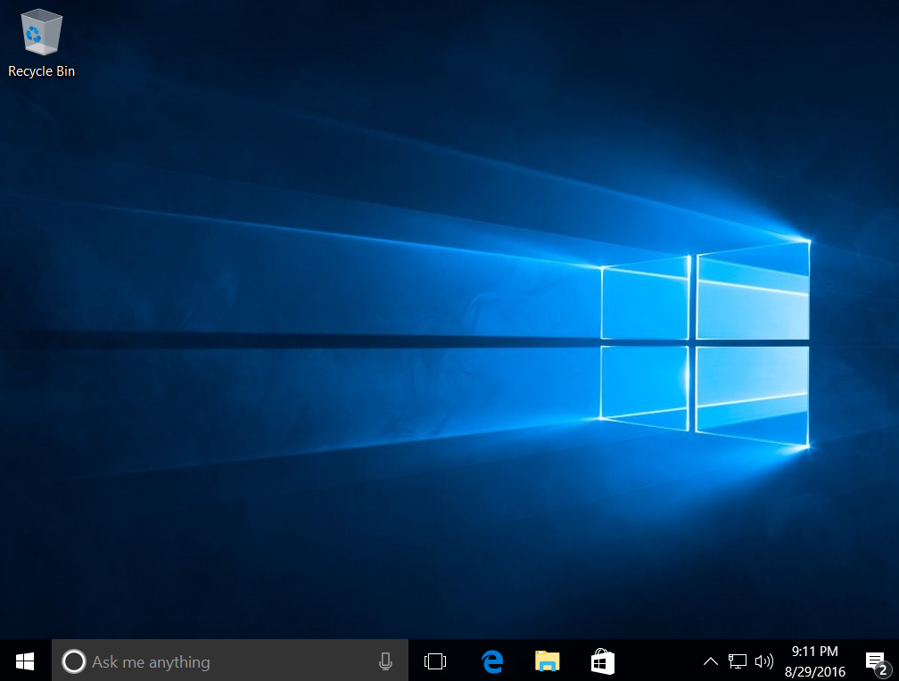
30

Slide 31
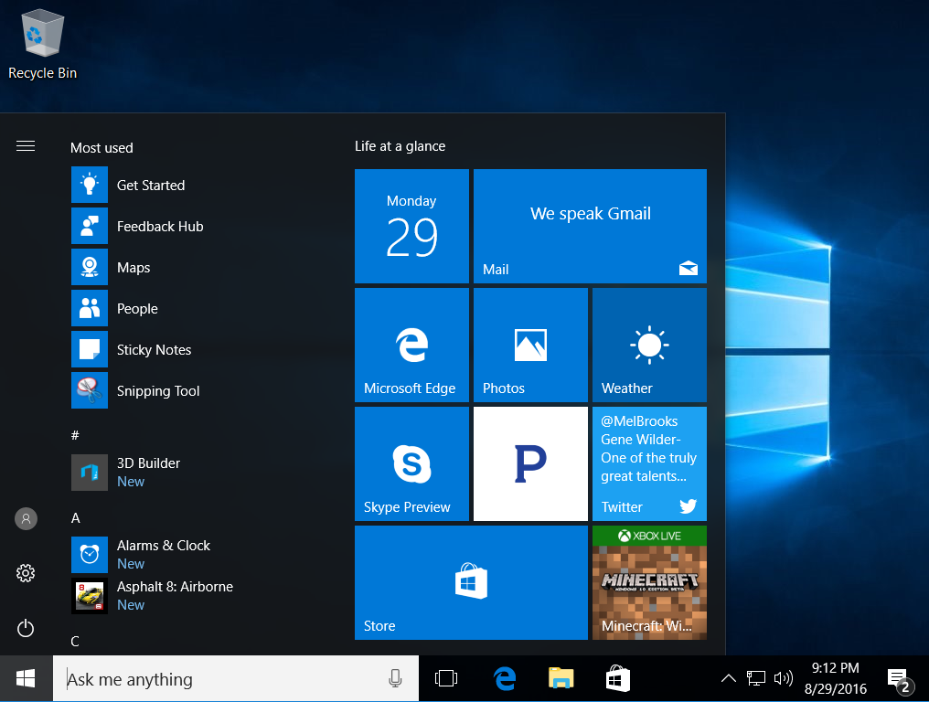
31

Slide 32
WHICH METHOD OF ACTIVATION WAS USED IN MY WINDOWS 10 OR 11 COMPUTER? (continued)
Step 2: Click on the "Settings" icon:
32

Slide 33
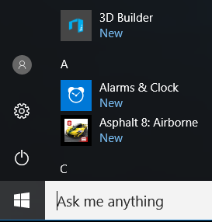
33

Slide 34

34

Slide 35
WHICH METHOD OF ACTIVATION WAS USED IN MY WINDOWS 10 OR 11 COMPUTER? (continued)
Step 3: Click on "Update & Security":
35

Slide 36
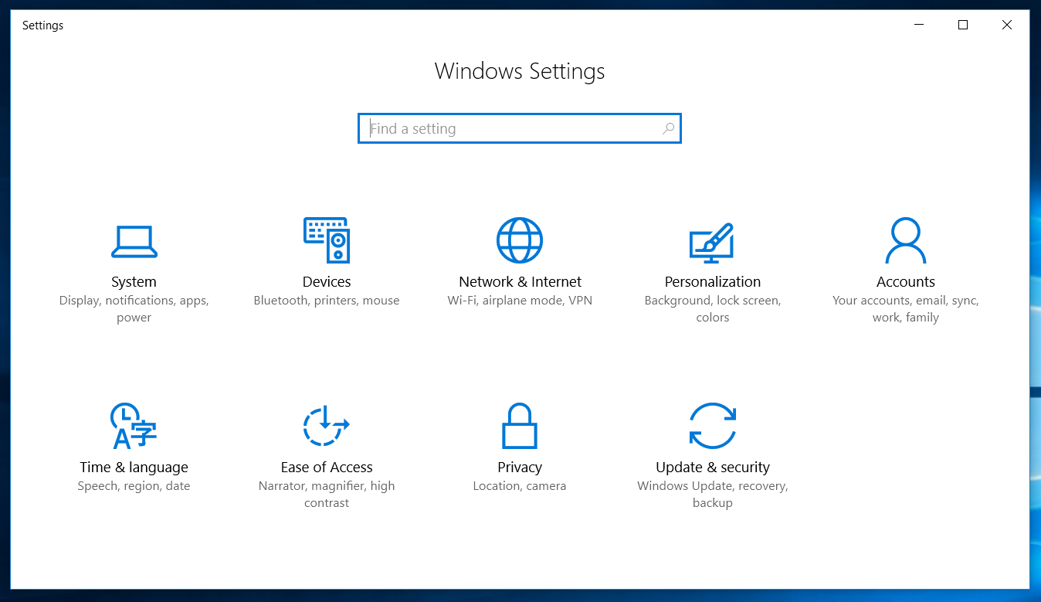
36

Slide 37
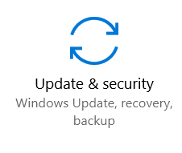
37

Slide 38
WHICH METHOD OF ACTIVATION WAS USED IN MY WINDOWS 10 OR 11 COMPUTER? (continued)
Step 4: Click on "Activation":
38

Slide 39
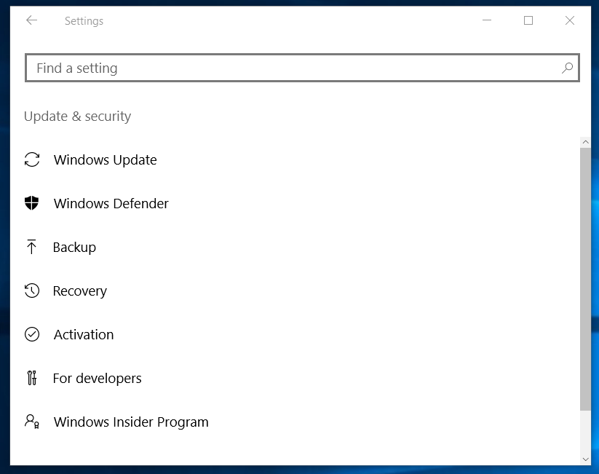
39

Slide 40

40

Slide 41
WHICH METHOD OF ACTIVATION WAS USED IN MY WINDOWS 10 OR11 COMPUTER? (continued)
If Windows 10 or 11 has already been activated with a "digital license", the "Activation" screen in "Settings" will state Activation: Windows is activated with a digital license and there will be no "Product Key:" line:
41

Slide 42
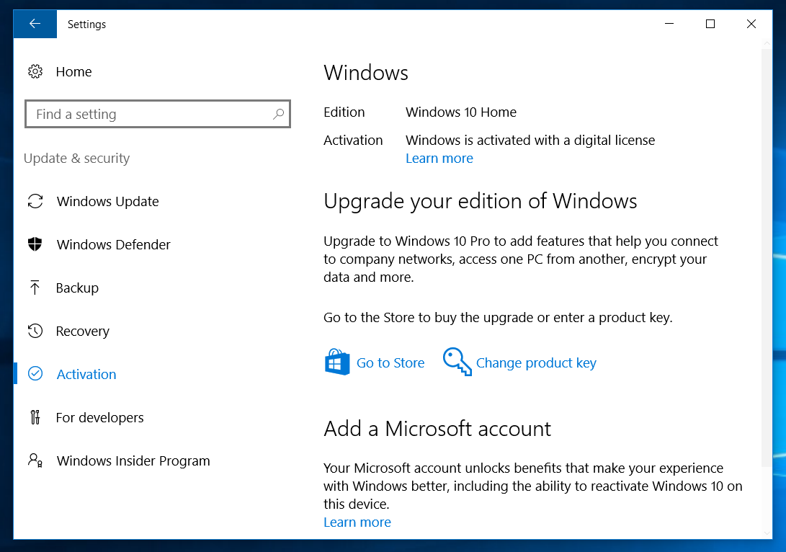
42

Slide 43
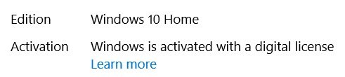
43

Slide 44
WHICH METHOD OF ACTIVATION WAS USED IN MY WINDOWS 10 OR 11 COMPUTER? (continued)
If Windows 10 or 11 has already been activated with a "Product Key", the "Activation" screen in "Settings" will state Activation: Windows is activated and Product Key: xxxxx-xxxxx-xxxxx.. like this:
44

Slide 45
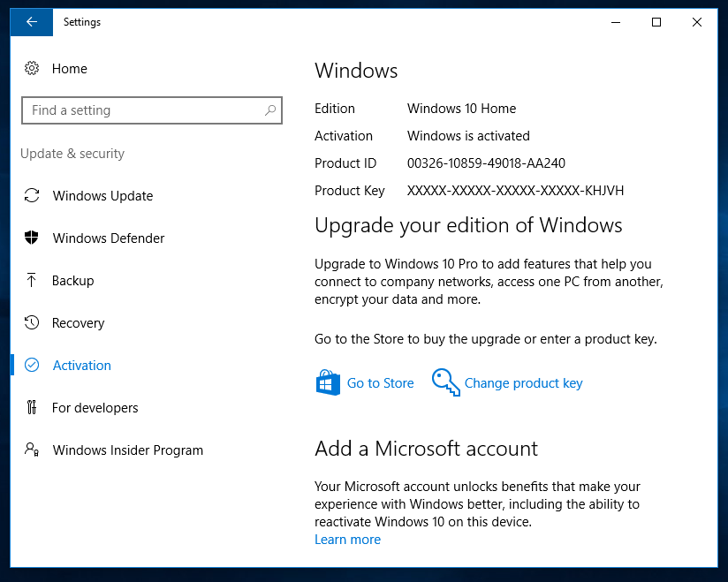
45

Slide 46
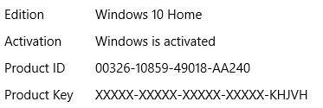
46

Slide 47
DETAILS OF "DIGITAL LICENSE " ACTIVATION (continued)
Digital License (= "Digital Entitlement" ="Device Based Activation") "Windows 10" is the first and only "Windows.." product that can be activated by means of a "Digital License". "Windows 11" is the second such product.
47

Slide 48
DETAILS OF "DIGITAL LICENSE " ACTIVATION (continued)
When you activate a copy of "Windows.." prior to "Window 10..", Microsoft does not store the UUID of the motherboard of your computer in it's activation servers
48

Slide 49
DETAILS OF "DIGITAL LICENSE " ACTIVATION (continued)
"Digital License" means that Microsoft's activation servers in their server farms store the UUID of the motherboard of a computer, and the edition of Windows 10 or 11 ("Home" or "Pro"), as part of the activation process.
49

Slide 50
DETAILS OF "DIGITAL LICENSE " ACTIVATION (continued)
"UUID" stands for "Universally Unique Identifier"
A UUID is a 128-bit value that has a high probability of being unique that is used to label devices such as motherboards, hard drives, graphics adapters, etc.
50

Slide 51
DETAILS OF "DIGITAL LICENSE " ACTIVATION (continued)
According to https://en.wikipedia.org/wiki/Universally_unique_identifier: .. a UUID is represented by 32 lowercase hexadecimal digits, displayed in five groups separated by hyphens, in the form 8-4-4-4-12 for a total of 36 characters
51

Slide 52
DETAILS OF "DIGITAL LICENSE " ACTIVATION (continued)
If you look at the UUID that is stored inside the firmware of your computer's motherboard, it would look like this:
52

Slide 53

53

Slide 54
DETAILS OF "DIGITAL LICENSE " ACTIVATION (continued)
595B4D56-3B34-BA91-4F7C-F030072DAE75
54

Slide 55
DETAILS OF "DIGITAL LICENSE " ACTIVATION (continued)
When "Windows 10" is not activated: If you go to "System" in the "Control Panel":
55

Slide 56
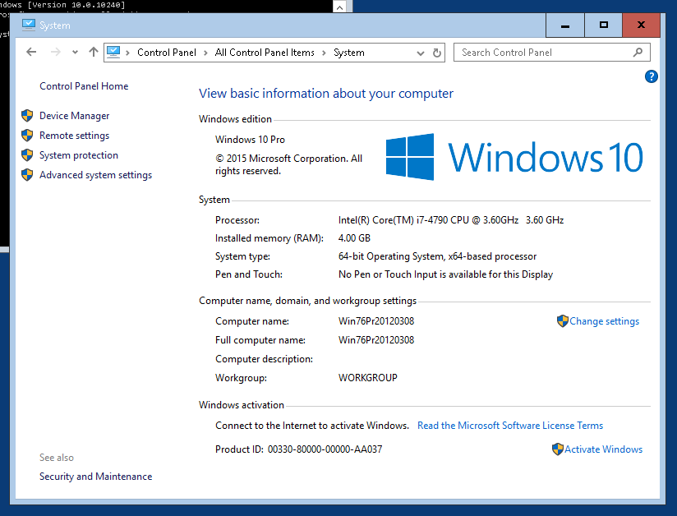

Slide 59
DETAILS OF "DIGITAL LICENSE "ACTIVATION (continued)
When Windows 10 or 11 is "activated": If you go to "System" in the "Control Panel":
59

Slide 60
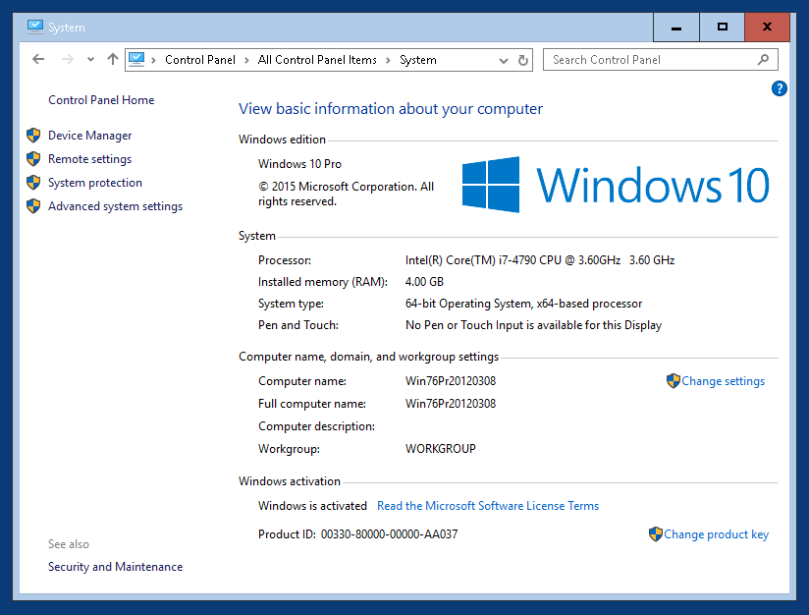

Slide 63
DETAILS OF "DIGITAL LICENSE " ACTIVATION (continued)
If you upgrade a computer that has a genuine copy of "Windows 7.." or "Windows 8.1.." to "Windows 10 or 11, it will activate your new copy of "Windows 10 or 11 and the UUID of the motherboard of the computer will be stored in Microsoft's activation servers and a default, placeholder 25-character product key will be placed into the Windows registry in your computer:
63

Slide 64
DETAILS OF "DIGITAL LICENSE " ACTIVATION (continued)
This means that everyone who upgrades from Windows 7 or Windows 8 to Windows 10 or 11 sees the same default, placeholder product keys listed at https://www.maketecheasier.com/windows-10-activation-procedure/ when running "Belarc Advisor" or other diagnostic software:
64

Slide 65
DETAILS OF "DIGITAL LICENSE " ACTIVATION (continued)
Use any Web browser in an Internet-connection computer to go to belarc.com
Then download the free "Belarc Advisor":
65

Slide 66
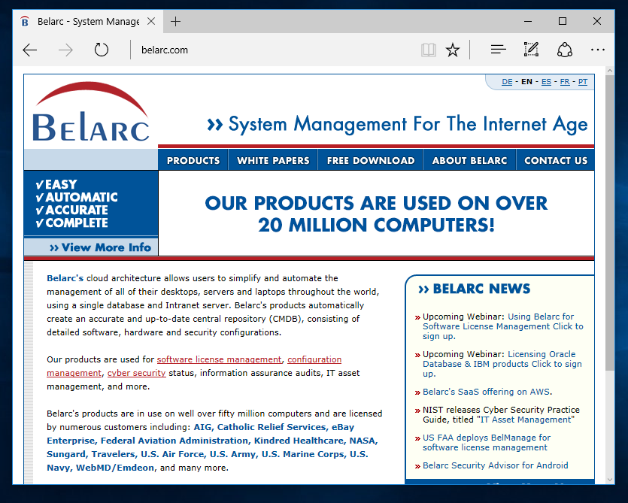

Slide 67


Slide 68
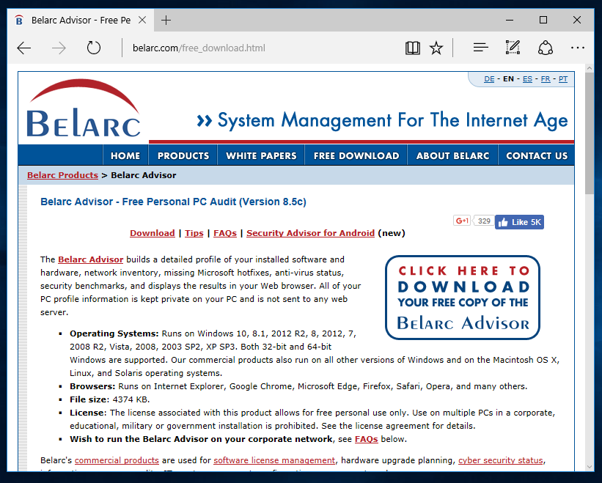

Slide 69


Slide 70
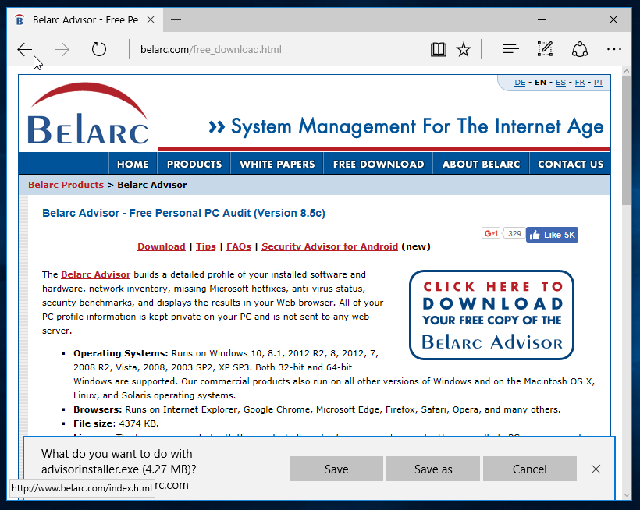

Slide 71
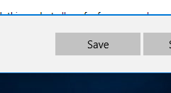

Slide 72
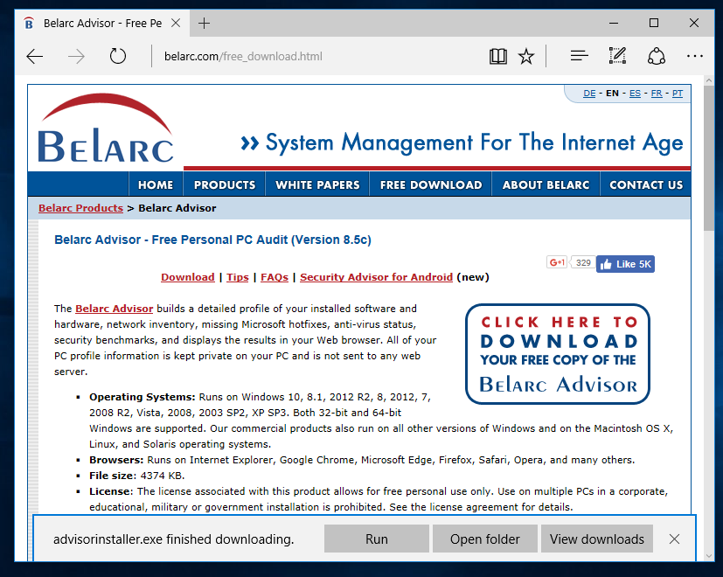

Slide 73
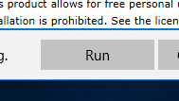

Slide 74
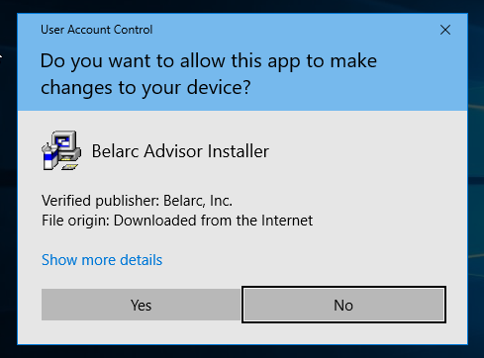

Slide 75


Slide 76
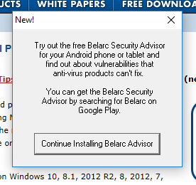

Slide 77
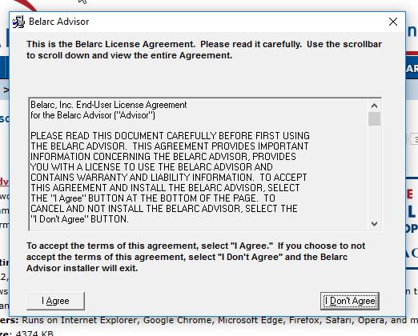

Slide 78
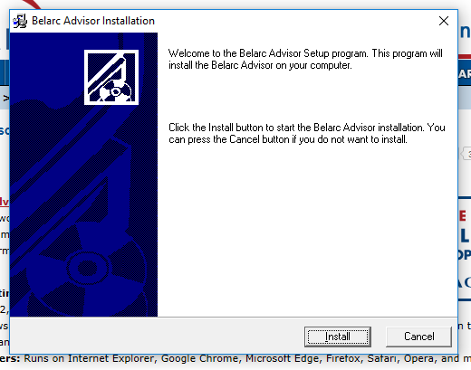

Slide 79


Slide 80
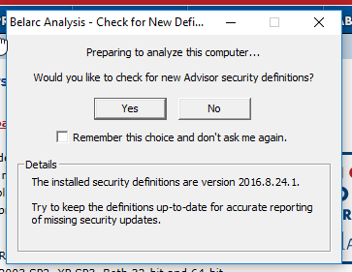

Slide 81


Slide 82
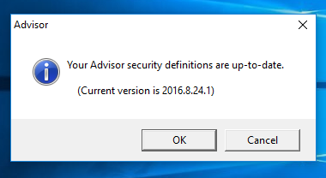

Slide 83


Slide 84
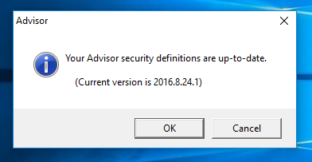

Slide 85


Slide 86
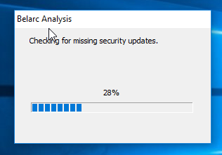

Slide 87
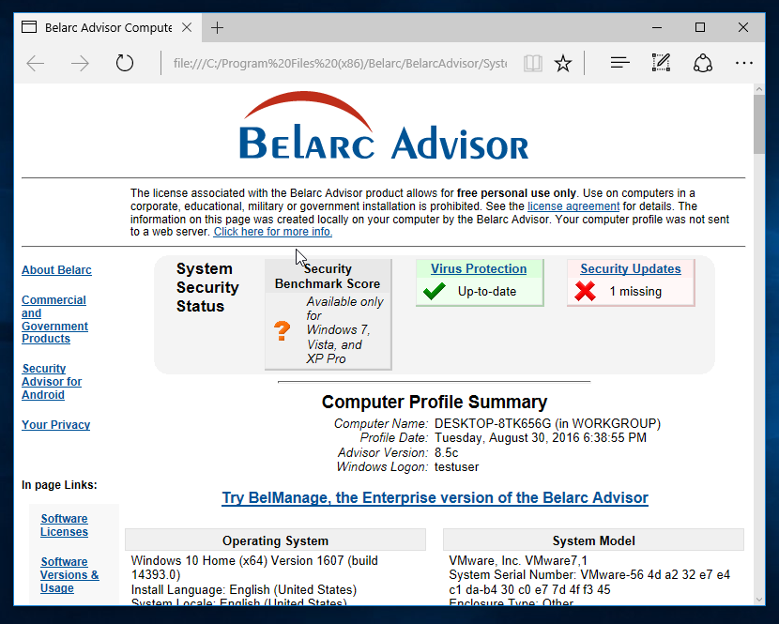

Slide 88
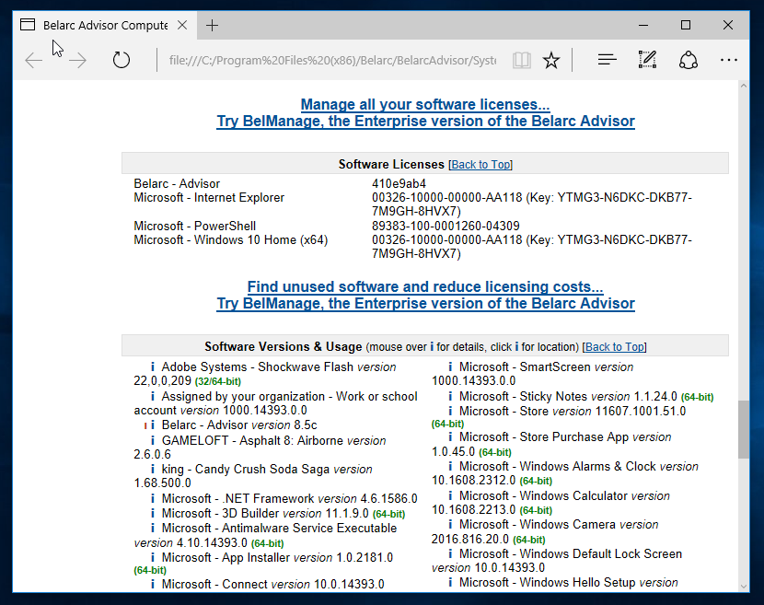

Slide 90


Slide 91

When Windows 10 is activated with a "Digital License", a generic placehold product key is stored in the Windows registry

Slide 92
DETAILS OF "DIGITAL LICENSE " ACTIVATION (continued)
When you use a Windows 7, 8, or 8.1 product key to activate Windows 10 or 11 successfully, Microsoft's activation servers actually store the UUID of the motherboard and the edition of Windows 10 or 11 (Home or Pro)
92

Slide 93
93

Slide 94
" DIGITAL LICENSE" ACTIVATION
Activation Servers Operated by Microsoft:
UUID of your motherboard,
edition (Windows 10 Home, Windows 10 Pro, Windows 11 Home, or Windows 11 Pro),
and
optionally, your Microsoft account's email address if you link your digital license to a Microsoft Account
Internet Connection
Activated "Windows 10"
94

Slide 95
" DIGITAL LICENSE" ACTIVATION
Activation Servers Operated by Microsoft:
UUID of motherboard, edition (Windows 10 Home, Windows 10 Pro, Windows 11 Home, or Windows 11 Pro),
and optionally, your Microsoft account's email address if you link your digital license to a Microsoft Account
95

Slide 96
DETAILS OF "PRODUCT KEY" ACTIVATION
"Product Key" activation is the original method of activating "Windows.." .
A 25-character :Product Key" is provided inside each retail copy of Windows 10 or 11 that you purchase.
96

Slide 97
DETAILS OF "PRODUCT KEY" ACTIVATION (continued)
"Product Key" activation occurs when you purchase and install a retail copy of Windows 10 or 11 and you use a "Product Key" to activate a copy of Windows 10 or 11
97

Slide 98
DETAILS OF "PRODUCT KEY" ACTIVATION (continued)
When you purchase a copy of Windows 10 or 11 and you use it to either upgrade from any prior version of "Windows.." OR to install into a blank hard drive, Microsoft's activation servers actually store : UUID of the motherboard and the edition of Windows 10 or 11 (Home or Pro),
98

Slide 99
" PRODUCT KEY" ACTIVATION
Microsoft's Activation Servers
UUID of motherboard, edition (Windows 10 Home, Windows 10 Pro, Windows 11 Home, or Windows 11 Pro)
Internet Connection
Activated "Windows 10"
99

Slide 100
" PRODUCT KEY" ACTIVATION
Microsoft's Activation Servers
UUID of motherboard, edition (Windows 10 Home or Windows 10 Pro or Windows 11 Home or "Windows 11 Pro")
100

Slide 101
DIFFERENCES BETWEEN "DIGITAL LICENSE" AND "PRODUCT KEY" ACTIVATION
There are is only one difference between "Digital License" and "Product Key" activation:
101

Slide 102
DIFFERENCES BETWEEN "DIGITAL LICENSE" AND "PRODUCT KEY" ACTIVATION (continued)
DIFFERENCE: In "Product Key" activation with a "Product Key " that is purchased from the "Retail" distribution channel, the 25-character "Windows 10 Product Key" (that you purchased) is stored up in the Windows registry inside your computer (instead of a placeholder key).
102

Slide 103
"DIGITAL LICENSE" ACTIVATION
Activation Servers Operated by Microsoft:
UUID of motherboard, edition (Windows 10 Home or Windows 10 Pro or Windows 11 Home or Windows 11 Pro), status of Windows.. (trial, full, or "Insider Preview")
and
your Microsoft account's email address username if you have linked your "Microsoft Account"
to the digital license
103

Slide 104
LINKING YOUR "MICROSOFT ACCOUNT" TO A "DIGITAL LICENSE" ACTIVATION
(continued)
If your "Microsoft account" is linked to your "Digital License" activation, you can then use the "Activation Troubleshooter" in Windows 10 or 11 when you change your computer's motherboard and also resolve other activation issues.
104

Slide 105
LINKING YOUR "MICROSOFT ACCOUNT" TO A "DIGITAL LICENSE" ACTIVATION (continued)
After you "link your digital license to your Microsoft account", the email address that you use to log into your Microsoft account will be stored up at Microsoft's activation servers along with the other information that corresponds to your "Digital License".
105

Slide 106
LINKING YOUR "MICROSOFT ACCOUNT" TO A "WINDOWS 10" ACTIVATION (continued)
Prior to making your digital license linked to your Microsoft Account, your digital license will look like this up at Microsoft's activation servers:
106

Slide 107
Microsoft's Activation Servers
UUID of motherboard, edition (Windows 10 Home, Windows 10 Pro, Windows 11 Home, or Windows 11 Pro"
status (trial, full, or "Insider Preview"),
107

Slide 108
LINKING YOUR "MICROSOFT ACCOUNT" TO A "WINDOWS 10" ACTIVATON (continued)
After making your digital license linked to your Microsoft Account, your digital license will look like this:
108

Slide 109
"DIGITAL LICENSE" ACTIVATION
Microsoft's Activation Servers
UUID of motherboard, edition (Windows 10 Home, Windows 10 Pro, Windows 11 Home, or "Windows 11 Pro), status (trial, full, or "Insider Preview")
and
your linked Microsoft
account's
email address or username
109

Slide 110
LINKING YOUR "MICROSOFT ACCOUNT" TO THE ACTIVATION OF WINDOWS 10 OR 11 (continued)
There are two ways for you to link your "Digital License" to a "Microsoft Account": Method 1: "Add a Microsoft Account" from the "Activation" screen in "Settings" Method 2: Run the "Sign in with a Microsoft Account instead" from "Accounts" in "Settings"
110

Slide 111
LINKING YOUR "MICROSOFT ACCOUNT" TO THE ACTIVATION OF
OF WINDOWS 10 OR 11(continued)
Details of Method 1: Click on the "Settings" gear icon. Click on "Update & security". Click on "Activation". Click on "Add an account".
111

Slide 112
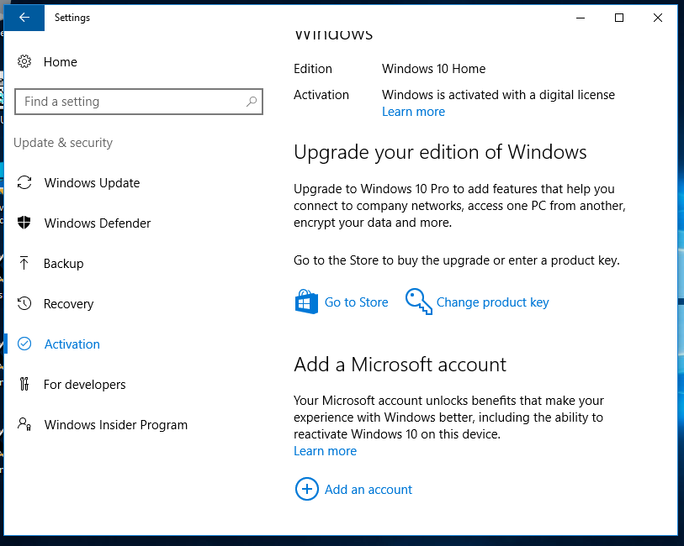
112

Slide 113
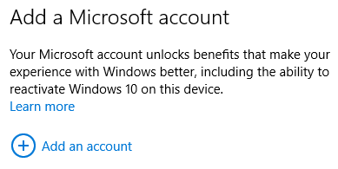
113

Slide 114
LINKING YOUR "MICROSOFT ACCOUNT" TO THE ACTIVATION
OF WINDOWS 10 OR 11 (continued)
Details of Method 2: Click on the "Settings" gear icon. Click on "Accounts". Click on "Sign in with a Microsoft account instead". etc.
114

Slide 115
LINKING YOUR "MICROSOFT ACCOUNT" TO THE ACTIVATION OF
OF WINDOWS 10 OR 11 (continued)
After you link your "Microsoft Account" to the activation process, your "Activation" screen will say "..linked to your Microsoft Account."
115

Slide 116
LINKING YOUR "MICROSOFT ACCOUNT" TO THE ACTIVATION OF WINDOWS 10 OR 11 (continued)
If you are running "Windows 10 Home", it looks like this:
116

Slide 117
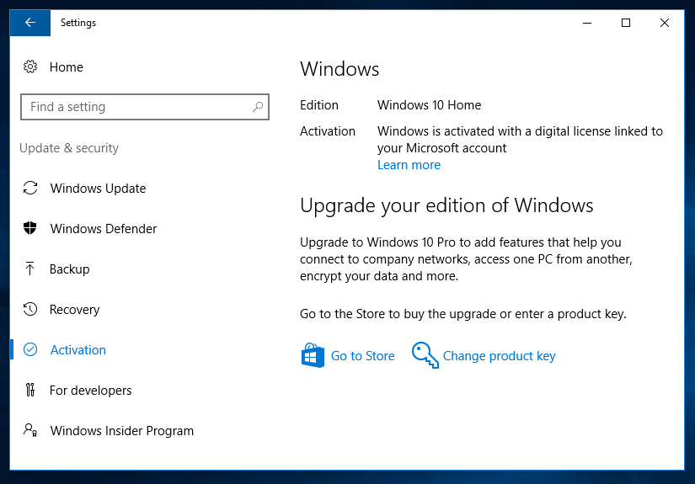
117

Slide 118
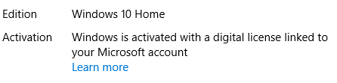
118

Slide 119
LINKING YOUR "MICROSOFT ACCOUNT" TO THE ACTIVATION OF WINDOWS 10 OR 11 (continued)
After you link your "Microsoft Account" to the activation process, if you originally activated Windows 10 or 11 with a "Product Key", the registry of "Windows 10" will still have your original 25-character "Product Key" in it as determined by software programs such as "Belarc Advisor", if your key is a "Retail" channel key.
119

Slide 120
LINKING YOUR "MICROSOFT ACCOUNT" TO THE ACTIVATION OF WINDOWS 10 OR 11" (continued)
After you link your "Microsoft Account" to the activation process, Windows 10 or 11 will start requiring you to log into your computer with your "Microsoft Account" (if you were logging into your computer with a "local account" prior to the linking process).
120

Slide 121
LINKING YOUR "MICROSOFT ACCOUNT" TO THE ACTIVATION OF WINDOWS 10 OR 11 (continued)
If you wish to go back to logging into Windows 10 or 11 with a "local account" after "Adding a Microsoft Account" to the activation of "Windows 10", go to "Settings", "Accounts", "Sign in with a local account", etc.
121

Slide 122
LINKING YOUR "MICROSOFT ACCOUNT" TO THE ACTIVATION OF WINDOWS 10 OR 11 (continued)
If you go back to logging into Windows 10 or 11 with a local account, Microsoft's activation servers will no longer store your Microsoft account's email address so you can no longer use the "Activation Troubleshooter" to re-activate if you change the motherboard of the computer
122

Slide 123
LINKING YOUR "MICROSOFT ACCOUNT" TO THE ACTIVATION OF WINDOWS 10 OR 11 (continued)
The process of linking a Microsoft Account to a copy of Windows 10 or 11 that was activated by means of a "Product key" converts the activation to a "Digital License" even if you then revert back to logging into Windows 10 or 11 with a "local account".
123

Slide 124
IF YOU REVERT BACK TO LOGGING IN WITH A "LOCAL ACCOUNT", MICROSOFT'S ACTIVATION SERVERS WILL STOP STORING YOUR MICROSOFT ACCOUNT'S EMAIL ADDRESS:
Activation Servers Operated by Microsoft:
DIGITAL LICENSE RECORD:
UUID of motherboard, edition (Win10 Home, Win10 Pro, Win11 Home, or Win11 Pro), status (trial, full, or "Insider Preview")
& your Microsoft account's email address (optional)
124

Slide 125
LINKING YOUR "MICROSOFT ACCOUNT" TO THE ACTIVATION OF WINDOWS 10 OR 11 (continued)
See https://support.microsoft.com/en-us/help/20530/windows-10-reactivating-after-hardware-change
125

Slide 126
LINKING YOUR "MICROSOFT ACCOUNT" TO THE ACTIVATION OF WINDOWS 10 OR 11 (continued)
The process of linking your "Microsoft Account" and then continuing or starting to log into your copy of Windows 10 or 11 is only important if you plan to change the motherboard of your computer soon.
126

Slide 127
LINKING YOUR "MICROSOFT ACCOUNT" TO THE ACTIVATION OF WINDOWS 10 OR 11 (continued)
We recommend linking your "Microsoft Account" and then going back to logging in with a local account in order to convert your "product key" activation to a "digital license" activation in order to mitigate the privacy issues of logging into Windows 10 or 11 with a "Microsoft Account".
127

Slide 128
TO GET THE UUID OF A MOTHERBOARD
Many not-free diagnostic software programs can give you the UUID of a motherboard
However, to get the UUID of a motherboard for free: open a "Windows Powershell" or a "Command Prompt" window and copy one of the following lines of code into it. Then press the <Enter> key once:
128

Slide 129
wmic csproduct get uuid
wmic path win32_computersystemproduct get uuid
get-wmiobject Win32_ComputerSystemProduct | Select-Object -ExpandProperty UUID
(get-wmiobject Win32_ComputerSystemProduct).UUID
129

Slide 130
WHEN YOU INSTALL OR UPGRADE FROM FROM AN EARLIER VERSION OF "WINDOWS.."
If you use a Windows 10 or 11 installation media DVD to either install onto a blank hard drive or to upgrade from Windows 7, 8, or 8.1, AND you put in an invalid Windows 7, 8, 8.1, or 10 "Product Key", the installation process will continue but you will have an "not activated" copy of Windows 10.. unless a digital license already exists for the UUID of the motherboard of the computer.
130

Slide 131
WINDOWS 10 OR 11 COMPUTER
Motherboard's UUID is stored in non-volatile memory (for all desktop and laptop computers) If this is a OEM_DM computer that is built by a large computer manufacter, then an "OEM Product Key" is stored in a the "MSDM" table of the "ACPI" of the motherboard
Hard drive stores the Windows "Registry" in "hive" folders and in RAM:
a "Placeholder Product Key" is stored in the "Windows Registry":
131

Slide 132
WHEN YOU INSTALL OR UPGRADE FROM FROM AN EARLIER VERSION OF "WINDOWS.." (continued)
If a large computer manufacturer built the computer, the computer manufacturer will place a unique, single-use "OEM Product Key" in the MSDM table in the motherboard of the computer AND the computer manufacturer will place a generic administrative product key in the Windows "Registry" in the hard drive of the computer
132

Slide 133
WHEN YOU INSTALL OR UPGRADE FROM FROM AN EARLIER VERSION OF "WINDOWS.." (continued)
The generic administrative product key in the Windows "Registry" in the hard drive of the computer is not unique: The computer manufacturer will re-use this generic administrative product key thousands of the computers that it installs "Windows 10" into.
133

Slide 134
WHEN YOU INSTALL OR UPGRADE FROM FROM AN EARLIER VERSION OF "WINDOWS.." (continued)
If you buy and install a "Retail" "Product Key Channel" copy of "Windows 10", the actual 25-character "product key" that you buy and then use will be stored in the Windows "Registry"
If you buy and install a "OEM_.." copy of Windows 10 or 11, a generic, administrative, placeholder 25-character product key will be stored in the Windows "Registry"
134

Slide 135
WHEN YOU INSTALL OR UPGRADE FROM FROM AN EARLIER VERSION OF "WINDOWS.." (continued)
To determine if a 25-character "product key" that is stored in the Windows "Registry" is a "Retail" product key or a generic, administrative, placeholder product key, search for it in the Google or Bing search engine since all generic and manufacturer's generic product keys are published on the Internet
135

Slide 136
IF YOU ACQUIRE A USED WINDOWS 10 OR 11 COMPUTER
If you acquire a used Windows 10 or 11 computer that does not have a hard drive, you can install a hard drive into it and then install using "installation media" DVD's for "Windows 10 Home", "Windows 10 Pro", "Windows 11 Home" or "Windows 11 Pro" into the computer to determine if the computer has any existing "digital licenses" up in Microsoft's activation servers: Do not buy a new copy of Windows 10 or 11 until you determine this!
136

Slide 137
Activation Servers Operated by Microsoft:
"PRODUCT KEY" DATABASE
UUID of motherboard of your newly-acquired, used computer, edition = "Home"
UUID of motherboard of your newly-acquired, used computer, edition = "Home"
137

Slide 138
IF YOU ACQUIRE A USED WINDOWS 10 OR 11 COMPUTER (continued)
If you buy a new copy of Windows 10 or Windows 11 with a new "Product Key" and the computer already has a "Digital License", AND then you use the new "Product Key", Microsoft has then managed to sell the same "digital license" twice since they only store one "digital license" for a specific motherboard "UUID": For a specific edition and bitness of Windows 10 or 11, their activation servers can only store one "digital license".
138

Slide 139
IF YOU USE A "WINDOWS 7 PRO" KEY TO ACTIVATE OR RE-ACTIVATE A "WINDOWS 10 HOME" COMPUTER..
Then your "Windows 10 Home" computer will upgrade itself to "Windows 10 Pro". However, if you use key.vbs or "Belarc Advisor" to view the 25-character "activation key" that is stored in the "Registry" will not have the "Windows 7 Pro" key stored. Instead a default "placeholder" key for "Windows 10 Pro" will be stored inside the "Registry" of the "Windows 10 Pro" operating system
139

Slide 140
DIFFERENCES BETWEEN "WINDOWS 7", AND WINDOWS 10 OR 11
In "Windows 7", the 25-character "activation key" is stored inside the "Registry" and you can use key.vbs or "Belarc Advisor" to view it
140

Slide 141
DIFFERENCES BETWEEN "WINDOWS 7", AND WINDOWS 10 OR 11 (continued)
In Windows 10 or 11, the 25-character "activation key" that is stored in the "Registry" is a "placeholder key" that used for hundreds of thousands of computers. While you can still view this "placeholder key" using key.vbs or "Belarc Advisor", this "placeholder key" is of no use to you for re-installing the "Windows 10" operating system,
141

Slide 142
REFERENCES
Placeholder keys for the additional flavors of "Windows 10" can also be found at https://winaero.com/blog/generic-key-to-install-windows-10-rtm/ However, ignore their advice to use these keys during the installation or upgrade process.
142

Slide 143
REFERENCES (continued)
Placeholder keys for the additional flavors of "Windows 10" can also be found at https://www.tenforums.com/tutorials/95922-generic-product-keys-install-windows-10-editions.html
143

Slide 144
REFERENCES (continued)
Placeholder keys for the "Windows 11" can be found at https://www.elevenforum.com/t/generic-product-keys-to-install-or-upgrade-windows-11-editions.3713/
144

Slide 145
REFERENCES (continued)
https://www.elevenforum.com/t/windows-10-and-windows-11-digital-licencing-explained.14051/
145

