Slide 1
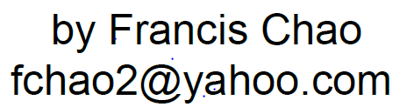


MOVING & COPYING & STARTING UP
VIRTUAL MACHINES
IN
"VIRTUALBOX"

Slide 2
Web location for this presentation:
http://aztcs.apcug.org
Click on “Meeting Notes”

Slide 3
SUMMARY
Moving and copying virtual machines in "VirtualBox" requires exporting and importing. Start up a virtual machine in VirtualBox by using the LEFT mouse button to double-click on the *.vbox file of the virtual machine.

Slide 4
TOPICS
Default Location for Virtual Machines in "VirtualBox"
Exporting
Importing
Starting up a virtual machine in "Virtual Box"

Slide 5
DEFAULT LOCATION FOR VIRUTAL MACHINES IN VMWARE WORKSTATION PRO OR PLAYER
C:\Users\<user name>\\VirtualBox VMs\ <Name of Virtual Machine>

Slide 6
EXPORT THE VIRTUAL MACHINE
Start "VirtualBox".
Right-click on the virtual machine and click on "Export to.."
An "Export Virtual Appliance" dialog box will be displayed

Slide 7
IMPORT THE VIRTUAL MACHINE
Start "VirtualBox"
Click on "File"
Click on "Import Appliance..."

Slide 8
STARTING UP A VIRTUAL MACHINE IN "VIRTUALBOX"
Locate the folder that contains the virtual machine.
Use the LEFT mouse button to double-click on the *.vbox virtual motherboard file.

