Slide 1




2-INSTALLING FREE "VIRTUAL MACHINE PROGRAMS" FOR YOUR REAL "WINDOWS.." COMPUTER
1

Slide 2
Web location for this presentation:
http://aztcs.apcug.org
Click on
“Meeting Notes”
2

Slide 3
SUMMARY
At the present time, you can install one or more free programs for creating and running virtual machines in a real "Windows.." computer: Here is some advice on how to get one or more of these programs installed.
3

Slide 4
TOPICS
THREE FREE PROGRAMS FOR CREATING "VIRTUAL MACHINES"
INSTALLING MORE THAN ONE "VIRTUAL MACHINE PROGRAM" INTO YOUR WINDOWS.. COMPUTER
4

Slide 5
TOPICS (continued)
INSTALLING "VMWARE WORKSTATION PRO"
INSTALLING "VIRTUALBOX"
INSTALLING "DESKTOP HYPER-V"
5

Slide 6
THREE FREE PROGRAMS FOR CREATING "VIRTUAL MACHINES"
Three free "virtual machine programs" are available for a real "Windows.." computer: VMware Workstation Pro VirtualBox and Hyper-V
6

Slide 7
INSTALLING MORE THAN ONE "VIRTUAL MACHINE PROGRAM" INTO A "WINDOWS.." COMPUTER
"VMware Workstation Pro" and "Oracle VM VirtualBox 7" can be installed into the same computer
You can also install Microsoft's free "Hyper-V" into a "Windows 11 Pro" or "Windows 10 Pro" computer but most people have the "Windows 11 Home" or "Windows 10 Home"
7

Slide 8
INSTALLING MORE THAN ONE "VIRTUAL MACHINE PROGRAM" INTO A "WINDOWS.." COMPUTER (continued)
To determine which version of Windows.., you have: Use the RIGHT mouse button to click on the Start button of Windows. Use the LEFT mouse button to click on Run in the pop-up menu. Type in "winver". Use the LEFT mouse button to click on the OK button.
8

Slide 9
INSTALLING "VMWARE WORKSTATION PRO" INTO A "WINDOWS.." COMPUTER
Use a Web browser to go to https://www.vmware.com/products/desktop-hypervisor/workstation-and-fusion
9

Slide 10
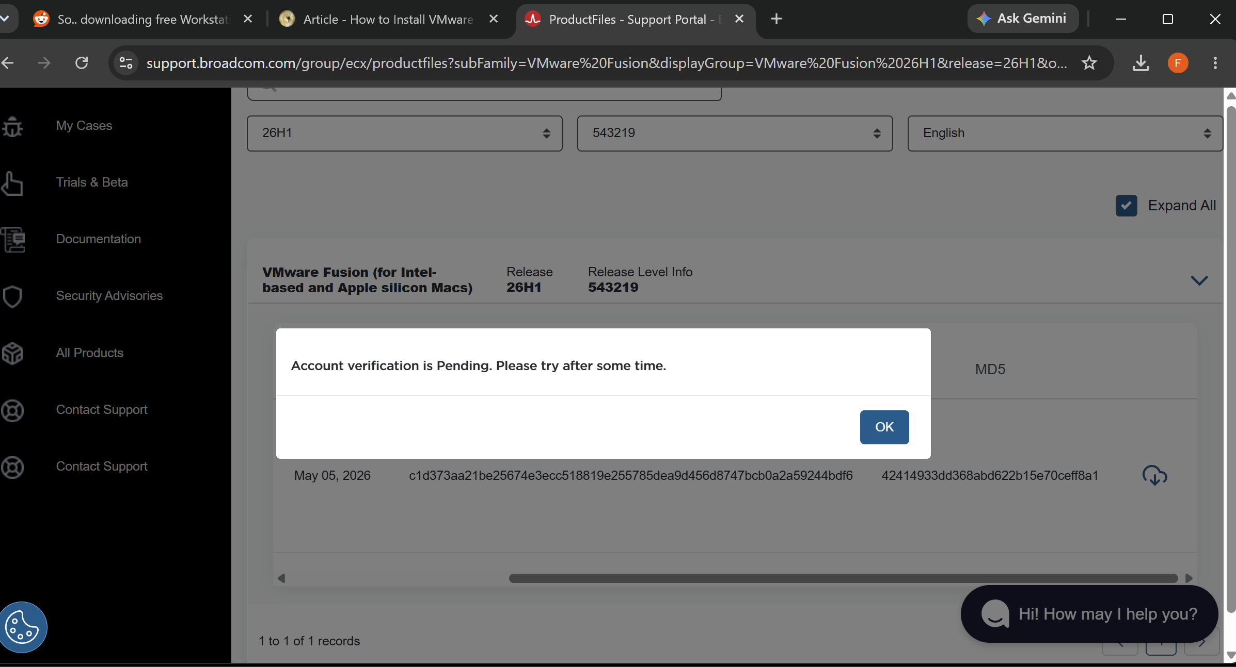
10

Slide 11
11

Slide 12
12

Slide 13
INSTALLING "VMWARE WORKSTATION PRO" INTO A "WINDOWS.." COMPUTER (continued)
https://knowledge.broadcom.com/external/article/368588/
13

Slide 14
INSTALLING "VMWARE WORKSTATION PRO" INTO A "WINDOWS.." COMPUTER (continued)
https://www.reddit.com/r/vmware/comments/1ry3ycb/so_downloading_free_workstation_pro_for_personal/?solution=e51e336e9430709ae51e336e9430709a&js_challenge=1&token=7afd7253fec22262ff1c52b1703fe9ec3f860f8206dff1971f9c304482c365f8&jsc_orig_r=
14

Slide 15
INSTALLING "VMWARE WORKSTATION PRO" INTO A "WINDOWS.." COMPUTER (continued)
https://criticalx.substack.com/p/stuck-trying-to-download-vmware-fusion
15

Slide 16
INSTALLING "VMWARE WORKSTATION PRO" INTO A "WINDOWS.." COMPUTER (continued)
https://community.broadcom.com/blogs/julia-klaus/2025/05/25/trouble-downloading-fusion-or-workstation-account
16

Slide 17
INSTALLING "VMWARE WORKSTATION PRO" INTO A "WINDOWS.." COMPUTER (continued)
https://community.broadcom.com/vmware-cloud-foundation/question/account-verification-stuck-on-pending-profile-complete-account-active-manual-review-needed
17

Slide 18
INSTALLING "VMWARE WORKSTATION PRO" INTO A "WINDOWS.." COMPUTER (continued)
https://www.techpowerup.com/download/vmware-workstation-pro/
https://www.techpowerup.com/download/vmware-workstation-pro/
18

Slide 19
INSTALLING "ORACLE VM VIRTUALBOX" INTO A "WINDOWS.." COMPUTER
Use a Web browser to go to https://www.virtualbox.org/wiki/Downloads
19

Slide 20
INSTALLING "HYPER-V" INTO A "WINDOWS.." COMPUTER
For a "Windows 11 Pro" or a "Windows 10 Pro" computer, use a Web browser to go to
https://pureinfotech.com/enable-hyper-v-windows-11/
20

Slide 21
INSTALLING "HYPER-V" INTO A "WINDOWS.." COMPUTER (continued)
For a "Windows 11 Home" computer, use a Web browser to go to https://pureinfotech.com/install-hyperv-home-windows-11/
21

Slide 22
INSTALLING "HYPER-V" INTO A "WINDOWS.." COMPUTER (continued)
To determine which version of Windows.., you have: Use the RIGHT mouse button to click on the Start button of Windows. Use the LEFT mouse button to click on Run in the pop-up menu. Type in "winver". Use the LEFT mouse button to click on the OK button.
22

Slide 23
INSTALLING "HYPER-V" INTO A "WINDOWS.." COMPUTER (continued)
For a "Windows 11 Home" computer, use a Web browser to go to https://pureinfotech.com/install-hyperv-home-windows-11/ to install a "workaround" that was created by some Microsoft employees.
23

