Slide 1
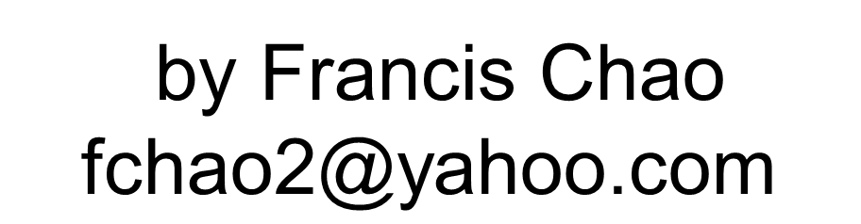



1-A COMPARISON OF FREE "VIRTUAL MACHINE PROGRAMS" FOR YOUR REAL "WINDOWS.." COMPUTER
1

Slide 2
Web location for this presentation:
http://aztcs.apcug.org
Click on
“Meeting Notes”
2

Slide 3
SUMMARY
At the present time, you have a choice between running three free programs for creating and running virtual machines in a real "Windows.." computer: "VMware Workstation Pro", "VirtualBox", and "Hyper-V". There are differences in host operating system requirements and virtual graphics adapters.
3

Slide 4
TOPICS
INTRODUCTION TO THE THREE FREE PROGRAMS FOR CREATING "VIRTUAL MACHINES"
DIFFERENCES IN HOST OPERATING SYSTEM REQUIREMENTS
4

Slide 5
TOPICS (continued)
DIFFERENCES IN VIRTUAL GRAPHICS ADAPTERS
5

Slide 6
"INTRODUCTION TO THE THREE FREE PROGRAMS FOR CREATING "VIRTUAL MACHINES"
6

Slide 7
INTRODUCTION TO THE THREE FREE PROGRAMS FOR CREATING "VIRTUAL MACHINES"
Three free "virtual machine programs" are available for a real "Windows.." computer: VMware Workstation Pro, VirtualBox, and Hyper-V (also known as "Desktop Hyper-V")
7

Slide 8
INTRODUCTION TO THE THREE FREE PROGRAMS FOR CREATING "VIRTUAL MACHINES" (continued)
All of these three programs are now free for use by homes, organizations or businesses
8

Slide 9
INTRODUCTION TO THE THREE FREE PROGRAMS FOR CREATING "VIRTUAL MACHINES" (continued)
However, the "Extension Pack" for "VirtualBox" is not free for businesses and organization !
https://community.broadcom.com/vmware-cloud-foundation/discussion/how-i-can-purchase-a-vmware-workstation-pro-license-after-the-closer-of-cloudvista
9

Slide 10
INTRODUCTION TO THE THREE FREE PROGRAMS FOR CREATING "VIRTUAL MACHINES" (continued)
https://www.tacticallawgroup.com/oracle-software-audit-blog/how-oracle-uses-online-agreements-for-free-software-to-trap-companies-into-paying-large-licensing-penalties-the-hidden-costs-of-oracle-java-se-and-virtualbox-software
10

Slide 11
INTRODUCTION TO THE THREE FREE PROGRAMS FOR CREATING "VIRTUAL MACHINES" (continued)
https://computingforgeeks.com/install-virtualbox-extension-pack-using-vboxmanage/
https://redresscompliance.com/oracle-virtualbox-licensing-article
11

Slide 12
INTRODUCTION TO THE THREE FREE PROGRAMS FOR CREATING "VIRTUAL MACHINES" (continued)
https://www.tacticallawgroup.com/oracle-software-audit-blog/how-oracle-uses-online-agreements-for-free-software-to-trap-companies-into-paying-large-licensing-penalties-the-hidden-costs-of-oracle-java-se-and-virtualbox-software
12

Slide 13
INTRODUCTION TO THE THREE FREE PROGRAMS FOR CREATING "VIRTUAL MACHINES" (continued)
https://www.reddit.com/r/virtualbox/comments/fvt7a5/virtualbox_extension_pack/
13

Slide 14
INTRODUCTION TO THE THREE FREE PROGRAMS FOR CREATING "VIRTUAL MACHINES" (continued)
"VMware Workstation Pro" is a free, closed-source program. When it's capabilities and features are compared to "VirtualBox and "Hyper-V", "VMware Workstation Pro" usually is the superior "virtual machine program".
14

Slide 15
INTRODUCTION TO THE THREE FREE PROGRAMS FOR CREATING "VIRTUAL MACHINES" (continued)
"VirtualBox" is a free, open-source program. It's weak point is low-end virtual graphics adapters which severely limit it's multimedia playing, and video, editing capabilities.
15

Slide 16
INTRODUCTION TO THE THREE FREE PROGRAMS FOR CREATING "VIRTUAL MACHINES" (continued)
VirtualBox's strong point is it's flexibility in dealing with virtual hard drive files: "VirtualBox" can create or utilize hard drive files that have been or can be recognized by other virtual machine programs.
16

Slide 17
INTRODUCTION TO THE THREE FREE PROGRAMS FOR CREATING "VIRTUAL MACHINES" (continued)
"Hyper-V" is bundled with "Windows 11 Pro", "Windows 10 Pro", "Windows 11 Enterprise", "Windows 10 Enterprise, "Windows 11 Education",and "Windows 10 Education. It uses Microsoft's "VMBus" which makes it faster than any other virtual machine program.
17

Slide 18
DIFFERENCES IN HOST OPERATING SYSTEM REQUIREMENTS
VMWARE WORKSTATION PLAYER 17 | "WINDOWS 11" HOME OR PRO "WINDOWS 10" HOME OR PRO (64-BIT) ..LINUX..
ORACLE VIRTUALBOX 7 | "WINDOWS 11" HOME OR PRO "WINDOWS 10" HOME OR PRO (64-BIT) macOS 10.13 and higher ..LINUX..
18

Slide 19
DIFFERENCES IN HOST OPERATING SYSTEM REQUIREMENTS (continued)
HYPER-V ("Hyper-V role" is bundled with some versions of Windows) | "WINDOWS 11 PRO" "WINDOWS 10 PRO" 64-BIT ("HYPER-V" CANNOT BE INSTALLED INSIDE ..LINUX..)
19

Slide 20
DIFFERENCES IN HOST OPERATING SYSTEM REQUIREMENTS (continued)
Since 95+ percent of the "Windows 11.." and "Windows 10.." computers that are sold in stores have the low-end "Home" editon of "Windows 10.." and "Windows 8.1", you will probably have to buy the "Windows 11 Pro Upgrade" or the "Windows 10 Pro Upgrade" before you can run "Hyper-V".
20

Slide 21
DIFFERENCES IN VIRTUAL GRAPHICS ADAPTERS FOR THE THREE VIRTUAL MACHINE PROGRAMS:
21

Slide 22
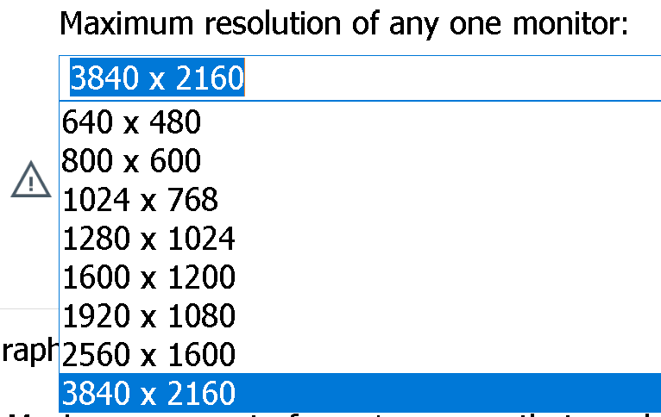
DIFFERENCES IN
VIRTUAL GRAPHICS ADAPTERS
VMWARE WORKSTATION PLAYER 17 | MAXIMUM OF 8 GIGABYTES OF GRAPHICS MEMORY
22

Slide 23
DIFFERENCES IN VIRTUAL GRAPHICS ADAPTERS (continued)
ORACLE VM VIRTUAL-BOX 7.X | MAXIMUM OF 256 MEGABYTES OF GRAPHICS MEMORY
23

Slide 24
DIFFERENCES IN VIRTUAL GRAPHICS ADAPTERS (continued)
HYPER-V | MAXIMUM OF 1600 x 1200 RESOLUTION OF THE VIRTUAL MONITOR FOR A VIRTUAL MACHINE THAT IS RUNNING WINDOWS 11, WINDOWS 10, OR UBUNTU 18.04 OR HIGHER AS A GUEST OPERATING SYSTEM IS USUALLY SET FROM THE "DISPLAY SETTINGS" OF THE GUEST OPERATING SYSTEM
24

Slide 25
DIFFERENCES IN VIRTUAL GRAPHICS ADAPTERS (continued)
The very low end graphics capability of "VirtualBox" will cause you to experience recoverable problems when you are installing or using various operating systems inside virtual machines: If your guest operating system inside a virtual machines displays a black screen for more than 4 minutes, use te LEFT mouse button to click on "Reset" in the "Machine" pull-down menu:
25

Slide 26
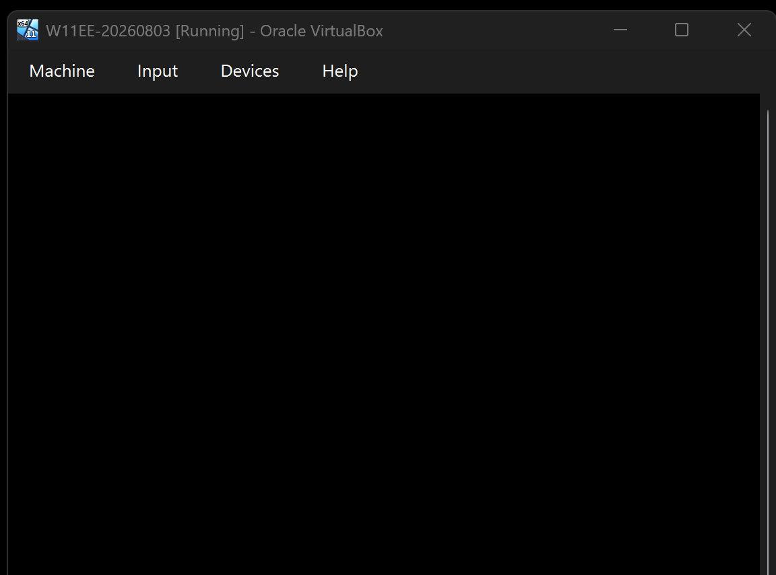
26

Slide 27
27

Slide 28
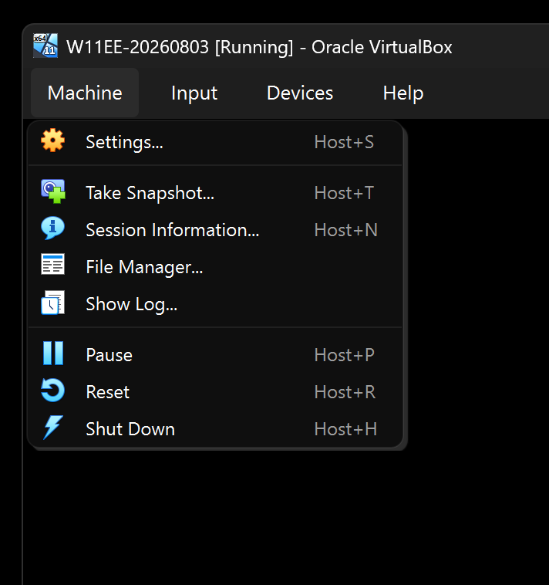
28

Slide 29
29

Slide 30
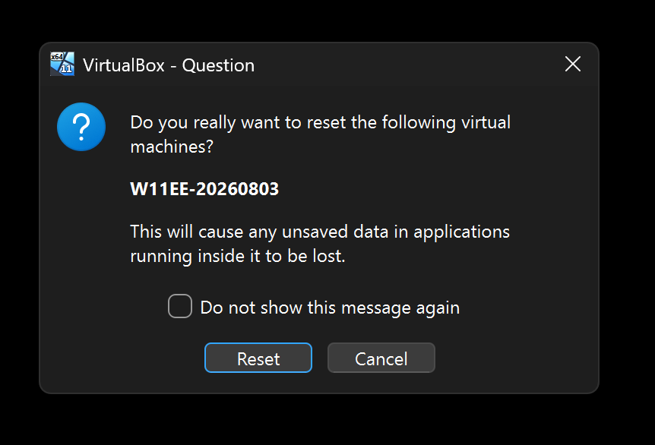
30

Slide 31
31

Slide 32
DIFFERENCES IN USB SUPPORT
VMWARE WORKSTATION PLAYER 17 | Pass-through for USB 1, USB 2, and USB 3 devices. (Sound devices can pass-through via either USB passthrough or virtual motherboard pass-through.)
ORACLE VIRTUALBOX 7 | Pass-through for USB 1, USB 2, and USB 3 devices. (Sound devices can pass-through via either USB passthrough or virtual motherboard pass-through.)
32

Slide 33
DIFFERENCES IN USB SUPPORT (continued)
HYPER-V ("role" is bundled with some versions of Windows) | No direct USB pass-through. Some passthrough of USB devices is a allowed by means of Remote Desktop Protocol requiring configuration in both the host computer and the virtual machine.
33

Slide 34
DIFFERENCES IN SOUND SUPPORT
VMWARE WORKSTATION PLAYER 17 | Pass-through of sound cards and controllers through the virtual motherboard of the virtual machine
ORACLE VIRTUALBOX 7 | Pass-through of sound cards and controllers through the virtual motherboard of the virtual machine
34

Slide 35
DIFFERENCES IN SOUND SUPPORT (continued)
HYPER-V ("role" is bundled with some versions of Windows) | No pass-through of sound cards and controllers through the virtual motherboard of the virtual machine. Some passthrough of USB devices is a allowed by means of Enhanced Session Mode via Remote Desktop Protocol requiring configuration in both the host computer and the virtual machine.
35

Slide 36
SOME CHALLENGING BUT DOABLE SOLUTIONS FOR HYPER-V'S USB AND AUDIO LIMITATIONS
https://www.eltima.com/article/hyper-v-usb-passthrough/
https://learn.microsoft.com/en-us/windows-server/virtualization/hyper-v/enhanced-session-mode
https://woshub.com/how-to-connect-a-usb-drive-directly-to-a-hyper-v-vm/
36

Slide 37
DIFFERENCES IN VIRTUAL NETWORKS
"VMware Workstation Pro" provides you with 5 virtual routers so that you can connect to other computers and to the Internet in a variety of ways
37

Slide 38
DIFFERENCES IN VIRTUAL NETWORKS (continued)
"VirtualBox" provides you with a default virtual router that is directly connected to the your Internet provider's gateway device. "VirtualBox" also provides you with a "VBOXSVR" virtual router that lets you connect a virtual machine to other computers in your local network.
38

Slide 39
DIFFERENCES IN VIRTUAL NETWORKS (continued)
Hyper-V provides you with a virtual network switch hub device that connects each virtual machine to the host computer which then allows a virtual machine to access the Internet through the host computer.
39

Slide 40
40

