Slide 1
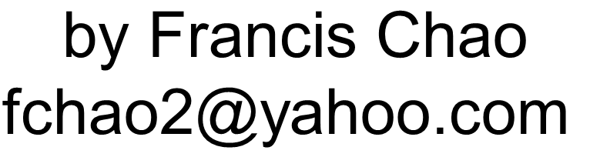



0-VIRTUAL MACHINES--
AN OVERVIEW

Slide 2
Web location for this presentation:
http://aztcs.apcug.org
Click on "Meeting Notes"
2

Slide 3
SUMMARY
You can use free virtual machine programs to run separate operating systems in your existing computer. By doing so, you can realize massive savings in time, space, and costs.
3

Slide 4
TOPICS
Two Types of "Virtual Machine Programs" (= "Hypervisors")
3 "Hypervisor" options: "VMware Player", "VirtualBox", and "Hyper-V"

Slide 5
TYPE 1 VERSUS TYPE 2 "HYPERVISORS"
"Virtual machine program" = "Hypervisor" = software program that can create virtual machines
"Virtual machines" have virtual motherboards, virtual USB ports, virtual sound cards, virtual hard drive controllers, virtual mice, virtual keyboards, etc.

Slide 6
Real computer (="host computer") runs 64-bit version of "Windows.."
"Type 2" Hypervisor such as "VMware Workstation Pro" or "VirtualBox" runs inside "Windows.."
"Virtual Machine(s)" running Linux, Windows.., Unix, etc.

Slide 7
Real computer (= host computer) runs "Type 1" Hypervisor such as "Hyper-V"
"Virtual Machine(s)" inside "Hyper-V" running Linux, Windows.., Unix, etc.
"Windows 11" or "Windows 10" runs inside "Hyper-V" as a "Root Partition"

Slide 8
IMPLEMENTING "VIRTUAL MACHINES"

Slide 9
Real computer (="host computer") runs
64-bit version of "Windows 10",
or "Windows 11"

Slide 10
BIG STEP 100: INSTALL A "VIRTUAL MACHINE PROGRAM"

Slide 11
Real computer (="host computer") runs 64-bit version of "Windows.."
Install the free "VMware Workstation Pro"
or the free "VirtualBox"
= "virtual machine program"

Slide 12
The actual steps for "BIG STEP 100" are located at: http://aztcs.apcug.org/meeting_notes/winhardsig/virtualmachines/vmware-1-installing.pdf

Slide 13
BIG STEP 200: CREATE A NEW "VIRTUAL MACHINE" USING THE "VIRTUAL MACHINE” PROGRAM

Slide 14
Real computer (="host computer") runs 64-bit version of "Windows.."
"VMware Workstation Pro"
= "virtual machine program"
Create a new "virtual machine"

Slide 15
The actual steps for “Big Step 200" are located at: http://aztcs.apcug.org/meeting_notes/winhardsig/virtualmachines/vmware-2-createVM.pdf
15

Slide 16
BIG STEP 300: INSTALL A "GUEST OPERATING SYSTEM" INTO THE "VIRTUAL MACHINE"

Slide 17
Real computer (="host computer") runs 64-bit version of "Windows.."
"VMware Workstation Pro" or "VirtualBox" = "virtual machine program"
Install "Windows 11", or "Windows 10" or "Linux Mint" as a "guest operating system" inside the "virtual machine"

Slide 18
BIG STEP 400: INSTALL THE VIRTUAL MACHINE PROGRAM'S DRIVERS INTO THE "VIRTUAL MACHINE"

Slide 19
= INSTALL VMWARE'S "VMWARE TOOLS" OR VIRTUALBOX'S "GUEST ADDITIONS" INTO THE "GUEST OPERATING SYSTEM"

Slide 20
Real computer (="host computer") runs "Windows 11" or "Windows 10"
"virtual machine program" such as "VMware Workstation Pro" or "VirtualBox"
"Virtual machine"runs a "guest operating system" ("Linux Mint" or "Windows 10" or "..11")
Install "VMware Tools" or VirtualBox "Guest Additions

