Slide 1



MOST WINDOWS.. COMPUTERS NOW HAVE TWO "OUTLOOK" APPS

Slide 2
Web location for this presentation:
http://aztcs.apcug.org
Click on "Meeting Notes"
2

Slide 3
SUMMARY
Most "Windows 11" computers will have two "Outlook" apps: "Outlook (Classic") and "Outlook"
3

Slide 4
TOPICS
Two "Outlook.." apps in most Windows 11 or Windows 10 computer
To avoid confusion, only keep the instance of "Outlook" that you need
4

Slide 5
"WINDOWS APPS" (continued)
Windows 11 has both "Outlook" and "Outlook (classic)" in the "Start Menu":
"Outlook (classic) " is a legacy desktop app and "Outlook" is a "Windows app".

Slide 6
"WINDOWS APPS" (continued)
Like all "Windows Platform" apps, "Outlook" resides at C:\Program Files\WindowsApps\
The name of the folder where they reside is "WindowsApps" but you cannot get into it directly without destroying it.

Slide 7
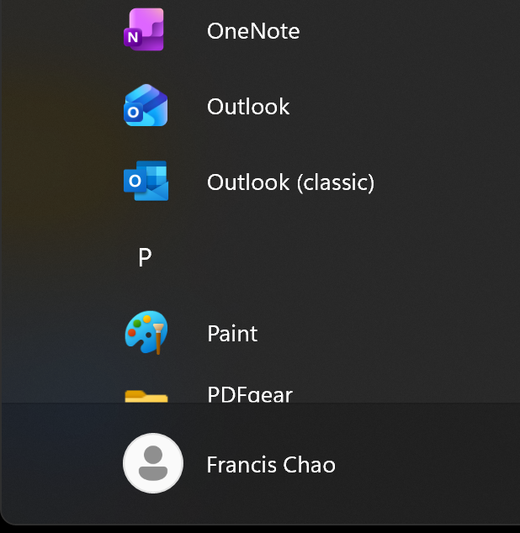

Slide 9
"WINDOWS APPS" (continued)
"Outlook" is the free, bundled replacement for "Windows Mail and Calendar". It does not create or open PST files.
"Outlook (classic)" is the paid version of Outlook that comes with the not-free "Microsoft Office" or the not-free "Microsoft 365. It allows you to create or open PST files.

