Slide 1




TYPES OF SOFTWARE PROGRAMS INSIDE A "WINDOWS.." COMPUTER

Slide 2
Web location for this presentation:
http://aztcs.apcug.org
Click on "Meeting Notes"
2

Slide 3
TOPICS
Four kinds of software application programs in a "Windows.." computer:
Appendix 1: Making a shortcut for a "Windows App"
Appendix 2: Placing a shortcut for a "Portable App" into the "Start Menu" of "Windows.."
3

Slide 4
FOUR KINDS OF SOFTWARE APPLICATION PROGRAMS IN "WINDOWS 11" OR "WINDOWS 10"
1. "desktop apps" 2. "Windows apps" 3. "portable apps"
4. "Web apps"
4

Slide 5
"DESKTOP APPS"
"Desktop Apps" were formerly known as "desktop applications" but Microsoft started calling them "desktop apps" when they released "Windows 8" in October 2012

Slide 6
"DESKTOP APPS" (continued)
Prior to October 2012 "apps" usually meant "software programs that run in cell phones, BlackBerrys, and tablets".

Slide 7
"DESKTOP APPS" (continued)
Listed in "Programs and Features" in the Windows "Control Panel".
Listed in "Installed apps" inside "Apps" inside "Settings" in "Windows 11" and "Windows 10"

Slide 8
"DESKTOP APPS" (continued)
"Desktop apps" in "Windows.." usually have a *.exe file that resides in C:\Program Files\<name of program>\ or C:\Program Files (x86)\<name of program>\
Some "Desktop apps" have *.exe files in both of these locations

Slide 9
"DESKTOP APPS" (continued)
"Legacy Desktop apps" in "Windows.." usually install files into C:\ProgramData\ and C:\<your user name>\AppData

Slide 10
"DESKTOP APPS" (continued)
The desktop-based "Microsoft 365" and "Microsoft Office.." suite of programs are "desktop apps": Microsoft Word.., Microsoft Excel.., Microsoft PowerPoint.., Microsoft Outlook.., Microsoft Publisher.., Microsoft Access.. are all "desktop apps".

Slide 11
"DESKTOP APPS" (continued)
"Desktop apps": Some are bundled with the "Windows.." operating system. Others are obtained by downloading them from a Web site using a Web browser. Some are purchased as CDs or DVDs. Some are obtained from the "Windows Store" app in the "Start Menu"

Slide 12
"WINDOWS APPS"
Starting with "Windows 8" in October 2012" and continuing to
"Windows 10" and then to "Windows 11", a folder called "WindowsApps" appeared in C:\ProgramFiles

Slide 13
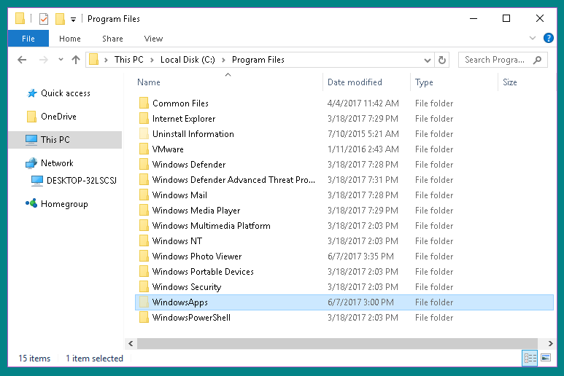

Slide 14
"WINDOWS APPS" (continued)
"Windows Apps" reside inside the "WindowsApps" folder. These folders are "read only", "hidden", and "sandboxed". Do not make any modifications to them.

Slide 15
"WINDOWS APPS" (continued)
If you wish to look at the contents of these folders, use the RIGHT mouse button to drag them to the "Desktop". Then click on "Copy here" to make a copy of the "Desktop". The use the RIGHT mouse button to click on "Properties".

Slide 16
"WINDOWS APPS" (continued)
Then use the LEFT mouse button to remove the check mark from "Read only".
The use the LEFT mouse button to remove the check mark from "Hidden"

Slide 17
"WINDOWS APPS" (continued)
The use the LEFT mouse button to double-click on the "WindowsApps" folder or the "SystemApps" folder on the "Desktop" to look at the contents of them.

Slide 18
"WINDOWS APPS" (continued)
"Windows Apps" apps have gone through many overlapping name changes with different Microsoft employees using different names at any given point in time:

Slide 19
"WINDOWS APPS" (continued)
  TIMELINE:
  October 2012: "Metro-style Apps" in "Windows 8" October 2013: "Windows Store Apps" in "Windows 8.1" September 2014: "Modern Apps" in Windows 8.1" October 2012: "Universal Apps" in "Windows 8.1"

Slide 20
"WINDOWS APPS" (continued)
  TIMELINE (continued):
  March 2015: "Windows apps" in "Windows 10" and in "Windows 11"
  July 2015: "Universal Windows Platform" Apps in "Windows 10" and in "Windows 11"

Slide 21
"WINDOWS APPS" (continued)
Most "Windows Apps" tend to have simpler, less-cluttered user interfaces with hidden vertical and/or horizontal scroll bars, if any vertical and/or horizontal scroll bars exist at all
Most "Windows Apps" do not have a menu bar at the top of the application window

Slide 22
"WINDOWS APPS" (continued)
"Windows Apps" do not show up in "Programs and Features" in the "Control Panel"

Slide 23
"WINDOWS APPS" (continued)
Most "Windows Apps" can be uninstalled or repaired or re-installed from inside "Installed Apps" inside "Apps" inside "Settings" inside "Windows 11" or "Windows 10":

Slide 24
"WINDOWS APPS" (continued)
"Windows Apps" are usually uninstalled from either a Start Menu sub-menu option or, in some cases, they are uninstalled from the pop-up menu that is displayed when you right-click on the title of the "Windows app".

Slide 25
"WINDOWS APPS" (continued)
However, the safest way to uninstall a "Windows App" is from inside "Revo Uninstaller Portable" as explained in a PowerPoint PPTX file at https://aztcs.apcug.org/meeting_notes/winhardsig/software/utils/uninstaller/RevoUninstallerPortable.pptx ...
or as explained in an Adobe PDF file at
https://aztcs.apcug.org/meeting_notes/winhardsig/software/utils/uninstaller/RevoUninstallerPortable.pdf

Slide 26
"WINDOWS APPS" (continued)
or as explained in an Adobe PDF file at https://aztcs.apcug.org/meeting_notes/winhardsig/software/utils/uninstaller/RevoUninstallerPortable.pdf

Slide 27
"WINDOWS APPS" (continued)
Most "Windows Apps" apps are only available for download and installation from the "Windows Store" icon which resides either in the "Start Menu" or as an icon that is "pinned" to the "Taskbar"

Slide 28
"WINDOWS APPS" (continued)
Windows 11 has both "Outlook" and "Outlook (classic)" in the "Start Menu":
"Outlook (classic) " is a legacy desktop app and "Outlook" is a "Windows app".

Slide 29
"WINDOWS APPS" (continued)
Like all "Windows Platform" apps, "Outlook" resides at C:\Program Files\WindowsApps\
The name of the folder where they reside is "WindowsApps" but you cannot get into it directly without destroying it.

Slide 30
"WINDOWS APPS" (continued)
Getting a safe look at "Windows Apps" in a Windows 11 or Windows 10 omputer: Go to the "WindowsApps" in the "Program Files" folder.

Slide 32
"WINDOWS APP" APP
In "Windows 11" and "Windows 10", an app called "Windows App" is an app that is a "Windows app".
This "Windows App" app was released by Microsoft in 2024.

Slide 33
"WINDOWS APP" APP (continued)
This "Windows App" app inadequately replaces the "Remote Desktop Connection" app that was located in "Windows 10" and earlier versions of "Windows..".

Slide 34
"WINDOWS APP" APP (continued)
The target computer is the one that your Windows 11 or 10 computer is connecting to. The target computer has to be running "Windows 11 Pro" or "Windows 11 Enterprise.

Slide 35
"WINDOWS APP" APP (continued)
Your computer is the one that has to have the bundled "Windows App" app in it. If you chose to "log in", you have to use a "work account" or a "school account" which Microsoft also calls an "organizational account".

Slide 36
"WINDOWS APP" APP (continued)
If you do not have a "work account" or a "school account", you can use the target computer's "private IP address" or "computer name" to get control of the target computer, and thus bypassing the requirement for a "work account" or a "school account".

Slide 37
"PORTABLE APPS"
"Desktop apps" and "Windows apps" depend on the Windows "Registry". They have and put "keys", "values", and "data" into the Windows "Registry"
In contrast, "portable apps" usually do not place information into the Windows "Registry"

Slide 38
"PORTABLE APPS" (continued)
Most "portable apps" have the word "portable" in their name. However, some "portable apps" do not have the word "portable" in their name.

Slide 39
PORTABLE APPS (continued)
"Portable apps" usually do not "install" files and folders into the C:\Programs Files\ or C:\Program Files (x32)\ locations of your Windows computer.

Slide 40
PORTABLE APPS (continued)
"Portable apps" put no or very few files into the C: drive and other existing hard drives of your computer.

Slide 41
PORTABLE APPS (continued)
"Portable apps" are better behaved relative to "desktop apps": "Portable apps" do not conflict with each other and "Portable apps" do not conflict with existing or subsequent installations of "desktop" apps

Slide 42
PORTABLE APPS (continued)
"Portable apps" are not "installed" so they do not end up as the "default app" for specific type of file type
If you want a certain app to be the "default app" for a specific type of file, you will have to install the "desktop app" version of that app
https://portableapps.com

Slide 43
PORTABLE APPS (continued)
Obtaining "portable apps": Use a Web browser to download them from https://portableapps.com and https://portapps.io/

Slide 44
PORTABLE APPS (continued)
"Portable apps" usually do not show up in the "Start Menu" of "Windows.." (unless you put a shortcut to a portable app inside the "Start Menu" of "Windows.."

Slide 45
PORTABLE APPS (continued)
"Portable apps" do not show up in "Programs and Features" inside the "Control Panel" of "Windows.."
"Portable apps" do not show up in "Apps" in the "Settings" screens of "Windows 10" and "Windows 8"

Slide 46
PORTABLE APPS (continued)
"Portable apps" do not show up inside "Revo Uninstaller Portable"
"Portable apps" do not show up inside "Geek Uninstaller"

Slide 47
PORTABLE APPS (continued)
To remove a "portable app": delete the files and/or folders of the "portable app"
  from inside "File Explorer" in "Windows 8.1" and "Windows 10
  from inside "Windows Explorer" in "Windows 7" and earlier

Slide 48
PORTABLE APPS (continued)
To learn more about "portable apps", see https://en.wikipedia.org/wiki/Portable_application

Slide 49
WEB APPS
Web apps (web applications) are software programs that run directly in a web browser, requiring no installation and offering cross-device accessibility via the internet.

Slide 50
IS A PROGRAM A "DESKTOP APP", A "WINDOWS APP", OR A "PORTABLE APP"?
To determine if an app is a "desktop app", "Windows app", a "portable app", a "Web app", click on the "Start" button locate the app in the Start Menu, right click on it, left click on "More", if "Open file location" exists then the app is a "Desktop app". If "Open file location does not exist then the app is a "Windows App" app.

Slide 51
IS A PROGRAM A "DESKTOP APP", A "WINDOWS APP", OR A "PORTABLE APP"? (continued)
If the app in question is a "portable app", it will not show up in the "Start Menu" of "Windows.." unless you have placed a shortcut for the app in the "Start Menu" of "Windows..". as explained in "Appendix 2"

Slide 52
IS A PROGRAM A "DESKTOP APP", A "WINDOWS APP", OR A "PORTABLE APP"? (continued)
In "Windows 11" or "Windows 10", another way to determine if a program is a "desktop app", a "Windows app", or a "portable app" is from inside "Settings":

Slide 53
IS A PROGRAM A "DESKTOP APP", A "WINDOWS APP", OR A "PORTABLE APP"? (continued)
In "Windows 11" or "Windows 10": click on the "Settings" gear, a "Windows Settings" window will be displayed, click on "Apps", double-click on the program in question: If a "Move" button is displayed, the program is a "Windows app". If a "Modify" button is displayed, the program is a "desktop app".

Slide 54
IS A PROGRAM A "DESKTOP APP", A "WINDOWS APP", OR A "PORTABLE APP"? (continued)
In "Windows 11" or "Windows 10", a "portable app" will never show up in the "Apps" list inside "Settings"

Slide 55
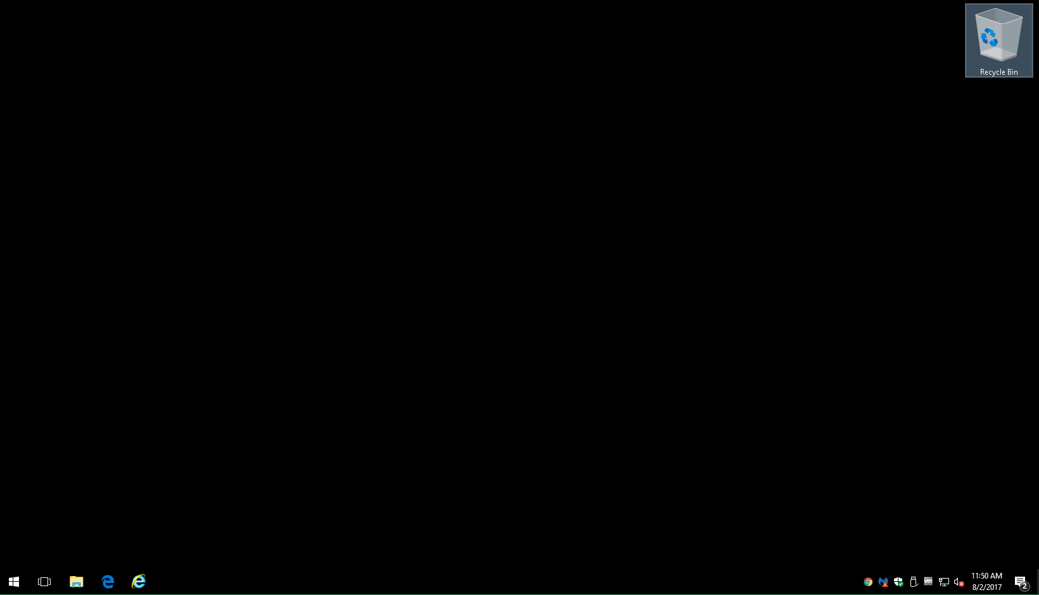

Slide 56
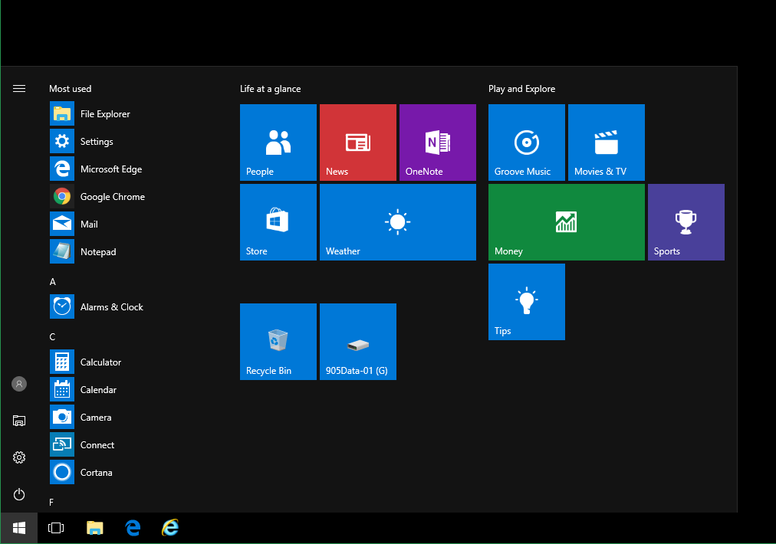

Slide 57
IS A PROGRAM A "DESKTOP APP", A "WINDOWS APP", OR A "PORTABLE APP"? (continued)
Click on the "Settings" gear:

Slide 58
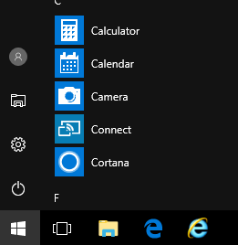

Slide 59


Slide 60
IS A PROGRAM A "DESKTOP APP", A "WINDOWS APP", OR A "PORTABLE APP"? (continued)
A "Windows Settings" window will be displayed:

Slide 61
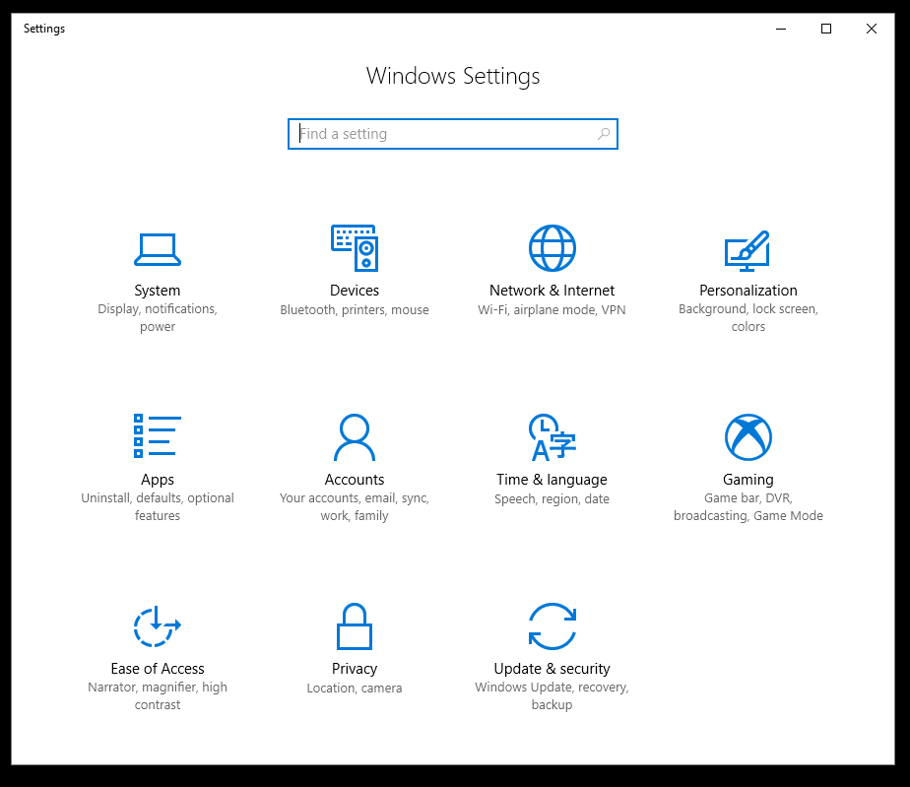

Slide 62
IS A PROGRAM A "DESKTOP APP", A "WINDOWS APP", OR A "PORTABLE APP"? (continued)
Click on apps:

Slide 63
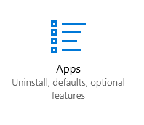

Slide 64
IS A PROGRAM A "DESKTOP APP", A "WINDOWS APP", OR A "PORTABLE APP"? (continued)
Click on the program in question:

Slide 65
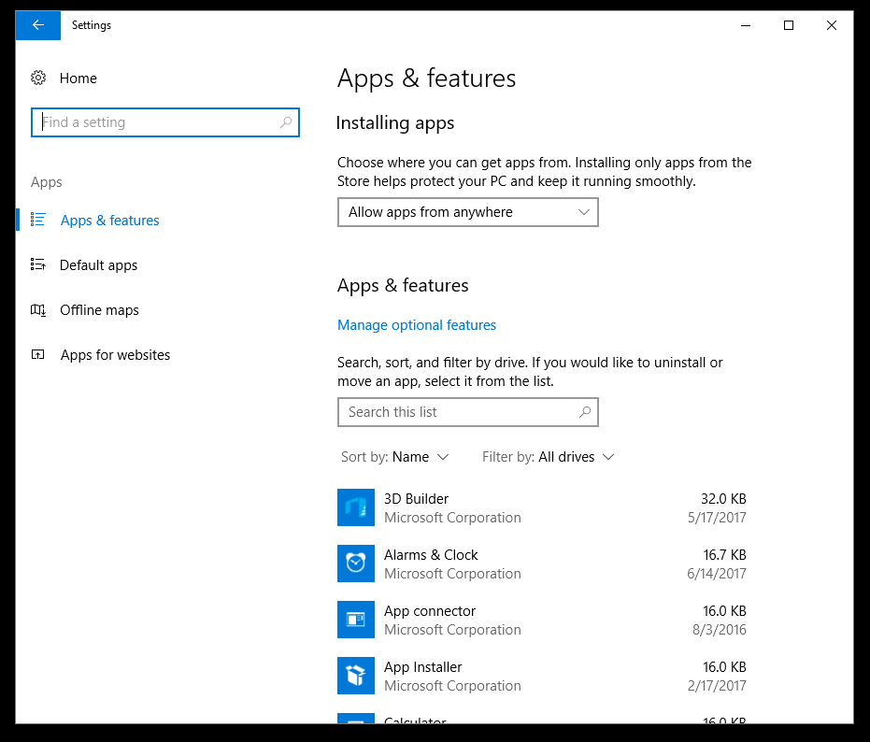

Slide 66
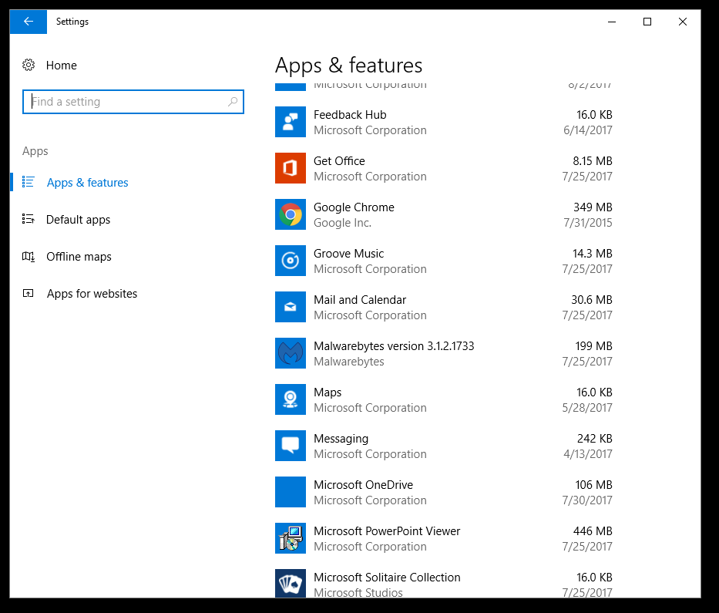

Slide 67


Slide 68
IS A PROGRAM A "DESKTOP APP", A "WINDOWS APP", OR A "PORTABLE APP"? (continued)
If, after you double-click on a program, a "Move" button is displayed, the program is a "Windows app" app:

Slide 69
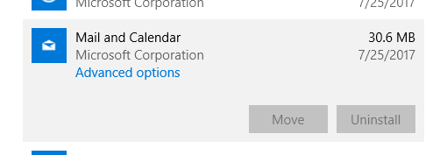

Slide 70
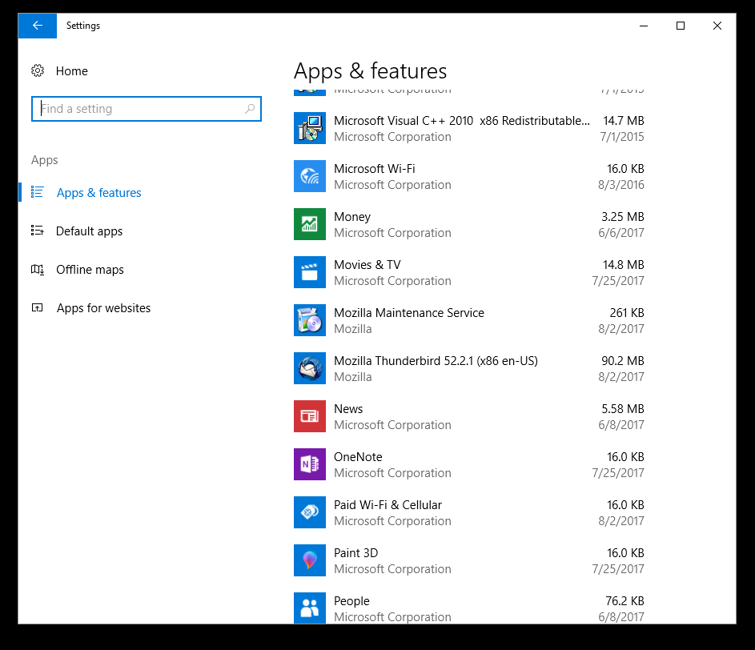

Slide 71
IS A PROGRAM A "DESKTOP APP", A " WINDOWS APP", OR A "PORTABLE APP"? (continued)
If, after you click on a program, a "Modify" button is displayed, the program is a "desktop app".

Slide 72


Slide 73
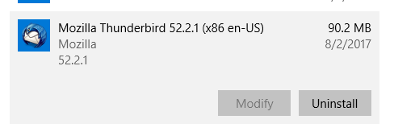

Slide 74
UNINSTALLING "DESKTOP APPS" OR ""WINDOWS APPS" " IN "WINDOWS.."
To uninstall a "desktop app", use "Revo Uninstaller Portable
To uninstall a "Web App" app, use "Revo Uninstaller Portable, then click on "Windows Apps"
To uninstall a "portable app", use the delete key in either the Desktop or "File Explorer"

Slide 75
UNINSTALLING "DESKTOP APPS" OR "WINDOWS APPS" IN "WINDOWS.." (continued)
If you use "Programs and Features" in the "Control Panel" or "Apps" in "Settings" to uninstall a "desktop app" in "Windows 11" or "Windows 10", you will leave a lot of unneeded and unwanted "digital junk" in the C: drive and in the Windows "Registry".

Slide 76
UNINSTALLING "DESKTOP APPS" OR "WEB APPS" IN "WINDOWS.." (continued)
To do a clean uninstall of a "desktop app" or a "Windows App", use the free "Revo Uninstaller Portable" as described in http://aztcs.apcug.org/meeting_notes/winhardsig/software/utils/uninstaller/RevoUninstallerPortable.pdf

Slide 77
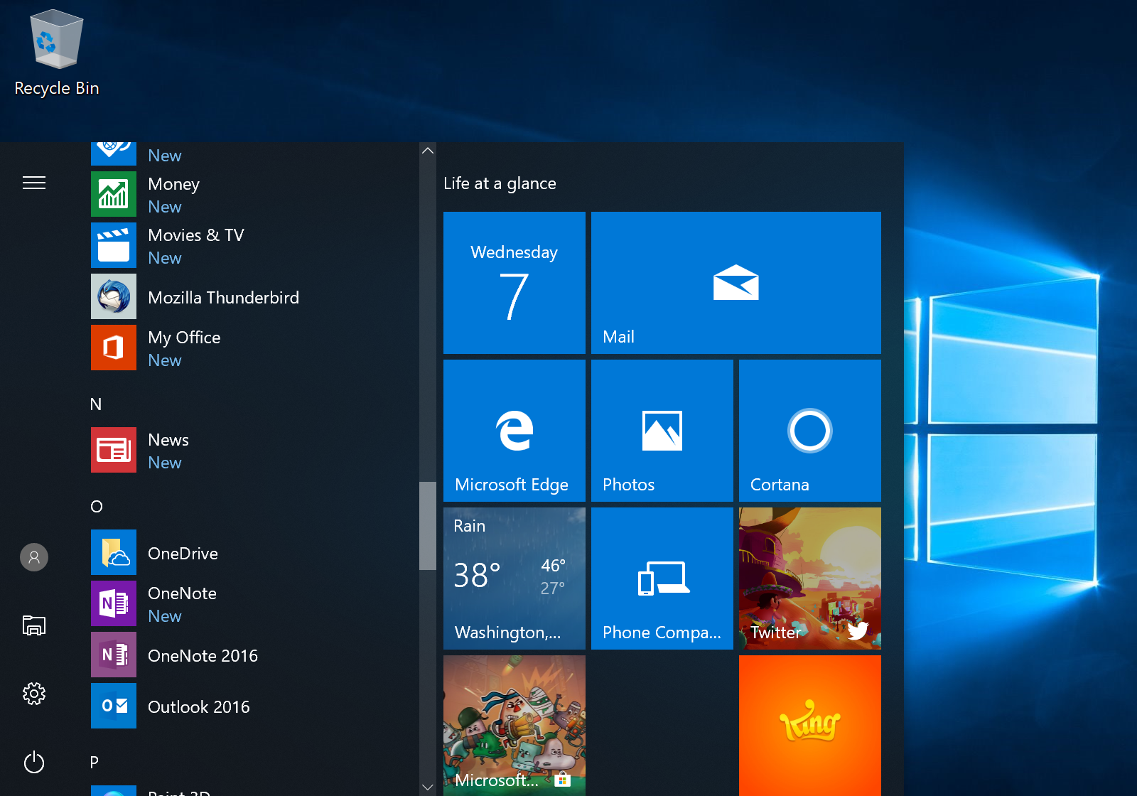

Slide 79
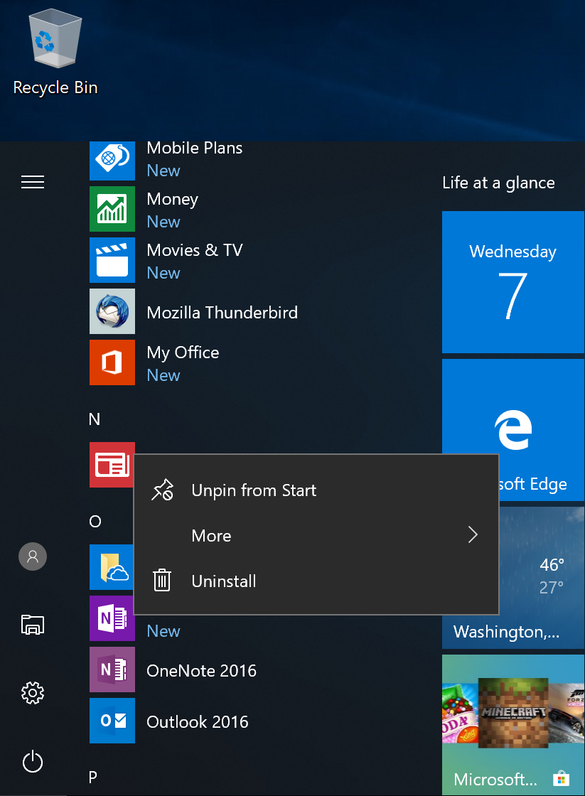

Slide 80
UNINSTALLING "WEB APPS" IN "WINDOWS.."
To remove some but not all "web apps" in Windows.., you can remove some of the "Web apps" directly within the browser by finding the app in the browser’s app list:

Slide 81
UNINSTALLING "WEB APPS" IN "WINDOWS.." (continued)
In the Edge browser, go to edge://apps and via
In the Chrome browser, go to chrome://apps

Slide 82
APPENDIX 1
MAKING A SHORTCUT
FOR A "WINDOWS APP" OR A "LEGACY DESKTOP APP"
For any "Windows app" in "Windows 11" or "Windows 10", you can make a shortcut by performing the following steps:

Slide 83
APPENDIX 1 (continued)
MAKING A SHORTCUT
FOR A "WINDOWS APP" OR A "LEGACY DESKTOP APP" (continued)
Step 1: Use the RIGHT mouse button to click on the "Start" button of "Windows.."

Slide 84
APPENDIX 1 (continued)
MAKING A SHORTCUT
FOR A "WINDOWS APP" OR A "LEGACY DESKTOP APP" (continued)
Step 2: A "Power Users" menu will be displayed:

Slide 85
APPENDIX 1 (continued)
MAKING A SHORTCUT
FOR A "WINDOWS APP" OR A "LEGACY DESKTOP APP" (continued)
Step 3: Use the left mouse button to click on "Run" in the "Power Users" menu:

Slide 86
APPENDIX 1 (continued)
MAKING A SHORTCUT
FOR A "WINDOWS APP" OR A "LEGACY DESKTOP APP" (continued)
Step 4: Type shell:appsfolder into the "Run" box

Slide 87
APPENDIX 1 (continued)
MAKING A SHORTCUT
FOR A "WINDOWS APP" OR A "LEGACY DESKTOP APP"(continued)
Step 5: Use the left mouse button to click on the "OK" button of the "Run" box

Slide 88
APPENDIX 1 (continued)
MAKING A SHORTCUT
FOR A "WINDOWS APP" OR A "LEGACY DESKTOP APP"(continued)
Step 6: An "Applications" window will be displayed

Slide 89
APPENDIX 1 (continued)
MAKING A SHORTCUT
FOR A "WINDOWS APP" OR A "LEGACY DESKTOP APP" (continued)
Step 7: You can make shortcuts to both "Windows apps" and "desktop apps" in this window by using the RIGHT mouse button click on an app and then clicking on "Create shortcut" in the pop-up context menu

Slide 90
APPENDIX 1 (continued)
MAKING A SHORTCUT
FOR A "WINDOWS APP" OR A "LEGACY DESKTOP APP" (continued)
Step-by-step instructions and screenshots for making a shortcut for a "Windows App" are available at https://www.thurrott.com/windows/windows-10/5328/windows-10-tip-create-shortcuts-for-universal-apps

Slide 91
APPENDIX 2
PLACING A SHORTCUT FOR A "PORTABLE APP" INTO THE "START MENU" OF "WINDOWS.."
See https://www.zdnet.com/article/windows-10-tip-add-custom-shortcuts-to-the-start-menu/

Slide 92
APPENDIX 2
PLACING A SHORTCUT FOR A "PORTABLE APP" INTO THE "START MENU" OF "WINDOWS.."
or see https://www.windowscentral.com/add-app-shortcuts-start-menu-manually-windows-10

Slide 93
APPENDIX 2
PLACING A SHORTCUT FOR A "PORTABLE APP" INTO THE "START MENU" OF "WINDOWS.."
In short, to create a shortcut for a "portable app" in the "Start Menu" of "Windows..", put a short-cut for the "portable app" at C:\Users\<your Windows user account>\AppData\Roaming\Microsoft\Windows\Start Menu\Programs\

Slide 94
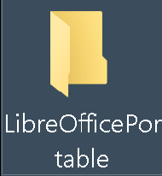

Slide 95
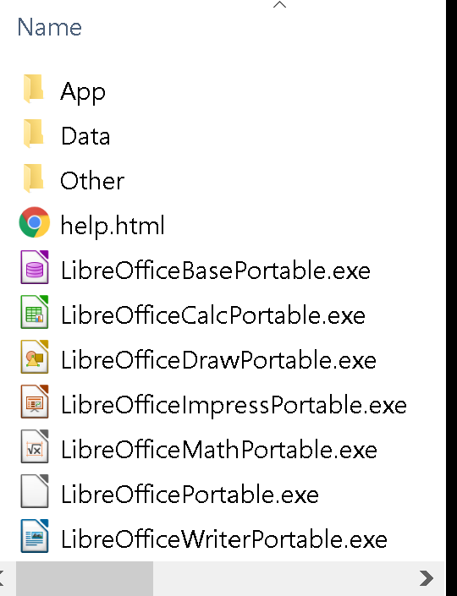

Slide 96
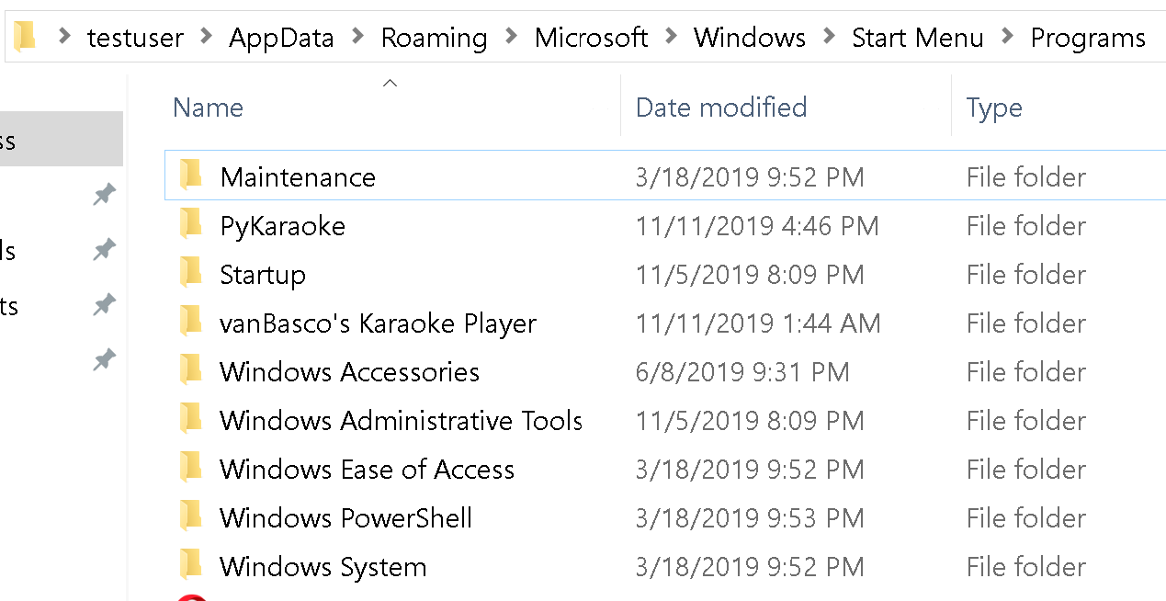

Slide 97
APPENDIX 2
PLACING A SHORTCUT FOR A "PORTABLE APP" INTO THE "START MENU" OF "WINDOWS.."
Use the RIGHT mouse button to drag the .EXE file of the "portable app" to the "Programs" window:

Slide 98


Slide 99
