Slide 1



PORTABLE WEB BROWSER THAT STORES NO HISTORY

Slide 2
Web location for this presentation:
http://aztcs.apcug.org
Click on "Meeting Notes"
2

Slide 3
TOPICS
Portable Web Browser That Does Not Store History
Steps to Create It
3

Slide 4
Private Browsing by Por
Private Browsing by PortableApps.com is a specialized version of Mozilla Firefox designed to run from a USB drive or cloud folder without installation, leaving no local browsing traces. It enhances privacy by forcing private mode, blocking tracking scripts, and using Adblock Plus to prevent tracking, making it ideal for temporary, secure browsing on any computer.
4

Slide 5
STEPS FOR INSTALLING IT
In a single folder, put two sub-folders:
One folder contains "Firefox Portable".
One folder contains "PrivateBrowsingByPortableApps"
Use the left mouse button to double-click on PrivateBrowsingByPortableApps.exe
5

Slide 6
"Firefox Portable"
Download and expand "Firefox Portable" from https://portableapps.com/apps/internet/firefox_portable

Slide 7
"PrivateBrowsingByPortableApps"
Download and expand "PrivateBrowsingByPortableApps" from https://portableapps.com/apps/internet/private_browsing

Slide 8


Slide 9
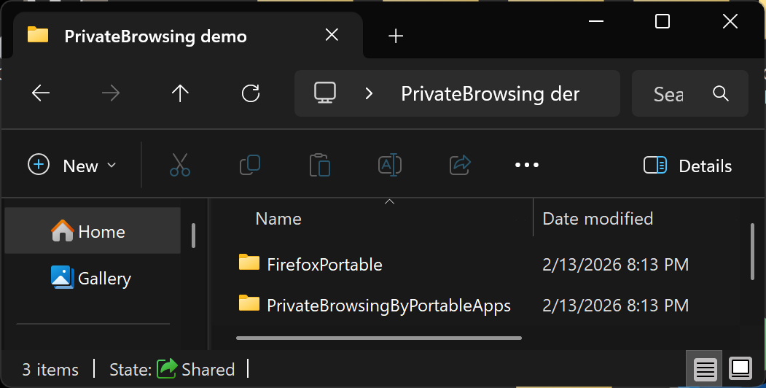

Slide 10
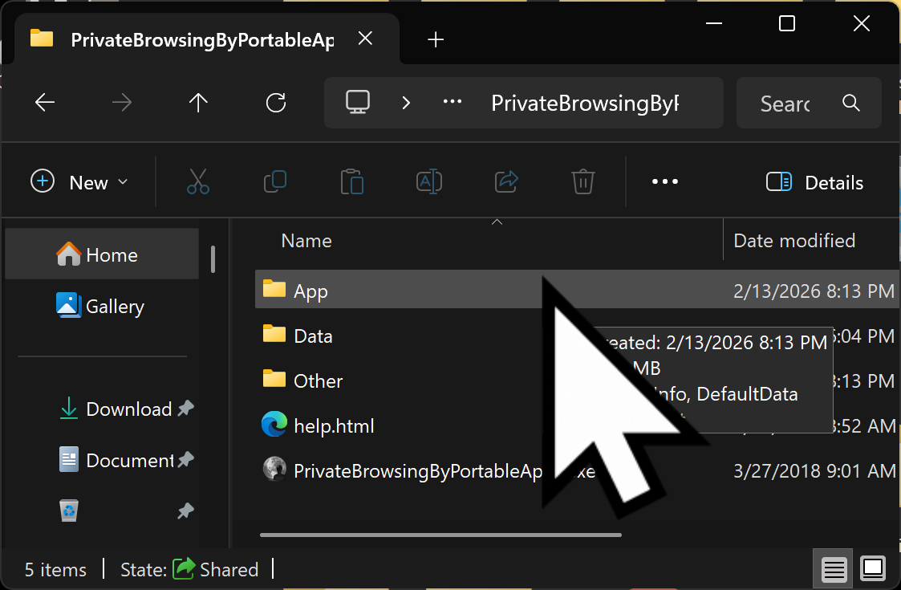

Slide 11


