Slide 1



"Windows App" in "Windows Apps" in Windows..

Slide 2
Web location for this presentation:
http://aztcs.apcug.org
Click on "Meeting Notes"
2

Slide 3
"Windows App" IS USELESS FOR MOST COMPUTER USERS
"Windows App" is a "Windows App" in Windows 11 and Windows 10
3

Slide 4
"Windows App" IS USELESS FOR MOST COMPUTER USERS (continued)
Microsoft claims that the "Windows App" app will replace the "Remote Desktop Connection" app
However "Windows App" only works if you are logged into your Windows.. computer with a "school or business account".
4

Slide 5
"Windows App" IS USELESS FOR MOST COMPUTER USERS (continued)
"Windows App" is a "Windows App" in Windows 11 and Windows 10
Microsoft claims that the "Windows App" app will replace the "Remote Desktop Connection" app
However "Windows App" only works if you are logged into your Windows.. computer with a "school or business account".
5

Slide 6
"Windows App" IS USELESS FOR MOST COMPUTER USERS (continued)
A "school or business account" is created from inside a "Windows server" by a "server administrator". You probably do not have one.
6

Slide 7
"Windows App" IS USELESS FOR MOST COMPUTER USERS (continued)
In contrast, "Remote Desktop Connection" works if you are logged into your computer with a "Microsoft account" which is what most us have.
7

Slide 8
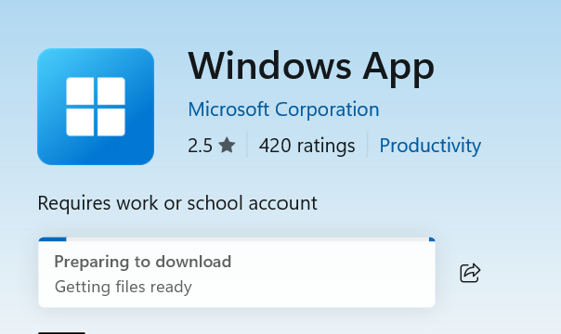

Slide 9
"Remote Desktop Connection"
For an unknown amount of time, "Remote Desktop Connection" will still be available in "Windows 11" computers:
9

Slide 10
"Remote Desktop Connection"
"Remote Desktop Connection" in your "Windows 11 Home" or your "Windows 11 Pro" computer connects to your local network router which then connects to a "Windows 11 Pro" computer with "Remote Desktop" enabled.
10

Slide 11
USE "VNC" TO AVOID THE PROBLEMS IN THE "WINDOWS APP" APP
After Microsoft gets rid of "Remote Desktop Connection", you can use "VNC" in a "Windows 11.." computer to remotely access and control a locally-connectied "Windows 11.." computer as follows:
11

Slide 12
USE "VNC" TO AVOID THE PROBLEMS IN THE "WINDOWS APP" APP
Use TightVNC's free "VNC Server" on the target computer See https://www.tightvnc.com/download.php
Use UltraVNC's free "VNC Viewer" on the Windows.. computer that you are using See https://uvnc.com/
12

Slide 13
ADDITIONAL INFORMATION
https://windowsforum.com/threads/microsoft-ends-support-for-remote-desktop-app-what-you-need-to-know-about-the-transition-to-windows-app.362533/
13

