Slide 1


MAKING SHORTCUTS TO APPS IN WINDOWS 11 AND WINDOWS 10

Slide 2
Web location for this presentation:
http://aztcs.apcug.org
Click on
"Meeting Notes"

Slide 3
SUMMARY
The newer "Windows Apps" do not allow you to right click on them to place a shortcut into the Windows 11, 10, or 8 "Desktop". To create shortcuts to all "Windows Apps" and all "Desktop Apps", you have to run "shell:appsfolder" in a "Run" command box.

Slide 4
TOPICS
USE the shell:appsfolder command to make shortcuts to apps

Slide 5
USE THE shell:appsfolder COMMAND INSTEAD..
..to make shortcuts to all "Windows Apps" and "Desktop Apps" in Windows 11 or Windows 10, you can run the shell:appsfolder command in either a "Search" box or a "Run" box

Slide 6
USE THE shell:appsfolder COMMAND INSTEAD.. (continued)
To get to a "Run" box or a "Search" box in Windows 11 or Windows 10, use the RIGHT mouse button to click on the "Start" menu:

Slide 7
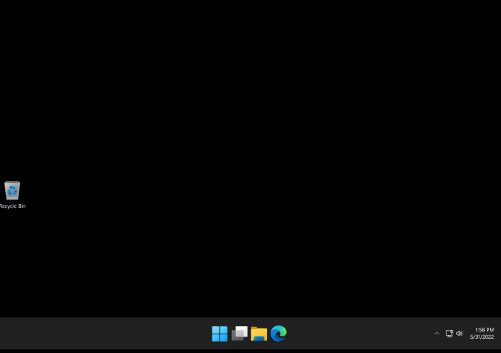

Slide 9
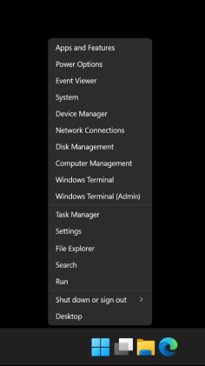

Slide 11
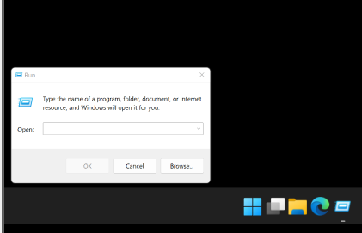

Slide 12
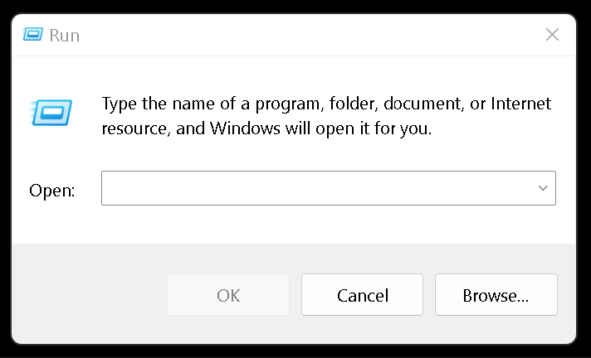

Slide 13
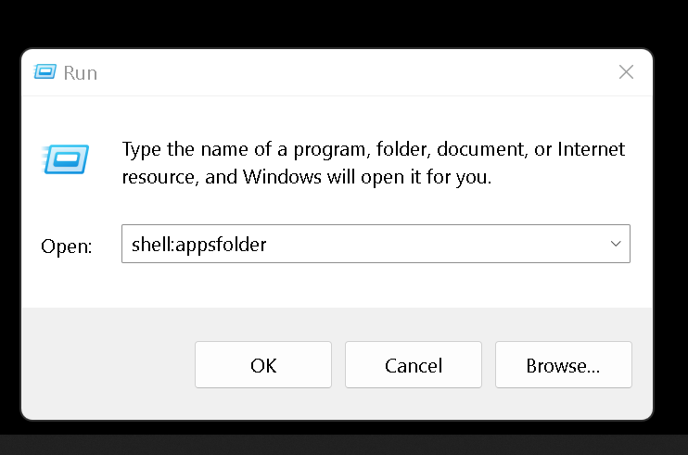

Slide 15
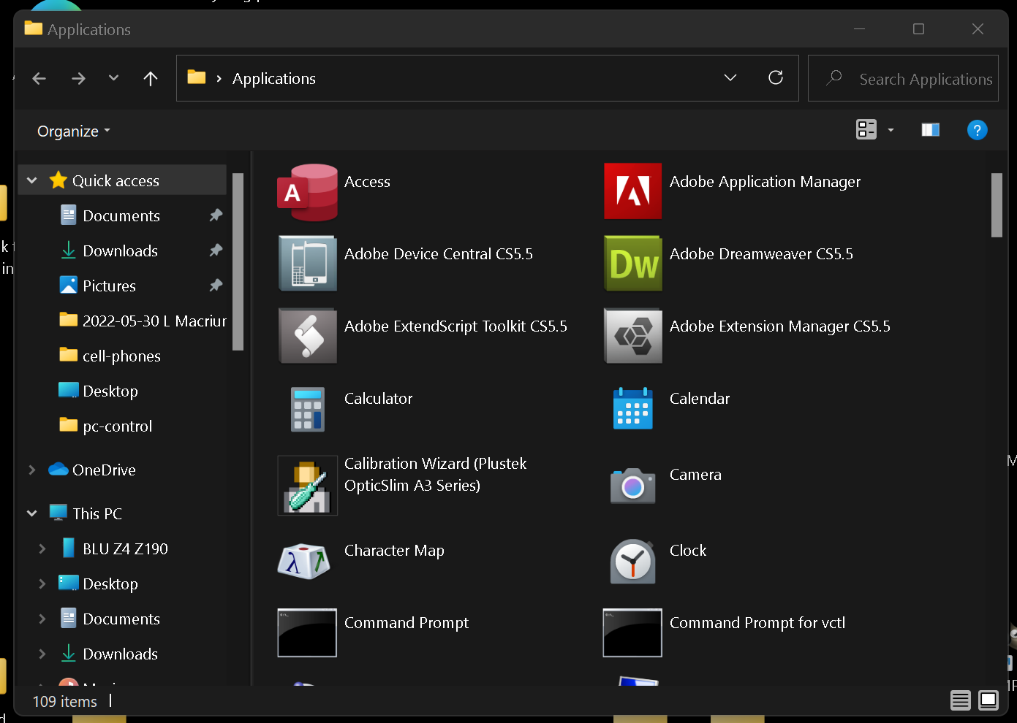

Slide 16
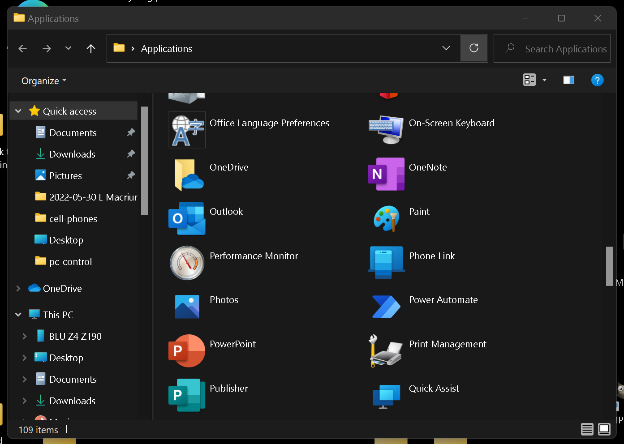

Slide 18
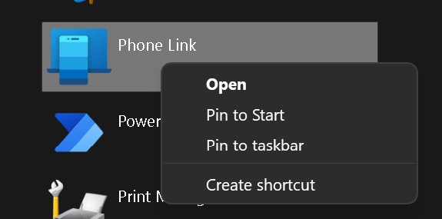

Slide 20
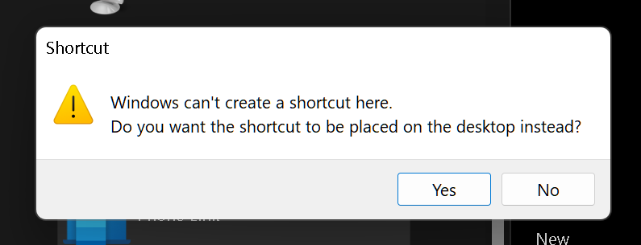

Slide 22
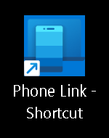

Slide 23
MAKING SHORTCUTS IN THE PINNED SECTION OF THE START MENU
For Windows 11
Locate the app, file, or folder you want to add to the Start Menu.
Right-click on the item and select Pin to Start from the context menu.
Open the Start Menu to confirm the shortcut appears in the Pinned section.
For Windows 10
Press Windows + R to open the Run dialog box.
Type shell:Start Menu and press Enter to open the Start Menu folder for your user account.
Navigate to the Programs subfolder within the opened directory.
Drag and drop the app's .exe file or its shortcut into the Programs folder.
Open the Start Menu and check the All apps list to confirm the shortcut is added.

Slide 24
MAKING SHORTCUTS IN THE PINNED SECTION OF THE START MENU (continued)
For Windows 10
Press Windows + R to open the Run dialog box.
Type shell:Start Menu and press Enter to open the Start Menu folder for your user account.
Navigate to the Programs subfolder within the opened directory.
Drag and drop the app's .exe file or its shortcut into the Programs folder.
Open the Start Menu and check the All apps list to confirm the shortcut is added.

Slide 25
MAKING SHORTCUTS IN THE ALL SECTION OF THE START MENU
To add a shortcut to the "All apps" section of the Start menu (not the pinned section) in Windows 11, follow these steps:
Press Win + R, type shell:Common Start Menu, and press Enter. This opens the Start Menu folder for all users: C:\ProgramData\Microsoft\Windows\Start Menu

Slide 26
MAKING SHORTCUTS IN THE ALL SECTION OF THE START MENU (continued)
If you want it only for your user account, use shell:Start Menu instead: C:\Users\<YourUsername>\AppData\Roaming\Microsoft\Windows\Start Menu
Inside that folder, open the Programs subfolder.
Move or create a shortcut to your app in this Programs folder.
You can drag the shortcut from the desktop,

Slide 27
MAKING SHORTCUTS IN THE ALL SECTION OF THE START MENU (continued)
If you want it only for your user account, use shell:Start Menu instead: C:\Users\<YourUsername>\AppData\Roaming\Microsoft\Windows\Start Menu
Inside that folder, open the Programs subfolder.
Move or create a shortcut to your app in this Programs folder.
You can drag the shortcut from the desktop,

Slide 28
MAKING SHORTCUTS IN THE ALL SECTION OF THE START MENU (continued)
Or right-click → New → Shortcut and point or link to the .exe file.
Open the Start menu → Click on All apps, and your app should now be listed alphabetically.
That's it! This ensures the app appears in the All apps list, not just in the pinned section.

Slide 29
ADDITIONAL INFORMATION
https://www.techrepublic.com/article/how-to-use-the-shell-command-to-view-all-your-applications-in-file-explorer/

