Slide 1
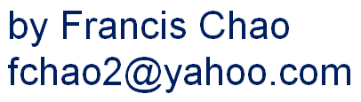


REMOTE CONTROL VIA "ZOOM"

Slide 2
Web location for this presentation:
http://aztcs.apcug.org
Then click on "Meeting Notes"
2

Slide 3
SUMMARY
During a "Zoom" meeting, an attendee using a Windows.., MacOS, or Linux computer can allow other attendees to remotely control their computer, if the host of the meeting the remote Zoom participant first does a "share screen" of their entire screen.
3
33

Slide 4
TOPICS
During a "Zoom" meeting, any attendee (who is not sharing their screen) can ask any other attendee who is sharing their screen for permission to remotely control the screen sharer's computer after the host allows the remote user to "share screen".
4

Slide 5
ENABLING THE REMOTE CONTROL CAPABILITY OF "ZOOM"
The remote target computer that is being helped needs to have all of Zoom's "Remote Assistance" capabilities turned on as follows
5

Slide 6
On the remote Windows machine, open Zoom → Settings → Meeting → Remote Control, and ensure Remote control of all applications is turned on
6

Slide 7
ENABLING THE REMOTE CONTROL CAPABILITY OF "ZOOM"
The host of the meeting (the one with the free, Pro, or Corporate) Zoom account should ask the remote attendee who needs help with their computer to share their screen.
7

Slide 8
ENABLING THE REMOTE CONTROL CAPABILITY OF "ZOOM"
In some cases, if the remote attendee's "Share screen" button is grayed out, the host of the meeting might have to find the remote attendee in the Attendees list, click on the three dots, and give the remote attendee permission to share their screen.
8

Slide 9
ENABLING THE REMOTE CONTROL CAPABILITY OF "ZOOM" (continued)
After any attendee shares their screen, any other attendee including the host of the meeting can request remote control of the remote attendee's computer with the shared screen by clicking on "View options" and then clicking on "Request Remote Control":
9

Slide 10
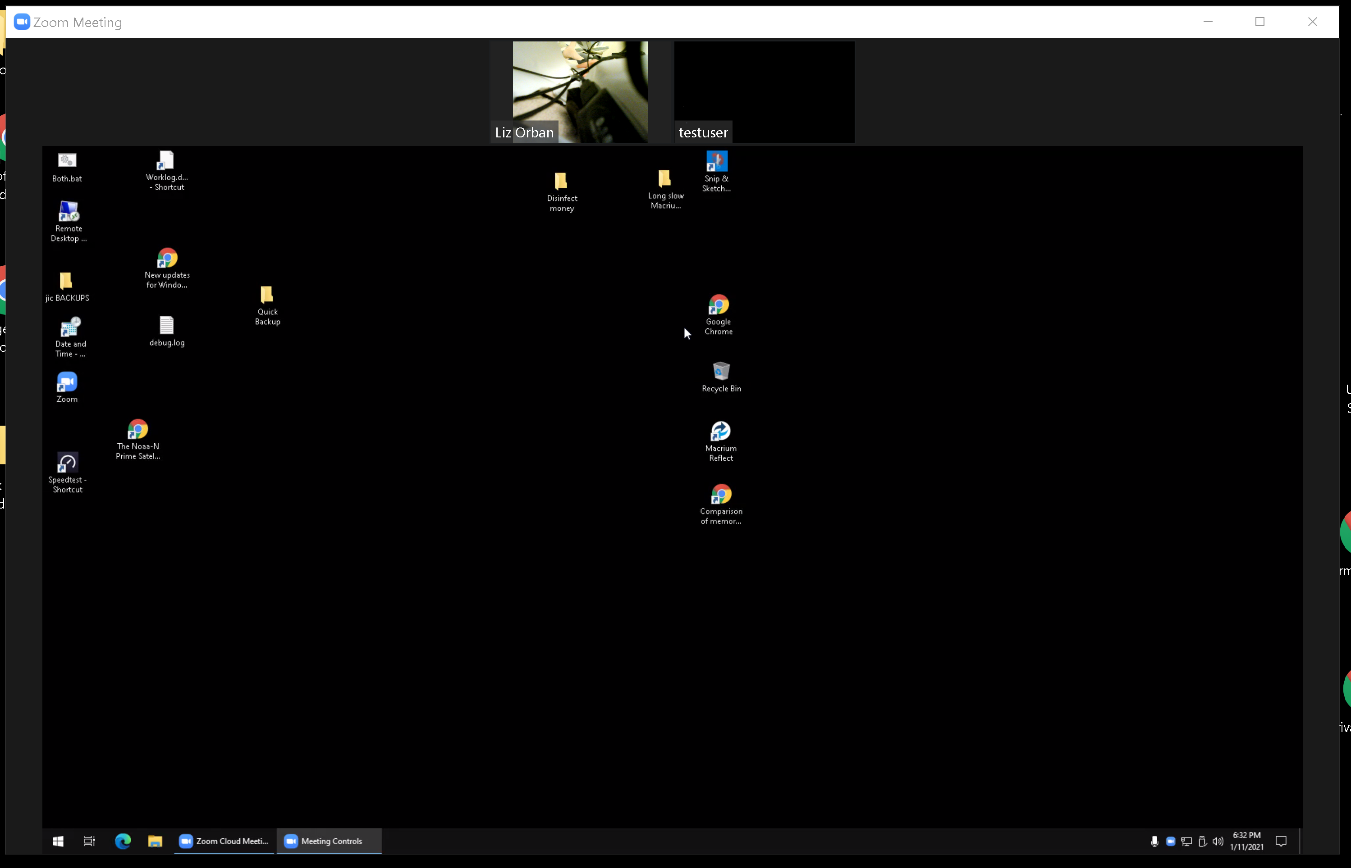
10

Slide 11
11

Slide 12
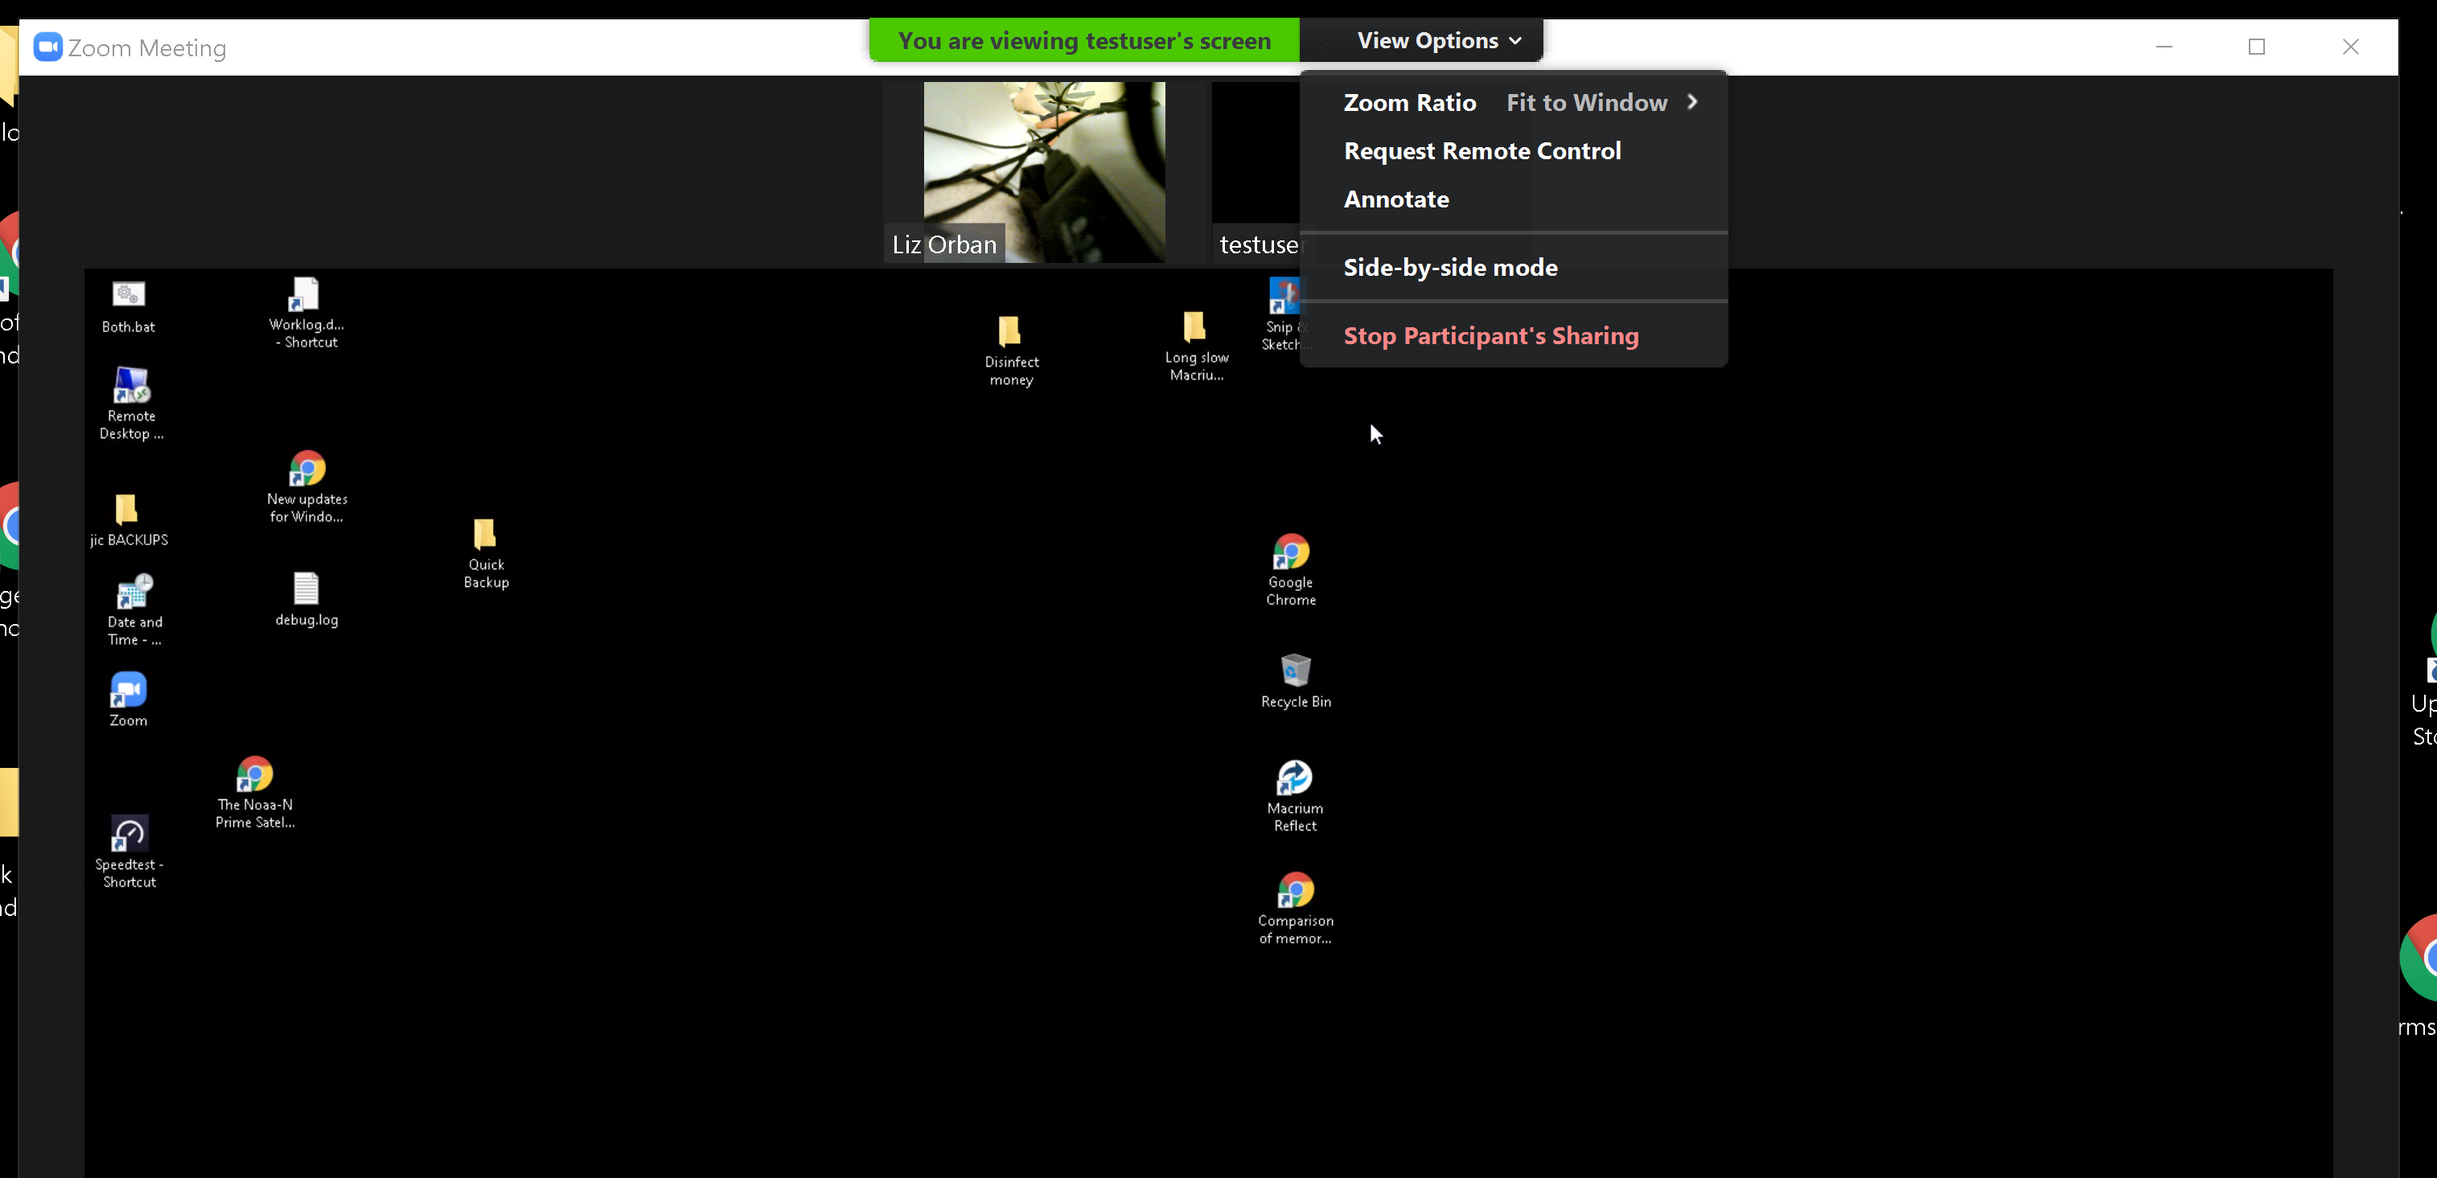
12

Slide 13
13

Slide 14
14

Slide 15
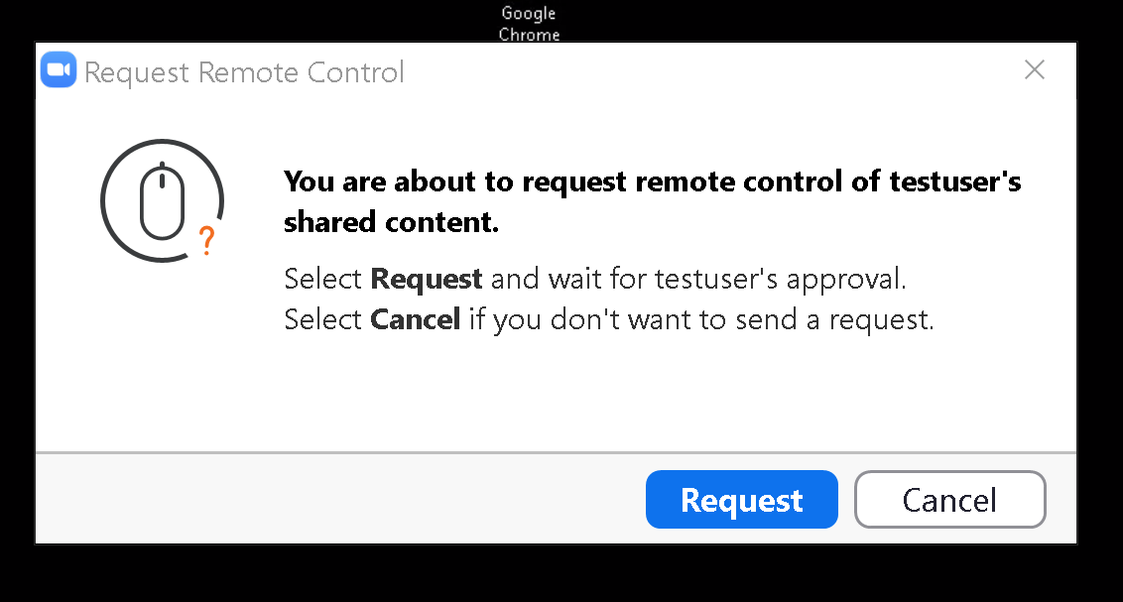
15

Slide 16
16

Slide 17
ENABLING THE REMOTE CONTROL CAPABILITY OF "ZOOM" (continued)
The remote attendee (= "helped computer user"who is doing the screen sharing then has to give permission to the attendee who is requesting the ability to remotely control the computer:
17

Slide 18
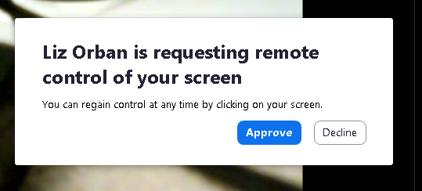
18

Slide 19
19

Slide 20
ENABLING THE REMOTE CONTROL CAPABILITY OF "ZOOM" (continued)
At this point, the person who requested control of the shared screen will get non-exclusive control of the shared screen, if they click once into their view of the shared screen. The remote attendee who is sharing his or her screen can still use their mouse and keyboard on the screen that they are sharing.
20

Slide 21
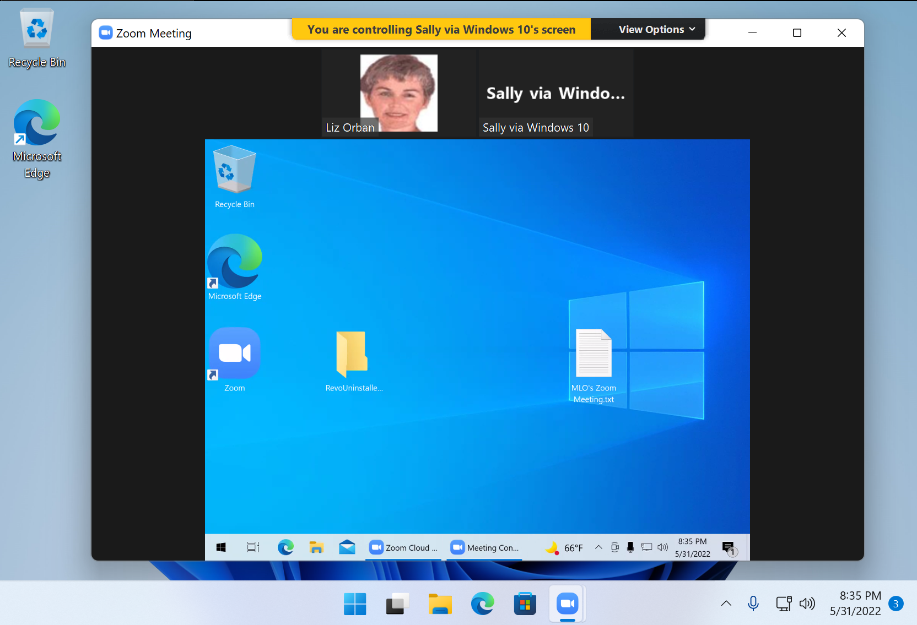
21

Slide 22

22

Slide 23
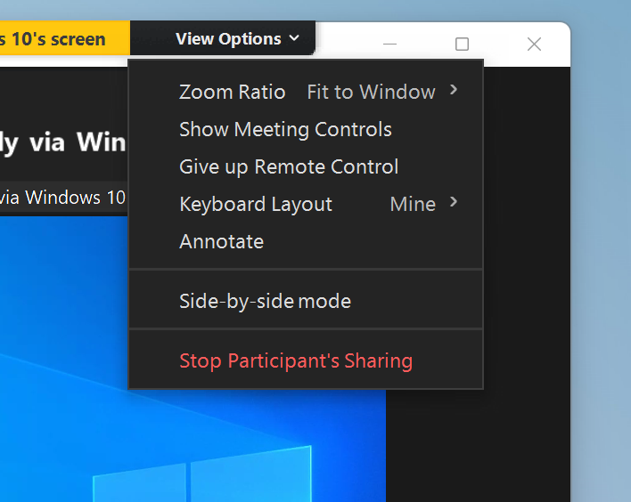
23

Slide 24
24

Slide 25
25

Slide 26
26

Slide 27
ENABLING THE REMOTE CONTROL CAPABILITY OF "ZOOM" (continued)
If the person who is controlling the remote computer does something to cause the remote computer to reboot, the person whose computer was being controlled will have to restart the "Zoom Meeting Client" and log back into the Zoom session and share their screen before any other meeting attendee can control their computer again.
27

Slide 28
MORE HOW-TO DOCUMENTATION:
https://support.zoom.us/hc/en-us/articles/201362673-Requesting-or-giving-remote-control
28

Slide 29
MORE INFORMATION ON "ZOOM" REMOTE CONTROL
A Windows 10.. computer or a Windows 11.. computer can control a Windows 10.. computer or a Windows 11.. computer.
29

Slide 30
MORE INFORMATION ON "ZOOM" REMOTE CONTROL (control)
An Android Samsung phone cannot remotely control a Windows.. PC and vice versa
An iPhone cannot remotely control a Windows.. PC and vice versa
An iPhone cannot remotely control an Android phone and vice versa
30

Slide 31
MORE INFORMATION ON "ZOOM" REMOTE CONTROL (continued)
A Windows.. computer can control a MacOS computer if the Zoom app in the MacOS computer is provided with accessibility privileges (during the first control attempt): If and when the Zoom app in MacOS asks for "Accessibility privileges", click on "Yes", then click on the unlock icon, then put a checkmark next to Zoom. The click again on the lock icon.
31

Slide 32
MORE INFORMATION ON "ZOOM" REMOTE CONTROL (continued)
A MacOS computer can control another MacOS computer
32

Slide 33
MORE INFORMATION ON "ZOOM" REMOTE CONTROL (continued)
A MacOS computer can control a Ubuntu Desktop Linux computer and vice versa
33

Slide 34
MORE INFORMATION ON "ZOOM" REMOTE CONTROL (continued)
A Ubuntu Desktop Linux computer can control a "MX Linux" computer and vice versa
34

Slide 35
MORE INFORMATION ON "ZOOM" REMOTE CONTROL (continued)
A "MX Linux" computer can control a "Ubuntu Desktop" computer and vice versa
35

Slide 36
MORE INFORMATION ON "ZOOM" REMOTE CONTROL (continued)
A "MX Linux" computer can control a "Windows 10.." computer and vice versa
A "Ubuntu Desktop" computer can control a "Windows 10.." computer and vice versa
36

Slide 37
37

