Slide 1



WINDOWS' "QUICK ASSIST"

Slide 2
Web location for this presentation:
http://aztcs.apcug.org
Click on “Meeting Notes”
2

Slide 3
SUMMARY
Microsoft's "Quick Assist" allows any "Windows 11" or "Windows 10" computer to remotely control another "Windows 11" or "Windows 10" computer. The remote "helper" person can perform repairs and installations on the computer of the "helped" person.
3

Slide 4
TOPICS
Basic Concept of Microsoft "Quick Access"
Advantages and Disadvantages
Helped Computer: "Allow Remote Assistance"
"Helped Computer: "Invite someone..to help you"
"Helper Computer": Take control..

Slide 5
BASIC CONCEPT OF MICROSOFT'S "QUICK ASSIST"
"Helper computer" connects securely through the "Internet" to control the "Helped" computer"
Saves the helper from having to physically visit the helped computer

Slide 6
ADVANTAGE OF MICROSOFT'S "QUICK ASSIST"
Ease of use relative to other remotes assistance methods, especially for the user of the "Helped Computer" when compared to "Microsoft's Remote Assistance" ("msra") and Zoom's "Remote Control".

Slide 7
DISADVANTAGE OF MICROSOFT'S "QUICK ASSIST"
"Quick Assist" does not give you access to the Windows "Taskbar" of the helped computer, unlike "Microsoft's Remote Assistance" ("msra") and Zoom's "Remote Control".

Slide 8
INITIAL SETUP OF "HELPED COMPUTER"
Either start up "Quick Assist" by locating it in the "Start Menu" of the Windows 11 or 10 computer (just type q) or double-click on a "Quick Assist" shortcut on the Windows "Desktop".

Slide 9
INITIAL SETUP OF "HELPED COMPUTER" (continued)
To make a shortcut for "Quick Assist" on the Windows "Desktop" please follow the instructions at https://aztcs.apcug.org/meeting_notes/winhardsig/software/remote-assistance/Making-Shortcuts-to-apps-in-Win11&10&8.pdf

Slide 10


Slide 11
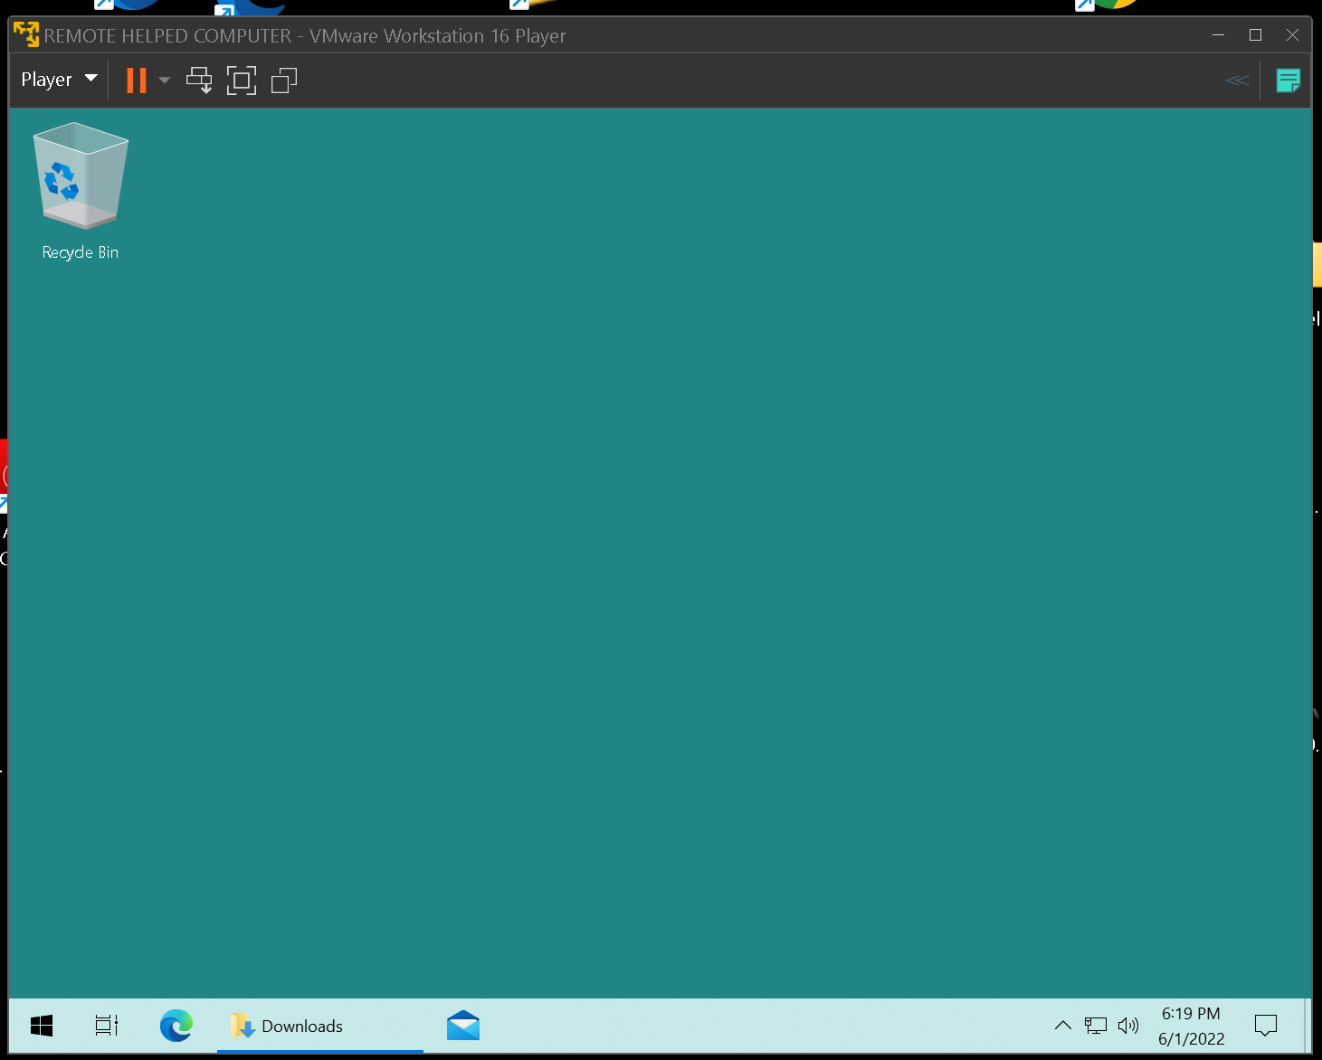

Slide 13
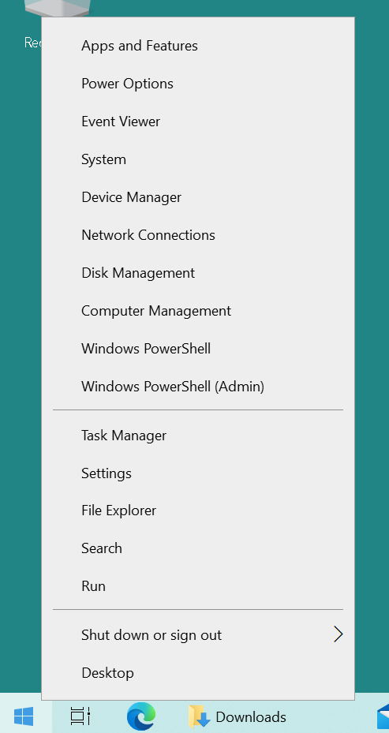

Slide 15
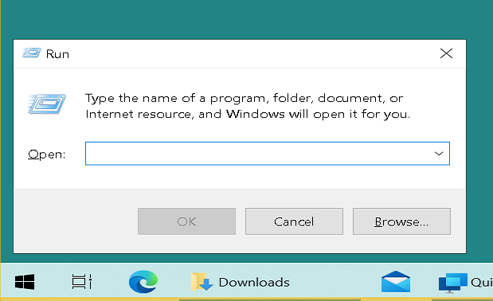

Slide 16
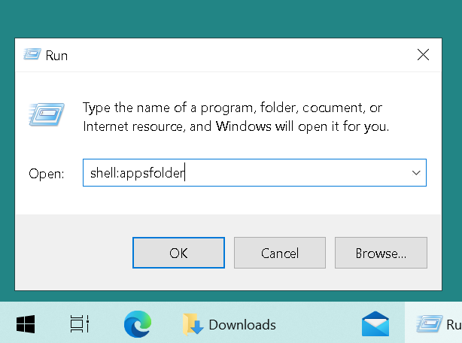

Slide 18
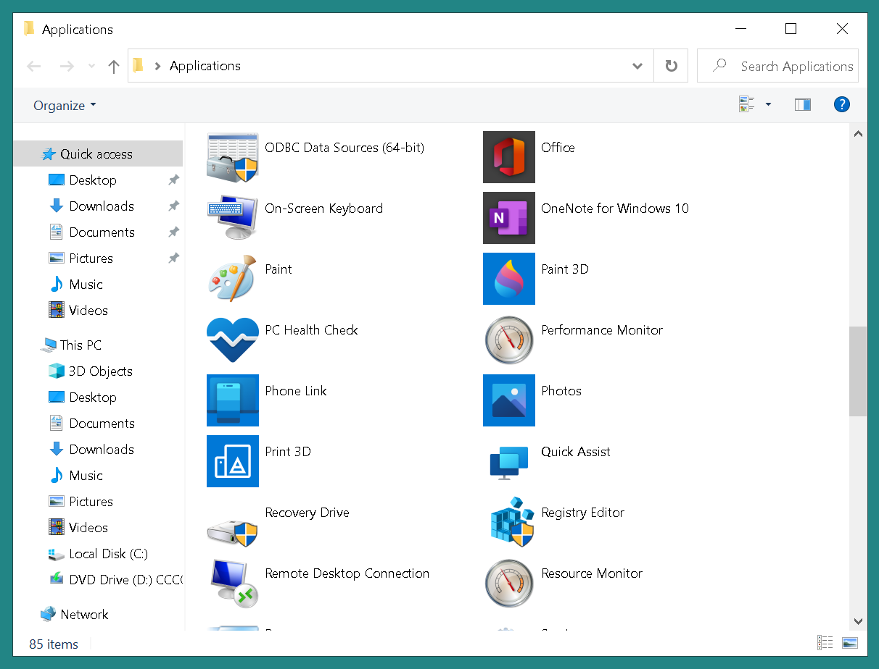

Slide 20
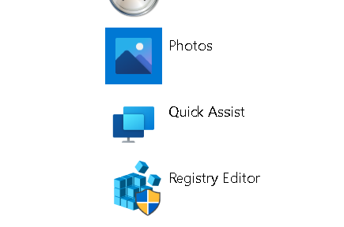

Slide 21
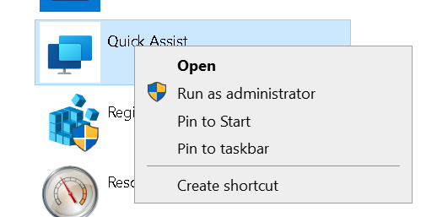

Slide 23
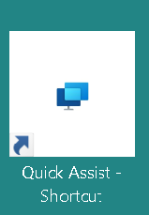

Slide 24
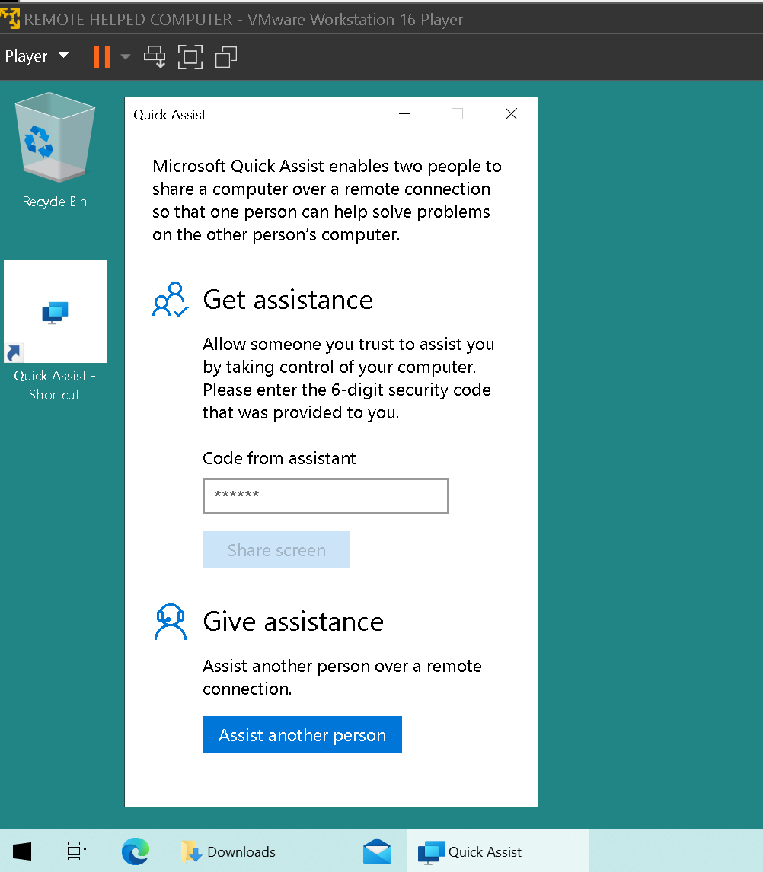

Slide 25
INITIAL SETUP OF "HELPER COMPUTER"
Either start up "Quick Assist" by locating it in the "Start Menu" of the Windows 11 or 10 computer or double-click on a "Quick Assist" shortcut on the Windows "Desktop".

Slide 26
INITIAL SETUP OF "HELPER COMPUTER" (continued)
To make a shortcut for "Quick Assist" on the Windows "Desktop" please follow the instructions at https://aztcs.apcug.org/meeting_notes/winhardsig/software/remote-assistance/Making-Shortcuts-to-apps-in-Win11&10&8.pdf

Slide 31
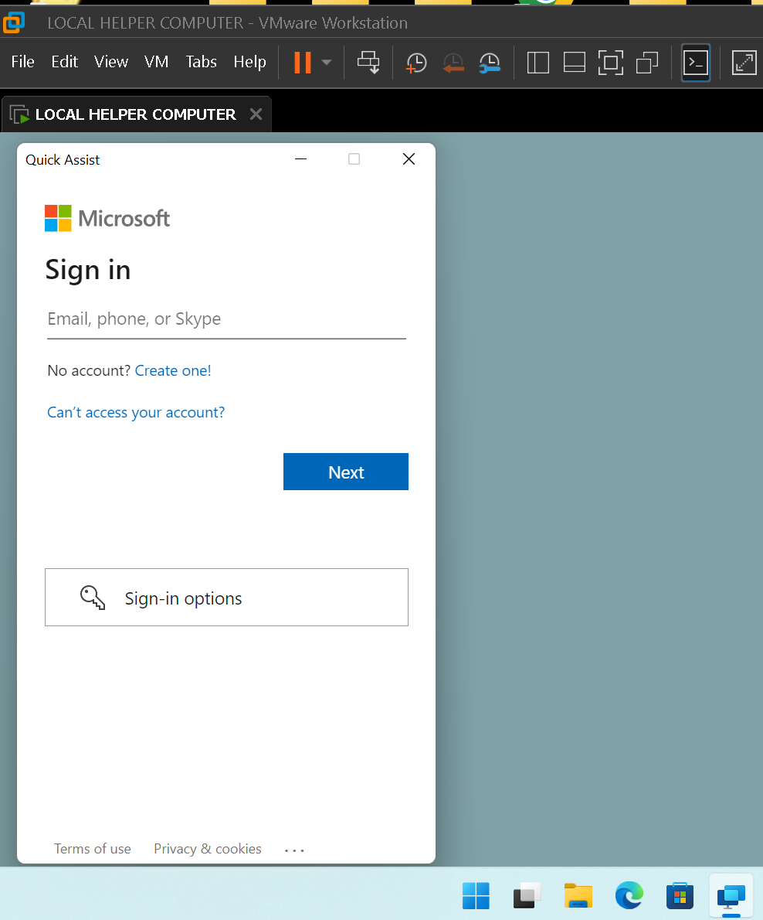

Slide 32
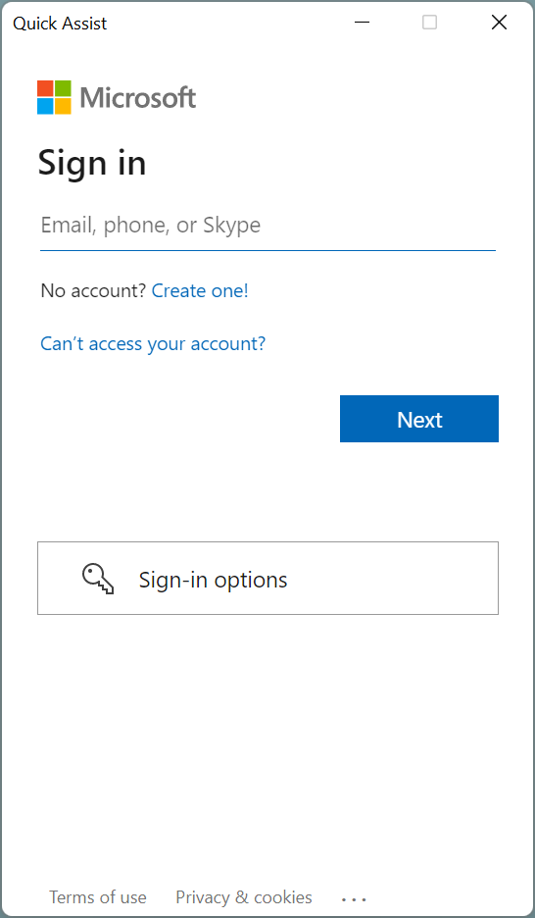

Slide 33
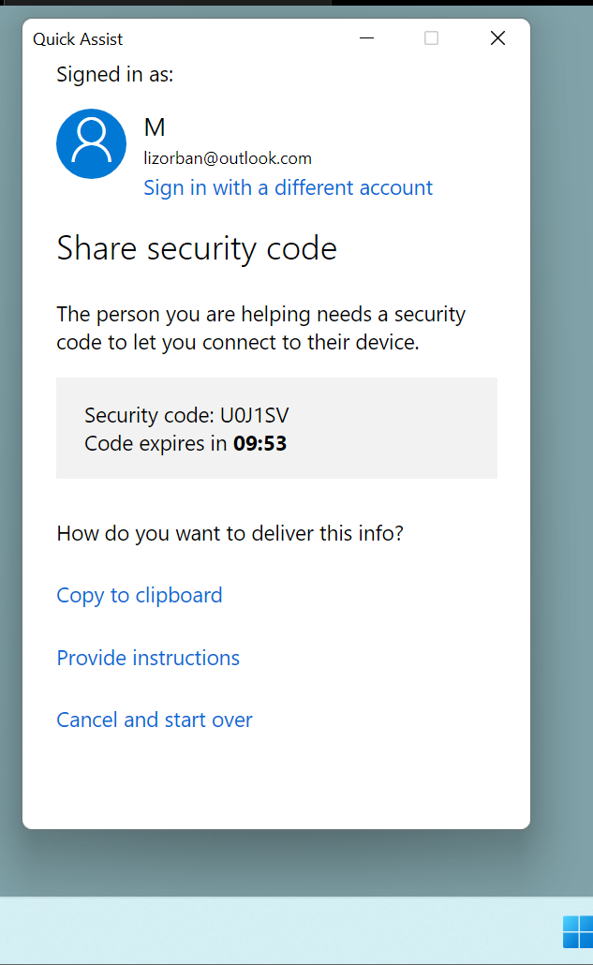

Slide 35
SECURITY CODE IS ENTERED INTO THE "HELPED COMPUTER"
After the user of the local "Helper Computer" gives the "Security code" to the user of the remote "Helped Computer", the user of the "Helped Computer" types the security code into the "Helped Computer" and the asterisks will go away:

Slide 37
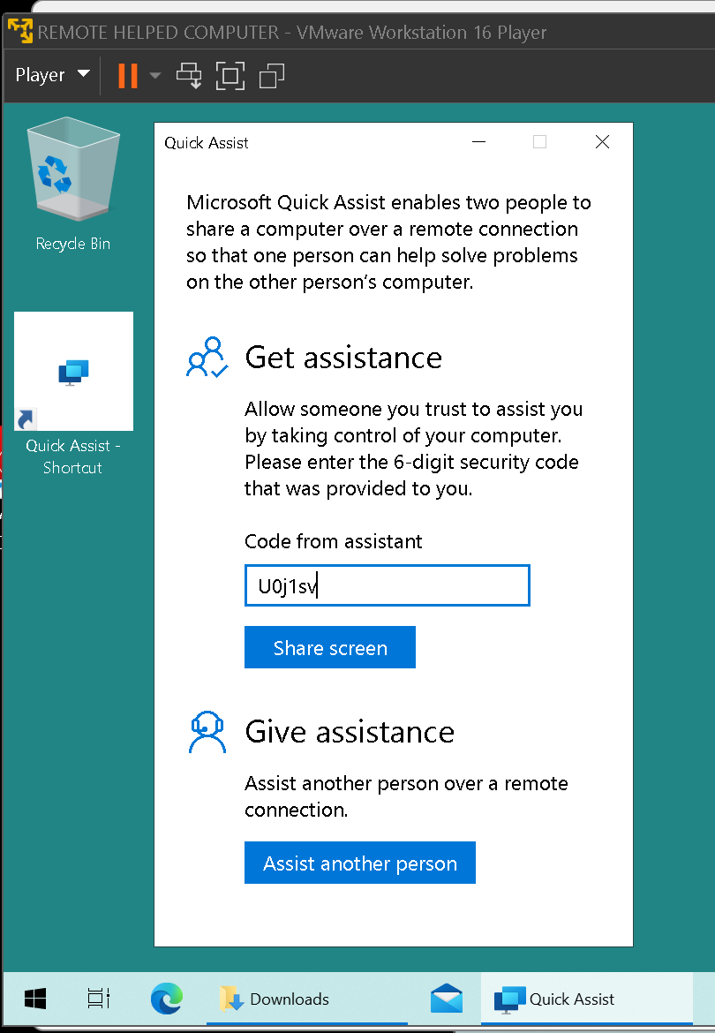

Slide 38
SECURITY CODE IS ENTERED INTO THE "HELPED COMPUTER"
Then the user of the remote "Helped Computer" will click on the "Share screen" button:

Slide 40
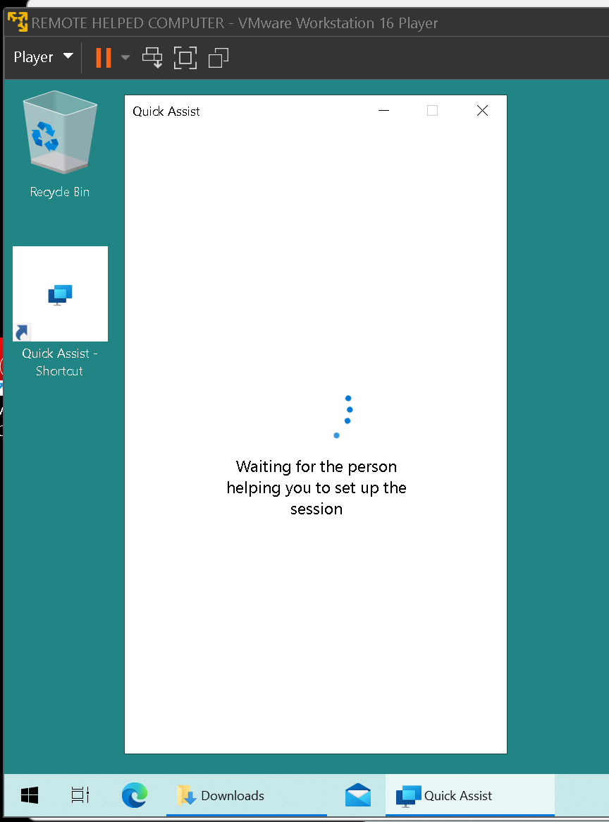

Slide 41
THEN THE "HELPER" COMPUTER FINALLY TAKES CONTROL..
Then the user of the local "Helper Computer" clicks on "Request Control" of the "Helped Computer. Finally the user of the remote "Helped Computer" clicks on the "Allow" button:

Slide 42
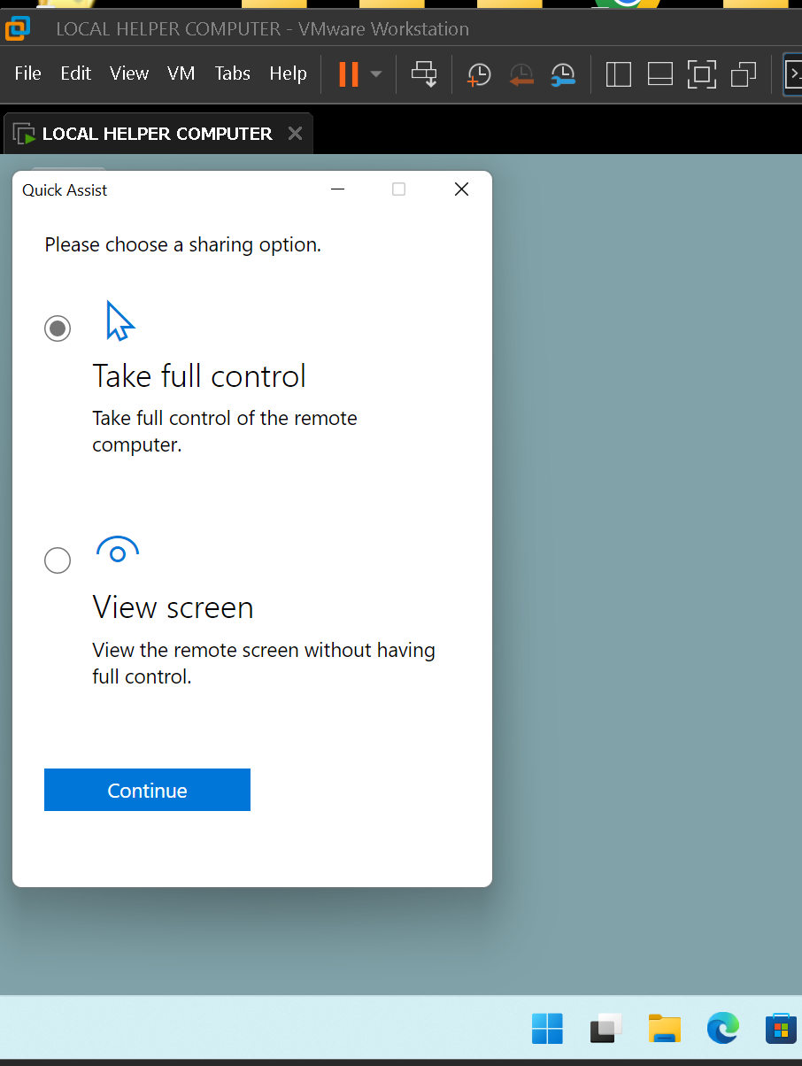

Slide 44
THEN THE "HELPED COMPUTER" SHARES IT'S SCREEN..
..with the "Helper Computer:

Slide 45
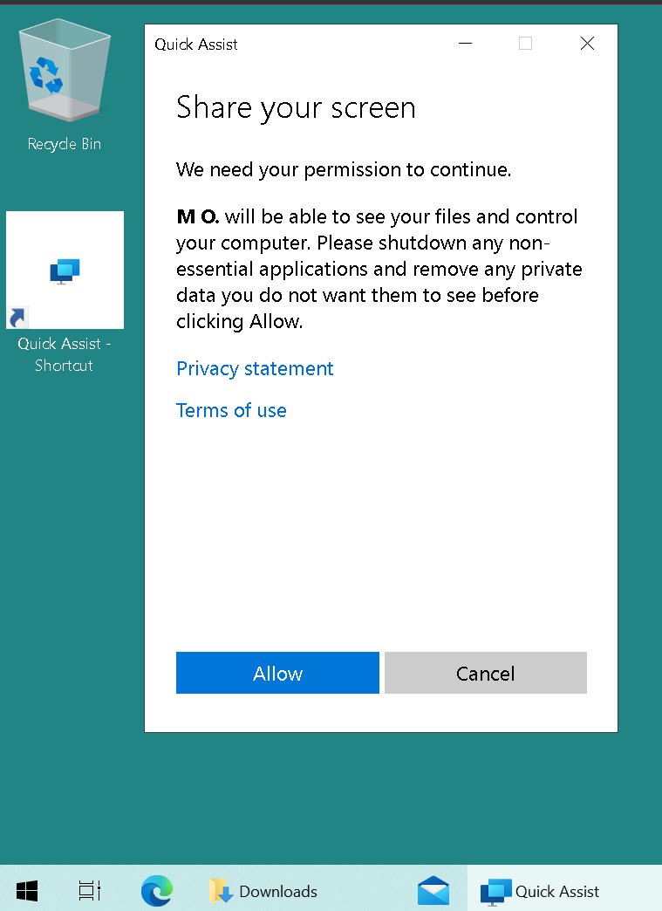

Slide 47
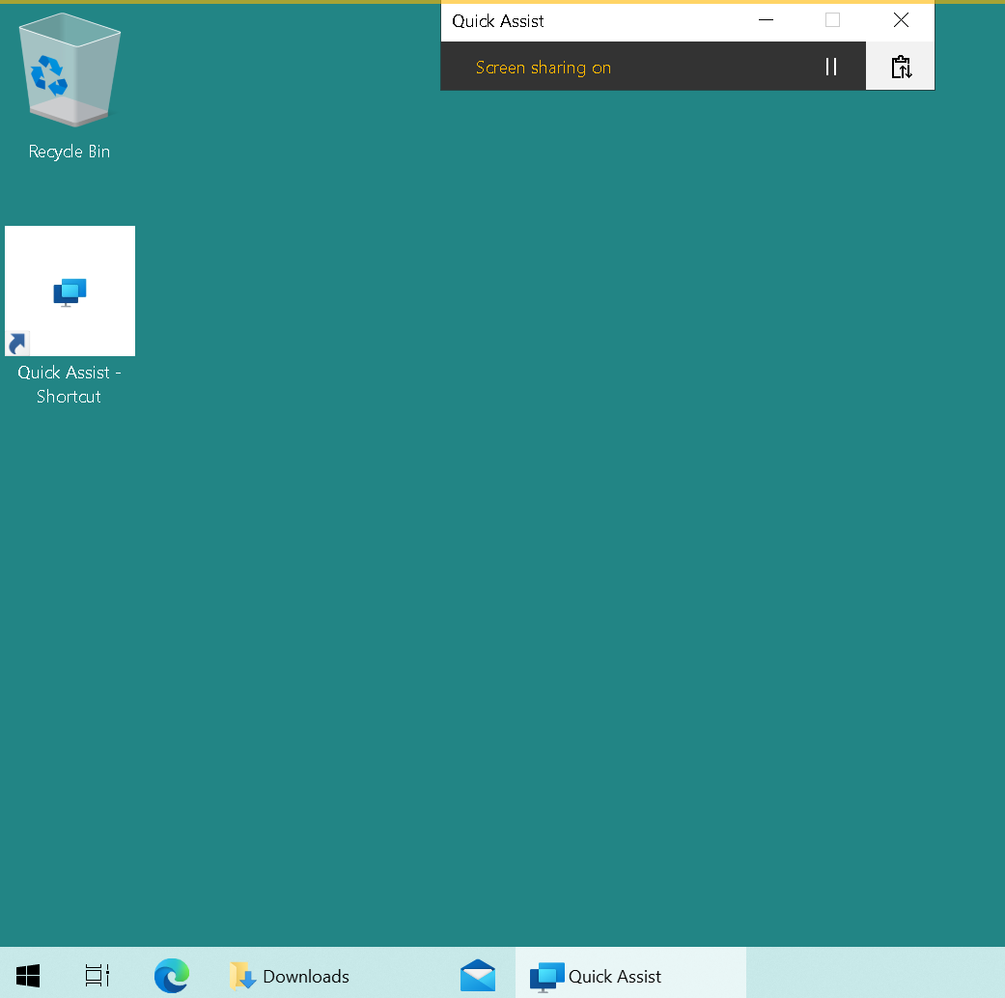

Slide 48
THE "HELPED COMPUTER" NOW HAS A "QUICK ASSIST" WINDOW..
..that will remain as long as the "Quick Assist" connection with the "Helper Computer" is active:

Slide 49
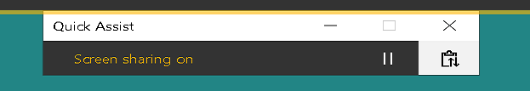

Slide 50
THE "HELPED COMPUTER" NOW HAS A "QUICK ASSIST" WINDOW..
..that has full control of the "Helped Computer":

Slide 51
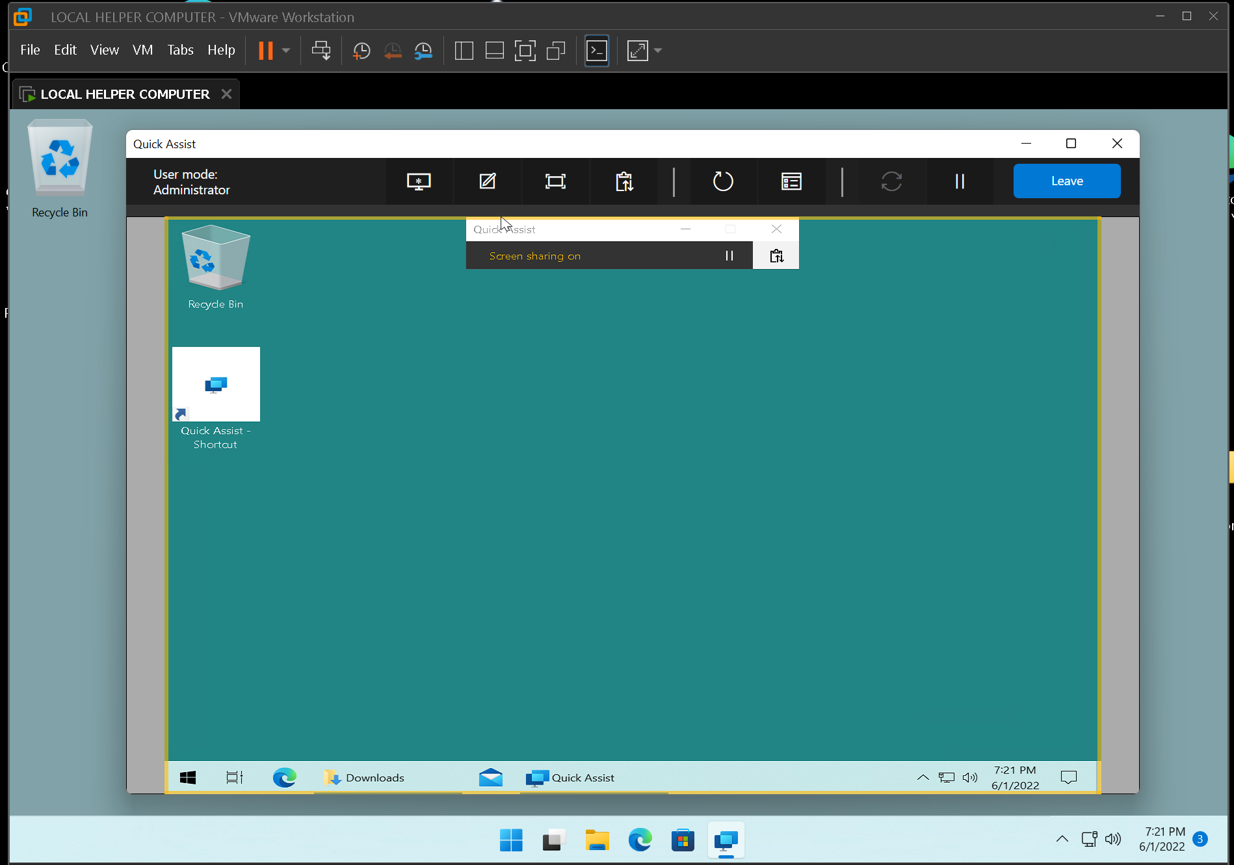

Slide 52
THE "HELPER COMPUTER" CAN RELINQUISH CONTROL..
..of the "Helped Computer" if the use of the "Helper Computer" clicks in one of these three places:

Slide 56
IF "QUICK ASSIST" STARTS UP INCORRECTLY..
..keep restarting it until it starts correctly. Then exit out of all of the incorrectly started dialog boxes of "Quick Assist" and use the dialog box of "Quick Assist" that started up correctly.

Slide 57
FORMER ADVANTAGE OF MICROSOFT'S "QUICK ASSIST"
Prior to May 31, 2022: if the circular "Restart" button in the "Quick Assist" window in the "Helper Computer", is clicked, the remote "Helped computer" will reboot and afterwards, the "Quick Assist" connection between the "Helper Computer" and the "Helped Computer" would be restored! We hope that Microsoft restores this feature!

Slide 58
APPENDIX
https://en.wikipedia.org/wiki/Quick_Assist

