Slide 1



"MICROSOFT REMOTE ASSISTANCE"

Slide 2
Web location for this presentation:
http://aztcs.apcug.org
Click on "Meeting Notes"
2

Slide 3
SUMMARY
"Windows Remote Access" allows any "Windows.." computer to remotely control another "Windows.." computer. The "helper" person can perform repairs and installations on the computer of the "helped" person.
3

Slide 4
TOPICS
Basic Concept of "Remote Access"
Helped Computer: "Allow Remote Assistance"
"Helped Computer: "Invite someone..to help you"
"Helper Computer": Take control..

Slide 5
BASIC CONCEPT OF "REMOTE ASSISTANCE"
"Helper computer" connects securely through the "Internet" to control the "Helped" computer"
Saves the helper from having to physically visit the helped computer

Slide 6
REMOTE "HELPED COMPUTER" USER INVITES SOMEONE TO HELP
Right-click on the "Start" button
Click on "Run"
Type msra in the "Open" box
Click on "Invite someone you trust to help you"

Slide 7
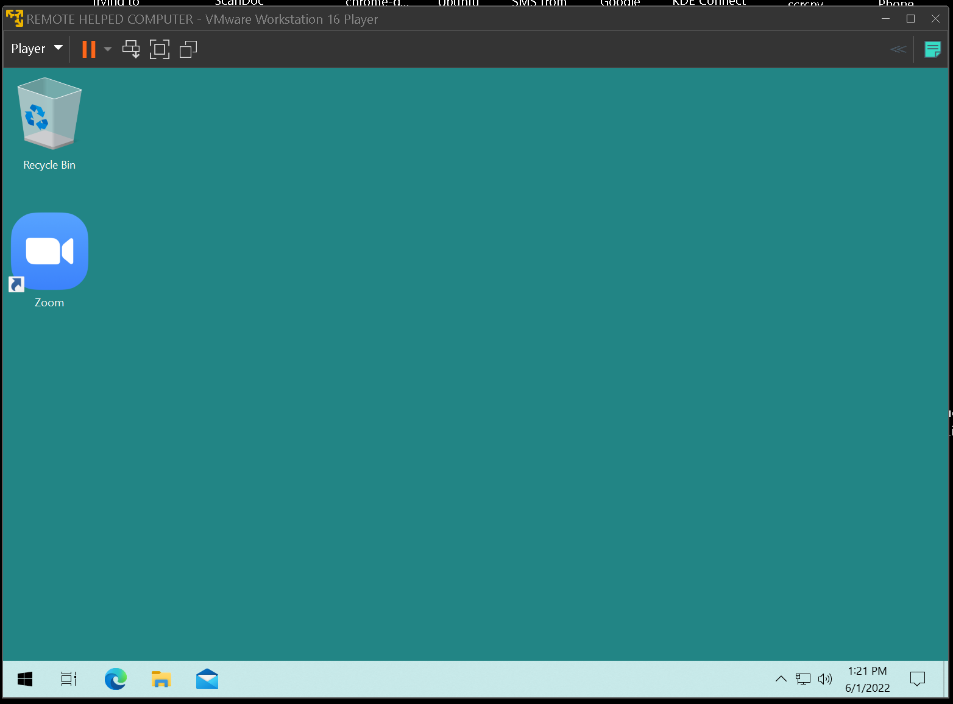

Slide 9
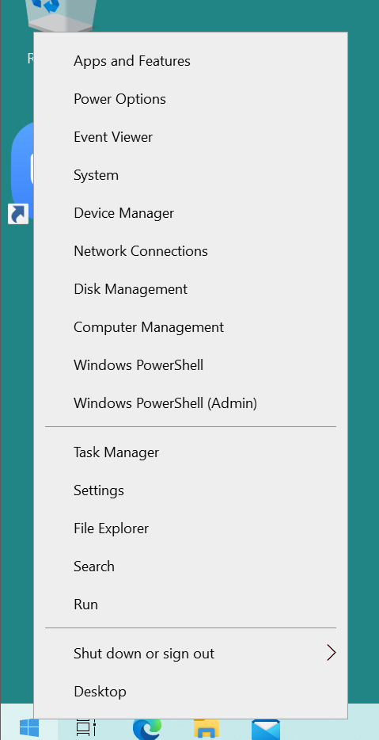

Slide 11
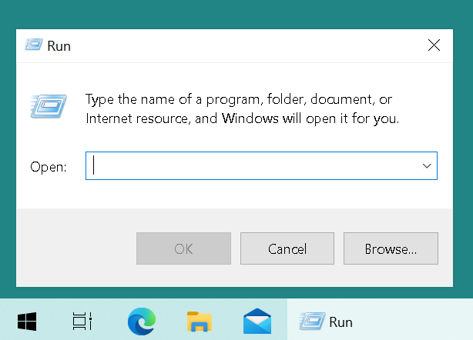

Slide 13
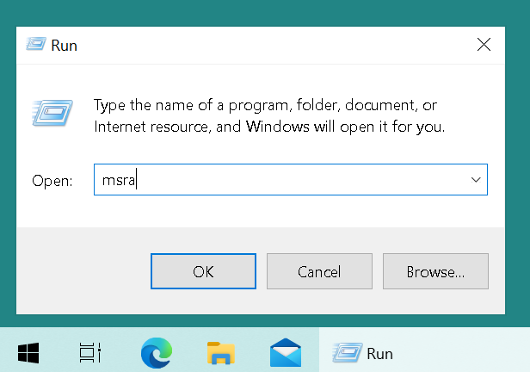

Slide 15
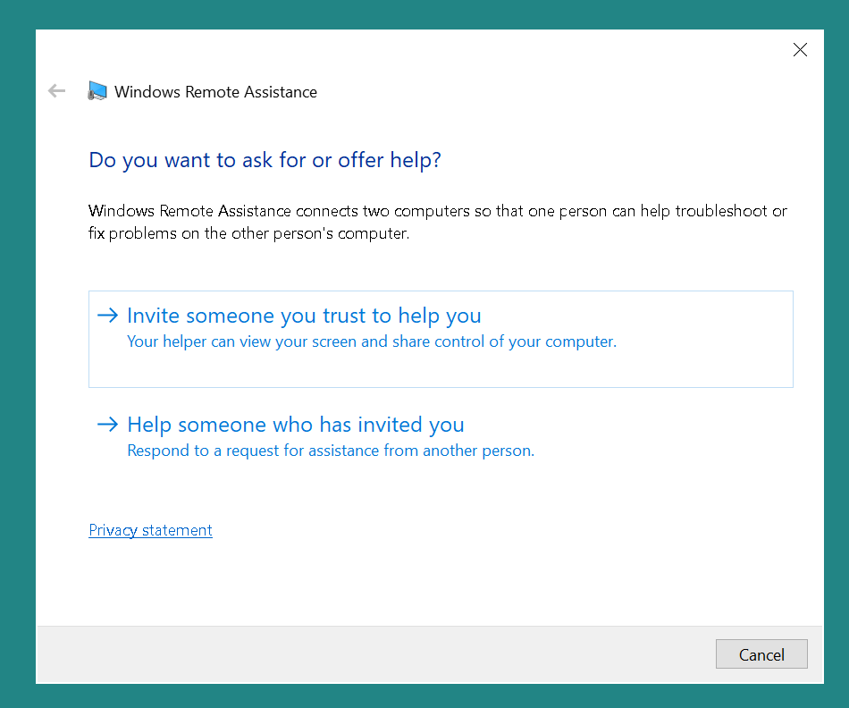

Slide 17
"QUICK ASSIST" (continued)
If you run shell:appsfolder in a Run box and you locate "Quick Assist" in the list of apps, and then you right click on it and then click on "Create shortcut", then it looks like this on the Desktop of Windows..:

Slide 18


Slide 19
"QUICK ASSIST" (continued)
If "Quick Assist" is running and you right-click on the Taskbar" button and tell it to "Pin to taskbar", it looks like this

Slide 20


Slide 21
REMOTE "HELPED COMPUTER" USER INVITES SOMEONE TO HELP (continued)
Click on "Save this invitation as a file"
Click on the "Save" button.
If a dialog box says "Invitation.msrcIncident already exists. Do you want to replace it", click on the "Yes" button

Slide 22
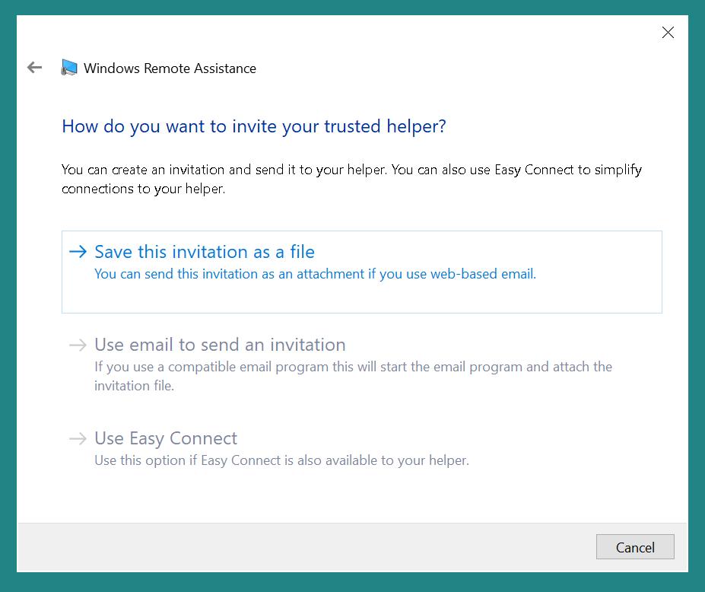

Slide 24
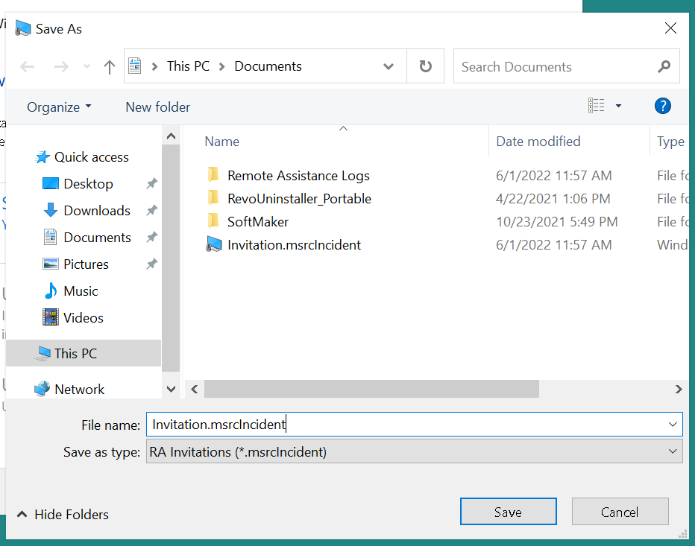

Slide 26
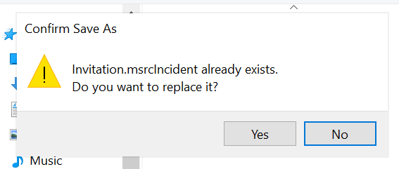

Slide 28
REMOTE "HELPED COMPUTER" USER INVITES SOMEONE TO HELP (continued)
Do not close the "Windows Remote Assistance" box until the remote assistance session is totally finished.
Write down the password in the "Windows Remote Assistance" box
Locate the "Invitation.msrcIncident" and send it AND the password to your helper

Slide 29
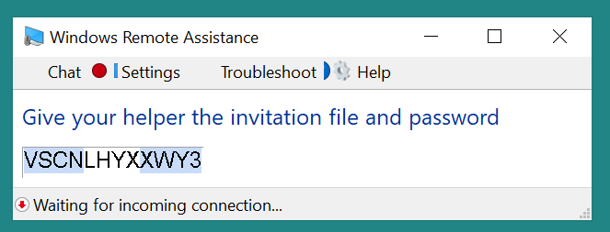

Slide 30
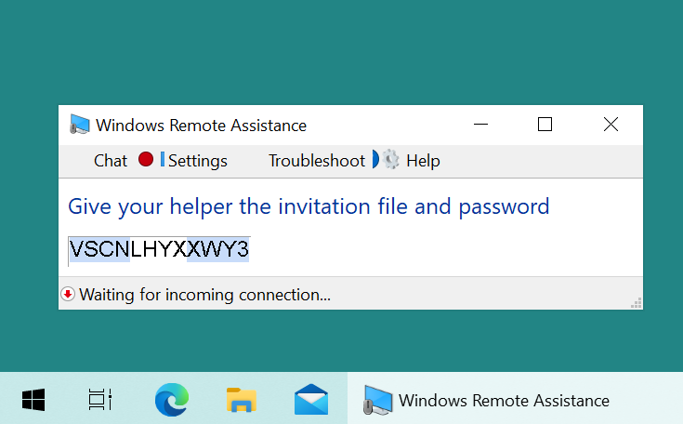

Slide 32
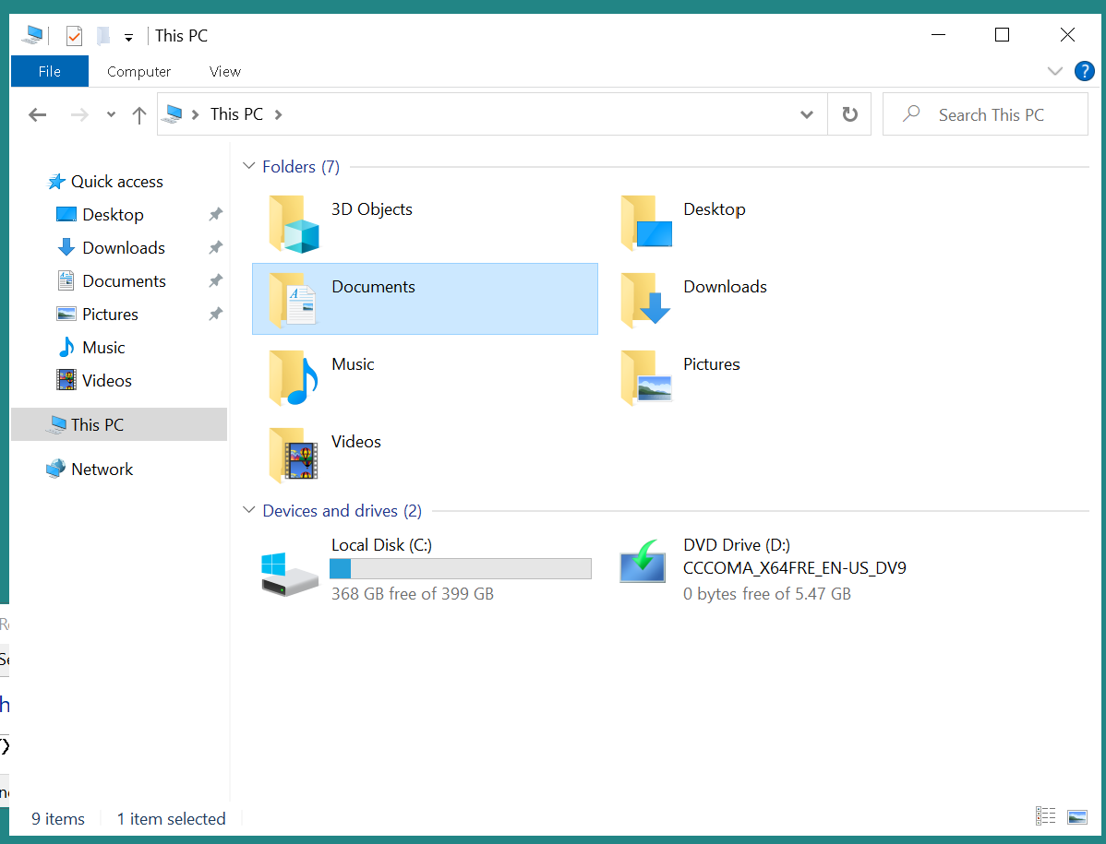

Slide 34
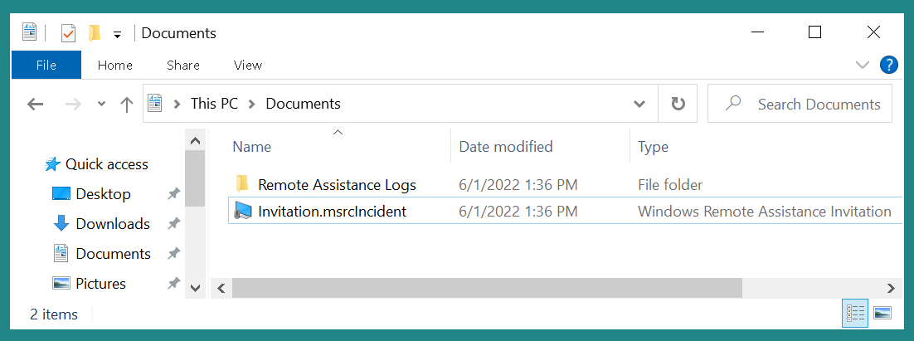

Slide 36
LOCAL "HELPER COMPUTER" USER TAKES CONTROL OF THE REMOTE "HELPED" COMPUTER
Local "Helper Computer" user double-clicks on the "Invitation.msrcIncident" file
Local "Helper Computer" user types in the password

Slide 37
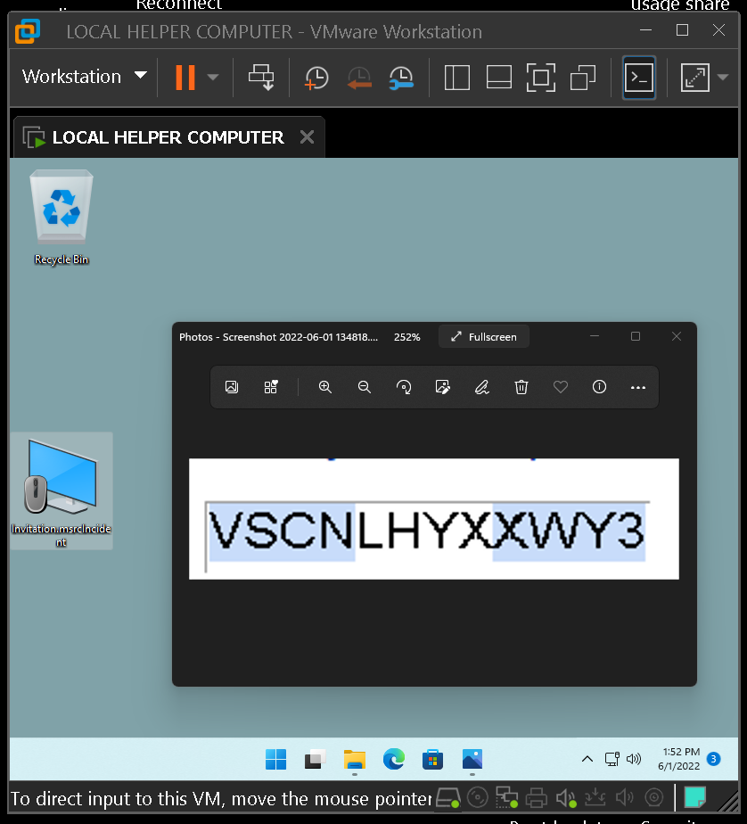

Slide 39
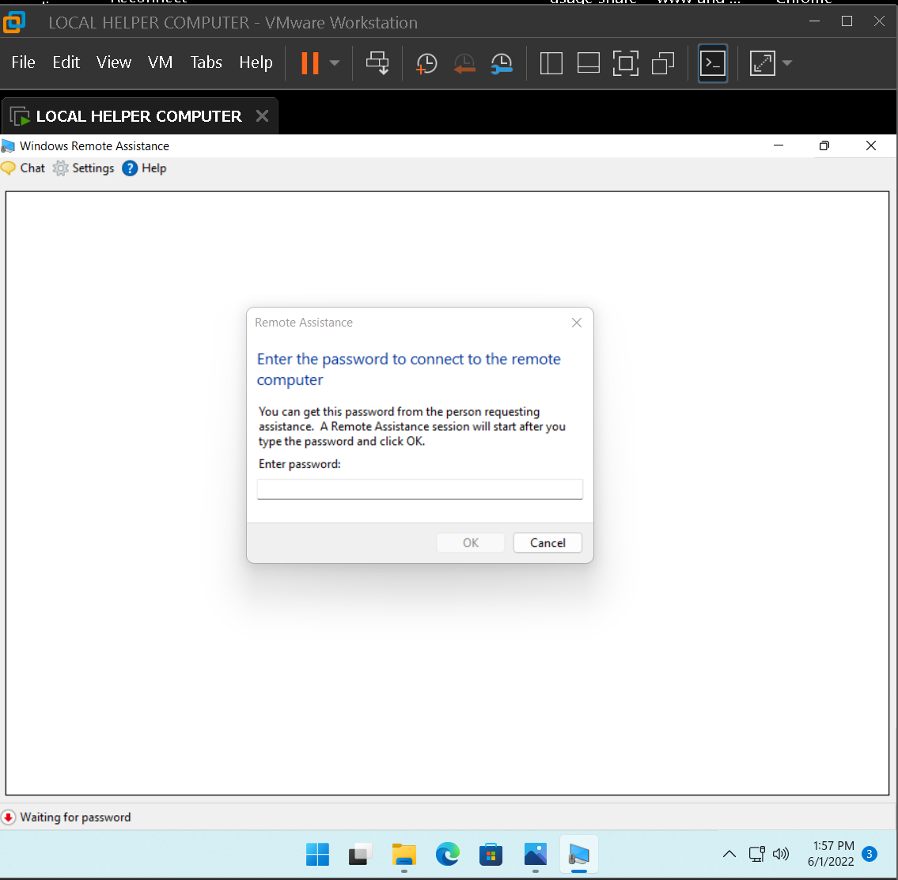

Slide 41
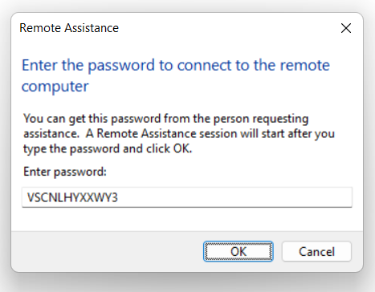

Slide 43
REMOTE "HELPED COMPUTER" ACCEPTS THE HELP
"Helped Computer" displays a "Would you like to allow.." box.
"Helped Computer" user clicks on "Yes" button of the "Would you like to allow" dialog box

Slide 44
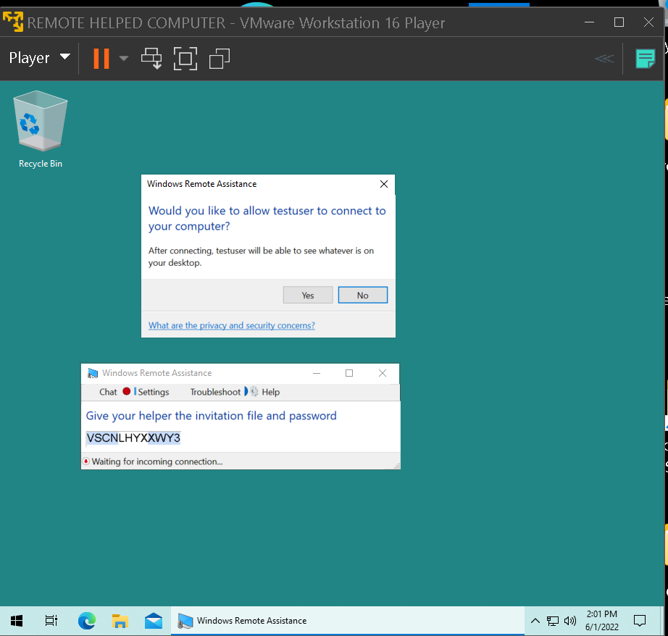

Slide 46
LOCAL "HELPER COMPUTER" HAS TO REQUEST CONTROL
"Helper Computer" user clicks on "Request control" button of the "Windows Remote Assistance" window

Slide 47
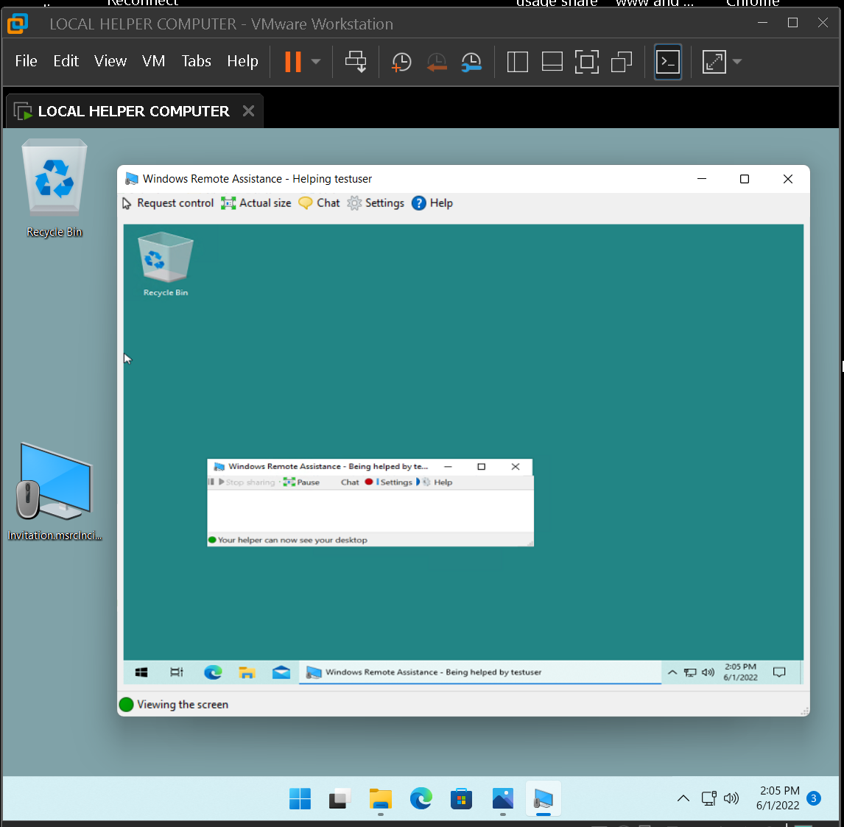

Slide 49
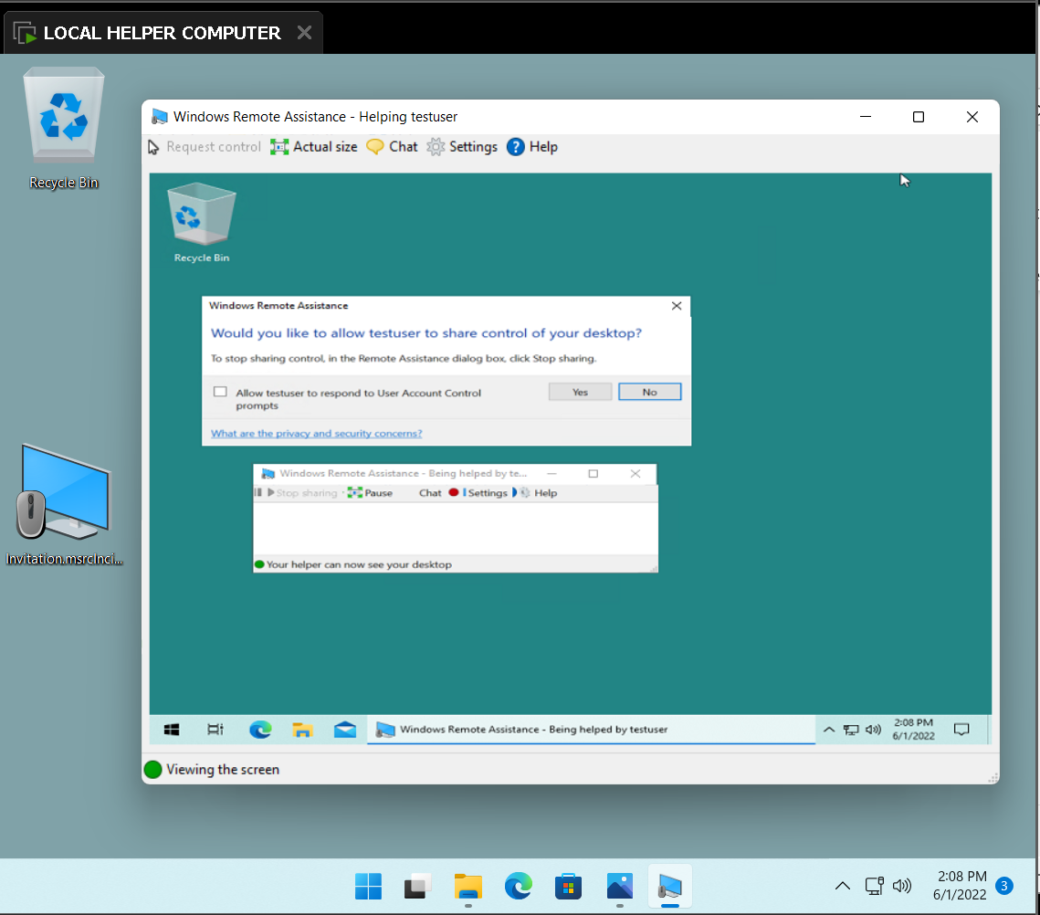

Slide 50
"HELPED COMPUTER" USER ACCEPTS THE HELP
"Helped Computer" user should put a checkmark for "Allow <name of helper> to respond to "User Account Control" prompts.
"Helped Computer" user clicks on "Yes" button of the "Would like to allow <username> to share control your desktop?"

Slide 51
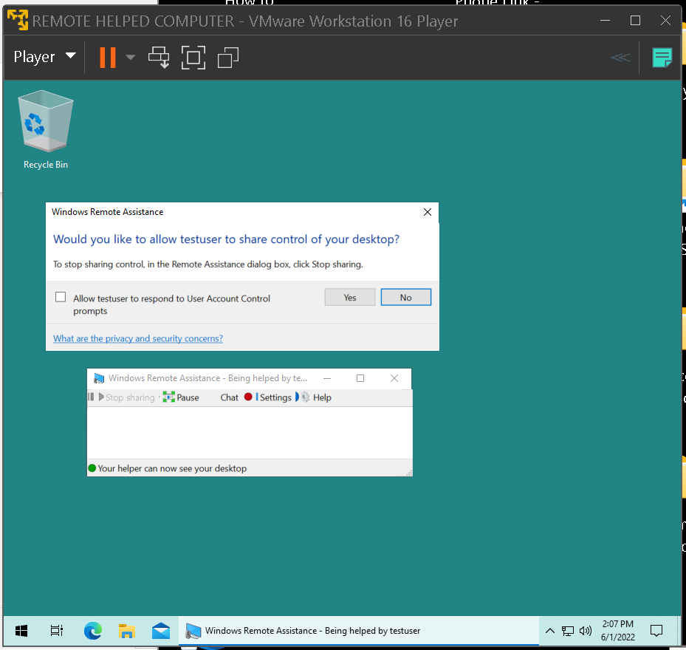

Slide 53
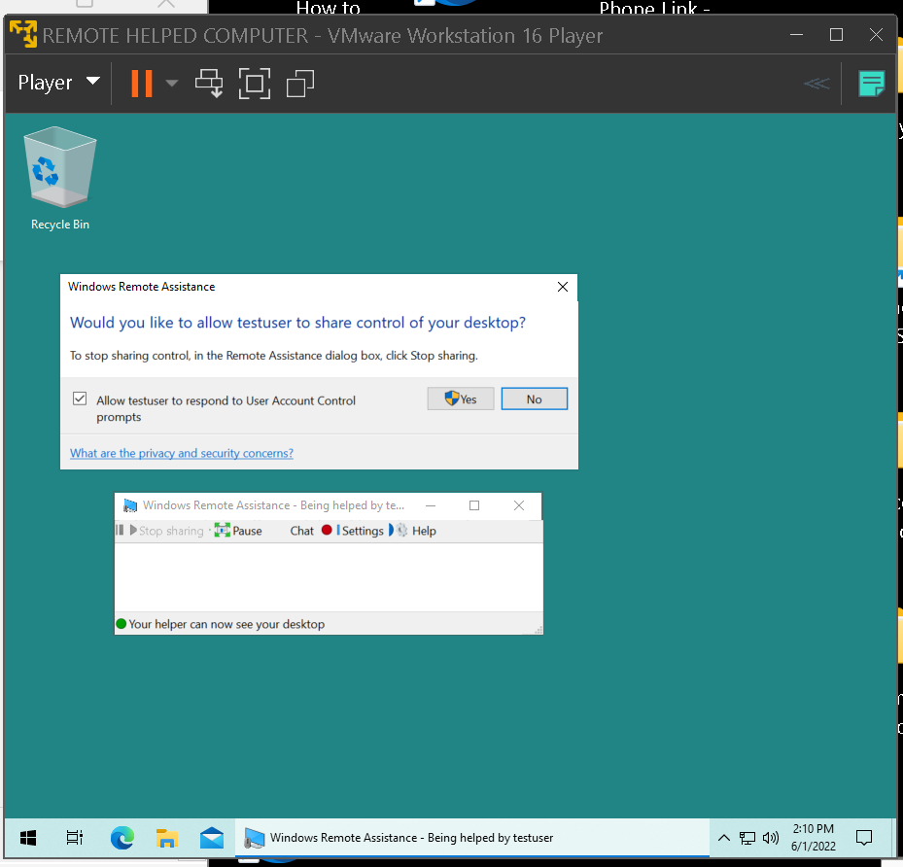

Slide 55
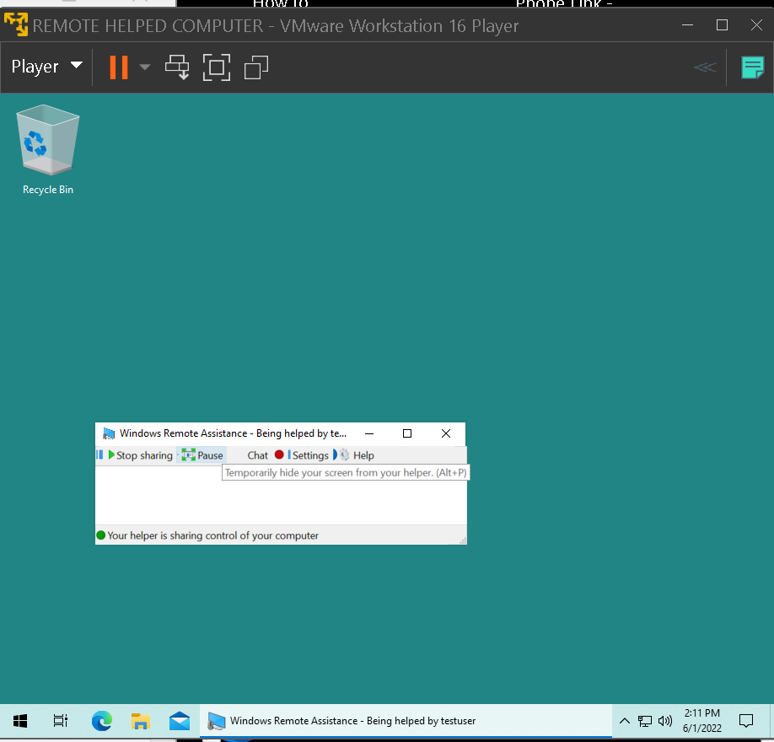

Slide 56
"HELPER COMPUTER" USER FINALLY TAKES CONTROL OF THE "HELPED" COMPUTER (continued)
The displayed desktop of the "Helped Computer" will be displayed as a maximized window so it is best to click on the "restore size" button of the maximized window that represents the desktop of thethe "Helped Computer".

Slide 57
"HELPER COMPUTER" USER FINALLY TAKES CONTROL OF THE "HELPED" COMPUTER (continued)
"Helper Computer" user should click inside the displayed desktop of the "Helped Computer" and start controlling the "Helped Computer"

Slide 58
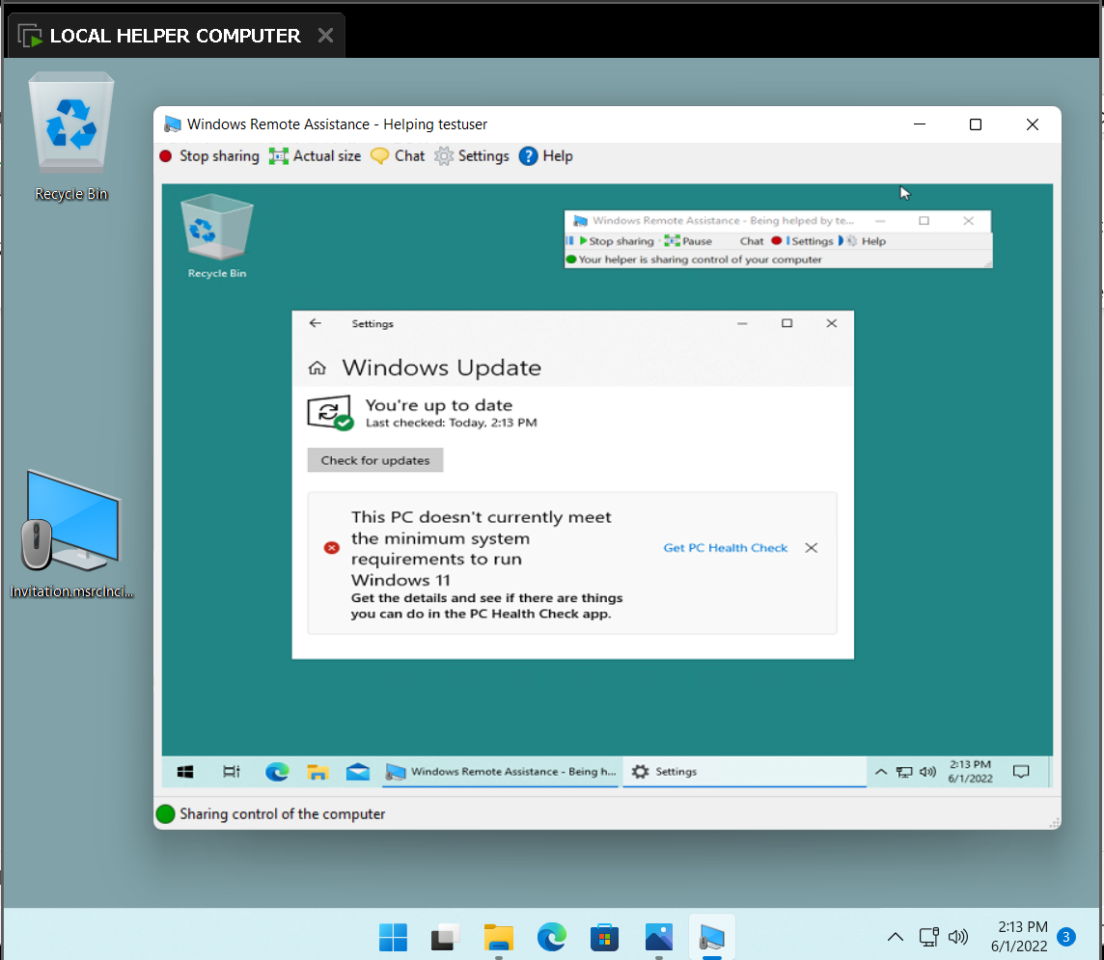

Slide 59
"HELPER COMPUTER" USER FINALLY TAKES CONTROL OF THE "HELPED" COMPUTER (continued)
If either the "Helper Computer" user or the "Helped Computer" user closes the "Windows Remote Assistance" box on the "Desktop" of the "Helped Computer", the "Remote Assistance" session will be terminated

Slide 60
"HELPER COMPUTER" USER TAKES CONTROL OF THE "HELPED" COMPUTER (continued)
However, it is okay for either the "Helper Computer" user or the "Helped Computer" user to minimize the "Microsoft Remote Assistance" box of the "Helped Computer" during the "Remote Assistance" session

Slide 61
"HELPER COMPUTER" USER FINALLY TAKES CONTROL OF THE "HELPED" COMPUTER (continued)
If either the "Helper Computer" user or the "Helped Computer" user does anything to cause the "Helped Computer" to reboot, the "Remote Assistance" session will be terminated

Slide 62
APPENDIX
https://en.wikipedia.org/wiki/Quick_Assist

