Slide 1



POWERLINE NETWORKING

Slide 2
Web location for this presentation:
http://aztcs.apcug.org
Click on
“Meeting Notes”

Slide 3
SUMMARY
"Powerline networking" has improved greatly in speed and reliably. It can now be as fast as wired "Gigabit Ethernet". To get it at 100 percent as fast as wired "Gigabit Ethernet", follow the advice in this presentation.

Slide 4
TOPICS
Advantages of "Powerline Networking"
Measuring the Speed of a "Powerline Networking" Connection
"Across The House" Demonstration of a "Powerline Networking" Connection
How to Get Full Gigabit Ethernet Speeds with "Powerline Networking"
The Two Best "Powerline Networking" Models"

Slide 5
TOPICS (continued)
Surge-suppression Power Cords slow down Powerline Networking
If a Power Line Device Is Not In Use, Remove It From The Power Outlet
Using Non-complimentary Standards to Avoid Neighbor Interference
Beware of Exaggerated Manufacturer's Statements
Power Networking Devices That Failed

Slide 6
ADVANTAGES OF "POWERLINE NETWORKING"
No signal attenuation by walls and furniture
No signal attenuation by radio frequency interference (unless you place one or both ends next to a shortwave radio transmitter)

Slide 7
MEASURING THE SPEED OF A "POWERLINE NETWORKING CONNECTION"
Use the the "speedtest" app and fusionconnect's "Speed Test Plus" Web site: The "speedtest" app is available at http://speedtest.net The "Speed Test Plus" Web site is available at https://www.fusionconnect.com/speed-test-plus?ref=speakeasy

Slide 8
Our across-the-house test of "powerline networking" consists of a router separated from a "Windows 11" laptop computer by 75 feet:

Slide 9
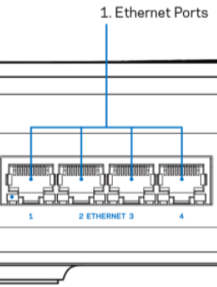
Router (south wall)
"Windows 11"
Laptop Computer (north wall)
_{Cat 6 cable}
versus
"Powerlink Networking"

Slide 10
A demonstration of a "powerline networking" link that is 100 percent as fast as Gigabit Ethernet:

Slide 11
Wired Cat 6 Ethernet line as a baseline for comparison:

Slide 12
Router (south wall)
"Windows 11"
Laptop Computer (north wall)
Cat 6 Cable (75 feet)

Slide 13

Internet Service Provider
"Windows 11"
Laptop Computer (north wall)
Cat 6 Cable (75 feet)
_{Router (south wall)}

Slide 14


Slide 16
Logical diagram of our "Across the house test" of a "Powerline Networking" connection:

Slide 17
Internet Service Provider
"Windows 11"
Laptop Computer (north wall)
Powerline Networking Link (> 95 feet net distance)
_{Router (south wall)}

Slide 18
The actual physical house powerline connection that the data signals travel and how up-to-date the "Powerline Networking" equipment is determines the actual speed of a "Powerline Networking" connection:

Slide 19
For most U.S. homes, the electric power utility provides a 3-wire "drop": L1, L2, and Neutral
This "drop" comes from a step-down transformer that belongs to the electric power utility.

Slide 20
The 3-wire drop from the electric utility ends up at the main electrical circuit breaker panel of your house:

Slide 21
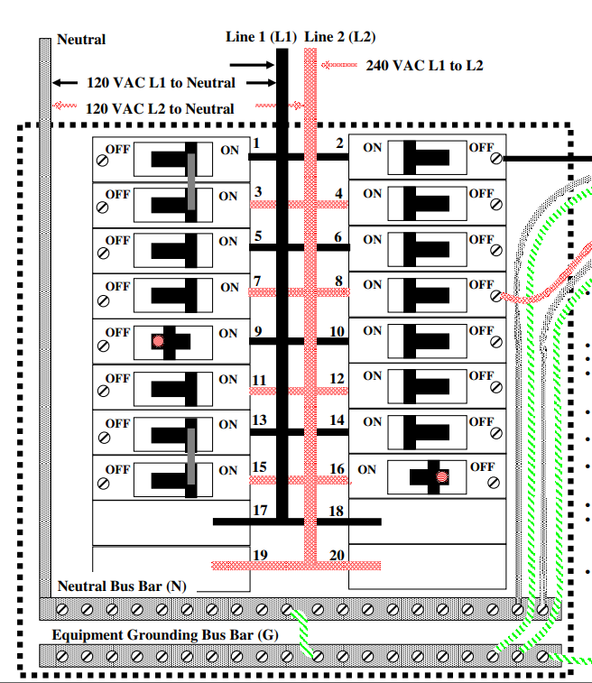

Slide 22
LINE "L1" BUS IN THE ELECTRICAL CIRCUIT BREAKER PANEL IS CONNECTED TO THE "L1" LINE FROM THE ELECTRIC POWER UTILITY:

Slide 24
LINE "L2" BUS IN THE ELECTRICAL CIRCUIT BREAKER PANEL IS CONNECTED TO THE "L2" LINE FROM THE ELECTRIC POWER UTILITY:

Slide 26
LINE "NEUTRAL" BUS IN THE ELECTRICAL CIRCUIT BREAKER PANEL IS CONNECTED TO THE "NEUTRAL" LINE FROM THE ELECTRIC POWER UTILITY:

Slide 28
"L1" is connected to breakers #1, 2, 5, 6, 9, 10, 13, 14, etc.

Slide 30
"L2" is connected to breakers #3, 4, 7, 8, 11, 12, 15, 16 etc.

Slide 32
ELECTRIC POWER UTILITY HAS THREE-WIRE DROP GOING FROM THEIR STEP-DOWN TRANS-FORMER

Slide 33
When the electrical outlets on both ends of a powerline networking pair are both connected to breakers on the "L1" side of the electrical panel, you can get the same Internet speeds as a wired Ethernet connection (if you are using one of the two models of "Powerline Networking" devices that are capable of doing so):

Slide 34
Breaker Panel's L1 side (west wall):
Breaker 9
Breaker 17
Internet Service Provider
Router (south wall)
_{Powerline Network Unit}
_{-->Outlet}
_{Powerline Networking Link}
_{Powerline Network Unit}
_{-->Outlet}
Computer (north wall)

Slide 36
If the electrical outlets on both ends of a "powerline networking" pair were both connected to breakers on the "L2" side of the electrical panel, you could get the same Internet speeds as a wired Ethernet connection (if you are using one of the two models of "Powerline Networking" devices that are capable of doing so):

Slide 37
Breaker panel's
L2 side (west wall)
Internet Service Provider
Router (south wall)
_{Powerline Network Unit}
_{-->Outlet}
_{Powerline Network Unit}
_{-->Outlet}
Computer (north wall)

Slide 38
When the electrical outlet at the router side is connected to a breaker on the L1 side of the electrical panel, and the electrical outlet at the computer side is connected to the L2 side, you will get 60 percent or less of the speed of a wired Ethernet connection:

Slide 39
Breaker 9 on panel's L1 side (west wall)
Breaker 11 on panel's L2 side (west wall)
Internet Service Provider
Router (south wall)
_{Powerline Network Unit}
_{-->Outlet}
_{Powerline Network Unit}
_{-->Outlet}
_{Powerline Networking Link}
Computer (north wall)

Slide 40
Electric Power Utility's Step-down Transformer
Internet Service Provider
Router (south wall)
Breaker 9 on panel's L1 side (west wall)
Breaker 11 on panel's L2 side (west wall)
Comp u t e r
_{Powerline Network Unit}
_{-->Outlet}
_{Powerline Network Unit}
_{-->Outlet}

Slide 42
ELECTRIC POWER UTILITY HAS THREE-WIRE DROP GOING FROM THEIR STEP-DOWN TRANS-FORMER

Slide 43
An equipment description of our "Powerline Networking" demonstration:

Slide 44
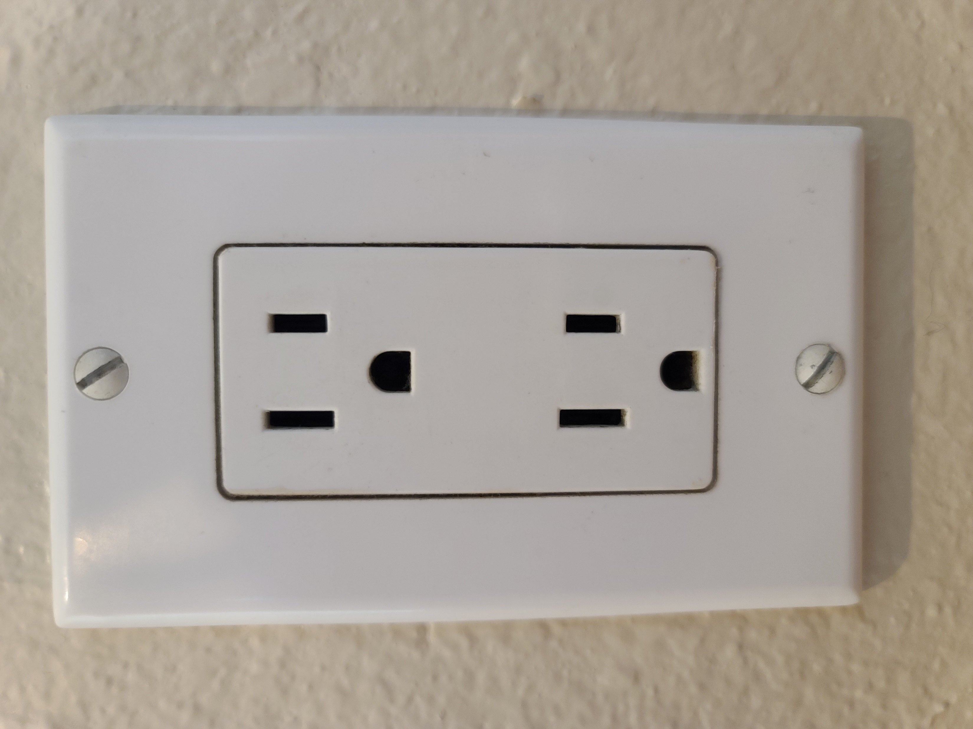

Slide 45
_{"Hot"}

Slide 47
_{"Ground"}

Slide 48
_{"Neutral"}

Slide 49
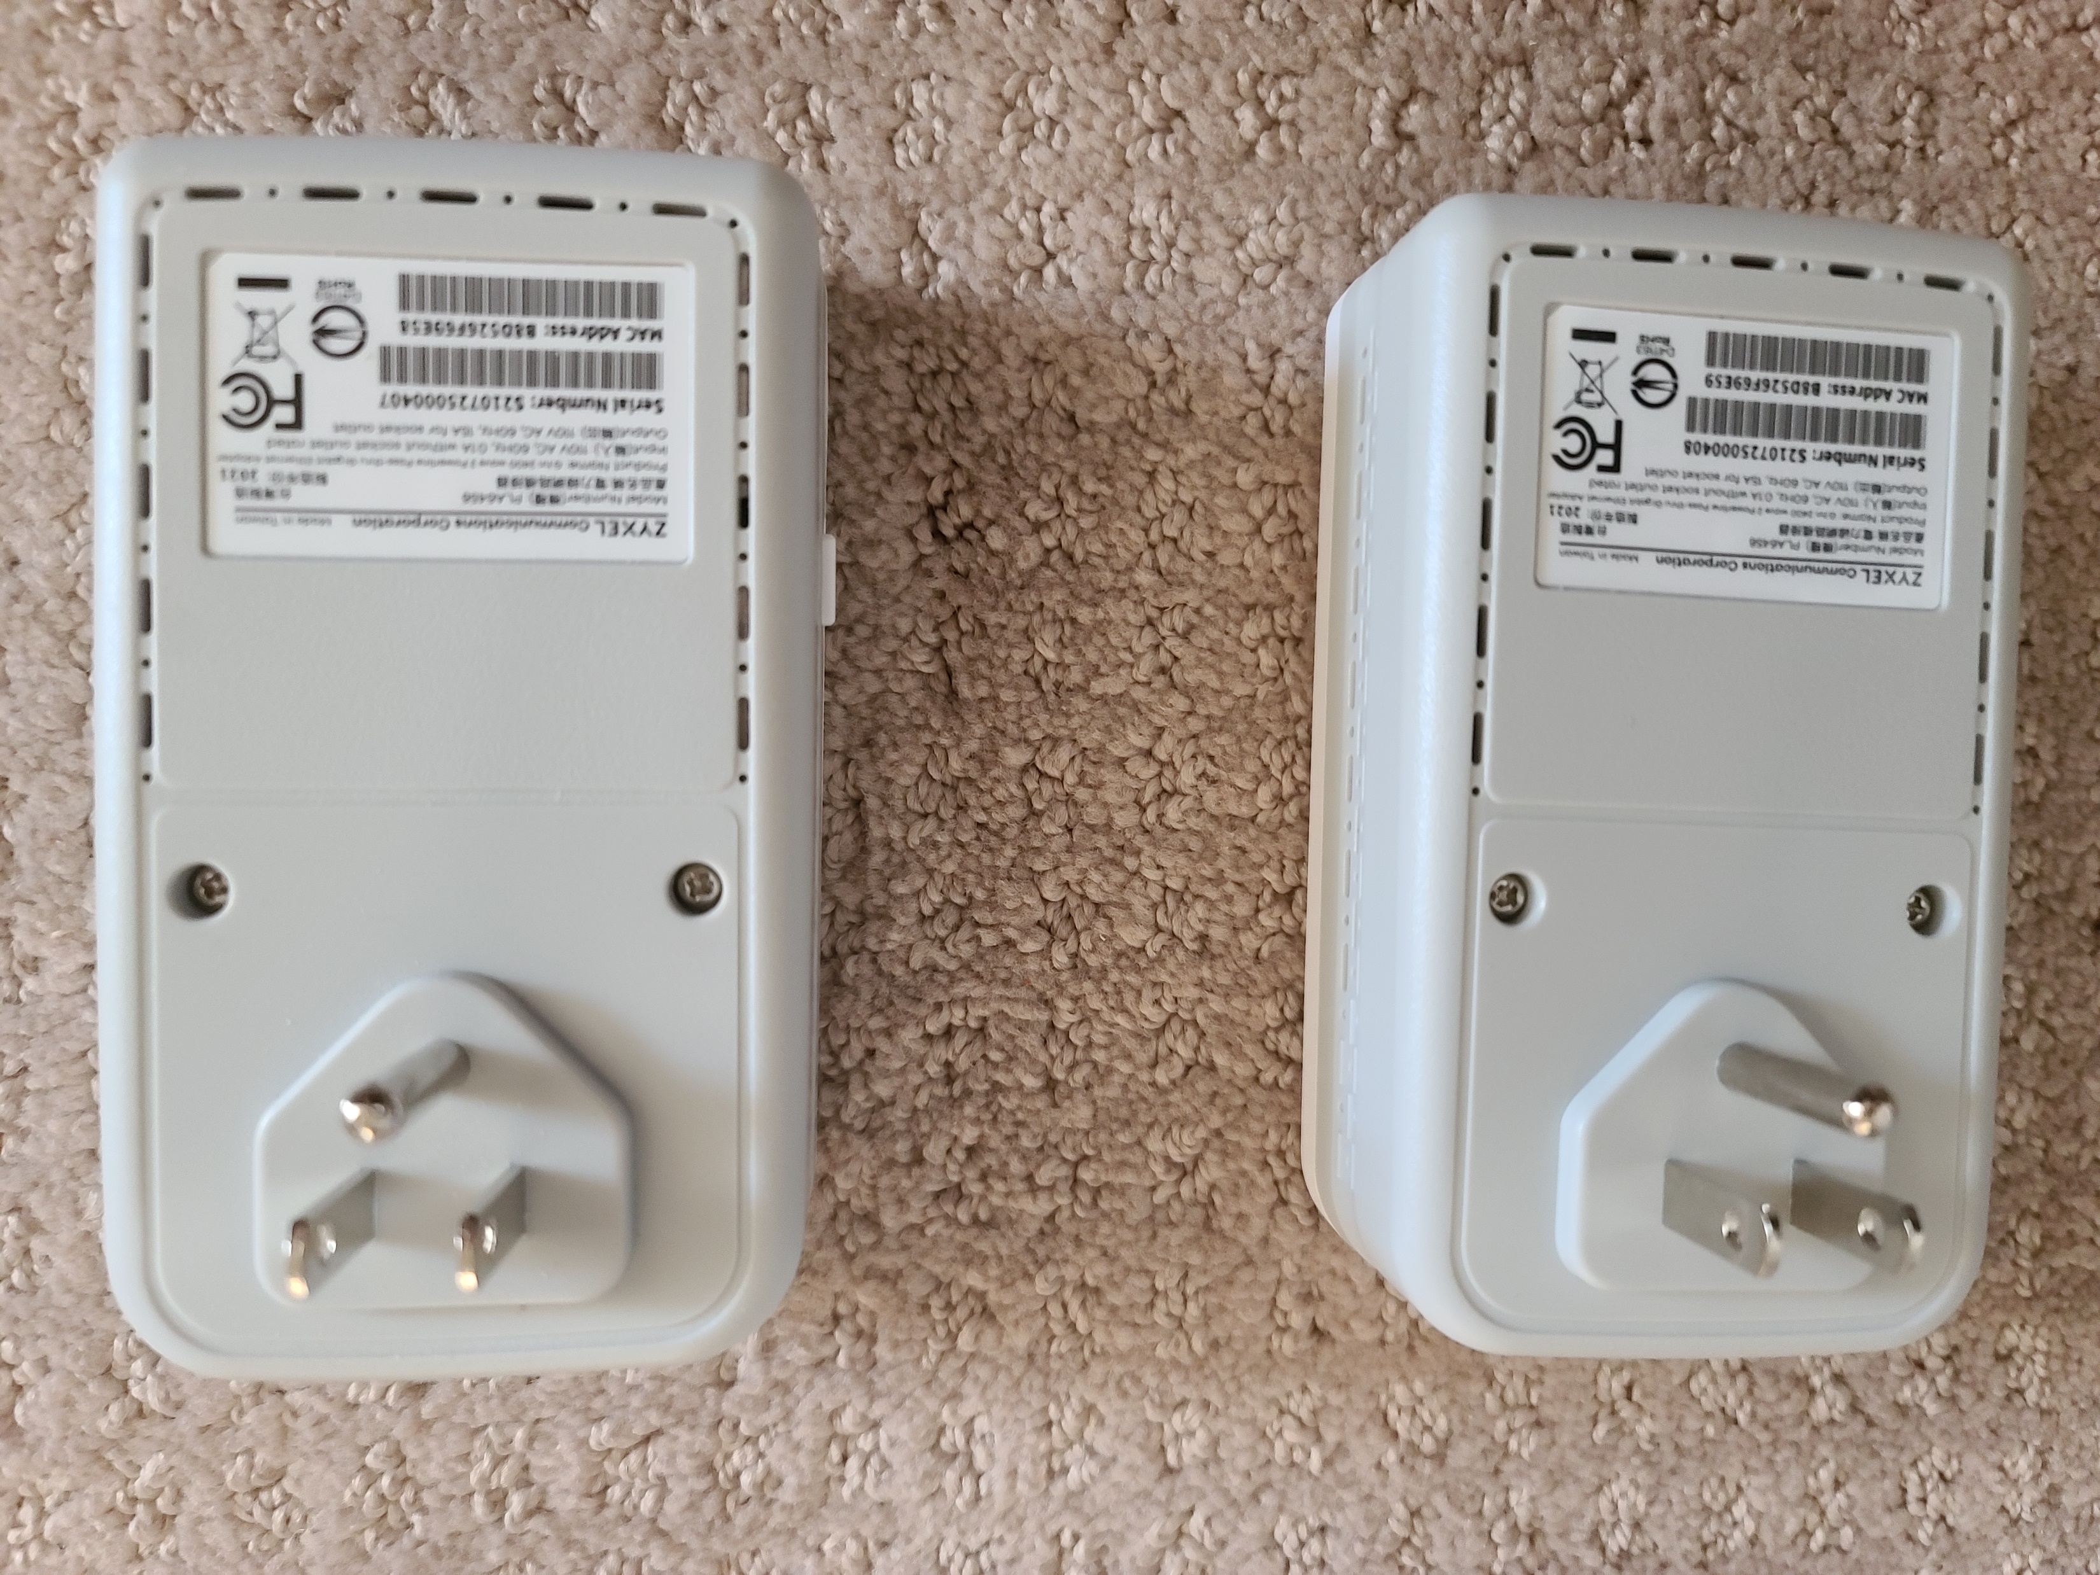

Slide 53
3-ft. Cat. 5E Ethernet cable
3-ft. Cat. 5E Ethernet cable
_{Linksys Router (south wall)}
Laptop Computer (north wall)

Slide 54
At the South end, a "Powerline Networking" device connects by means of a short "Cat 5e" "jumper cable" to a Linksys router

Slide 55
3-ft. Cat. 5E Ethernet cable
3-ft. Cat. 5E Ethernet cable
_{Linksys Router (south wall)}
Laptop Computer (north wall)

Slide 56
At the North end, a "Powerline Networking" device connects by means of a short "Cat 5e" "jumper cable" to my laptop computer

Slide 57
3-ft. Cat. 5E Ethernet cable
3-ft. Cat. 5E Ethernet cable
_{Linksys Router (south wall)}
Laptop Computer (north wall)

Slide 58
"POWERLINE NETWORKING"
"Powerline networking" is one of many technologies that utilize carriers riding on conductors used for power distribution

Slide 59
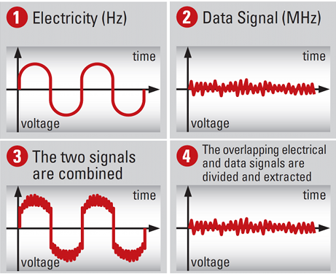

Slide 60
"POWERLINE NETWORKING" (continued)
See https://en.wikipedia.org/wiki/HomePlug

Slide 61
TWO COMPETING STANDARDS FOR "POWERLINE NETWORKING"
HomeGrid Forum's "G.hn"
HomePlug Alliance's "HomePlug AV2"

Slide 62
TWO COMPETING STANDARDS FOR "POWERLINE NETWORKING"
"G.hn" stands for "Gigabit Home Networking" according to https://homegridforum.org/homegrid-forum-overview/

Slide 63
TWO COMPETING STANDARDS FOR "POWERLINE NETWORKING"
HomeGrid Forum's "G.hn" standards creation process started in 2009
HomePlug Alliance's standards creation process started in 2001

Slide 64
TWO COMPETING STANDARDS FOR "POWERLINE NETWORKING"
HomeGrid Forum's "G.hn Wave 2": 500 meters maximum distance
HomePlug Alliance's "HomePlug AV2": 300 meters maximum distance
However, these distances are not important with most homes and small businesses

Slide 65
TWO COMPETING STANDARDS FOR "POWERLINE NETWORKING"
"Powerline Networking" units from these two standards do not communicate with each other but they can interfere with each other because they use similar carrier frequencies

Slide 66
HOMEGRID'S "G.hn Wave 2" STANDARD
Homegrid's "G.hn Wave 2" standard is a robust and rapidly evolving international standard with lots of support from "Best Buy" and other companies: http://www.homegridforum.org/

Slide 67
HOMEGRID'S "G.hn Wave 2" STANDARD (continued)
"G.hn" uses sub-carriers in the 6 to 78 Megahertz frequency range according to https://www.allnet.de/en/allnet-brand/produkte/pointopoint/ghn-lan-over-2-wire-and-coaxial/p/-d9f655bd32/

Slide 68
HOMEGRID'S "G.hn Wave 2" STANDARD (continued)
Do not buy equipment that says "G.hn" but does not say "Wave 2", since this signifies that the equipment is now obsolete and will be unable to reach "Gigabit Ethernet" speeds

Slide 69
"HOMEPLUG AV2" STANDARD
The HomePlug Alliance's "HomePlug AV" final standard is called "HomePlug AV2"
The "HomePlug Alliance" became dormant in October of 2016 according to https://en.wikipedia.org/wiki/HomePlug

Slide 70
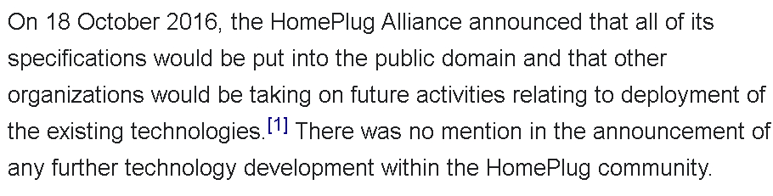

Slide 71
"HOMEPLUG AV2" STANDARD (continued)
The homeplug.org Web site ceased to exist during 2019 according to https://web.archive.org/web/2019*/homeplug.org
The Homeplug Alliance's Facebook page is still alive at https://www.facebook.com/HomePlugAlliance/ but they have not revised it since 2016

Slide 72
"HOMEPLUG AV2" STANDARD (continued)
  As they produced increasingly faster "HomePlug AV", products, the manufacturer's added in a nominal speed number to the nomenclature: "HomePlug AV2 500", "HomePlug AV2 600", "HomePlug AV2 1200", "HomePlug AV2 2000" and "HomePlug AV2 2400"

Slide 73
"HOMEPLUG AV2" STANDARD (continued)
The numbers after "AV" are the "claimed" nominal data transmission rates in Megabits per second
Some manufacturers put in the nominal data transmission rate value without prepending it with "AV"

Slide 74
"HOMEPLUG AV2" STANDARD (continued)
The current "AV1200", "AV2000", and "AV2400" monikers imply (often incorrectly and/or dishonestly) that "HomePlug AV2" equipment is now comparable in data transmission speeds to "Gigabit Ethernet" which is the current standard for network switches and routers

Slide 75
"HOMEPLUG AV2" STANDARD (continued)
Do not buy equipment that was manufacturered in accordance with the old "HomePlug AV" standard: These models are now obsolete and their reliability and capabilities are inferior to the current "HomePlug AV2" models

Slide 76
"HOMEPLUG AV2" STANDARD (continued)
Installing "Homeplug AV2" transceivers is usually a trial and error process: You plug them in and make sure at the three LEDs on each "Powerline Networking" device are lit up. Then you use a computer to run the "Speedtest" app to see if the "Powerline Networking" connection passes the upload and download speeds that your Internet provider is providing for you.

Slide 77
"HOMEPLUG AV2" STANDARD (continued)
Then you try another pair of electrical wall outlets and note it's Internet upload and download speeds.
This trial-and-error "across the house" process is usually more effective than analyzing the entire electrical circuit breaker panel(s) of the home or business that you are installing the "Powerline Networking" equipment into.

Slide 81
"POWER LIGHT" = 110 Volt AC
power is reaching this "Powerline Networking" device to provide power to it

Slide 82
"POWERLINE LIGHT" = At least one other "Powerline Networking" device is communicating over house electrical cabling with this "Powerline Networking" device

Slide 83
"ETHERNET LIGHT" = The computer, router, or other networking device that is connected to the network jack of this "Powerline Networking" device is successfully communicating with this "Powerline Networking" device

Slide 84
"HOMEPLUG AV2" STANDARD (continued)
The competing Universal Powerline Association ceased to exist at the end of 2010.
"HomePlug AV2" equipment and obsolete "Universal Powerline Association" equipment are NOT compatible so do not put them both on the same home or small business network.

Slide 85
"HOMEPLUG AV2" STANDARD (continued)
Mix and match strategies?
  The equipment of the various "HomePlug AV2" manufacturers inter-communicate well with each other. However, you lose proprietary, non-standard functions when you mix the equipment of different manufacturers

Slide 86
"HOMEPLUG AV2" STANDARD (continued)
"Homeplug AV2" uses sub-carriers in the 1.8 to 86 Megahertz frequency range according to http://www.hindawi.com/journals/jece/2013/892628/

Slide 87
"POWERLINE NETWORKING" KITS
"Powerline networking" kits consist of a pair of transceivers of the exact same model and firmware revision. You usually get a better price by buying a pair as a "..kit" relative to buying each transceiver separately.

Slide 88


Slide 89


Slide 90
DEFAULT MESH NETWORK
When you install more than two powerline networking transceivers, they will default to a "mesh network" where each transceiver communicates with with every other transceiver

Slide 91


Slide 92
DEFAULT MESH NETWORK (continued)
Source for the previous illustration: http://www.digi.com/technology/rf-articles/wireless-zigbee

Slide 93
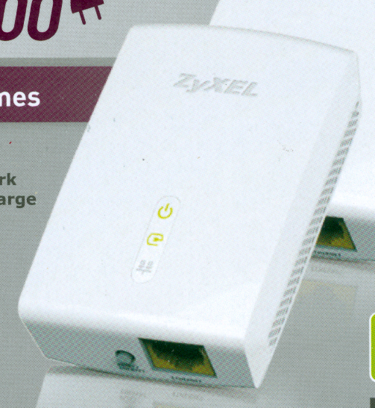
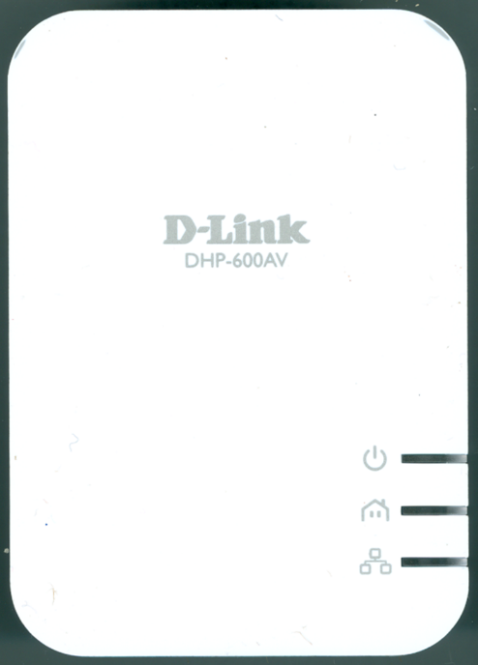

Slide 94
DEFAULT MESH NETWORK (continued)
You can install more that two "Homeplug AV2" transceivers and they all will communicate with each other with some loss in data throughput for each additional transceiver that you install.

Slide 95
DEFAULT MESH NETWORK (continued)
You can install more that two "G.hn Wave 2" transceivers and they all will communicate with each other with some loss in data throughput for each additional transceiver that you install.

Slide 96
DEFAULT MESH NETWORK (continued)
"HomePlug AV2.." and "G.hn Wave 2" transceivers will not communicate with each other

Slide 97
TO GET GIGABIT ETHERNET SPEEDS WITH POWERLINE NETWORKING
Only use "G.hn Wave 2" or "Powerline HomePlug AV2 2000" or "Powerline HomePlug AV2 2400"
Do not buy any powerline "G.hn Wave" that does not have "Wave 2" it's name or description
Do not buy any powerline HomePlug device that has a nominal value below "2000".

Slide 98
TO GET GIGABIT ETHERNET SPEEDS WITH POWERLINE NETWORKING (continued)
When buying "G.hn" devices, if the manufacturer or the packaging material does not say "Wave 2" and "2400", you will be unable to reach "Gigabit Ethernet" speeds. (Some earlier models of "G.hn" devices claimed to be "2000" but they were unable to reach Gigabit Ethernet speeds.)

Slide 99
TO GET GIGABIT ETHERNET SPEEDS WITH POWERLINE NETWORKING (continued)
When buying "Powerline HomePlug AV2" devices, if the manufacturer or the packaging material does not say "2000" or higher, you will be unable to reach "Gigabit Ethernet" speeds.

Slide 100
TO GET GIGABIT ETHERNET SPEEDS WITH POWERLINE NETWORKING (continued)
Do not buy any powerline HomePlug device or that does not have "AV2" in its description because this indicate that the device adheres to the the original "AV" standard which is now obsolete and runs much slower than "AV2" devices.

Slide 101
TO GET GIGABIT ETHERNET SPEEDS WITH POWERLINE NETWORKING (continued)
There are lots of sellers selling older, obsolete powerline networking devices at ridiculously high prices at Amazon, Best Buy, and Walmart. There are lots of less-than-honest "experts" and "influencers" providing glowing reviews on older, obsolete powerline devices!

Slide 102
TO GET GIGABIT ETHERNET SPEEDS WITH POWERLINE NETWORKING (continued)
When buying "G.hn" devices, if the manufacturer's description or the packaging material does not say "Wave 2", you will be unable to reach "Gigabit Ethernet" speeds

Slide 103
TO GET GIGABIT ETHERNET SPEEDS WITH POWERLINE NETWORKING (continued)
Only connect Powerline Networking devices to the L1 or the L2 side of an electrical circuit breaker panel (instead to both the L1 and the L2 sides of an electrical circuit breaker panel)

Slide 104
THE TWO BEST POWERLINE NETWORKING MODELS
After testing various models of "Powerline Networking" devices, we have determined that the only two models that can operate at full Gigabit Ethernet speeds at the present time (April 2022) are Zyxel PLA6456 and Netgear PLP2000

Slide 105
THE TWO BEST POWERLINE NETWORKING MODELS (continued)
We did not find any difference in average Internet speeds between the two models: Using 40 tests with the Ookla "Speedtest" app for our "across the house" test: Cat 6 Baseline: 200 down/229 up Zyxel PLA6456 pair: 202 down/208 up and Netgear PLP2000 pair: 200 down/229 up

Slide 106
THE TWO BEST POWERLINE NETWORKING MODELS (continued)
The Zyxel PLA6456 model conforms to the international "G.hn" standard while the Netgear PLP2000 model conforms to the "HomePlug AV2" standard

Slide 107
THE TWO BEST POWERLINE NETWORKING MODELS (continued)
Both models have a "pass-through outlet" so that you can power up other equipment with the electrical outlet that the powerline networking "transceiver" is plugged into

Slide 108
THE TWO BEST POWERLINE NETWORKING MODELS (continued)
In our "across the house" tests, the Netgear PLP2000 model was not blocked by a "Ground Fault Circuit Interupter" electrical outlet while the Zyxel PLA6456 model was blocked by a "Ground Fault Circuit Interupter" electrical outlet

Slide 109
THE TWO BEST POWERLINE NETWORKING MODELS (continued)
"Ground Fault Circuit Interrupter" ("GFCI") electrical outlets are usually installed in kitchens, bathrooms, outdoor receptacles, crawl spaces, and anywhere within 6 feet of a sink or water source:

Slide 110
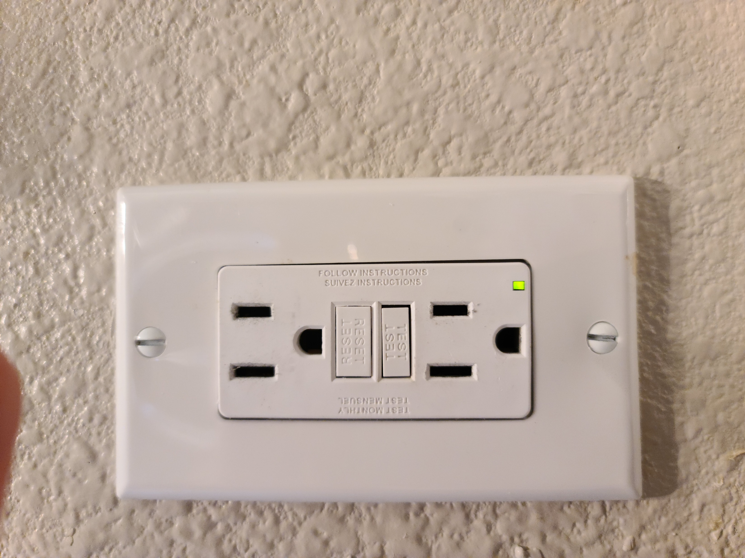

Slide 111
_{"Test" button}

Slide 112
_{"Reset" button}

Slide 113
THE TWO BEST POWERLINE NETWORKING MODELS (continued)
https://www.amazon.com/dp/B07ZHPY8WN/ref=redir_mobile_desktop?_encoding=UTF8&aaxitk=330e09210bb9d6fc50fe0562c2afca85&hsa_cr_id=5708102420001&pd_rd_plhdr=t&pd_rd_r=ffa9901e-91ff-40eb-80ab-26f611d34806&pd_rd_w=gGmJF&pd_rd_wg=BkgAE&ref_=sbx_be_s_sparkle_mcd_asin_1_img&th=1

Slide 114
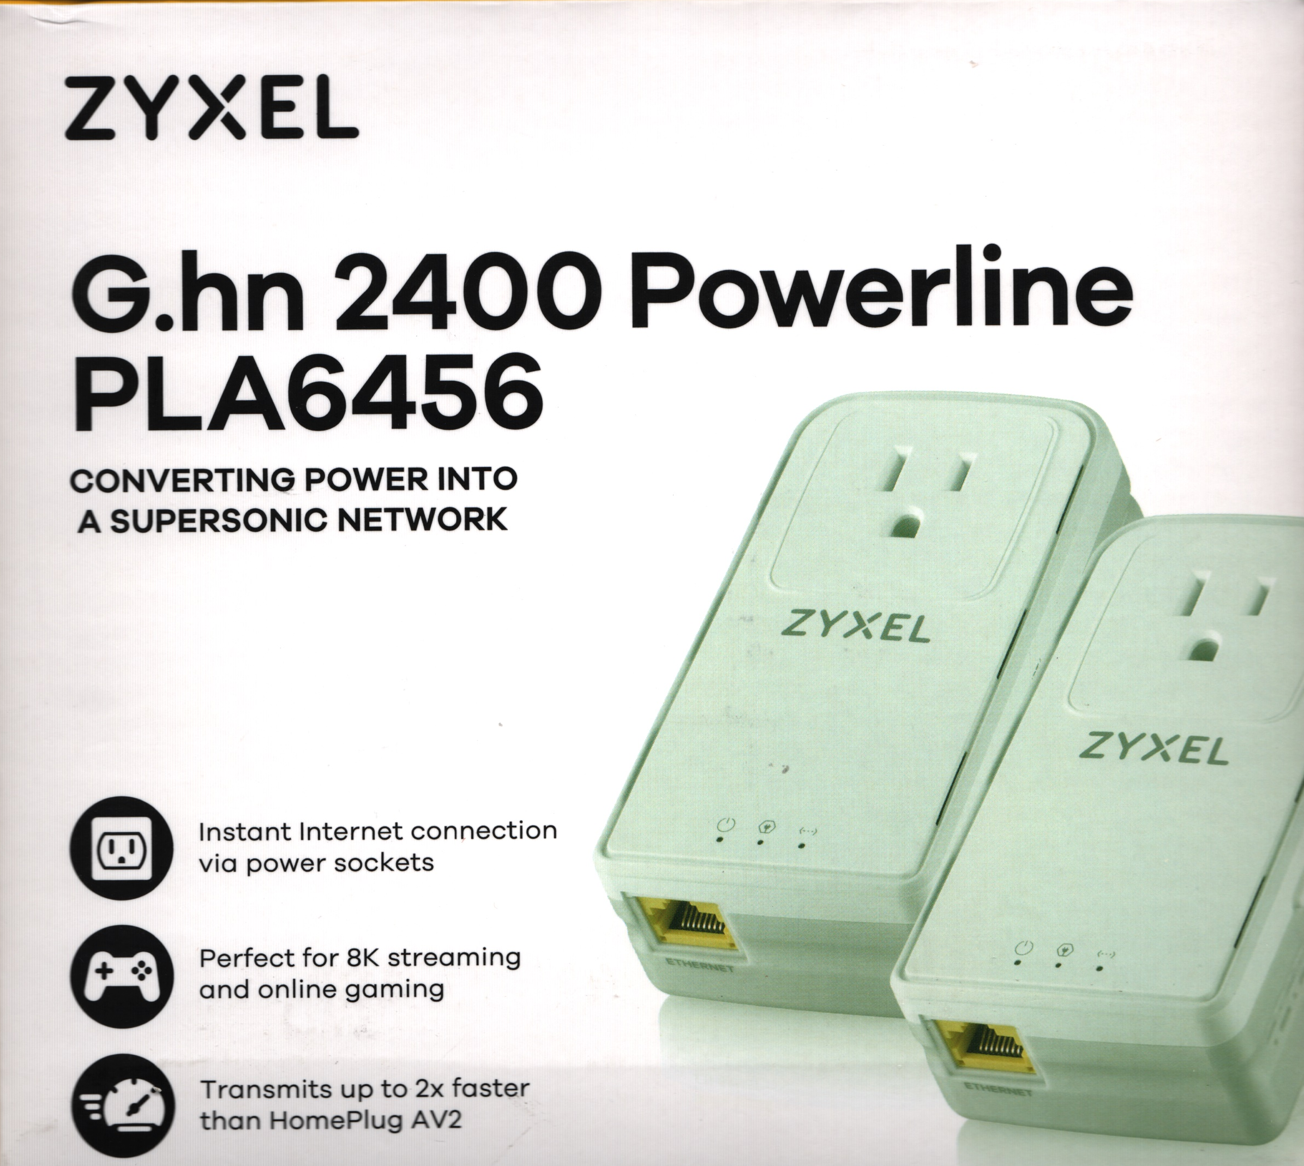

Slide 117
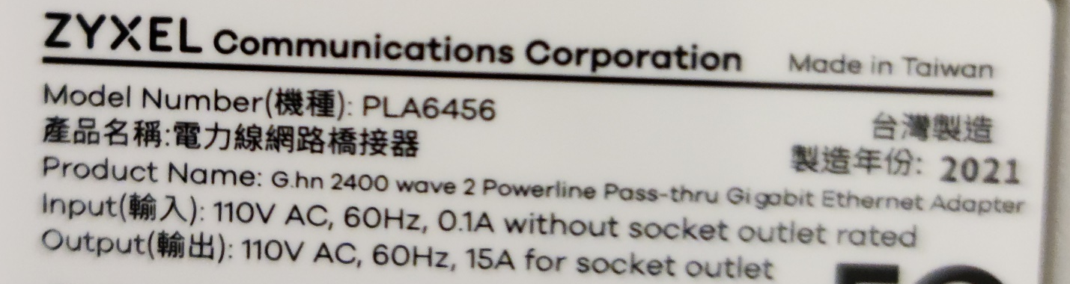

Slide 118
THE TWO BEST POWERLINE NETWORKING MODELS (continued)
https://www.amazon.com/NETGEAR-Powerline-Adapter-Ethernet-Passthrough/dp/B0778Y6K6N/ref=sr_1_3?crid=P3O8JPKRTM58&keywords=netgear+powerline&qid=1648772808&sprefix=netgear+powerline%2Caps%2C120&sr=8-3

Slide 119
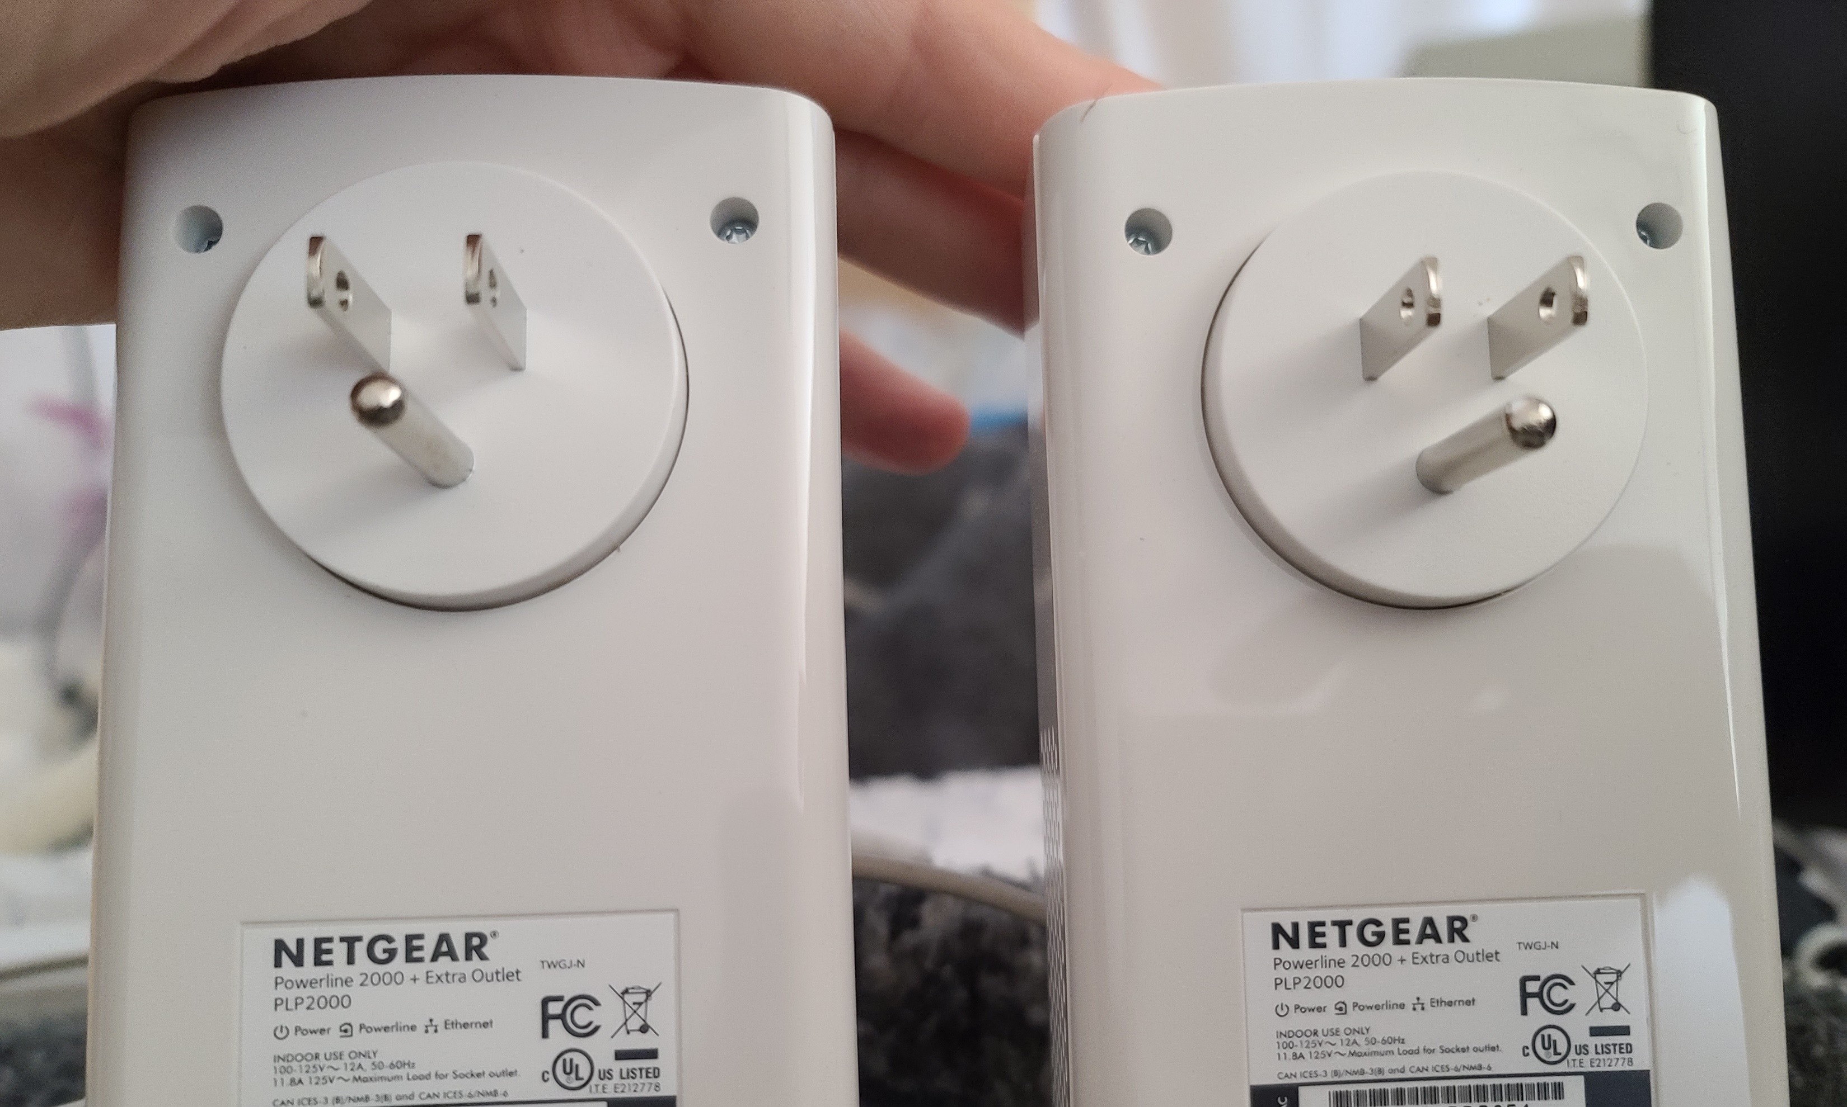

Slide 120
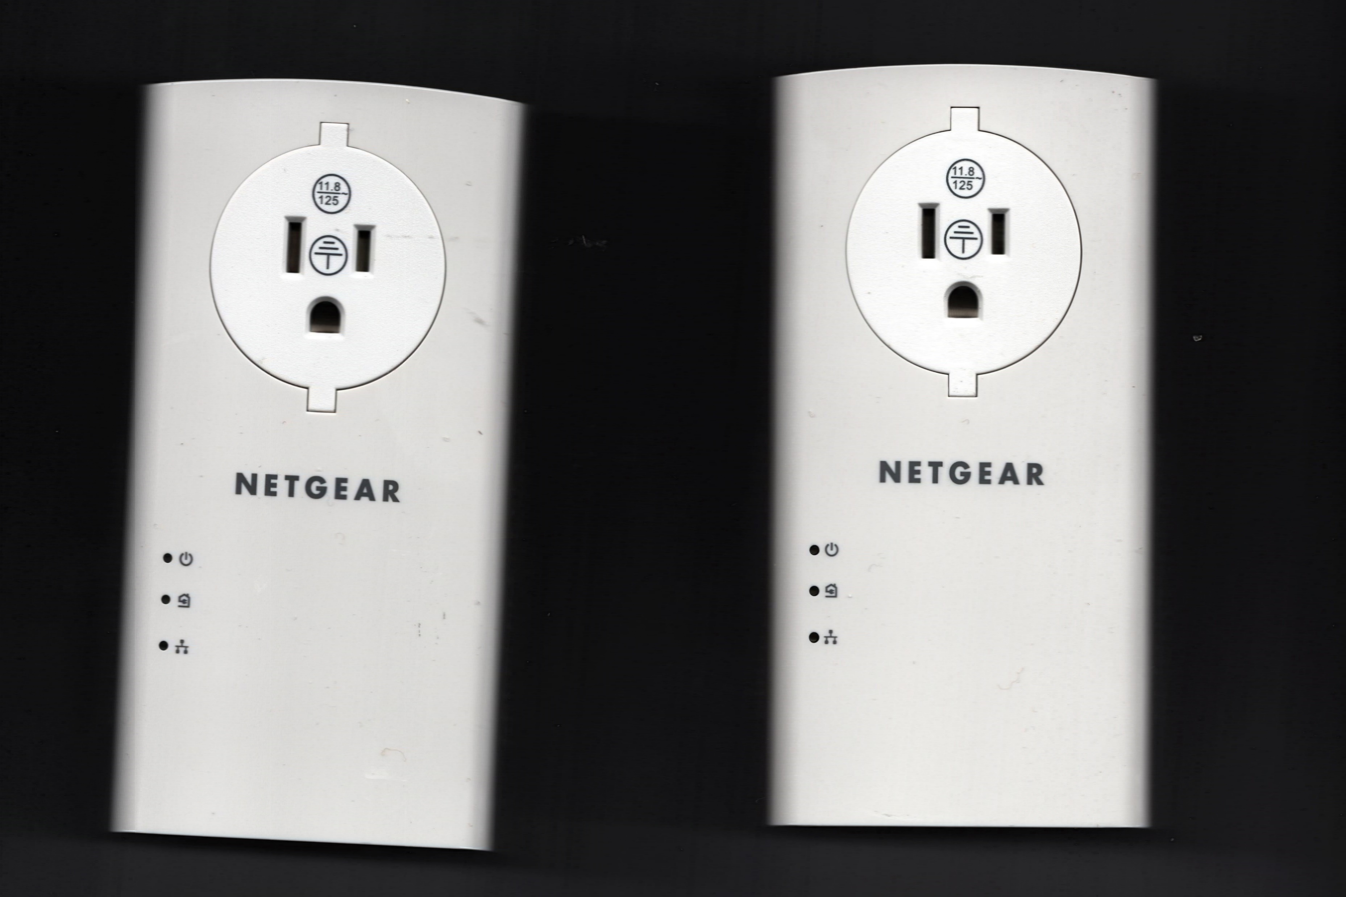

Slide 122
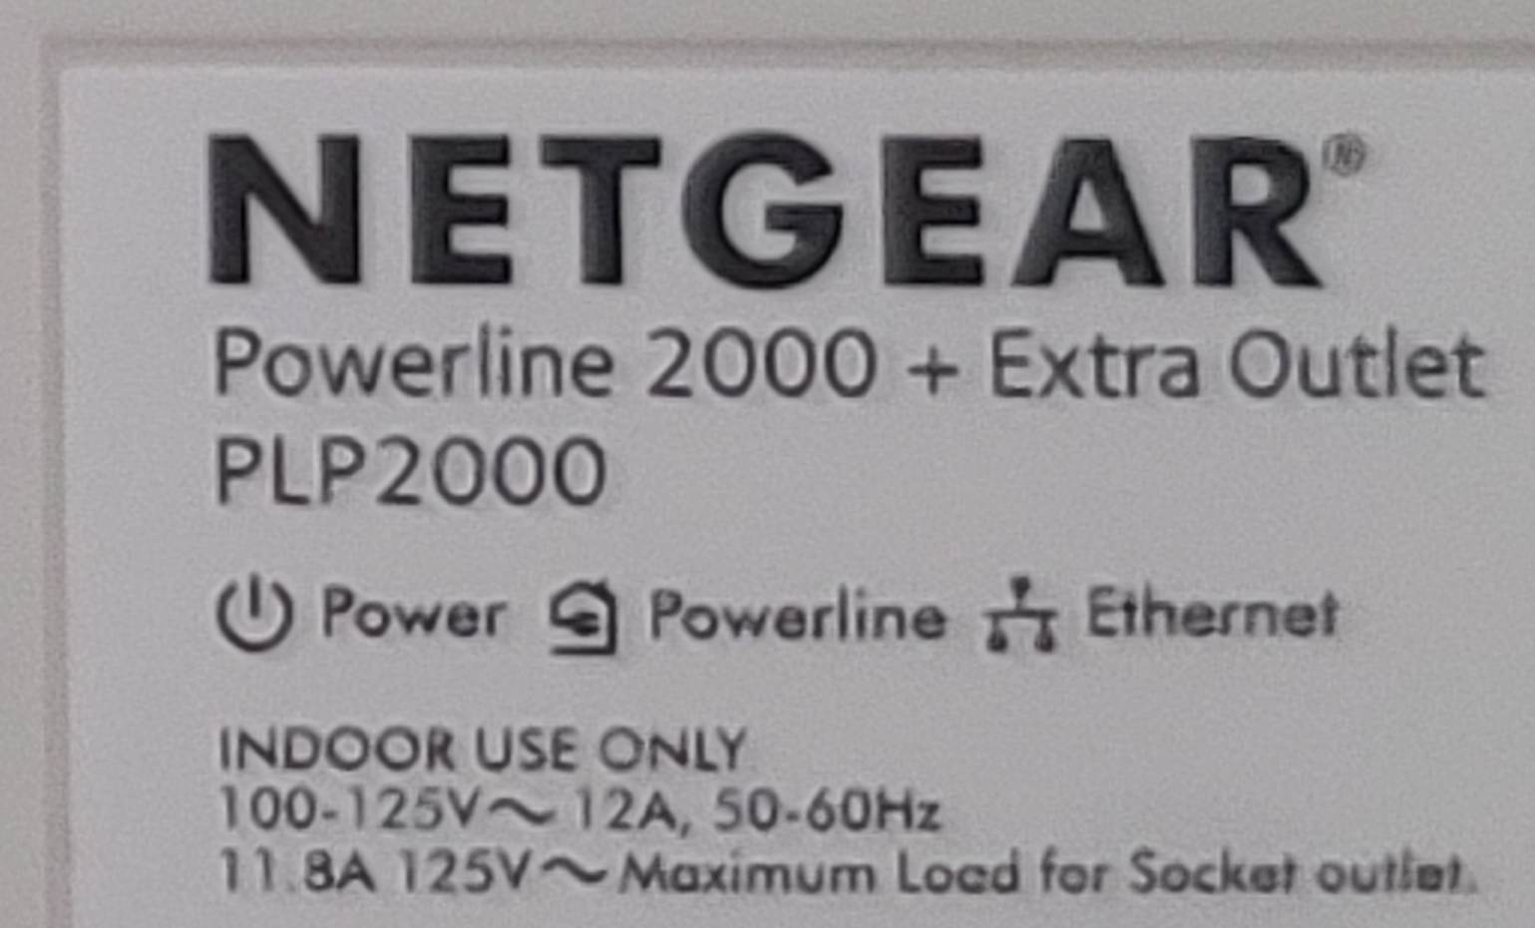

Slide 123
"POWERLINE NETWORKING" KITS WITH AN INTEGRATED "Wi-Fi EXTENDER"..
Some "Powerline Networking" kits have an integral "Wi-Fi Extender" at one end. None of the models of these kits passed our "across the house" test. For example, the "Comtrend PG-9182AC-KIT" that we tested overheated whenever we ran the "across the house" test on it.

Slide 124
SURGE-SUPPRESSION POWER CORDS SLOW DOWN POWERLINE NETWORKING
Most power cords that have more than one outlet are surge-suppression power cords
All surge-suppression power cords slow down "Power Networking" devices, so avoid using them when installing "Power Networking" devices

Slide 125
SURGE-SUPPRESSION POWER CORDS SLOW DOWN POWERLINE NETWORKING (continued)
In other words: when connecting the power plug part of a powerline networking device, do not use any power cord or "multi-tap" power splitter that has the word "surge" or "current limiting" on it's packaging or on the device or on the documentation that is bundled with the power cord or "multi-tap" power splitter

Slide 126
SURGE-SUPPRESSION POWER CORDS SLOW DOWN POWERLINE NETWORKING (continued)
A example of a power cord that does not have "surge suppression" is located at https://www.amazon.com/Woods-41436-Outlets-Overload-Safety/dp/B077VDKQLV/ref=sr_1_15?crid=2GB4GIOBM1U7M&keywords=power%2Bstrip%2Bwood&qid=1648777603&s=electronics&sprefix=power%2Bstrip%2Bwoods%2Celectronics%2C104&sr=1-15&th=1

Slide 127
IF A POWER NETWORKING DEVICE IS NOT IN USE, DISCONNECT IT FROM THE POWER OUTLET..
If you leave a "Power Networking" device that is not in use that is still powered up and connected to a power outlet, it will still slow down the other ones that are in use: All "HomePlug AV2" and all "G.hn Wave 2" devices that are powered up will slow down all other such devices.

Slide 128
USING NON-COMPLEMENTARY STANDARDS TO AVOID NEIGHBOR INTERFERENCE
Testing for powerline data interference from a neighbor: Power down all existing powerline devices. Plug in a single powerline device. If it's "powerline" LED blinks or lights up, then you probably have a neighbor with a who is using "powerline networking" of some sort.

Slide 129
USING NON-COMPLEMENTARY STANDARDS TO AVOID NEIGHBOR INTERFERENCE (continued)
If your neighbor uses "Powerline HomePlug AV2 2000" powerline devices, use "G.hn Wave 2" powerline devices to avoid interference with them

Slide 130
USING NON-COMPLEMENTARY STANDARDS TO AVOID NEIGHBOR INTERFERENCE (continued)
If your neighbor uses "G.hn" powerline devices, use "Powerline HomePlug AV2 2000" powerline devices to avoid interence with them

Slide 131
BEWARE OF EXAGGERATED AND MISLEADING MANUFACTURER'S STATEMENTS
Like all aspects of cutting-edge technology, there are lots of lies, half-truths, and exaggerations by manufacturers, sellers,"influencers", and self-proclaimed experts on the Internet, in print, and on "YouTube":

Slide 132
BEWARE OF EXAGGERATED AND MISLEADING MANUFACTURER'S STATEMENTS (continued)
FALSE!!: "Powerline networking now works great between outlets that are on L1 and L2 sides of a breaker panel". (Actually, powerline networking now works but not great: it works with a significant slow-down between outlets that are on L1 and L2 sides of a breaker panel.)

Slide 133
BEWARE OF EXAGGERATED AND MISLEADING MANUFACTURER'S STATEMENTS (continued)
PARTLY FALSE!!: "Outlets with Ground Fault Circuit Interrupters (GFCIs) block powerline networking signals" (continued)

Slide 134
BEWARE OF EXAGGERATED AND MISLEADING MANUFACTURER'S STATEMENTS (continued)
ACTUAL TRUTH: "Outlets with Ground Fault Circuit Interrupters (GFCIs) do not block the current models of HomePlug AV2 powerline networking devices if they are "rated" for 2000 or higer (continued)

Slide 135
BEWARE OF EXAGGERATED AND MISLEADING MANUFACTURER'S STATEMENTS (continued)
ACTUAL TRUTH (continued): "Outlets with Ground Fault Circuit Interrupters (GFCIs) block powerline networking signals for all models of G.hn powerline devices

Slide 136
BEWARE OF EXAGGERATED AND MISLEADING MANUFACTURER'S STATEMENTS (continued)
FALSE!!: "Powerline networking units attached to neighboring homes, apartments, or condos never interfere with each other."

Slide 137
BEWARE OF EXAGGERATED AND MISLEADING MANUFACTURER'S STATEMENTS (continued)
FALSE!!: "Using a manufacturer's scheme for grouping power line networking units does not slow them down."

Slide 138
BEWARE OF EXAGGERATED AND MISLEADING MANUFACTURER'S STATEMENTS (continued)
FALSE!!: "Connecting a powerline unit to an non-surge electrical extension cord will slow down the data transmission signals". This rumor got started because most power cords have surge suppression circuitry that does slow down "Powerline Networking" signals.

Slide 139
POWERLINE NETWORKING DEVICES THAT FAILED FOR US
Here are some of the models of "Powerline Networking" devices that failed our "across-the-house" test: Zyxel PLA5405 and PLA5456 (these earlier models by Zyxel ran on the Homeplug AV2 standard) Comtrend PG-9172, PG-9182PT,and PT-9182AC D-Link DHP-600AV and DHP-701AV TP-Link TL-PA9020P Trendnet TPL-304E2K

Slide 140
POWERLINE NETWORKING DEVICES THAT FAILED FOR US (continued)
Here are some of the models of "Powerline Networking" devices that failed our "across-the-house" test: Zyxel PLA5405 and PLA5456 (these earlier models by Zyxel ran on the Homeplug AV2 standard) Comtrend PG-9172, PG-9182PT,and PT-9182AC Extollo LANsocket 1500 D-Link DHP-600AV and DHP-701AV TP-Link TL-PA9020P Trendnet TPL-304E2K

Slide 141
POWERLINE NETWORKING DEVICES THAT FAILED FOR US (continued)
Here are some of the models of "Powerline Networking" devices that failed our "across-the-house" test: Zyxel PLA5405 and PLA5456 (these earlier models by Zyxel ran on the Homeplug AV2 standard) Comtrend PG-9172, PG-9182PT,and PT-9182AC Extollo LANsocket 1500 D-Link DHP-600AV and DHP-701AV TP-Link TL-PA9020P Trendnet TPL-304E2K

Slide 142
POWERLINE NETWORKING DEVICES THAT FAILED FOR US (continued)
Here are some of the models of "Powerline Networking" devices that failed our "across-the-house" test: Zyxel PLA5405 and PLA5456 (these earlier models by Zyxel ran on the Homeplug AV2 standard) Comtrend PG-9172, PG-9182PT,and PT-9182AC Extollo LANsocket 1500 D-Link DHP-600AV and DHP-701AV TP-Link TL-PA9020P Trendnet TPL-304E2K

Slide 143
POWERLINE NETWORKING DEVICES THAT FAILED FOR US (continued)
Here are some of the models of "Powerline Networking" devices that failed our "across-the-house" test: Zyxel PLA5405 and PLA5456 (these earlier models by Zyxel ran on the Homeplug AV2 standard) Comtrend PG-9172, PG-9182PT,and PT-9182AC D-Link DHP-600AV and DHP-701AV TP-Link TL-PA9020P Trendnet TPL-304E2K

Slide 144
POWERLINE NETWORKING DEVICES THAT WORKED FOR US BUT..
Extollo LANsocket 1500 (uses HomePlug AV2 standard; passed our "across the house" test; always "out of stock" in the U.S.)
Extollo LANsocket 2000 (uses G.hn standard; raving reviews all over the Internet but we were unable to obtain one; has been "out of stock" in the U.S. since 2021)

