Slide 1



A COMPARISON OF ETHERNET, POWERLINE NETWORKING, AND MoCA

Slide 2
Web location for this presentation:
http://aztcs.apcug.org
Click on “Meeting Notes”
2

Slide 3
SUMMARY
There are three ways for you to extend wired networks from one place to another: Cat 6/7/8 Ethernet wires, powerline network kits, and Multimedia over Coax Alliance ("MoCA") kits.
3

Slide 4
TOPICS
  Wired and Wired Equivalent Methods
  Speed Comparison of the three Technologies

Slide 5
THREE WIRED AND WIRED EQUIVALENT TECHNOLOGIES
  CAT 5/6/7/8 Ethernet cabling
  Powerline Networking
  Multimedia over Ethernet Alliance ("MoCA")

Slide 6
INTERNET PROVIDER'S GATEWAY BOX
_{ASUS MESH ROUTER #1}
CAT 6/7/8 CABLING,
POWERLINE NETWORKING KITS, AND MULTIMEDIA over COAX ALLIANCE KTS
_{USE "SPEEDTEST" TO MEASURE TH}E INTERNET SPEEDS

Slide 7
CAT 8 ETHERNET CABLING
  CAT 8 Ethernet cabling is the baseline that we will use to compare the two wired-equivalent technologies:

Slide 8
INTERNET PROVIDER'S GATEWAY BOX
_{ASUS MESH ROUTER #1}
75 ft. run of Cat 8 cabling

Slide 9
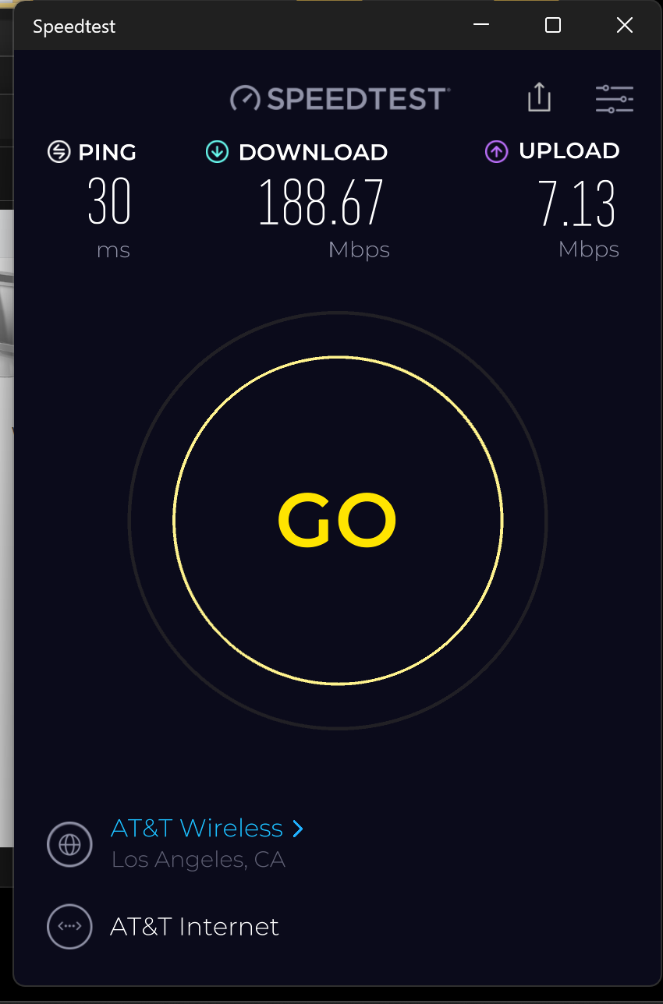

Slide 10
POWERLINE NETWORKING KIT
  ..from South wall to Northwest corner:

Slide 11

INTERNET PROVIDER'S GATEWAY BOX
_{ASUS MESH ROUTER #1}

Slide 12
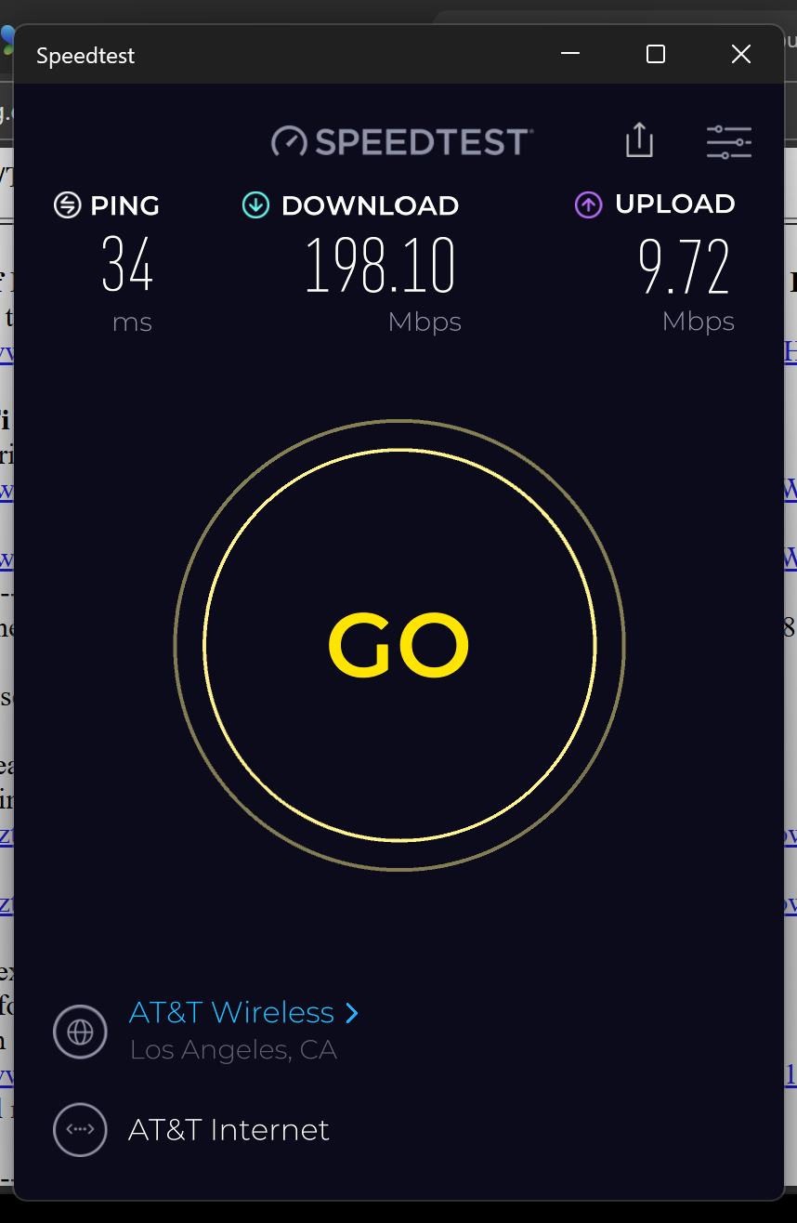

Slide 13
POWERLINE NETWORKING KIT (continued)
  ..from South wall to center of the North wall:

Slide 14
INTERNET PROVIDER'S GATEWAY BOX
_{ASUS MESH ROUTER #1}

Slide 15
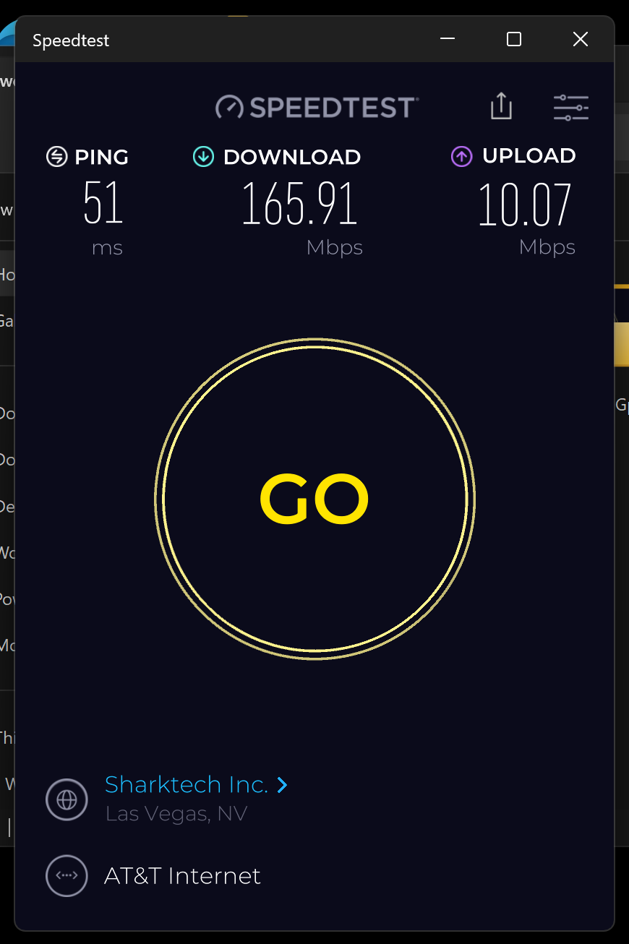

Slide 16
POWERLINE NETWORKING KIT
  ..from South wall to center of the Northwest corner:

Slide 17
INTERNET PROVIDER'S GATEWAY BOX
_{ASUS MESH ROUTER #1}

Slide 18
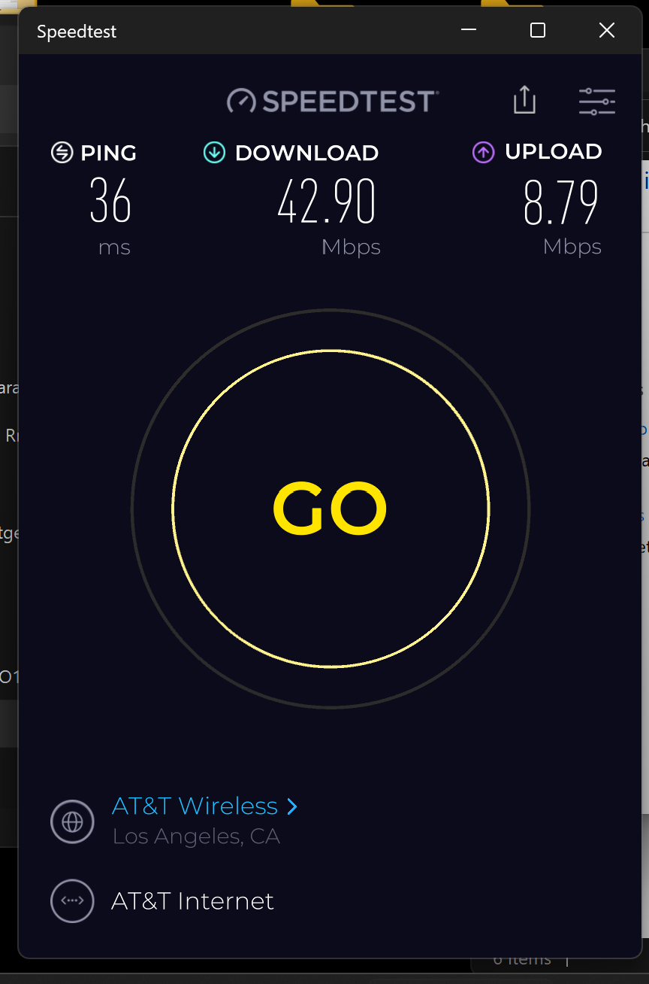

Slide 19
MULTIMEDIA over COAX ALLIANCE ("MoCA" ) KIT
  At a local speed of 2.5 Gigabits per second, this

Slide 20
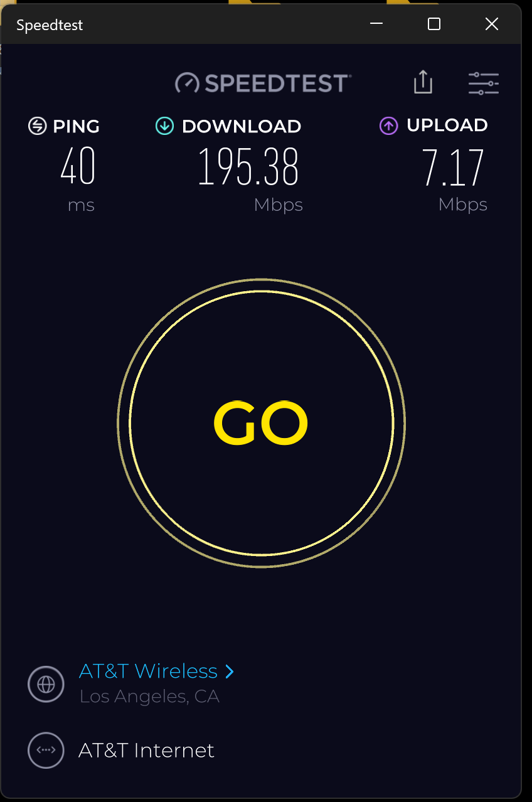

Slide 21
POWERLINE NETWORKING KIT
  This Powerline Networking kit is faster than any other that we have ever tested:

Slide 22
POWERLINE NETWORKING KIT (continued)
  https://www.amazon.com/dp/B07TBJML4R

Slide 23
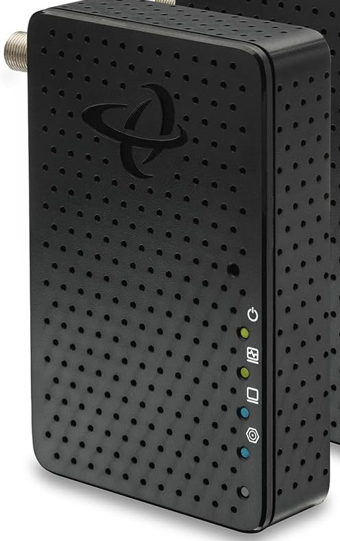
INTERNET PROVIDER'S GATEWAY BOX
_{ASUS MESH ROUTER #1}

Slide 24
MULTIMEDIA over COAX ALLIANCE (MoCA0 KIT
  This "G.hn Wave 2" MoCA kit is the fastest one that we have ever tested:

Slide 25
MULTIMEDIA over COAX ALLIANCE ("MoCA" ) KIT (continued)
  https://www.amazon.com/dp/B0C47MJT83

