Slide 1



4: Wi-Fi ADAPTERS

Slide 2
Web location for this presentation:
http://aztcs.apcug.org
Click on
“Meeting Notes”

Slide 3
SUMMARY
You can probably add a Wi-Fi 6E adapter or a Wi-Fi 7 adapter to your existing Windows 10 or 11, MacOS, or Linux computer to speed up it's wireless connection to a Wi-Fi router.

Slide 4
TOPICS
Netgear USB Wi-Fi Adapter
Fenvi PCIe Wi-Fi Adapter
BrosTrend USB Wi-Fi Adapter

Slide 5
NETGEAR USB Wi-Fi 7 ADAPTER
Netgear's "Nighthawk" USB adapter works for any Windows 11 computer. It will not work in any Windows 10 or earlier computer and it will not work with any macOS computer: https://www.amazon.com/NETGEAR-Nighthawk-WiFi-Adapter-A9000/dp/B0F9HTJXXC/

Slide 6
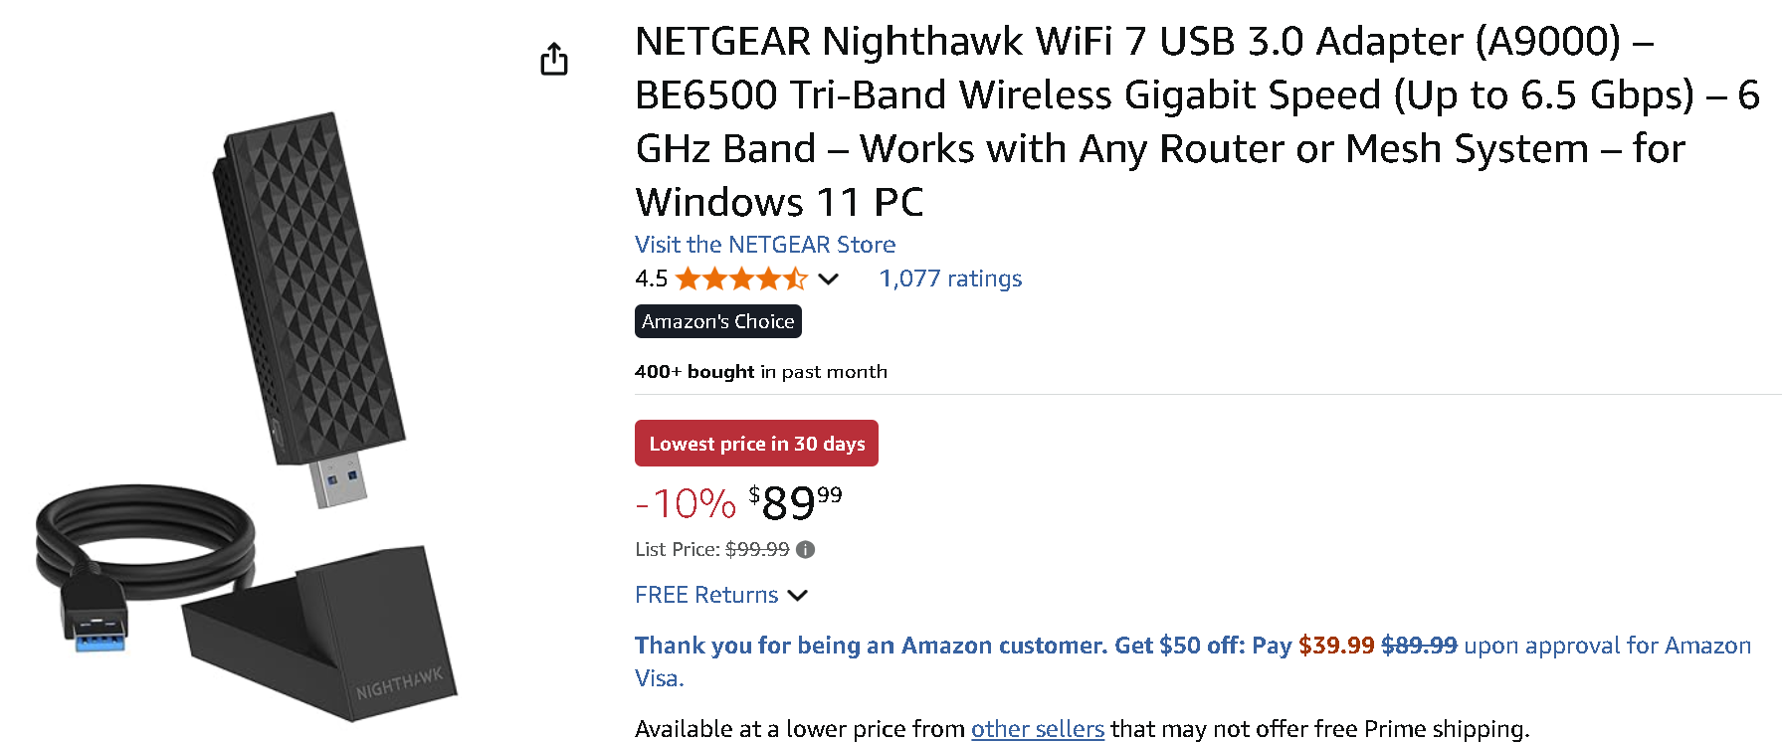

Slide 7
FENVI PCiE Wi-Fi 7 ADAPTER
FENVI's PCIe Wi-Fi adapter works well for Windows 11 or 10 computers that have Intel processors: https://www.amazon.com/Tri-Band-802-11be-8774Mbps-Network-Motherboards/dp/B073GW9SW9/

Slide 8
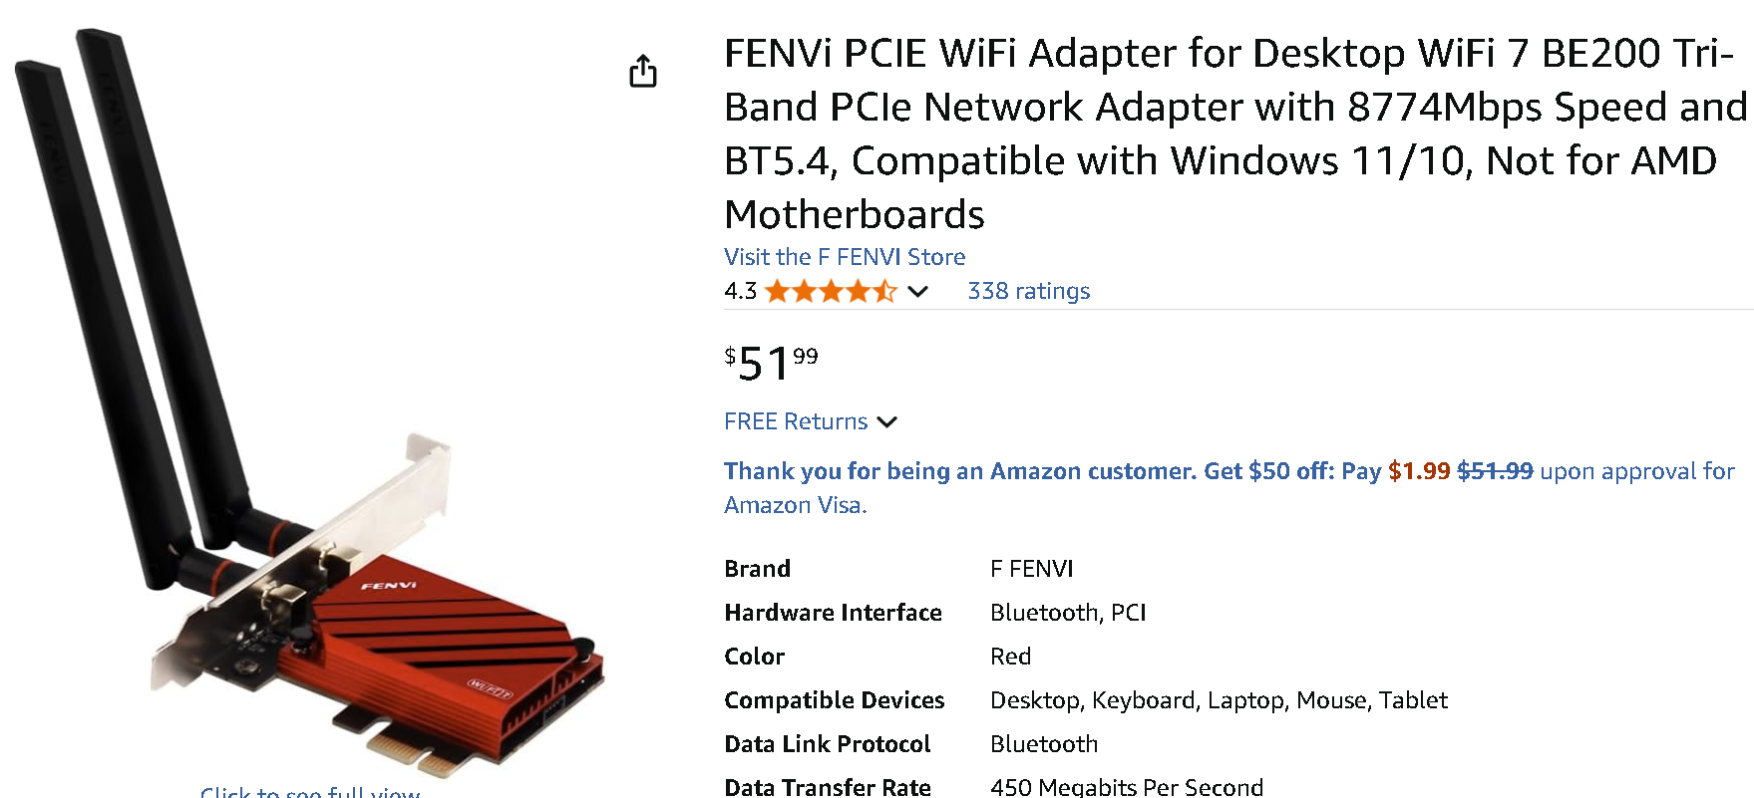

Slide 9
BROSTREND USB "Wi-Fi 6" ADAPTER FOR LINUX
As of October 2025, no Wi-Fi 7 adapters are available for Linux computers.
The following BrosTrend USB Wi-Fi adapter works for Linux or Windows 11 or 10 computers: https://www.amazon.com/BrosTrend-USB-WiFi-Linux-Adapter/dp/B0BTHQNK5S/

Slide 10
