Slide 1



3: Wi-Fi BACKHAUL

Slide 2
Web location for this presentation:
http://aztcs.apcug.org
Click on “Meeting Notes”
2

Slide 3
SUMMARY
There are three ways for you to connect Wi-Fi extender and mesh devices to expand the coverage of a wireless Wi-Fi network, without having to resort to wireless Wi-Fi backhaul connection.
3

Slide 4
TOPICS
Wired and Wired Equivalent Methods
Speed Comparison of the three Technologies

Slide 5
OPTIONS FOR THE BACKHAUL CONNECTION
Option 1: a CAT 6 cable or a CAT 7 cable or a CAT 8 cable
Option 2: a "Powerline Networking" kit
Option 3: a "Multimedia over Coax Alliance" (MoCA) kit

Slide 6
INTERNET PROVIDER'S GATEWAY BOX
_{ASUS MESH ROUTER #1}
CAT 6/7/8 CABLING, OR
"POWERLINE NETWORKING" KITS, OR "MULTIMEDIA over COAX ALLIANCE" KITS
_{USE "SPEEDTEST" TO MEASURE TH}E INTERNET SPEEDS

Slide 7
CAT 8 ETHERNET CABLING
CAT 8 Ethernet cabling is the baseline that we will use to compare the two wired-equivalent technologies:

Slide 8
INTERNET PROVIDER'S GATEWAY BOX
_{ASUS MESH ROUTER #1}
75 ft. run of Cat 8 cabling

Slide 9
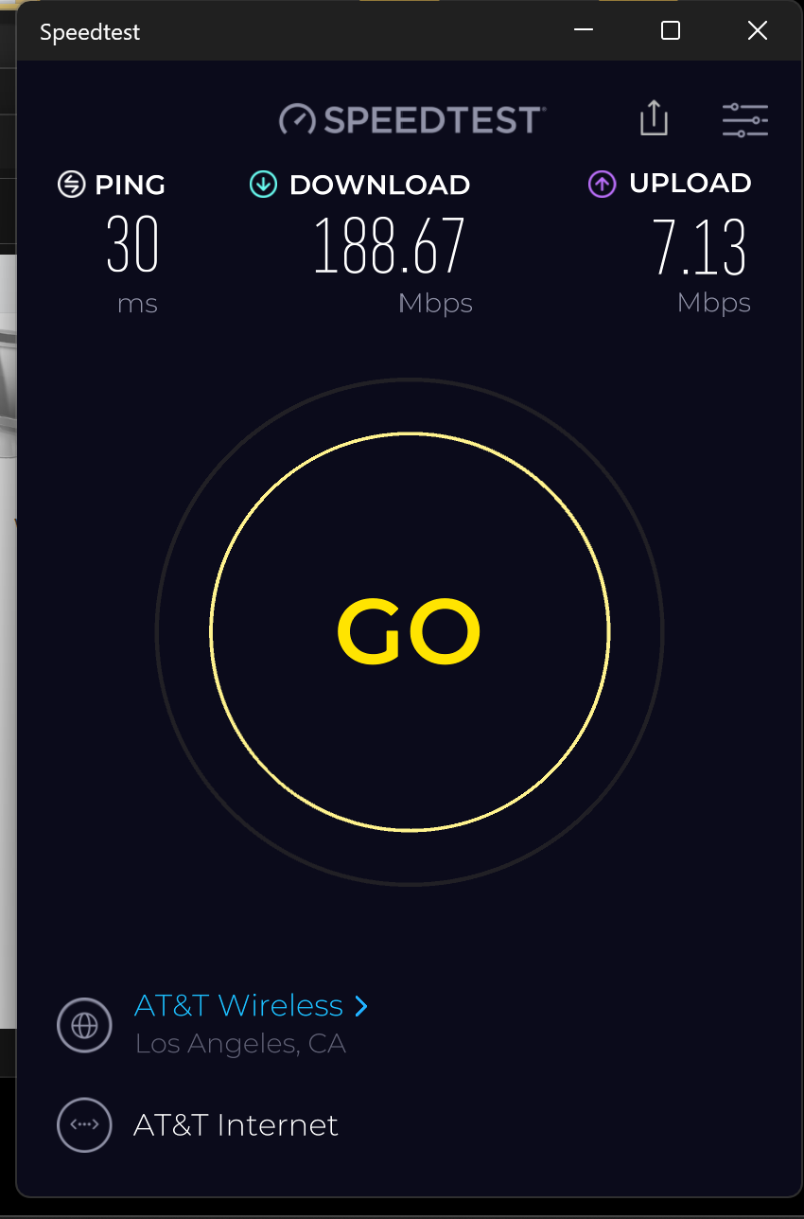

Slide 10
"POWERLINE NETWORKING" KIT
For most of us, a powerline networking kit is much easier and cheaper to install relative to a CAT 6 cable or a CAT 7 cable or a CAT 8 cable or an RG6 coax cable:

Slide 11
"POWERLINE NETWORKING" KIT (continued)
This Powerline Networking kit is faster and less expensive than any other that we have ever tested: https://www.amazon.com/dp/B07TBJML4R

Slide 12
POWERLINE NETWORKING KIT (continued)
..from North wall to Southeast corner:

Slide 13
POWERLINE NETWORKING KIT (continued)
..from North wall to the Southeast corner, the Powerline Networking kit was as fast as Cat 8 cabling so you usually can find a combination of electrical outlets that can allow a Powerline Networking kit to operate as fast as Cat 8 cabling!!

Slide 14
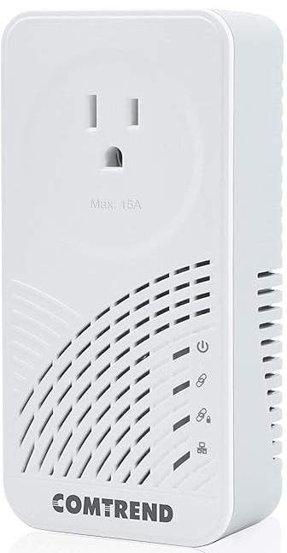
INTERNET PROVIDER'S GATEWAY BOX
_{ASUS MESH ROUTER #1}

Slide 15
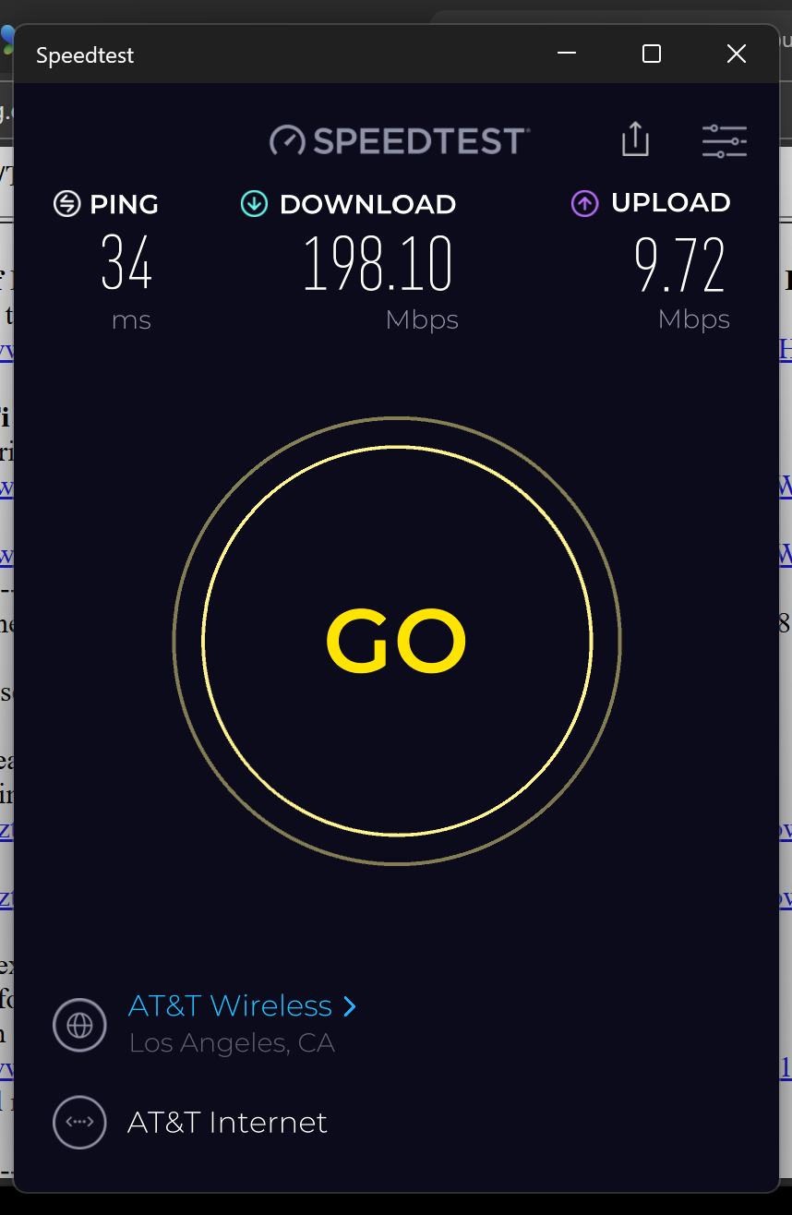

Slide 16
POWERLINE NETWORKING KIT (continued)
..from North wall to center of the South wall:

Slide 17
INTERNET PROVIDER'S GATEWAY BOX
_{ASUS MESH ROUTER #1}

Slide 18
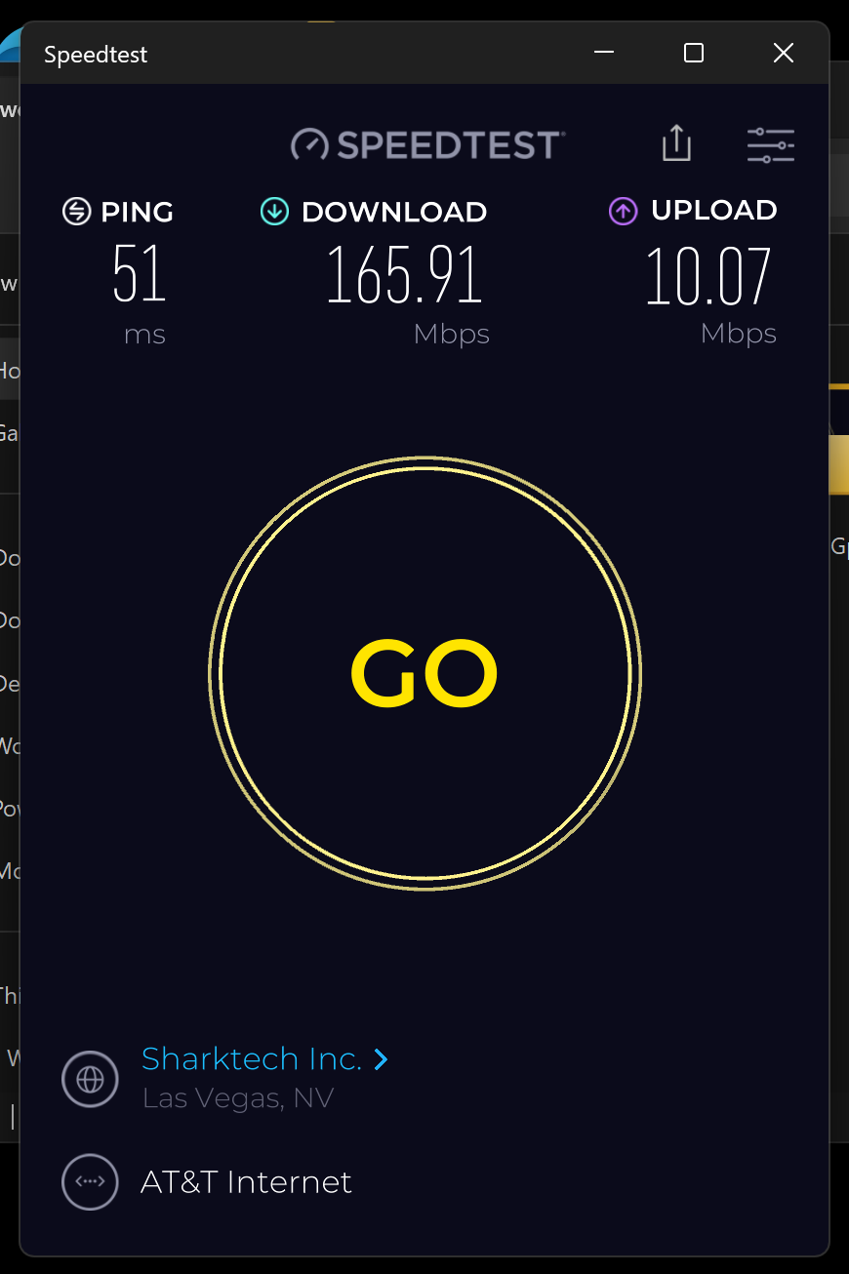

Slide 19
INTERNET PROVIDER'S GATEWAY BOX
_{ASUS MESH ROUTER #1}

Slide 20
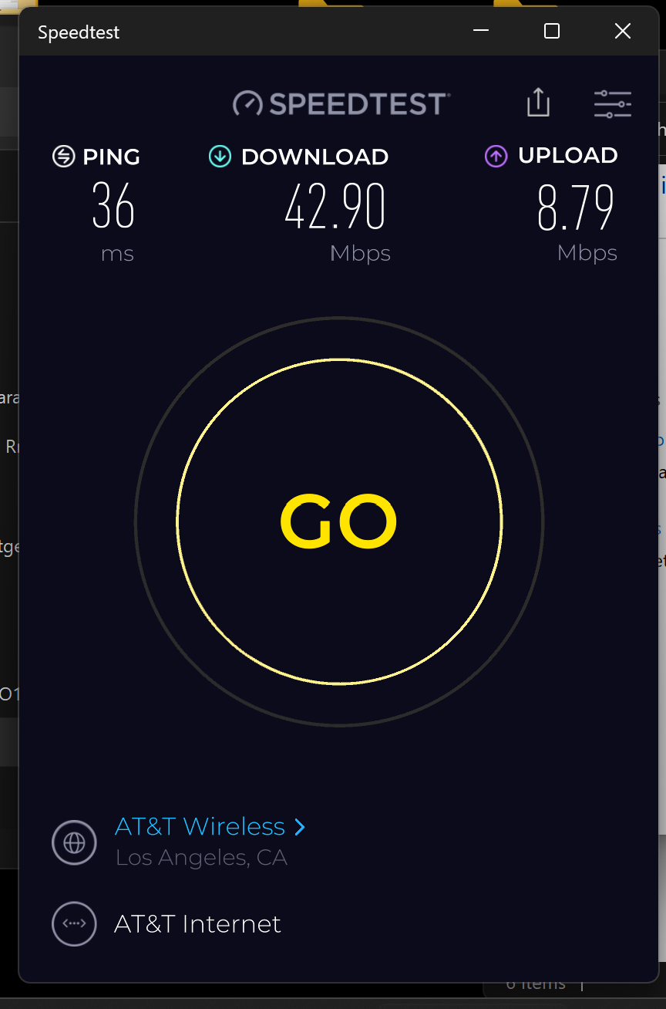

Slide 21
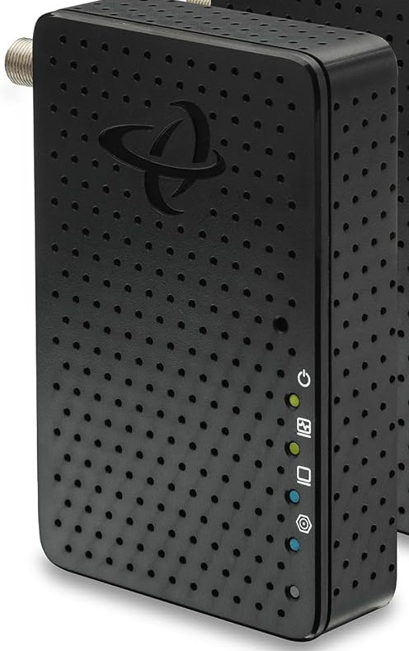
INTERNET PROVIDER'S GATEWAY BOX
_{ASUS MESH ROUTER #1}

Slide 22
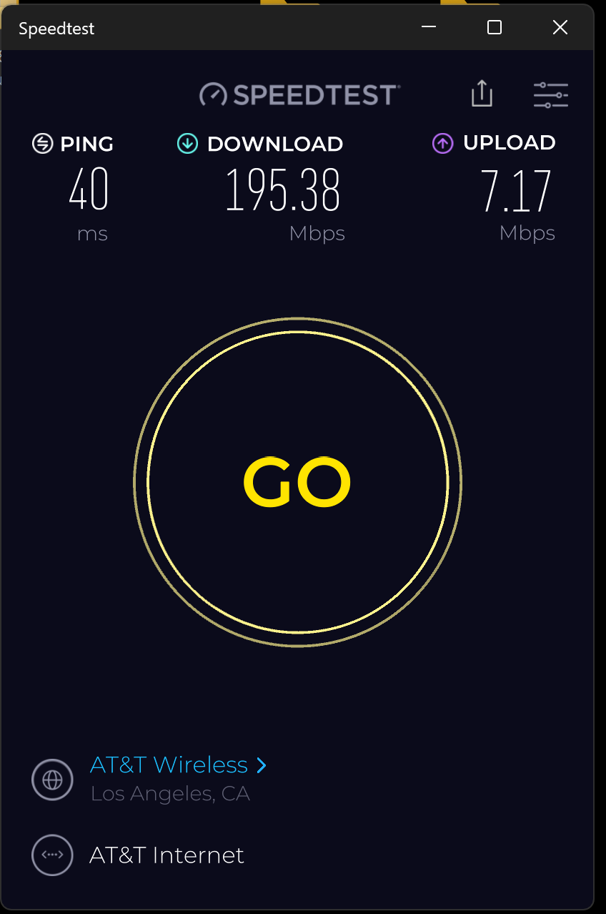

Slide 23
MULTIMEDIA over COAX ALLIANCE (MoCA) KIT
This "G.hn Wave 2" MoCA kit is the fastest one that we have ever tested. It has a nominal local area network speed of 2.5 Gigabits per second in both directions:

Slide 25
MULTIMEDIA over COAX ALLIANCE ("MoCA" ) KIT (continued)
https://www.amazon.com/dp/B0C47MJT83
Unfortunately, I had to run 75-ohm RG6 coaxial coast from the South side of the house to the North side

Slide 26
INSTALL CAT 6 OR 7 CABLING FOR THE LOWEST COST OF ETHERNET CABLING (continued)
https://aztcs.apcug.org/meeting_notes/winhardsig/networks/Ethernet/Cat7-6-5-installation.pdf and
https://aztcs.apcug.org/meeting_notes/winhardsig/networks/Ethernet/Cat7-6-5-installation.pptx

Slide 27
INSTALL CAT 8 CABLING FOR THE FASTEST POSSIBLE ETHERNET CONNECTION
as explained at is explained at https://aztcs.apcug.org/meeting_notes/winhardsig/networks/Ethernet/Cat8-installation.pdf and https://aztcs.apcug.org/meeting_notes/winhardsig/networks/Ethernet/Cat8-installation.pptx

