Slide 1



2: Wi-Fi MESH

Slide 2
Web location for this presentation:
http://aztcs.apcug.org
Click on "Meeting Notes"
2

Slide 3
SUMMARY
To increase the range and signal strength of a Wi-Fi local network, router, you can use a "mesh" which consists of two or more routers working cooperatively together to provide a coordinated Wi-Fi system.
3

Slide 4
TOPICS
Mesh Advantages

Slide 5
MESH ADVANTAGES
A "mesh" is a named grouping of two or more connected Wi-Fi routers that work together to provide you with: a larger coverage area, self-healing recovery from router failures, and hand-offs when user equipment moves between the actual coverage of each individual router

Slide 6
INTERNET PROVIDER'S GATEWAY BOX
(ASUS) (MESH) ROUTER #1
STEEL STAIRWELL & METAL FURNITURE
COSTLIER NETGEAR EXTENDER
CHEAPER
Wi-Fi EXTENDER
ASUS MESH ROUTER #2
MY OFFICE AREA NOW HAS Wi-Fi COVERAGE

Slide 7

INTERNET PROVIDER'S GATEWAY BOX
ASUS MESH ROUTER #1 $220
(Can be part of a mesh)
STEEL STAIRWELL & METAL FURNITURE
ASUS MESH ROUTER #2
$220
(Part of a mesh)
COSTLIER NETGEAR EXTENDER
$100
CHEAPER
Wi-Fi EXTENDER
$60

Slide 8
INTERNET PROVIDER'S GATEWAY BOX
(ASUS) (MESH) ROUTER #1 $220
(Can be part of a mesh)
STEEL STAIRWELL & METAL FURNITURE
ASUS MESH ROUTER #2
$220
(Part of a mesh)
COSTLIER NETGEAR EXTENDER
$100
CHEAPER
Wi-Fi EXTENDER
$60

Slide 9
MESH ADVANTAGES (continued)
For the mesh option, I need to have a mesh-capable router at both the North end of the house and the South end of the house and both routers have to belong to the same "mesh" system which, in practice", means that both routers have to belong to the same mesh group of the same manufacturer:

Slide 10
INTERNET PROVIDER'S GATEWAY BOX
ASUS MESH ROUTER #1
STEEL STAIRWELL & METAL FURNITURE
COSTLIER NETGEAR EXTENDER
CHEAPER
Wi-Fi EXTENDER
ASUS MESH ROUTER #2
MY OFFICE AREA NOW HAS Wi-Fi COVERAGE

Slide 11
MESH ADVANTAGES (continued)
In our live example, the two "ASUS" routers are part of a mesh. However, the Netgear Wi-Fi extender is not part of the mesh, even if it broadcasts the same "mesh1" SSID as the two "ASUS" routers.

Slide 12
_{ASUS MESH ROUTER #1}
"mesh1" at 2.45 Ghz RF band
"mesh1" at 5 Ghz RF band
"mesh1" at 6 Ghz RF band
_{ASUS MESH ROUTER #2}
"mesh1" at 2.45 Ghz
_{"mesh1" at 5 Ghz}
_{"mesh1" at 6 Ghz}
COSTLIER _{NETGEAR EXTENDER}
"mesh1" at 2.45 Ghz
_{"mesh1" at 5 Ghz}

Slide 13
MESH ADVANTAGES (continued)
For the mesh option, I need to have a mesh-capable router at both the North end of the house and the South end of the house and both routers have to belong to the same "mesh" system which, in practice", means that both routers have to belong to the same mesh group of the same manufacturer:

Slide 14
MESH ADVANTAGES (continued)
Mesh routers have more powerful transmitter-receivers and most have extra transmitter-receivers dedicated to backhaul communications: In my home, the two ASUS mesh routers let me use wireless Wi-Fi backhaul links to "punch through" the metal stairwell where none of the extenders that I have tried are able to do so !

Slide 15
MESH ADVANTAGES (continued)
The following diagram shows the extra Wi-Fi transmitter-receivers that the two ASUS mesh routers use for backhaul communications and administration of the "AiMesh" mesh group. The "AiMesh" brand of mesh is proprietary to the ASUS company.

Slide 16
MESH ADVANTAGES (continued)
These extra transmitter-receivers are not seen by my user equipment but you can see them using Wi-Fi analysis software apps:

Slide 17
_{ASUS MESH ROUTER #1}
[hidden SSID] for AiMesh at 2.45 Ghz [hidden SSID] for AiMesh at 5 Ghz
[hidden SSID] for AiMesh at 6 Ghz
_{ASUS MESH ROUTER #2}
[hidden SSID] for AiMesh at 2.45 Ghz
[hidden SSID] _{for AiMesh at 5 Ghz}
[hidden SSID] for AiMesh _{at 6 Ghz}

Slide 18
_{ASUS MESH ROUTER #1}
[hidden SSID] for AiMesh at 2.45 Ghz [hidden SSID] for AiMesh at 5 Ghz
[hidden SSID] for AiMesh at 6 Ghz
_{ASUS MESH ROUTER #2}
[hidden SSID] for AiMesh at 2.45 Ghz
[hidden SSID] _{for AiMesh at 5 Ghz}
[hidden SSID] for AiMesh _{at 6 Ghz}

Slide 19
MESH ROUTERS HAVE ADVANTAGES OVER Wi-Fi EXTENDERS (continued)
This moderately-priced pair of Asus mesh routers is the best deal that we have been able to find. You will need two of them for an entry-level mesh configuration: https://www.amazon.com/dp/B0DHWCQ3FP (You have to have two of these to create a Wi-Fi mesh setup.)

Slide 20
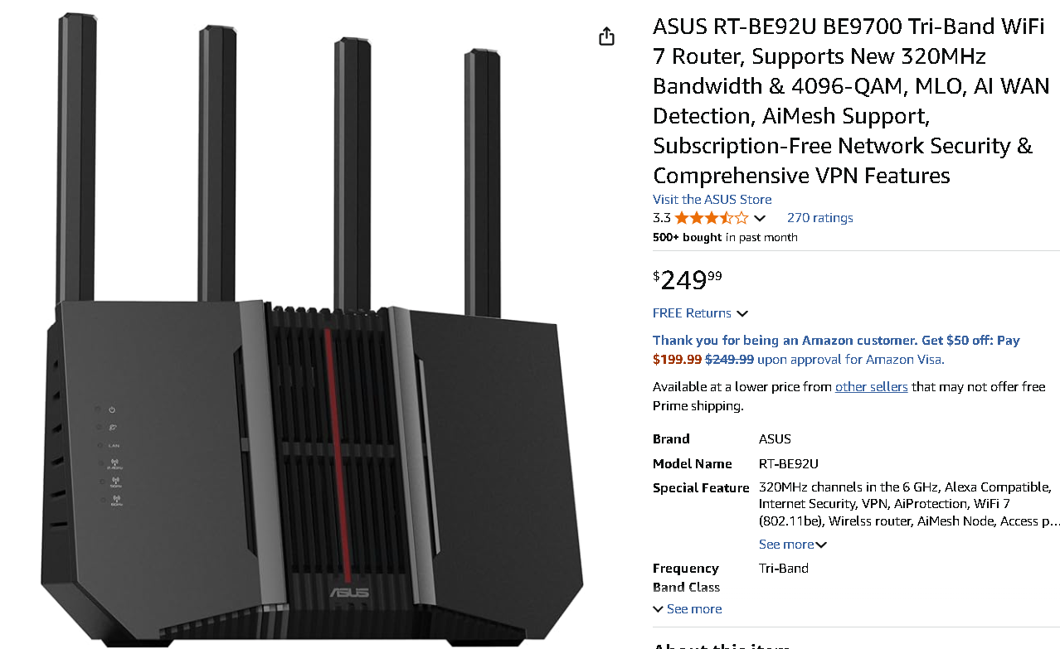

Slide 21
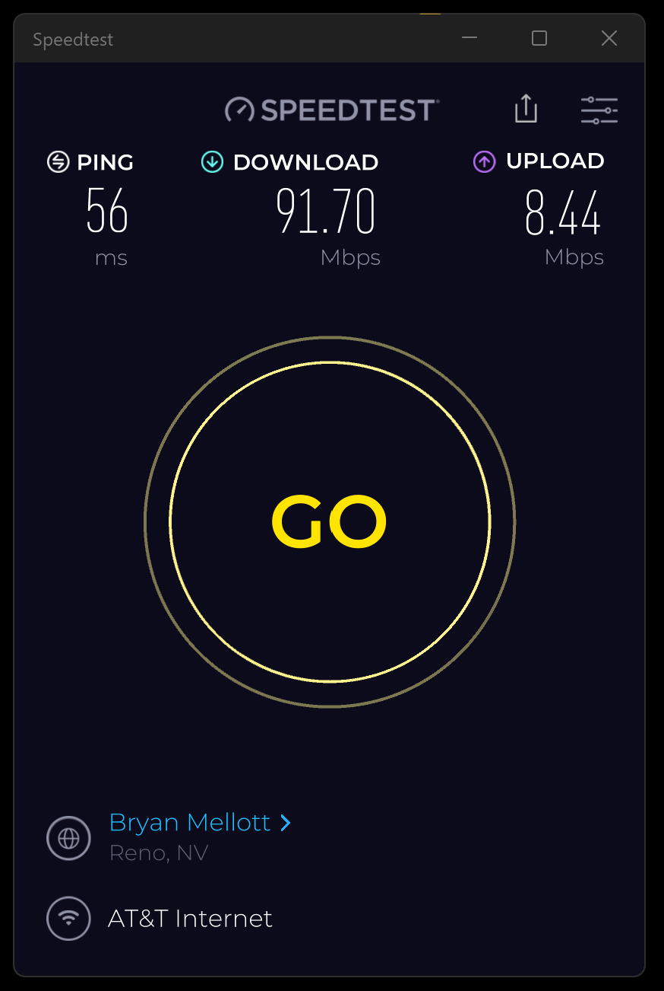

Slide 22
FOR GREATER AREA COVERAGE, YOU CAN USE THE NETGEAR'S VARIOUS MESH CONFIGURATIONS
https://www.amazon.com/stores/page/54AA6656-F644-4E52-B9CC-7F8ADDF0921B/?_encoding=UTF8&pd_rd_plhdr=t&pd_rd_i=B0D4JB6QJD

Slide 23
FOR GREATER AREA COVERAGE, YOU CAN USE THE NETGEAR'S VARIOUS MESH CONFIGURATIONS (continued)
We do not recommend the lowest option that Netgear offers (the rightmost option) because it is unable to communicate at the most current Wi-Fi 7 (802.11be) level of Wi-Fi capability

Slide 24
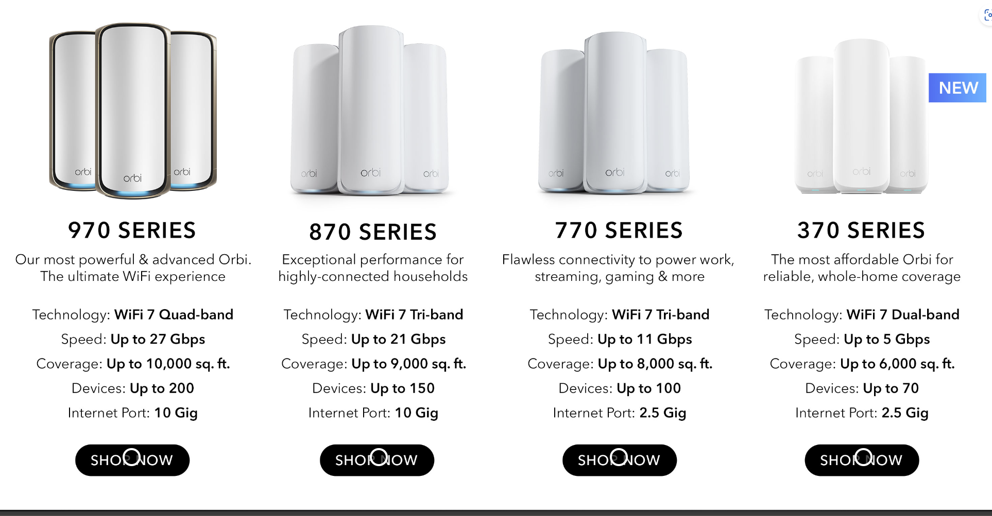

Slide 26
Wi-Fi MESH UNITS, AND Wi-Fi EXTENDERS (continued)
Wi-Fi mesh brands:
Amazon's "Eero 6"
Amazon's "TruMesh"
ASUS's "AiMesh"
ASUS's "ZenWiFi"
Google's "Nest Wifi"

Slide 27
Wi-Fi MESH UNITS, AND Wi-Fi EXTENDERS (continued)
Wi-Fi mesh brands (continued):
Linksys' "Atlas"
Linksys' "Velop"
Netgear's "Orbi"
(TP-Link's "Deco")
(TP-Link's "EasyMesh")

Slide 28
SECURITY CONCERNS FOR TP-LINK ROUTERS
https://nationalinterest.org/blog/techland/states-have-a-tp-link-problem
https://www.wired.com/story/tp-link-router-ban-investigation/

Slide 29
SECURITY CONCERNS FOR TP-LINK ROUTERS (continued)
https://www.digitaltrends.com/computing/tp-link-router-alternatives/
https://www.slashgear.com/1855885/tp-link-router-ban-explained-is-it-safe-to-buy/

Slide 30
SECURITY CONCERNS FOR TP-LINK ROUTERS (continued)
https://www.msn.com/en-us/news/technology/where-are-tp-link-routers-made-and-why-does-the-us-government-want-to-ban-them/ar-AA1HcCBY
https://www.micklerandassociates.com/blog/should-i-remove-tp-link-devices

