Slide 1




2: Wi-Fi Extenders

Slide 2
Web location for this presentation:
http://aztcs.apcug.org
Click on
“Meeting Notes”

Slide 3
EXECUTIVE SUMMARY
You can add a Wi-Fi extender to increase the speed and/or coverage area for computers, tablets, cell phones, televisions, or cameras that connect to the existing Wi-Fi routers in your home or business.

Slide 4
TOPICS
Examples of Wi-Fi Extenders and Wi-f Mesh
Two Modes of Operation for Wi-Fi Extenders
Features of Wi-Fi Extenders
Wi-Fi Extenders That We Recommend

Slide 5
INTERNET PROVIDER'S GATEWAY BOX
ASUS MESH ROUTER #1
STEEL STAIRWELL & METAL FURNITURE
MY OFFICE AREA LACKS Wi-Fi COVERAGE

Slide 6
INTERNET PROVIDER'S GATEWAY BOX
ASUS MESH ROUTER #1
STEEL STAIRWELL & METAL FURNITURE
COSTLY NETGEAR EXTENDER
CHEAP
Wi-Fi EXTENDER
ASUS MESH ROUTER #2
MY OFFICE AREA NOW HAS Wi-Fi COVERAGE

Slide 7
BACKHAUL CONNECTIONS
The vertical black lines represent the backhaul connections between the router in the North side of the house and the South side of the house represent the backhaul connections.

Slide 8
INTERNET PROVIDER'S GATEWAY BOX
ASUS MESH ROUTER #1
STEEL STAIRWELL & METAL FURNITURE
COSTLY NETGEAR EXTENDER
CHEAP
Wi-Fi EXTENDER
ASUS MESH ROUTER #2
MY OFFICE AREA NOW HAS Wi-Fi COVERAGE

Slide 9
BACKHAUL CONNECTIONS
The vertical black lines represent the connections between the router in the North side of the house and extender devices in the South side of the house.
These connections are called backhaul connections.
Backhaul connections can be either wireless or wired.

Slide 10


INTERNET PROVIDER'S GATEWAY BOX
ASUS MESH ROUTER #1
STEEL STAIRWELL & METAL FURNITURE
COSTLY NETGEAR EXTENDER
CHEAP
Wi-Fi EXTENDER
ASUS MESH ROUTER #2
MY OFFICE AREA NOW HAS Wi-Fi COVERAGE

Slide 11
INTERNET PROVIDER'S GATEWAY BOX
ASUS MESH ROUTER #1
STEEL STAIRWELL & METAL FURNITURE
COSTLY NETGEAR EXTENDER
CHEAP
Wi-Fi EXTENDER
ASUS MESH ROUTER #2
MY OFFICE AREA NOW HAS Wi-Fi COVERAGE

Slide 12
INTERNET PROVIDER'S GATEWAY BOX
ASUS MESH ROUTER #1
STEEL STAIRWELL & METAL FURNITURE
COSTLY NETGEAR EXTENDER
CHEAP
Wi-Fi EXTENDER
ASUS MESH ROUTER #2
MY OFFICE AREA NOW HAS Wi-Fi COVERAGE

Slide 13
TWO MODES OF OPERATION FOR A Wi-Fi EXTENDER
Repeater mode
Access Point mode

Slide 14
TWO MODES OF OPERATION FOR A Wi-Fi EXTENDER (continued)
Repeater mode reduces Internet download and upload speeds down to 20 to 40 percent of the source signals that are being repeated
Access Point mode does not reduce Internet download and upload speeds by much but requires Ethernet or Ethernet equivalent to connect the Wi-Fi extender

Slide 16
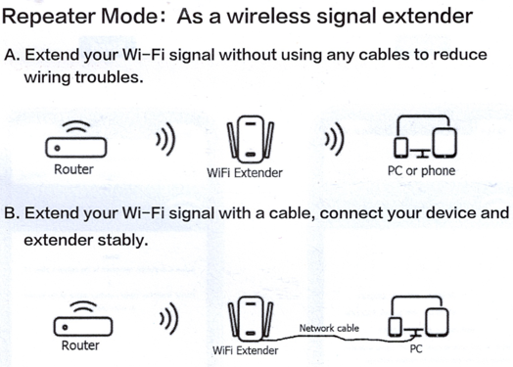

Slide 19
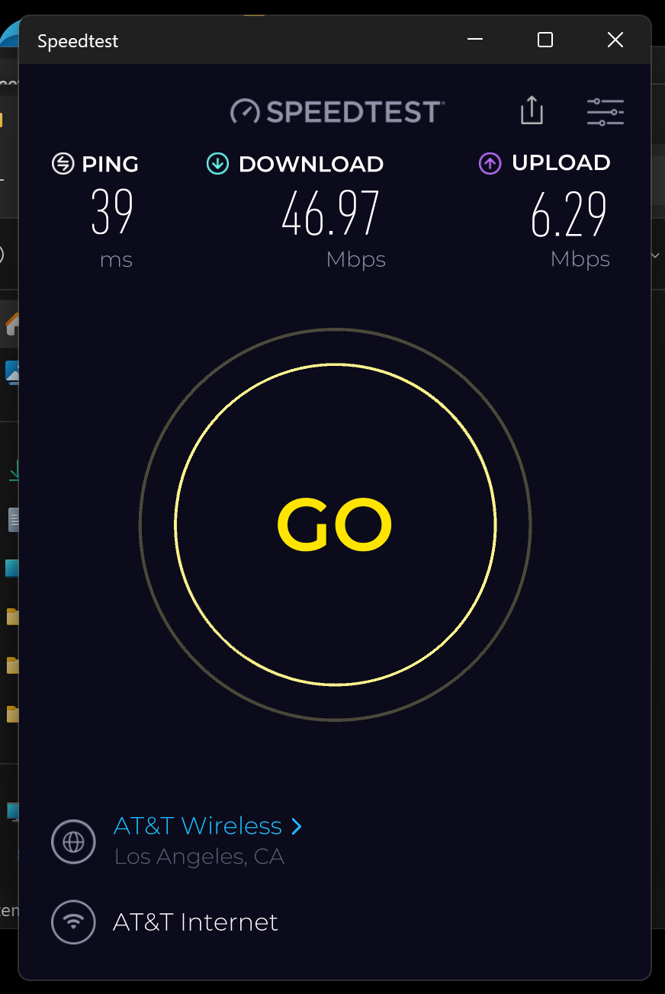

Slide 20
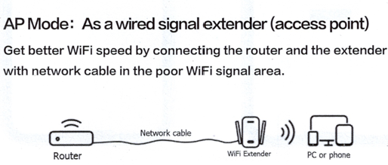

Slide 22
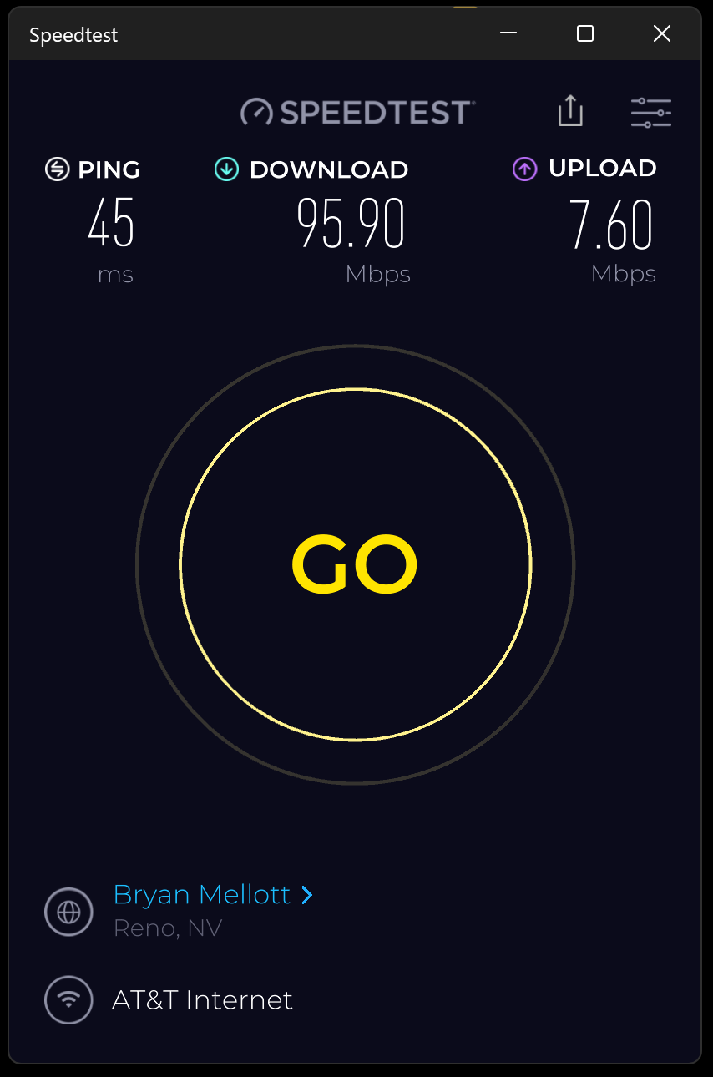

Slide 23
THE KEY TO GETTING REASONABLY FAST SPEEDS FOR THE BACKHAUL CONNECTION..
..is to use a wired or wired equivalent backhaul connection instead of wireless Wi-Fi backhaul connection.

Slide 24
OPTIONS FOR THE BACKHAUL CONNECTION
Option 1: A CAT 5E cable or a CAT 6 cable or a CAT 7 cable or a CAT 8 cable
Option 2: a Powerline Networking kit
Option 3: a Multimedia over Coax Alliance kit

Slide 25
POWERLINE NETWORKING KIT
For most of us, a powerline networking kit is much easier and cheaper to install relative to a CAT 6 or CAT 7 or CAT 8 cable: Installing a powerline networking kit will reduce Internet upload and download speeds that are provided by Wi-Fi extenders about 20 to 30 percent relative to using a CAT 6 or CAT 7 or CAT 8 cable

Slide 26
POWERLINE NETWORKING KIT (continued)
For the fastest possible "Powerline Networking" connection, install a "Powerline Networking" kit that conforms to the "Wave 2" version of the international "G.hn" standard:

Slide 27
POWERLINE NETWORKING KIT (continued)
https://www.amazon.com/Comtrend-2000Mbps-Powerline-Ethernet-PG-9182AC/dp/B07Z5R3N1M/

Slide 28
POWERLINE NETWORKING KIT (continued)
For step-by-step details, please see https://aztcs.apcug.org/meeting_notes/windhardsig/networks/powerline/powerline.pdf

Slide 29
POWERLINE NETWORKING KIT (continued)
For step-by-step details, please see https://aztcs.apcug.org/meeting_notes/windhardsig/networks/powerline/powerline.pdf

Slide 30
REQUIREMENTS FOR Wi-Fi EXTENDERS
Able to work in both "Repeater Mode" and "Access Point Mode"

Slide 31
REQUIREMENTS FOR Wi-Fi EXTENDERS (CONTINUED)
Dual channel extender for existing dual channel router
Tri-channel extender for existing tri-channel router
Quad-channel extender for existing tri-channel router

Slide 32
REQUIREMENTS FOR Wi-Fi EXTENDERS (continued)
Has at least one 2.5 Gigahertz Wi-Fi transmitter/receiver
Has at least one 5 Gigahertz Wi-Fi transmitter/receiver
Has at least one 6 Gigahertz Wi-Fi transmitter/receiver if the existing Wi-Fi router has one of more 6 Gigahertz Wi-Fi transmitter/receivers

Slide 33
REQUIREMENTS FOR Wi-Fi EXTENDERS (continued)
At least one "Fast Ethernet" 100-Gigabit" port if your Internet Provider is providing you with download speed is less than 100 Megabits per second and at least one Gigabit Ethernet or faster port if Internet Provider is greater tan 100 Megabits per second

Slide 34
REQUIREMENTS FOR Wi-Fi EXTENDERS (continued)
In "Repeater Mode", a 100 Megabits per second Ethernet port on a Wi-Fi extender will bottleneck the download and upload speeds of an Internet provider that is providing Internet speeds faster than 100 Megabits per second, if you are using the Ethernet port to connect to a downstream computer, tablet, or camera.

Slide 37
REQUIREMENTS FOR Wi-Fi EXTENDERS (continued)
In "Access Point Mode", a 100 Megabits per second Ethernet port on a Wi-Fi extender will bottleneck the download and upload speeds of an Internet provider that is providing Internet speeds faster than 100 Megabits per second, since the Ethernet port is used to connect the Wi-Fi extender to the existing router in "Access Point Mode".

Slide 39
REQUIREMENTS FOR Wi-Fi EXTENDERS (continued)
The Wi-Fi transmitter/receivers should be capable of operating at the highest Wi-Fi generation that the existing Wi-Fi router can operate on.

Slide 40
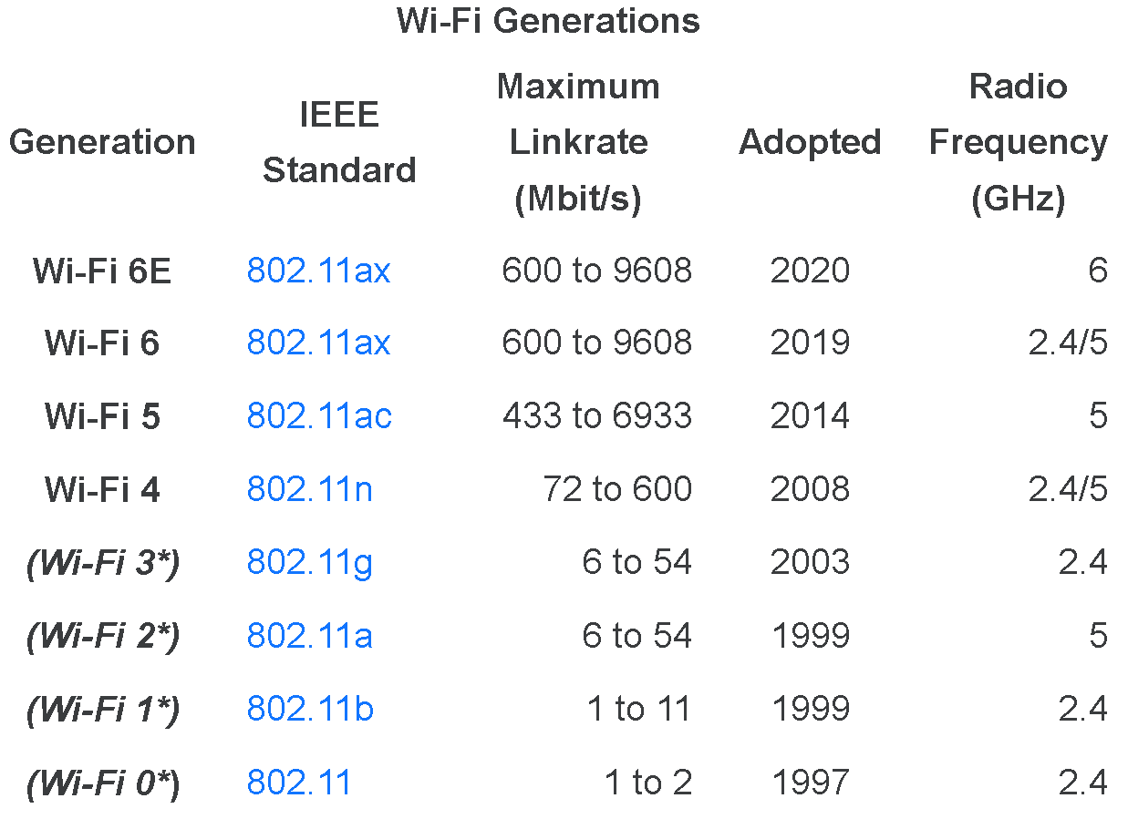
Wi-Fi 7 802.11be 721 to 46120 2024 2.4/5/6
2.4/5/6

Slide 41
INSTALL CAT 6 OR 7 CABLING FOR THE LOWEST COST FOR ETHERNET CABLING
as explained at https://aztcs.apcug.org/meeting_notes/winhardsig/networks/Ethernet/Ethernet.pdf and https://aztcs.apcug.org/meeting_notes/winhardsig/networks/Ethernet/Ethernet.pptx

Slide 42
INSTALL CAT 6 OR 7 CABLING FOR THE LOWEST COST OF ETHERNET CABLING (continued)
and https://aztcs.apcug.org/meeting_notes/winhardsig/networks/Ethernet/Cat7-6-5-installation.pdf and
https://aztcs.apcug.org/meeting_notes/winhardsig/networks/Ethernet/Cat7-6-5-installation.pptx

Slide 43
INSTALL CAT 8 CABLING FOR THE FASTEST POSSIBLE ETHERNET CONNECTION
as explained at is explained at
https://aztcs.apcug.org/meeting_notes/winhardsig/networks/Ethernet/Cat8-installation.pdf
and
https://aztcs.apcug.org/meeting_notes/winhardsig/networks/Ethernet/Cat8-installation.pptx

Slide 44
"MULTIMEDIA OVER COAX ALLIANCE" OPTION
"MoCA version 2.5" is an Ethernet equivalent technology that requires new or existing RG6 coaxial cable
https://www.amazon.com/Hitron-Adapter-Ethernet-Enhanced-Streaming/dp/B0C47MJT83/

Slide 45
Wi-Fi EXTENDERS THAT WE RECOMMEND
https://www.amazon.com/dp/B0DT1NYBMJ?ref_=ppx_hzsearch_conn_dt_b_fed_asin_title_6
This Wi-Fi extender is adequate if your Internet provider is providing your with upload and download speeds below 100 Megabits per second

Slide 46
Wi-Fi EXTENDERS THAT WE RECOMMEND (continued)
https://www.amazon.com/dp/B0D5YR7HKF?ref_=ppx_hzsearch_conn_dt_b_fed_asin_title_3
This Wi-Fi extender is adequate if your Internet provider is providing you with upload and download speeds below 100 Megabits per second

Slide 47
Wi-Fi EXTENDERS THAT WE RECOMMEND (continued)
https://www.amazon.com/dp/B0DMBXDY75?ref_=ppx_hzsearch_conn_dt_b_fed_asin_title_1&th=1
This Wi-Fi extender has a Gigabit Ethernet port so it is fast enough if your Internet provider is providing you with upload and/or download speeds greater than 100 Megabits per second.

Slide 48
MESH ROUTERS ARE USUALLY FASTER THAN Wi-Fi EXTENDERS
Mesh routers usually have extra access points/transmitter-receivers to speed up the backhaul communications between the subordinate mesh router(s) and the main mesh routers

Slide 49
MESH ROUTERS ARE USUALLY FASTER THAN Wi-Fi EXTENDERS
This moderately-priced pair of Asus mesh router is the best deal that we have been able to find. You will need two of them for an entry-level mesh: https://www.amazon.com/dp/B0DHWCQ3FP

Slide 50
