Slide 1




1: EXTENDING Wi-Fi

Slide 2
Web location for this presentation:
http://aztcs.apcug.org
Click on
“Meeting Notes”

Slide 3
SUMMARY
You can extend Wi-Fi to increase coverage area for computers, tablets, cell phones, televisions, or cameras that are connected to the existing Wi-Fi routers in your home or business.

Slide 4
TOPICS
Wi-Fi Extenders
Wi-fi Mesh
Wi-Fi Backhaul Options
Wi-Fi Adapters
Wi-Fi Troubleshooting

Slide 5
INTERNET PROVIDER'S GATEWAY BOX
(ASUS) (MESH) ROUTER #1
STEEL STAIRWELL & METAL FURNITURE
MY OFFICE AREA IN THE SOUTH SIDE OF THE HOUSE LACKS RELIABLE Wi-Fi COVERAGE

Slide 6
INTERNET PROVIDER'S GATEWAY BOX
(ASUS) (MESH) ROUTER #1
STEEL STAIRWELL & METAL FURNITURE
MY OFFICE AREA IN THE SOUTH SIDE OF THE HOUSE LACKS RELIABLE Wi-Fi COVERAGE

Slide 7
INTERNET PROVIDER'S GATEWAY BOX
(ASUS) (MESH) ROUTER #1
STEEL STAIRWELL & METAL FURNITURE
COSTLIER NETGEAR EXTENDER
CHEAPER
Wi-Fi EXTENDER
ASUS MESH ROUTER #2
OFFICE AREA NOW HAS RELIABLE Wi-Fi COVERAGE

Slide 8
INTERNET PROVIDER'S GATEWAY BOX
(ASUS) (MESH) ROUTER #1
STEEL STAIRWELL & METAL FURNITURE
COSTLIER NETGEAR EXTENDER
CHEAPER
Wi-Fi EXTENDER
ASUS MESH ROUTER #2
MY OFFICE AREA NOW HAS Wi-Fi COVERAGE

Slide 9
OPTIONS FOR EXTENDING Wi-Fi
The vertical black lines represent the connections between the router in the North side of the house and the South side of the house.
These connections are called backhaul connections.
Backhaul connections can be either wireless or wired.

Slide 10
OPTIONS FOR EXTENDING Wi-Fi (continued)
For your home or business, you only need to have one of these three options for extending the coverage of a wireless Wi-Fi network:

Slide 11
OPTIONS FOR EXTENDING Wi-Fi (continued)
With each increased-cost option, you get better penetration through walls and obstructions and greater Internet & local network speeds:

Slide 12
INTERNET PROVIDER'S GATEWAY BOX
ASUS MESH ROUTER #1 $220
(Can be part of a mesh)
STEEL STAIRWELL & METAL FURNITURE
ASUS MESH ROUTER #2
$220
(Part of a mesh)
COSTLIER NETGEAR EXTENDER
$100
CHEAPER
Wi-Fi EXTENDER
$34

Slide 13
OPTIONS FOR EXTENDING Wi-Fi (continued)
The vertical black lines represent the connections between the router in the North side of the house and the equipment on the South side of the house.

Slide 14
OPTIONS FOR EXTENDING Wi-Fi (continued)
These connections are called backhaul connections.
Backhaul connections can be either wireless or wired.

Slide 15

INTERNET PROVIDER'S GATEWAY BOX
(ASUS) (MESH) ROUTER #1 $220
STEEL STAIRWELL & METAL FURNITURE
ASUS MESH ROUTER #2
$220
(Part of a mesh)
COSTLIER NETGEAR EXTENDER
$100
CHEAPER
Wi-Fi EXTENDER
$34

Slide 16
INTERNET PROVIDER'S GATEWAY BOX
_{(ASUS) (MESH) ROUTER #1 $220}
STEEL STAIRWELL & METAL FURNITURE
_{ASUS MESH ROUTER #2}
_{$220}
_{(Part of a mesh)}
_{COSTLIER NETGEAR EXTENDER}
_{$100}
_{CHEAPER}
_{Wi-Fi EXTENDER}
_{$34}

Slide 17
COSTLIER EXTENDER CONFIGURATION DETAILS
For the cheap extender option and the costly extender option, I do not need a mesh-capable router at the North end of the house:

Slide 18
INTERNET PROVIDER'S GATEWAY BOX
_{(ASUS) (MESH) ROUTER #1 $220}
STEEL STAIRWELL & METAL FURNITURE
_{ASUS MESH ROUTER #2}
_{$220}
_{(Part of a mesh)}
_{COSTLIER NETGEAR EXTENDER}
_{$100}
_{CHEAPER}
_{Wi-Fi EXTENDER}
_{$34}

Slide 19
_{ASUS MESH ROUTER #1}
_{"mesh1" at 2.45 Ghz RF band}
_{"mesh1" at 5 Ghz RF band}
_{"mesh1" at 6 Ghz RF band}
_{ASUS MESH ROUTER #2}
_{"mesh1" at 2.45 Ghz}
_{"mesh1" at 5 Ghz}
_{"mesh1" at 6 Ghz}
_{COSTLIER NETGEAR EXTENDER}
_{"mesh1" at 2.45 Ghz}
_{"mesh1" at 5 Ghz}

Slide 20
COSTLIER EXTENDER CONFIGURATION DETAILS (continued)
https://www.amazon.com/dp/B0DMBXDY75?ref_=ppx_hzsearch_conn_dt_b_fed_asin_title_1&th=1
This Wi-Fi extender has a Gigabit Ethernet port so it is fast enough if your Internet provider is providing you with upload and/or download speeds greater than 100 Megabits per second.

Slide 21
INTERNET PROVIDER'S GATEWAY BOX
_{(ASUS) (MESH) ROUTER #1 $220}
STEEL STAIRWELL & METAL FURNITURE
_{ASUS MESH ROUTER #2}
_{$220}
_{(Part of a mesh)}
_{COSTLIER NETGEAR EXTENDER}
_{$100}
_{CHEAPER}
_{Wi-Fi EXTENDER}
_{$34}

Slide 22
CHEAPER EXTENDER CONFIGURATION DETAILS
https://www.amazon.com/dp/B0D5YR7HKF?ref_=ppx_hzsearch_conn_dt_b_fed_asin_title_3
This Wi-Fi extender is adequate if your Internet provider is providing you with upload and download speeds below 100 Megabits per second because it only has a "Fast Ethernet" port

Slide 23

INTERNET PROVIDER'S GATEWAY BOX
(ASUS) (MESH) ROUTER #1
STEEL STAIRWELL & METAL FURNITURE
COSTLIER NETGEAR EXTENDER
CHEAPER
Wi-Fi EXTENDER
ASUS MESH ROUTER #2
MY OFFICE AREA NOW HAS Wi-Fi COVERAGE

Slide 24
INTERNET PROVIDER'S GATEWAY BOX
ASUS MESH ROUTER #1 $220
(Can be part of a mesh)
STEEL STAIRWELL & METAL FURNITURE
CHEAPER
Wi-Fi EXTENDER
$34

Slide 25
INTERNET PROVIDER'S GATEWAY BOX
(ASUS) (MESH) ROUTER #1
STEEL STAIRWELL & METAL FURNITURE
COSTLY NETGEAR EXTENDER
CHEAPER
Wi-Fi EXTENDER
ASUS MESH ROUTER #2
MY OFFICE AREA NOW HAS Wi-Fi COVERAGE

Slide 26
CHEAP EXTENDER CONFIGURATION DETAILS (continued)
For the cheap extender option, user equipment that is located at the South end of the house will display both "WiFi pro_531EFC"
and
"WiFi pro_531EFC-5G"

Slide 27
_{(ASUS) (MESH) ROUTER #1}
_{"mesh1" at 2.45 Ghz RF band}
_{"mesh1" at 5 Ghz RF band}
_{"mesh1" at 6 Ghz RF band}
STEEL STAIRWELL & METAL FURNITURE
_{CHEAPER Wi-Fi EXTENDER}
"WiFi pro_531EFC_{" at 2.45 Ghz}
_{"WiFi pro_531EFC-5G" at 5 Ghz}

Slide 28
CHEAP EXTENDER CONFIGURATION DETAILS (continued)
For the cheap extender option, user equipment that is located at the South end of the house will display both "WiFi pro_531EFC"
and
"WiFi pro_531EFC-5G"

Slide 29
CHEAP EXTENDER CONFIGURATION DETAILS (configuration)
For the cheap extender option, user equipment that is located at the North end of the house will display "mesh1" because any item of user equipment can only display a case-sensitive SSID only once.

Slide 30
CHEAP EXTENDER CONFIGURATION DETAILS (continued)
For the cheap extender option, user equipment that is located at the South end of the house will display both "WiFi pro_531EFC"
and
"WiFi pro_531EFC-5G"

Slide 31
"USER EQUIPMENT" (=UE) VIEWPOINT
In the Wi-Fi standards, the term "User Equipment" refers to any computer, tablet, cell phone, camera, refrigerator, or television that is used to connect to a Wi-Fi router or a Wi-Fi extender.

Slide 32
"USER EQUIPMENT" (=UE) VIEWPOINT (continued)
In a mesh system of routers, every transmitter-receiver on a Wi-Fi router and on a Wi-Fi extender will broadcast the same exact case-sensitive "Service Set Identifier" (SSID) unless you configure the specific transmitter-receiver to not to do so.

Slide 33
"USER EQUIPMENT" (=UE) VIEWPOINT (continued)
SSIDs are case sensitive so "mesh1", "Mesh1, "mEsh1", "meSh1" and "mesH1" would be seen as separate SSIDs by your user equipment.

Slide 34
"USER EQUIPMENT" (=UE) VIEWPOINT (continued)
When you use a UE device (a computer, a tablet, a cell phone, a smart TV, or a Wi-Fi camera) to look at available wireless Wi-Fi networks, any single SSID that is displayed can represent 1 to n number of Wi-Fi transmitter receivers in 1 to n number of physical Wi-Fi routers and Wi-Fi extenders

Slide 35
"USER EQUIPMENT" (=UE) VIEWPOINT (continued)
All devices broadcasting with transmitter-receivers identifying as as an SSID of "mesh1" in my example:

Slide 36
INTERNET PROVIDER'S GATEWAY BOX
_{(ASUS) (MESH) ROUTER #1}
STEEL STAIRWELL & METAL FURNITURE
_{COSTLIER NETGEAR EXTENDER}
_{ASUS MESH ROUTER #2}
MY OFFICE AREA NOW HAS Wi-Fi COVERAGE

Slide 37
"USER EQUIPMENT" (=UE) VIEWPOINT (continued)
My iPhone shows only one "mesh1" even though it see's all transmitter-receivers identifying as as an SSID of "mesh1"
Even though my iPhone sees all transmitter-receivers identifying as an SSD of "mesh1", my iPhone will only let me connect to the transmitter-receiver that has the strongest radio signal.

Slide 38
_{ASUS MESH ROUTER #1}
_{"mesh1" at 2.45 Ghz RF band}
_{"mesh1" at 5 Ghz RF band}
_{"mesh1" at 6 Ghz RF band}
_{ASUS MESH ROUTER #2}
_{"mesh1" at 2.45 Ghz}
_{"mesh1" at 5 Ghz}
_{"mesh1" at 6 Ghz}
_{COSTLIER NETGEAR EXTENDER}
_{"mesh1" at 2.45 Ghz}
_{"mesh1" at 5 Ghz}

Slide 39
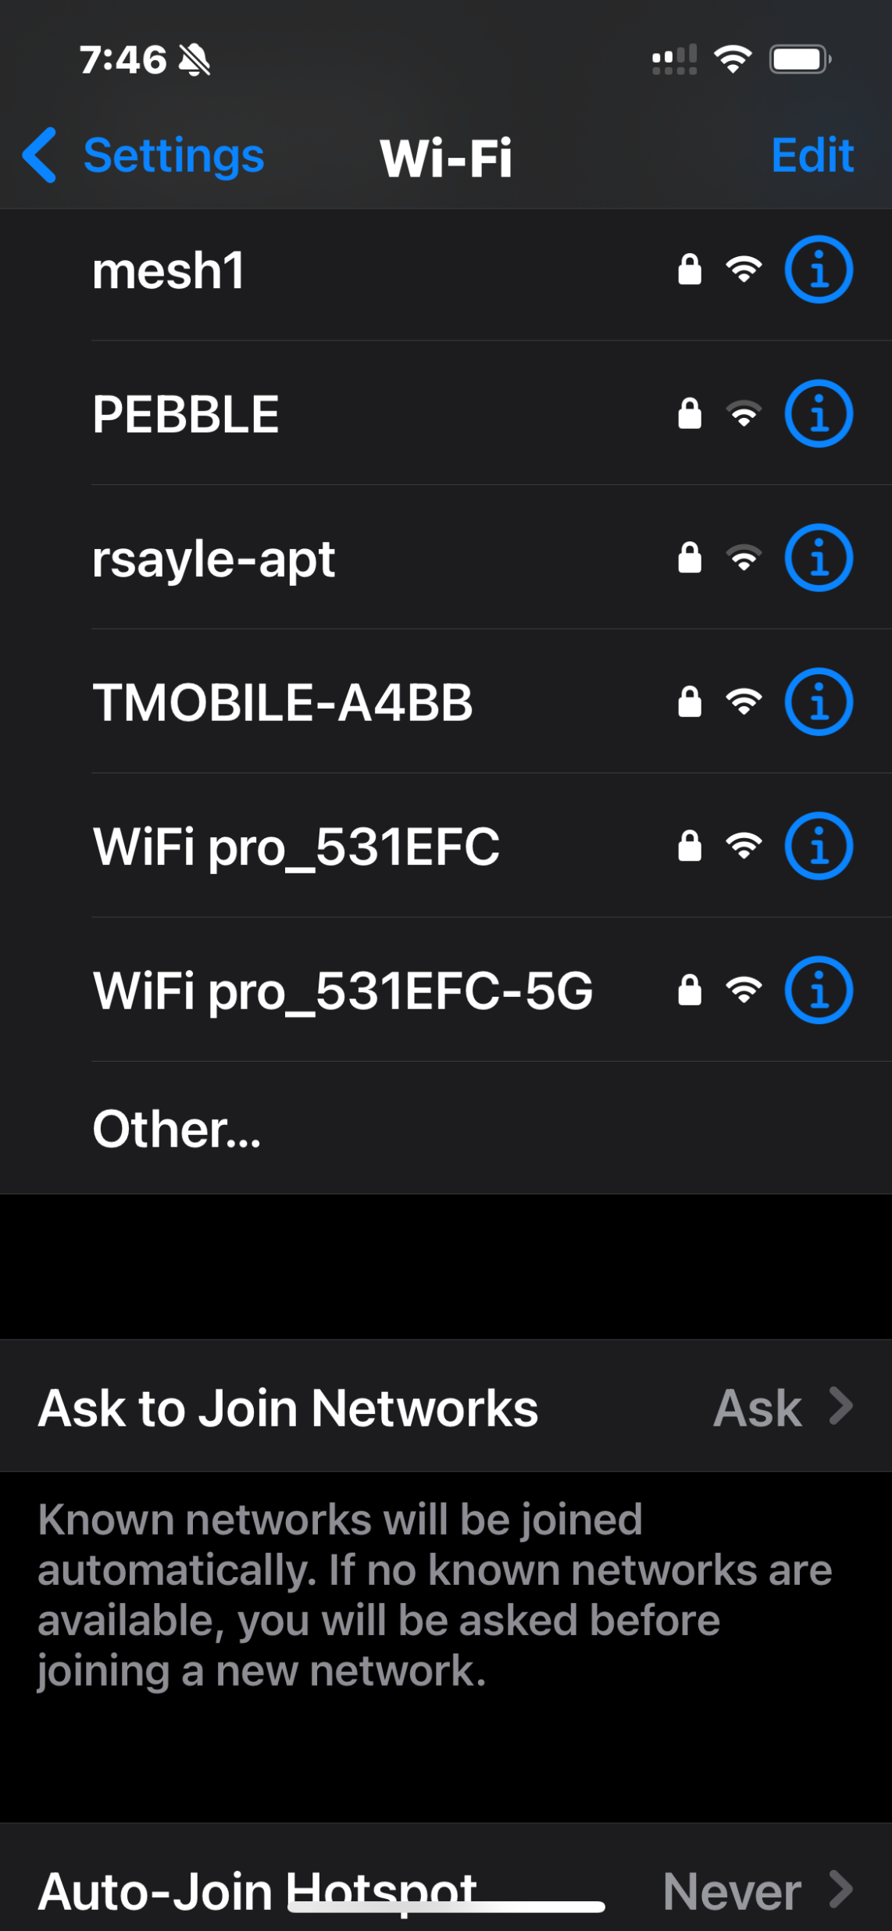

Slide 41
"USER EQUIPMENT" (=UE) VIEWPOINT (continued)
My Samsung cell phone shows only one "mesh1" even though it see's all transmitter-receivers identifying as as an SSID of "mesh1". Even if my Samsung cell phone sees all transmitter-receivers identifying as an SSD of "mesh1", my iPhone will only let me connect to the transmitter-receiver that has the strongest radio signal.

Slide 42
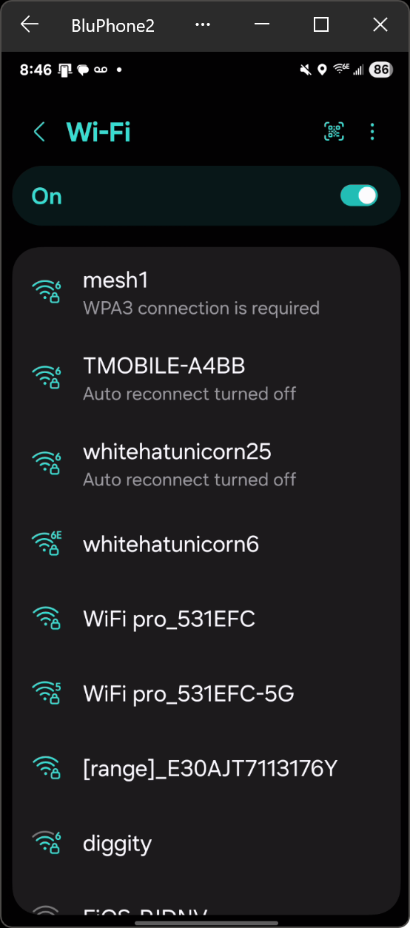

Slide 44
"USER EQUIPMENT" (=UE) VIEWPOINT (continued)
My Windows 11 computer shows only one "mesh1" even though it see's all transmitter-receivers identifying as as an SSID of "mesh1". Even if my Windows 11 computer sees all transmitter-receivers identifying as an SSD of "mesh1", my iPhone will only let me connect to the transmitter-receiver that has the strongest radio signal.

Slide 45
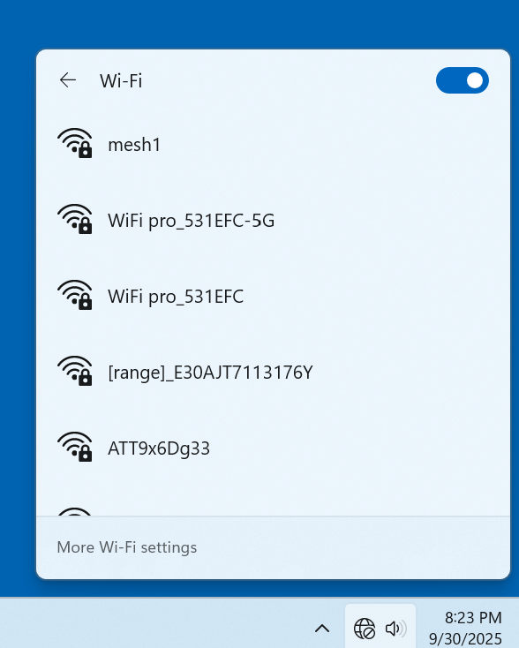

Slide 47
"USER EQUIPMENT" (=UE) VIEWPOINT (continued)
Windows 11 and Windows 10 sometimes shows a space <number> after the actual SSIDs that it detects. Please ignore this oddity as explained at https://learn.microsoft.com/en-us/answers/questions/4020055/why-is-there-a-number-after-the-wifi-im-connected

Slide 48
3

Slide 49
3

Slide 50
"USER EQUIPMENT" (=UE) VIEWPOINT (continued)
The actual SSIDs that are being detected are the charactors to the left of the space <number>

Slide 51
"USER EQUIPMENT" VIEWPOINT (continued)
For the mesh option, I need to have a mesh-capable router at both the North end of the house and the South end of the house and both routers have to belong to the same "mesh" system which, in practice", means that both routers have to belong to the same mesh group of the same manufacturer:

Slide 52
INTERNET PROVIDER'S GATEWAY BOX
ASUS MESH ROUTER #1
STEEL STAIRWELL & METAL FURNITURE
COSTLIER NETGEAR EXTENDER
CHEAPER
Wi-Fi EXTENDER
ASUS MESH ROUTER #2
MY OFFICE AREA NOW HAS Wi-Fi COVERAGE

Slide 53
TWO MODES OF OPERATION FOR MOST Wi-Fi EXTENDERS
Repeater mode
Access Point mode

Slide 54
INTERNET PROVIDER'S GATEWAY BOX
(ASUS) (MESH) ROUTER #1 $220
STEEL STAIRWELL & METAL FURNITURE
ASUS MESH ROUTER #2
$220
(Part of a mesh)
COSTLIER NETGEAR EXTENDER
$100
CHEAPER
Wi-Fi EXTENDER
$60

Slide 55
INTERNET PROVIDER'S GATEWAY BOX
(ASUS) (MESH) ROUTER #1 $220
STEEL STAIRWELL & METAL FURNITURE
ASUS MESH ROUTER #2
$220
(Part of a mesh)
COSTLIER NETGEAR EXTENDER
$100
CHEAPER
Wi-Fi EXTENDER
$60

Slide 56
TWO MODES OF OPERATION FOR MOST Wi-Fi EXTENDERS (continued)
Repeater mode reduces Internet download and upload speeds down to 20 to 40 percent of the source signals that are being repeated
Access Point mode does not reduce Internet download and upload speeds by much but requires Ethernet or Ethernet equivalent to connect the Wi-Fi extender to the existing router

Slide 57
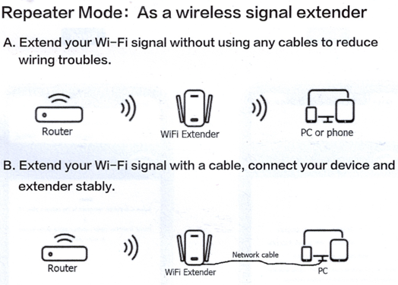

Slide 60
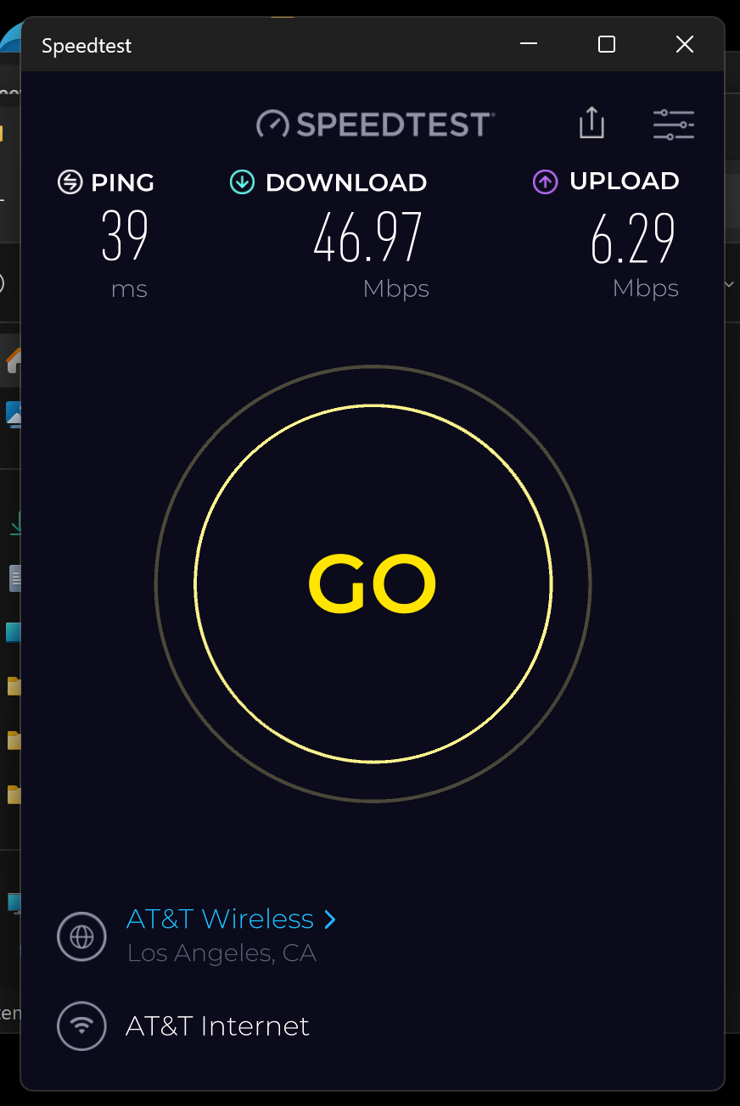

Slide 61
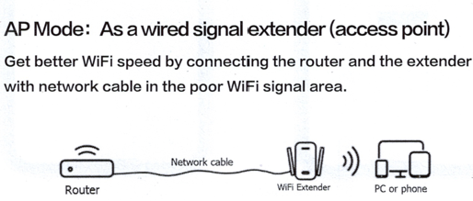

Slide 63
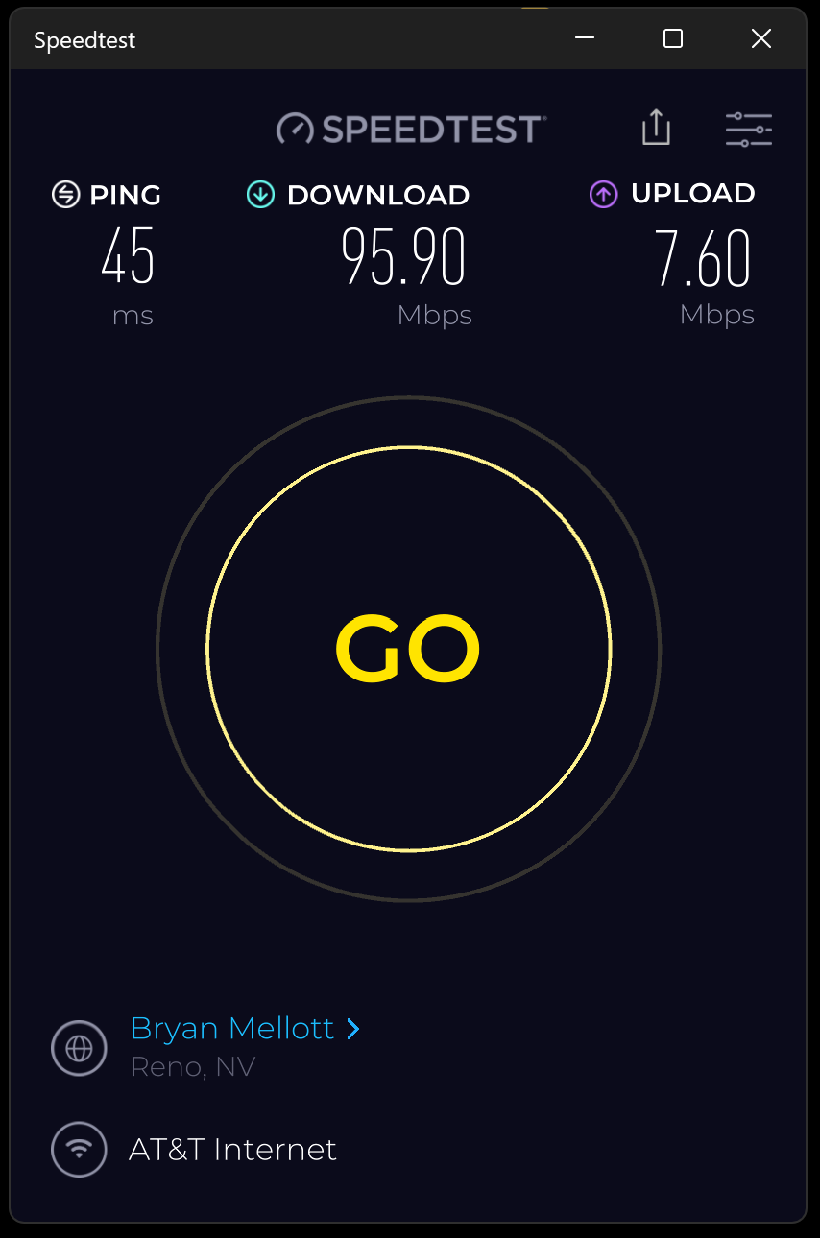

Slide 64
REQUIREMENTS FOR Wi-Fi EXTENDERS (continued)
In "Repeater Mode", a 100 Megabits per second Ethernet port on a Wi-Fi extender will bottleneck the download and upload speeds of an Internet provider that is providing Internet speeds faster than 100 Megabits per second, if you are using the Ethernet port to connect to a downstream computer, tablet, or camera.

Slide 67
REQUIREMENTS FOR Wi-Fi EXTENDERS (continued)
In "Access Point Mode", a 100 Megabits per second Ethernet port on a Wi-Fi extender will bottleneck the download and upload speeds of an Internet provider that is providing Internet speeds faster than 100 Megabits per second, since the Ethernet port is used to connect the Wi-Fi extender to the existing router in "Access Point Mode".

Slide 69
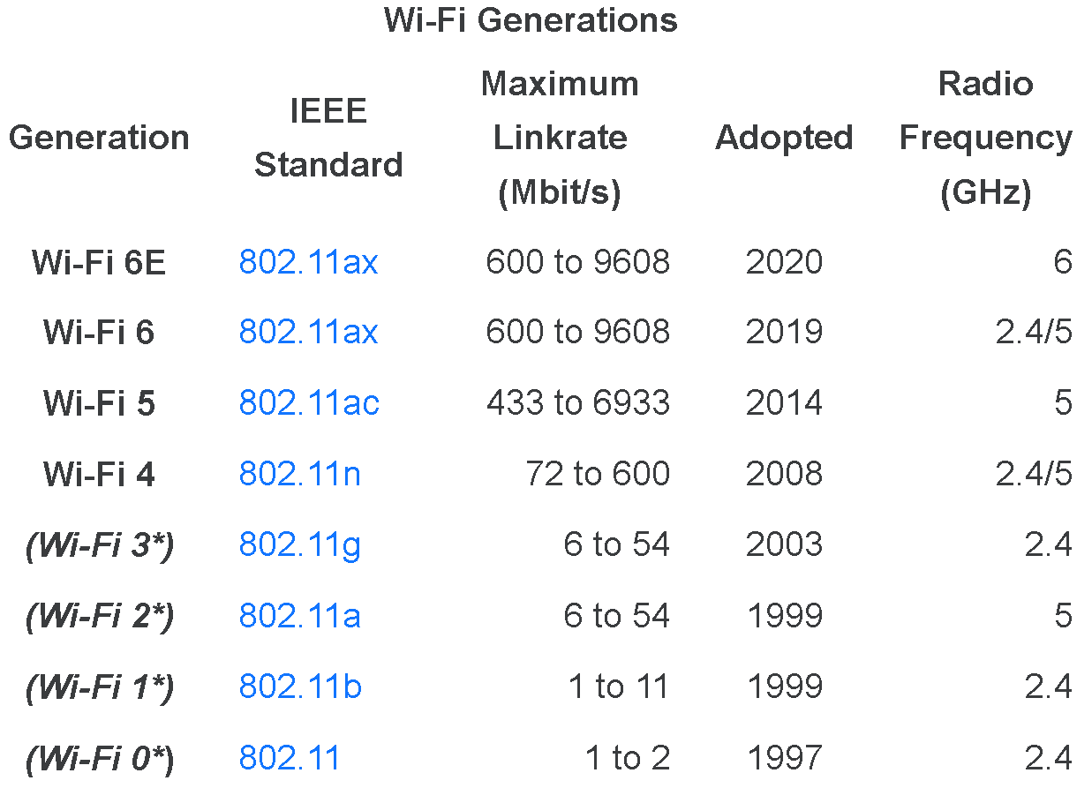
Wi-Fi 7 802.11be 721 to 46120 2024 2.4/5/6
2.4/5/6

