Slide 1



0: Wi-Fi FROM AN END-USER DEVICE

Slide 2
Web location for this presentation:
http://aztcs.apcug.org
Click on
“Meeting Notes”

Slide 3
SUMMARY
From any end-user computer, cell phone, or tablet, you will see a simplified view of the actual Wi-
Fi environment

Slide 4
SUMMARY
From any end-user computer, cell phone, or tablet, you will see a simplified view of the actual Wi-
Fi environment

Slide 5
INTERNET PROVIDER'S GATEWAY BOX
_{(ASUS) (MESH) ROUTER #1}
STEEL STAIRWELL & METAL FURNITURE
_{COSTLY NETGEAR EXTENDER}
_{CHEAP}
_{Wi-Fi EXTENDER}
_{ASUS MESH ROUTER #2}
MY OFFICE AREA NOW HAS Wi-Fi COVERAGE

Slide 6
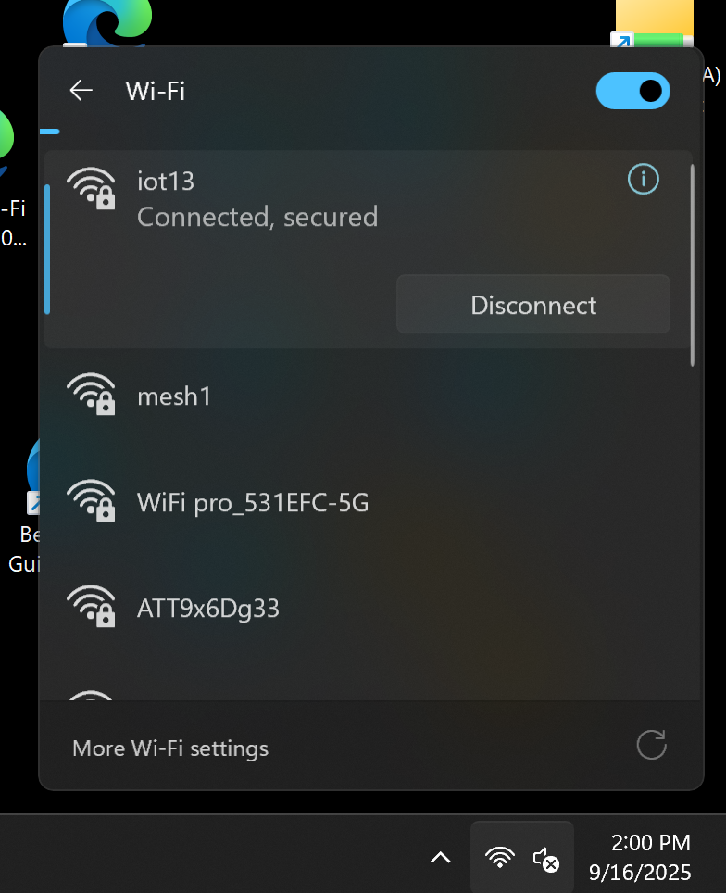

Slide 9
8 ACTUAL TRANSMITTER-RECEIVERS
2.5 Gigahertz transmitter-receiver from Netgear Wi-Fi extender with SSID of mesh1
5 Gigahertz transmitter-receiver from Netgear Wi-Fi extender with SSID of mesh1

Slide 10
8 ACTUAL TRANSMITTER-RECEIVERS (continued)
2.5 Gigahertz transmitter-receiver from ASUS Mesh router #1 with SSID of mesh1
5 Gigahertz transmitter-receiver from ASUS Mesh router #1 with SSID of mesh1
6 Gigahertz transmitter-receiver from ASUS Mesh router #1 with SSID of mesh1

Slide 11
8 ACTUAL TRANSMITTER-RECEIVERS (continued)
2.5 Gigahertz transmitter-receiver from ASUS Mesh router #2 with SSID of mesh1
5 Gigahertz transmitter-receiver from ASUS Mesh router #2 with SSID of mesh1
6 Gigahertz transmitter-receiver from ASUS Mesh router #2 with SSID of mesh1

Slide 12
8 ACTUAL TRANSMITTER-RECEIVERS (continued)
Your operating system (Windows 11) will pick the strongest and most stable transmitter-receiver for you to connect to.
Your operating system (Windows 11) will not let you choose which transmitter-receiver that you are being connected to.

