Slide 1


MAKING SHORTCUTS TO APPS IN WINDOWS 11, 10, AND 8

Slide 2
Web location for this presentation:
http://aztcs.apcug.org
Click on
"Meeting Notes"

Slide 3
SUMMARY
The newer "Universal Windows Platform Apps (such as the "Phone Link" app) do not allow you to right click on them to place a shortcut into the Windows 11, 10, or 8 "Desktop". To create shortcuts to all apps in Windows 11,10, or 8, you have to run "shell:appsfolder" in a "Run" command box.

Slide 4
TOPICS
Registry hacks are not recommended
USE the shell:appsfolder command to make shortcuts to apps

Slide 5
REGISTRY HACKS ARE NOT RECOMMENDED
"Universal Windows Platform" apps reside in a secure folder at C:\Program Files\WindowsApps
Many registry hacks have been posted on the Web to help Windows 11, 10, and 8 users get access to the programs that reside at this location
We do not recommend any of them

Slide 6
USE THE shell:appsfolder COMMAND INSTEAD..
..to make shortcuts to all apps, including UWP apps in Windows 11, 10, or 8, you can run the shell:appsfolder command in either a "Search" box or a "Run" box in Windows 11, 10, or 8

Slide 7
USE THE shell:appsfolder COMMAND INSTEAD.. (continued)
To get to a "Run" box or a "Search" box in Windows 11, 10, or 8, use the RIGHT mouse button to click on the "Start" menu:

Slide 8
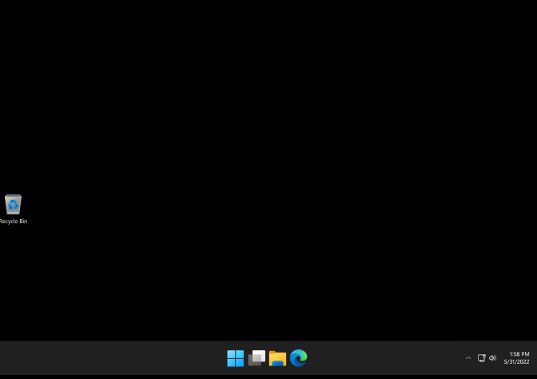

Slide 10
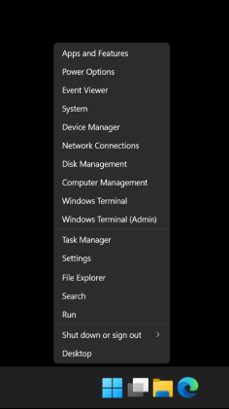

Slide 12
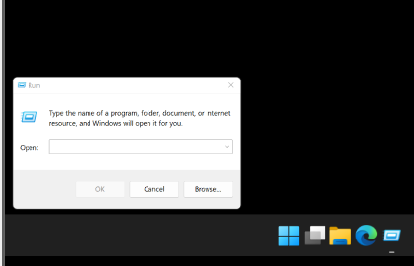

Slide 13
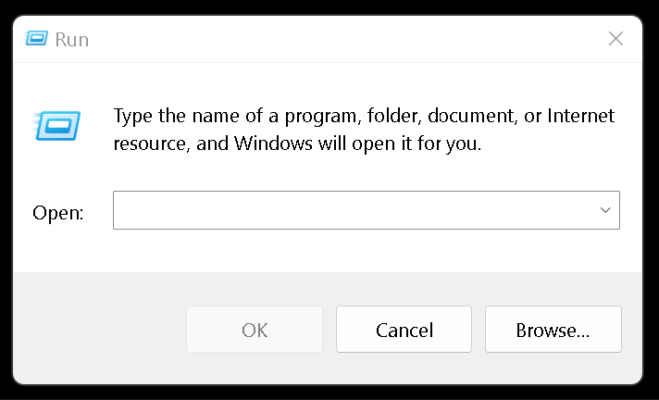

Slide 14
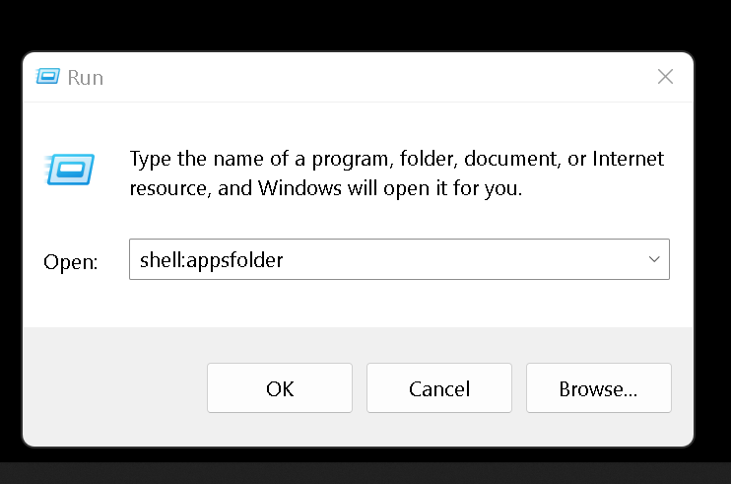

Slide 16
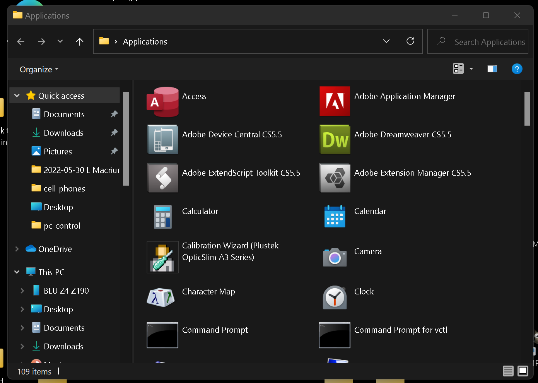

Slide 17
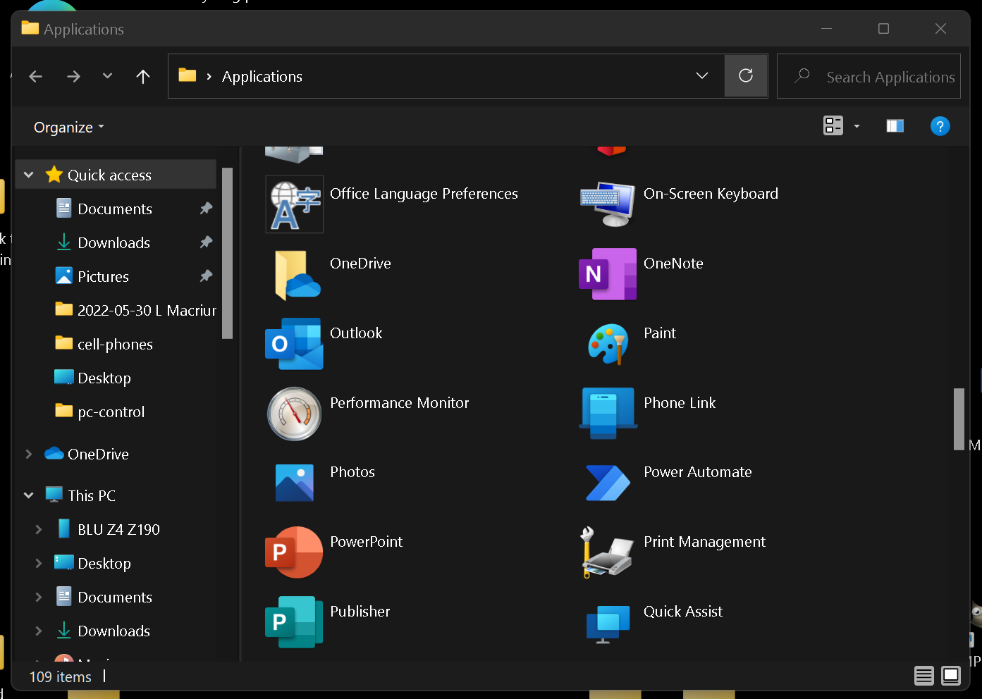

Slide 19
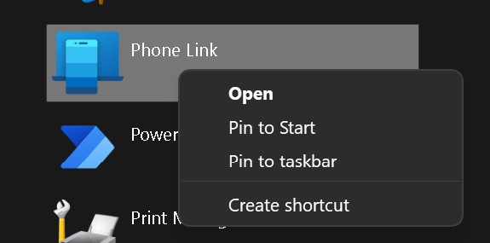

Slide 21
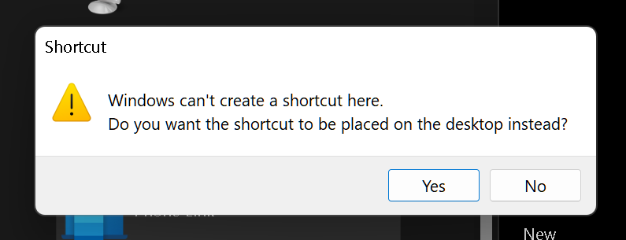

Slide 23
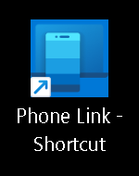

Slide 24
ADDITIONAL INFORMATION
https://www.techrepublic.com/article/how-to-use-the-shell-command-to-view-all-your-applications-in-file-explorer/

