Slide 1


CONTROLLING
AN ANDROID CELL PHONE USING "scrcpy" IN WINDOWS.. OR LINUX

Slide 2
Web location for this presentation:
http://aztcs.apcug.org
Click on
"Meeting Notes"

Slide 3
SUMMARY
Using the free and open source "scrcpy" software app, an Android cell phone will show up in a Windows 11 or 10 computer or in a Linux computer as a window that looks exactly like the screen of the Android phone. From this window, you can make and receive phone calls and text messages and operate all of the apps that are inside the cell phone.

Slide 4
TOPICS
Demos of "scrcpy" in Windows.. and Linux
Detailed Steps for installing "scrcpy"
Detailed Steps for Using "scrcpy"

Slide 5
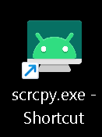

Slide 6
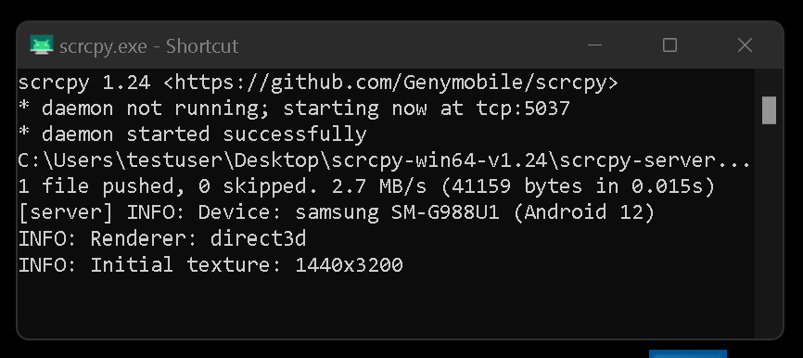

Slide 7
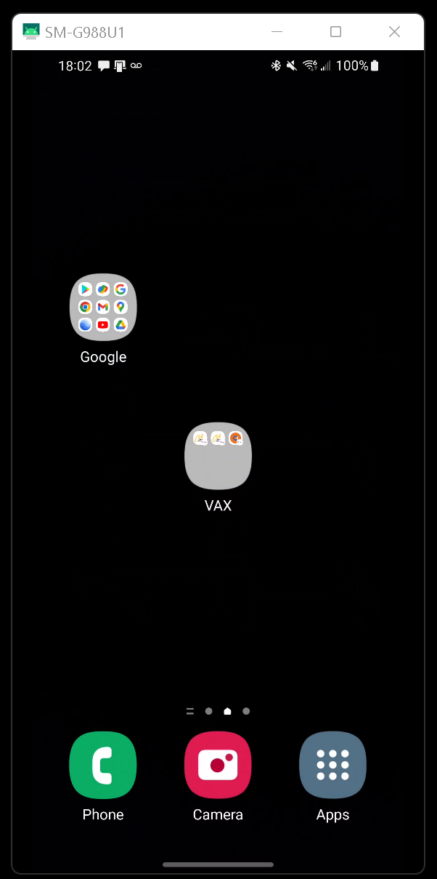

Slide 8
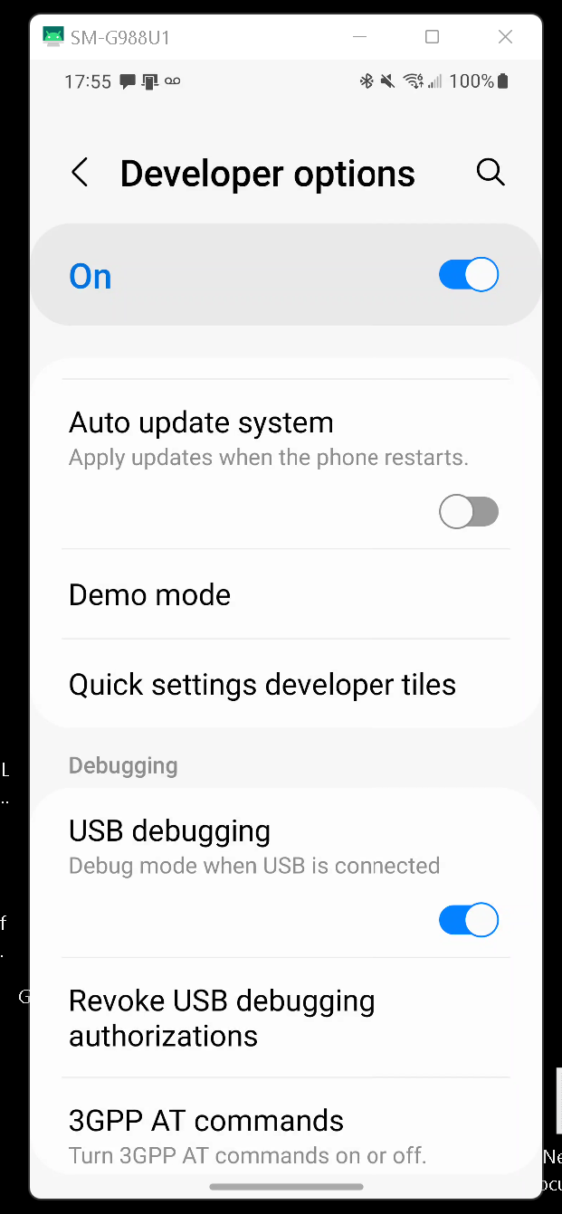

Slide 10


Slide 11
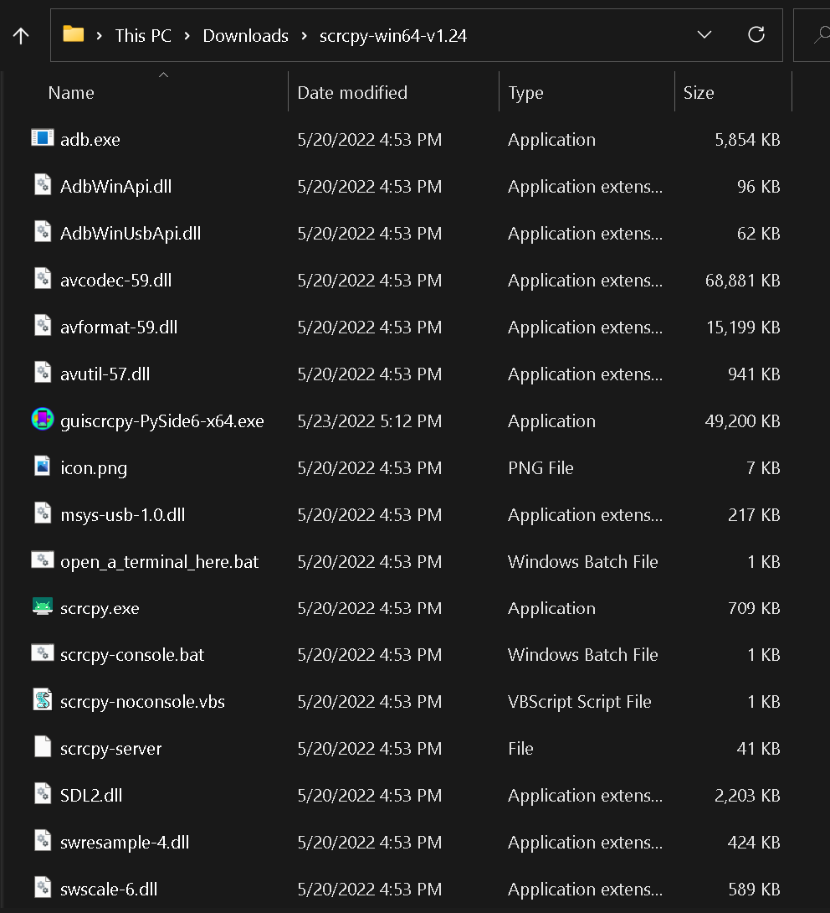

Slide 12
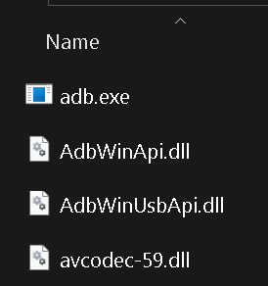

Slide 13
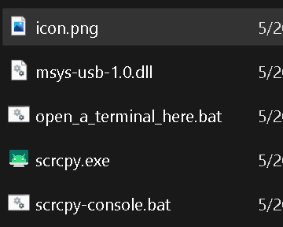

Slide 16
Android cell phone with "Developer
options" enabled (which include "Android Debug Bridge")
Windows 11 or 10 running the free "scrcpy" app
USB connection
or
_{Wi-Fi connection via router}
_{or}
wired Ethernet dongle via router

Slide 17
_{"Ubuntu"}
_{Linux}
_{or}
_{"Linux Mint"}
_{or}
_{"Manjaro" Linux}
or "Pop!OS" Linux
or
_{"EndeavourOS" Linux}
_{running the free "scrcpy" app}
Android cell phone with "Developer
options" enabled (which include "Android Debug Bridge")
USB connection
or
_{Wi-Fi connection via router}
_{or}
wired Ethernet dongle via router

Slide 18
"scrcpy" INSIDE "WINDOWS..
In a Windows.. computer, "scrcpy" is a portable app that downloads initially as a Zip file. Then you right-click on it to extract it into a file named "scrcpy-win64-v1.24"

Slide 19
"scrcpy" INSIDE LINUX
We have successfully used "scrcpy" inside: Ubuntu 22.04 EndeavourOS Apollo 22.1 Linux Mint xfce 20.3 Manjaro xfce 21.2.6 and Pop-OS amd64 nvidia 22.04

Slide 20
"scrcpy" INSIDE LINUX (continued)
In a "Ubuntu" Linux computer, "scrcpy" is available in the "Ubuntu Software" app or the "Synaptic Package Manager" app

Slide 21
"scrcpy" DOES NOT WORK OVER A CELLULAR DATA PLAN
"scrcpy" does not work over cellular data plan: it requires a USB connection or a Wi-Fi router connection between the Android cell phone and the computer

Slide 22
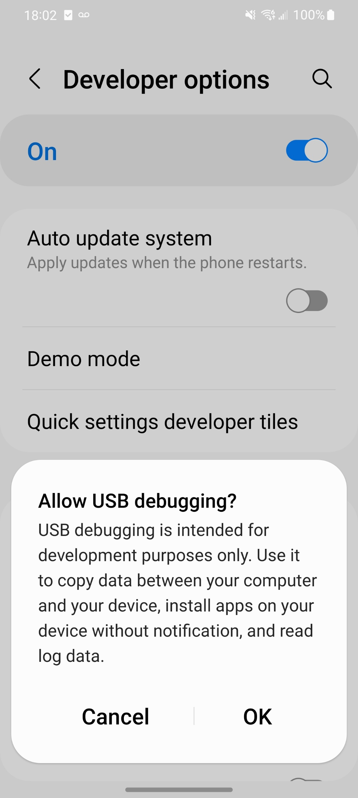

Slide 24
INSTALLING "scrcpy" INTO "WINDOWS.." OR LINUX
Inside the Android cell phone, enable "adb debugging" by installing "Developer options" as described at https://developer.android.com/studio/command-line/adb#Enabling and https://appuals.com/fix-adb-devices-not-found/

Slide 25
INSTALLING "scrcpy" INTO "WINDOWS.." OR LINUX (continued)
Then, install "scrcpy" into "Windows.." or Linux by following the instructions at https://github.com/Genymobile/scrcpy

Slide 26
INSTALLING "scrcpy" INTO "WINDOWS.." OR LINUX (continued)
Other useful commands from the the ..scrcpy.. folder via the Windows Terminal (Admin) window: adb kill-server adb devices adb -s <name of device> adb --tcpip=<tcpip address of device>

