Slide 1




12--USING "PHONE LINK" TO CONTROL AN APPLE "iPHONE" FROM A "WINDOWS 11" COMPUTER

Slide 2
Web location for this presentation:
http://aztcs.apcug.org
Click on
"Meeting Notes"

Slide 3
SUMMARY
An Apple "iPhone" can be controlled from the bundled "Phone Link" app in a "Windows 11" computer.

Slide 4
TOPICS
Using Microsoft's "Phone Link" app in a "Windows 11" computer
Advantages of Controlling An "iPhone" r
Locating or Installing "Link to Windows" In An "iPhone"
Detailed Steps for Using "Phone Link" to Control an "iPhone".

Slide 5
USING "WINDOWS 11" TO CONTROL AN iPHONE
Microsoft's bundled "Phone Link" app in a "Windows 11" computer can be used to control a cell phone if you install Microsoft's free "Link to Windows" app into the cell phone.

Slide 6
USING "PHONE LINK"IN WINDOWS" TO CONTROL AN "iPHONE" (continued)
Microsoft's bundled "Phone Link" app in "Windows 11" can be used to control an "iPhone" if Microsoft's free "Link to Windows" app is installed in the "iPhone".

Slide 7
USING "PHONE LINK"IN WINDOWS" TO CONTROL AN "iPHONE" (continued)
From inside your Apple "iPhone", go to the "App Store" and install Microsoft's free "Link to Windows" app

Slide 8
USING "PHONE LINK" IN WINDOWS" TO CONTROL AN "iPHONE" (continued)
Then use your LEFT mouse button to click on "For iOS users" at https://www.microsoft.com/en-us/windows/sync-across-your-devices?r=1

Slide 9
USING "PHONE LINK" IN WINDOWS" TO CONTROL AN "iPHONE" (continued)
When you use "Phone Link" in "Windows 11" to connect to "Link to Windows" in an "iPhone", some of the screens that would otherwise be available in "Phone Link" in an Android cell phone are missing:

Slide 10
USING "PHONE LINK" IN WINDOWS" TO CONTROL AN "iPHONE" (continued)
Inside the "Desktop" of your "Windows 11" computer, there is no screen image of the iPhone
Inside the "Phone Link" app of your "Windows 11" computer, there is no "Apps" tab, and there is no "Photos" tab.

Slide 11
USING "PHONE LINK" IN WINDOWS" TO CONTROL AN "iPHONE" (continued)
When you use "Phone Link" in "Windows 11" to connect to "Link to Windows" in an "iPhone", all you have is a "Messages" tab and a "Calls" tab:

Slide 12
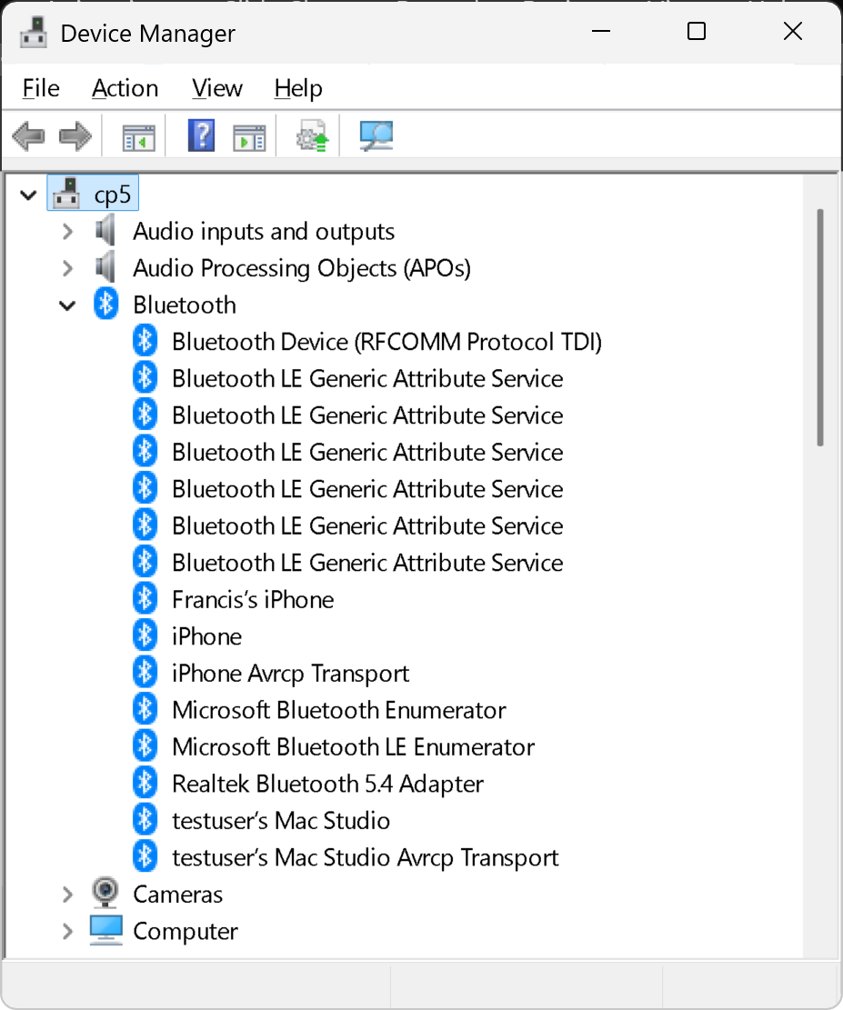

Slide 13
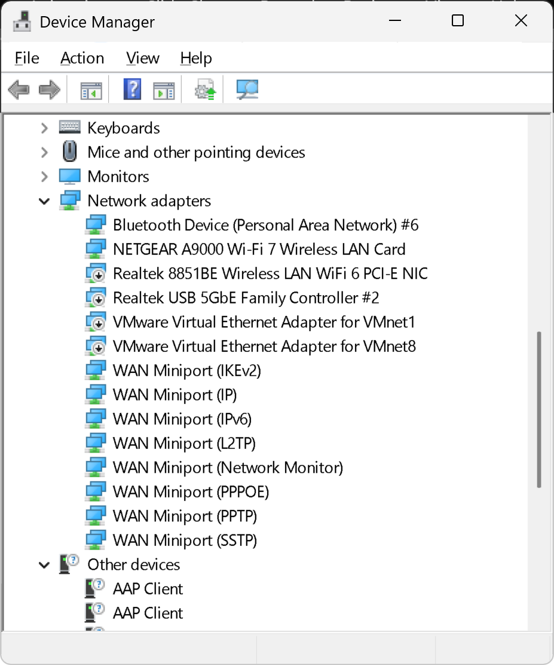

Slide 14
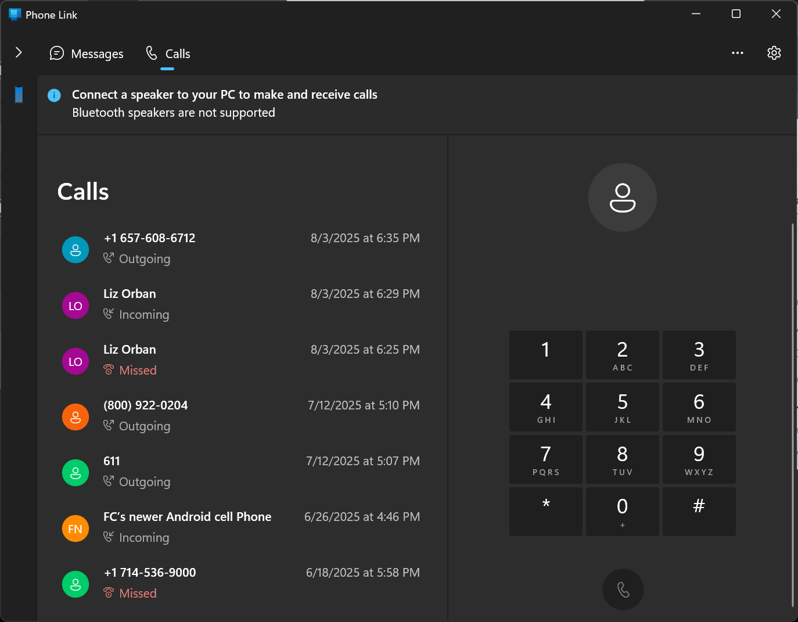

Slide 15
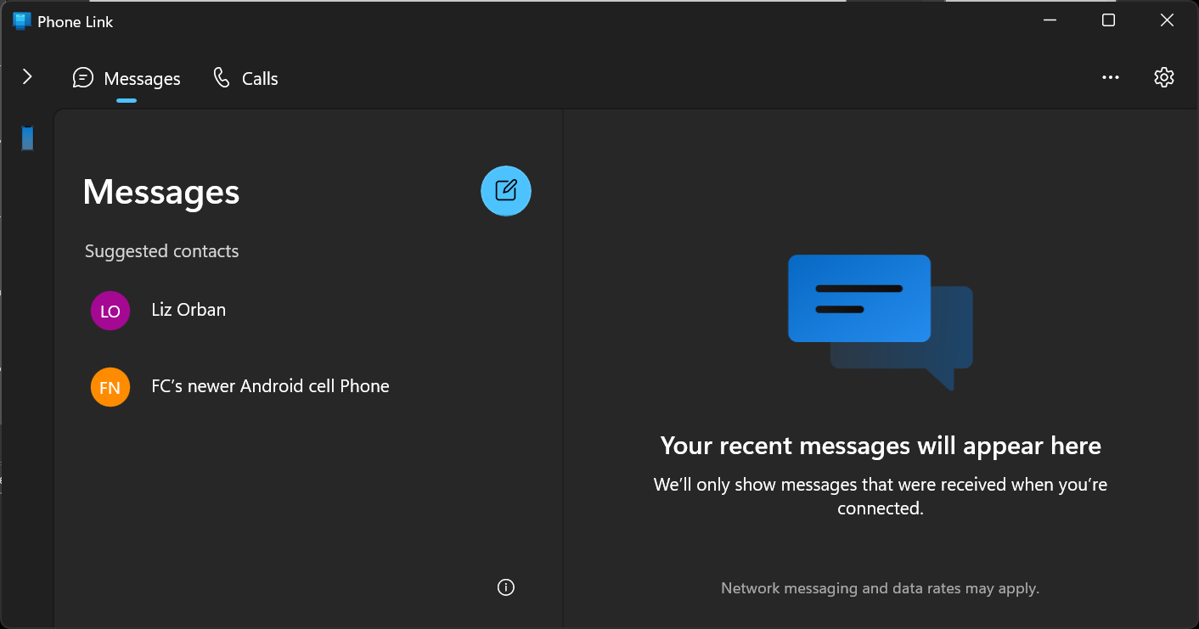

Slide 16
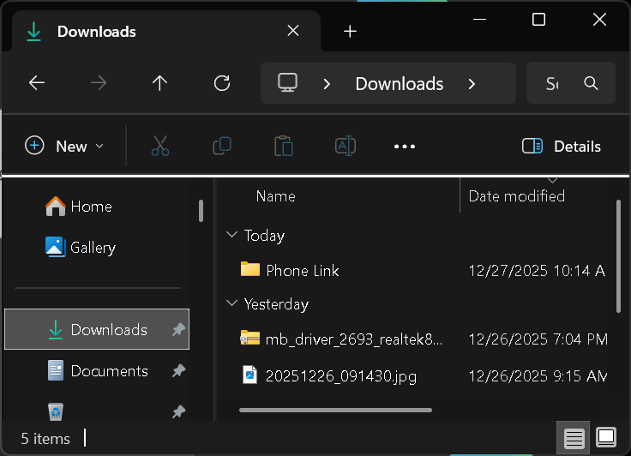

Slide 17
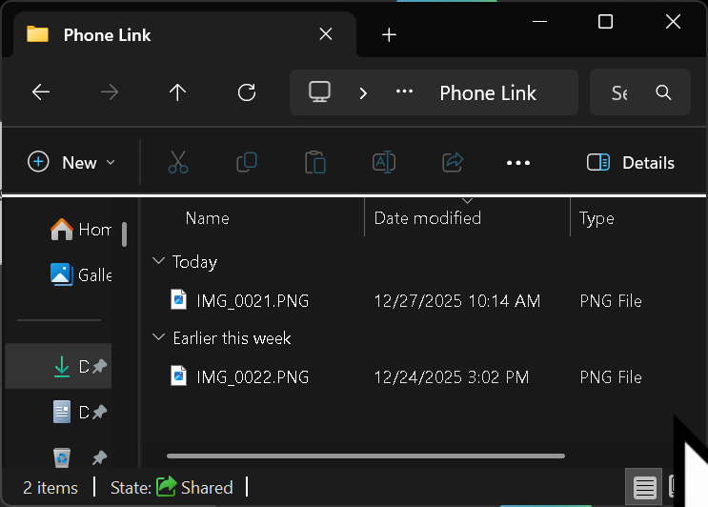

Slide 18
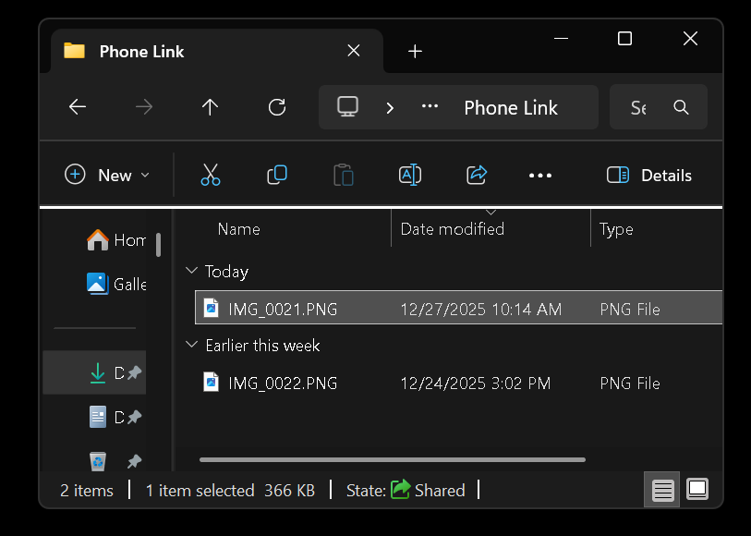

Slide 19
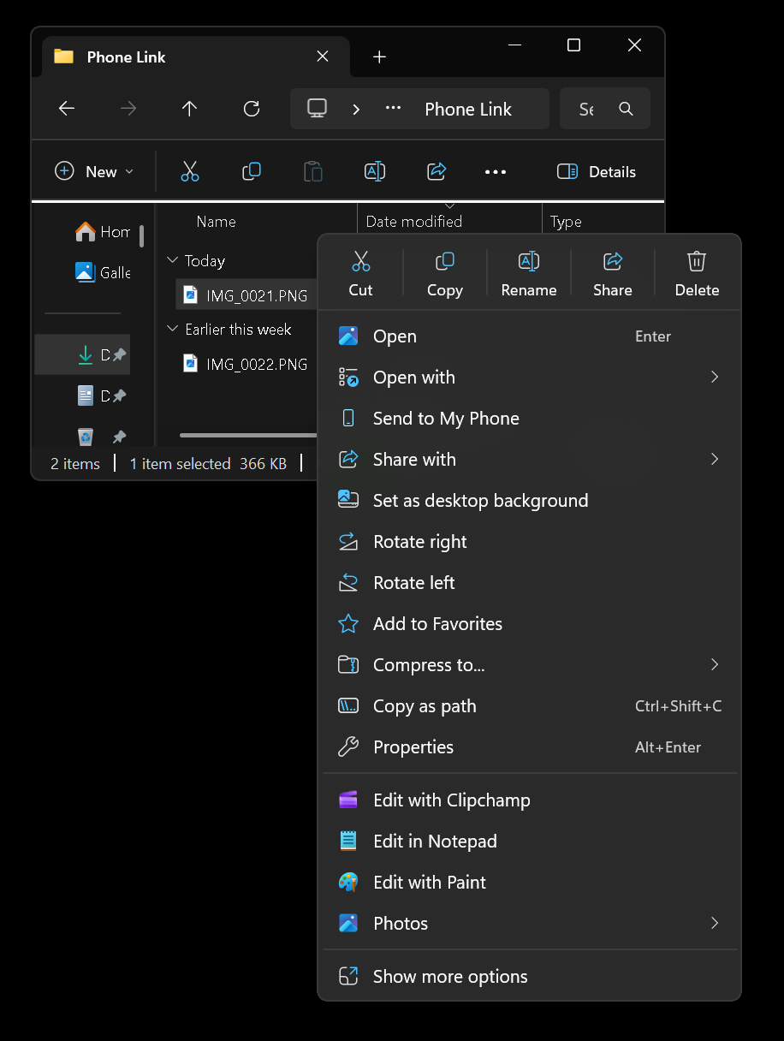

Slide 20
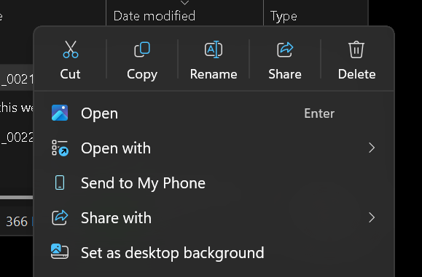

Slide 21
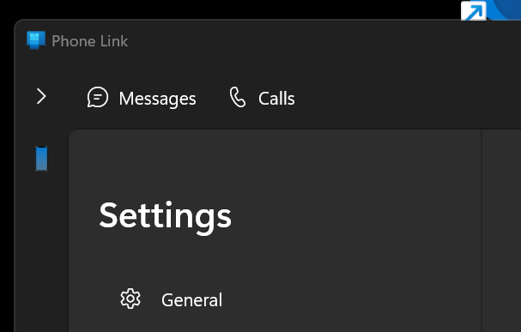

Slide 23
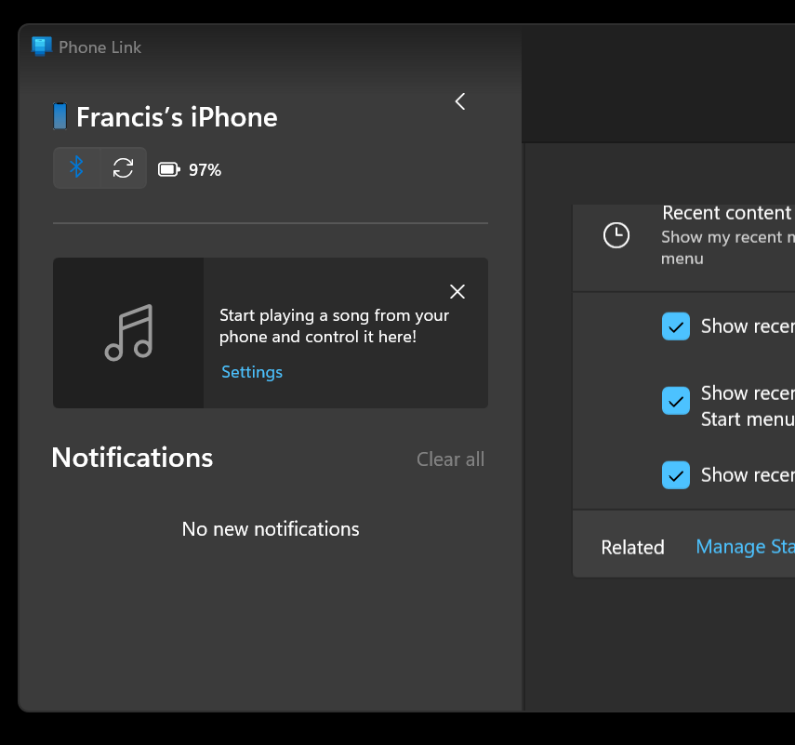

Slide 24
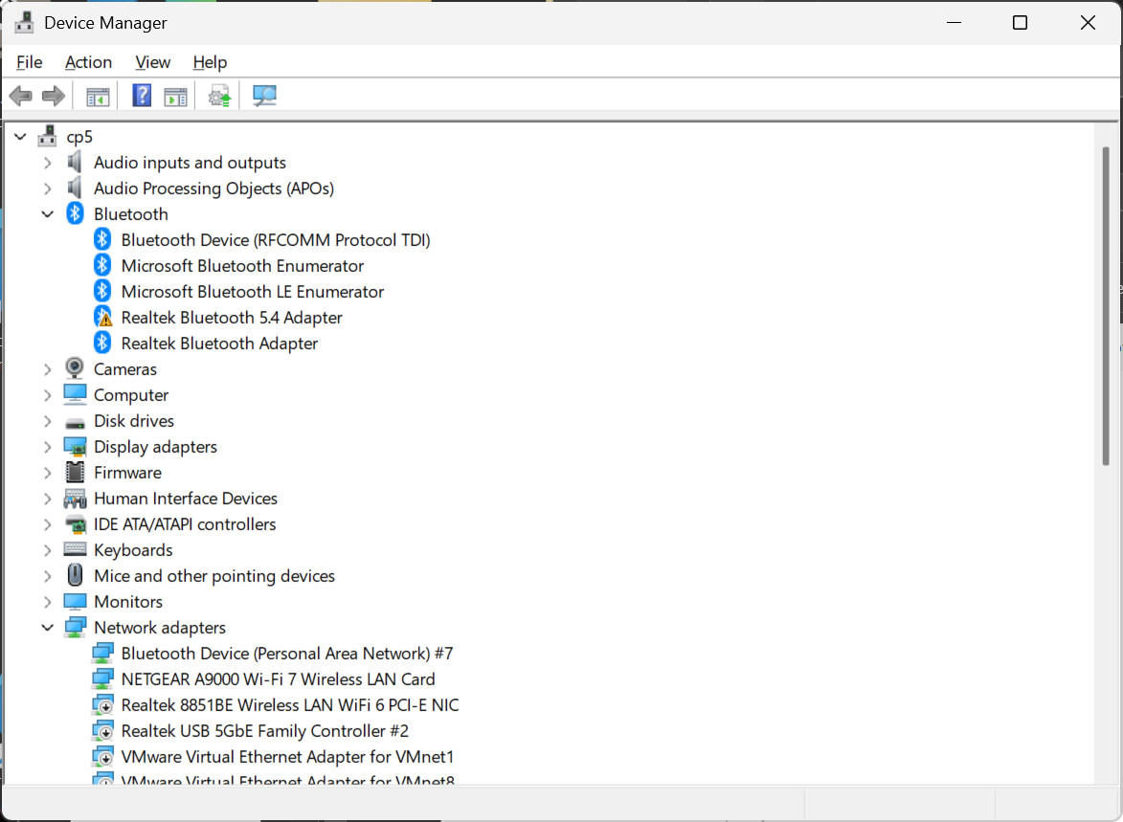

Slide 25

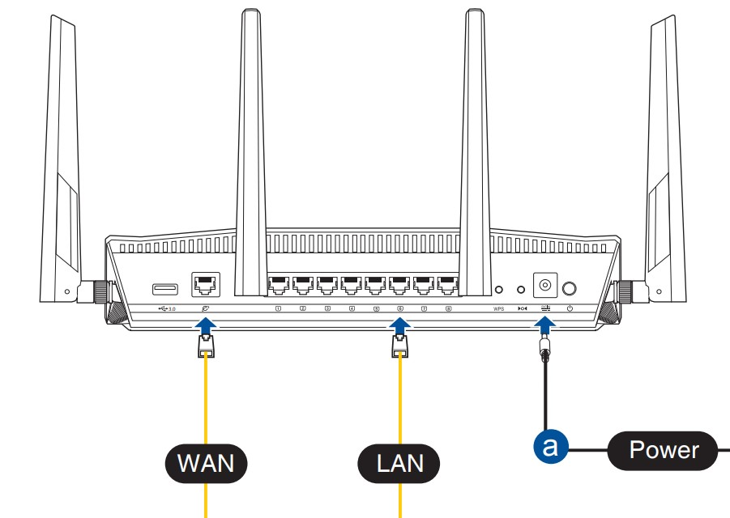
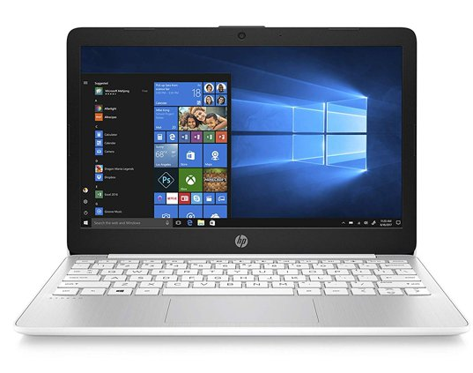

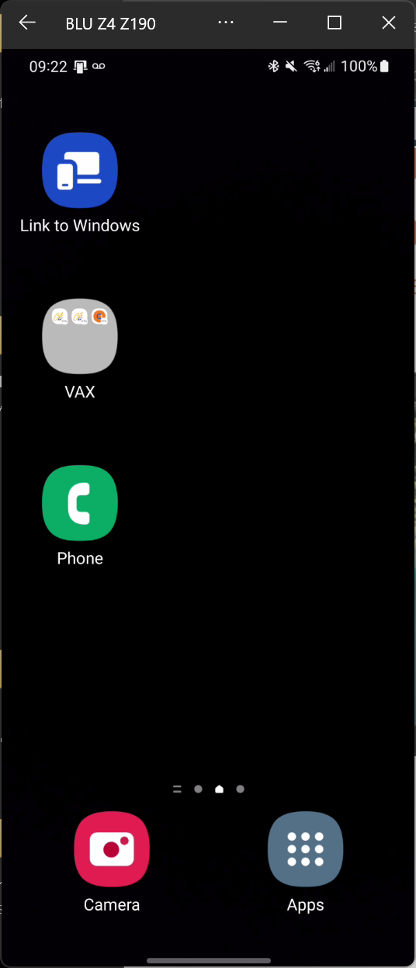
_{Microsoft's}
_{servers}
(do authentication)
_{Optional Bluetooth connection}
(for sending the cell phone's audio to the PC)

Slide 26
_{Microsoft's}
_{servers}
(do authentication)
_{Bluetooth connection}

Slide 27
_{Microsoft's}
_{servers}
do authentication
_{local router}
(for the cell phone's screen, texting, and apps)
_{Windows 11 computer with}
_{"Phone Link"}
_{app}
_{Android cell phone with}
_{"Link to Windows"}
_{app}
_{Bluetooth connection}

Slide 28
Wi-Fi SETTINGS TO SET PRIOR TO USING "LINK TO WINDOWS" IN AN ANDROID CELL PHONE
The computer and the cell phone DO NOT HAVE TO CONNECT TO THE SAME Wi-Fi wireless access point in the local router

Slide 29
ADDITIONAL ADVICE FOR PC CONNECTIONS TO iPHONES
https://www.macobserver.com/tips/how-to/connect-your-iphone-to-a-windows-pc-with-and-without-microsoft-phone-link/

