Slide 1




2--A INEXPENSIVE HEADSET FOR A COMPUTER

Slide 2
Web location for this presentation:
http://aztcs.apcug.org
Click on
"Meeting Notes"

Slide 3
SUMMARY
You can build a high-quality headset from the following list of parts.

Slide 4
PARTS FOR AN INEXPENSIVE HEADSET:
https://www.amazon.com/dp/B00C121ZOK?ref_=ppx_hzsearch_conn_dt_b_fed_asin_title_5&th=1

Slide 5
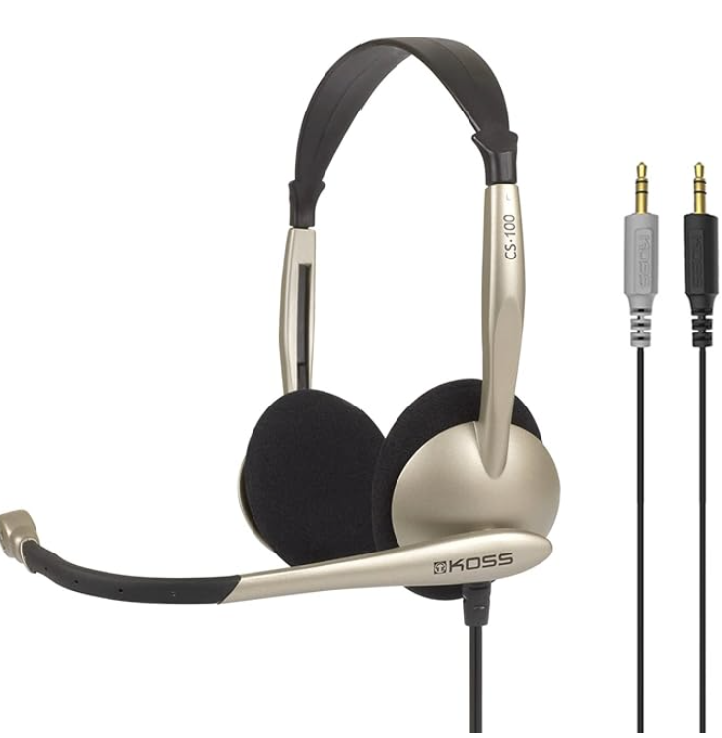

Slide 6
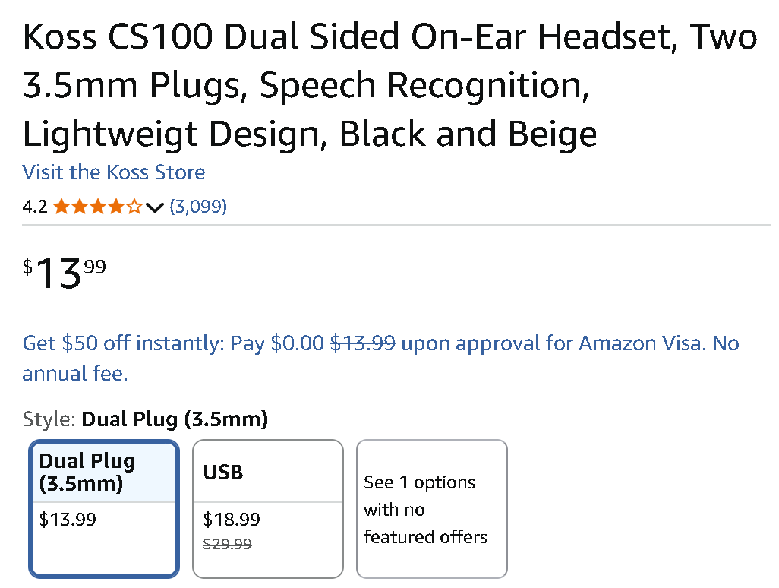

Slide 7
PARTS FOR AN INEXPENSIVE HEADSET: (continued)
https://www.amazon.com/dp/B06XBZ38ZJ

Slide 8
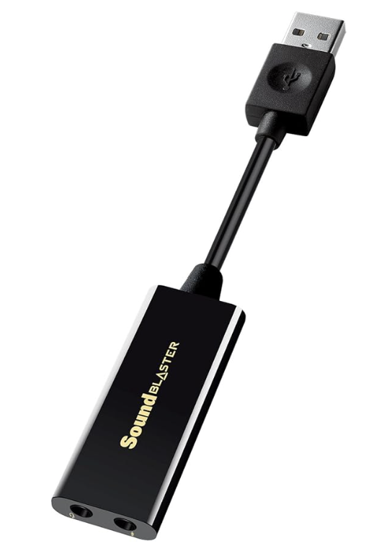

Slide 9
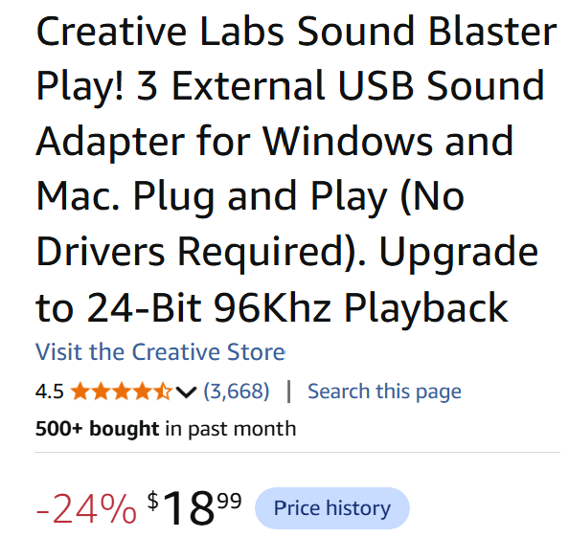

Slide 10
PARTS FOR AN INEXPENSIVE HEADSET (continued)
If you want the received audio of the phone call to also go into a set of external speakers, you have to use a Y-adapter to split the headset audio between the headset and the external speakers:

Slide 11
PARTS FOR AN INEXPENSIVE HEADSET (continued)
https://www.amazon.com/UGREEN-Splitter-Extension-Earphone-Compatible/dp/B00LM0ZGK6/

Slide 12
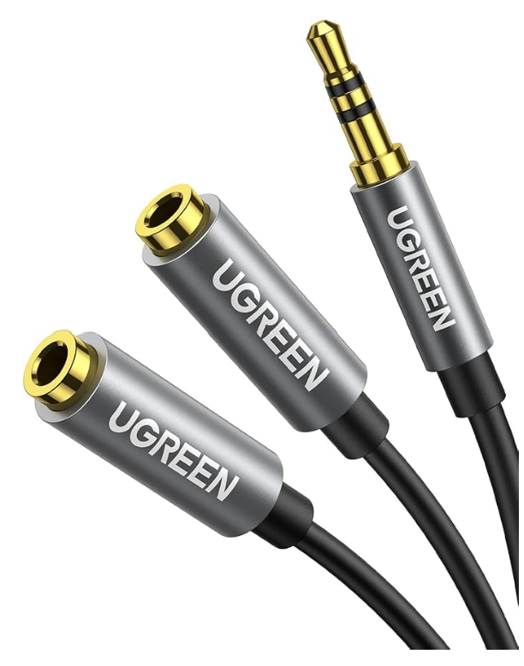

Slide 13
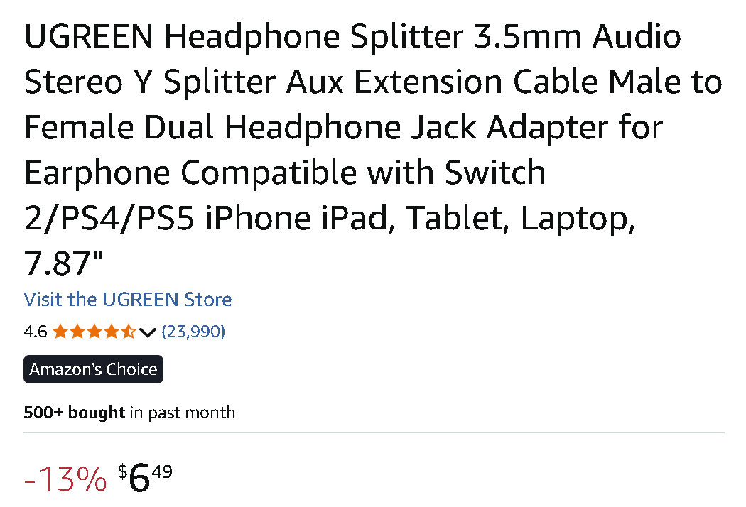

Slide 14
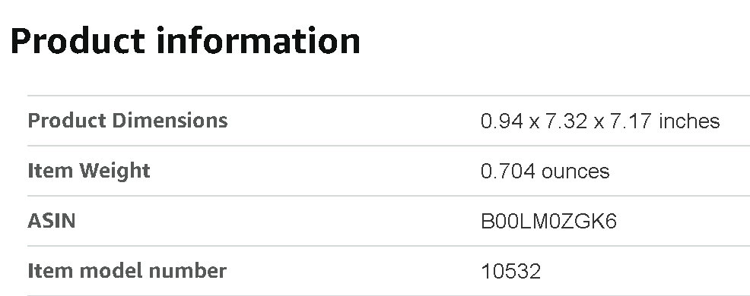

Slide 15
PARTS FOR AN INEXPENSIVE HEADSET (continued)
If you install this inexpensive headset, you probably will need to go to "Sound" in the Windows.. "Control Panel" to enable it's speakers in the "Playback" tab and you also probably need to enable it's "Microphone" in the "Recording" tab

