Slide 1




1--CONFIGURING "PHONE LINK" IN "WINDOWS 11" TO CONTROL A CELL PHONE

Slide 2
Web location for this presentation:
http://aztcs.apcug.org
Click on
"Meeting Notes"

Slide 3
SUMMARY
Here the the logical steps for installing the free "Link to Windows" app in a cell phone and then configuring the bundled "Phone Link" app in "Windows 11" so that it can control the cell phone.

Slide 4
TOPICS
Microsoft's Detailed Instructions For Using "Phone Link" in "Windows 11" To Control "Link To Windows" In A Cell Phone
Big Steps for Installing " 'Phone Link' to 'Link to Windows' "
Small Steps for Installing "Link to Windows" In A Cell Phone
Small Steps for Activating "Phone Link" in "Windows 11"

Slide 5

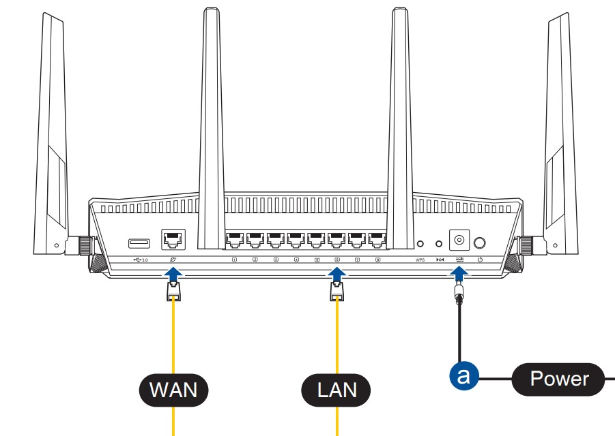

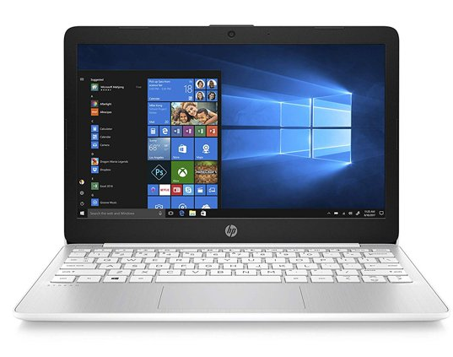


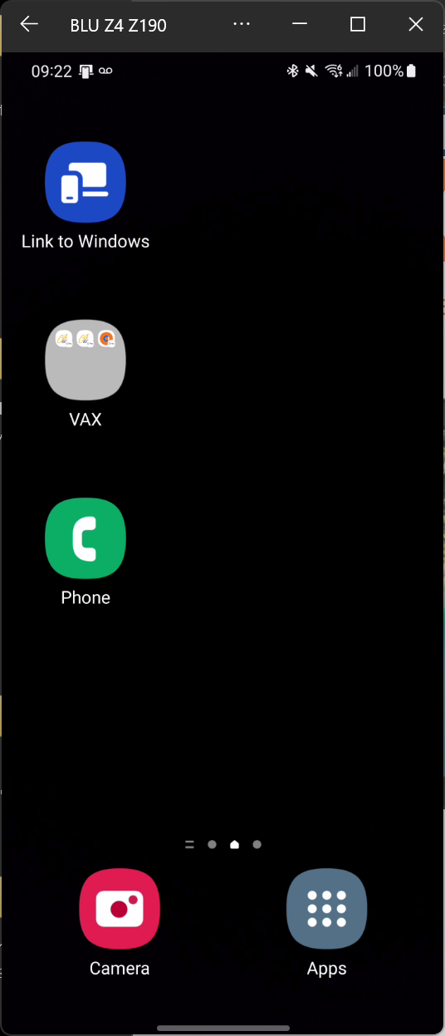
_{Microsoft's}
_{servers}
(do authentication)
_{Bluetooth connection}

Slide 6
_{Microsoft's}
_{servers}
(do authentication)
_{Bluetooth connection}

Slide 7
_{Microsoft's}
_{servers}
do authentication
_{local router}
(for the cell phone's screen, texting, and apps)
_{Windows 11 computer with}
_{"Phone Link"}
_{app}
_{Android cell phone with}
_{"Link to Windows"}
_{app}
_{Bluetooth connection}

Slide 8
MICROSOFT'S
"PHONE LINK" APP INSIDE A "WINDOWS 11" PC
Bluetooth Wi-Fi connection cloud-based router
connection
MICROSOFT'S "LINK TO WINDOWS" APP INSIDE A CELL PHONE

Slide 9
"PHONE LINK" CONNECTION FROM "WINDOWS 11" TO THE CELL PHONE
Four Requirements:
1) Wi-Fi router's connection to the Internet (for authentication)
2) "Windows 11" computer's Wi-Fi connection to the Wi-Fi router
3) Cell phone's Wi-Fi connection to the Wi-Fi router
4) Bluetooth connection to between the cell phone and the "Windows 11" computer

Slide 10
"PHONE LINK" CONNECTION FROM "WINDOWS 11" TO CELL PHONE (continued)
Four Requirements (continued):
The "Phone Link" in "Windows 11" to "Link to Windows" in the cell phone relies on all four of the above-mentioned network connections. If any of these network connections are not active, the "Phone Link" to "Link to Windows" connection cannot be started up.

Slide 11
STEPS FOR INSTALLING "LINK TO WINDOWS" INTO A CELL PHONE
Step 1: If "Link to Windows" is not already installed in a cell phone, you can locate "Link to Windows" in the "store" of the cell phone:

Slide 12
STEPS FOR INSTALLING "LINK TO WINDOWS" IN A CELL PHONE (continued)
For a partial list of Android cell phones that can run Microsoft's "Link to Windows" app, please see https://support.microsoft.com/en-us/topic/supported-devices-for-phone-link-experiences-cb044172-87aa-9e41-d446-c4ac83ce8807

Slide 13
STEPS FOR INSTALLING "LINK TO WINDOWS" IN A CELL PHONE (continued)
In Samsung cell phones, the "Link to Windows" app is bundled by Samsung shows up in two places: the "Quick Settings" screens and the "Apps" screens

Slide 14
STEPS FOR INSTALLING "LINK TO WINDOWS" IN A CELL PHONE (continued)
If "Link to Windows" is missing, you can get it for free from the "Play Store" app in an Android cell phone or, alternatively, from the "Galaxy Store" app in a Samsung cell phone or, alternatively, from the "App Center" app in an "ASUS cell phone

Slide 15
STEPS FOR INSTALLING "LINK TO WINDOWS" IN A CELL PHONE (continued)
or, alternatively, from the "Honor App Market" in an Honor cell phone.

Slide 16
STEPS FOR INSTALLING "LINK TO WINDOWS" IN A CELL PHONE (continued)
Most recent Android cell phones will have the free "Link to Windows" app somewhere on their "Apps" screens
In Samsung cell phones, the "Link to Windows" shows up in two places: the "Quick Settings" screens and the "Apps" screens

Slide 17
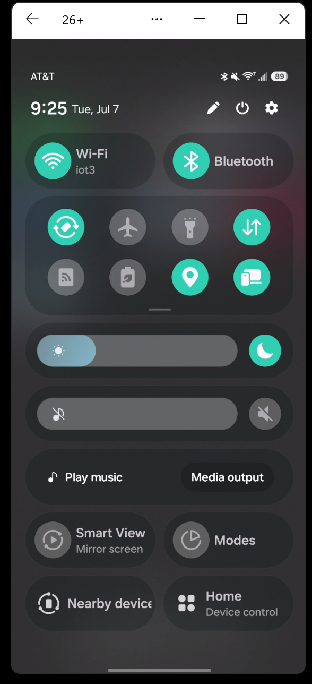

Slide 18
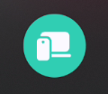

Slide 19
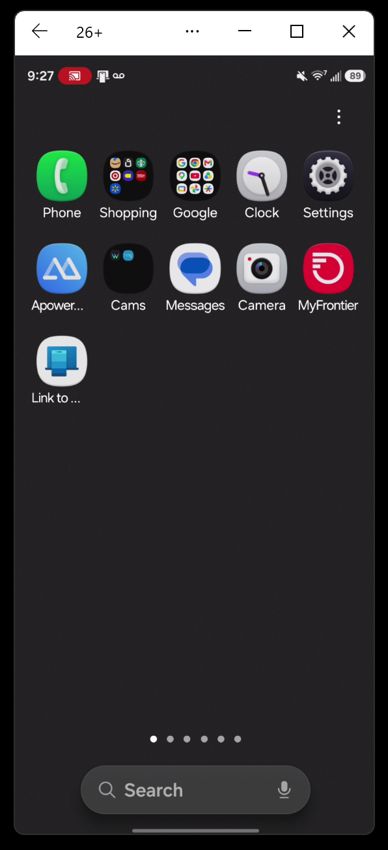

Slide 20
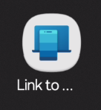

Slide 21
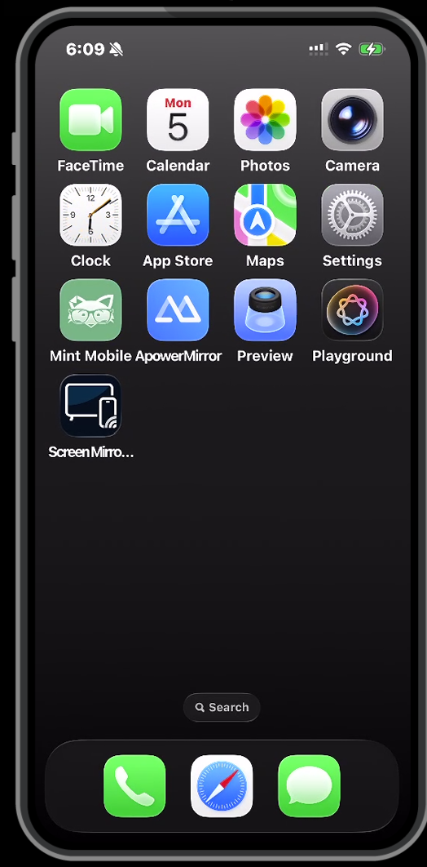

Slide 22
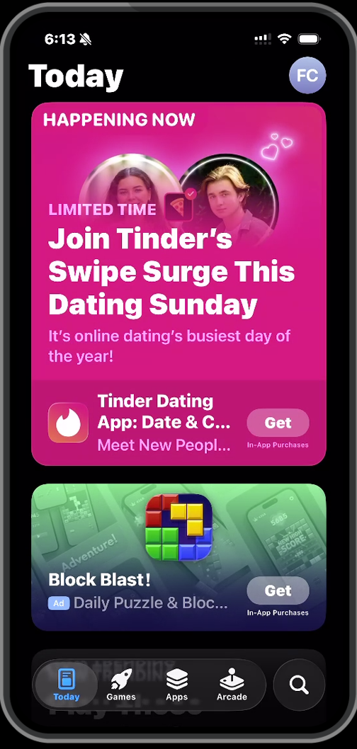

Slide 23
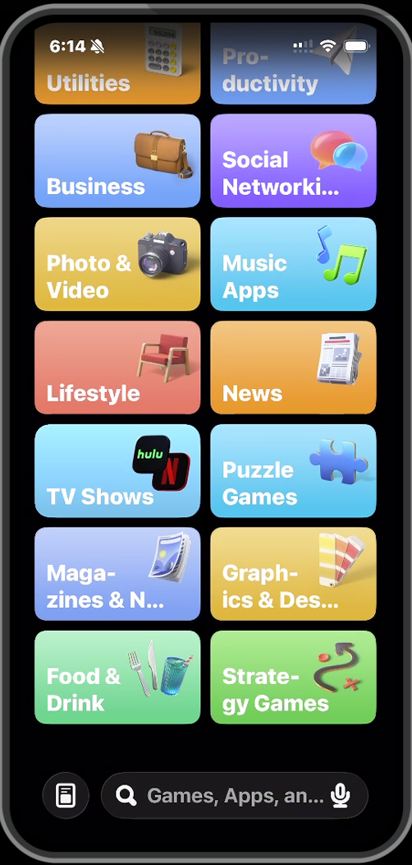

Slide 24
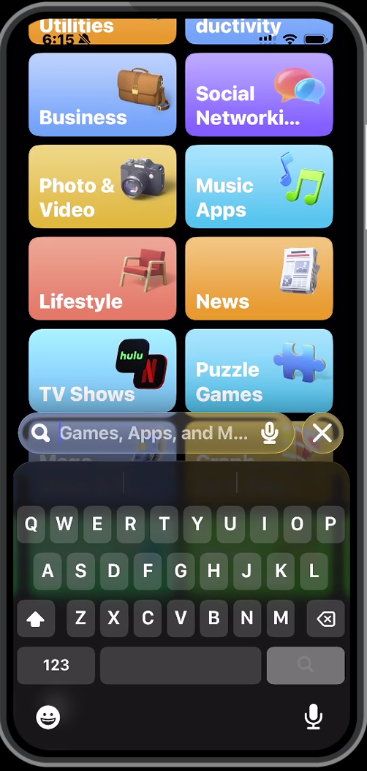

Slide 25
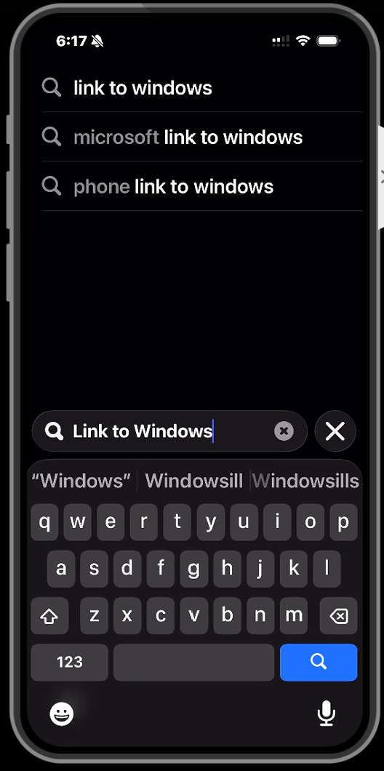

Slide 26
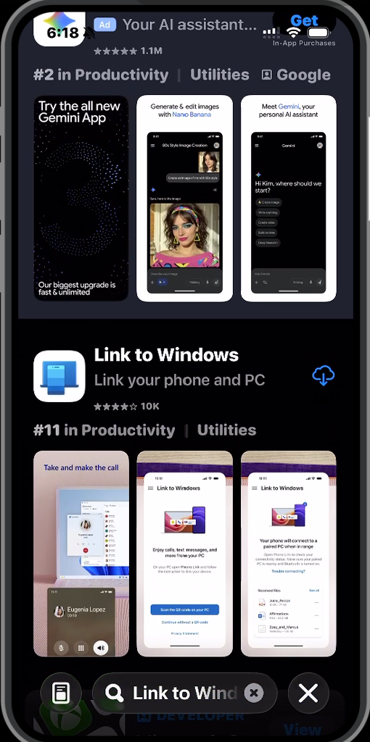

Slide 27
STEPS FOR INSTALLING "LINK TO WINDOWS" INTO A CELL PHONE (continued)
Step 2: Install or update "Link to Windows" in the cell phone (if you cannot find it already installed in the cell phone):

Slide 30
STEPS FOR INSTALLING "LINK TO WINDOWS" INTO A CELL PHONE (continued)
Step 3: From inside the cell phone, i then start up "Link to Windows":

Slide 31
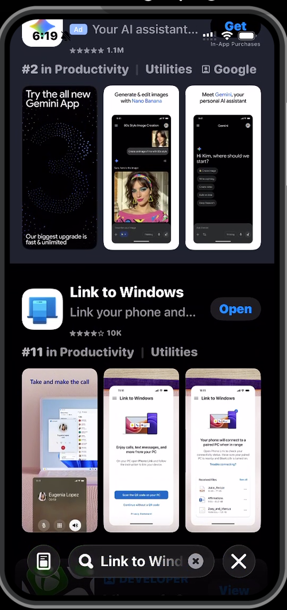

Slide 33
STEPS FOR INSTALLING "LINK TO WINDOWS" INTO A CELL PHONE (continued)
Step 4: From "Link to Windows" inside the cell phone, either log into an existing "Microsoft Account" or create a new one

Slide 34
STEPS FOR INSTALLING "LINK TO WINDOWS" INTO A CELL PHONE (continued)
Step 5: Leave the cell phone in it's vertical orientation so that it does not fall asleep

Slide 35
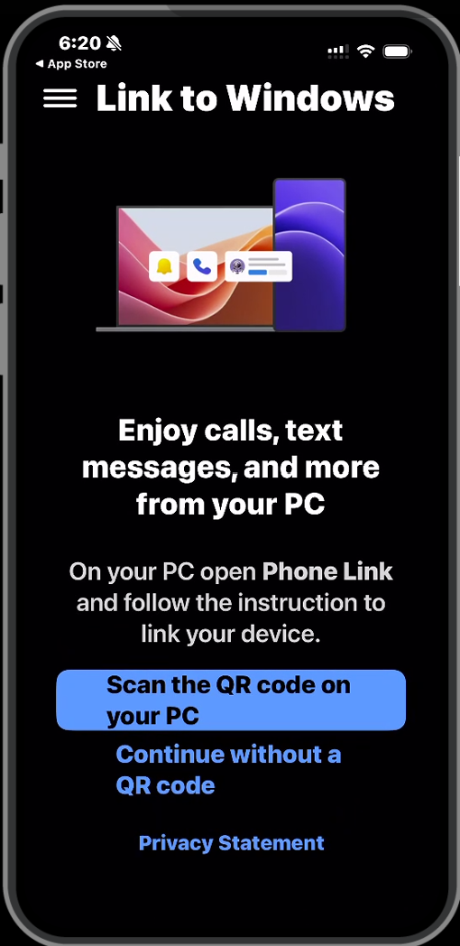

Slide 36
STEPS FOR CONFIGURING "PHONE LINK" IN "WINDOWS 11" (continued)
Step 1: From inside the "Windows 11" computer, locate the bundled "Phone Link" app in the "Start Menu" of a Windows 11 computer or a Windows10 computer:
("Phone Link" is a regular part of the "Windows 11" operating system.)

Slide 37
STEPS FOR CONFIGURING "PHONE LINK" IN "WINDOWS 11" (continued)
In "Windows 11", you usually have to click on the "All" button of the "Start Menu" before you can locate "Phone Link" or you can usually find it in "Search" or "Type here to search"

Slide 38
STEPS FOR CONFIGURING "PHONE LINK" IN "WINDOWS 11" (continued)
If you have an old computer, "Phone Link" might be present under one of it's now obsolete names over the past 10 years,
"Phone Companion" (2015) which morphed into "Your Phone" (2020) which morphed into "Phone Link" (2022)

Slide 39


Slide 41
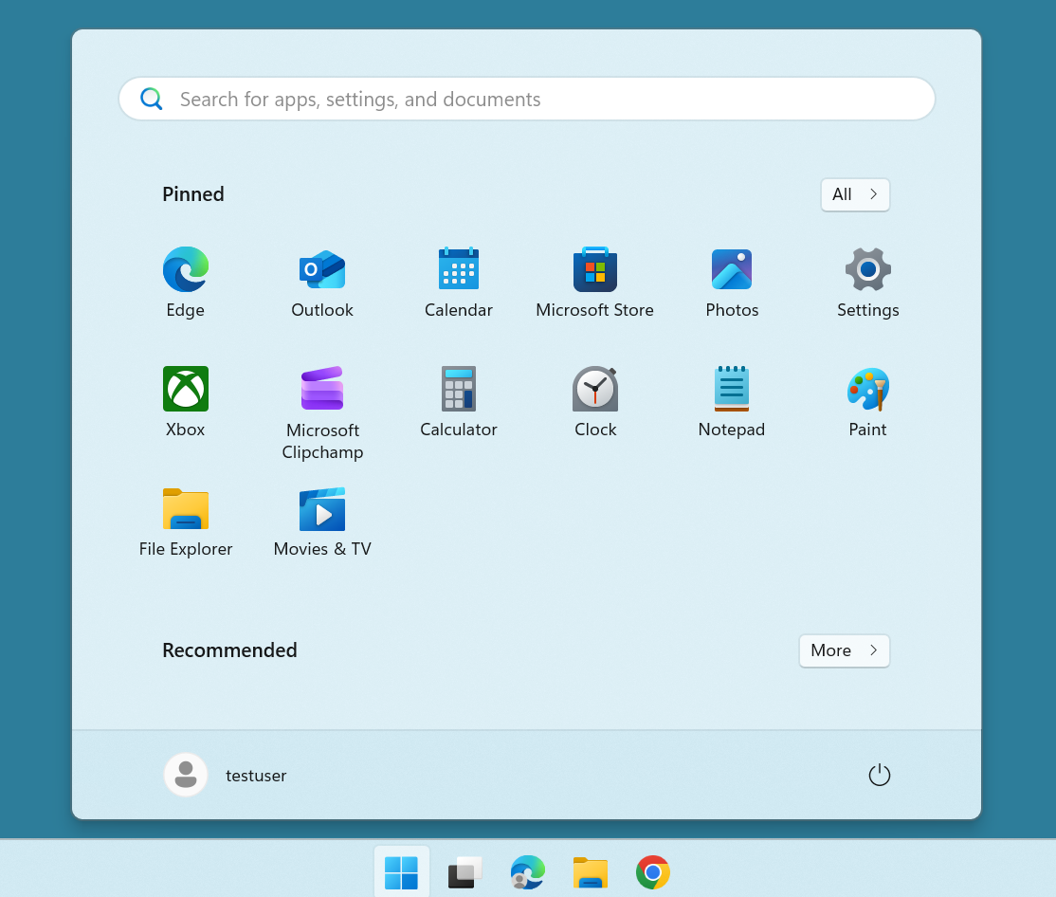

Slide 43
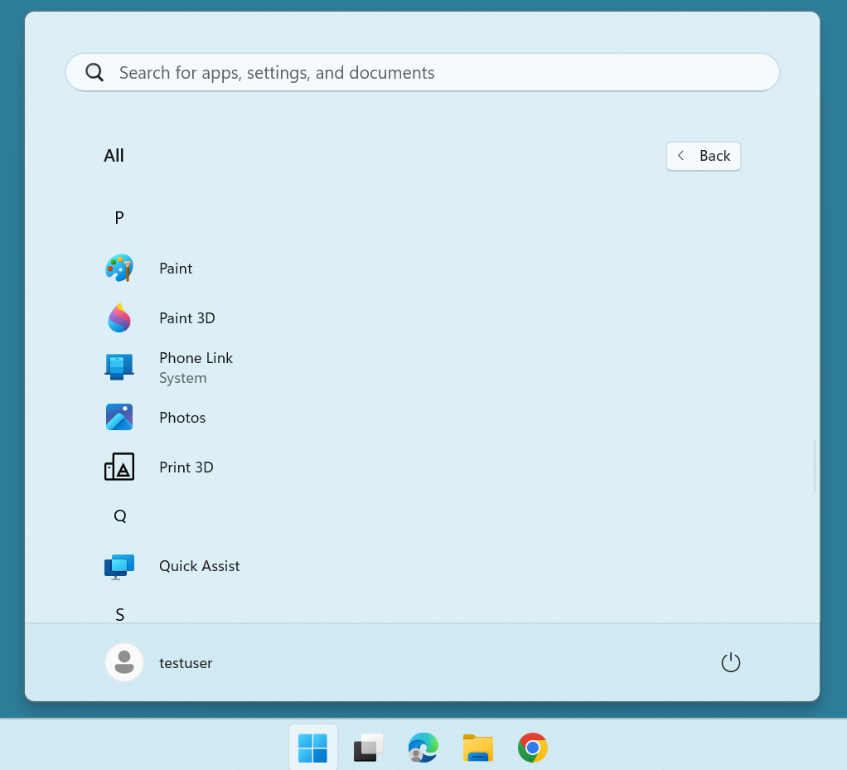

Slide 44
STEPS FOR CONFIGURING "PHONE LINK" IN "WINDOWS 11" (continued)
Step 2: Use the LEFT mouse button to double-click on the "Phone Link" app

Slide 45
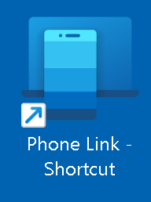

Slide 46


Slide 48
STEPS FOR CONFIGURING "PHONE LINK" IN "WINDOWS 11" (continued)
Step 3: A "Phone Link" box will be displayed:

Slide 49
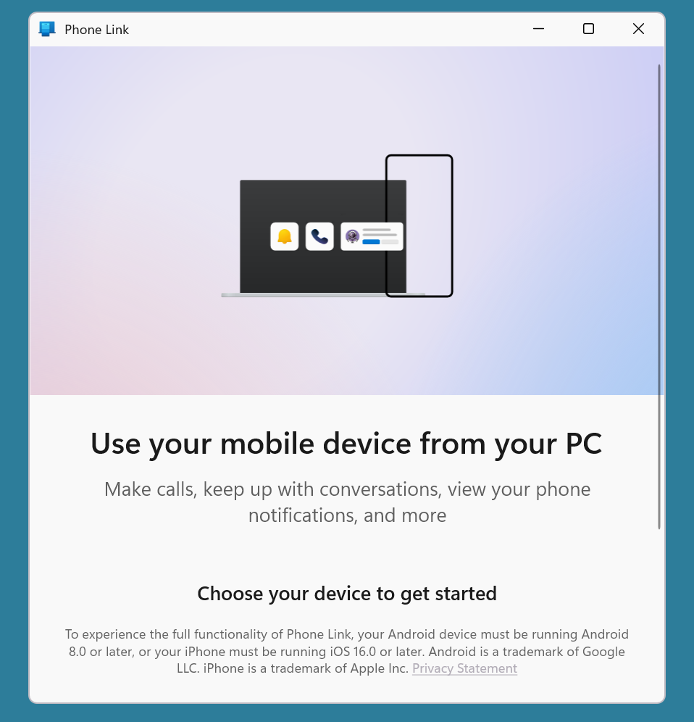

Slide 50
STEPS FOR CONFIGURING "PHONE LINK" IN "WINDOWS 11" (continued)
Step 4: Scroll vertically downward to display the bottom of the "Phone Link" box:

Slide 52
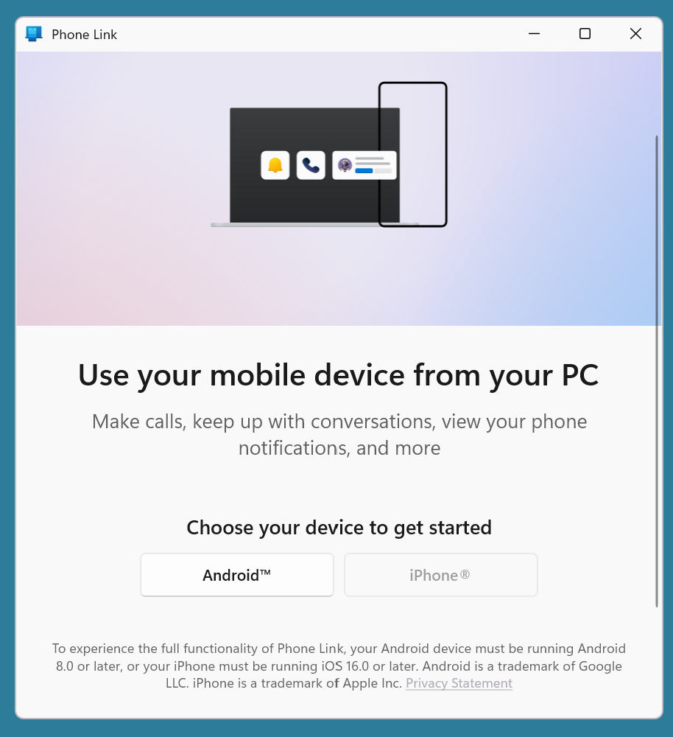

Slide 54
STEPS FOR CONFIGURING "PHONE LINK" IN "WINDOWS 11" (continued)
Step 5: Use the LEFT mouse button to select whether you want to connect to an Android cell phone or an Apple "iPhone"

Slide 55
STEPS FOR CONFIGURING "PHONE LINK" IN "WINDOWS 11" (continued)
Step 5 (continued): The "iPhone" button will be grayed out and unavailable if your "Windows 11" computer has a "Bluetooth" transmitter-receiver that is not capable of communicating in the "Bluetooth Low Energy" format since "Bluetooth" pairing and connecting with an "iPhone" has to be in the "Bluetooth Low Energy" format. (Android cell phones are not as picky.)

Slide 56
STEPS FOR CONFIGURING "PHONE LINK" IN "WINDOWS 11" (continued)
Step 5 (continued): To see if the Bluetooth transmitter-receiver in your computer is capable of communicating with "Bluetooth Low Energy" format (only if you are connecting "Phone Link" to an "iPhone"): Use the RIGHT mouse button to click on the Windows "Start Button. Then use the LEFT mouse button to click on Device Manager. Then use the LEFT mouse button to click on the ">" to expand the "Bluetooth" item.

Slide 57
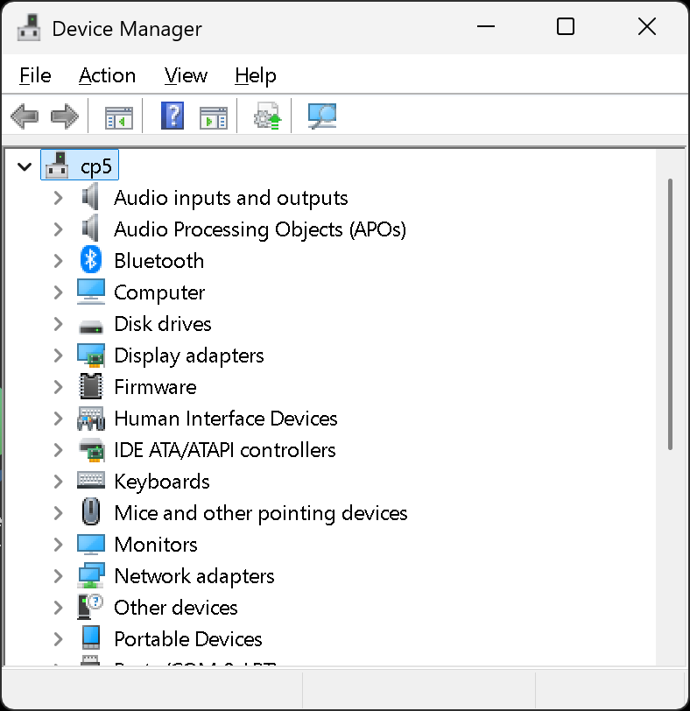

Slide 60
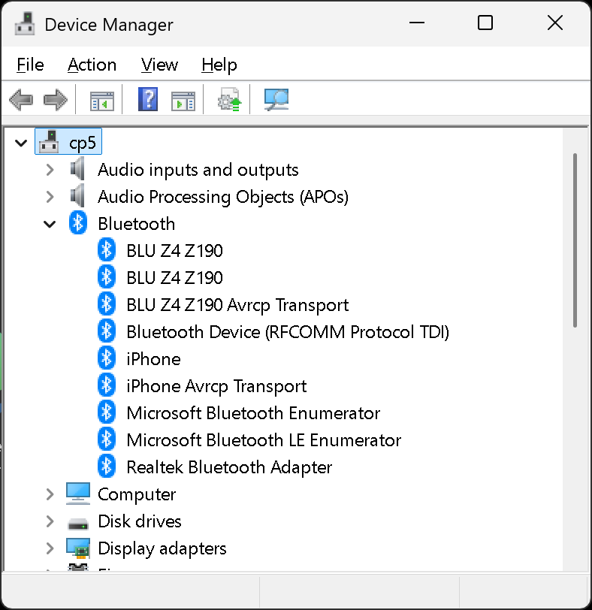

Slide 64
STEPS FOR CONFIGURING "PHONE LINK" IN "WINDOWS 11" (continued)
Step 6: Use the camera of the cell phone to scan the QR code that is being displayed inside the "Phone Link" app inside "Windows 11":

Slide 65
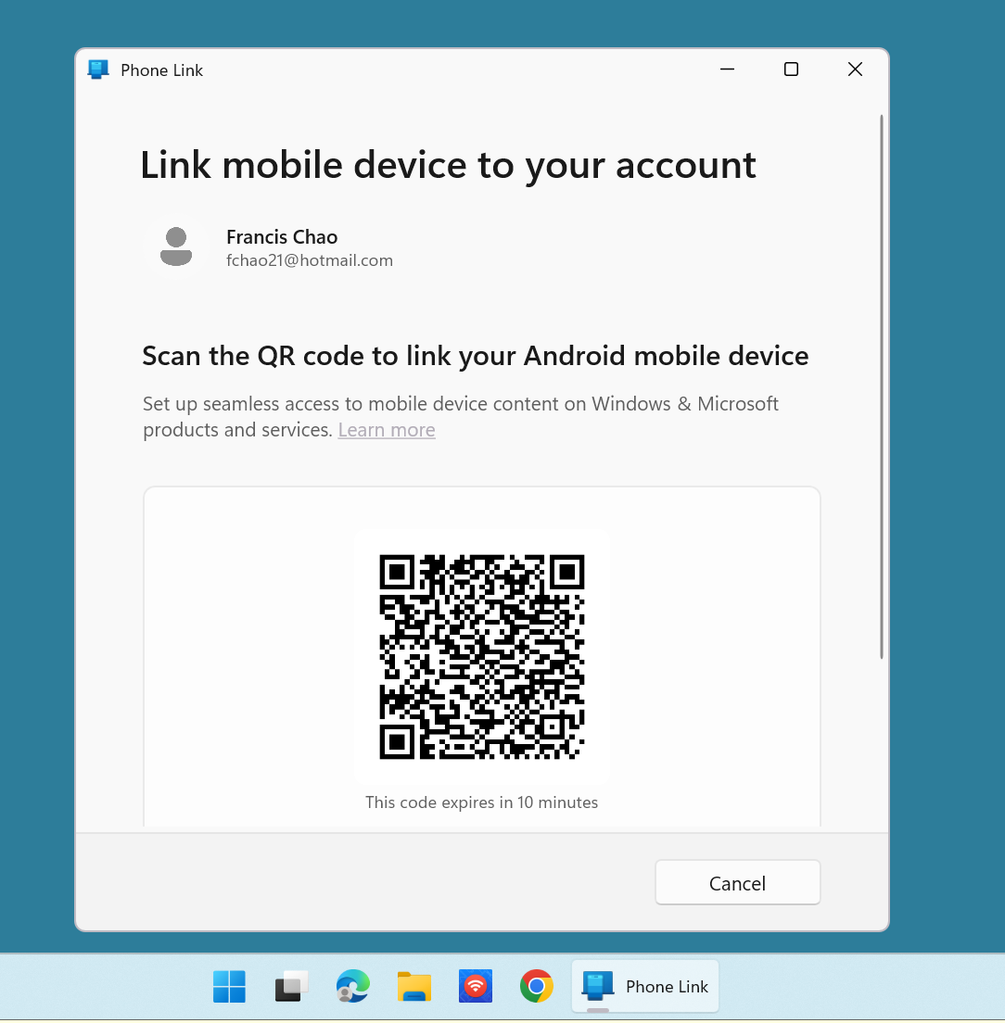

Slide 66
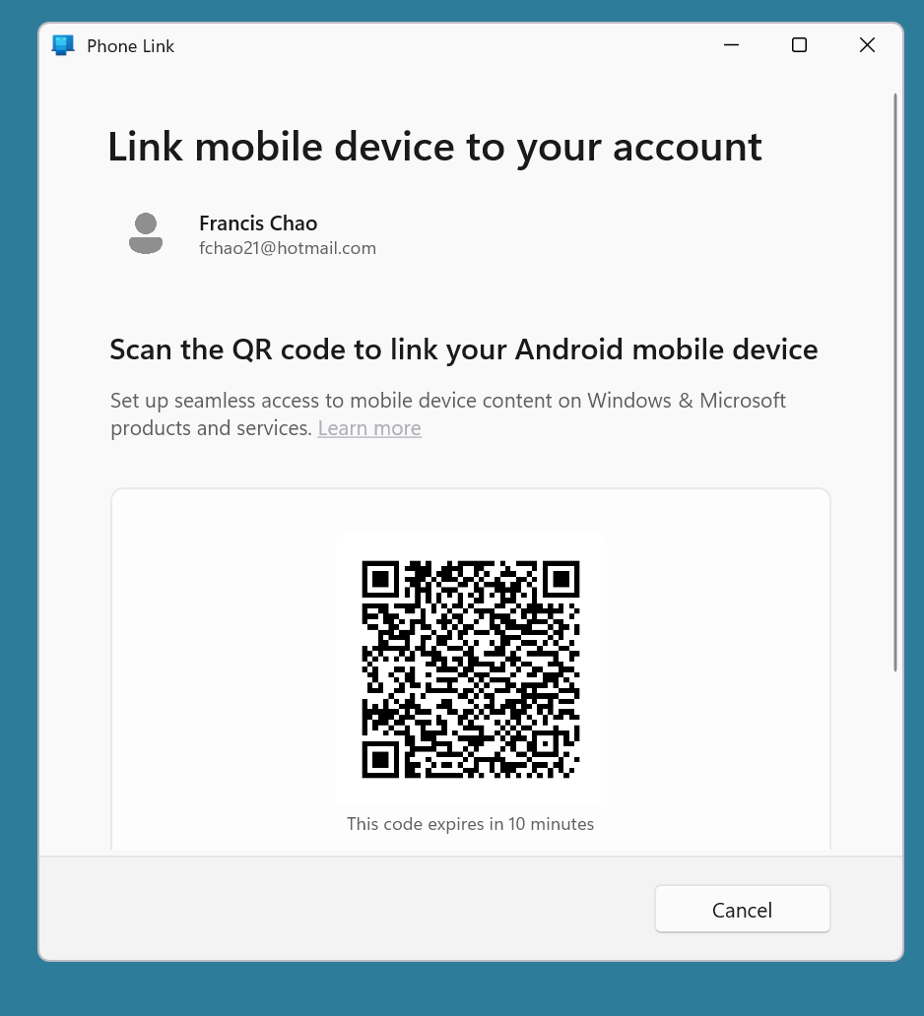

Slide 67
STEPS FOR CONFIGURING "PHONE LINK" IN "WINDOWS 11" (continued)
Step 7: Follow the instructions in the cell phone AND in the "Phone Link" app in "Windows 11" to establish a connection between "Link to Windows" in the cell phone and "Phone Link in the Windows 11 computer

Slide 68
STEPS FOR CONFIGURING "PHONE LINK" IN "WINDOWS 11" (continued)
Step 8: When a connection is established between "Link to Windows" in the cell phone and "Phone Link" in the Windows 11 computer, a "Phone Link" window with the activated "Messages", "Calls", "Apps", and "Photos" tabs will be displayed.

Slide 69
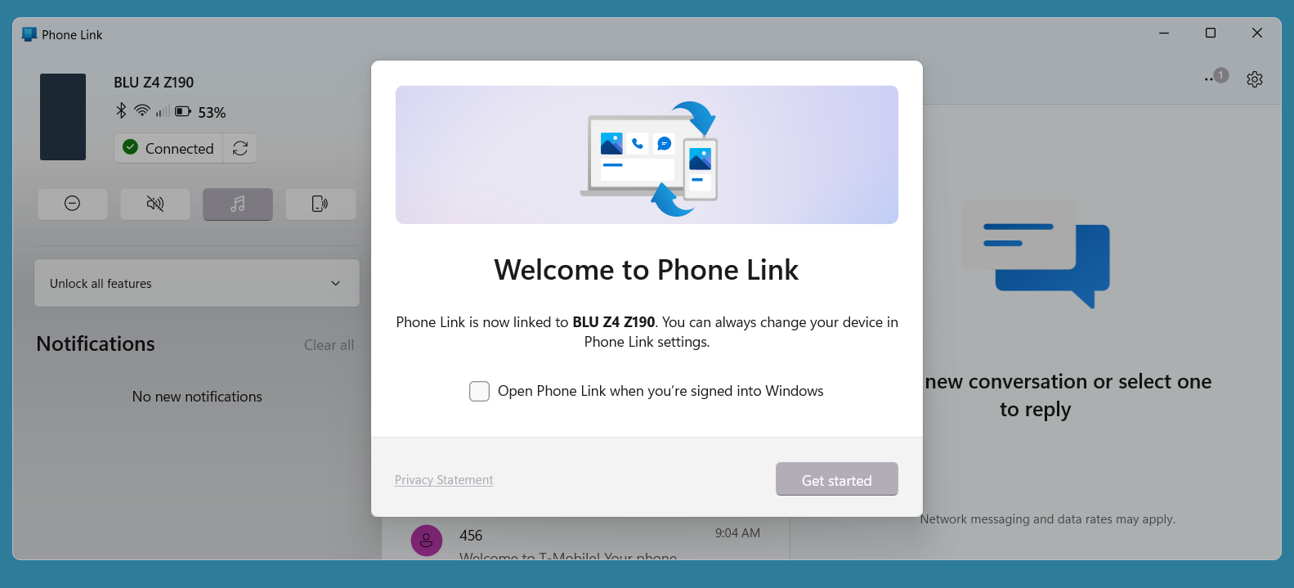

Slide 70
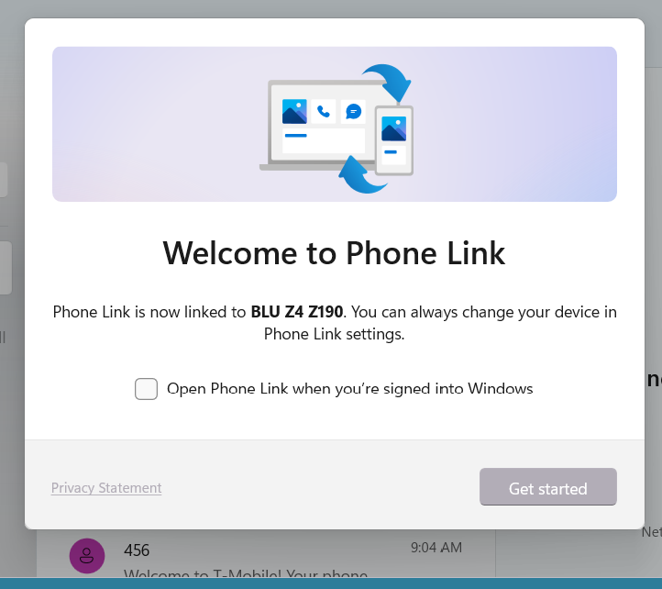

Slide 71
STEPS FOR CONFIGURING "PHONE LINK" IN "WINDOWS 11" (continued)
Step 9: Click on the "Get started" button in order to start using the activated "Phone Link" window to control the cell phone:

Slide 72
STEPS FOR CONFIGURING "PHONE LINK" IN "WINDOWS 11" (continued)
Step 9: continued: For most functions of the cell phone, you will have a choice between using the displayed image of the cell phone, the tabbed screens of the "Phone Link" app, or the actual cell phone:

Slide 73
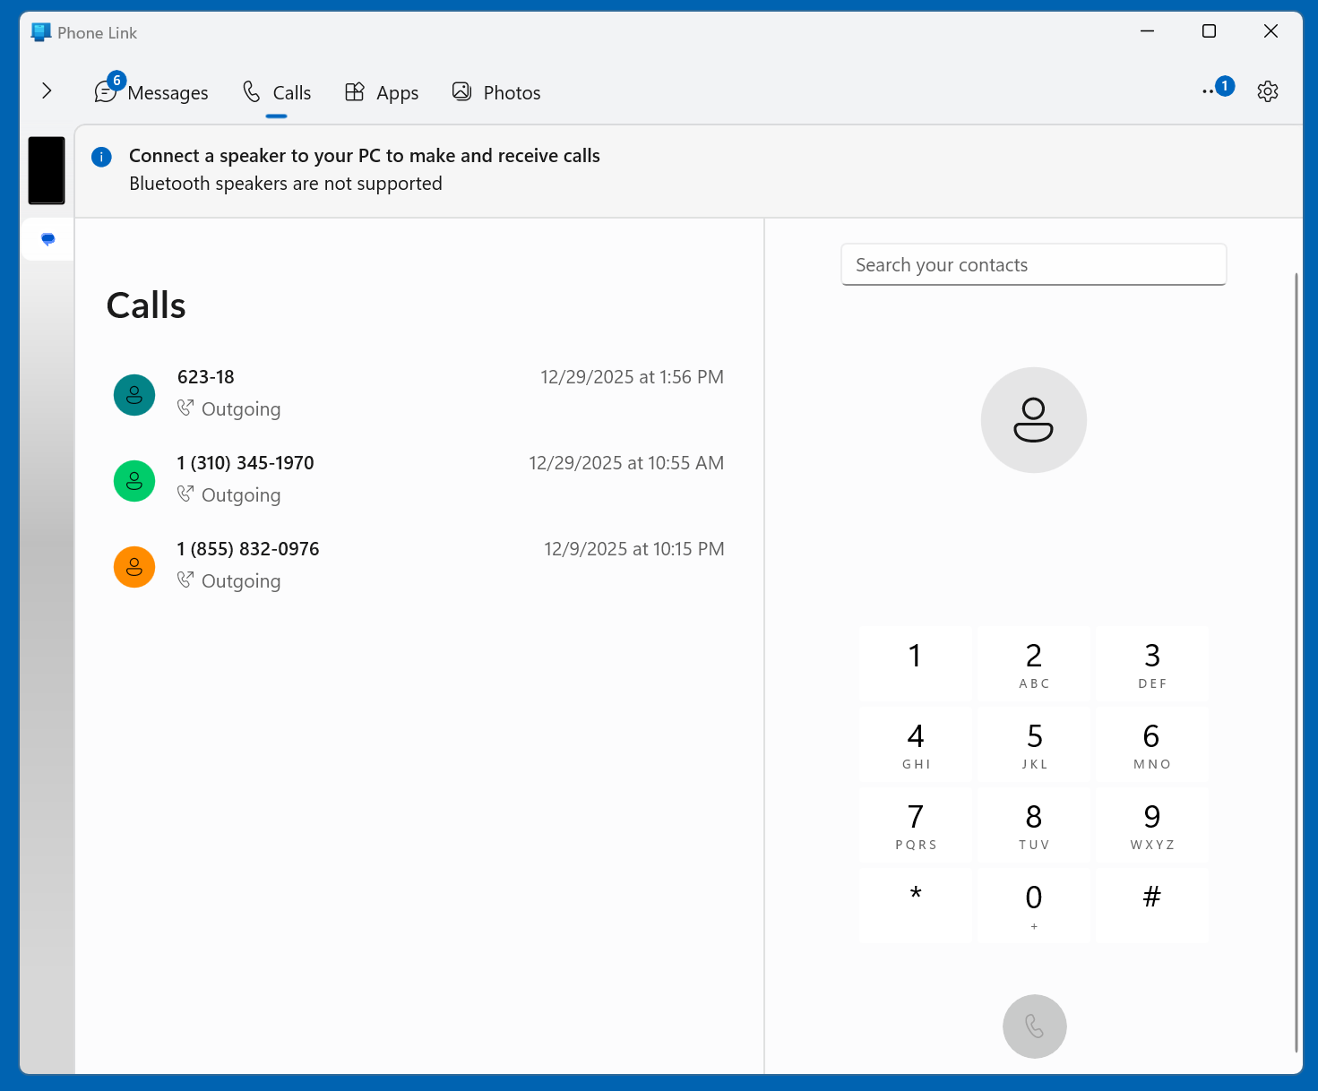

Slide 74
IF THE "CALLS" TAB OF "PHONE LINK" IS NOT WORKING..
..and all the other tabs and functions in "Phone Link" work, go to "Device Manager" in "Windows 11" and expand the "Bluetooth" section. Then use the RIGHT mouse button to do an "Uninstall device" on the "Bluetooth adapter. Then reboot the computer.

Slide 75
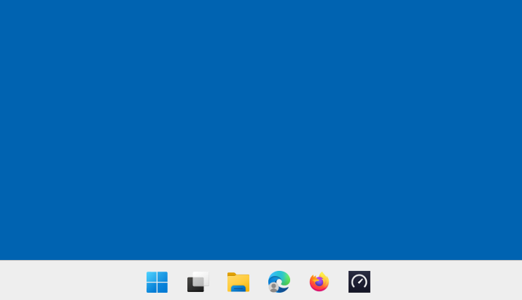

Slide 77
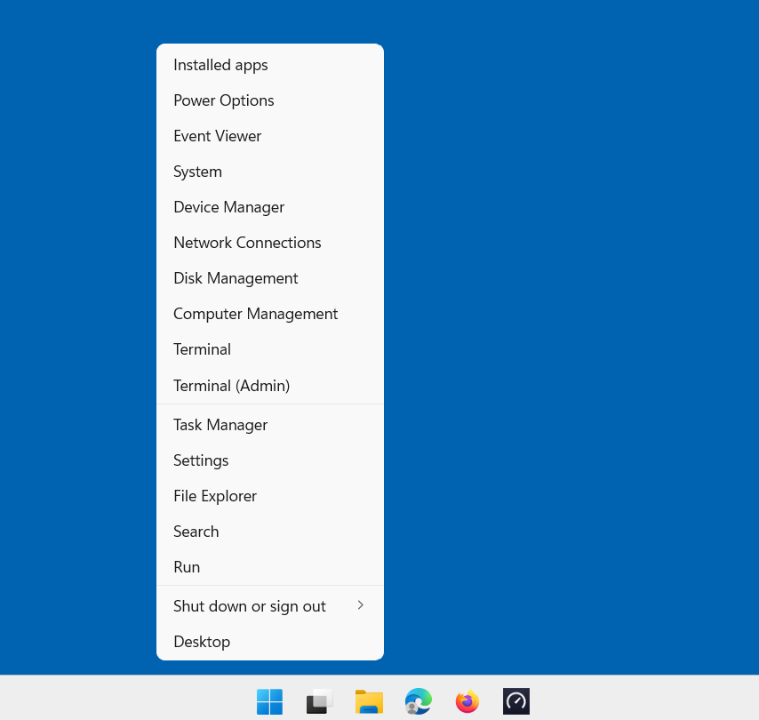

Slide 79
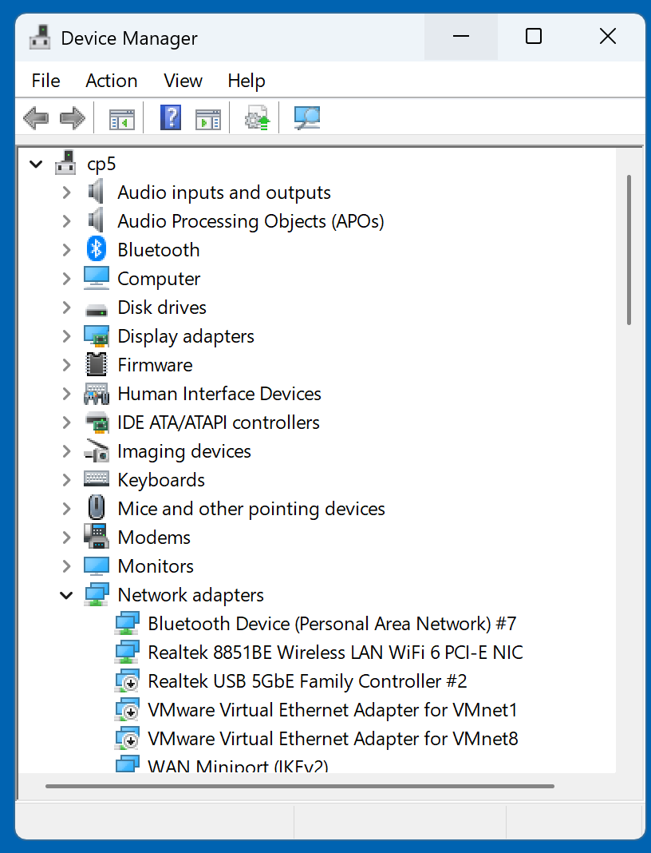

Slide 81
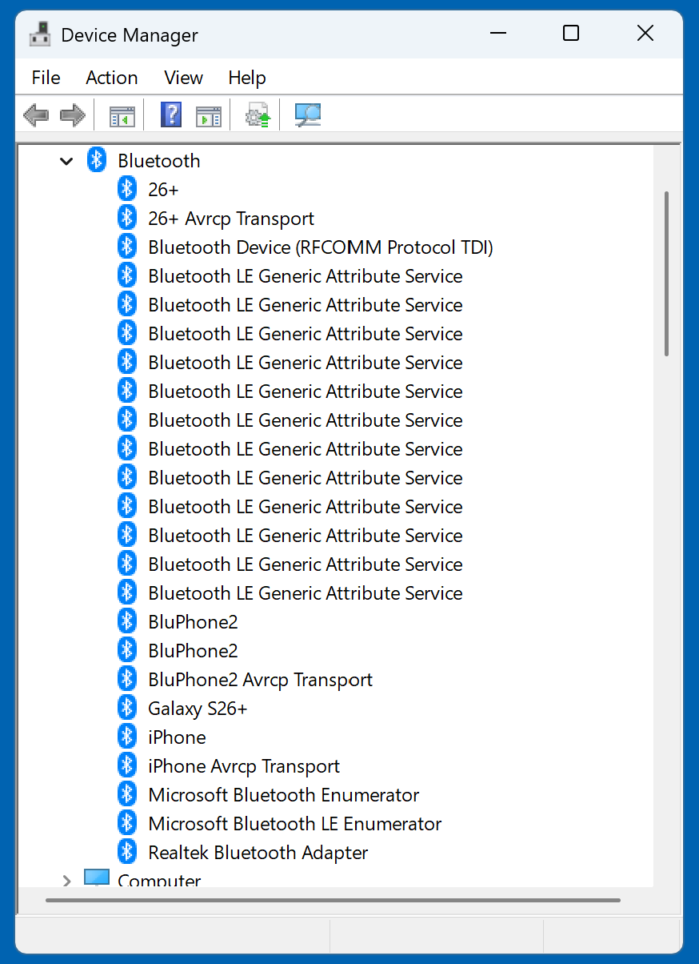

Slide 83
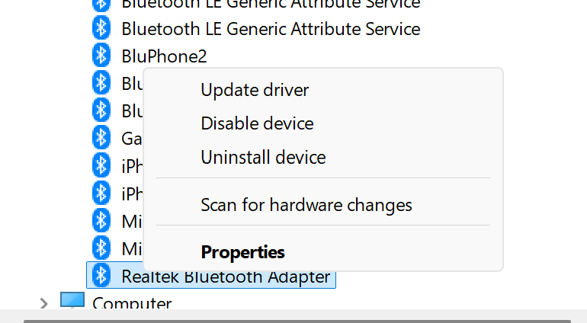

Slide 85
IF YOU HAVE MULTIPLE CELL PHONES TO SELECT FOR "PHONE LINK"..
..you can select between them as follows: Start up "Phone Link" Use the LEFT mouse button to click on the "Settings" gear icon. Use the LEFT mouse button to click on the ">" icon. Use the drop-down-list-arrow button to select the desired cell phone.

Slide 86
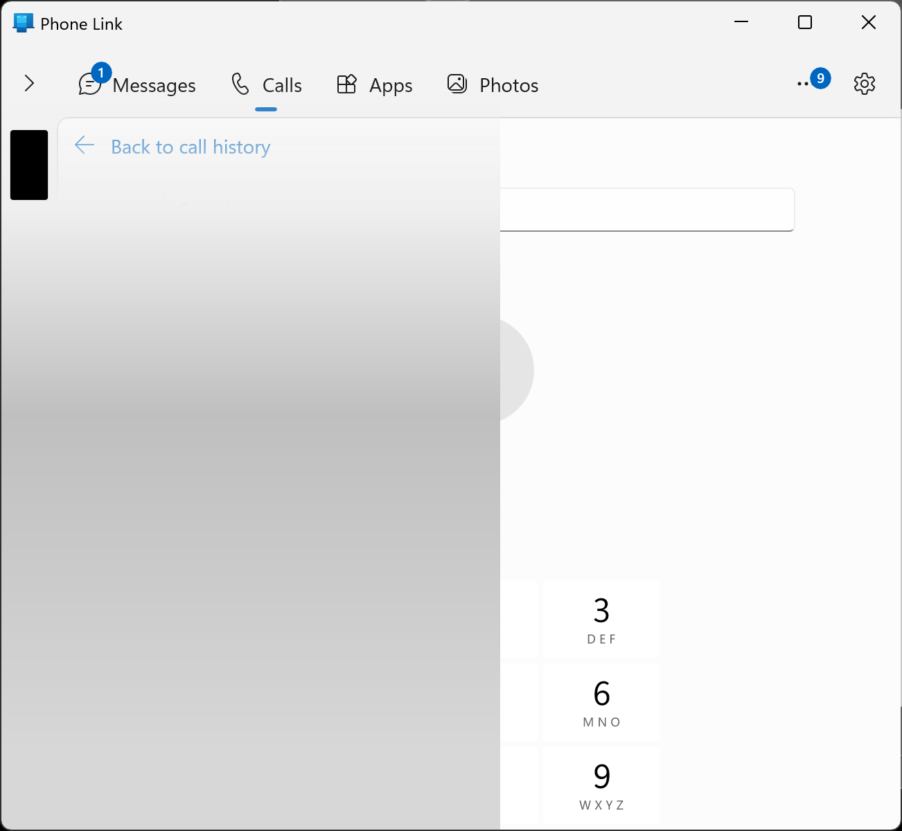

Slide 88
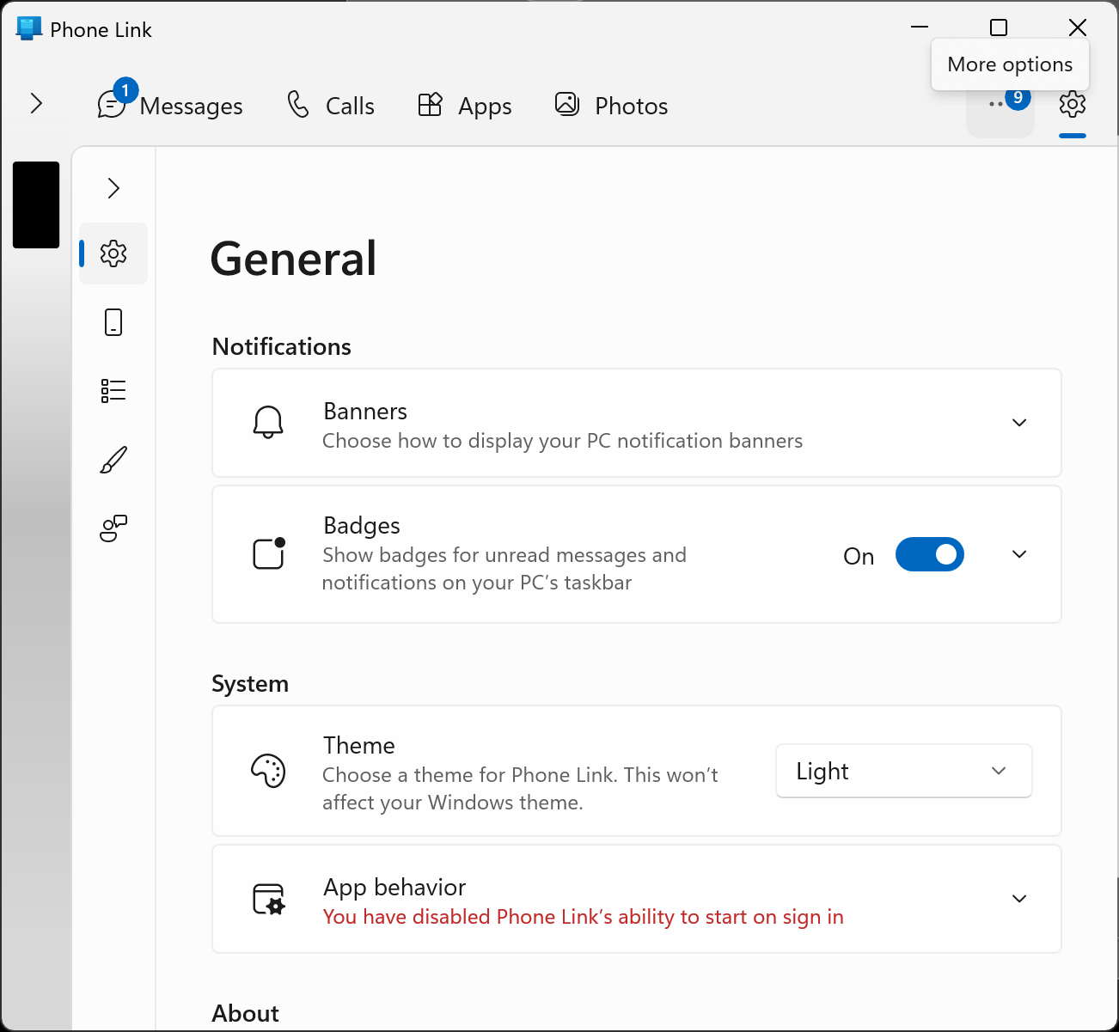

Slide 90
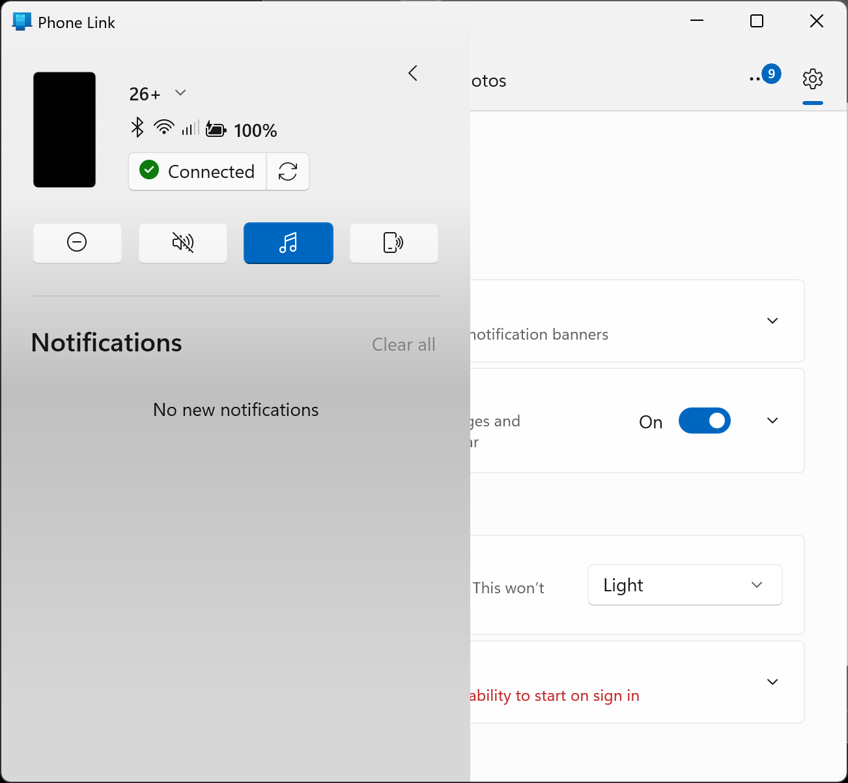

Slide 92
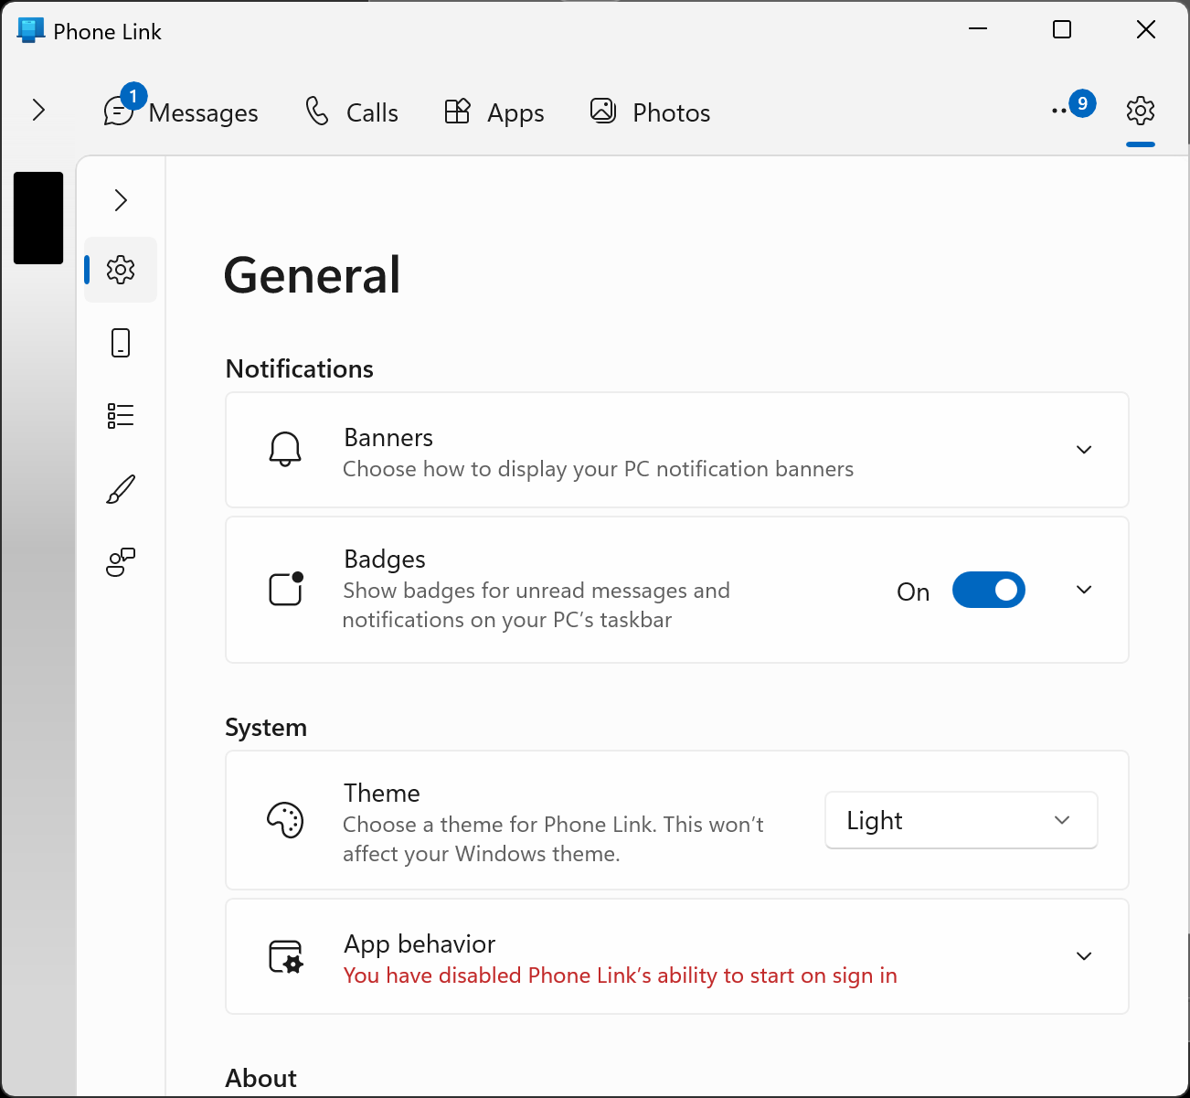

Slide 94
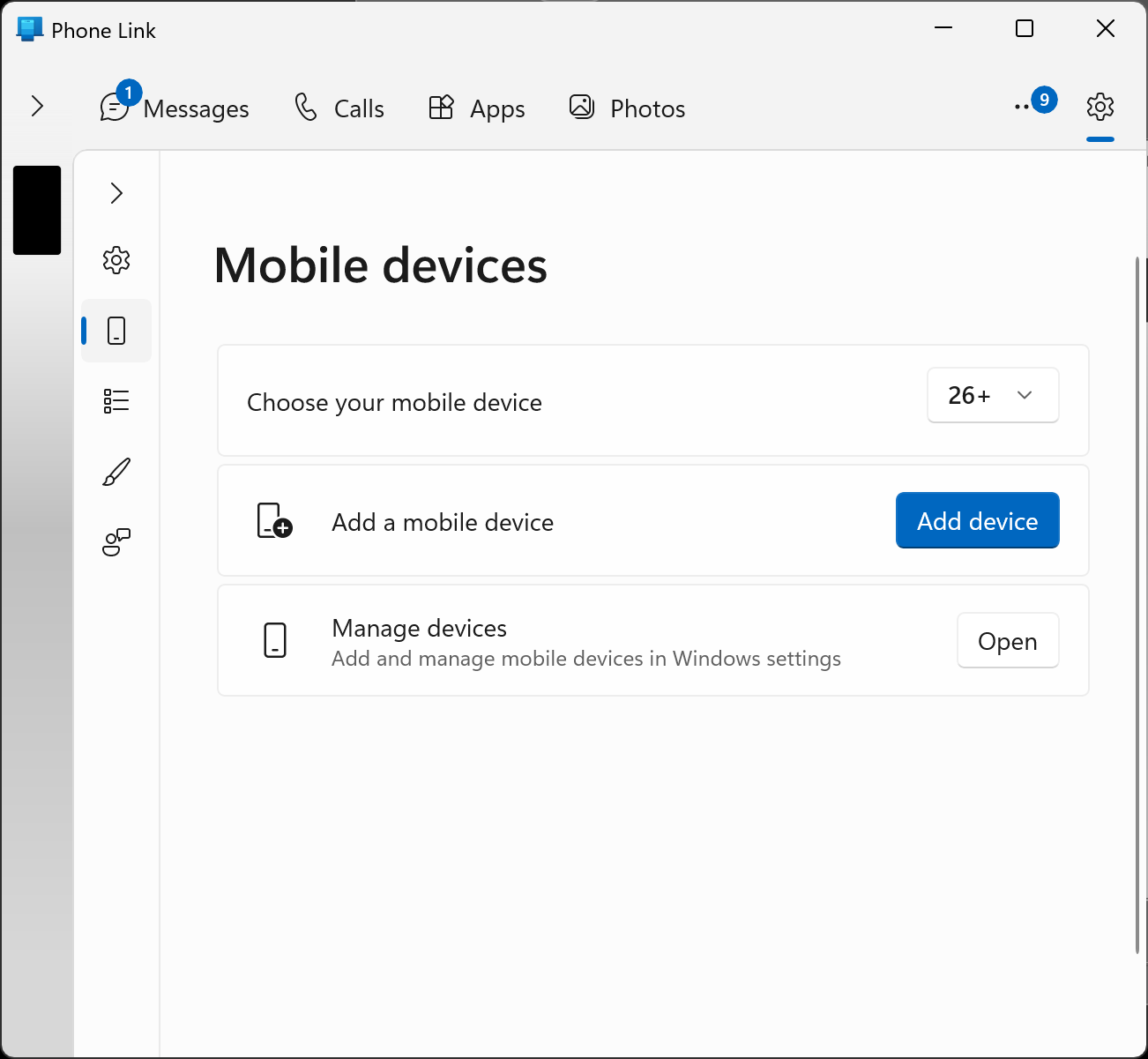

Slide 96
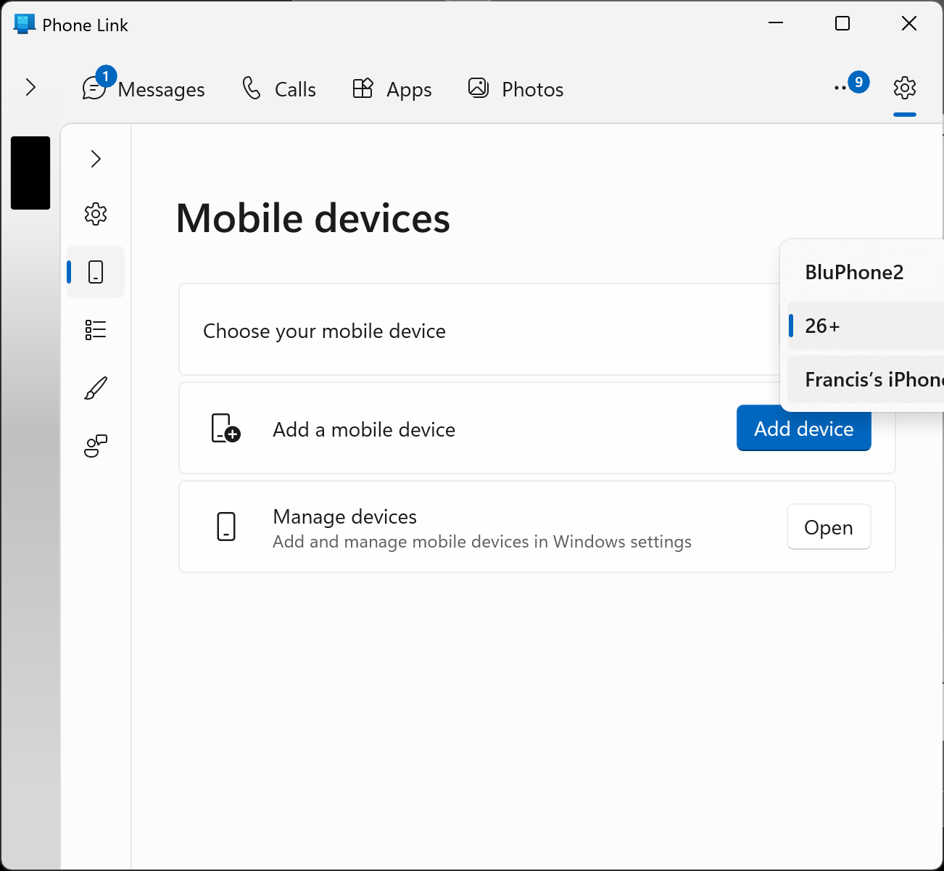

Slide 97
ADDITIONAL ADVICE FOR RUNNING "PHONE LINK" IN "WINDOWS 11" (continued)
https://support.microsoft.com/en-us/topic/setting-up-calls-in-the-phone-link-c7e75908-c65d-bd42-fcb2-ea4d5fb783f1#id0efd=android

Slide 98
ADDITIONAL ADVICE FOR RUNNING "PHONE LINK" IN "WINDOWS 11" (continued)
https://support.microsoft.com/en-us/topic/troubleshooting-the-phone-link-82b6c6aa-544e-d4af-fd5d-2629a2a95835

Slide 99
ADDITIONAL ADVICE FOR RUNNING "PHONE LINK" IN "WINDOWS 11" (continued)
https://www.macobserver.com/tips/how-to/connect-your-iphone-to-a-windows-pc-with-and-without-microsoft-phone-link/

