Slide 1




1--USING "PHONE LINK" TO CONTROL
AN ANDROID CELL PHONE FROM A "WINDOWS 11" COMPUTER

Slide 2
Web location for this presentation:
http://aztcs.apcug.org
Click on
"Meeting Notes"

Slide 3
SUMMARY
An Android cell phone can be controlled from the bundled "Phone Link" app in a "Windows 11" computer.

Slide 4
TOPICS
Using Microsoft's "Phone Link" app in a "Windows 11" computer
Advantages of Controlling An Android Phone From A Computer
Locating "Link to Windows" In A Cell Phone
Locating "Phone Link" in a "Windows 11"
Detailed Steps for Using "Phone Link"

Slide 5
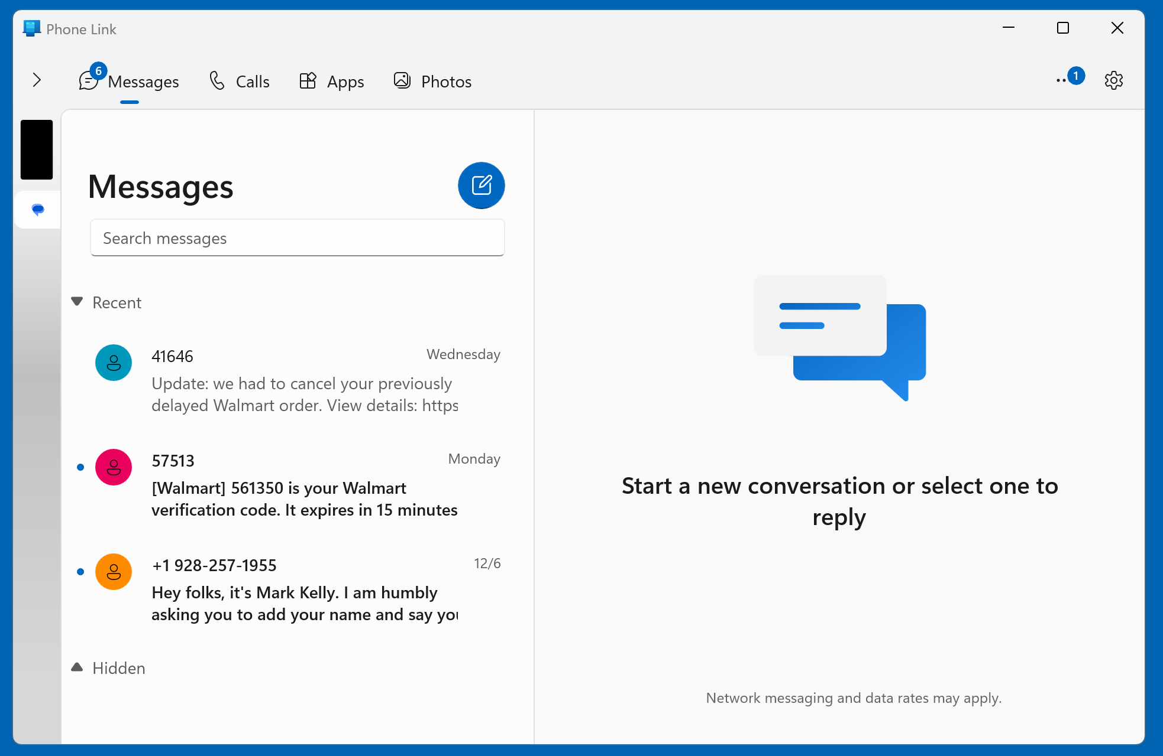

Slide 6
USING "PHONE LINK" IN WINDOWS" TO CONTROL AN ANDROID CELL PHONE (continued)
Then use your LEFT mouse button to click on the black rectangle to get an active display of the Android cell phone's screen:

Slide 8
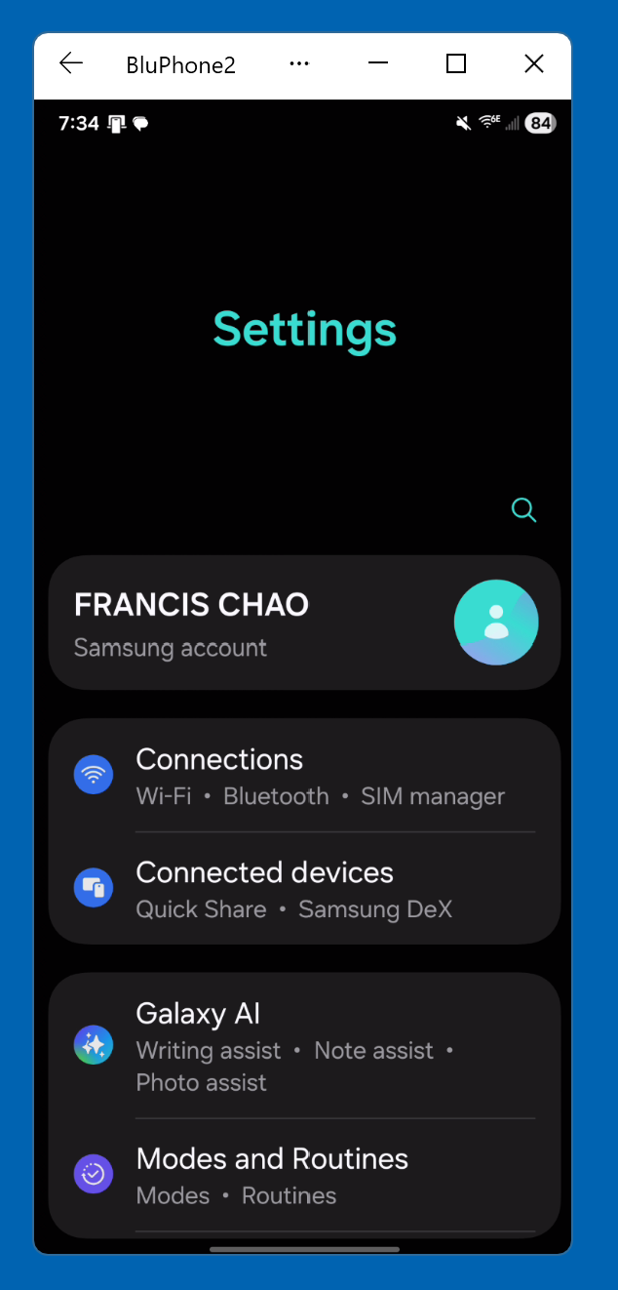

Slide 9
USING "PHONE LINK" IN WINDOWS" TO CONTROL AN ANDROID CELL PHONE (continued)
To move the phone screen window, drag the name of the phone:

Slide 11
USING "PHONE LINK" IN WINDOWS" TO CONTROL AN ANDROID CELL PHONE (continued)
If the image of the screen of the Android cell phone disappears after 10 to 20 seconds: Shut down background apps that are running in the Windows 11 computer or get more RAM for your Windows 11 computer.

Slide 12
USING "PHONE LINK" IN WINDOWS" TO CONTROL AN ANDROID CELL PHONE (continued)
Casting the screen of any cell phone to a Windows 11 computer is a heavy drain on the cell phone's battery so you should charge the cell phone while using "Phone Link" with a wireless Qi charger such the the excellent one made by Nanami:

Slide 13
USING "PHONE LINK" IN WINDOWS" TO CONTROL AN ANDROID CELL PHONE (continued)
https://www.amazon.com/NANAMI-Upgraded-Wireless-Charging-Compatible/dp/B07WRXFCPD/

Slide 14
USING "PHONE LINK" IN WINDOWS" TO CONTROL AN ANDROID CELL PHONE (continued)
"Phone Link" has 5 tabbed screens: Messages, Calls, Apps, Photos, and Notifications

Slide 19
TEXTING FROM THE "PHONE LINK" APP IN "WINDOWS 11"
Three ways: 1. From the "Messages" tab where the Enter key of the keyboard sends the text message 2. From the "Apps" tab 3. From the phone screen display when the Enter key just drops you down to a new line

Slide 20
USING "PHONE LINK" IN WINDOWS" TO CONTROL AN ANDROID CELL PHONE (continued)
The "Calls" tabbed screen is the default screen that is displayed when the "Phone Link" app connects to the "Link to Windows" app for the first time:

Slide 21
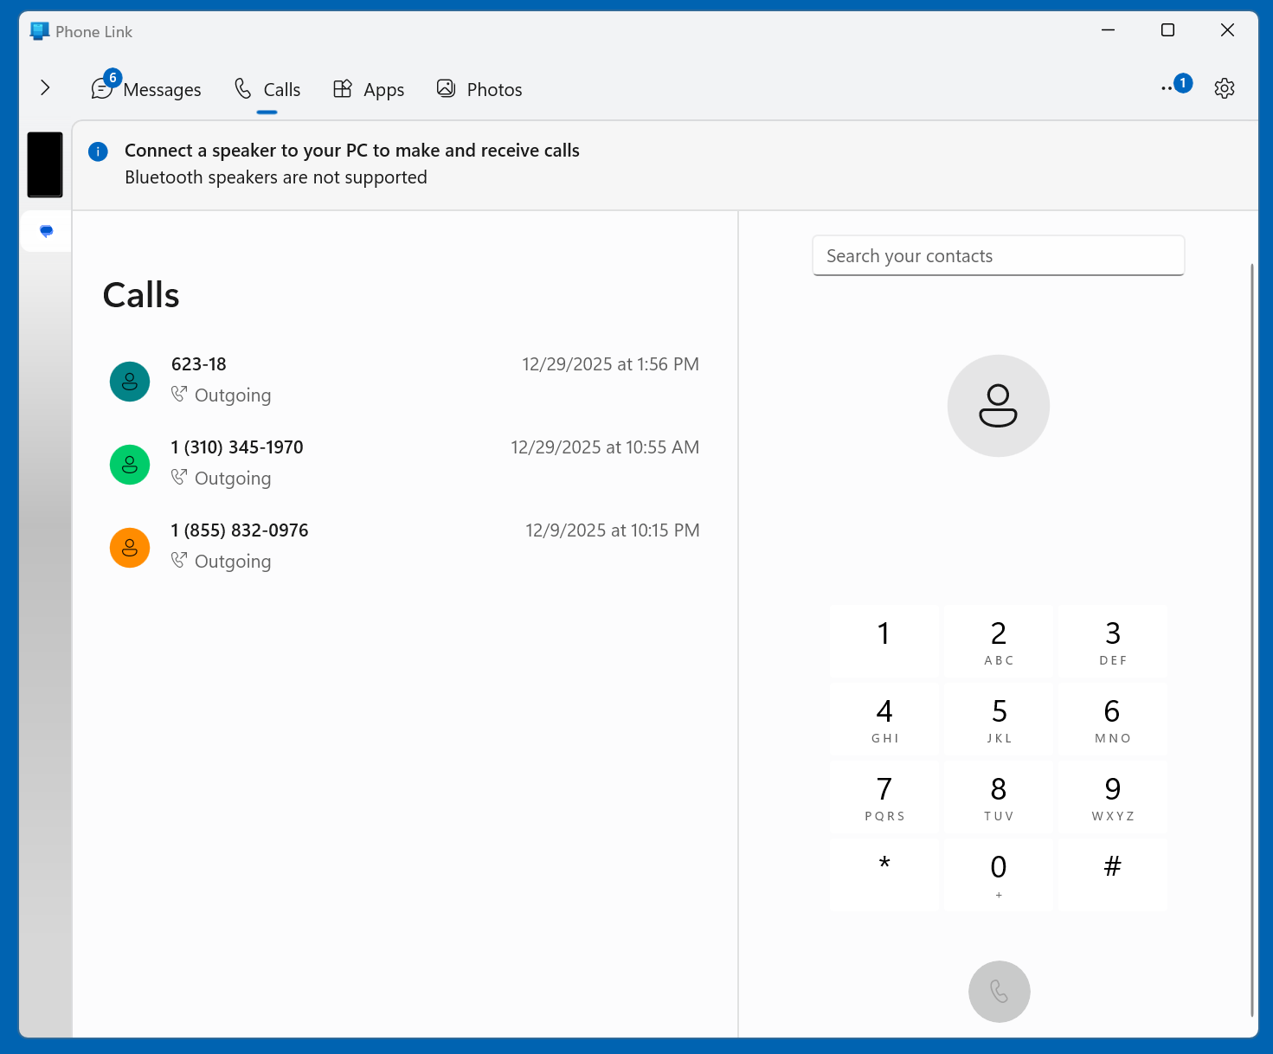

Slide 22
USING "PHONE LINK" IN WINDOWS" TO CONTROL AN ANDROID CELL PHONE (continued)
The "Apps" tabbed screen lets you display more the many cell phone apps at the same time. When you are using the screen of a cell phone, you can display only two separate apps screens at the same time: one app in the upper half of the screen and one screen in the lower half of the screen.

Slide 23
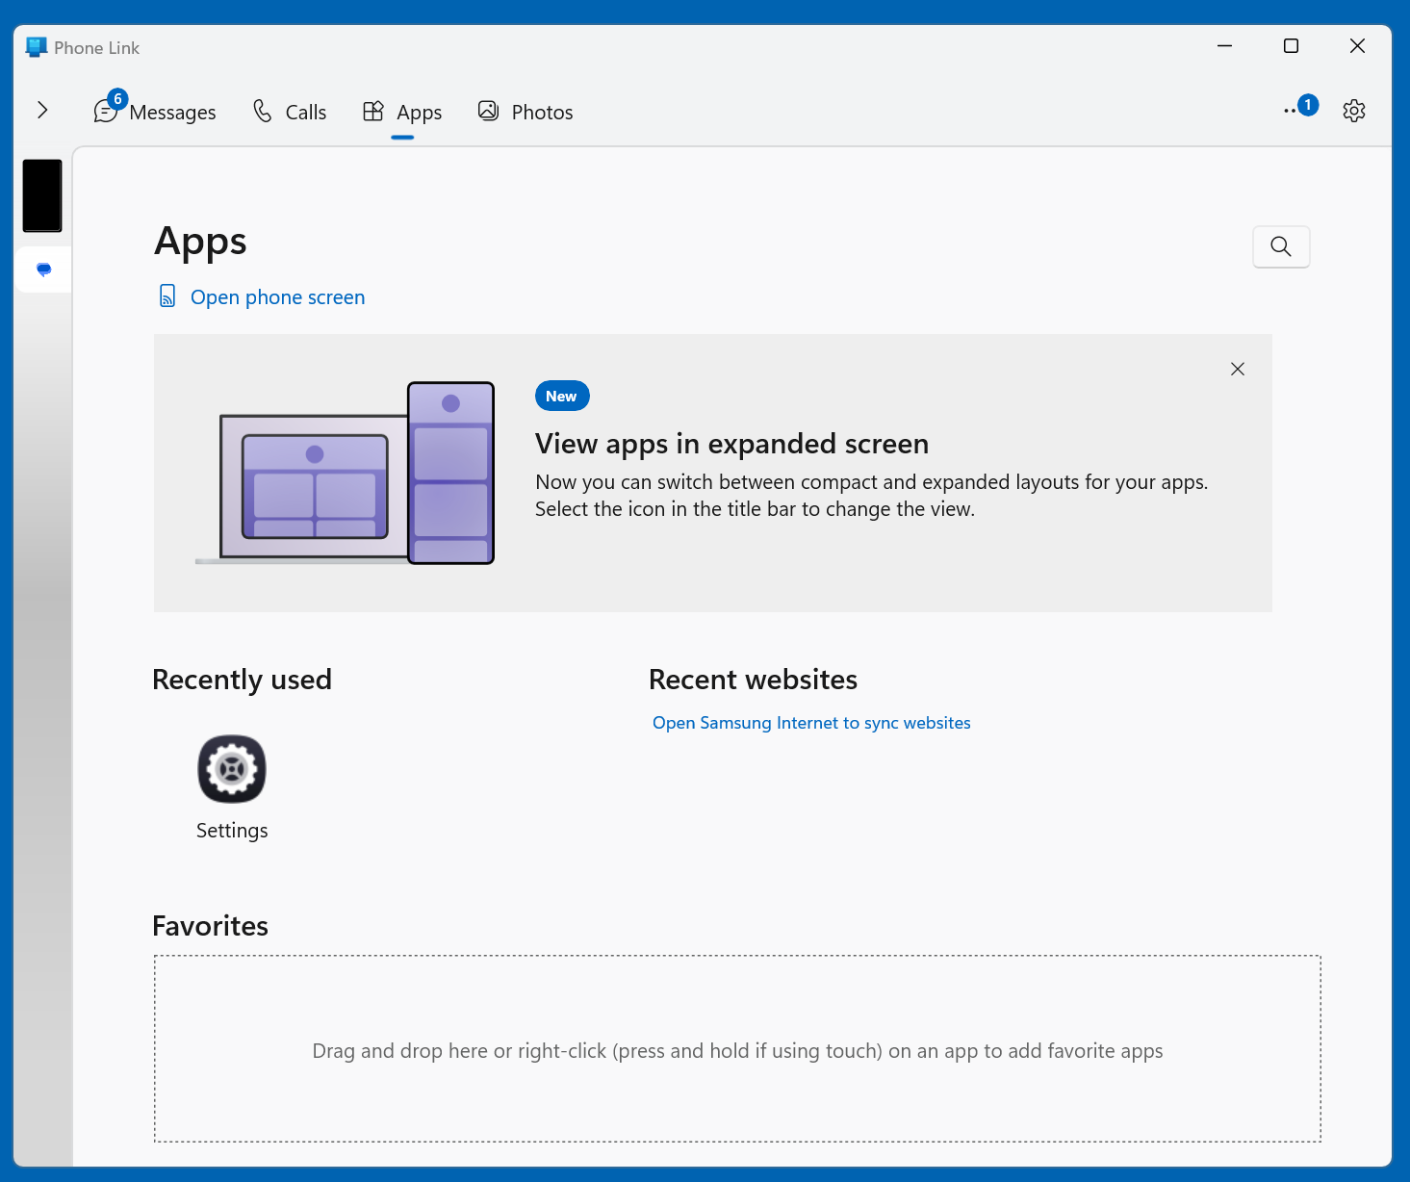

Slide 24
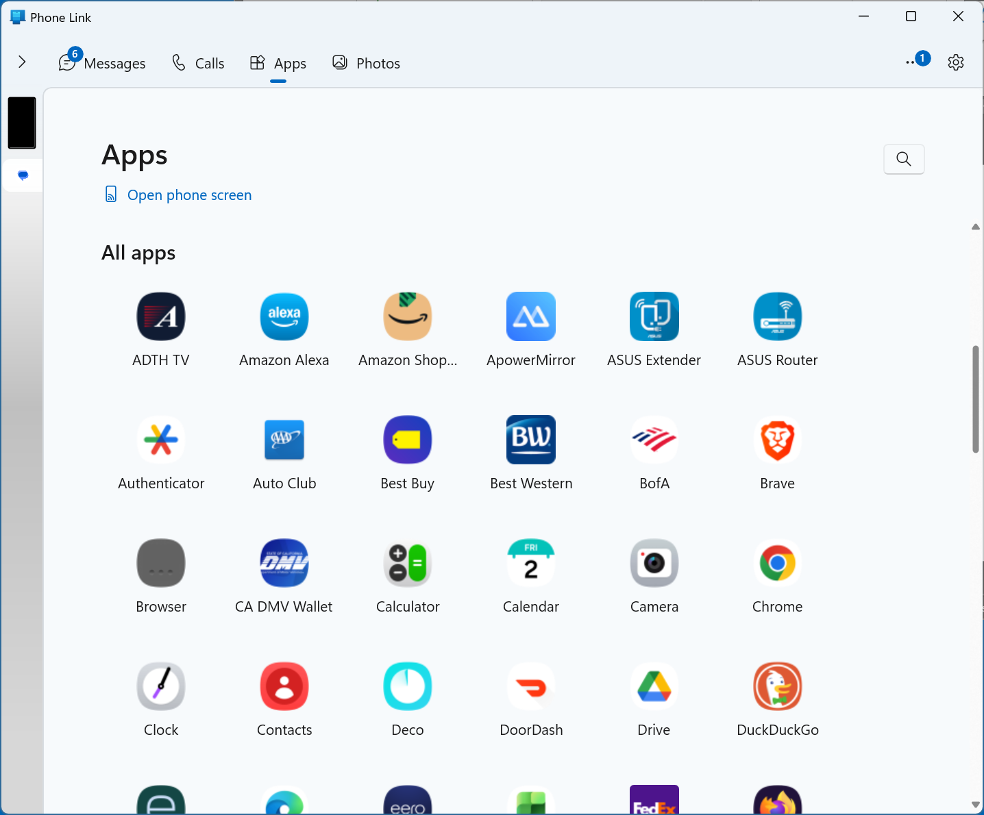

Slide 25
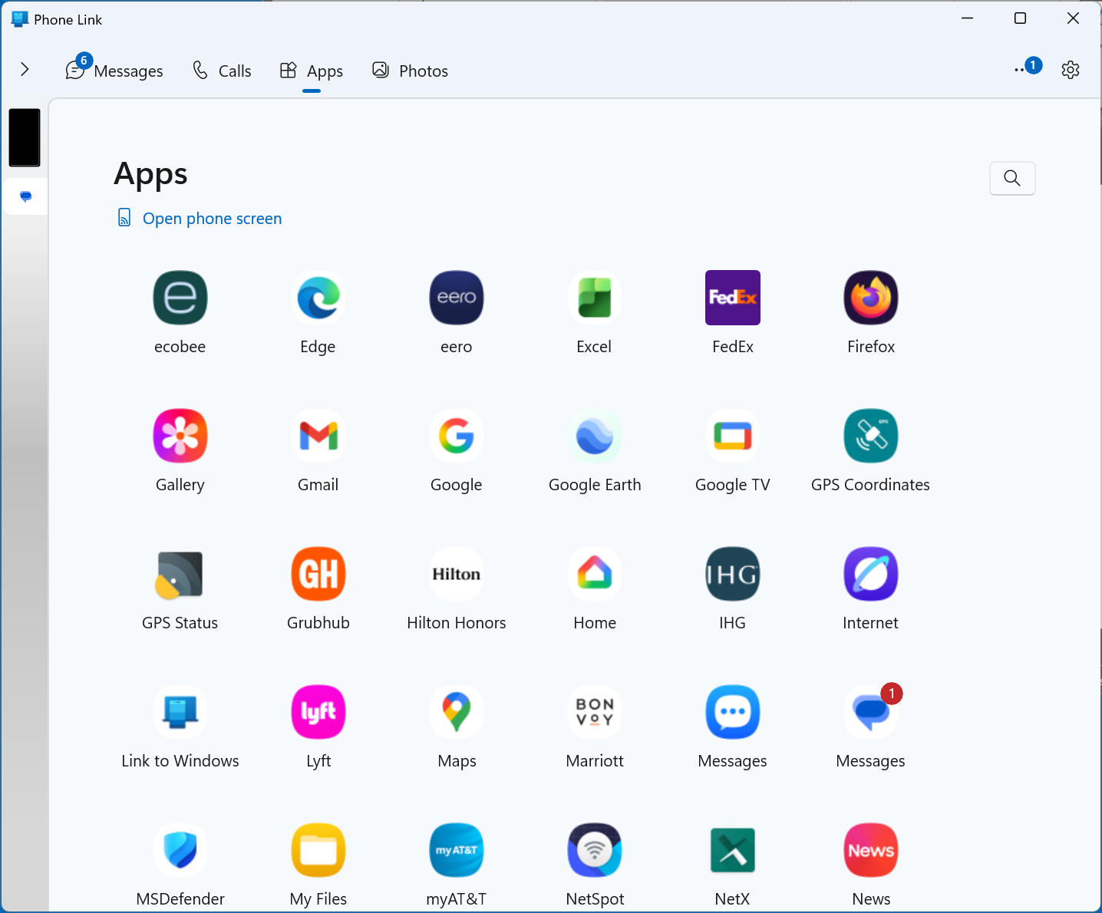

Slide 26
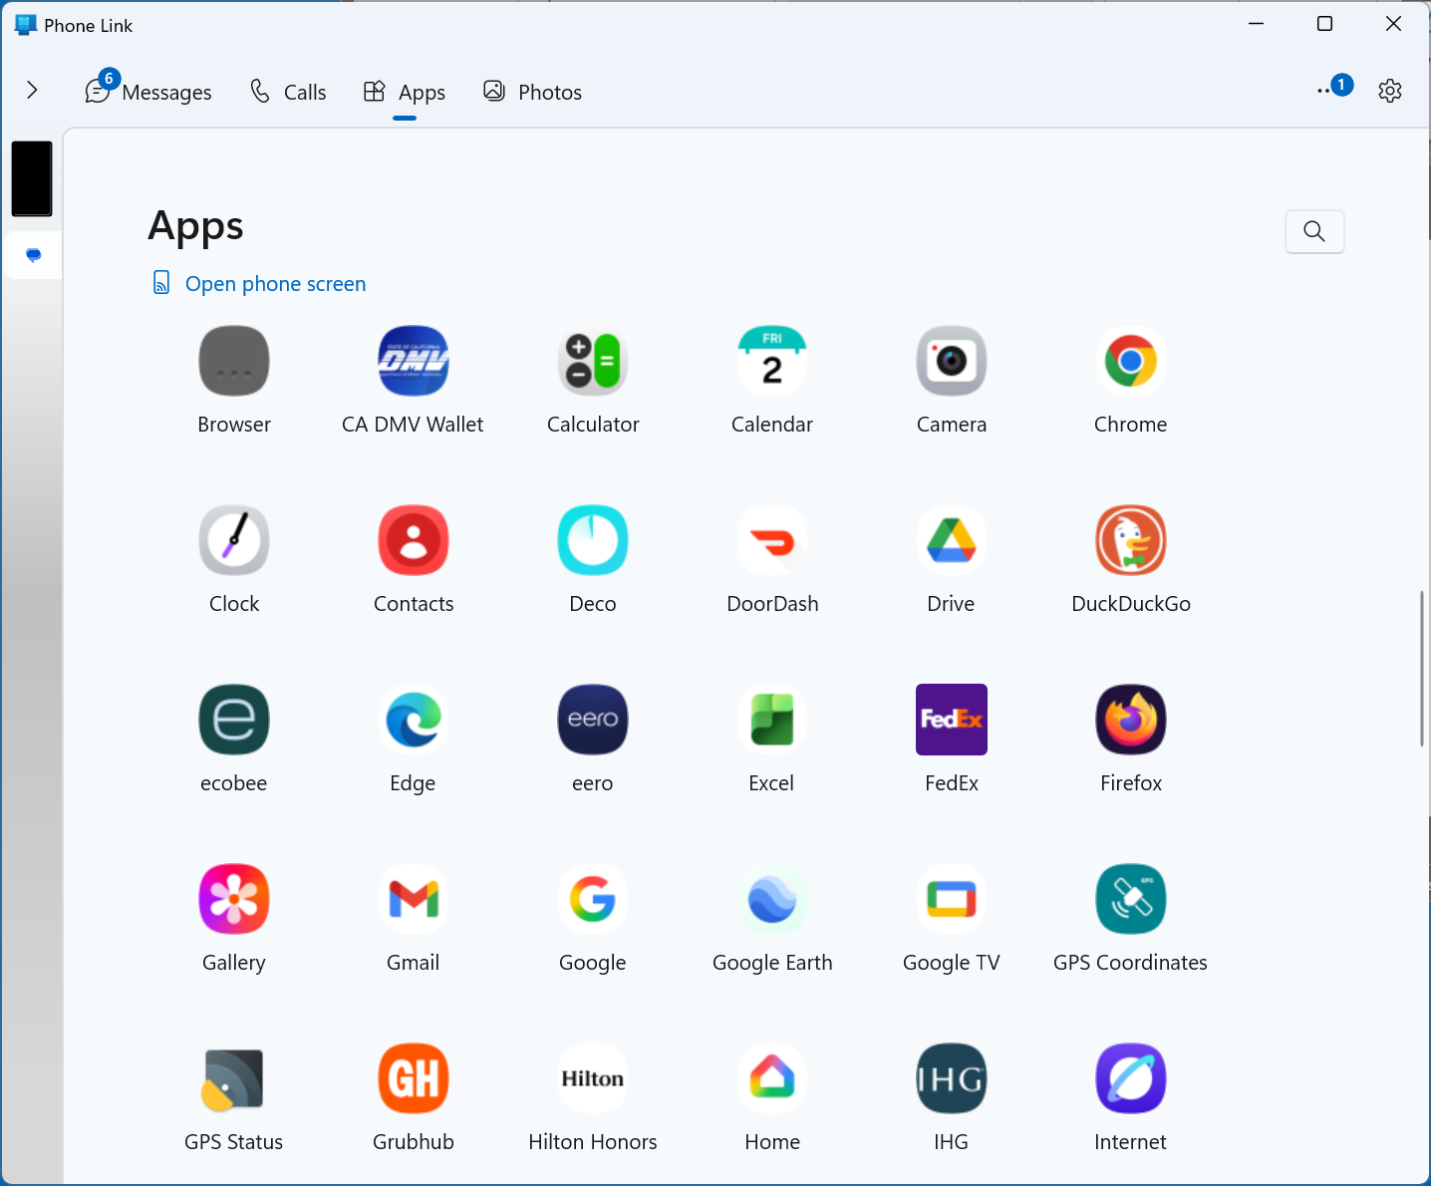

Slide 27
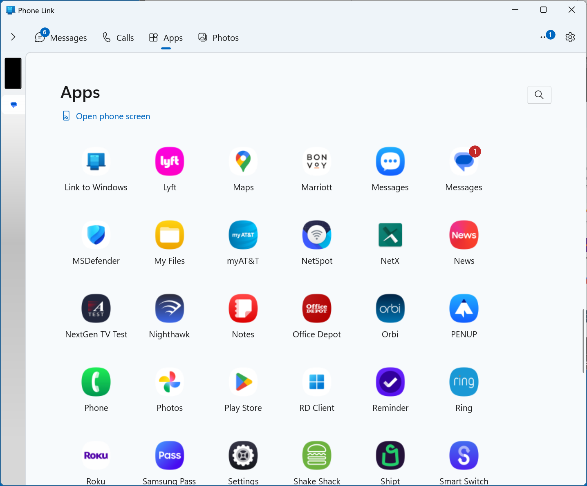

Slide 28
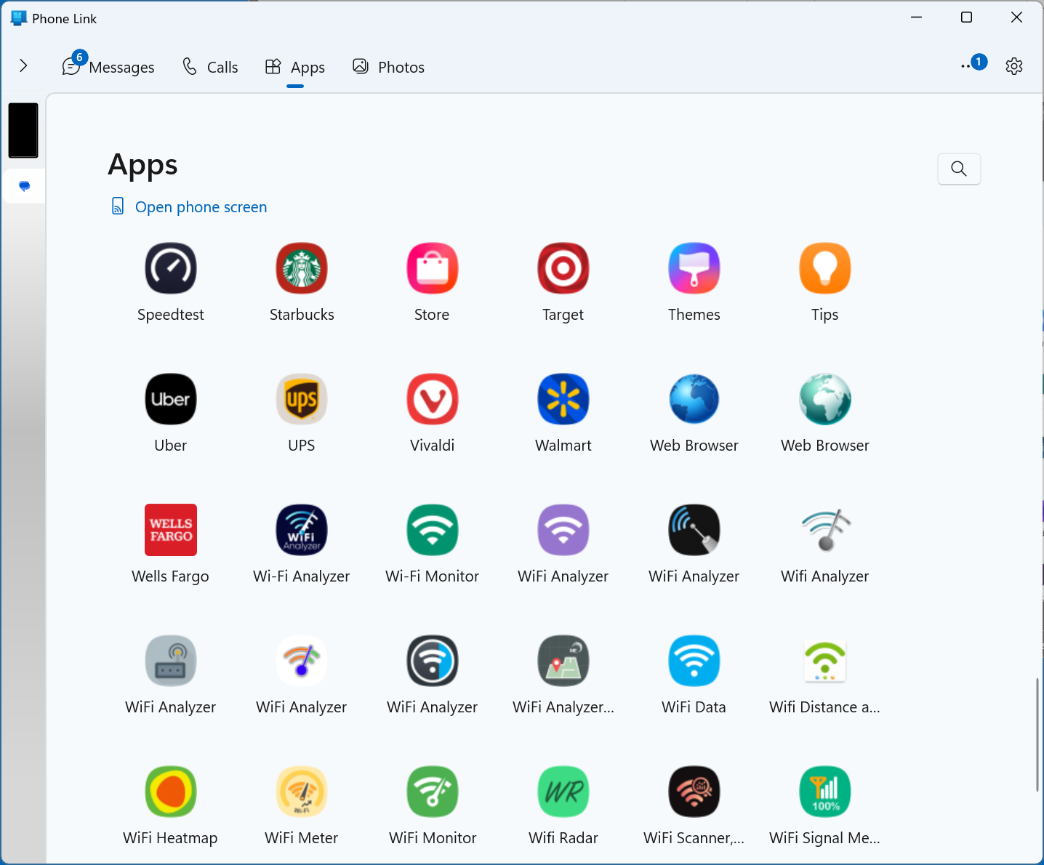

Slide 29
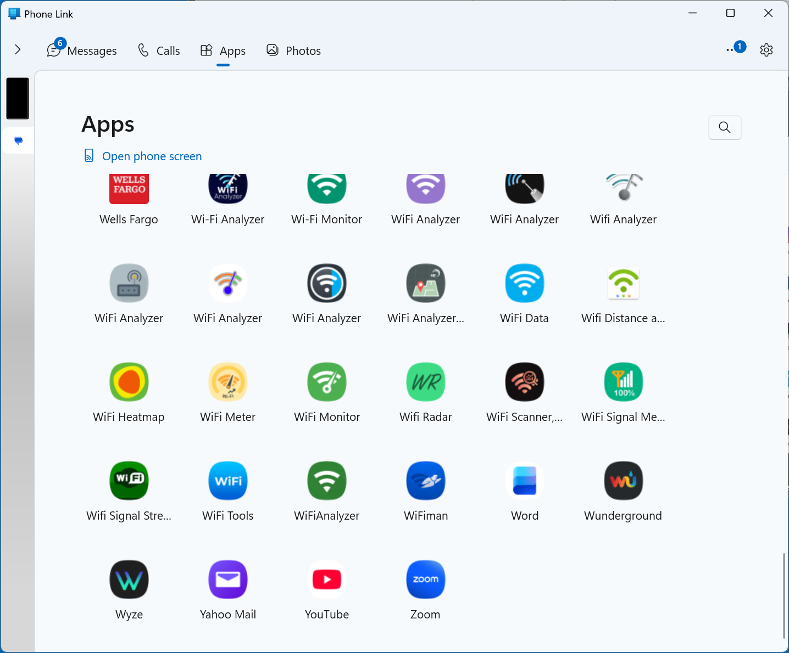

Slide 30
USING "PHONE LINK" IN WINDOWS" TO CONTROL AN ANDROID CELL PHONE (continued)
The "Photos" tabbed screen is supposed to display all photos that you have taken with the camera of your cell phone. However, it does not work right if you do not have the "OneDrive" app in your Windows 11 computer synchronizing your photos and files up to a "OneDrive" account up in the Internet cloud.

Slide 31
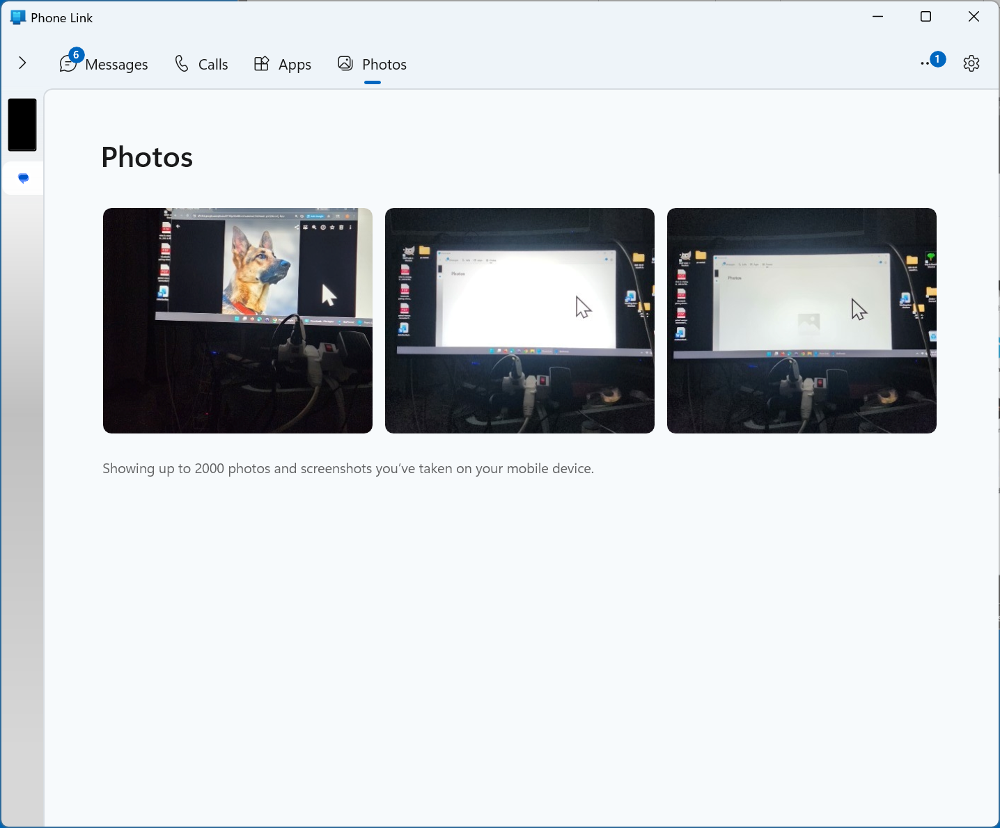

Slide 32
USING "PHONE LINK" IN WINDOWS" TO CONTROL AN ANDROID CELL PHONE (continued)
https://support.microsoft.com/en-us/topic/setting-up-photos-in-the-phone-link-11406d1d-f226-ab0f-56bf-db163e75d81e#id0efd=windows_11

Slide 34
USING "PHONE LINK" IN WINDOWS" TO CONTROL AN ANDROID CELL PHONE (continued)
If "Phone Link" is of the opinion that its window on the Windows 11 desktop is not wide enough, it will hide the "Notifications" tab and display a "greater than" button that you used to open the "Notifications" tabbed screen will appear:

Slide 36
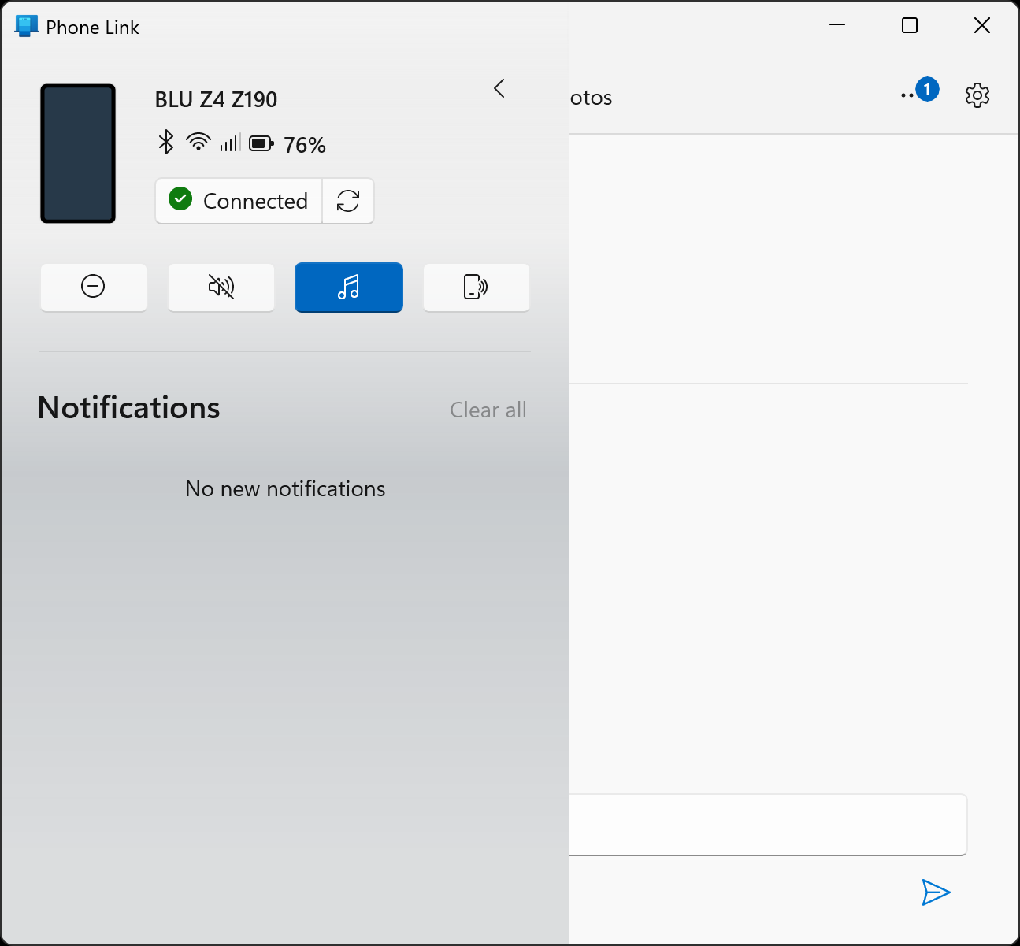

Slide 37
USING "PHONE LINK" IN WINDOWS" TO CONTROL AN ANDROID CELL PHONE (continued)
If you use the LEFT mouse button to click on the "less than" button, then the "Notifications" tabbed screen will disappear and the regular four tabbed screens will reappear:

Slide 39
ADVANTAGES OF CONTROLLING A CELL PHONE FROM A COMPUTER
Larger screen
Can use keyboard and mouse
Faster to take screen shots of a cell phone from a computer
Can show a sharper image of the screen of cell phone inside Windows 11 (relative to using a USB-connected Web cam)

Slide 40
ADVANTAGES OF CONTROLLING A CELL PHONE FROM A COMPUTER (continued)
Third party Web sites for sending text messages are not reliable (while sending from a cell phone or from the "Messages" tab inside the "Phone Link" app of "Windows 11" is very reliable)

Slide 41
ADVANTAGES OF CONTROLLING A CELL PHONE FROM A COMPUTER (continued)
Using your email account to send text messages to cell phones is not reliable (while using a computer linked to a cell phone to send out text messages is very reliable)

Slide 42
IT IS EASIER TO USE "PHONE LINK" IN A WINDOWS 11 COMPUTER IF YOU CREATE A DESKTOP SHORTCUT..
..for it. Since "Phone Link" is a "Universal Windows Platform" app, please follow the instructions at https://aztcs.apcug.org/meeting_notes/winhardsig/software/remote-assistance/Making-Shortcuts-to-apps-in-Win11&10&8.pdf

Slide 43
USING THE "CALLS' TAB OF "PHONE LINK"
You must use the "Calls" tab of "Phone Link" app in Windows 11 if you want to use the PC's speaker and the PC's Microphone audio for phone calls.

Slide 44
USING THE "CALLS' TAB OF "PHONE LINK" (continued)
Cannot initiate phone calls from the phone screen image in "Phone Link" if you want to use the PC's speaker and Microphone audio for phone calls.
If you initiate phone calls from the phone screen image in "Phone Link", you will have to use the phone's speaker and microphone

Slide 46
USING THE "CALLS' TAB OF "PHONE LINK" (continued)
If you initiate or answer a phone call from the "Calls" tab, the actual hardware speaker and microphone of the phone will be muted when you use the keypad in the Calls tab and you will have to use the microphone and speakers of the computer to talk and listen to the audio of the phone

Slide 47
MICROSOFT'S "PHONE LINK" FROM INSIDE "WINDOWS 11" OR "..10" (continued)
If you click on an app inside the Apps tab, a usable screen image of the app will be displayed.

Slide 48
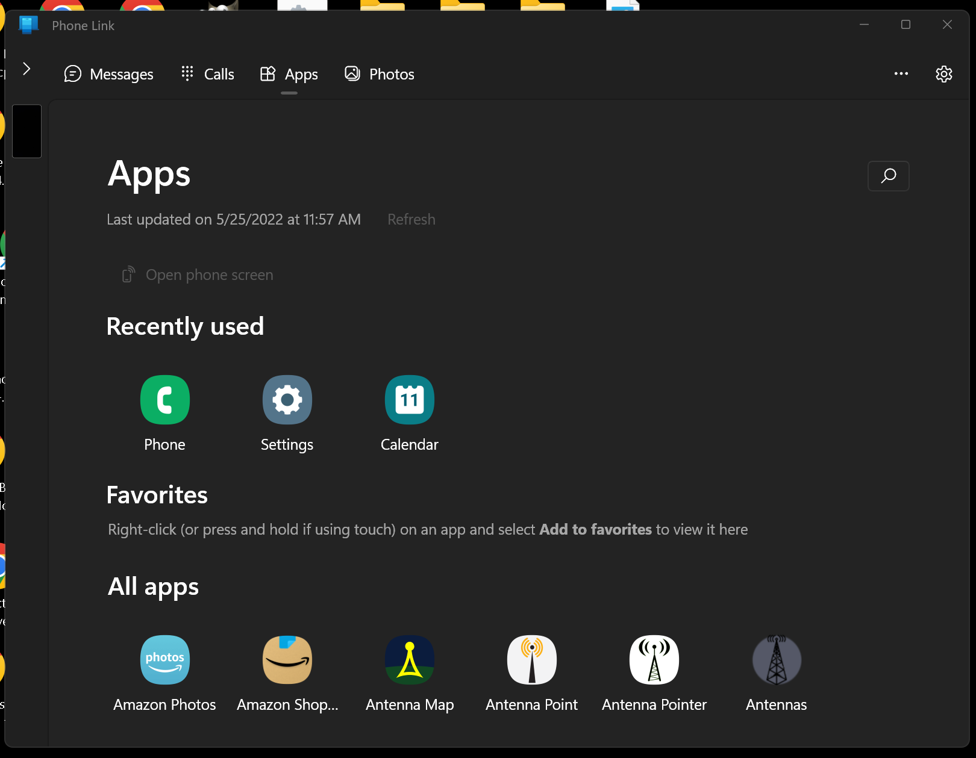

Slide 49
CREATING A SHORTCUT TO "PHONE LINK" IN "WINDOWS 11"
If you close the window of the "Phone Link" app, you will have to re-start the "Phone Link" app. Some Windows.. users will find it handy to have a shortcut to the "Phone Link" app on the Desktop:

Slide 50
CREATING A SHORTCUT TO "PHONE LINK" IN "WINDOWS 11" (continued)
To make a shortcut to "Phone Link" on the Windows "Desktop":
Right click on the Start button, click on "Run", type in shell:appsfolder Click on "OK" Left click on "Phone Link" Click on "Create shortcut"

Slide 52
ADDITIONAL POSSIBILITIES
There is lots of not-free third-party software apps for sending the screen of an Android cell phone or an iPhone with or without the ability for your Windows.. computer to control your cell phone. See https://www.howtogeek.com/430466/how-to-mirror-and-control-your-android-phone-on-any-windows-pc/

