Slide 1




0--INSTALLING "LINK TO WINDOWS" IN A CELL PHONE AND THEN USING "PHONE LINK" IN "WINDOWS 11" TO CONTROL "LINK TO WINDOWS" IN THE CELL PHONE

Slide 2
Web location for this presentation:
http://aztcs.apcug.org
Click on
"Meeting Notes"
fchao2@yahoo.com

Slide 3
SUMMARY
Here the the logical steps for installing the free "Link to Windows" in a cell phone and then configuring the bundled "Phone Link" app in "Windows 11" so that it can control the cell phone.

Slide 4
TOPICS
Microsoft's Detailed Instructions For Using "Phone Link" in "Windows 11" To Control "Link To Windows" In A Cell Phone
Big Steps for Installing "Link to Windows" to "Phone Link"
Small Steps for Installing "Link to Windows" In A Cell Phone
Small Steps for Activating "Phone Link" in "Windows 11"

Slide 5
MICROSOFT'S DETAILED INSTRUCTIONS
Microsoft's instructions for using "Phone Link" to in "Windows 11" to control "Phone Link" in a cell phone are located at https://support.microsoft.com/en-gb/topic/phone-link-app-requirements-and-setup-cd2a1ee7-75a7-66a6-9d4e-bf22e735f9e3

Slide 6
STEPS FOR INSTALLING "LINK TO WINDOWS" INTO A CELL PHONE
Step 1: Locate "Link to Windows" in the "store" of the cell phone

Slide 7
STEPS FOR INSTALLING "LINK TO WINDOWS" IN A CELL PHONE (continued)
For a partial list of Android cell phones that can run Microsoft's "Link to Windows" app, please see https://support.microsoft.com/en-us/topic/supported-devices-for-phone-link-experiences-cb044172-87aa-9e41-d446-c4ac83ce8807

Slide 8
STEPS FOR INSTALLING "LINK TO WINDOWS" IN A CELL PHONE (continued)
In Samsung cell phones, the "Link to Windows" app shows up in two places: the "Quick Settings" screens and the "Apps" screens

Slide 9
STEPS FOR INSTALLING "LINK TO WINDOWS" IN A CELL PHONE (continued)
If "Link to Windows" is missing, you can get it for free from the "Play Store" app in an Android cell phone or, alternatively, from the "Galaxy Store" app in a Samsung cell phone or, alternatively, from the "App Center" app in an "ASUS cell phone

Slide 10
STEPS FOR INSTALLING "LINK TO WINDOWS" IN A CELL PHONE (continued)
or, alternatively, from the "Honor App Market" in an Honor cell phone.

Slide 11
STEPS FOR INSTALLING "LINK TO WINDOWS" IN A CELL PHONE (continued)
Most recent Android cell phones will have the free "Link to Windows" app somewhere on their "Apps" screens
In Samsung cell phones, the "Link to Windows" shows up in two places: the "Quick Settings" screens and the "Apps" screens

Slide 12
STEPS FOR INSTALLING "LINK TO WINDOWS" IN A CELL PHONE (continued)
If "Phone Link" is missing, you can get it for free from the "Play Store" app in an Android cell phone or, alternatively, from the "Galaxy Store" app in a Samsung cell phone or, alternatively, from the "App Center" app in an ASUS cell phone

Slide 13
STEPS FOR INSTALLING "LINK TO WINDOWS" IN A CELL PHONE (continued)
or, alternatively, from the "Honor App Market" in an Honor cell phone.

Slide 14
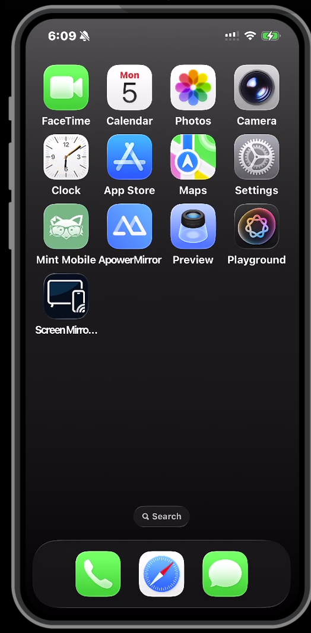

Slide 15
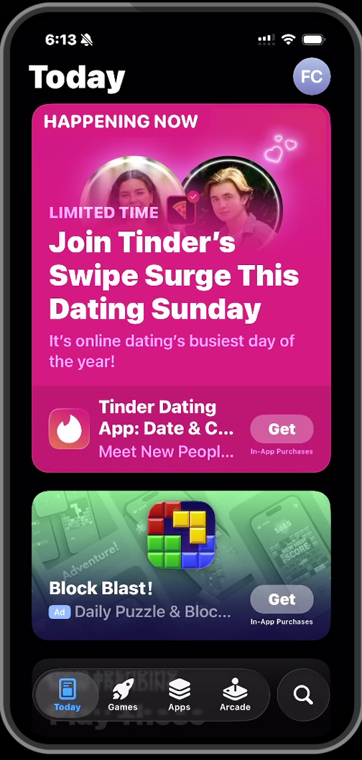

Slide 16
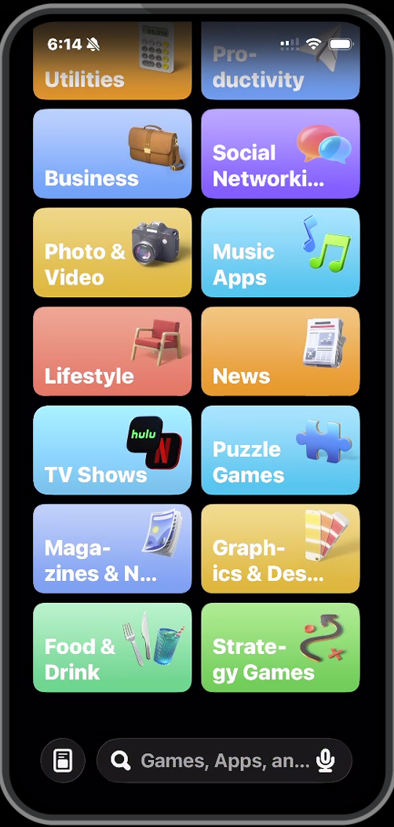

Slide 17
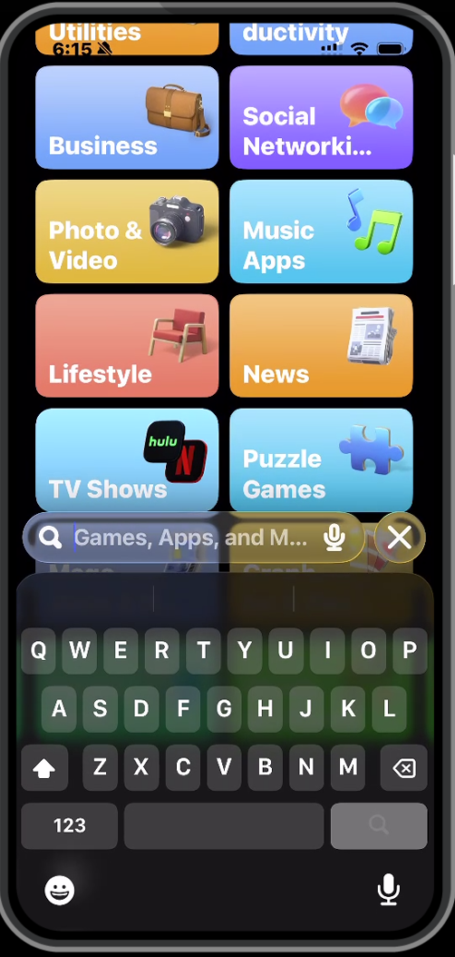

Slide 18
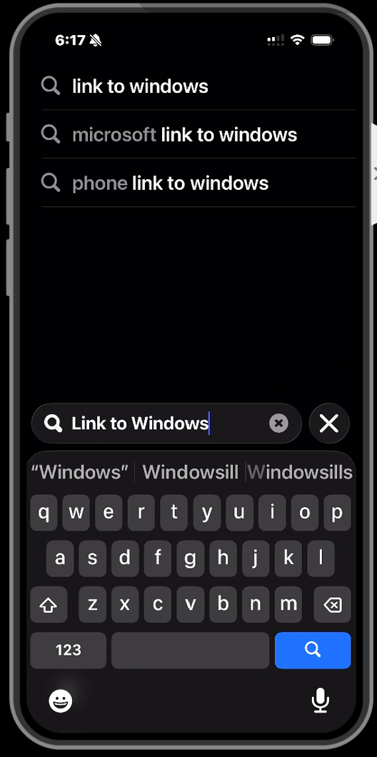

Slide 19
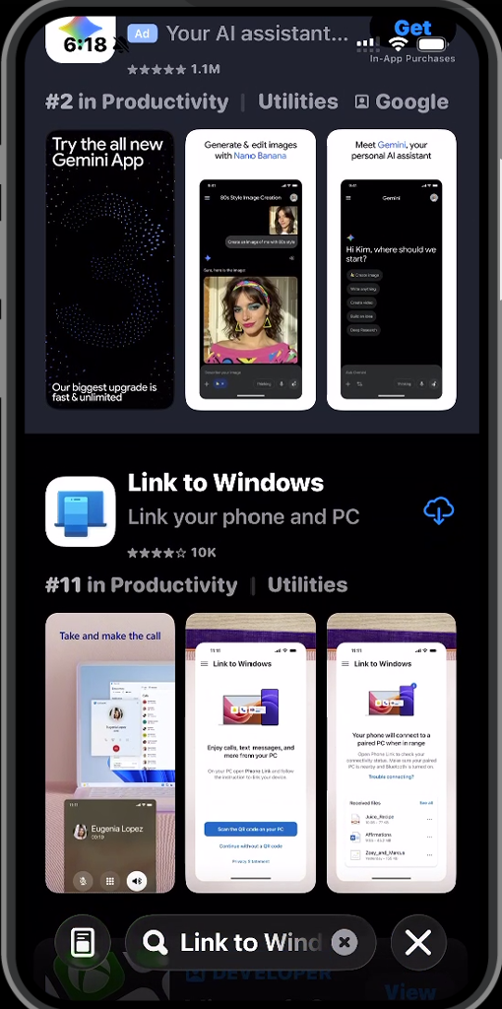

Slide 20
STEPS FOR INSTALLING "LINK TO WINDOWS" INTO A CELL PHONE
Step 2: Install or update "Link to Windows" into the cell phone

Slide 22
STEPS FOR INSTALLING "LINK TO WINDOWS" INTO A CELL PHONE
Step 3: From inside the cell phone, start up "Link to Windows"

Slide 23
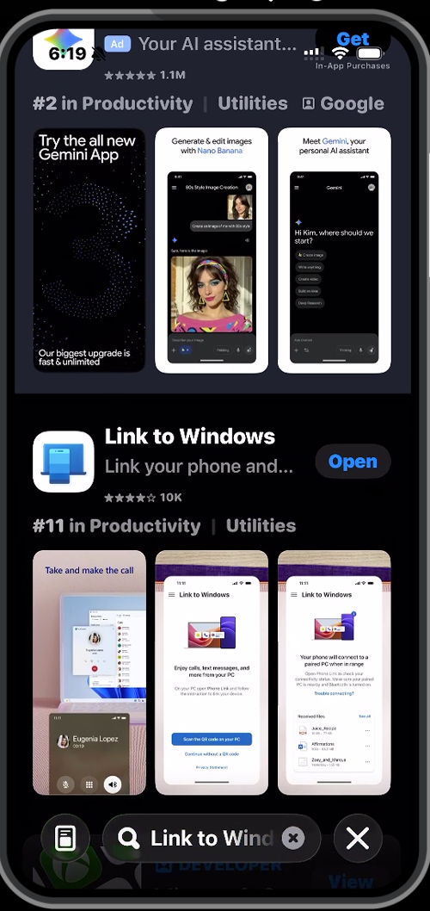

Slide 24
STEPS FOR INSTALLING "LINK TO WINDOWS" INTO A CELL PHONE (continued)
Step 4: From "Link to Windows" inside the cell phone, either log into an existing "Microsoft Account" or create a new one

Slide 25
STEPS FOR INSTALLING "LINK TO WINDOWS" INTO A CELL PHONE (continued)
Step 5: Leave the cell phone in it's vertical orientation so that it does not fall asleep

Slide 26
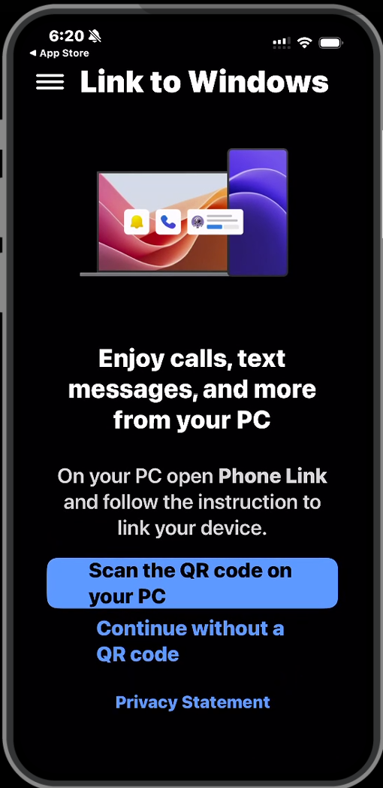

Slide 27
STEPS FOR RUNNING "PHONE LINK" IN "WINDOWS 11"
Step 1: From inside the "Windows 11" computer, locate the bundled "Phone Link" app. ("Phone Link" is a regular part of the "Windows 11" operating system.)

Slide 28
STEPS FOR RUNNING "PHONE LINK" IN"WINDOWS 11" (continued)
..in the "Start Menu" of a Windows 11 computer or a Windows10 computer:

Slide 29
STEPS FOR RUNNING "PHONE LINK" IN"WINDOWS 11" (continued)
In "Windows 11", you usually have to click on the "All" button of the "Start Menu" before you can locate "Phone Link" or you can usually find it in "Search" or "Type here to search"

Slide 30
STEPS FOR RUNNING "PHONE LINK" IN "WINDOWS 11" (continued)
"Phone Link" might be present under one of it's now obsolete names over the past four years, "Your Phone Companion" morphed into "Your Phone" which morphed into "Phone Link"

Slide 31


Slide 33
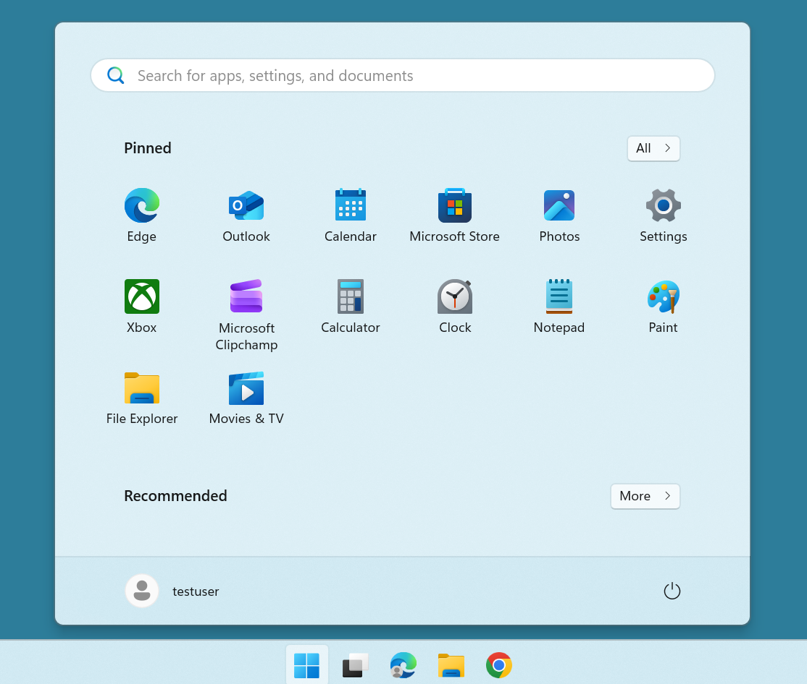

Slide 35
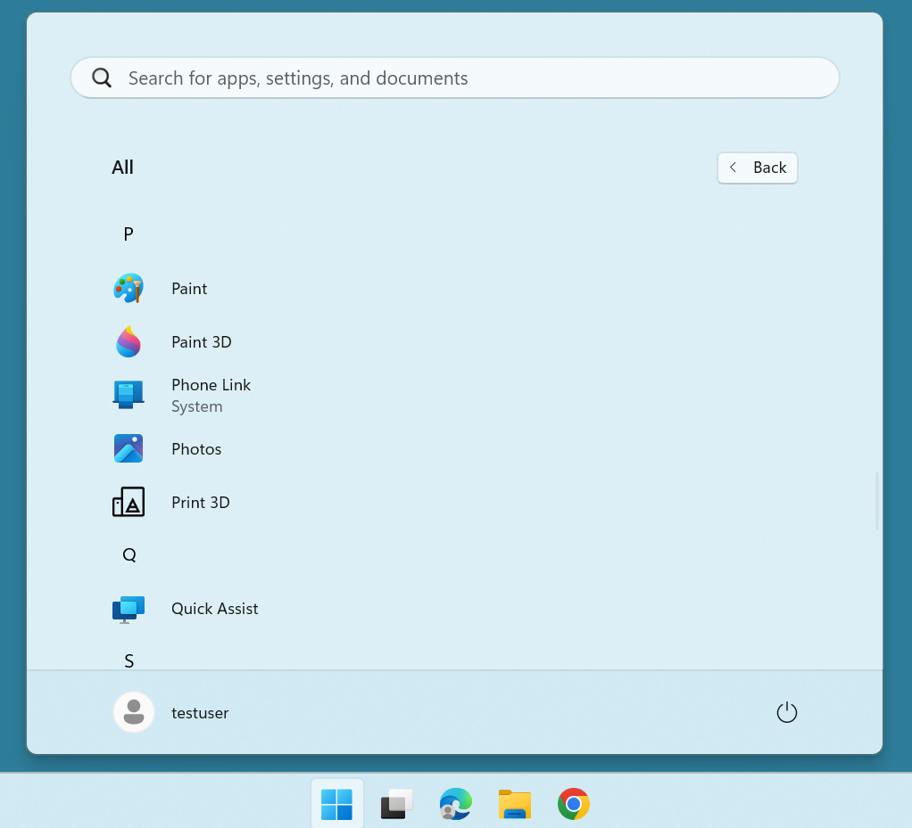

Slide 36
STEPS FOR RUNNING "PHONE LINK" IN "WINDOWS 11" (continued)
Step 2: Use the LEFT mouse button to double-click on the "Phone Link" app

Slide 37
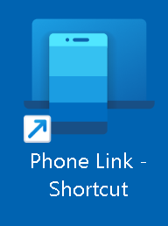

Slide 38


Slide 40
STEPS FOR RUNNING "PHONE LINK" IN "WINDOWS 11" (continued)
Step 3: A "Phone Link" box will be displayed:

Slide 41
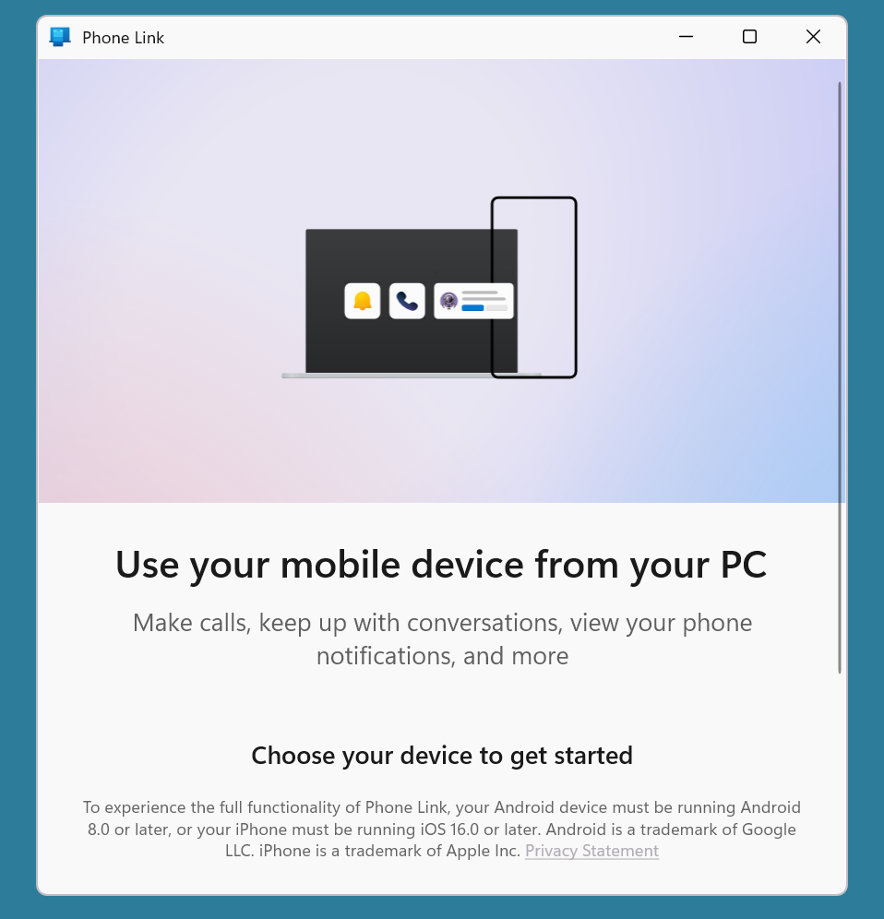

Slide 42
STEPS FOR RUNNING "PHONE LINK" IN "WINDOWS 11" (continued)
Step 4: Scroll vertically downward to display the bottom of the "Phone Link" box:

Slide 44
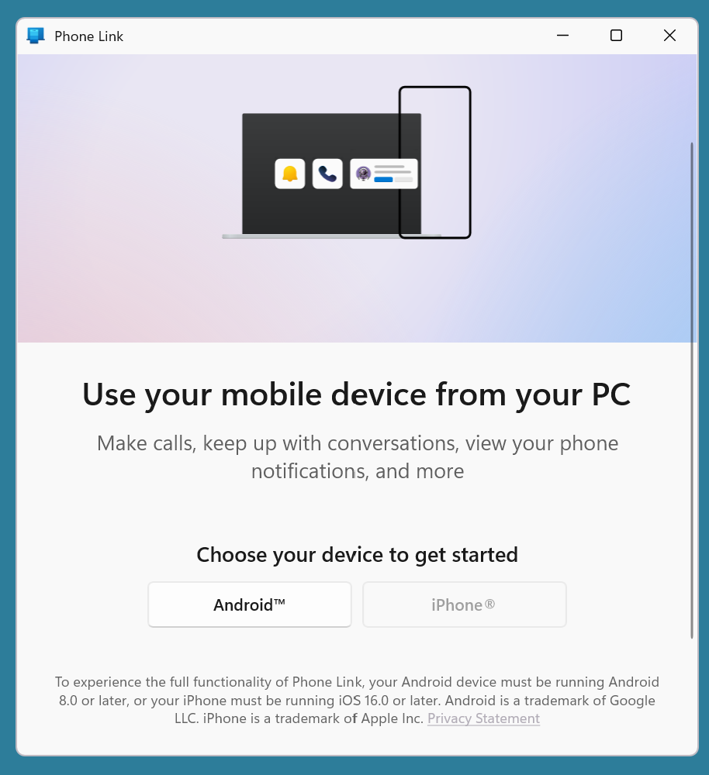

Slide 45
STEPS FOR RUNNING "PHONE LINK" IN "WINDOWS 11" (continued)
Step 5: Use the LEFT mouse button to select whether you want to connect to an Android cell phone or an Apple "iPhone"

Slide 46
STEPS FOR RUNNING "PHONE LINK" IN "WINDOWS 11" (continued)
Step 5 (continued): The "iPhone" button will be grayed out and unavailable if your "Windows 11" has a "Bluetooth" transmitter-receiver that is not capable of communicating in the "Bluetooth Low Energy" format since "Bluetooth" pairing and connecting with an "iPhone" has to be in this format.

Slide 47
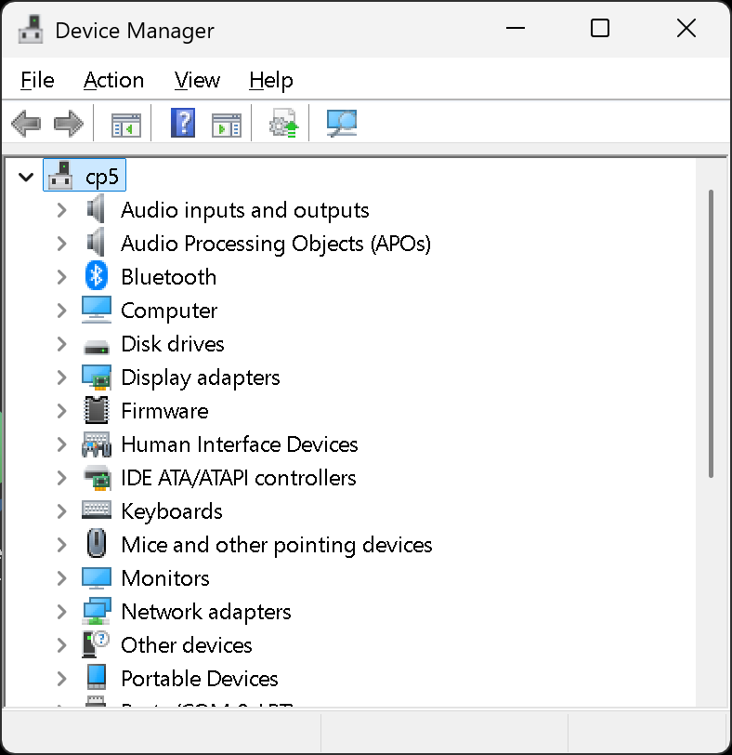

Slide 49
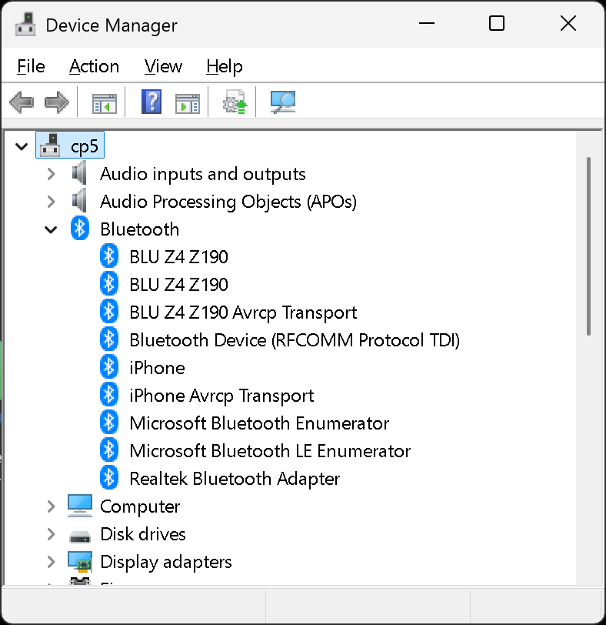

Slide 51
STEPS FOR RUNNING "PHONE LINK" IN "WINDOWS 11" (continued)
Step 6: Use the camera of the cell phone to scan the QR code that is being displayed inside the "Phone Link" app inside "Windows 11":

Slide 52
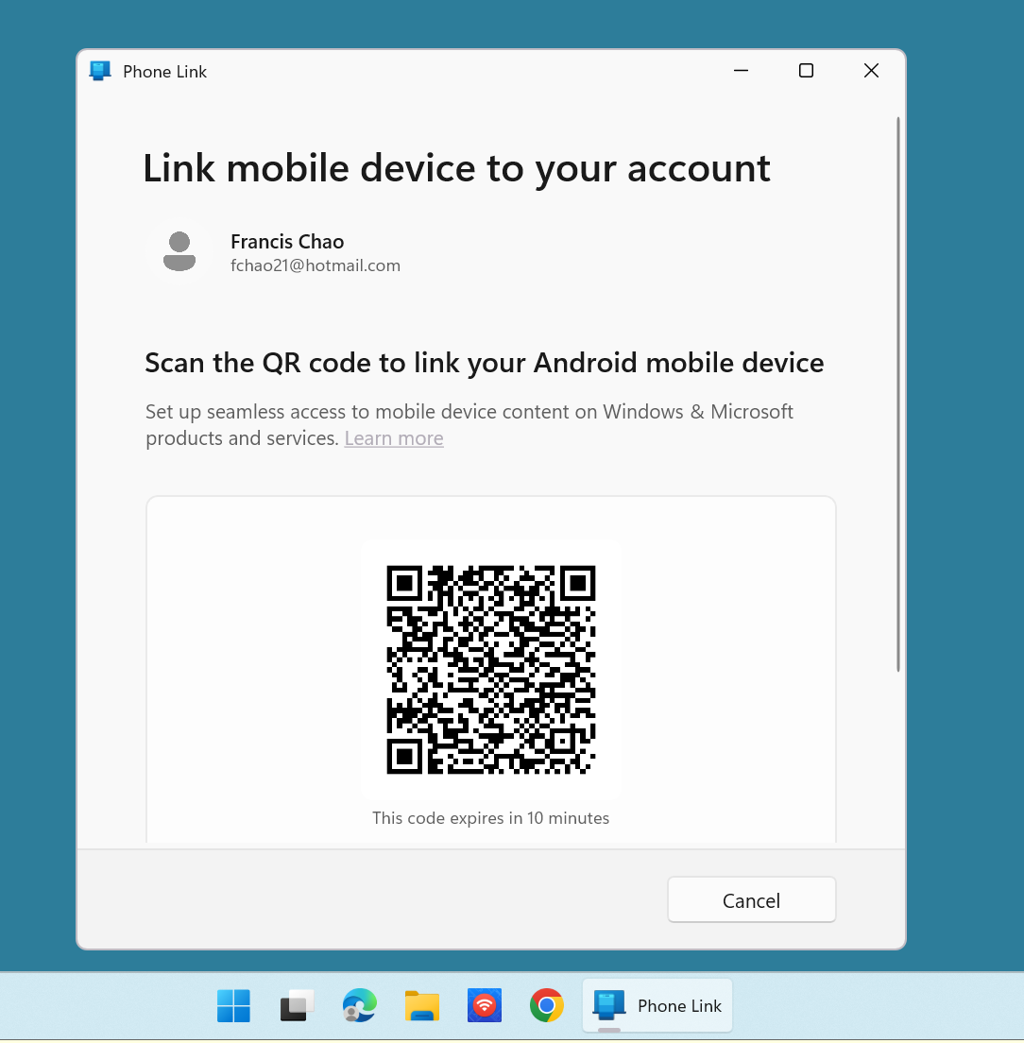

Slide 53
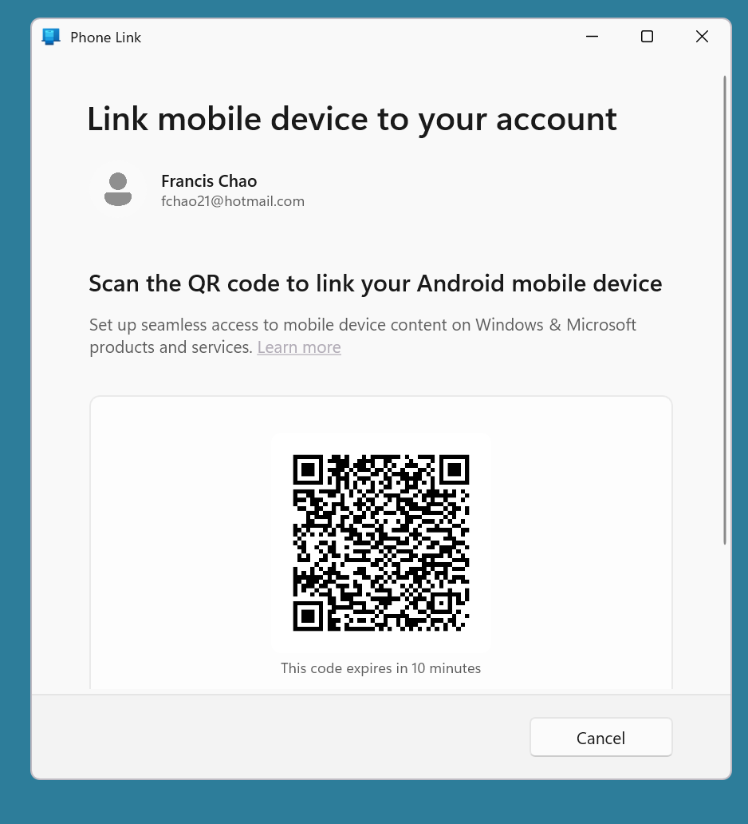

Slide 54
STEPS FOR RUNNING "PHONE LINK" IN "WINDOWS 11" (continued)
Step 7: Follow the instructions in the cell phone AND in the "Phone Link" app in "Windows 11" to establish a connection between "Link to Windows" in the cell phone and "Phone Link in the Windows 11 computer

Slide 55
STEPS FOR RUNNING "PHONE LINK" IN "WINDOWS 11" (continued)
Step 8: When a connection is established between "Link to Windows" in the cell phone and "Phone Link" in the Windows 11 computer, a "Phone Link" window with the activated "Messages", "Calls", "Apps", and "Photos" tabs will be displayed.

Slide 56
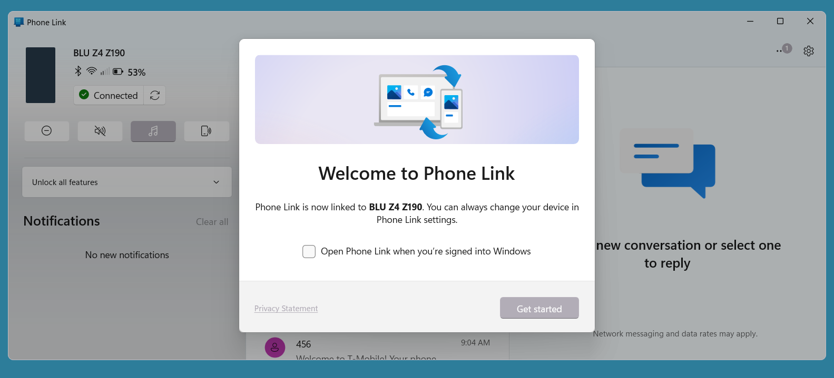

Slide 57
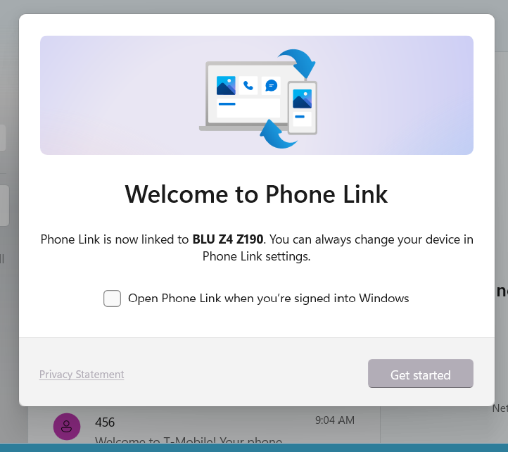

Slide 58
STEPS FOR RUNNING "PHONE LINK" IN "WINDOWS 11" (continued)
Step 9: Click on the "Get started" button in order to start using the activated "Phone Link" window to control the cell phone:

Slide 59
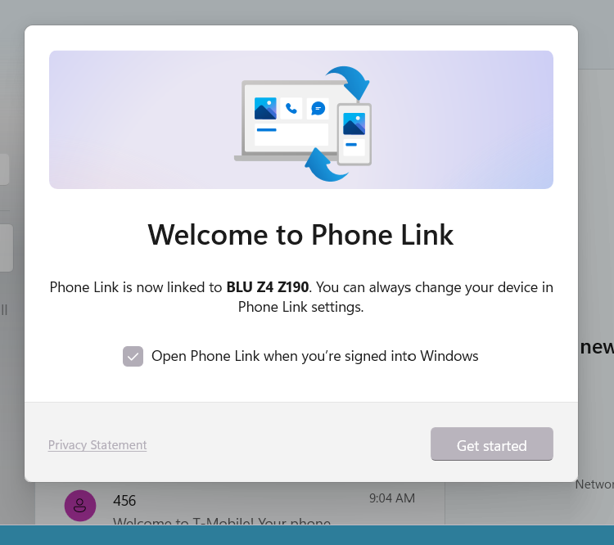

Slide 60
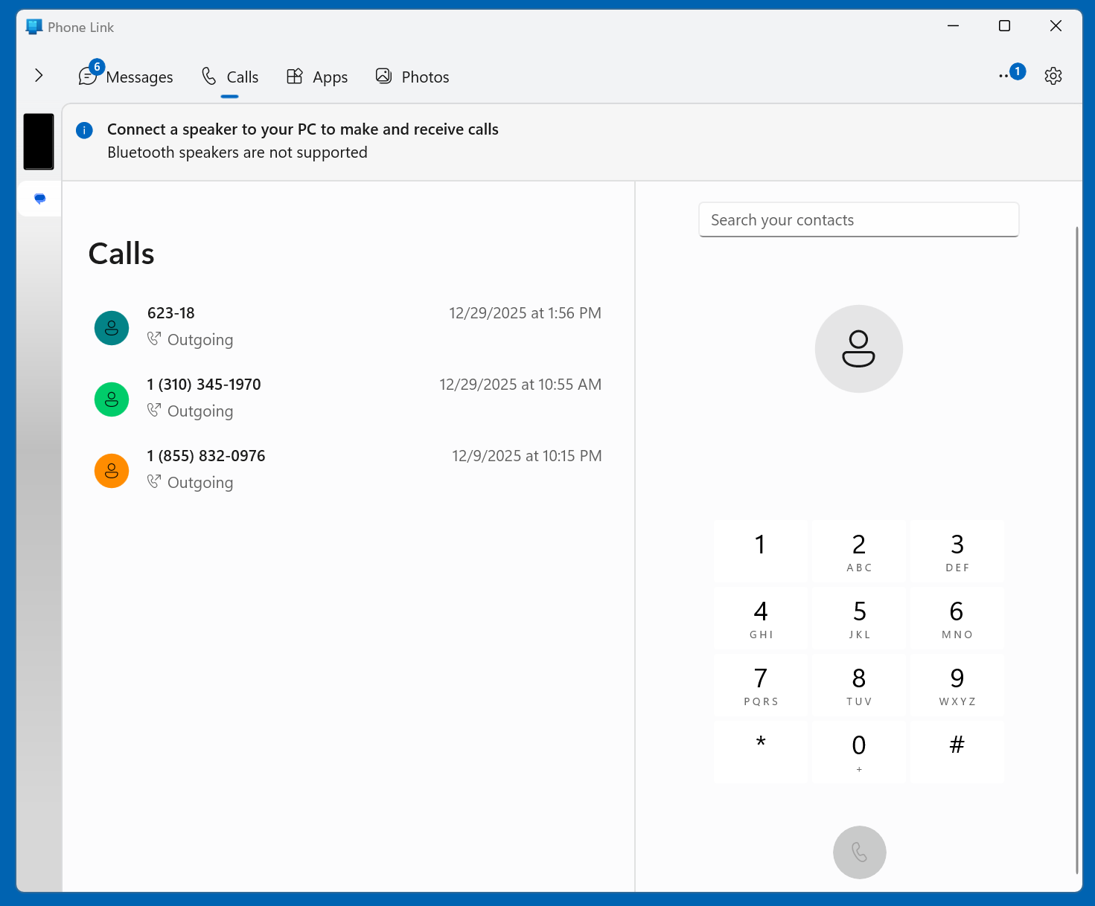

Slide 61
ADDITIONAL ADVICE FOR CONFIGURING "PHONE LINK" IN "WINDOWS 11"
https://support.microsoft.com/en-us/topic/setting-up-calls-in-the-phone-link-c7e75908-c65d-bd42-fcb2-ea4d5fb783f1#id0efd=android

Slide 62
ADDITIONAL ADVICE FOR CONFIGURING "PHONE LINK" IN "WINDOWS 11" (continued)
https://support.microsoft.com/en-us/topic/troubleshooting-the-phone-link-82b6c6aa-544e-d4af-fd5d-2629a2a95835

Slide 63
ADDITIONAL ADVICE FOR "WINDOWS 11" CONNECTIONS TO iPHONES
https://www.macobserver.com/tips/how-to/connect-your-iphone-to-a-windows-pc-with-and-without-microsoft-phone-link/

