Slide 1




0--DEMONSTRATION OF USING "PHONE LINK" TO CONTROL
AN ANDROID CELL PHONE FROM A "WINDOWS 11" COMPUTER

Slide 2
Web location for this presentation:
http://aztcs.apcug.org
Click on
"Meeting Notes"

Slide 3
SUMMARY
An Android cell phone can be controlled from the bundled "Phone Link" app in a "Windows 11" computer. Here is a demonstration how "Phone Link" works, after you install and configure it.

Slide 4
TOPICS
Using Microsoft's "Phone Link" app in a "Windows 11" computer
Advantages of Controlling An Android Phone From A Computer
Locating "Link to Windows" In A Cell Phone
Locating "Phone Link" in "Windows 11"
Detailed Steps for Using "Phone Link"

Slide 5
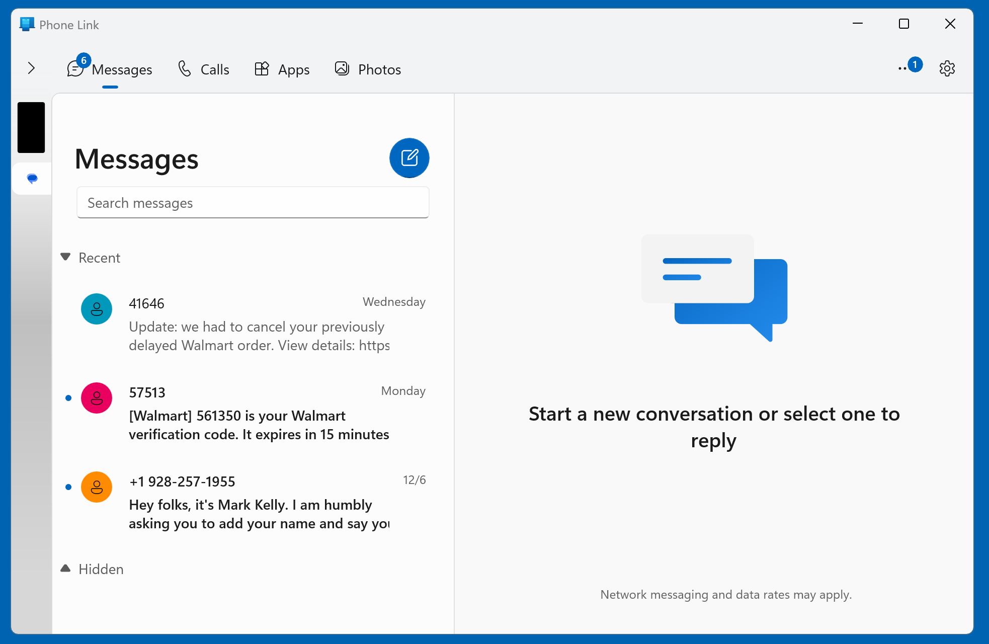

Slide 6
USING "PHONE LINK" IN WINDOWS" TO CONTROL AN ANDROID CELL PHONE (continued)
Then use your LEFT mouse button to click on the black rectangle to get an active display of the Android cell phone's screen:

Slide 8
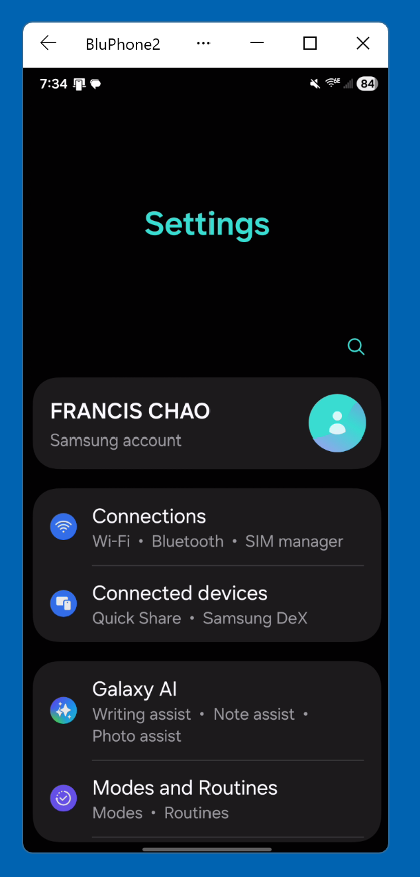

Slide 9
USING "PHONE LINK" IN WINDOWS" TO CONTROL AN ANDROID CELL PHONE (continued)
To move the phone screen window, drag the name of the phone:

Slide 11
USING "PHONE LINK" IN WINDOWS" TO CONTROL AN ANDROID CELL PHONE (continued)
Casting the screen of any cell phone to a Windows 11 computer is a heavy drain on the cell phone's battery so you should charge the cell phone while using "Phone Link" with a wireless Qi charger such the the excellent one made by Nanami:

Slide 12
USING "PHONE LINK" IN WINDOWS" TO CONTROL AN ANDROID CELL PHONE (continued)
https://www.amazon.com/NANAMI-Upgraded-Wireless-Charging-Compatible/dp/B07WRXFCPD/

Slide 13
USING "PHONE LINK" IN WINDOWS" TO CONTROL AN ANDROID CELL PHONE (continued)
"Phone Link" has 5 separate sections: Messages, Calls, Apps, Photos, and Notifications

Slide 18
TEXTING FROM THE "PHONE LINK" APP IN "WINDOWS 11"
Three ways: 1. From the "Messages" tab where the Enter key of the keyboard sends the text message 2. From the "Messages" in the "Apps" tab 3. From "Messages" in the phone screen display when the Enter key just drops you down to a new line

Slide 19
USING "PHONE LINK" IN WINDOWS" TO CONTROL AN ANDROID CELL PHONE (continued)
The "Calls" tabbed screen is the default screen that is displayed when the "Phone Link" app connects to the "Link to Windows" app for the first time:

Slide 20
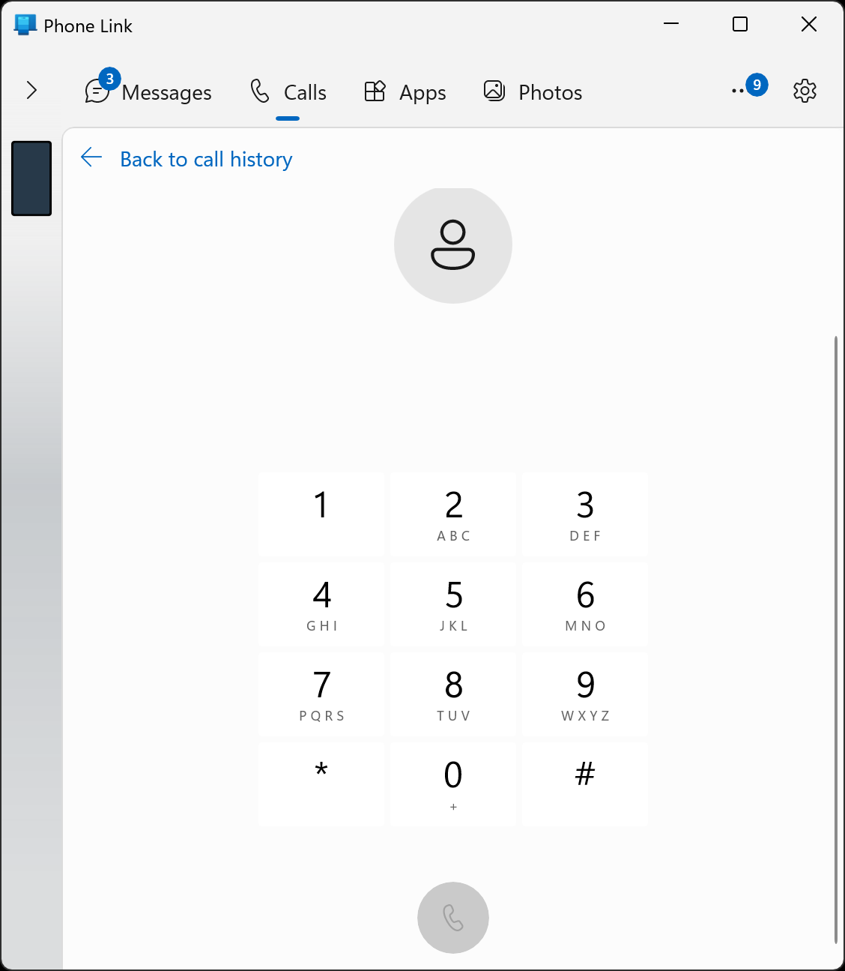

Slide 21
USING "PHONE LINK" IN WINDOWS" TO CONTROL AN ANDROID CELL PHONE (continued)
If you click on "Back to call history", you will be see a list of all phone calls that are stored in the "Phone" app of the cell phone:

Slide 23
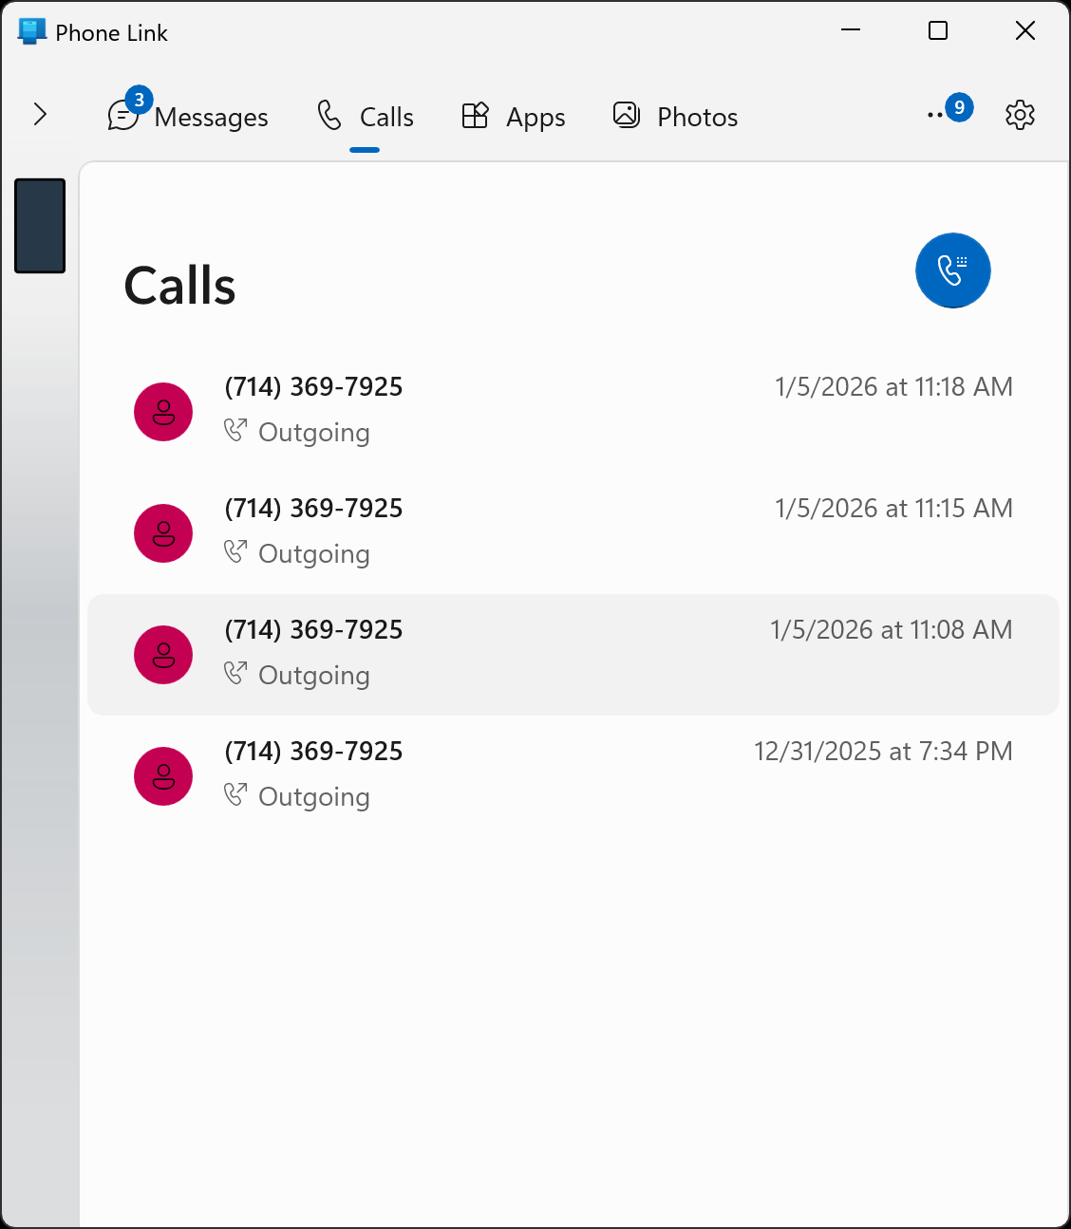

Slide 24
USING "PHONE LINK" IN WINDOWS" TO CONTROL AN ANDROID CELL PHONE (continued)
If you click on the blue telephone call symbol, you will return to the dial pad in the "Calls" tab

Slide 27
WHEN PLACING OR RECEIVING A PHONE CALL..
..you will get a dialog box that asks you if you wish to "Transfer to mobile device". If you do not have a USB headset attached to your "Windows 11", you will have to click on "Transfer" in order to continue the phone call.

Slide 28
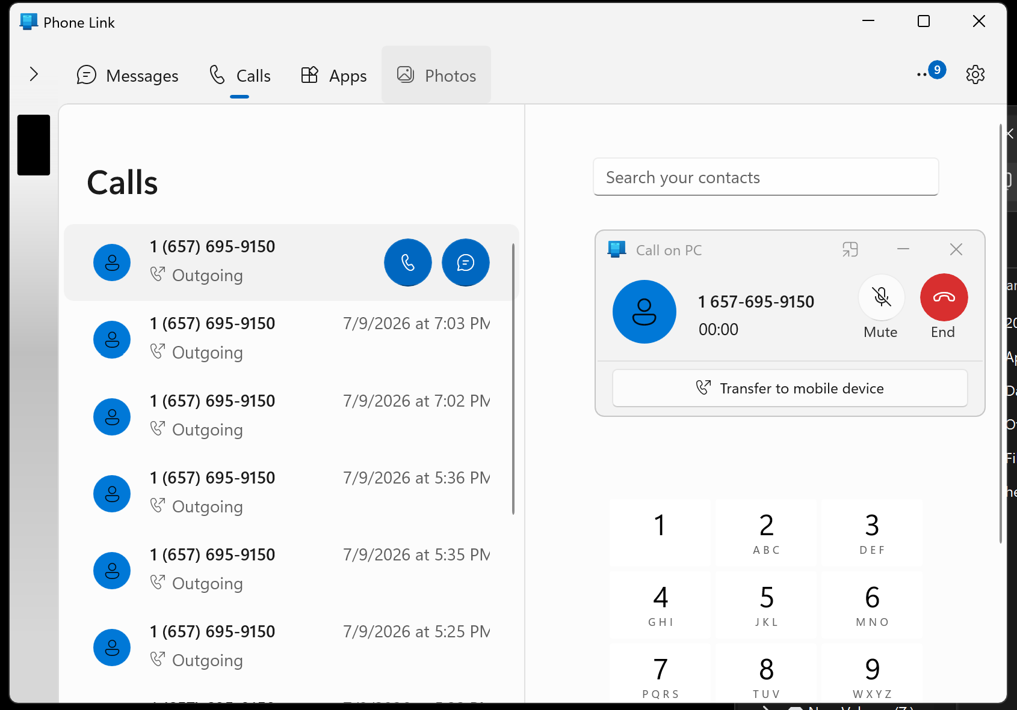

Slide 30
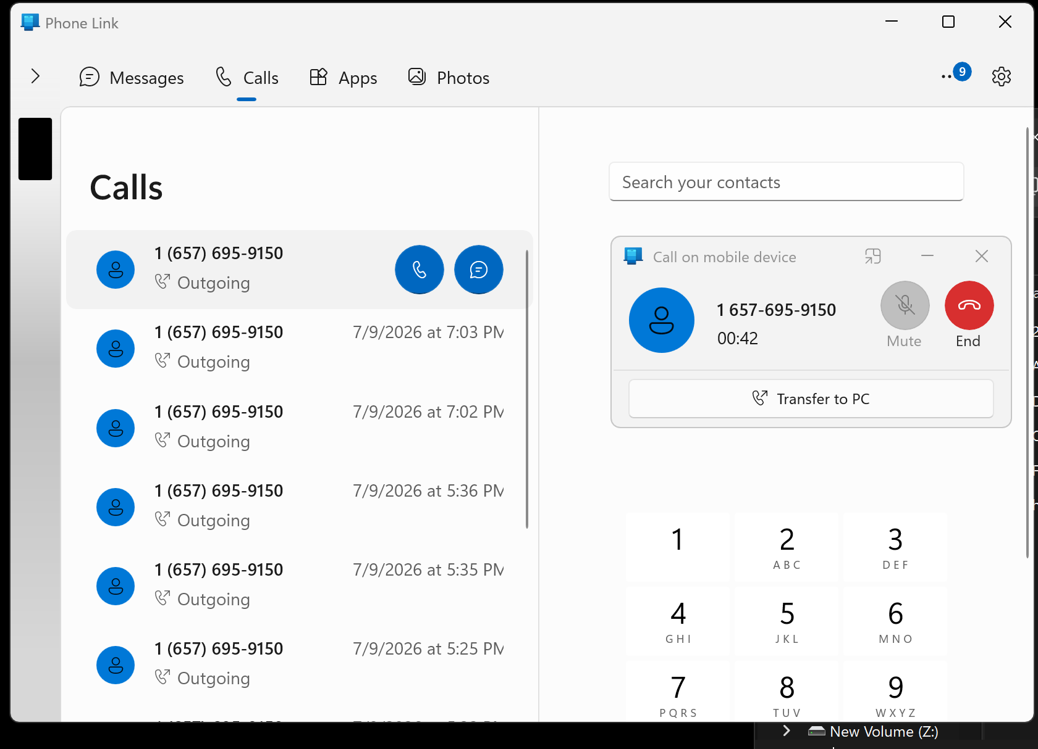

Slide 32
Difference Between “Transfer call to mobile device” and “Transfer call to PC” in Phone Link
In Microsoft Phone Link, these two options let you manage calls between your Android phone and your Windows PC, but they route the call to different devices:

Slide 33
1. Transfer call to mobile device
This option sends the incoming call back to your Android phone.
Your phone will ring, and you can answer it from there.
It’s useful if you want to keep the call on your phone for features like voicemail, call forwarding, or if you prefer to answer on your phone.

Slide 34
2. Transfer call to PC (continued)
If you have no non-Bluetooth headset, no non-Bluetooth microsoft, and/or no non-Bluetooth speakers and you click on "Transfer call to PC", no outgoing or incoing audio will be heard by you.

Slide 35
2. Transfer call to PC
This option sends the incoming call to your Windows PC.
Your PC will use its built‑in microphone and speakers to answer the call.
You can use your PC’s keyboard and mouse to talk, and the call will appear in your PC’s call history.
This is handy if you want to keep the conversation on your PC while working or if you want to avoid picking up your phone

Slide 36
2. Transfer call to PC (continued)
If you are using a USB headset on your PC during a phone call and you need to walk away from the PC, you can transfer the call to your cell phone and then walk away from your PC (with your cell phone in your hand or your shirt pocket).

Slide 37
Phone Link is not a replacement for your phone’s emergency services — you must still use your mobile device for 911 or similar calls geekrewind.com.
Users must always dial 911 or similar emergency numbers directly from their physical mobile device, not through PC-based companion software [Microsoft Support]. For more information, visit Microsoft Support. [1, 2, 3]

Slide 38
Phone Link is not a replacement for your phone’s emergency services — you must still use your mobile device for 911 or similar calls geekrewind.com.
Users must always dial 911 or similar emergency numbers directly from their physical mobile device, not through PC-based companion software [Microsoft Support]. For more information, visit Microsoft Support. [1, 2, 3]

Slide 39
Phone Link software cannot be used for emergency calls, as it lacks the direct carrier connection and precise GPS tracking required for emergency services [Microsoft Support]. Users must always dial 911 or similar emergency numbers directly from their physical mobile device, not through PC-based companion software [Microsoft Support]. For more information, visit M

Slide 40
USING "PHONE LINK" IN WINDOWS" TO CONTROL AN ANDROID CELL PHONE (continued)
If any Bluetooth devices are attached to a "Windows 11" computer or a cell phone, no call audio will be sent to the Bluetooth device. However, call audio will be sent to the speaker and microphone of the cell phone if you tap on "Transfer to mobile device" at the start of an incoming or outgoing phone call.

Slide 41
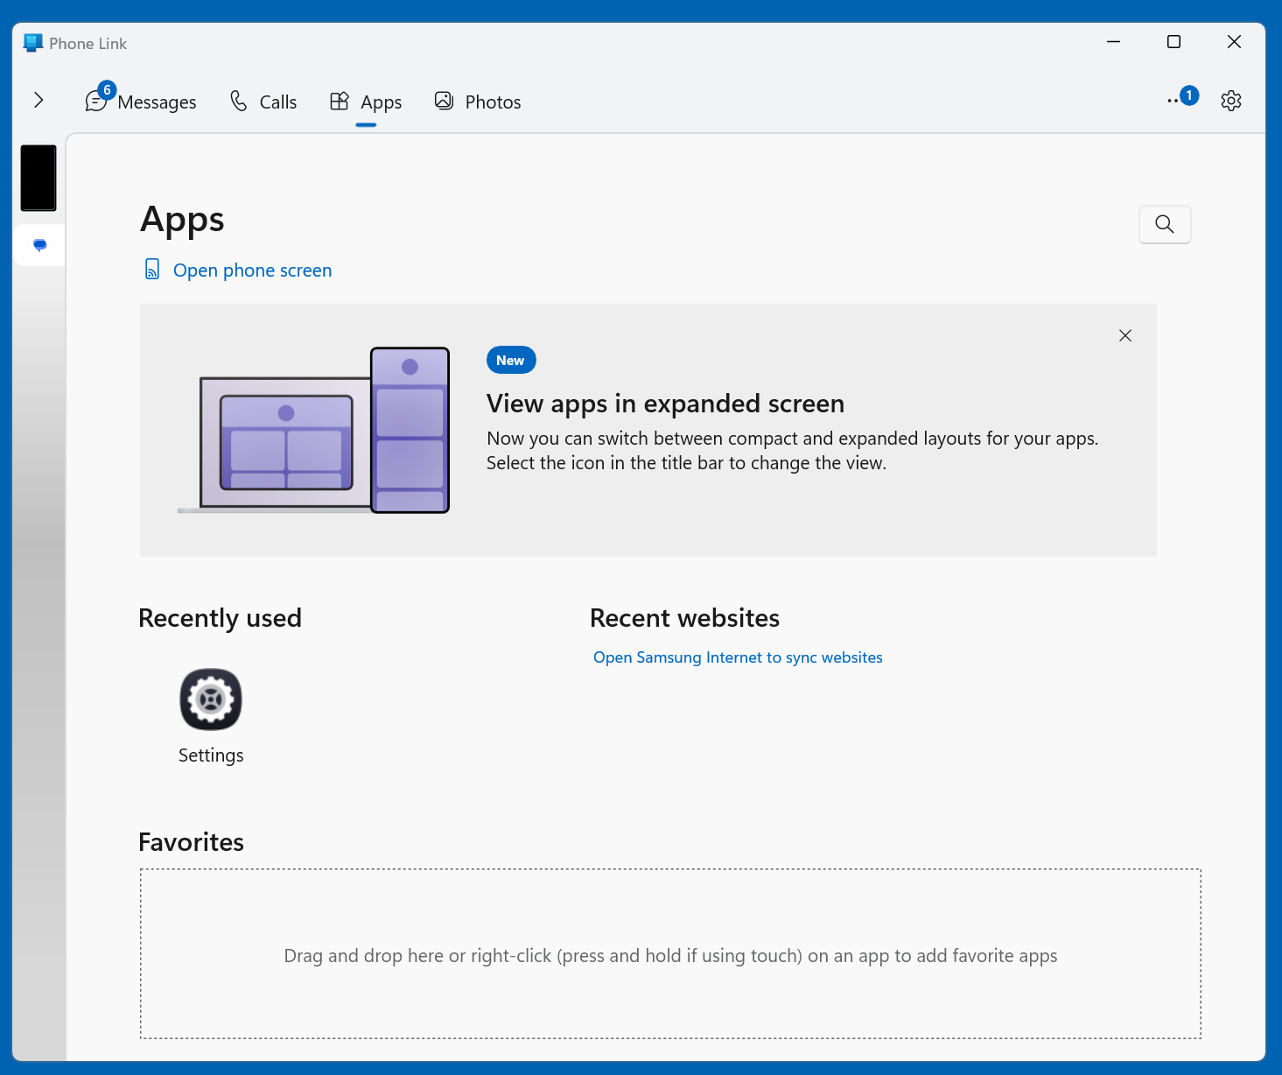

Slide 42
USING "PHONE LINK" IN WINDOWS" TO CONTROL AN ANDROID CELL PHONE (continued)
To see all of the apps that are currently installed into your cell phone, scroll or page downward in the Apps tab:

Slide 43
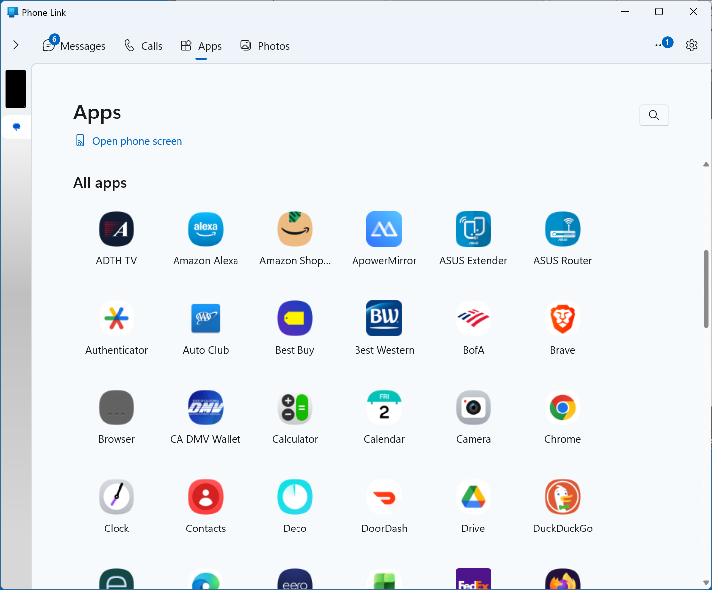

Slide 44
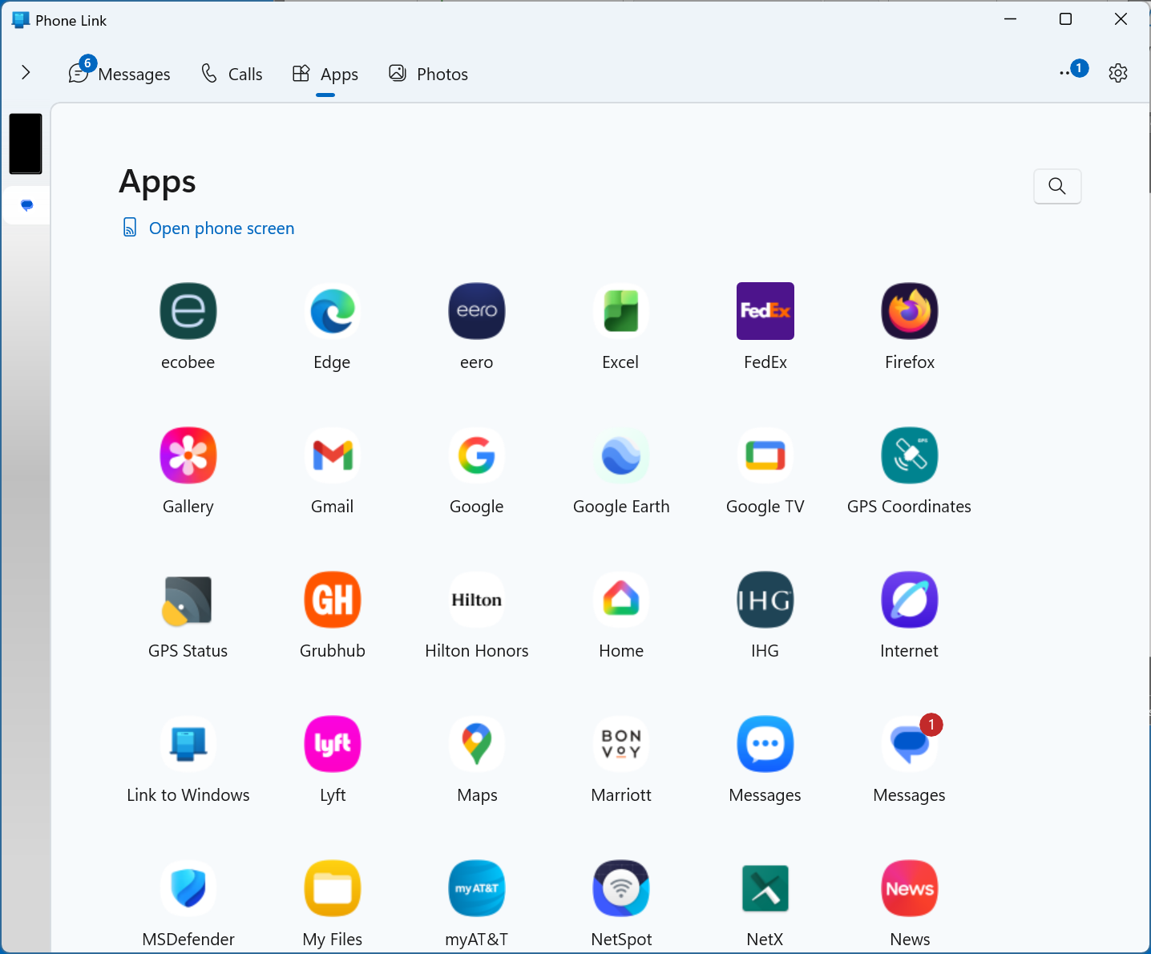

Slide 45
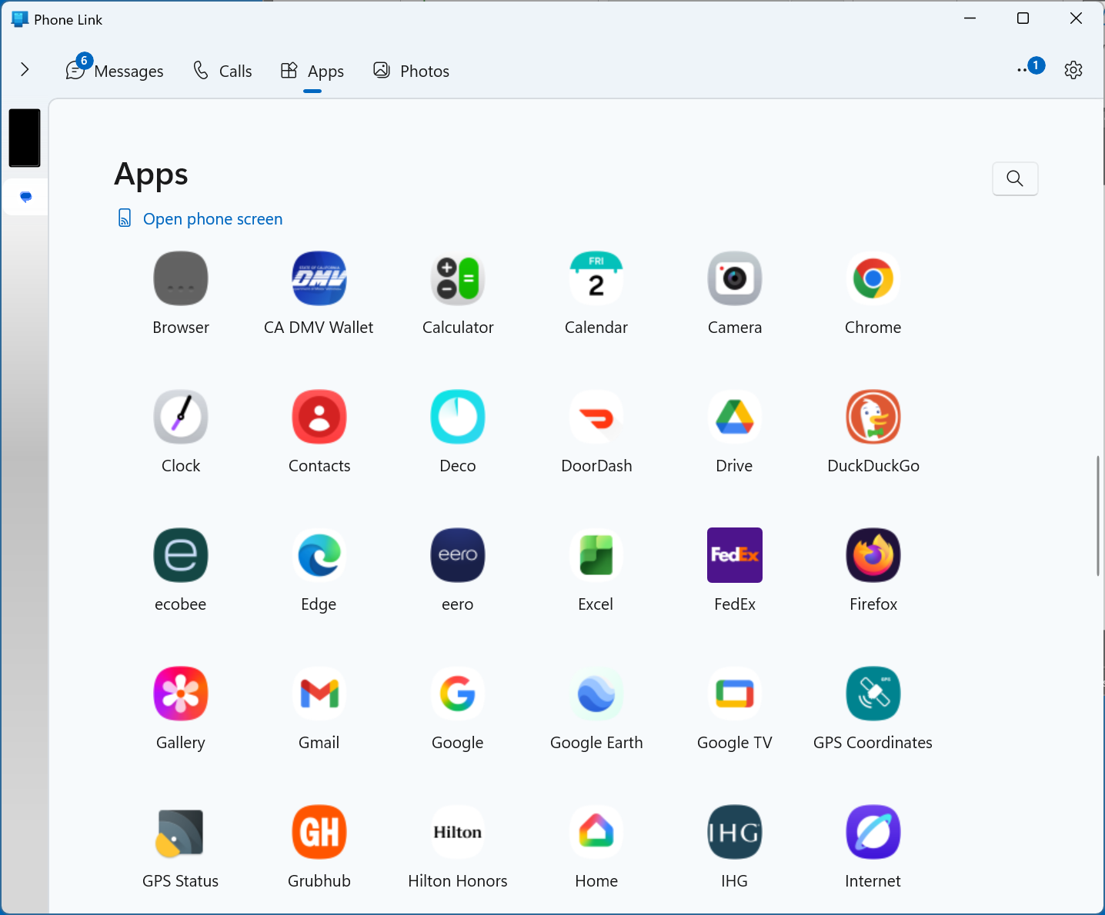

Slide 46
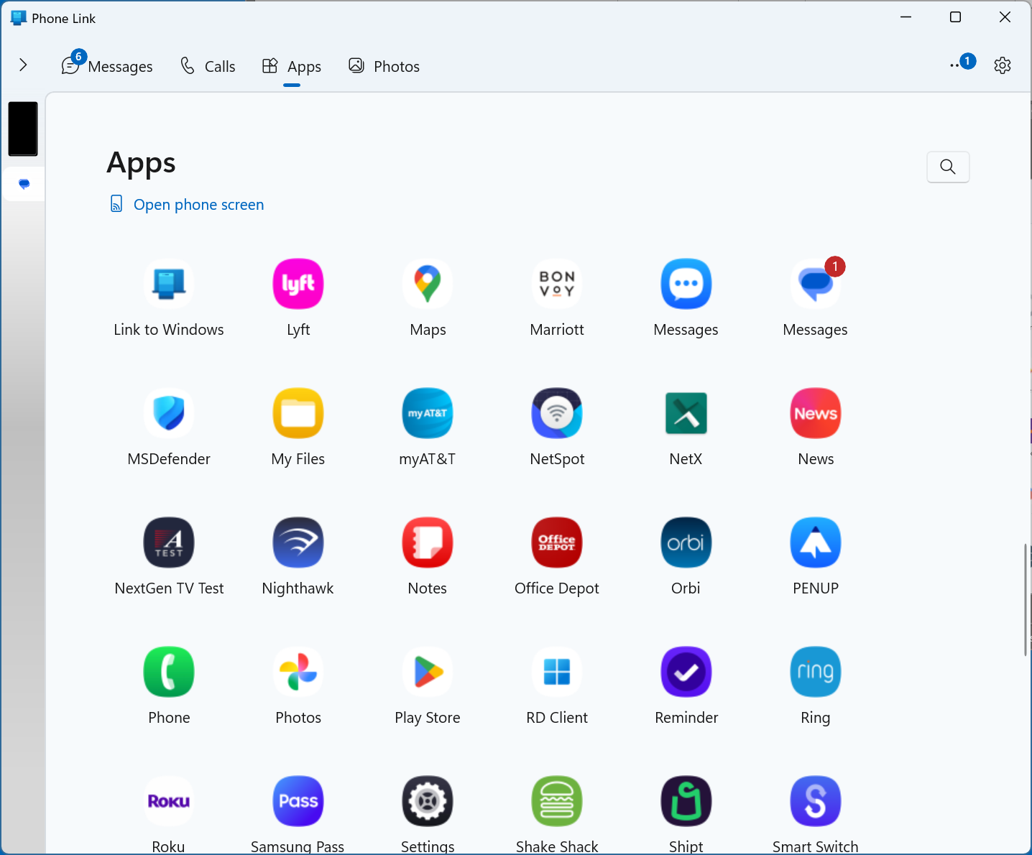

Slide 47
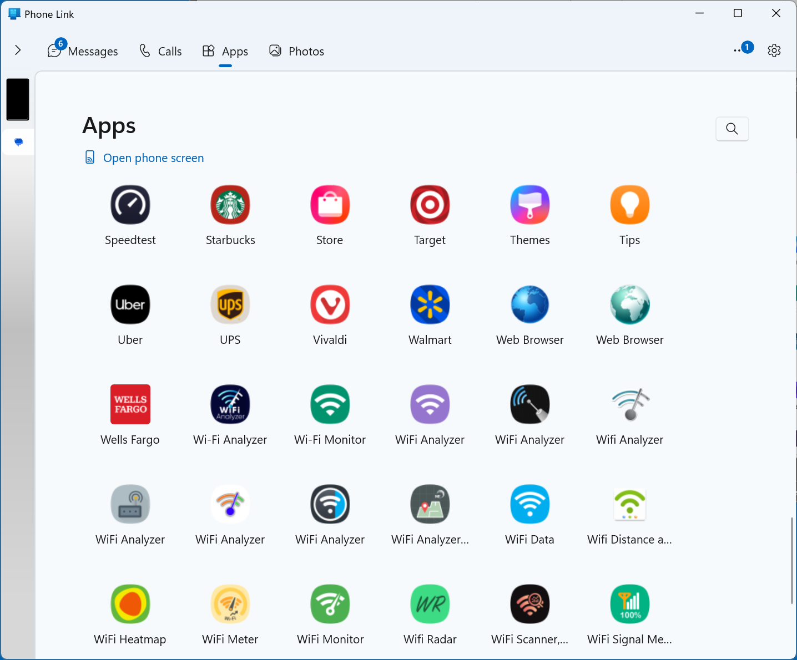

Slide 48
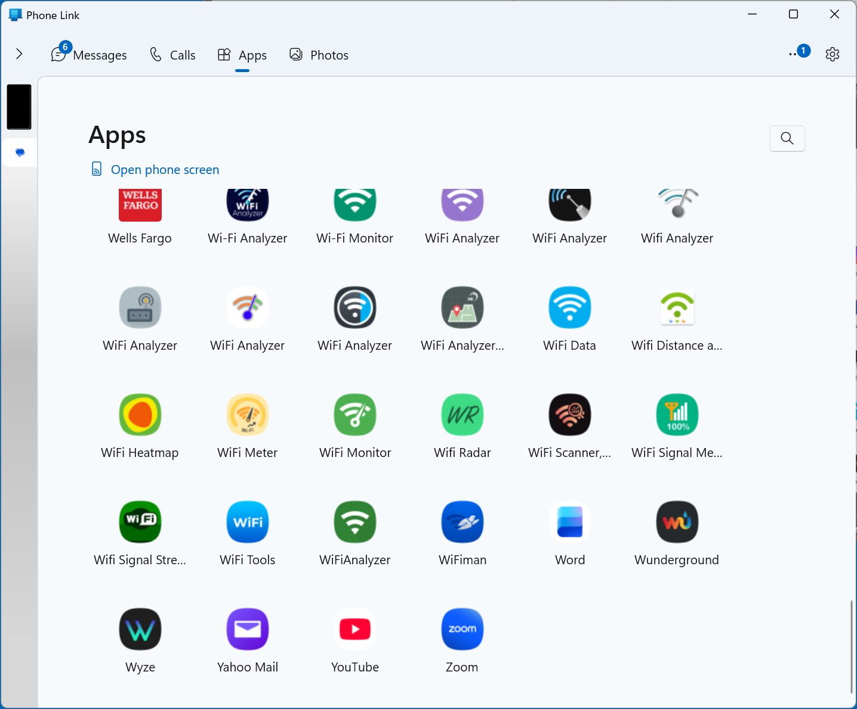

Slide 49
USING "PHONE LINK" IN WINDOWS" TO CONTROL AN ANDROID CELL PHONE (continued)
The "Photos" tabbed screen is supposed to display all photos that you have taken with the camera of your cell phone. However, it does not work right if you do not have the "OneDrive" app always active your Windows 11 computer since the "Photos" tab only stores photos up in "OneDrive" but you can use "Google Photos" app installed and active instead.

Slide 50
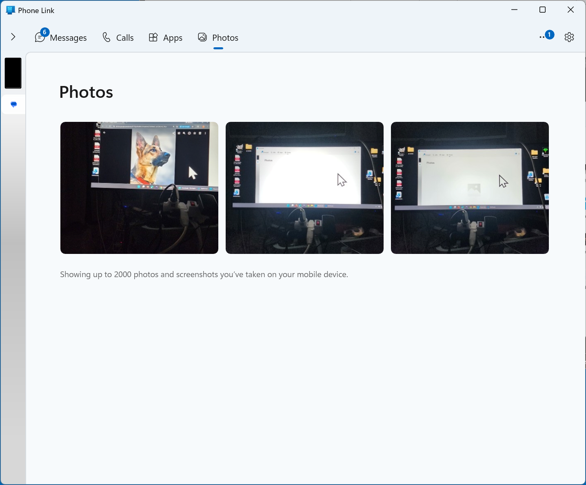

Slide 51
USING "PHONE LINK" IN WINDOWS" TO CONTROL AN ANDROID CELL PHONE (continued)
https://support.microsoft.com/en-us/topic/setting-up-photos-in-the-phone-link-11406d1d-f226-ab0f-56bf-db163e75d81e#id0efd=windows_11

Slide 53
USING "PHONE LINK" IN WINDOWS" TO CONTROL AN ANDROID CELL PHONE (continued)
If the "Phone Link" app determines that its window on the "Windows 11" desktop is not wide enough, it will hide the "Notifications" tab and display a "greater than" button that you can use to open the "Notifications" section:

Slide 55
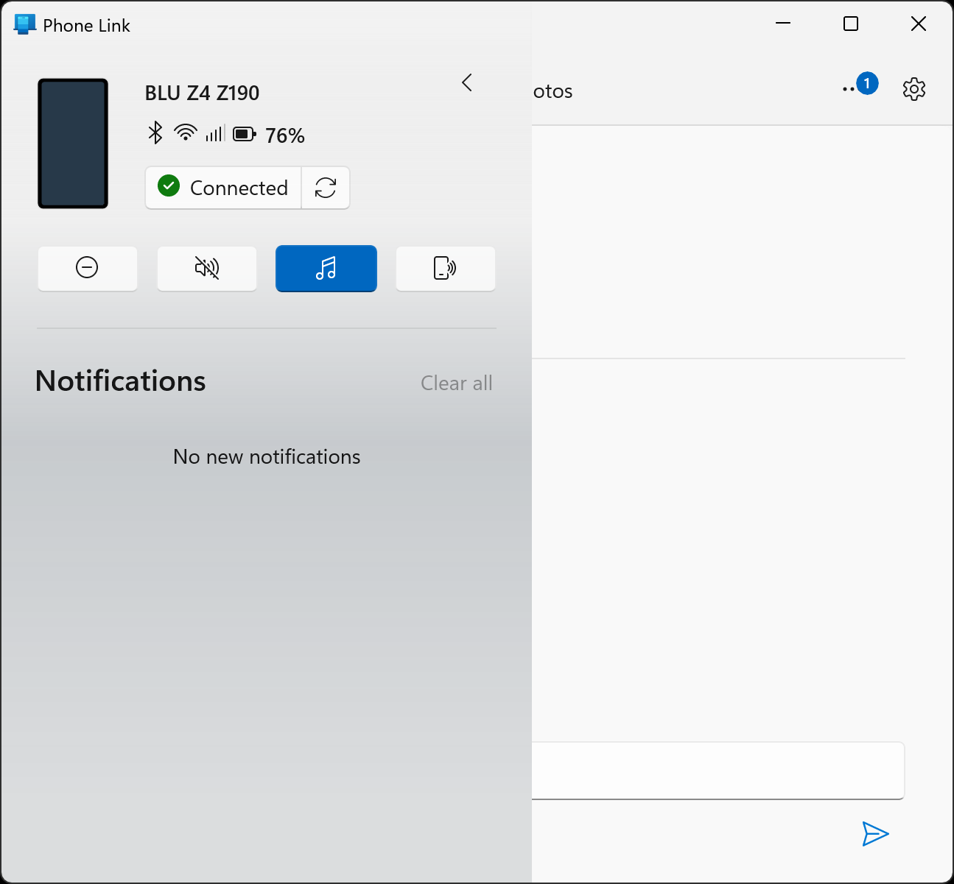

Slide 56
USING "PHONE LINK" IN WINDOWS" TO CONTROL AN ANDROID CELL PHONE (continued)
If you use the LEFT mouse button to click on the "less than" button, then the "Notifications" tabbed screen will disappear and the regular four tabbed screens will reappear:

Slide 58
ADVANTAGES OF CONTROLLING A CELL PHONE FROM A COMPUTER
Computer has a larger screen
Can use keyboard and mouse of a computer relative to using a stylus to tap on a cell phone
Faster to take screen shots of a cell phone from "Snip & Sketch" in a computer relative to screen capture function in a cell phone.

Slide 59
ADVANTAGES OF CONTROLLING A CELL PHONE FROM A COMPUTER (continued)
Third party Web sites for sending text messages are not reliable (while sending from a cell phone or from the "Messages" tab inside the "Phone Link" app of "Windows 11" is very reliable).

Slide 60
ADVANTAGES OF CONTROLLING A CELL PHONE FROM A COMPUTER (continued)
Using your email account to send text messages to cell phones is not reliable (while using a computer linked to a cell phone to send out text messages is very reliable)

Slide 61
IT IS EASIER TO USE "PHONE LINK" IN A "WINDOWS 11" COMPUTER IF YOU CREATE A DESKTOP SHORTCUT..
..for it: Right click on the Start button, click on "Run", type in shell:appsfolder Click on "OK" Left click on "Phone Link" Click on "Create shortcut"

Slide 62
AFTER USING "PHONE LINK" IN "WINDOWS 11"..
..even if you click on the "X" in the upper-right corner of the "Phone Link" window, "Phone Line" continues running in the background. To fully turn "Phone Link" off (and to save on its unneeded use of RAM), use the LEFT mouse button to click on the "Phone Link" icon in the "Notification Area":

Slide 63
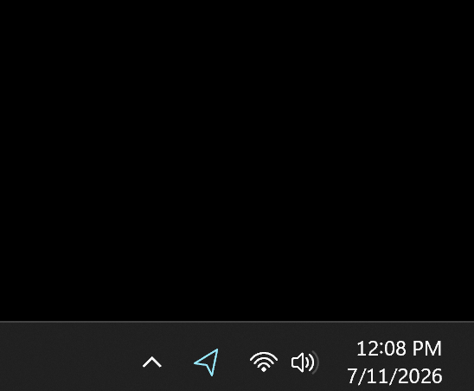

Slide 65
AFTER USING "PHONE LINK" IN "WINDOWS 11".. (continued)
Then use the RIGHT mouse button to click on the "Phone Link" icon in the "Notification Area":

Slide 66
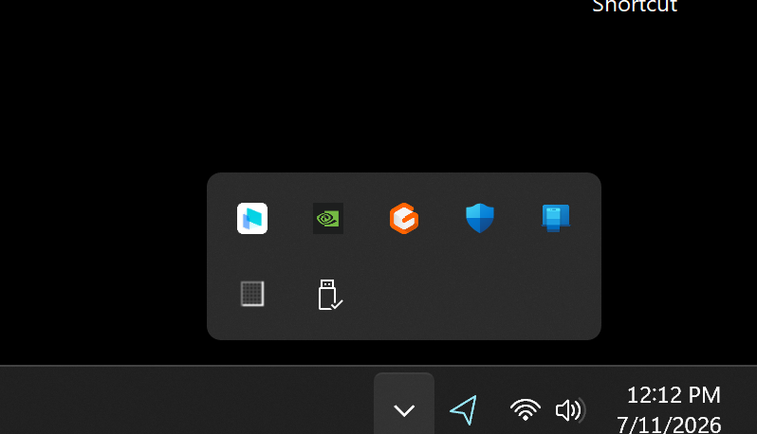

Slide 68
AFTER USING "PHONE LINK" IN "WINDOWS 11".. (continued)
Then use the LEFT mouse button to click on "Quit":

Slide 69
