Slide 1

11-"FAXTALK FAXCENTER PRO"
INSTALLATION AND USE FOR
A "WINDOWS 11.." COMPUTER
1

Slide 2
Web location for this presentation:
http://aztcs.apcug.org
Click on "Meeting Notes"
email: fchao2@yahoo.com
2

Slide 3
SUMMARY
The not-free "FaxTalk FaxCenter Pro" works reliably in all feature editions of "Windows 11.." while the Microsoft's free "Windows Fax and Scan" has a history of temporary failures such as for the 24H2 feature edition of "Windows 11..
3

Slide 4
SHORT DESCRIPTION FOR INSTALLING "WINDOWS FAX AND SCAN" INTO WINDOWS 11..
You can install the free 15-day trial of "FaxTalk FaxCenter Pro" at https://www.faxtalk.com/download-trial-software/
4

Slide 5
5

Slide 6
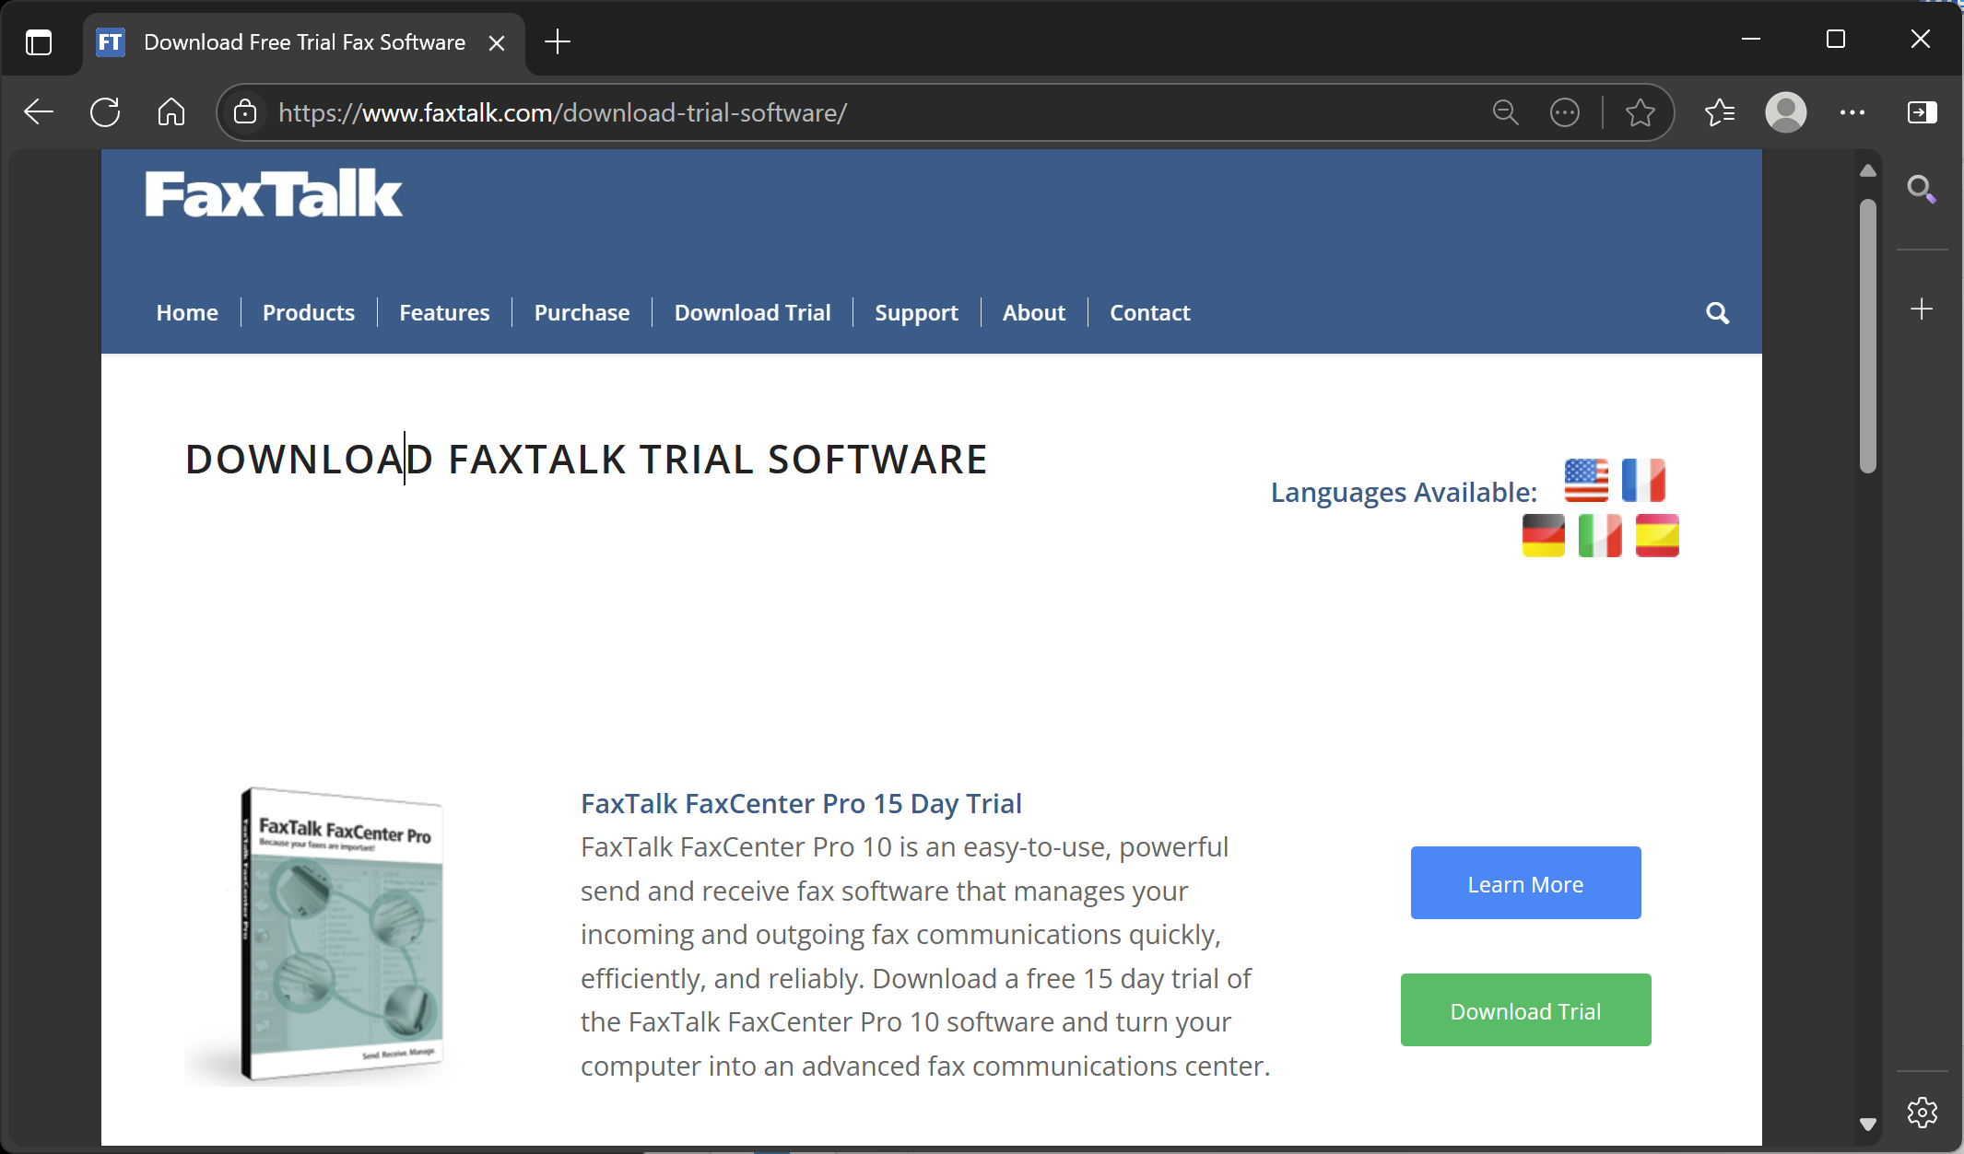
6

Slide 7
7

Slide 8
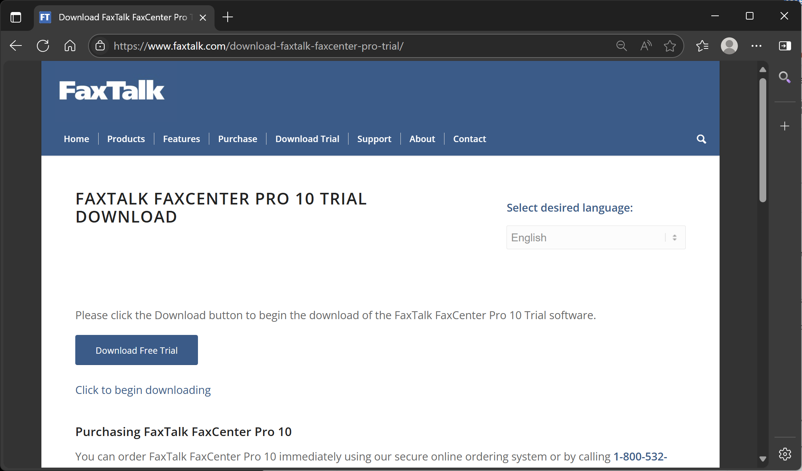
8

Slide 9
9

Slide 10
10

Slide 11
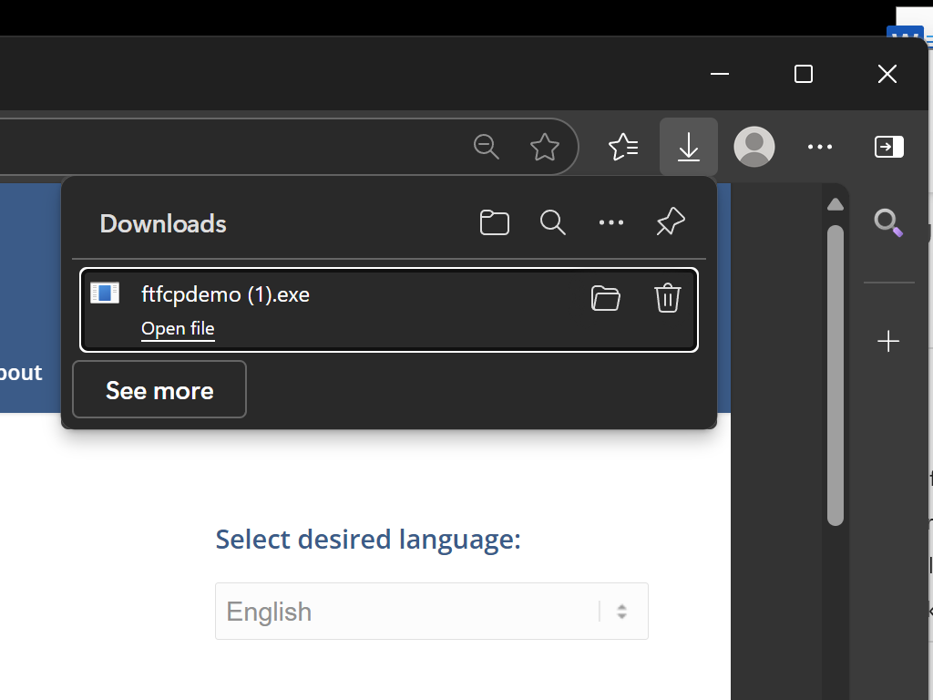
11

Slide 12
12

Slide 13
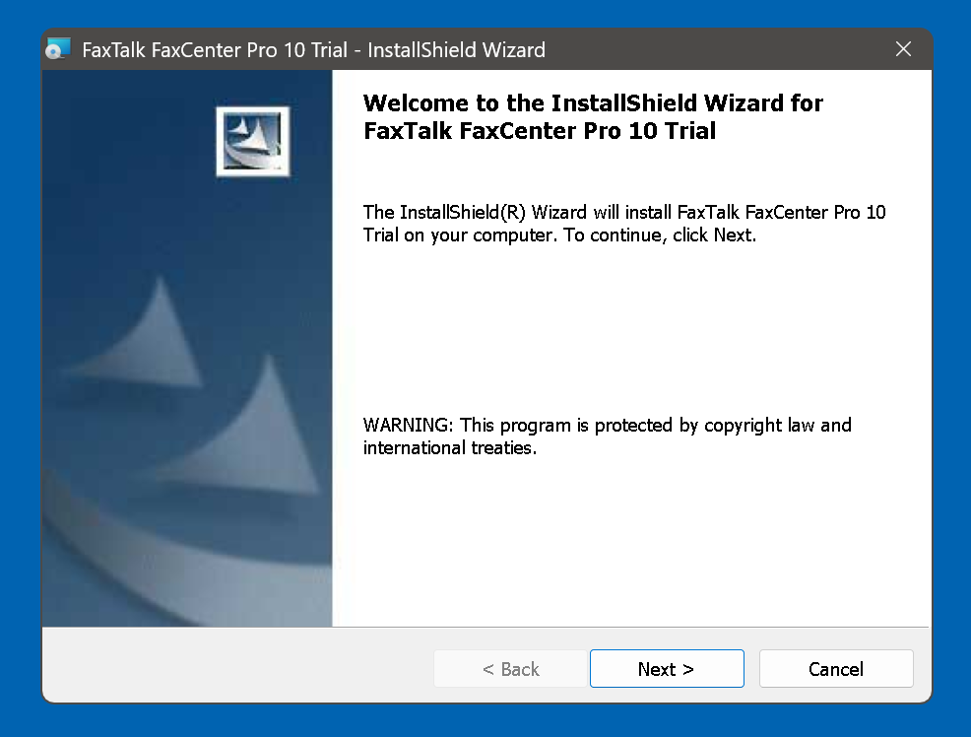
13

Slide 14
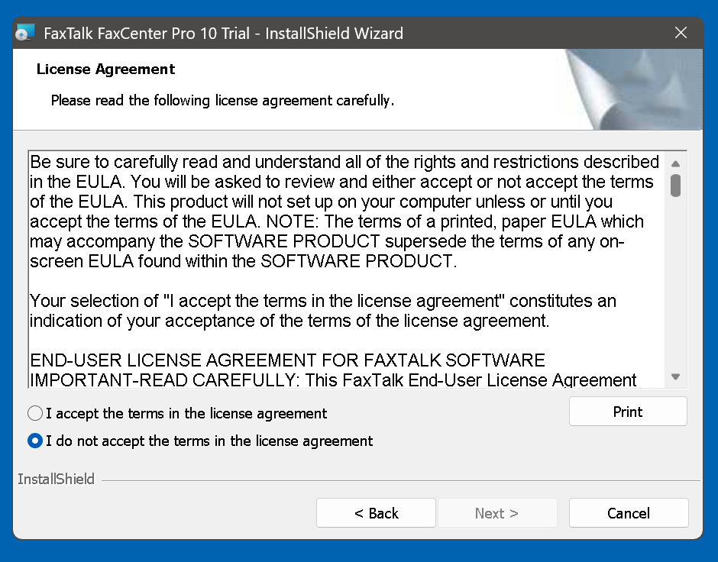
14

Slide 15
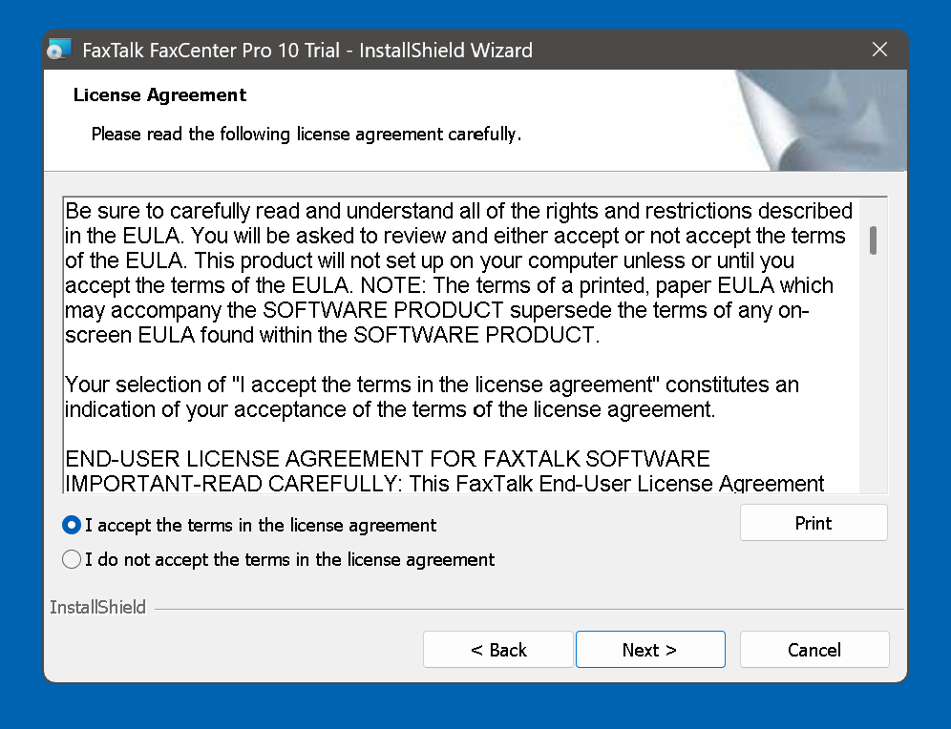
15

Slide 16
16

Slide 17
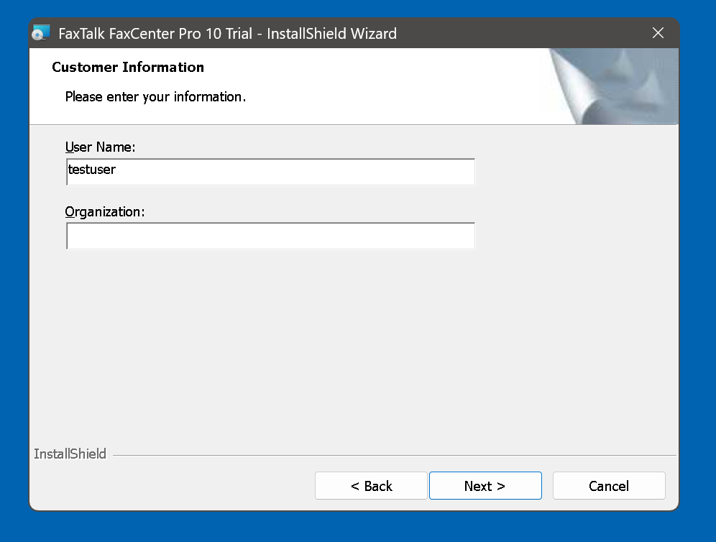
17

Slide 18
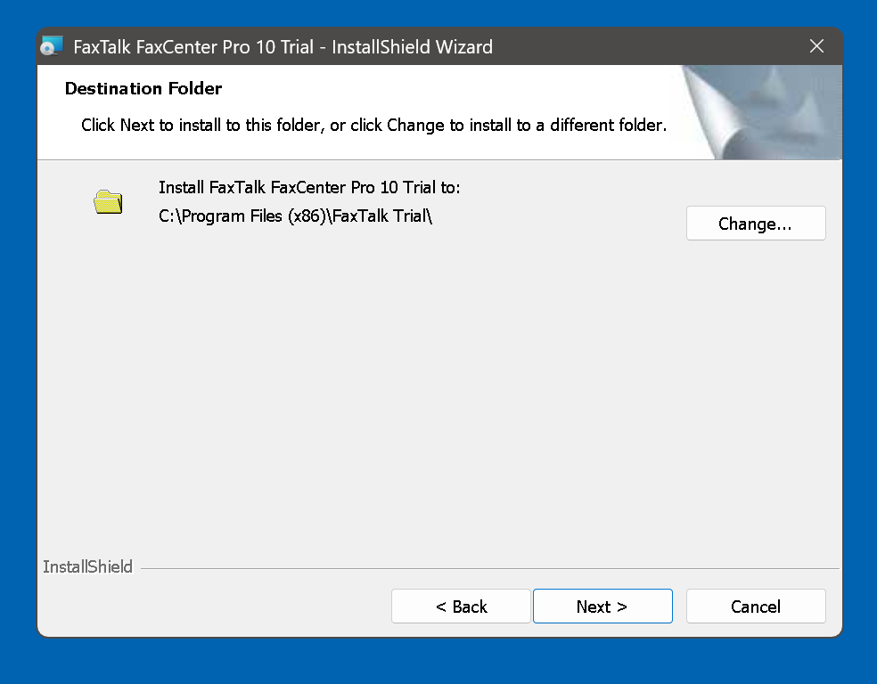
18

Slide 19
19

Slide 20
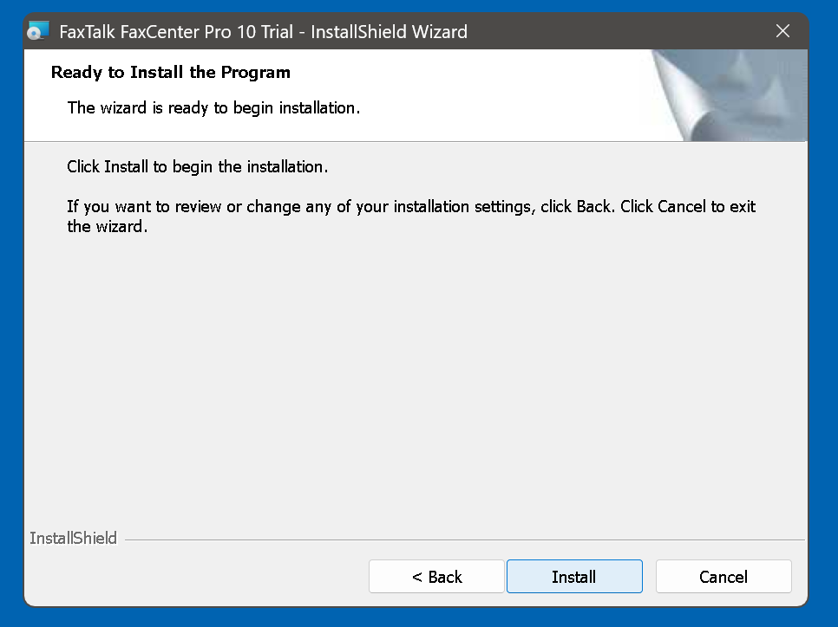
20

Slide 21
21

Slide 22
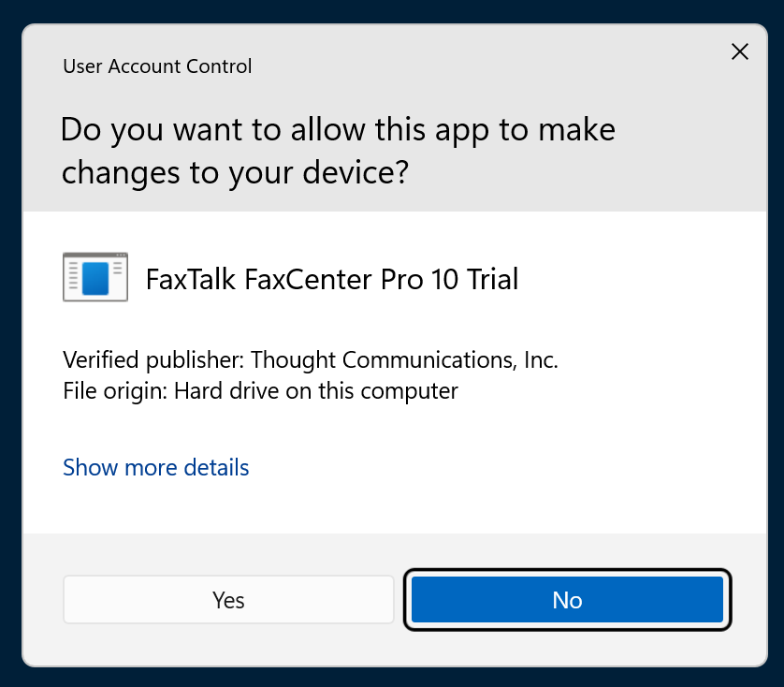
22

Slide 23
23

Slide 24
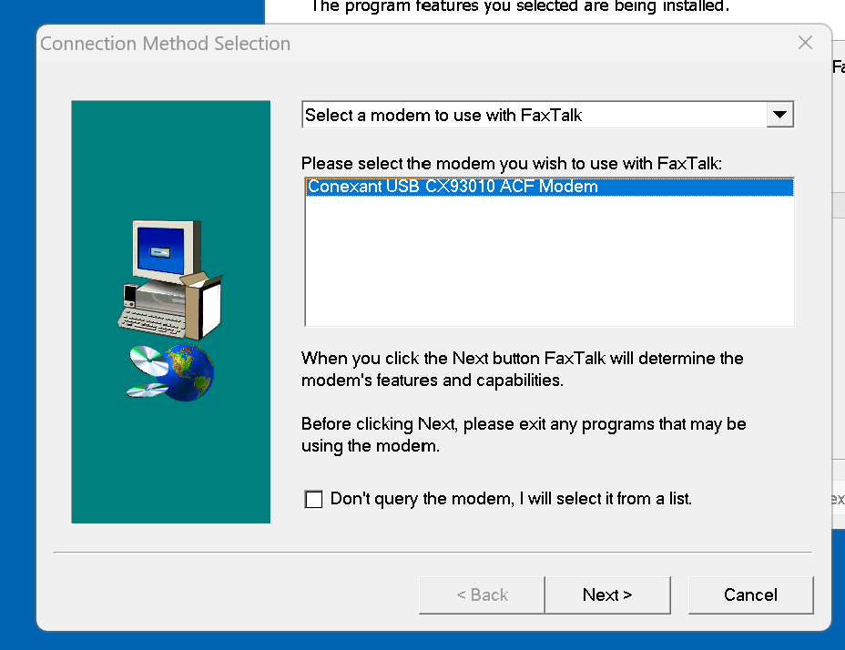
24

Slide 25
25

Slide 26
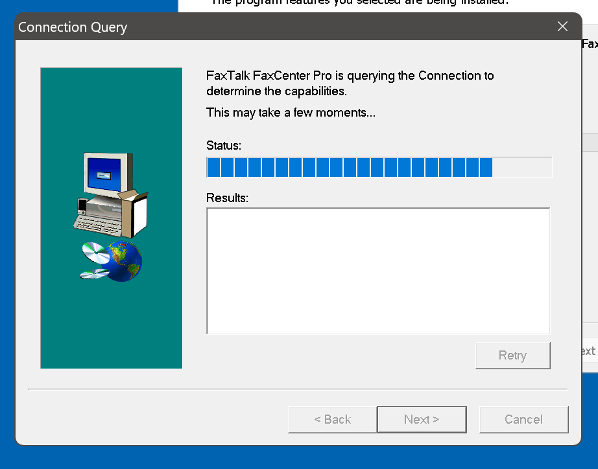
26

Slide 27
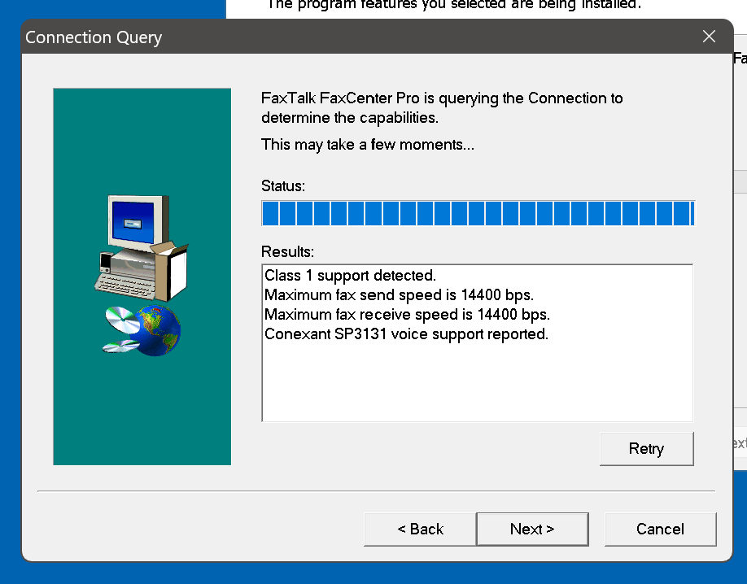
27

Slide 28
28

Slide 29
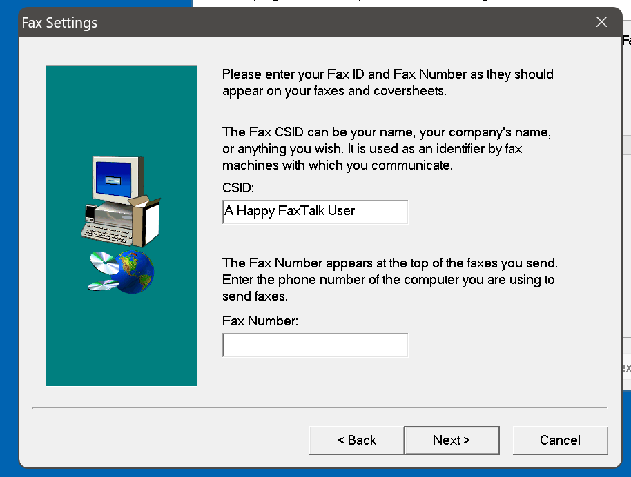
29

Slide 30
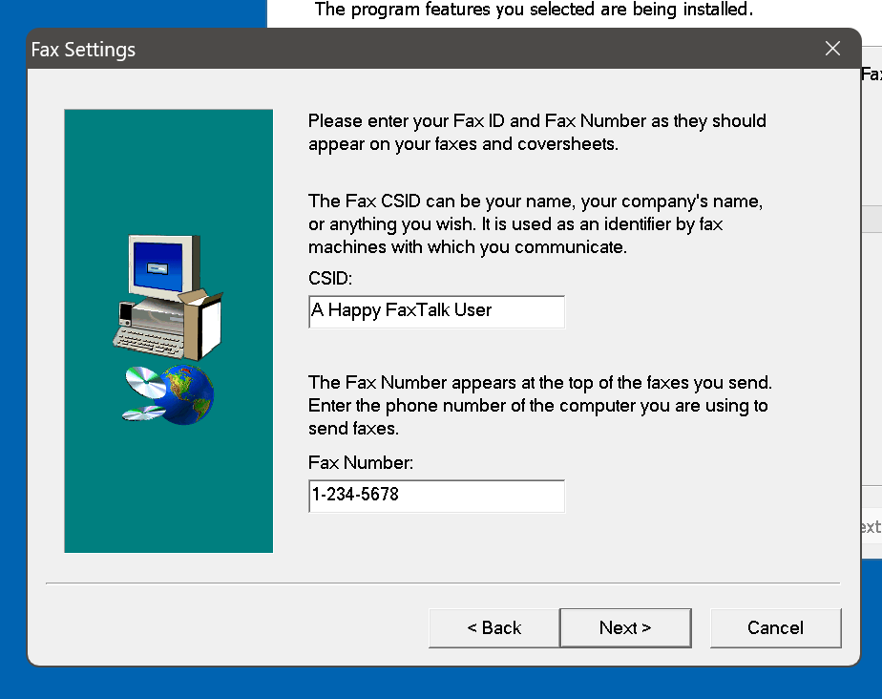
30

Slide 31
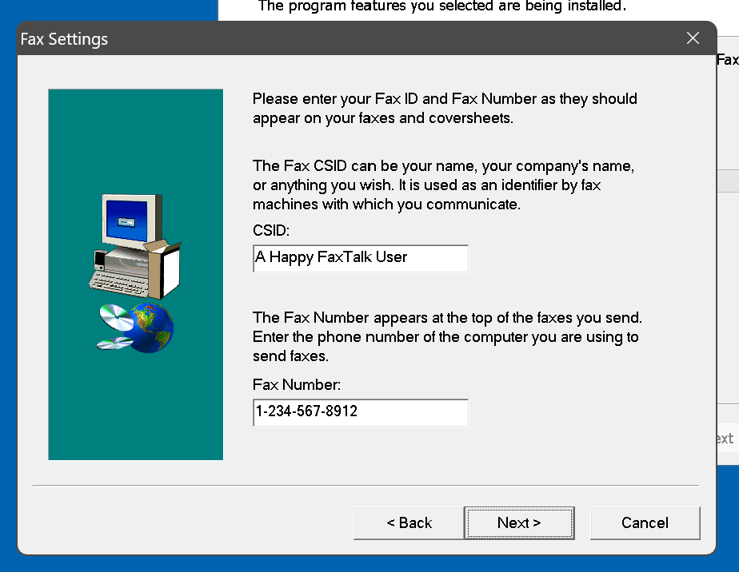
31

Slide 32
32

Slide 33
33

Slide 34
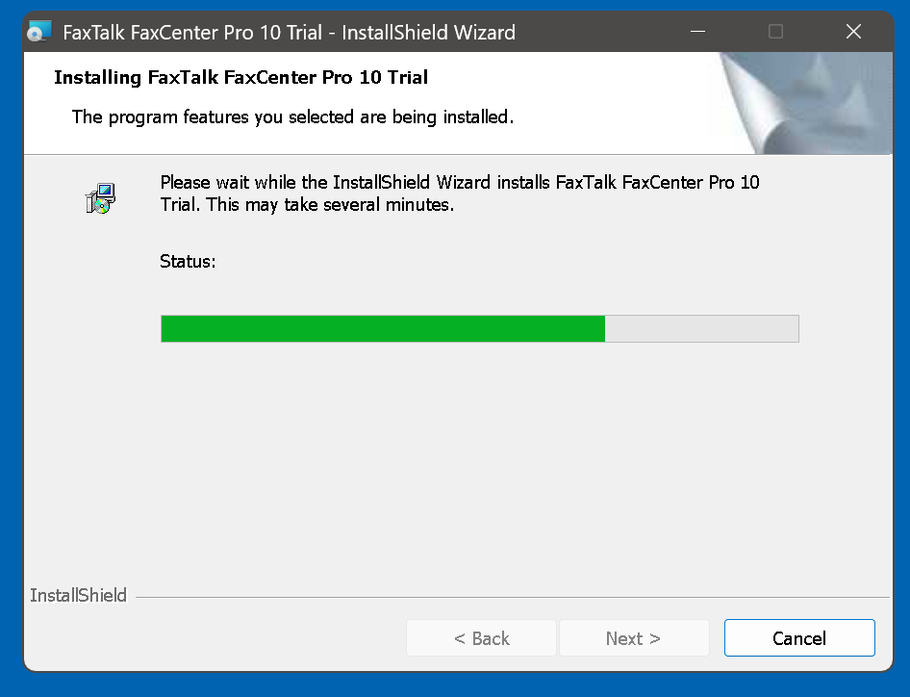
34

Slide 35
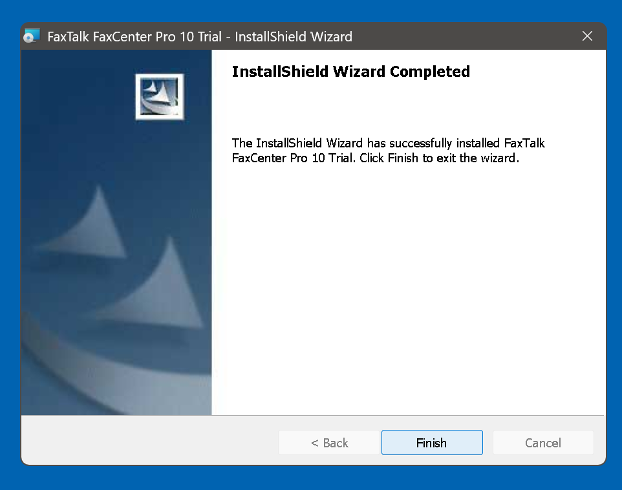
35

Slide 36
36

Slide 37

37

Slide 38
RESOLVING "VOICE OVER IP" PHONE LINE PROBLEMS
Unlike the free "Windows Fax and Scan", the "FaxTalk FaxCenter Pro" app lets you follow the problem resolution steps when you encounter fax transmitting and/or receiving problems when you are using a "Voice Over IP" phone line:
38

Slide 39
RESOLVING "VOICE OVER IP" PHONE LINE PROBLEMS (continued)
Step 1: Start up the "FaxTalk FaxCenter Pro" app:
39

Slide 40
40

Slide 41
RESOLVING "VOICE OVER IP" PHONE LINE PROBLEMS (continued)
Step 2: Use the left mouse button to click on "Continue Trial":
41

Slide 42
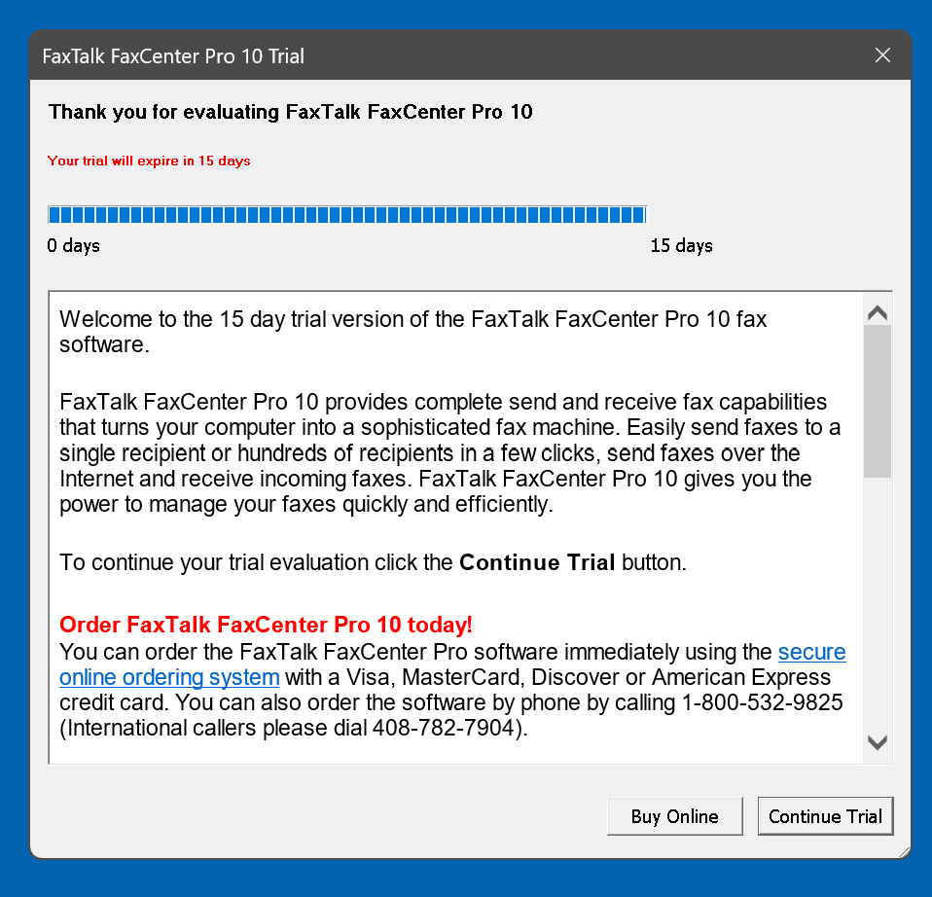
42

Slide 43
43

Slide 44
RESOLVING "VOICE OVER IP" PHONE LINE PROBLEMS (continued)
Step 3: Use the left mouse button to click on "Tools":
44

Slide 45
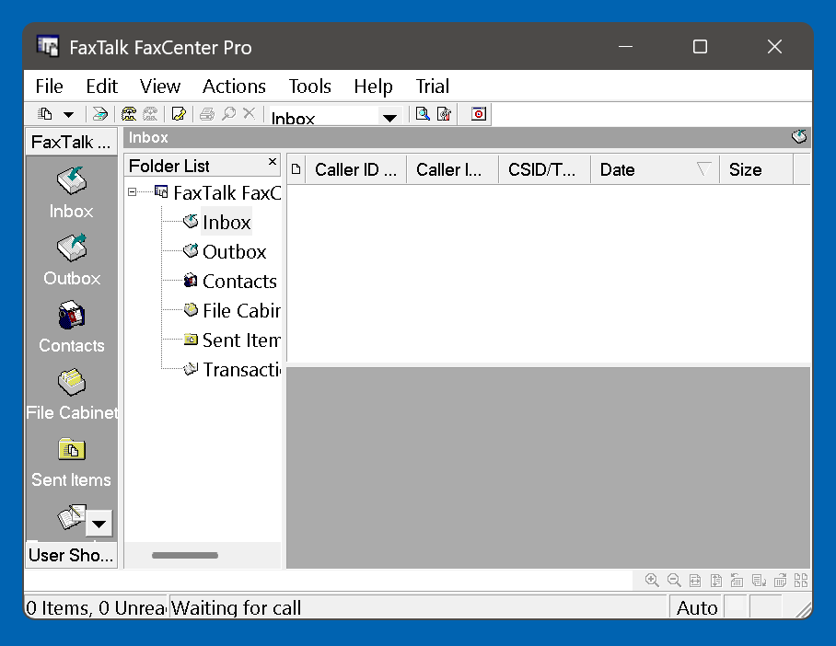
45

Slide 46
46

Slide 47
RESOLVING "VOICE OVER IP" PHONE LINE PROBLEMS (continued)
Step 4: Use the left mouse button to click on "Options":
47

Slide 48
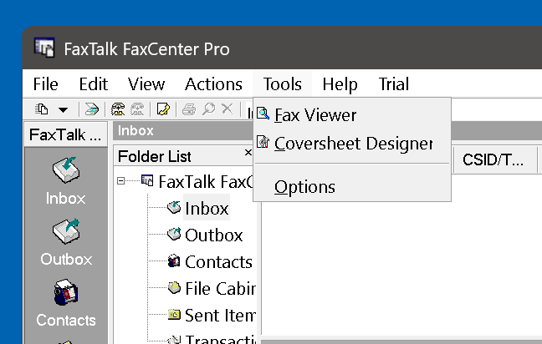
48

Slide 49
49

Slide 50
RESOLVING "VOICE OVER IP" PHONE LINE PROBLEMS (continued)
Step 5: Use the left mouse button to click on "adfa":
50

Slide 51
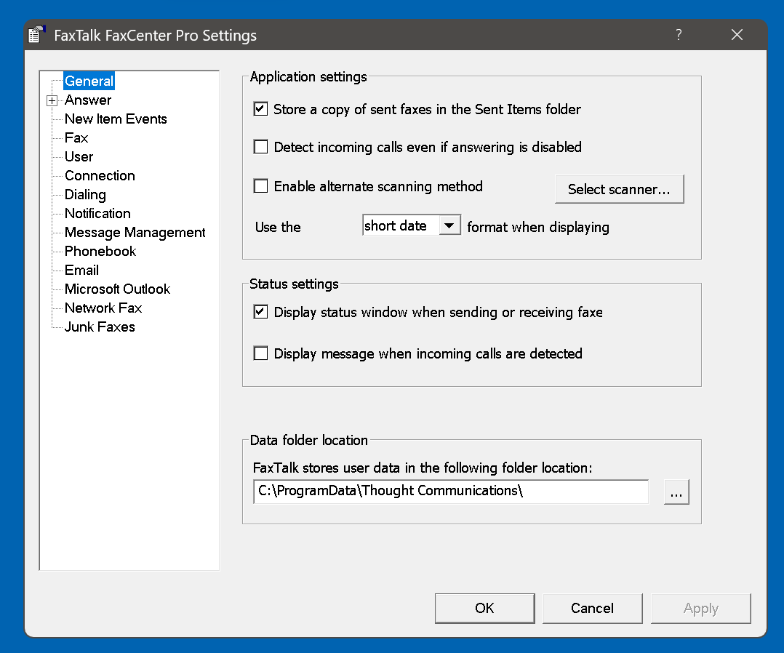
51

Slide 52
52

Slide 53
RESOLVING "VOICE OVER IP" PHONE LINE PROBLEMS (continued)
Step 6: Use the "PgDn" button or the "v" move downward button to highlight the "Connection" button:
53

Slide 54
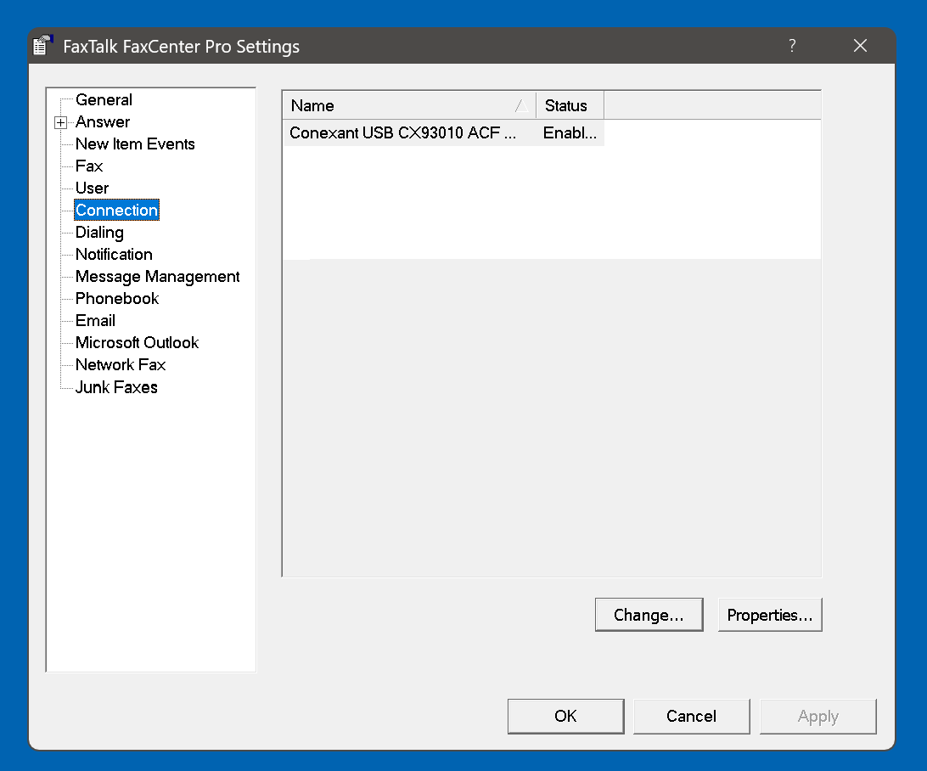
54

Slide 55
55

Slide 56
RESOLVING "VOICE OVER IP" PHONE LINE PROBLEMS (continued)
Step 7: Use the left mouse button to click once on the name of the modem to highlight the name of the modem:
56

Slide 57
57

Slide 58
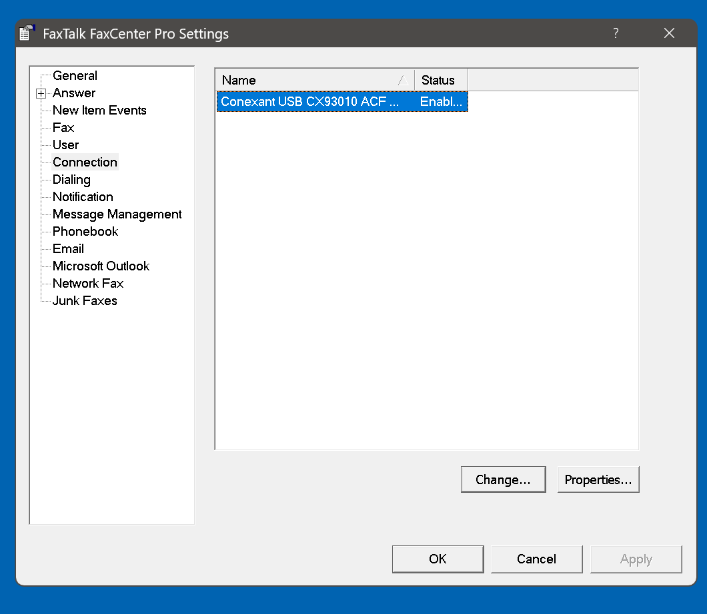
58

Slide 59
RESOLVING "VOICE OVER IP" PHONE LINE PROBLEMS (continued)
Step 8: Use the left mouse button to click on "Properties":
59

Slide 60
60

Slide 61
RESOLVING "VOICE OVER IP" PHONE LINE PROBLEMS (continued)
Step 9: Use the left mouse button to double-click on the "Fax" tab:
61

Slide 62
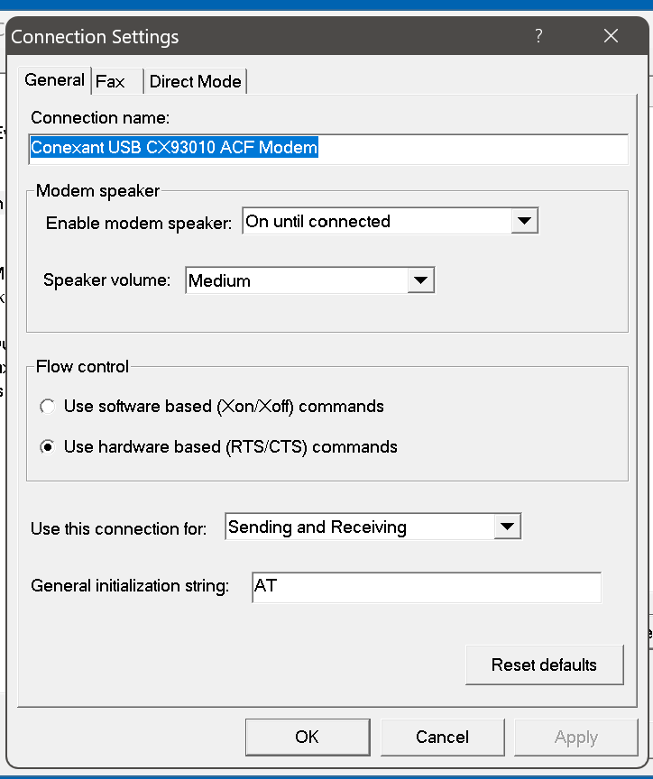
62

Slide 63
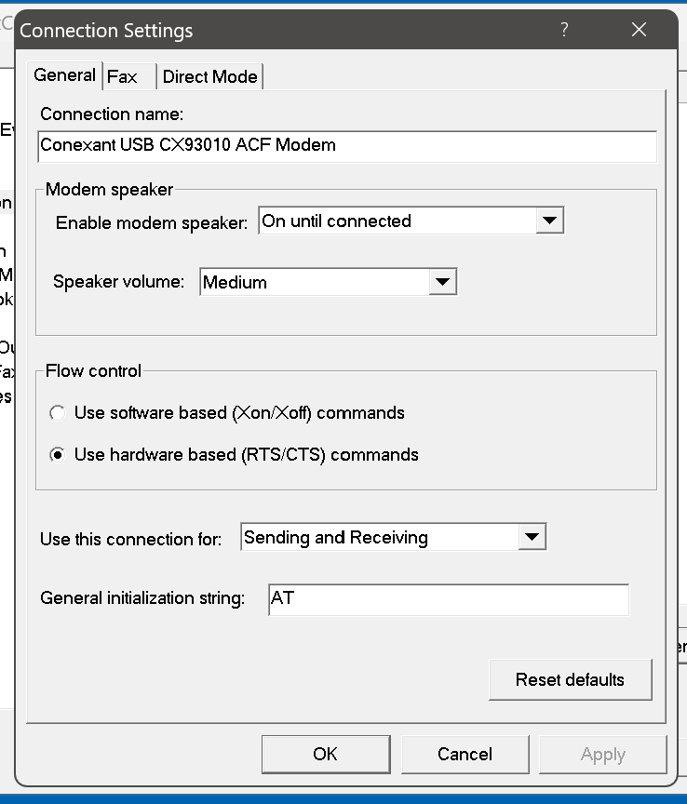
63

Slide 64
RESOLVING "VOICE OVER IP" PHONE LINE PROBLEMS (continued)
Step 10: Adjust the various settings in accordance with the recommendations of your "Voice Over IP" telephone provider:
64

Slide 65
PROBLEM RESOLUTION ACTIONS
If you have problems with sending or receiving faxes when your fax modem or your fax machine, then the various "Voice Over IP" phone providers have various steps for you to follow, as stated in their various Web site. However, you can only follow these remediation steps, if you are using the not-free "FaxTalk FaxCenter Pro. You cannot follow these remediation steps if you are using "Windows Fax and Scan".
65

Slide 66
PROBLEM RESOLUTION ACTIONS (continued)
To follow the "Voice Over IP" providers' remediation steps in FaxTalk FaxCenter Pro": Use the left mouse button to click on "Tools". --->Use the left mouse button to click on "Options". -->Use the left mouse button to click on "Connection". -->Click on the name of the modem to highlight it.
66

Slide 67
PROBLEM RESOLUTION ACTIONS (continued)
To follow the "Voice Over IP" providers' remediation steps in FaxTalk FaxCenter Pro" (continued): -->Use the left mouse button to click on "Properties". -->Use the left mouse button to click on the "Fax" tab. -->Follow the problem resolution steps provided by the "Voice Over IP" provider, as stated in the following Web site locations:
67

Slide 68
"VONAGE" VOIP PHONE LINES
https://support.vonage.com/articles/answer/Vonage-Residential-Fax-Line-843 :
68

Slide 69
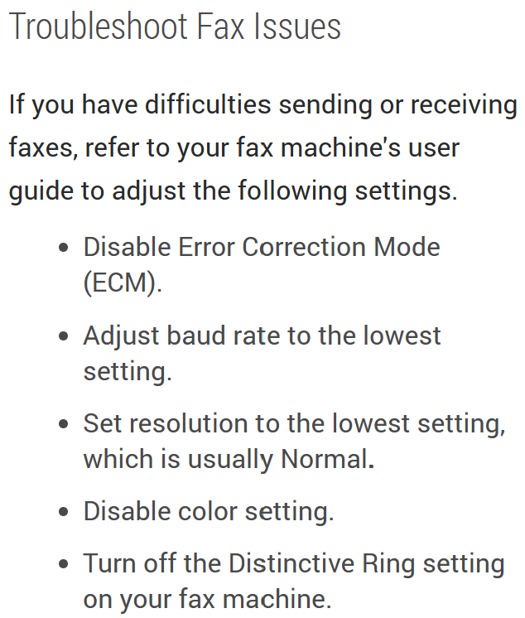
69

Slide 70
"OOMA" VOIP PHONE LINES
https://support.ooma.com/home/faxing-with-ooma/ :
70

Slide 71
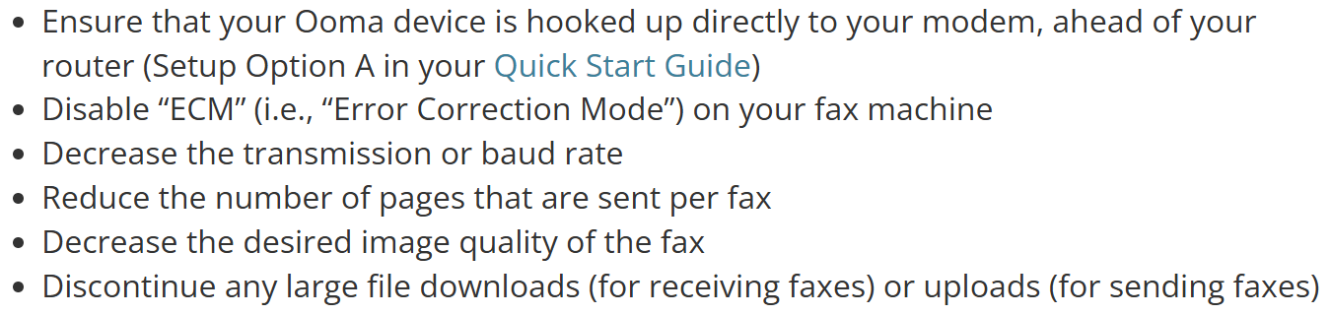
71

Slide 72
"SPECTRUM" VOIP PHONE LINES
https://documentation.spectrumvoip.com/fax-machine-faxing-in-stratus/fax-machine-settings-for-voip-faxing
72

Slide 73
73

Slide 74
74

