Slide 1



Adding An Additional Power Switch to a Computer

Slide 2
Web location for this presentation:
http://aztcs.apcug.org
Click on “Meeting Notes”
2

Slide 3
SUMMARY
You can add a power switch to your PC either inside the case (replacing or supplementing the built‑in one) or outside the case for easier access. The key is to connect it to the motherboard’s PWR_SW (power switch) header.
3

Slide 4
WHAT YOU WILL NEED..
A momentary push‑on/push‑off switch (PC‑rated). See https://blog.silverpc.hu/2025/10/20/want-to-attach-a-custom-power-button-to-your-pc-heres-the-definitive-guide/

Slide 5
WHAT YOU WILL NEED.. (continued)
https://www.amazon.com/dp/B0CDXRVF9W: The three options are only important if you want the computer's motherboard to light up the optional LED that is part of the push button switch:

Slide 6
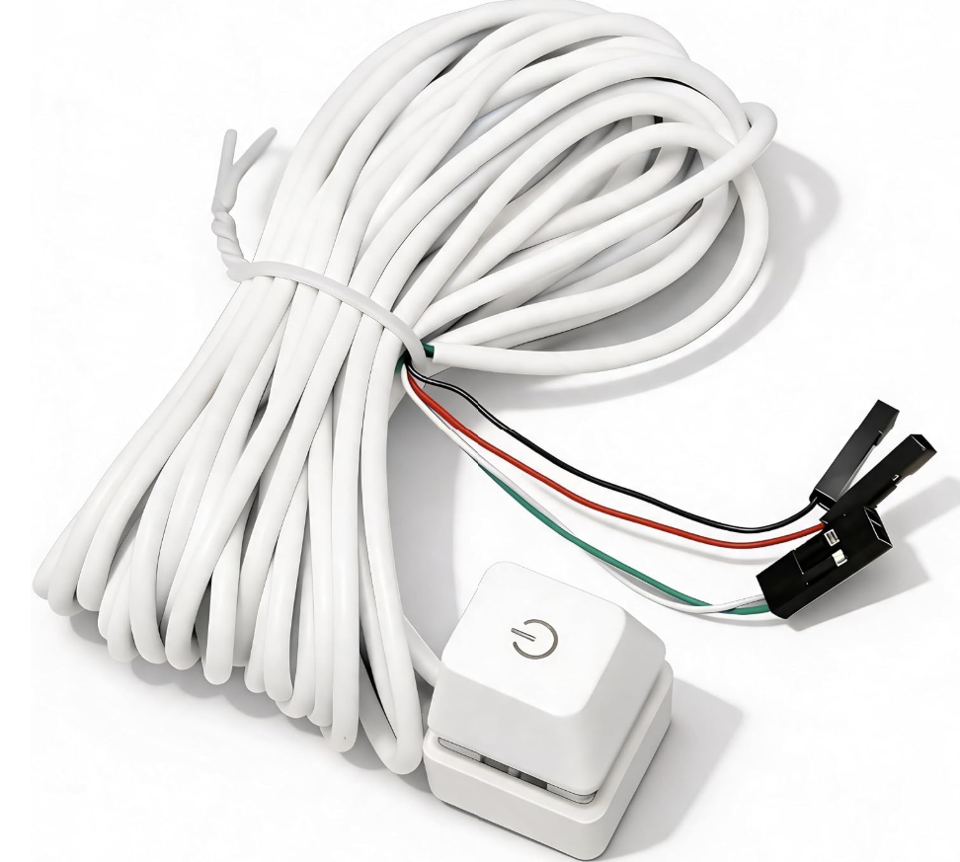

Slide 7
WIRE COLORS
The green and white leads go to the add-on push-button switch
The optional red and black leads go to the optional LED that is part of the add-on push-button switch
The optional red lead goes to the + side of the optionl LED
The optional black lead goes to the - side of the optional LED

Slide 8
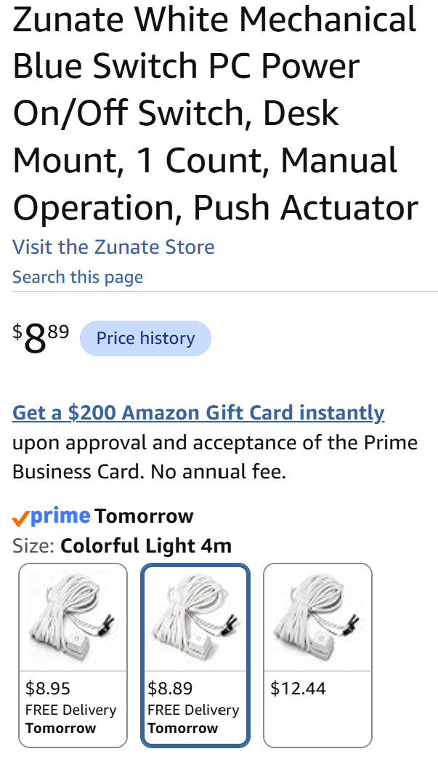

Slide 9
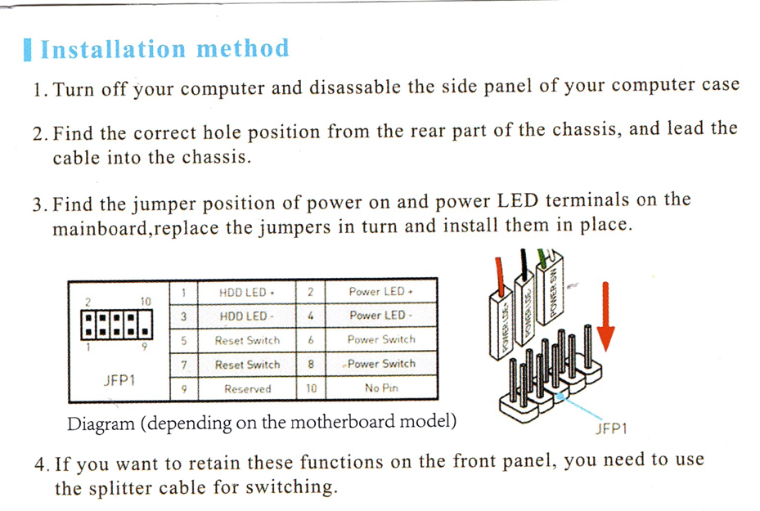

Slide 10
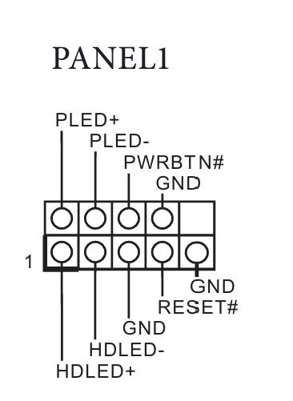

Slide 12
TO LOCATE THE OWNERS MANUAL OF YOUR COMPUTER'S MOTHERBOARD:
You can find your motherboard’s manufacturer (MFR) and model number without opening the case, using built‑in Windows tools or other methods.
1. Using Windows System Information (msinfo32) Press Windows + R to open the Run dialog.
Type msinfo32 and press Enter.

Slide 13
TO LOCATE THE OWNERS MANUAL OF YOUR COMPUTER'S MOTHERBOARD: (continued)
Type msinfo32 and press Enter.
In the System Information window, select System Summary from the left pane.
Look for:
  Baseboard Manufacturer – your motherboard’s MFR.
  BaseBoard Product – the model number.
  BaseBoard Version – optional version info.

Slide 14
TO LOCATE THE OWNERS MANUAL OF YOUR COMPUTER'S MOTHERBOARD: (continued)
3. Using PowerShell (Get‑CimInstance)
Press Windows + R, type powershell, and press Enter.
Type or copy the following into the PowerShell prompt:
Get-CimInstance -ClassName Win32_BaseBoard | Select-Object Manufacturer, Product, Version

Slide 15
TO LOCATE THE OWNERS MANUAL OF YOUR COMPUTER'S MOTHERBOARD: (continued)
Go to the manufacturer's Web site for the motherboard of the computer and search for the owner's manual PDF file
Search for the power button "header" information in the owner's manual.

Slide 16
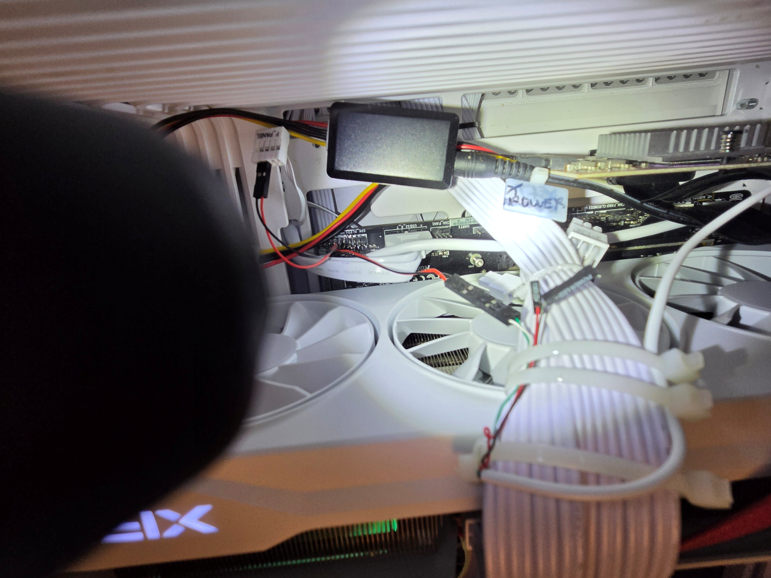

Slide 17
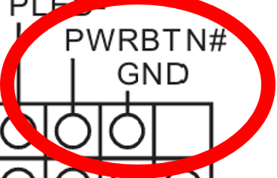

Slide 19
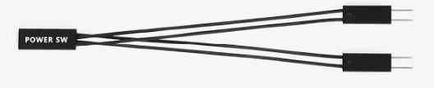

Slide 21
connects to wire pair that goes to add-on momentary push button switch
connects to the existing wire bundle that goes to the push-button power-on switch, which is typically mounted on the computer case’s front panel

