Slide 1


RESOLVING COMPUTER HARDWARE LIMITATIONS THAT LIMIT THE SPEEDS PROVIDED BY AN INTERNET SUPPLIER-PART 2

Slide 2
Web location for this presentation:
http://aztcs.apcug.org
Click on "Meeting Notes"
2

Slide 3
TOPICS
After a mandatory speed upgrade from a fiber-optic based residential Internet Provider from 200 Megabits per second up to 1000 Megabits per second: all computers in the residence were limited to Internet speeds that were only a fraction of the speeds that were now provided by the Internet Provider. Adding parts to the existing computers resolved the slowdown but let's look first at what the speed upgrade did to our home network:
3

Slide 4
MEASURED INTERNET SPEEDS AT VARIOUS PARTS OF THE LOCAL NETWORK
980 Megabits per second downloads and 1020 Megabits per second uploads the Internet Provider's point of entry into the residence.
Same speeds at the "Wide Area Network" port of the main router of the residence
30 percent or less speeds at all of the computers in the residence
4

Slide 5
CONTRIBUTING HARDWARE ISSUES
None of the on-board wired and wireless network adapters on the motherboards of the computers were fast enough to handle the upgraded Internet speeds
Add-on Ethernet adapters and add-on Wi-Fi adapters were the obvious solution but they require USB 3 ports and the computers at the house only had spare USB 2 ports.
5

Slide 6
CONTRIBUTING HARDWARE ISSUES
Installing a PCIe-to-multiple USB-C adapter was the obvious solution but the only free PCIe slot was partially covered up by the NVIDIA graphics adapter of the computer:
6

Slide 7
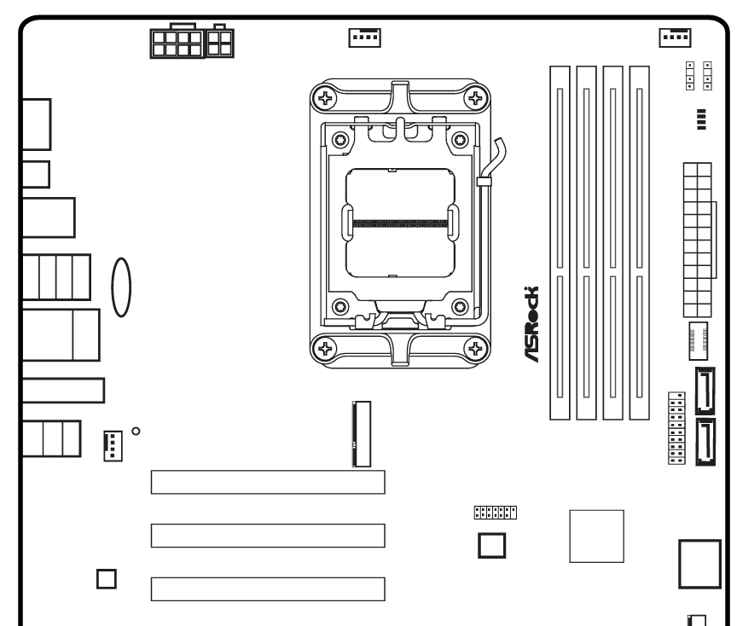
NVIDIA adapter
Available PCIe slot is blockec by the NVIDIA graphics adapter
7

Slide 8
NVIDIA adapter
Installed a PCIe riser cable
8

Slide 9
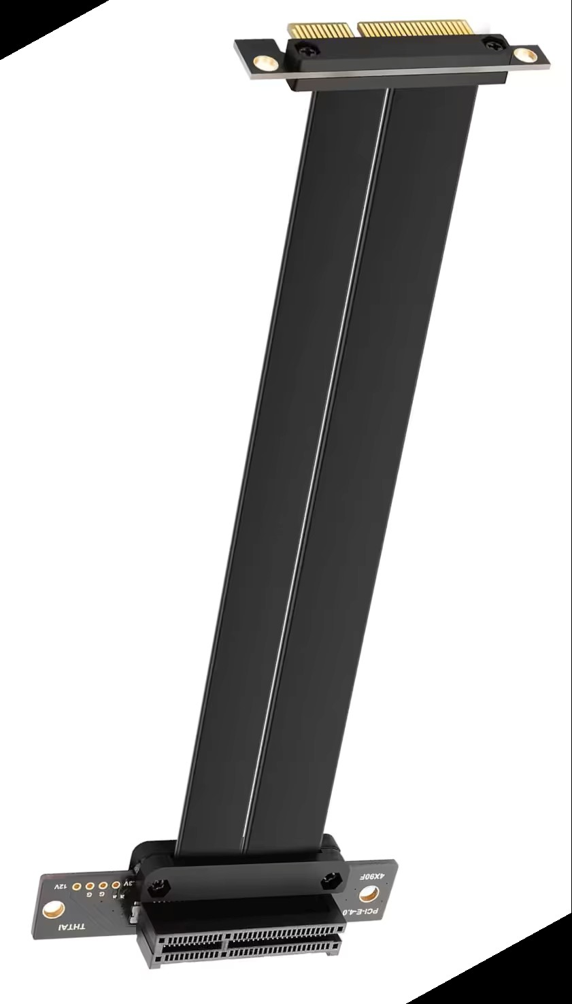
NVIDIA adapter
Installed a PCIe riser cable
9

Slide 10
NVIDIA adapter
PCIe to 4 USB 3/USB-C adapter
Attached a PCIe to 4 USB 3/USB-C adapter to the PCIe riser cable
10

Slide 11
INSTALLING ADDITIONAL HARDWARE TO RESOLVE THE ISSUES
Install of PCIe riser cable to make the spare PCIe slot on the motherboard available
Connect a 4-port USB-C to PCIe adapter to the PCIe riser cable
Connect a multiple Gigabyte Ethernet adapter to the 4-port USB-C to PCIe adapter
Connect a Wi-Fi 7 Wi-Fi adapter to the 4-port USB-C to PCIe adapter
11

Slide 12
INSTALLING ADDITIONAL HARDWARE TO RESOLVE THE ISSUES
https://www.amazon.com/dp/B0HB4741PS?ref=ppx_yo2ov_dt_b_fed_asin_title&th=1 The 90-degree angle at the PCIe side is critical for getting past obstructions such as the NVIDIA graphics card that is right above the spare PCIe connector.
12

Slide 13
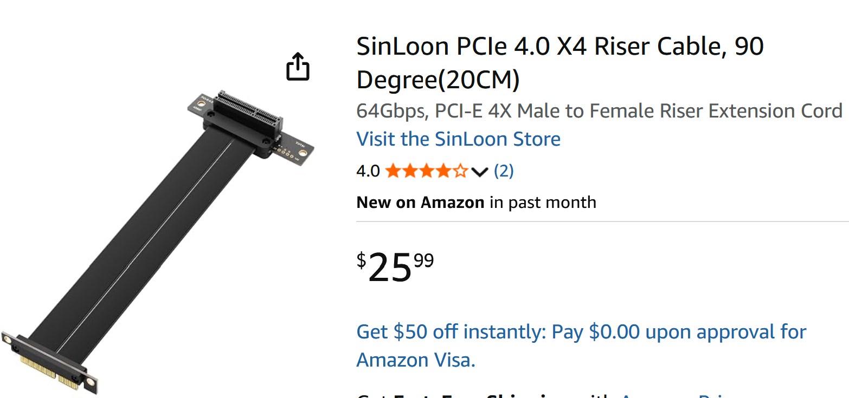

Slide 14
INSTALLING ADDITIONAL HARDWARE TO RESOLVE THE ISSUES
https://www.amazon.com/StarTech-4-Port-USB-C-10Gbps-P10Q4C-USB-CARD/dp/B0F7NBCW4K/ This is one of the few USB-C adapter cards that actually provide USB 3.0 ports instead of USB 2.0 ports. USB 3.0 ports are mandatory for Ethernet to USB adapters and Wi-Fi 7 to USB adapters at the Internet speeds that are typically available.
14

Slide 15
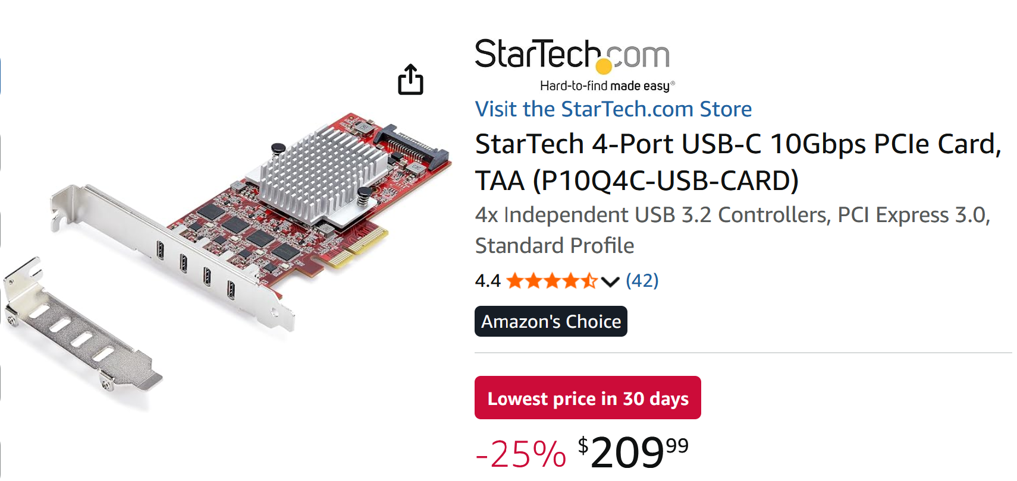

Slide 16
INSTALLING ADDITIONAL HARDWARE TO RESOLVE THE ISSUES
https://www.amazon.com/BrosTrend-Ethernet-Adapter-Laptop-Desktop/dp/B0GYDFH1CW/
16

Slide 17
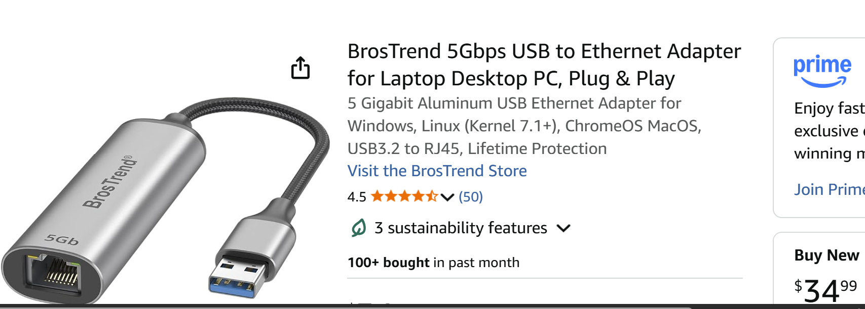

Slide 18
INSTALLING ADDITIONAL HARDWARE TO RESOLVE THE ISSUES
https://www.amazon.com/s?k=netgear+a9000&crid=3QYKBSDZT4554
18

Slide 19
