Slide 1


RESOLVING COMPUTER HARDWARE LIMITATIONS THAT LIMIT THE SPEEDS PROVIDED BY AN INTERNET SUPPLIER-PART 1

Slide 2
Web location for this presentation:
http://aztcs.apcug.org
Click on "Meeting Notes"
2

Slide 3
TOPICS
After a mandatory speed upgrade from a fiber-optic based residential Internet Provider from 200 Megabits per second up to 1000 Megabits per second: all computers in the residence were limited to Internet speeds that were only a fraction of the speeds that were now provided by the Internet Provider. Here are the parts that we added to the existing computers to resolve the slowdown:
3

Slide 4
BIG STEPS
BIG STEP 100: Obtain a Ethernet adapter for a newer cell phone or an lightning to Ethernet adapter for an older iPhone
BIG STEP 200: Temporarily connect the Ethernet adapter to your cell phone and disconnect the cell phone from Wi-Fi, BlueTooth, and the SIM or eSIM module
BIG STEP 300: Use the cell phone to test the Internet speeds at various points of your home or business network
BIG STEP 400: Restore the cell phone back to it's normal configuration

Slide 5
BIG STEP 100:
OBTAIN A ETHERNET ADAPTER
BIG STEP 100: Procure a USB-C to Ethernet adapter for the later-model Android cell phone or a micro-USB-C to Ethernet adapter for a really old Android phone or an lightning to Ethernet adapter for a older iPhone:

Slide 6
BIG STEP 100: OBTAIN A ETHERNET ADAPTER (continued)
https://www.amazon.com/dp/B0C2H9HVH3
is a good example of a USB-C to Gigabit Ethernet adapter for a later model Android cell phone or a later model iPhone

Slide 7
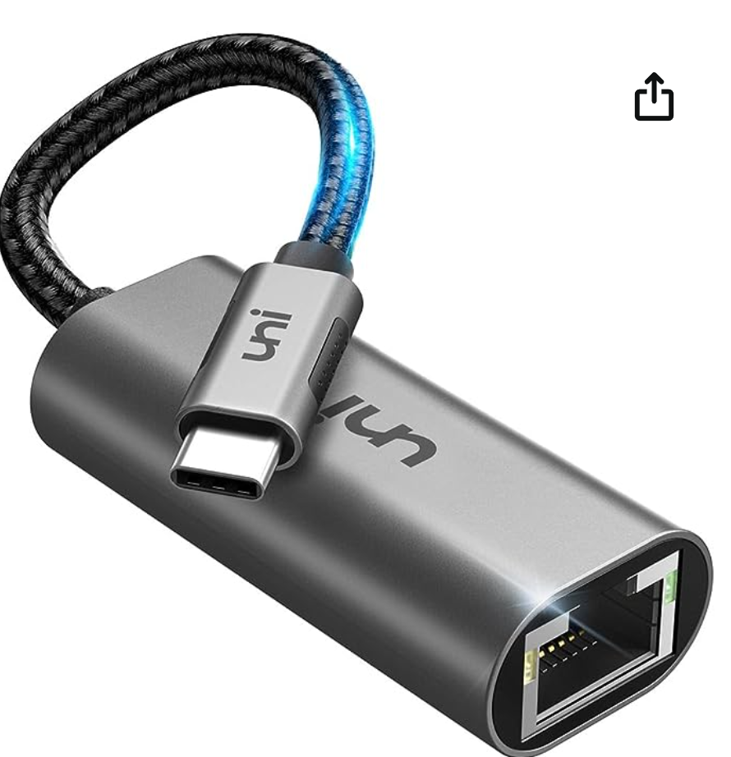

Slide 8
BIG STEP 100: OBTAIN A ETHERNET ADAPTER (continued)
https://www.amazon.com/Lightning-1000Mbps-Ethernet-IVSHOWCO-Charging/dp/B0CSSVXM1M/ AND https://www.amazon.com/sunshot-Ethernet-Charging-Connector-Compatible/dp/B09DRR5YMT/
are good examples of a lightning to Gigabit Ethernet adapter for an older iPhone.

Slide 9
BIG STEP 100: OBTAIN A ETHERNET ADAPTER (continued)
https://www.amazon.com/1000-Ethernet-Adapter-ELECTOP-Micro/dp/B0D7MBSNS4/ and https://www.amazon.com/ZEXMTE-Ethernet-1000Mbps-Compatible-Chromecast/dp/B0D22PT2D5/ are good examples of a micro USB to Gigabit Ethernet adapter for an older Android cell phone.

Slide 10
BIG STEP 200: TEMPORARILY CONFIGURE THE ANDROID PHONE TO ONLY CONNECT THROUGH THE ETHERNET ADAPTER
Connect the Ethernet adapter to your cell phone
Then turn off the following connections inside the the cell phone: the the Wi-Fi connection, the SIM or eSIM cellular connection and the Bluetooth connection

Slide 11
BIG STEP 200: TEMPORARILY CONFIGURE THE ANDROID PHONE TO ONLY CONNECT THROUGH THE ETHERNET ADAPTER (continued)
Attach the Ethernet adapter to the USB-C port or the micro-USB port or the lightning port of the cell phone
Get into the Settings applet of the cell phone
Tap on "Connections"

Slide 12
BIG STEP 200: TEMPORARILY CONFIGURE THE ANDROID PHONE TO ONLY CONNECT THROUGH THE ETHERNET ADAPTER (continued)
Tap on "Connections"
Tap on "Ethernet" and make sure that the cell phone recognizes the "Ethernet" adapter
Turn off the Wi-Fi connection.
Turn off the Bluetooth connection.
Turn off the active SIM or eSAM, if there is one.

Slide 13
BIG STEP 200: TEMPORARILY CONFIGURE THE ANDROID PHONE TO ONLY CONNECT THROUGH THE ETHERNET ADAPTER (continued)
From inside the "..store" of the cell phone, install the "Speedtest" (= "Speedtest by Ookla") app
With the Ethernet adapter NOT connected to any network, tap on the "Speedtest" (by "Ookla") app of the cell phone and run a speedtest. The speedtest needs to fail. If the speedtest does not fail, find out what other ways that your cell phone is connected to the Internet.

Slide 14
BIG STEP 200: TEMPORARILY CONFIGURE THE ANDROID PHONE TO ONLY CONNECT THROUGH THE ETHERNET ADAPTER (continued)
Go to "gateway", or "fiber optic terminal" or "cable modem" of your Internet provider and disconnect the line that connects to the local network of your home or business.

Slide 15
BIG STEP 200: TEMPORARILY CONFIGURE THE ANDROID PHONE TO ONLY CONNECT THROUGH THE ETHERNET ADAPTER (continued)
Use a short Ethernet cable to connect the gateway", or "fiber optic terminal" or "cable modem" of your Internet provider to the Ethernet adapter that is connected to your cell phone

Slide 16
BIG STEP 200: TEMPORARILY CONFIGURE THE ANDROID PHONE TO ONLY CONNECT THROUGH THE ETHERNET ADAPTER (continued)
Tap on "Settings" inside the cell phone.
Then tap on "Connections".
Swipe up to go vertically downward.

Slide 17
BIG STEP 200: TEMPORARILY CONFIGURE THE ANDROID PHONE TO ONLY CONNECT THROUGH THE ETHERNET ADAPTER (continued)
Tap on "Ethernet"
If you do not find "Ethernet", tap on "More connection settings"
Tap on "Ethernet". (If "Ethernet" is not shown, disconnect and the re-connect the Ethernet-to-USB-C adapter.)

Slide 18
BIG STEP 200: TEMPORARILY CONFIGURE THE ANDROID PHONE TO ONLY CONNECT THROUGH THE ETHERNET ADAPTER (continued)
The slider inside the "Ethernet" screen should indicate that it is "Enabled". If this slider is not "Enabled", tap on it to Enable it.

Slide 19
BIG STEP 200: TEMPORARILY CONFIGURE THE ANDROID PHONE TO ONLY CONNECT THROUGH THE ETHERNET ADAPTER (continued)
The Enable slider in the Ethernet screen should now show that it is "enabled".
Tap on the "Speedtest" app of the cell phone.
After the "Speedtest" process completes, take a screenshot of the results.

Slide 20
BIG STEP 300: USE THE ANDROID CELL PHONE TO TEST THE INTERNET SPEED AT VARIOUS POINTS OF YOUR HOME OR BUSINESS NETWORK
Disconnect the short Ethernet cable from the cell phone. Reconnect your home or business to the interface of your Internetsupplier.
Test the Internet speed at various points in your home or business network.

Slide 21
BIG STEP 300: USE THE ANDROID CELL PHONE TO TEST THE INTERNET SPEED AT VARIOUS POINTS OF YOUR HOME OR BUSINESS NETWORK (continued)
If your Windows.. or ..Linux.. computer has a USB-to-Ethernet adapter attached to a USB-C or USB-A port, only the ports that run at "USB 3" or "USB 4" or "Thunderbolt" signal formats will be as fast as the Internet speeds that are provide by your Internet supplier at their "point of entry".

Slide 22
BIG STEP 400: RESTORE THE CELL PHONE BACK TO IT'S NORMAL CONFIGURATION (continued)
Tap on "Connections"
Turn on the Wi-Fi connection.
Turn on the Bluetooth connection.
Turn on the active SIM, if there is one.

Slide 23
BIG STEP 400: RESTORE THE CELL PHONE BACK TO IT'S NORMAL CONFIGURATION (continued)
Tap on the "Speedtest" (by "Ookla") app of the cell phone and run a speedtest. The speedtest should now be the same as before your performed BIG STEP 200.

Slide 24
MEASURED INTERNET SPEEDS AT VARIOUS PARTS OF THE LOCAL NETWORK
980 Megabits per second downloads and 1020 Megabits per second uploads at the Internet Provider's point of entry into the residence.
Same speeds at the "Wide Area Network" port of the main router of the residence
30 percent or less speeds at all of the computers in the residence
24

Slide 25
CONTRIBUTING HARDWARE ISSUES
None of the on-board wired and wireless adapters on the motherboards of the computers were fast enough to handle the upgraded Internet speeds of 1 Gigabits per second download and upload.
There were not enough USB 3 ports on the computers to allow for the installation of any add-on Ethernet adapters or Wi-Fi adapters
25

Slide 26
CONTRIBUTING HARDWARE ISSUES
The existing graphics adapters inside the motherboards of the computers were too wide to allow for the use of the available PCIe slots inside the computers.
26

