Slide 1




TUNERS AND TV SETS FOR OVER-THE-AIR ATSC TELEVISION
1

Slide 2
Web location for this presentation:
http://aztcs.apcug.org
Click on "Meeting Notes"
email = fchao2@yahoo.com
2

Slide 3
SUMMARY
You can install a low-cost ATSC 3.0 tuner to either add the newfangled ATSC 3.0 signals to an existing television or to use a computer monitor connected to the tuner as a low-cost over-the-air television receiver.
3

Slide 4
TOPICS
Three types of over-the-air TV channels in the U.S.A. and Canada: ATSC 1.0 TV channels, unencrypted ATSC 3.0 TV channels, and encrypted ATSC 3.0 TV channels
Obtaining and installing an ATSC 3.0-capable tuner or TV set
4

Slide 5
"ATSC"
"ATSC" stands for "Advanced Television Systems Committee" and it is sometimes called "digital television"
5

Slide 6
"ATSC" (continued)
In the U.S. there are three types of "ATSC" signals for receiving television channels "over-the-air" for free: Type 1: "ATSC 1.0" TV channels, Type 2: "unencrypted ATSC 3.0" TVchannels, Type 3: "encrypted ATSC 3.0" TV channels (= "with DRM" = "with Digital Rights Management)
6

Slide 7
"ATSC" (continued)
All of the "Type 2" unencrypted ATSC 3.0 channels and the "Type 3" encrypted ATSC 3.0 channels in the San Francisco area example as shown at https://www.rabbitears.info/market.php and https://www.rabbitears.info/market.php?request=atsc3
7

Slide 8
"ATSC" (continued)
The pink shaded channels with the yellow padlock icon are Type 3 encypted ATSC 1 channels:
8

Slide 9
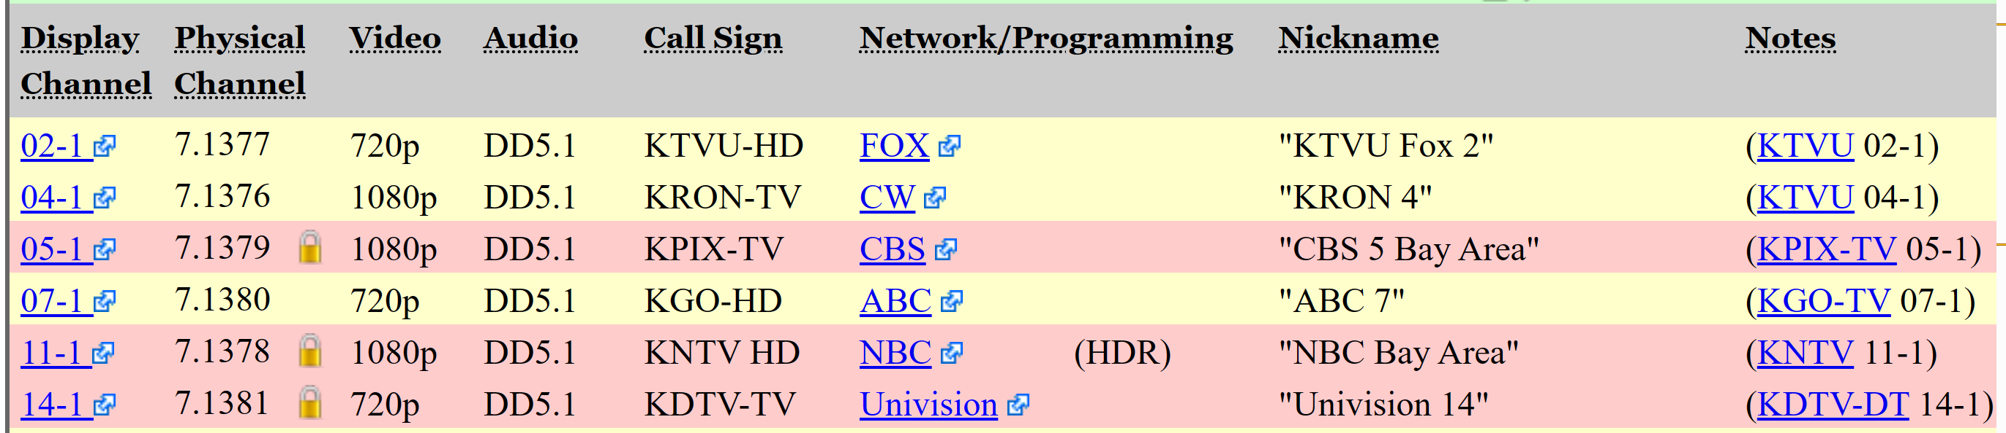
9

Slide 10
10

Slide 11
"ATSC" (continued)
At the Mount Sutro tower site in the middle of San Francisco: Only KRON-TV is transmitting an ATSC 3.0 signal. 3 out of 6 of a KRON-TV's channels stations are in the "Type 3 Encrypted ATSC 3.0" format The remaining 3 are in the "Type 2 Unencrypted ATSC 3.0" format.
11

Slide 12
"ATSC" (continued)
KRON-TV's channels have 1080p video resolution and DD5.1 audio format and these are the highest video and audio resolutions that are offered for over-the-air television in the San Francisco area.
12

Slide 13
"ATSC" (continued)
https://en.wikipedia.org/wiki/5.1_surround_sound
13

Slide 14
"ATSC" (continued)
All of the other TV channels emanating from Mount Sutro are in the "Type 1 ATSC 1.0" format and they are shown at https://www.rabbitears.info/market.phpwithout a green arrowhead
14

Slide 15
"ATSC" (continued)
Type 1 "ATSC 1.0" channels have been available since 2009
Type 2 "unencrypted ATSC 3.0 TV channels have been available since 2021
Type 3 "encrypted ATSC 3.0" TV channels have been available since 2023
15

Slide 16
"ATSC" (continued)
"ATSC 3.0" is also called "NEXTGEN TV"
The "NEXTGEN TV" logo is a registered trademark of the "Consumer Technology Assocation"
The "Consumer Technology Association" is the sponsor of the "Consumer Electronics Show"
16

Slide 17

17

Slide 18
"ATSC" (continued)
"ATSC 3.0" is also called "NEXTGEN TV"
The "NEXTGEN TV" logo is a registered trademark of the "Consumer Technology Assocation"
The "Consumer Technology Association" is the sponsor of the "Consumer Electronics Show"
18

Slide 19
"ATSC" (continued)
The "NEXTGEN TV" logo will be used widely for television ads, documentation, and specifications. When used for a specific model of TV tuner or TV set, the "NEXTGET TV" logo implies that the tuner or TV set is at least capable of receiving the first two types of "ATSC" television signals.
19

Slide 20
"ATSC" (continued)
A "NEXTGEN TV" certification is the buyer's assurance that the tuner or TV set is able to receive Type 1 "ATSC 1.0" television channels and Type 2 "unencrypted ATSC 3.0" television channels.
20

Slide 21
"ATSC" (continued)
A "NEXTGEN TV" certification has no bearing or indication on whether a specific television tuner or receiver is capable of receiving Type 3 "encrypted ATSC 3.0" TV channels Buyer beware ! A television tuner or receiver will be eventually useless as ATSC 3.0 channels convert from unencrypted to encrypted channels !
21

Slide 22
"ATSC" (continued)
"A3SA" stands for "ATSC 3.0 Security Authority"
The A3SA's Web site is located at https://a3sa.com
The A3SA's logo will rarely be used for television ads, documentation, or specifications. Instead, the term "encrypted ATSC 3.0" or "encrypted NextGen" will usually be used.
22

Slide 23

23

Slide 24
"ATSC" (continued)
"A3SA" provides certifications for TV tuners and TV sets
AN "A3SA" certification means that a tuner or a TV set is able to receive Type 3 "encrypted ATSC 3.0" television channels.
24

Slide 25
"ATSC" (continued)
The A3SA certification process and the "Nextgen TV" certification process are independent and unrelated to each other.
The "A3SA" certification program has massively slowed down the development and "uptake" of "ATSC 3.0" television channels, both from TV transmitter end and at the end-user TV tuner & receiver end.
25

Slide 26
"ATSC" (continued)
The television industry has been insistent on developing and implementing Type 3 encrypted ATSC 3.0 channels to prevented illegal piracy and malware injection into over-the-air TV channels as explained at https://cordcuttersnews.com/the-team-behind-nextgen-atsc-3-0-ota-tv-explains-why-drm-is-needed-for-free-ota-tv/
26

Slide 27
"ATSC" (continued)
The "A3SA" uses "Eonti" for digital certificates and Google subsidiary "Widevine" DRM (= "digital rights management") for encryption/decryption technology.
27

Slide 28
"ATSC" (continued)
A3SA provides two versions of certifications:
A3SA certification version 1: A3SA certification for a tuner or TV set that can only receive "Encrypted ATSC 3.0" (Type 3) channels when the tuner or TV is connected (wired or wirelessly) to an Internet provider
28

Slide 29
"ATSC" (continued)
A3SA certification version 2: A3SA certification for a tuner or TV set that can only receive Type 3 Encrypted ATSC 3.0" channels even when the tuner or TV set is not connected (wired or wirelessly) to an Internet provider. This higher version of A3SA certification is handy for tuners or TV sets that will not always be connect to an Internet provider (camping, etc).
29

Slide 30
"ATSC" (continued)
Any tuner or TV set that can receive Type 3 "encrypted ATSC 3.0" television channels will eventually need to have an Internet connection in order to get firmware upgrades or to perform channel rescans from the Internet or to receive any "encrypted ATSC 1" channel for the first time after a channel scan so the A3SA certification version 2's offline capability is only for the convenience of the enduser of TV tuners and TV sets, when their TV tuners and sets do not have an Internet connection.
30

Slide 31
"ATSC" (continued)
Some of sellers and manufacturers have incorrectly stated that their tuners or television sets that have "A3SA certification version 2" never need to be connected to the Internet.
31

Slide 32
"ATSC" (continued)
A TV tuner or a TV set that can receive the first two types of ATSC.. signals will have a "NextGen TV certification"
A TV tuner or a TV set that can receive all three types of ATSC.. signals will have both a "NextGen TV" certification AND an "A3SA certification"
32

Slide 33
"ATSC" (continued)
At the present time (April 2024), 90+ percent of the over-the-air TV tuners (and TV sets) that are available at retail are obsolete since most of them only can receive Type 1 ATSC 1.0" television channels (and apparently do not have NextGen and A3SA certifications.)
33

Slide 34
"ATSC" (continued)
At the present time (April 2024): some of the manufacturers of TV tuners (and TV sets) only have ATSC 1.0 tuners, while some of the manufacturers of TV tuners (and TV sets) have tuners that can only receive the first two types of ATSC channels
34

Slide 35
"ATSC" (continued)
At the present time (April 2024): a few of the manufacturers of TV tuners (and TV sets) have tuners that can receive all three types of ATSC channels.
35

Slide 36
"ATSC" (continued)
Between now (April 2024) and July 17, 2027, most of the existing Type 1 ATSC 1.0 television stations and most of the Type 2 unencrypted ATSC television stations will probably upgrade to Type 3 encrypted ATSC 3.0 channels so it is best to only purchase tuners and TV sets that can receive all three types of ATSC signals, to avoid rapid obsolescence.
36

Slide 37
"ATSC" (continued)
ATSC uses 8VSB (8-level vestigial sideband modulation) In some software apps and some TV tuners, "8VSB" is used as a configuration selection instead of "ATSC" so be sure to select "8VSB", if you are given a choice when configuring a TV set, a TV tuner, or a TV software app.
37

Slide 38
"ATSC" (continued)
Dash nomenclature in FCC assigned call signs -TV means "television station" -LP means "low power station" -CA means "Class A low power" -DT means "digital television" -HD means "high definition" -SD means "standard definition" -NX or -NG means "ATSC 3.0"
38

Slide 39
"ATSC" (continued)
However, a television station that is transmitting an Type 2 unencrypted ATSC 3.0 channel or an Type 2 encrypted ATSC 3.0 channel is not required to use the -NX or -NG in their call sign: Some do and some do not.
39

Slide 40
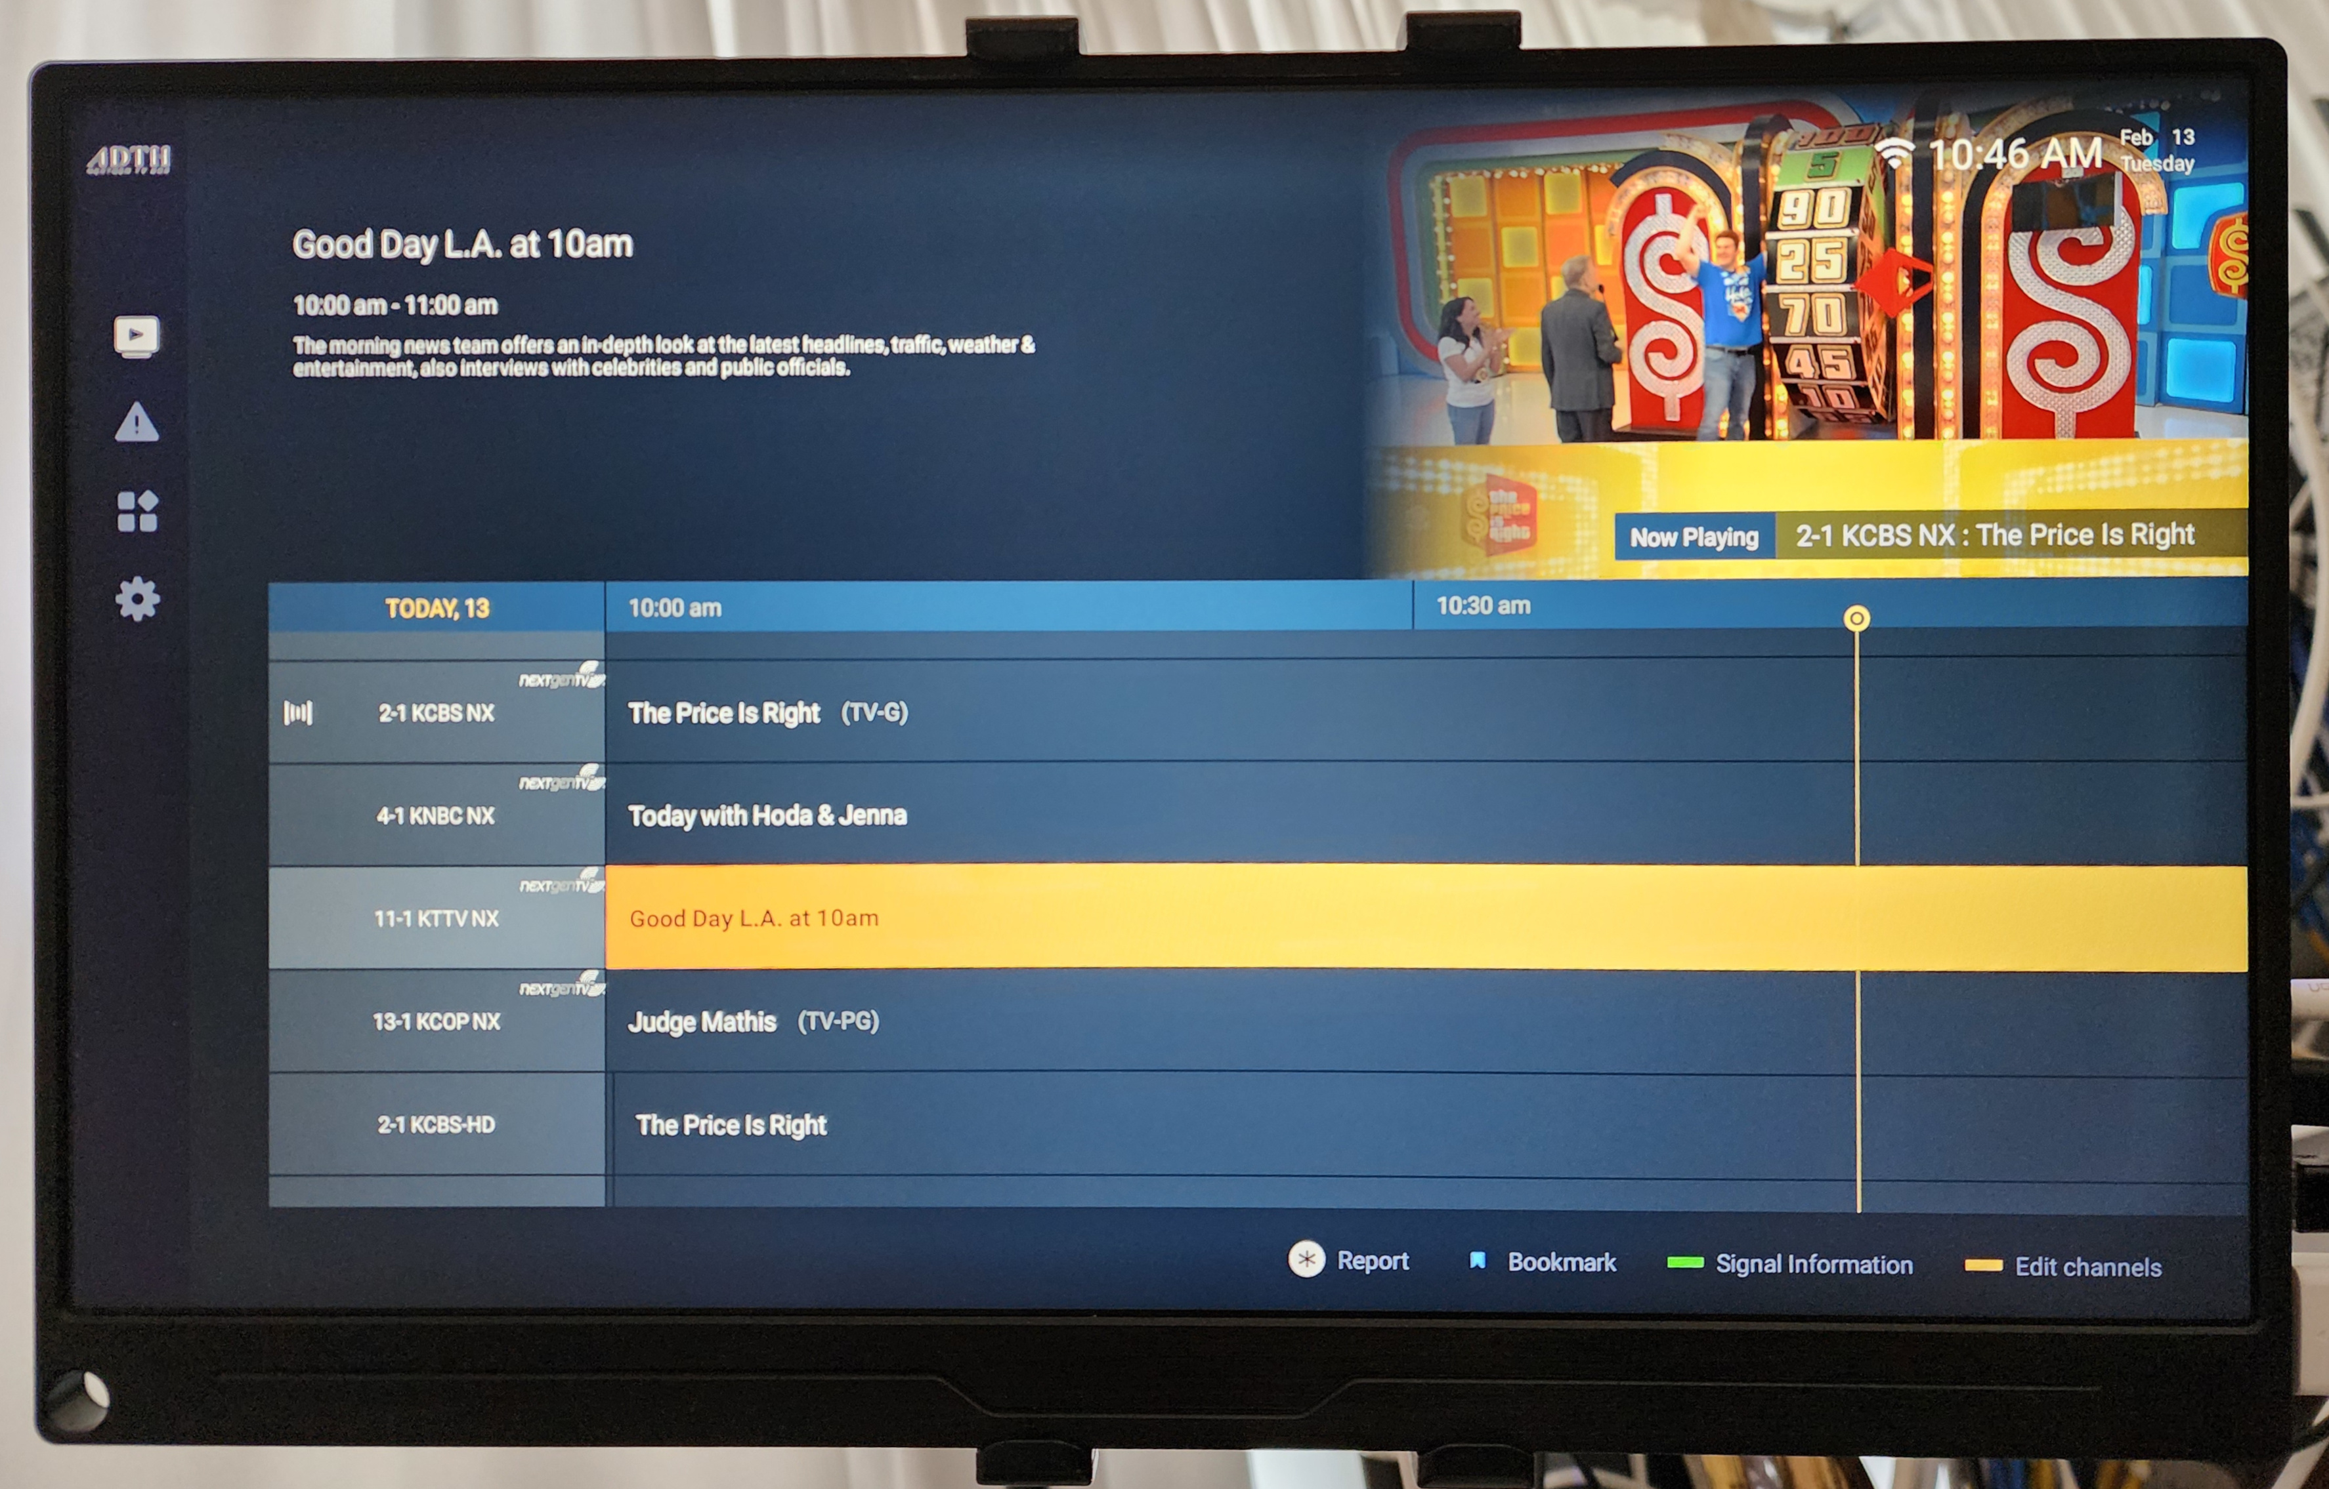
40

Slide 41
41

Slide 42
"ATSC" (continued)
Every channel that is transmitted over-the air by a television station has a "Radio Frequency Channel" and a "Virtual Channel"
42

Slide 43
"ATSC" (continued)
"Radio Frequency Channels" are sometimes called the "Physical Channels".
"Virtual Channels" are sometimes called "Displayed Channels" since they are the channel numbers that your television set or tuner shows to you.
43

Slide 44
"ATSC" (continued)
"PSIP" means "Program and System Information Protocol" This information consists of a set of tables that is constantly transmitted by every ATSC television transmitter for each RF sub-channel.
44

Slide 45
ATSC (continued)
The "PSIP virtual channel" and the "PSIP virtual subchannel" is displayed by set top boxes, TV sets, TV tuners, and TV software in one of four formats: 12.1, 12-1, 12-001, or 12001
When television viewers say "channel", they usually mean the "PSIP virtual channel" or the "PSIP virtual subchannel"
45

Slide 46
MARKETING MISINFORMATION !!
Please ignore the massive hyperbole by advertisers and sales personnel that "ATSC 3.0" (= "NextGen") TV provides 4K video resolution. That capability is not available on any existing "ATSC 3.0" television channels at the present time (April 2024). It will probably be available in the next few years.
46

Slide 47
MARKETING MISINFORMATION !! (continued)
Please ignore all marketing claims that an existing tuner or TV set that can receive ATSC 1.0 "Type 1" signals can be upgraded in the future via firmware upgrades so that they can then receive unencrypted ATSC 2.0 "Type 2" signals and/or encrypted "Type 3" signals. It cannot happen!!
47

Slide 48
MARKETING MISINFORMATION !!
Please ignore the massive hyperbole by advertisers and sales personnel that "ATSC 3.0" (= "NextGen") tuners and TVs provides 4K video resolution. That capability is not available on any existing "ATSC 3.0" television channels at the present time (April 2024). It will probably be available in the next few years.
48

Slide 49
IMPLEMENTING OVER-THE-AIR TELEVISION AT YOUR HOME
Step 1: Internet-based site survey
Step 2: Procure antenna and tuner
Step 3: Install and configure equipment and software
49

Slide 50
STEP 1 DETAILS INTERNET-BASED SITE SURVEY
Start off by getting a "short list" of possible television channels at http://antennaweb.org/Address and/or https://www.watchnextgentv.com/markets/ and/or https://www.channelmaster.com/pages/tv-antenna-map
50

Slide 51
STEP 1 DETAILS INTERNET-BASED SITE SURVEY (continued)
To determine if the ATSC 3.0 channels are a specific location are encrypted, you can go to https://www.rabbitears.info/market.php?request=atsc3
51

Slide 52
STEP 1 DETAILS INTERNET-BASED SITE SURVEY (continued)
This list at https://www.atsc.org/nextgen-tv/deployments/ will give you an idea as to which cities are about to have Nextgen TV stations start broadcasting.
52

Slide 53
STEP 2 DETAILS PROCURE TUNER AND ANTENNA
The low-cost antenna that I use is available at https://hauppauge.com/pages/webstore2/webstore_antenna.html (but do not buy their TV tuners because (as of April 2024) their tuners cannot receive ATSC 3.0 channels yet)
53

Slide 54
STEP 2 DETAILS PROCURE TUNER AND ANTENNA (continued)
To get an over-the-air tuner that can receive all three types of "ATSC.." channels, you can choose between the "ADTH NEXTGEN TV BOX" tuner, the "Zinwell ZAT-600B" tuner, or the "ZapperBox M1" tuner:
54

Slide 55
STEP 2 DETAILS PROCURE TUNER AND ANTENNA (continued)
The "ADTH NEXTGEN TV BOX" tuner is about $100 and requires an uninterrupted wired or wireless Internet connection for receiving Type 3 encrypted ATSC 3.0 channels. In other words, it has an "A3SA Type 1" certification.
55

Slide 56
STEP 2 DETAILS PROCURE TUNER AND ANTENNA (continued)
The "Zinwell ZAT-600B" tuner is about $150 and does not require a uninterrupted Internet connection for receiving Type 3 encrypted ATSC 3.0 channels. However, it requires an Internet connection for scanning for channels and also for the very first use of a newly-scanned channel. In other words, it has an "A3SA Type 2" certification.
56

Slide 57
STEP 2 DETAILS PROCURE TUNER AND ANTENNA (continued)
The "ZapperBox M1" tuners are available in two models. They requires a wired or wireless Internet connection for receiving Type 3 encrypted ATSC 3.0 channels. In other ther words, they have an "A3SA Type 1" certification.
Single tuner model = B0BNJS8PFS=$224
Dual Tuner model = B0BNJR924X = $274
57

Slide 58
STEP 2 DETAILS PROCURE TUNER AND ANTENNA (continued)
The "ADTH NEXTGEN TV BOX" tuner and the "ZapperBox M1" tuner both run the Google "Android" operating system according to Lon Seidman as explained by him at https://www.youtube.com/watch?v=e1vTpSJHVyo
58

Slide 59
STEP 2 DETAILS PROCURE TUNER AND ANTENNA (continued)
The "ADTH NEXTGEN TV BOX" tuner runs Linux as explained at https://adth.com/adth-and-tolka-awarded-first-certification-as-nextgen-tv-upgrade-accessory-receiver/
59

Slide 60
STEP 2 DETAILS PROCURE TUNER AND ANTENNA (continued)
The "ADTH NextGen TV Box" is available at the Walmart Web site at https://www.walmart.com/ip/ADTH-NextGen-TV-Box-ATSC-3-0-NextGen-TV-Certified-Watch-Free-OTA-ATSC-3-0-1-0-in-4K-UHD-resolution/5297873740
60

Slide 61
STEP 2 DETAILS PROCURE TUNER AND ANTENNA (continued)
The Zinwell "ZAT600B" tuner is available at https://www.channelmaster.com/products/nextgen-tv-receivers-zinwell-nextgen-tv-box
61

Slide 62
STEP 2 DETAILS PROCURE TUNER AND ANTENNA (continued)
The two Zapperbox M1 tuner models are available at https://www.amazon.com/ZapperBox-Over-Tuner-Channel-Guide/dp/B0BNJR924X/
62

Slide 63
STEP 2 DETAILS PROCURE TUNER AND ANTENNA (continued)
A RG6 coaxial cable that has been terminated with the default threaded "F connectors" such as https://www.amazon.com/Ultra-Clarity-Cables-Connectors-Connector/dp/B076VY8W8J
63

Slide 64
STEP 2 DETAILS PROCURE TUNER AND ANTENNA (continued)
An F-jack to F-jack adapter such as https://www.amazon.com/VCE-Coaxial-Connector-Extension-Adapter/dp/B0107LH932/
64

Slide 65
STEP 3 DETAILS INSTALL TUNER AND ANTENNA (continued)
Install the antenna in a window
Install an RG6 coaxial cable from the antenna to the tuner box
65

Slide 66
STEP 3 DETAILS INSTALL TUNER AND ANTENNA
Connect the tuner to a wired or wireless Internet connection (some lower-cost tuners will only be able to connect to a wireless Wi-Fi connection)
Connect the tuner box's HDMI port to the HDMI port on a computer monitor or a TV set
Power up the tuner and scan for TV channels.
66

Slide 67
TUNERS THAT CAN ACT AS GATEWAYS TO OTHER DEVICES
To prevent having to install separate antennas for each over-the-air tuner or TV in your home, you can procure a tuner with "network" capability, = "network tuner capability", = "gateway" capability, = "streaming" capability, = "extend" capability: "Tablo TV"
Hauppauge "WinTV with Extend"
SiliconDust's "HDHomeRun"
BUT DO NOT BUY ANY OF THESE
(AS OF APRIL 2024) BECAUSE THEY
CANNOT RECEIVE THE TWO TYPES OF ATSC 3.0 CHANNELS YET
67

Slide 68
TUNERS THAT CAN ACT AS GATEWAYS TO OTHER DEVICES (continued)
Tablo example is diagrammed at https://community.tablotv.com/t/connecting-tablo-to-fire-or-roku/20195/5
68

Slide 69
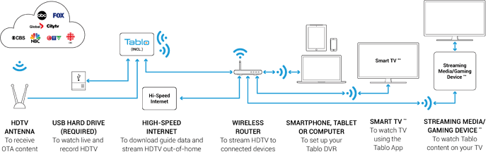
69

Slide 70
MANUFACTURERS OF ATSC 1.0 TV TUNERS THAT HAVE PROMISED TO PROVIDE ATSC 3.0 TUNERS IN THE FUTURE
Tablo
Hauppauge
SiliconDust's HDHomeRun
BUT we recommend not buying them at the present time (April 2024) because none of these tuner brands can receive the two types of ATSC 3.0-enabled channels yet.
70

Slide 71
APPENDIX 1
https://www.resillion.com/services/device-testing/devices-testing/atsc-nextgen-tv/
rabbitears.info's legend is located at https://www.rabbitears.info/static.php?name=icon_guide
Official list of NextGen certified devices: https://www.watchnextgentv.com/shop/
71

Slide 72
APPENDIX 2
Prior to 2024, some of LG's higher-end smart televisions were capable of receiving some of the "ATSC 3.0" television channels.
All of LG's 2024 smart televisions are unable to receive any of the "ATSC 3.0" television channels due to a patent dispute:
72

Slide 73
APPENDIX 2 (continued)
https://www.techradar.com/televisions/lg-drops-atsc-30-4k-tuners-from-its-2024-oled-tvs-and-samsung-or-sony-could-be-next
https://www.flatpanelshd.com/news.php?subaction=showfull&id=1695713180
73

Slide 74
APPENDIX 2 (continued)
https://blog.lon.tv/2023/09/26/new-lg-televisions-will-not-have-atsc-3-tuners-due-to-patent-dispute/
https://www.digitaltrends.com/home-theater/2024-lg-tvs-no-atsc-3/
74

Slide 75
APPENDIX 2 (continued)
LG's 2024 television sets can be retrofitted with add-on tuners that can receive Type 2 unencrypted ATSC 3.0 and Type 3 encrypted ATSC 3.0 channels !!
75

Slide 76
76

