Slide 1



"LIGHTHOUSE MODEL" TRANSITION FROM ATSC 1.0 TO ATSC 3.0
IN TUCSON, AZ ON MAY 23, 2024

Slide 2
Web location for this presentation:
http://aztcs.apcug.org
Click on
"Meeting Notes"

Slide 3
SUMMARY
The FCC has mandated that all existing ATSC 1.0 television channels that wish to upgrade to ATSC 3.0 are required to run both the existing ATSC 1.0 and new corresponding ATSC 3.0 channels until July 17, 2027. This cost-effective scheme to run both channels simultaneously is called "Lighthouse Model" transition.

Slide 4
FCC'S SIMULCAST MANDATE
https://docs.fcc.gov/public/attachments/FCC-23-53A1.pdf

Slide 5
FCC'S SIMULCAST MANDATE (continued)
https://www.atsc.org/wp-content/uploads/2020/10/f-36-26-13322575_PAu3M4S9_WhitePaper_Lighthouse_TESTTREE_v2.pdf

Slide 6
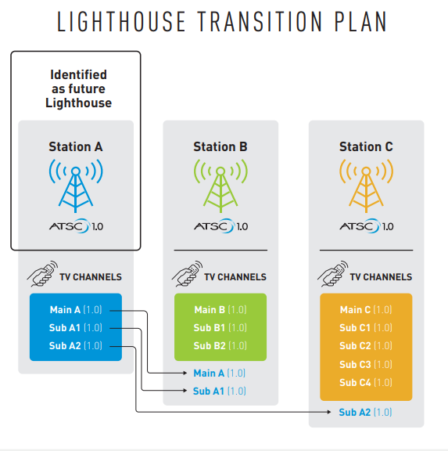
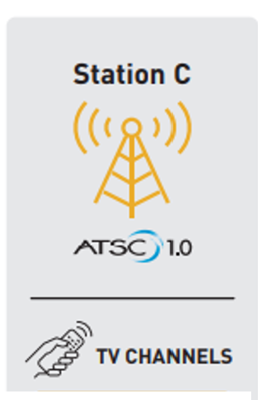
Virtual "Displayed" Channels Prior to Lighthouse Transition in Tucson on May 23, 2024
KMSB
(RF CH. 25)
KHRR (RF CH. 16)
KUAT-TV
(RF CH. 30)
KUAS-TV
(RF CH. 28
KVOA
(RF CH. 23)
KOLD
(RF CH. 32)
11.1 (ATSC1)
= "KMSB-HD"
--------------
11.2 (ATSC1)
= "Quest"
--------------
11.3 (ATSC1)
= "True Crime Network"
--------------
11.4 (ATSC1)
= "Nosey"
--------------
11.5 (ATSC1)
= "Shop LC"
--------------
11.6 (ATSC1)
= ?????
--------------
11.7 (ATSC1)
= "Comet"
--------------
11.8 (ATSC1)
= "QVC"
13.1 (ATSC1)
= "KOLD DT"
="CBS"
--------------
13.2 (ATSC1)
= "MeTV"
--------------
13.3 (ATSC1)
= "Oatlaw"
--------------
13.4 (ATSC1)
= "KOLDDT4"
="Defy TV"
--------------
13.5 (ATSC1")
= "KPHE-LD" ________
13.6 (ATSC1)
="CHARGE!"
6.1 (ATSC1)
27.1 (ATSC1)
= "PBS HD"
--------------
6.2 (ATSC1)
27.2 (ATSC1)
= "PBS KIDS"
--------------
6.3 (ATSC1)
27.3 (ATSC1)
= "PBS 6 PLUS"
--------------
40.1 (ATSC1) ="KHRR-DT"
="Telemundo"
-------------
40.2 (ATSC1) ="TeleXitos"
-------------
40.3 (ATSC1) ="NBC LX"
------------
40.4 (ATSC1) ="Oxygen"
4.1 (ATSC1)
="KVOANBC"
="NBC"
-----------------
4.2 (ATSC 1)
= "COZI TV"
-----------------
4.3 (ATSC1)
=" Ion Mystery"
-----------------
4.4 (ATSC1)
="DABL"
="This TV"
-----------------
4.5 (ATSC1)
= "Grit"
6

Slide 7
Relocation of ATSC 1.0 Virtual Displayed Channels of the Lighthouse Station to Existing ATSC 1.0 TV Stations in Tucson on May 23, 2024
KHRR (RF CH. 16)
KMSB
(RF CH. 25)
KUAT-TV
(RF CH. 30)
KUAS-TV
(RF CH. 28
KVOA
(RF CH. 23)
KOLD
(RF CH. 32)
11.1 (ATSC1)
= "KMSB-HD"
--------------
11.2 (ATSC1)
= "Quest"
--------------
11.3 (ATSC1)
= "True Crime Network"
--------------
11.4 (ATSC1)
= "Nosey"
--------------
11.5 (ATSC1)
= "Shop LC"
--------------
11.6 (ATSC1)
= ?????
--------------
11.7 (ATSC1)
= "Comet"
--------------
11.8 (ATSC1)
= "QVC"
4.1 (ATSC1)
="KVOANBC"
="NBC"
-----------------
4.2 (ATSC 1)
= "COZI TV"
-----------------
4.3 (ATSC1)
=" Ion Mystery"
-----------------
4.4 (ATSC1)
="DABL"
="This TV"
-----------------
4.5 (ATSC1)
= "Grit"
-----------------
13.1 (ATSC1)
= "KOLD DT"
="CBS"
--------------
13.2 (ATSC1)
= "MeTV"
--------------
13.3 (ATSC1)
= "Oatlaw"
--------------
13.4 (ATSC1)
= "KOLDDT4"
="Defy TV"
--------------
13.5 (ATSC1")
= "KPHE-LD" ________
13.6 (ATSC1)
="CHARGE!"
6.1 (ATSC1)
27.1 (ATSC1)
= "PBS HD"
--------------
6.2 (ATSC1)
27.2 (ATSC1)
= "PBS KIDS"
--------------
6.3 (ATSC1)
27.3 (ATSC1)
= "PBS 6 PLUS"
--------------
40.1 (ATSC1) ="KHRR-DT"
="Telemundo"
-------------
40.2 (ATSC1) ="TeleXitos"
-------------
40.3 (ATSC1) ="NBC LX"
------------
40.4 (ATSC1) ="Oxygen"
7

Slide 8
Relocation of ATSC 1.0 Virtual Displayed Channels of the Lighthouse Station to Existing ATSC 1.0 TV Stations in Tucson on May 23, 2024 (continued)
KHRR (RF CH. 16)
KUAT-TV
(RF CH. 30)
KUAS-TV
(RF CH. 28
KVOA
(RF CH. 23)
KOLD
(RF CH. 32)
KMSB
(RF CH. 25)
13.1 (ATSC1)
= "KOLD DT"
="CBS"
--------------
13.2 (ATSC1)
= "MeTV"
--------------
13.3 (ATSC1)
= "Oatlaw"
--------------
13.4 (ATSC1)
= "KOLDDT4"
="Defy TV"
--------------
13.5 (ATSC1")
= "KPHE-LD" ________
13.6 (ATSC1)
="CHARGE!"
--------------
40.4 (ATSC1) ="Oxygen"
11.1 (ATSC1)
= "KMSB-HD"
--------------
11.2 (ATSC1)
= "Quest"
--------------
11.3 (ATSC1)
= "True Crime Network"
--------------
11.4 (ATSC1)
= "Nosey"
--------------
11.5 (ATSC1)
= "Shop LC"
--------------
11.6 (ATSC1)
= ?????
--------------
11.7 (ATSC1)
= "Comet"
--------------
11.8 (ATSC1)
= "QVC"
4.1 (ATSC1)
="KVOANBC"
="NBC"
-----------------
4.2 (ATSC 1)
= "COZI TV"
-----------------
4.3 (ATSC1)
=" Ion Mystery"
-----------------
4.4 (ATSC1)
="DABL"
="This TV"
-----------------
4.5 (ATSC1)
= "Grit"
-----------------
40.3 (ATSC1)
="NBC LX"
6.1 (ATSC1)
27.1 (ATSC1)
= "PBS HD"
--------------
6.2 (ATSC1)
27.2 (ATSC1)
= "PBS KIDS"
--------------
6.3 (ATSC1)
27.3 (ATSC1)
= "PBS 6 PLUS"
--------------
40.1 (ATSC1)
="KHRR-DT"
="Telemundo"
--------------
40.2 (ATSC1)
="TeleXitos"
40.1 (ATSC1) ="KHRR-DT"
="Telemundo"
-------------
40.2 (ATSC1) ="TeleXitos"
-------------
40.3 (ATSC1) ="NBC LX"
------------
40.4 (ATSC1) ="Oxygen"
8

Slide 9
Relocation of ATSC 1.0 Virtual Displayed Channels of the Lighthouse Station to Existing ATSC 1.0 TV Stations in Tucson in May 23, 2024 (continued)
KHRR (RF CH. 16)
KUAT-TV
(RF CH. 30)
KUAS-TV
(RF CH. 28
KVOA
(RF CH. 23)
KOLD
(RF CH. 32)
KMSB
(RF CH. 25)
11.1 (ATSC1)
= "KMSB-HD"
--------------
11.2 (ATSC1)
= "Quest"
--------------
11.3 (ATSC1)
= "True Crime Network"
--------------
11.4 (ATSC1)
= "Nosey"
--------------
11.5 (ATSC1)
= "Shop LC"
--------------
11.6 (ATSC1)
= ?????
--------------
11.7 (ATSC1)
= "Comet"
--------------
11.8 (ATSC1)
= "QVC"
6.1 (ATSC1)
27.1 (ATSC1)
= "PBS HD"
--------------
6.2 (ATSC1)
27.2 (ATSC1)
= "PBS KIDS"
--------------
6.3 (ATSC1)
27.3 (ATSC1)
= "PBS 6 PLUS"
--------------
40.1 (ATSC1)
="KHRR-DT"
="Telemundo"
--------------
40.2 (ATSC1)
="TeleXitos"
4.1 (ATSC1) ="KCOP-DT"
-------------
4.2 (ATSC1)
="KRON-TV"
-------------
4.3 (ATSC1) ="Rewind TV"
------------
4.4 (ATSC1) ="Charge !"
-----------
4.5 (ATSC1) ="Shop LC"
4.1 (ATSC1)
="KVOANBC"
="NBC"
-----------------
4.2 (ATSC 1)
= "COZI TV"
-----------------
4.3 (ATSC1)
=" Ion Mystery"
-----------------
4.4 (ATSC1)
="DABL"
="This TV"
-----------------
4.5 (ATSC1)
= "Grit"
-----------------
40.3 (ATSC1)
="NBC LX"
Z13.1 (ATSC1)
= "KOLD DT"
="CBS"
--------------
13.2 (ATSC1)
= "MeTV"
--------------
13.3 (ATSC1)
= "Oatlaw"
--------------
13.4 (ATSC1)
= "KOLDDT4"
="Defy TV"
--------------
13.5 (ATSC1")
= "KPHE-LD" ________
13.6 (ATSC1)
="CHARGE!"
--------------
40.4 (ATSC1) ="Oxygen"
9

Slide 10
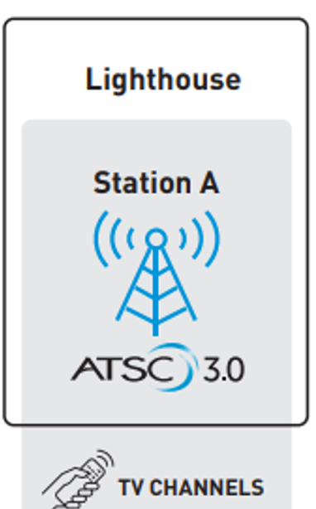
Creation of ATSC 3.0 Simulcasted Virtual "Displayed Channels" at the Upgraded Lighthouse Station
KHRR (RF CH. 16)
KVOA
(RF CH. 23)
KUAT-TV
(RF CH. 30)
KUAS-TV
(RF CH. 28
KOLD
(RF CH. 32)
KMSB
(RF CH. 25)
11.1 (ATSC1)
= "KMSB-HD"
--------------
11.2 (ATSC1)
= "Quest"
--------------
11.3 (ATSC1)
= "True Crime Network"
--------------
11.4 (ATSC1)
= "Nosey"
--------------
11.5 (ATSC1)
= "Shop LC"
--------------
11.6 (ATSC1)
= ?????
--------------
11.7 (ATSC1)
= "Comet"
--------------
11.8 (ATSC1)
= "QVC"
6.1 (ATSC1)
27.1 (ATSC1)
= "PBS HD"
--------------
6.2 (ATSC1)
27.2 (ATSC1)
= "PBS KIDS"
--------------
6.3 (ATSC1)
27.3 (ATSC1)
= "PBS 6 PLUS"
--------------
40.1 (ATSC1)
="KHRR-DT"
="Telemundo"
--------------
40.2 (ATSC1)
="TeleXitos"
4.1 (ATSC1)
="KVOANBC"
="NBC"
-----------------
4.2 (ATSC 1)
= "COZI TV"
-----------------
4.3 (ATSC1)
=" Ion Mystery"
-----------------
4.4 (ATSC1)
="DABL"
="This TV"
-----------------
4.5 (ATSC1)
= "Grit"
-----------------
40.3 (ATSC1)
="NBC LX"
13.1 (ATSC1)
= "KOLD DT"
="CBS"
--------------
13.2 (ATSC1)
= "MeTV"
--------------
13.3 (ATSC1)
= "Oatlaw"
--------------
13.4 (ATSC1)
= "KOLDDT4"
="Defy TV"
--------------
13.5 (ATSC1")
= "KPHE-LD" ________
13.6 (ATSC1)
="CHARGE!"
--------------
40.4 (ATSC1) ="Oxygen"
4.1 (ATSC1) ="KCOP-DT"
-------------
4.2 (ATSC1) ="KRON-TV"
-------------
4.3 (ATSC1) ="Rewind TV"
------------
4.4 (ATSC1) ="Charge !"
-----------
4.5 (ATSC1) ="Shop LC"
10

Slide 11
Creation of ATSC 3.0 Simulcasted Virtual "Displayed Channels" at the Upgraded Lighthouse Station
KHRR (RF CH. 16)
KRON-TV (RF CH. 7)
KUAT-TV
(RF CH. 30)
KUAS-TV
(RF CH. 28
KVOA
(RF CH. 23)
KOLD
(RF CH. 32)
KMSB
(RF CH. 25)
40.1 (ATSC3)
= "KHRR"
-------------
6.1 (ATSC3)
= "PBS HD"
-------------
4.1 (ATSC3)
= "KBOANBC"
= "NBC"
------------
13.1 (ATSC3)
= "KOLD-DT"
= "CBS"
------------
11.1 (ATSC3)
= "KMSB-HD "
------------
9.1 (ATSC3)
= "KGUN HD"
= "ABC"
11.1 (ATSC1)
= "KMSB-HD"
--------------
11.2 (ATSC1)
= "Quest"
--------------
11.3 (ATSC1)
= "True Crime Network"
--------------
11.4 (ATSC1)
= "Nosey"
--------------
11.5 (ATSC1)
= "Shop LC"
--------------
11.6 (ATSC1)
= ?????
--------------
11.7 (ATSC1)
= "Comet"
--------------
11.8 (ATSC1)
= "QVC"
6.1 (ATSC1)
27.1 (ATSC1)
= "PBS HD"
--------------
6.2 (ATSC1)
27.2 (ATSC1)
= "PBS KIDS"
--------------
6.3 (ATSC1)
27.3 (ATSC1)
= "PBS 6 PLUS"
--------------
40.1 (ATSC1)
="KHRR-DT"
="Telemundo"
--------------
40.2 (ATSC1)
="TeleXitos"
13.1 (ATSC1)
= "KOLD DT"
="CBS"
--------------
13.2 (ATSC1)
= "MeTV"
--------------
13.3 (ATSC1)
= "Oatlaw"
--------------
13.4 (ATSC1)
= "KOLDDT4"
="Defy TV"
--------------
13.5 (ATSC1")
= "KPHE-LD" ________
13.6 (ATSC1)
="CHARGE!"
--------------
40.4 (ATSC1) ="Oxygen"
4.1 (ATSC1)
="KVOANBC"
="NBC"
-----------------
4.2 (ATSC 1)
= "COZI TV"
-----------------
4.3 (ATSC1)
=" Ion Mystery"
-----------------
4.4 (ATSC1)
="DABL"
="This TV"
-----------------
4.5 (ATSC1)
= "Grit"
-----------------
40.3 (ATSC1)
="NBC LX"

Slide 12
Creation of ATSC 3.0 Simulcasted Virtual "Displayed
Channels" at the Upgraded Lighthouse Station (continued)
KHRR (RF CH. 16)
KTVU
(RF CH. 31)
KNTV
(RF CH. 13)
KPYX
(= "KPIX +")
(RF CH. 28)
KMSB
(RF CH. 25)
11.1 (ATSC1)
= "KMSB-HD"
--------------
11.2 (ATSC1)
= "Quest"
--------------
11.3 (ATSC1)
= "True Crime Network"
--------------
11.4 (ATSC1)
= "Nosey"
--------------
11.5 (ATSC1)
= "Shop LC"
--------------
11.6 (ATSC1)
= ?????
--------------
11.7 (ATSC1)
= "Comet"
--------------
11.8 (ATSC1)
= "QVC"
40.1 (ATSC3)
= "KHRR"
-------------
6.1 (ATSC3)
= "PBS HD"
-------------
4.1 (ATSC3)
= "KBOANBC"
= "NBC"
------------
13.1 (ATSC3)
= "KOLD-DT"
= "CBS"
------------
11.1 (ATSC3)
= "KMSB-HD "
------------
9.1 (ATSC3)
= "KGUN HD"
= "ABC"
6.1 (ATSC1)
27.1 (ATSC1)
= "PBS HD"
--------------
6.2 (ATSC1)
27.2 (ATSC1)
= "PBS KIDS"
--------------
6.3 (ATSC1)
27.3 (ATSC1)
= "PBS 6 PLUS"
--------------
40.1 (ATSC1)
="KHRR-DT"
="Telemundo"
--------------
40.2 (ATSC1)
="TeleXitos"
4.1 (ATSC1)
="KVOANBC"
="NBC"
-----------------
4.2 (ATSC 1)
= "COZI TV"
-----------------
4.3 (ATSC1)
=" Ion Mystery"
-----------------
4.4 (ATSC1)
="DABL"
="This TV"
-----------------
4.5 (ATSC1)
= "Grit"
-----------------
40.3 (ATSC1)
="NBC LX"
13.1 (ATSC1)
= "KOLD DT"
="CBS"
--------------
13.2 (ATSC1)
= "MeTV"
--------------
13.3 (ATSC1)
= "Oatlaw"
--------------
13.4 (ATSC1)
= "KOLDDT4"
="Defy TV"
--------------
13.5 (ATSC1")
= "KPHE-LD" ________
13.6 (ATSC1)
="CHARGE!"
--------------
40.4 (ATSC1) ="Oxygen"
12

Slide 13
NET RESULTS
The 6 most powerful TV channels in Tucson are now "simulcast" in both the new "NextGen" ATSC 3.0 format and the legacy ATSC 1.0 formats

Slide 14
ADDITIONAL DETAILS
https://www.radiodiscussions.com/threads/nextgen-atsc-3-0-coming-to-tucson-may-23.771340/

