Slide 1



INSTALLING AND USING
THE LOW-COST
"ADTH NEXTGEN TV BOX" TUNER
1

Slide 2
Web location for this presentation:
http://aztcs.apcug.org
Click on
"Meeting Notes"
2

Slide 3
SUMMARY
The "ADTH NextGen TV Box" is the only over-the-air tuner that is less than $100 that can receive all three types of "ATSC" TV channels.
3

Slide 4
TOPICS
Step 1: Procuring the "ATDH NextGen TV Box"
Step 2: Installing it.
Step 3: Using it.
4

Slide 5
"ATDH"
"ATDH" stands for "Atlanta Direct To Home" which is an acronym for satellite TV receivers which the ATDH company used to manufacture.
5

Slide 6
STEP 1: PROCURE TUNER
To purchase the "ADTH NextGen TV Box", you can go to https://adth.com/product/adth-nextgen-tv-box/ or https://www.walmart.com/ip/ADTH-NextGen-TV-Box-Watch-Free-OTA-ATSC-3-0-1-0-in-4K-UHD-resolution/5297873740
6

Slide 7
STEP 1: PROCURE TUNER (continued)
Warning: At the present time (April 2024), only one of ADTH's tuner models can receive all three types of ATSC signals--most of their other tuner models only receive "ATSC 1.0" (Type 1) channels
7

Slide 8
STEP 2: INSTALL TUNER
Install the antenna in a window
Install a RG6 coaxial cable from the antenna to the tuner box
Connect the tuner box's HDMI port to the HDMI port on a computer monitor or a TV set
Power up the tuner and scan for TV channels.
8

Slide 9
STEP 2: INSTALL TUNER (continued)
Detailed step-by-step how-to documentation is available at
https://support.adth.com/en/support/solutions/folders/43000591677
9

Slide 10
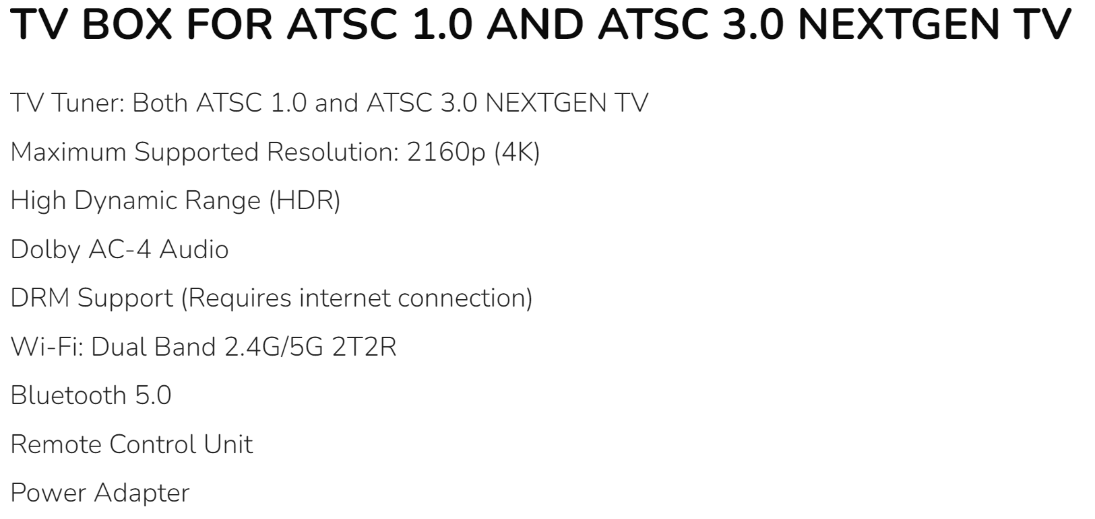
STEP 2: INSTALL TUNER
10

Slide 11
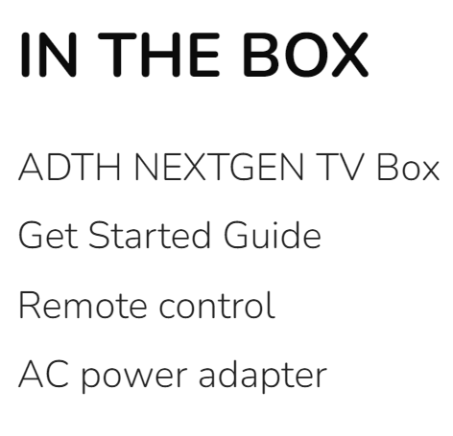
11

Slide 12
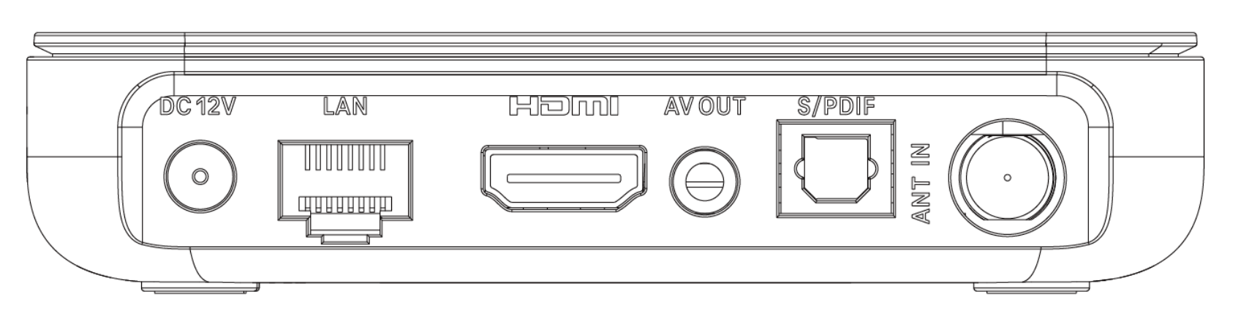
12

Slide 13
13

Slide 14
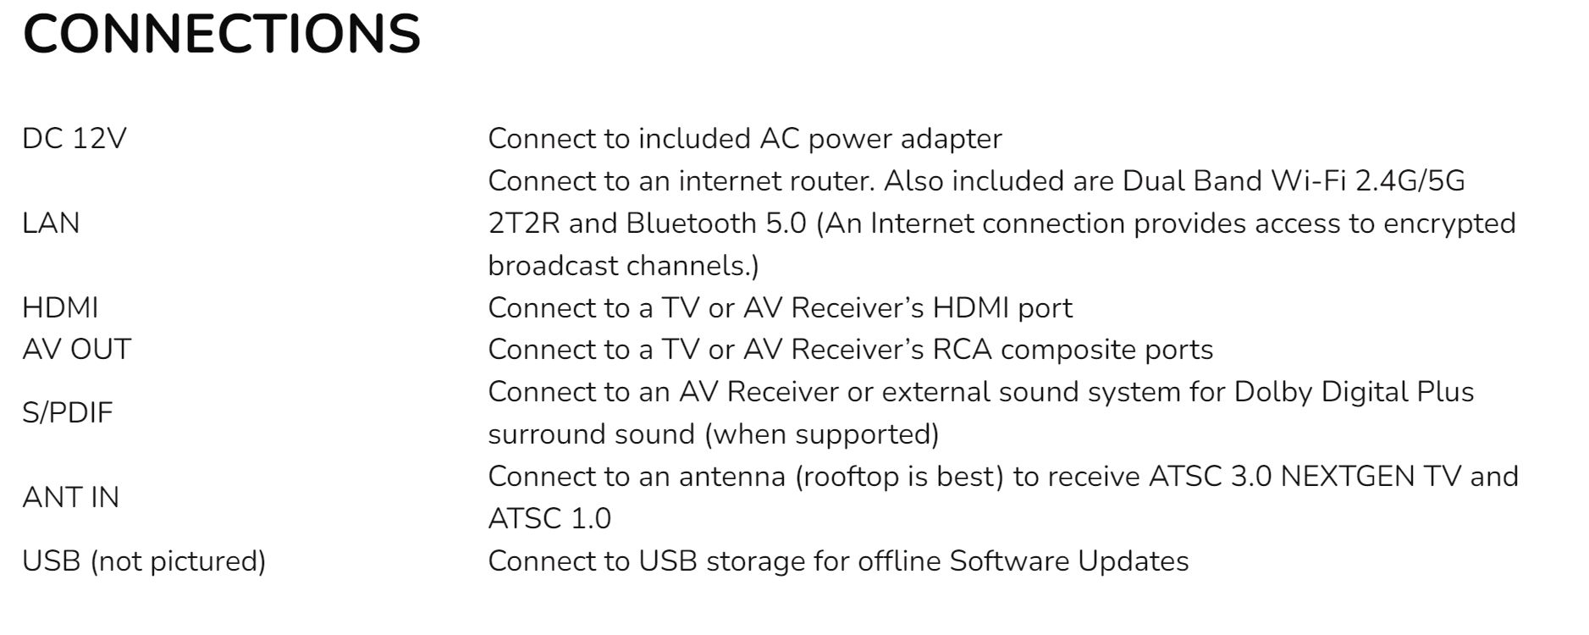
14

Slide 15
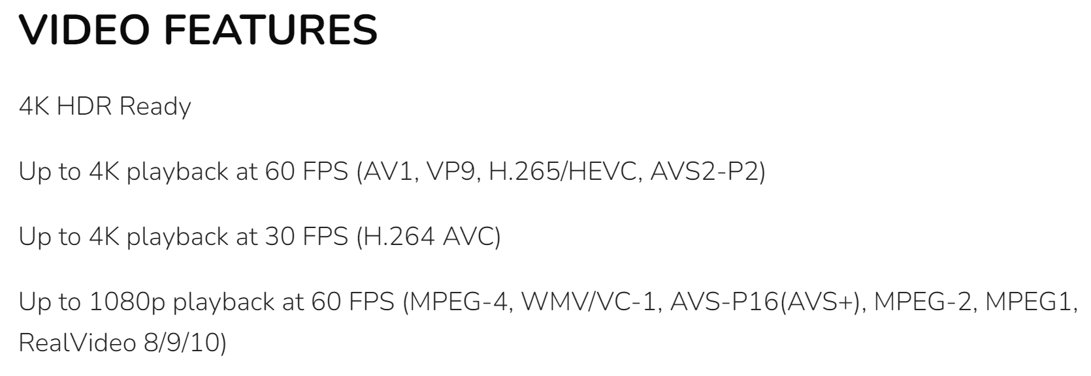
15

Slide 16
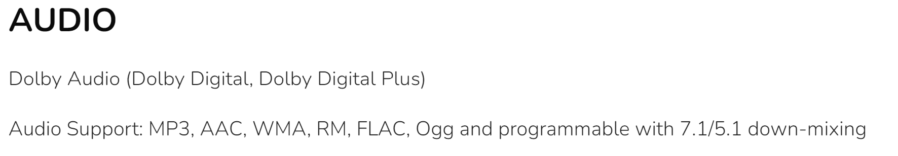
16

Slide 17
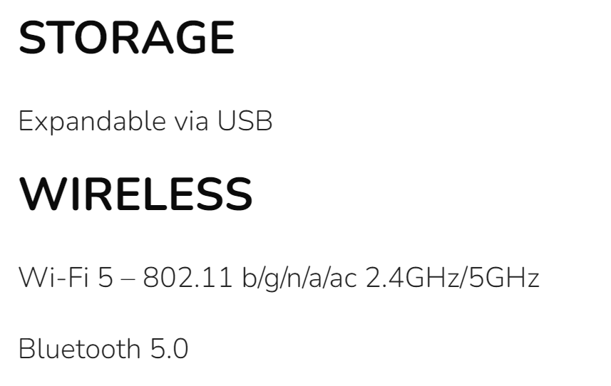
17

Slide 18

18

Slide 19
OPTIONAL STEP 3: INSTALL AN OPTIONAL WINEGARD "BOOST XT" PRE-AMPLIFIER
https://www.amazon.com/Winegard-LNA-200-Preamplifier-Antenna-Amplifier/dp/B00DQN3R9O/
19

Slide 20
OPTIONAL STEP 4: INSTALL AN AC POWER SWITCH FOR POWER-ON RESETS OF THE ADTH TUNER
https://www.amazon.com/Coleman-Cable-Control-Extension-15-Foot/dp/B00004SQHV/
20

Slide 21
OPTIONAL STEP 5: INSTALL TYPE-F TERMINATORS TO FINE TUNE THE SIGNALS GOING OUT OF THE PRE-AMPLIFIER
https://www.amazon.com/gp/product/B0CPXY2XK2/ref=ppx_yo_dt_b_asin_title_o00_s00?ie=UTF8&th=1
21

Slide 22
22

Slide 23
23

