Slide 1



GETTING STARTED WITH "LINUX MINT"

Slide 2
Web location for this presentation:
http://aztcs.apcug.org
Click on "Meeting Notes"
2

Slide 3
TOPICS
Options for Running "Linux Mint"
"Desktop Environment" Usage Percentages of "Linux Mint"
Disk Formats in "Linux Mint"
3

Slide 4
OPTIONS FOR RUNNING LINUX
Option 1: Obtain computer with Linux already installed in it, power it up, and answer a few questions
Option 2: Install Linux into an existing Windows.. computer so that it dual boots when powered up and lets you select between Linux and Windows..
4

Slide 5
OPTIONS FOR RUNNING LINUX
Option 3: Use an external solid state drive or external hard drive to non-destructively boot up Linux in an existing Windows.. computer
5

Slide 6
OPTION 1: OBTAIN A COMPUTER WITH LINUX ALREADY INSTALLED IN IT
Three U.S.-based sellers of desktop computers with "Linux Mint" already installed in them:
https://currentbuild.com/
https://thinkpenguin.com/catalog/desktop-computers-gnu-linux
https://pc.eightvirtues.com/step-1-base-system-am4/
6

Slide 7
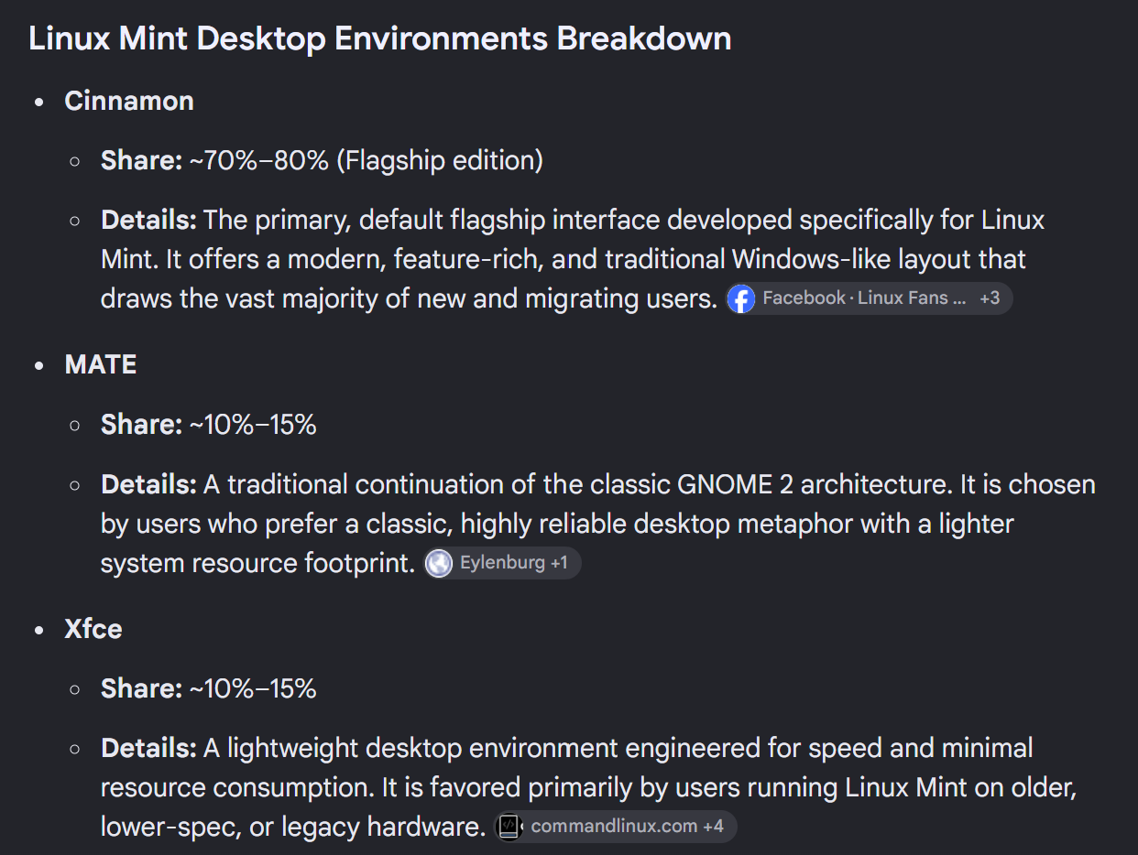
"DESKTOP ENVIRONMENT" USAGE PERCENTAGES OF "LINUX MINT"
7

Slide 8
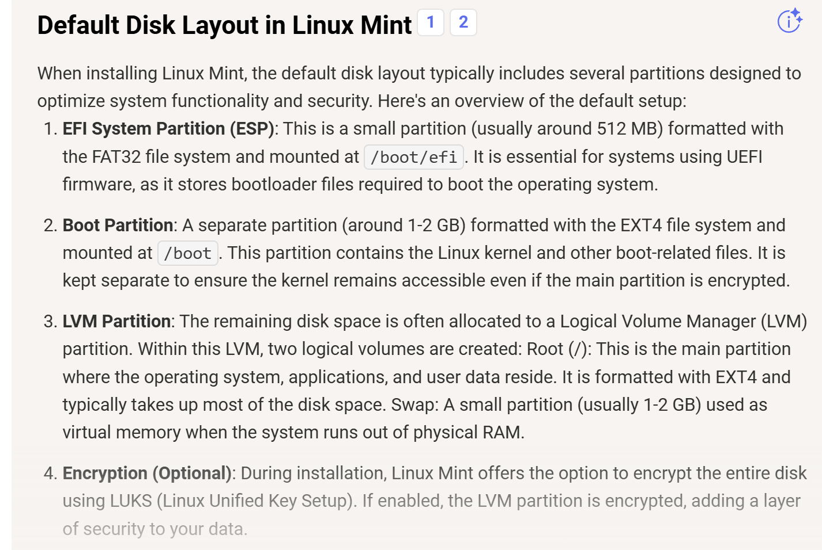
"DISK FORMATS" IN "LINUX MINT"
8

Slide 9
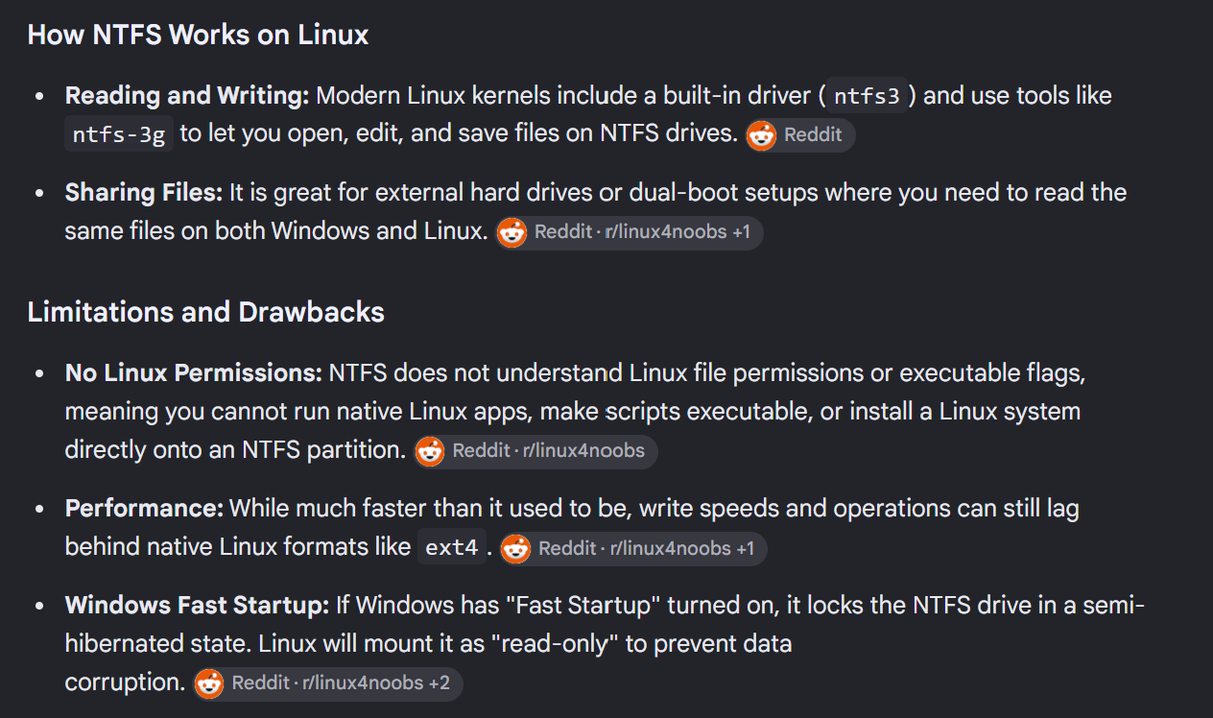
"NTFS DISK FORMATS" IN "LINUX MINT"
9

