Slide 1



8-"RESCUEZILLA" & "CLONEZILLA LIVE" VERSUS "MACRIUM REFLECT"
1

Slide 2
Web location for this presentation:
http://aztcs.apcug.org
Click on "Meeting Notes"
or contact fchao2@yahoo.com
2

Slide 3
SUMMARY
"Rescuezilla Live" and "Clonezilla" are both "Free and Open Source". "Macrium Reflect Home" and other not-free "apps" for cloning and image backups are not free. Unlike "Rescuezilla Live" and "Clonezilla", "Macrium Reflect Home" and other non-free apps do not clone the "signature" of a source drive and hence they do not cause "signature conflicts" for "Windows.." computers.
3

Slide 4
MACRIUM REFLECT HOME (continued)
..provides a 30-day free trial. This "Windows.." app prevents signature clashes and Windows.. failures by NOT modifying the GUID Partition Table's "Signature", the EFI System Partition's BCD (="Boot Configure Data" Store), and the C: partition so that the original "Signature" of the target drive is retained.
4

Slide 5
MACRIUM REFLECT HOME (continued)
The result is that no signature conflicts occur between the target drives for both bootable drives and data-only drives in Windows.. computers because the "Signature" of a source drive is NOT copied to the target cloned drive. When you use "Macrium Reflect Home" to clone a bootable Windows drive, it does some cleanup on the target drive at the end of the clone process:
5

Slide 6
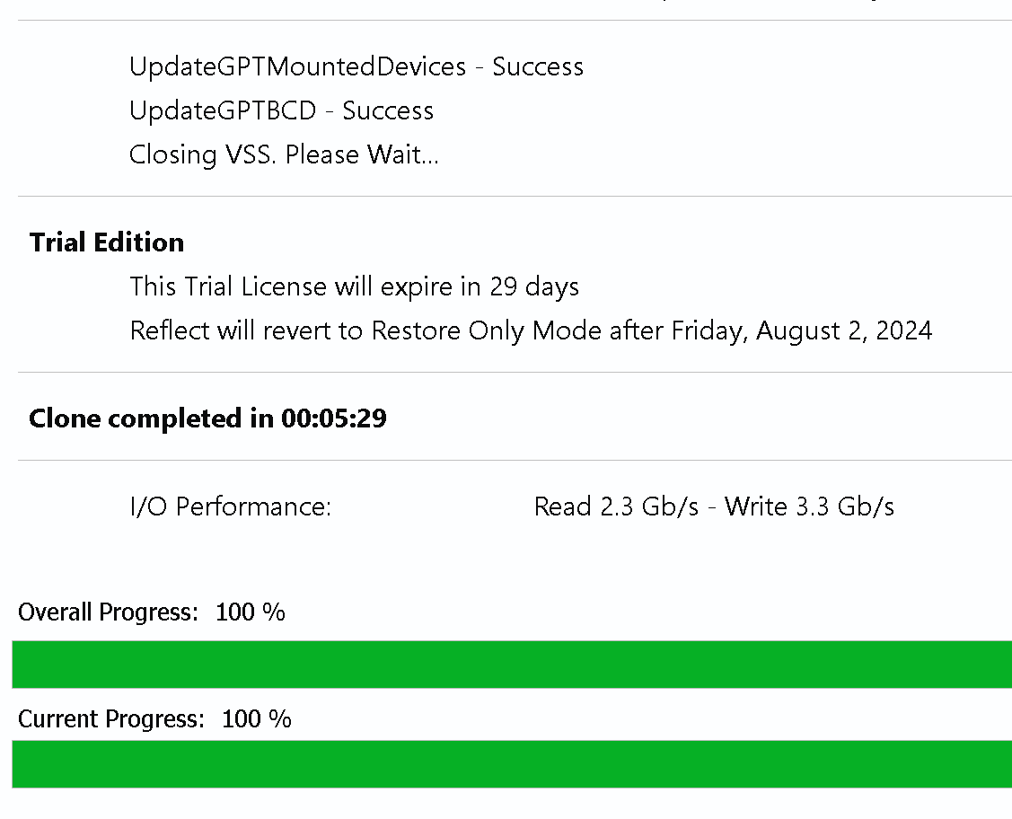
6

Slide 7
7

