Slide 1



7-USING "CLONEZILLA LIVE"
1

Slide 2
Web location for this presentation:
http://aztcs.apcug.org
Click on "Meeting Notes"
or contact fchao2@yahoo.com
2

Slide 3
SUMMARY
Here are the actual steps for using the free "Clonezilla Live" to clone or image backup an existing hard drive or solid state drive (SSD).
3

Slide 4
USING "CLONEZILLA LIVE"
Determine the manufacturer's serial numbers for the "source drive" and the "target drive"
Attach the bootable "CLONEZILLA LIVE" USB thumb drive or CD or DVD to the computer (and make sure that the bootable device is operational)
4

Slide 5
USING "CLONEZILLA LIVE" continued)
If the computer is powered up, shut it down. (Many computers will not boot up to a bootable flash drive or a bootable CD or DVD if you do a restart from an operating system that is running.)
5

Slide 6
USING "CLONEZILLA LIVE" (continued)
If the computer is powered up, shut it down. (Many computers will not boot up to a bootable flash drive or a bootable CD or DVD if you do a restart from an operating system that is running.)
6

Slide 7
USING "CLONEZILLA LIVE" (continued)
Power up or reboot the computer
Press the key(s) needed to get into the firmware setup for selecting the bootable device
7

Slide 8
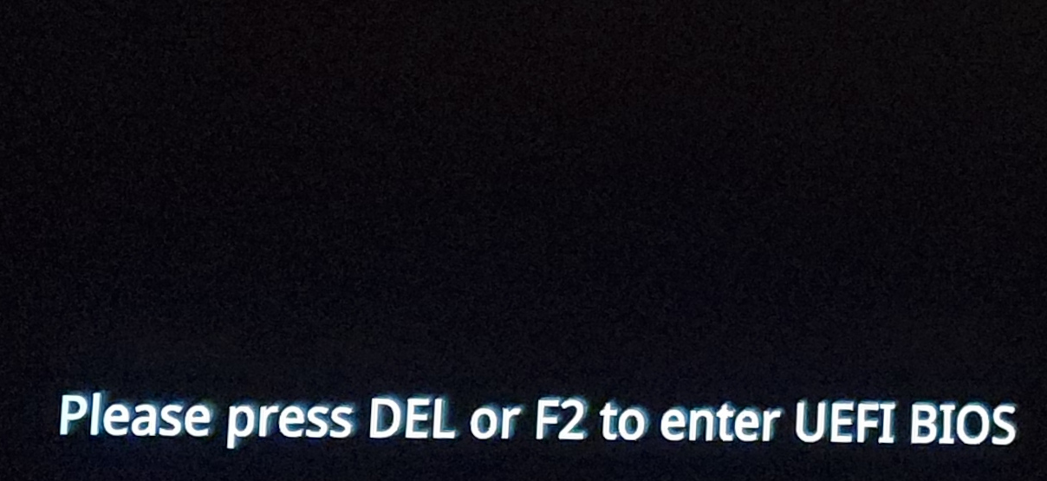
8

Slide 9
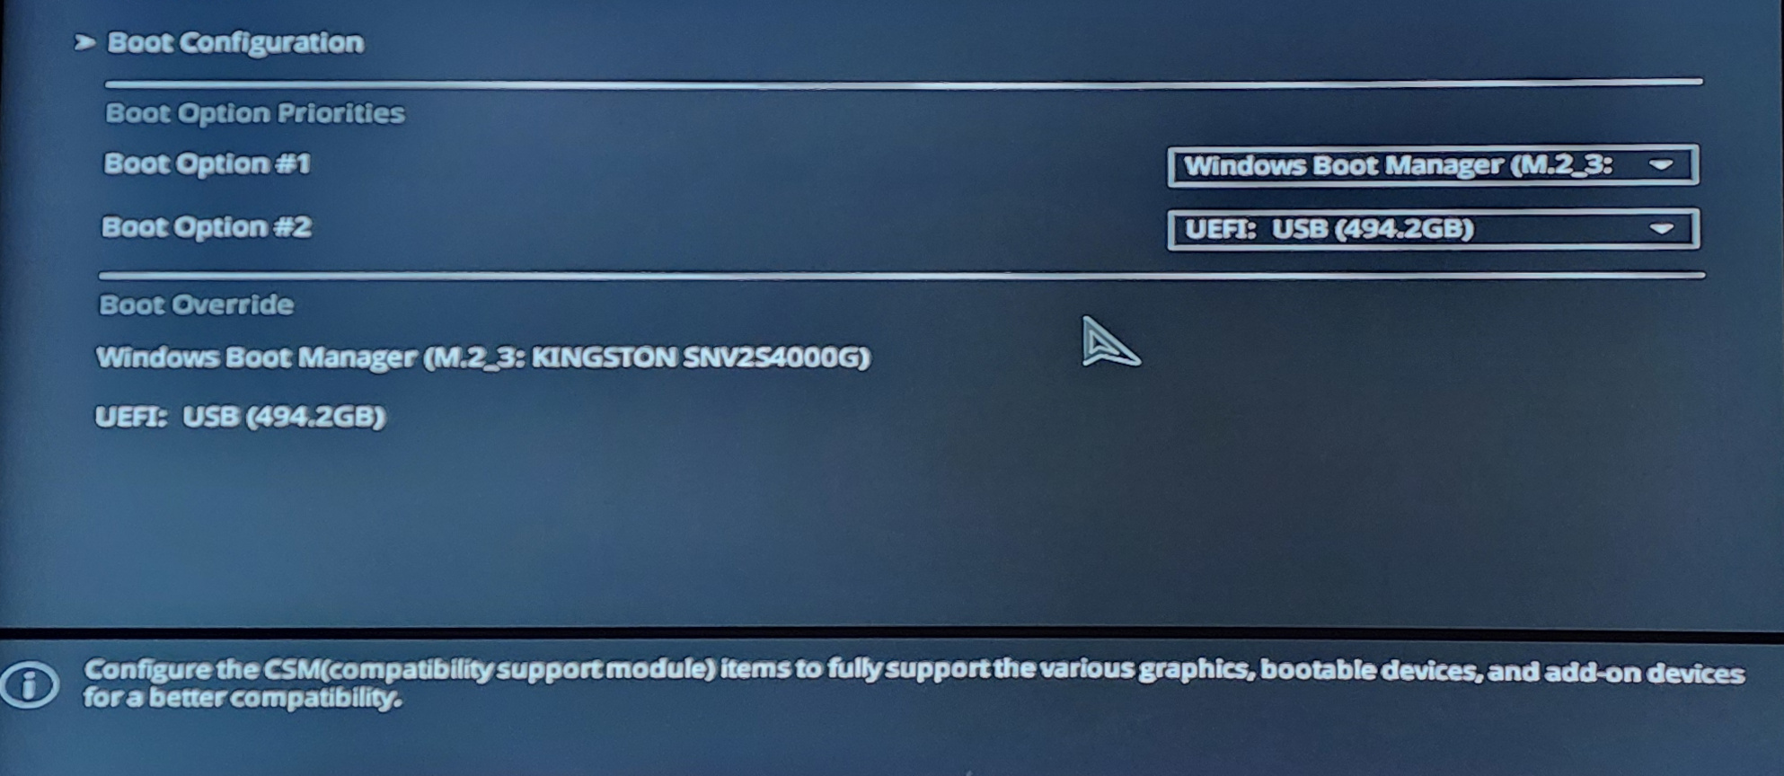
9

Slide 10
10

Slide 11
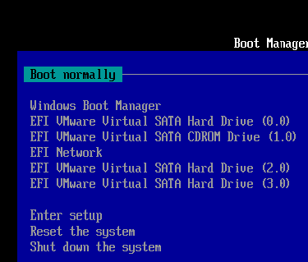
11

Slide 12
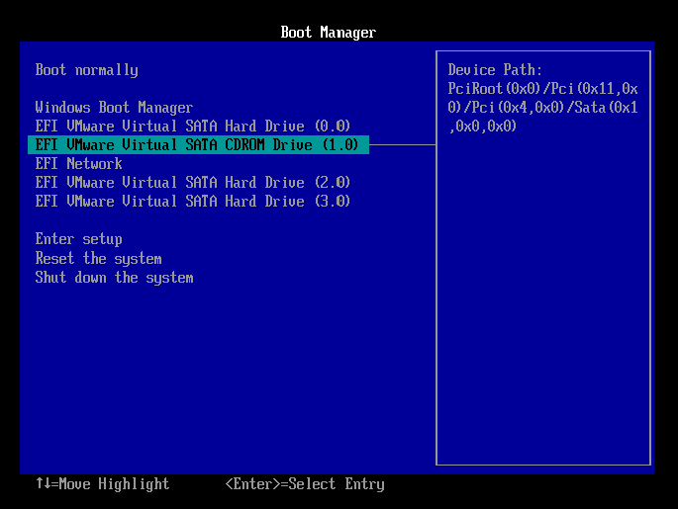
12

Slide 13
13

Slide 14
USING "CLONEZILLA LIVE" (continued)
Use the mouse or keyboard to highlight the bootable "Rescuezilla" device
Then press the Enter key of the keyboard
14

Slide 15
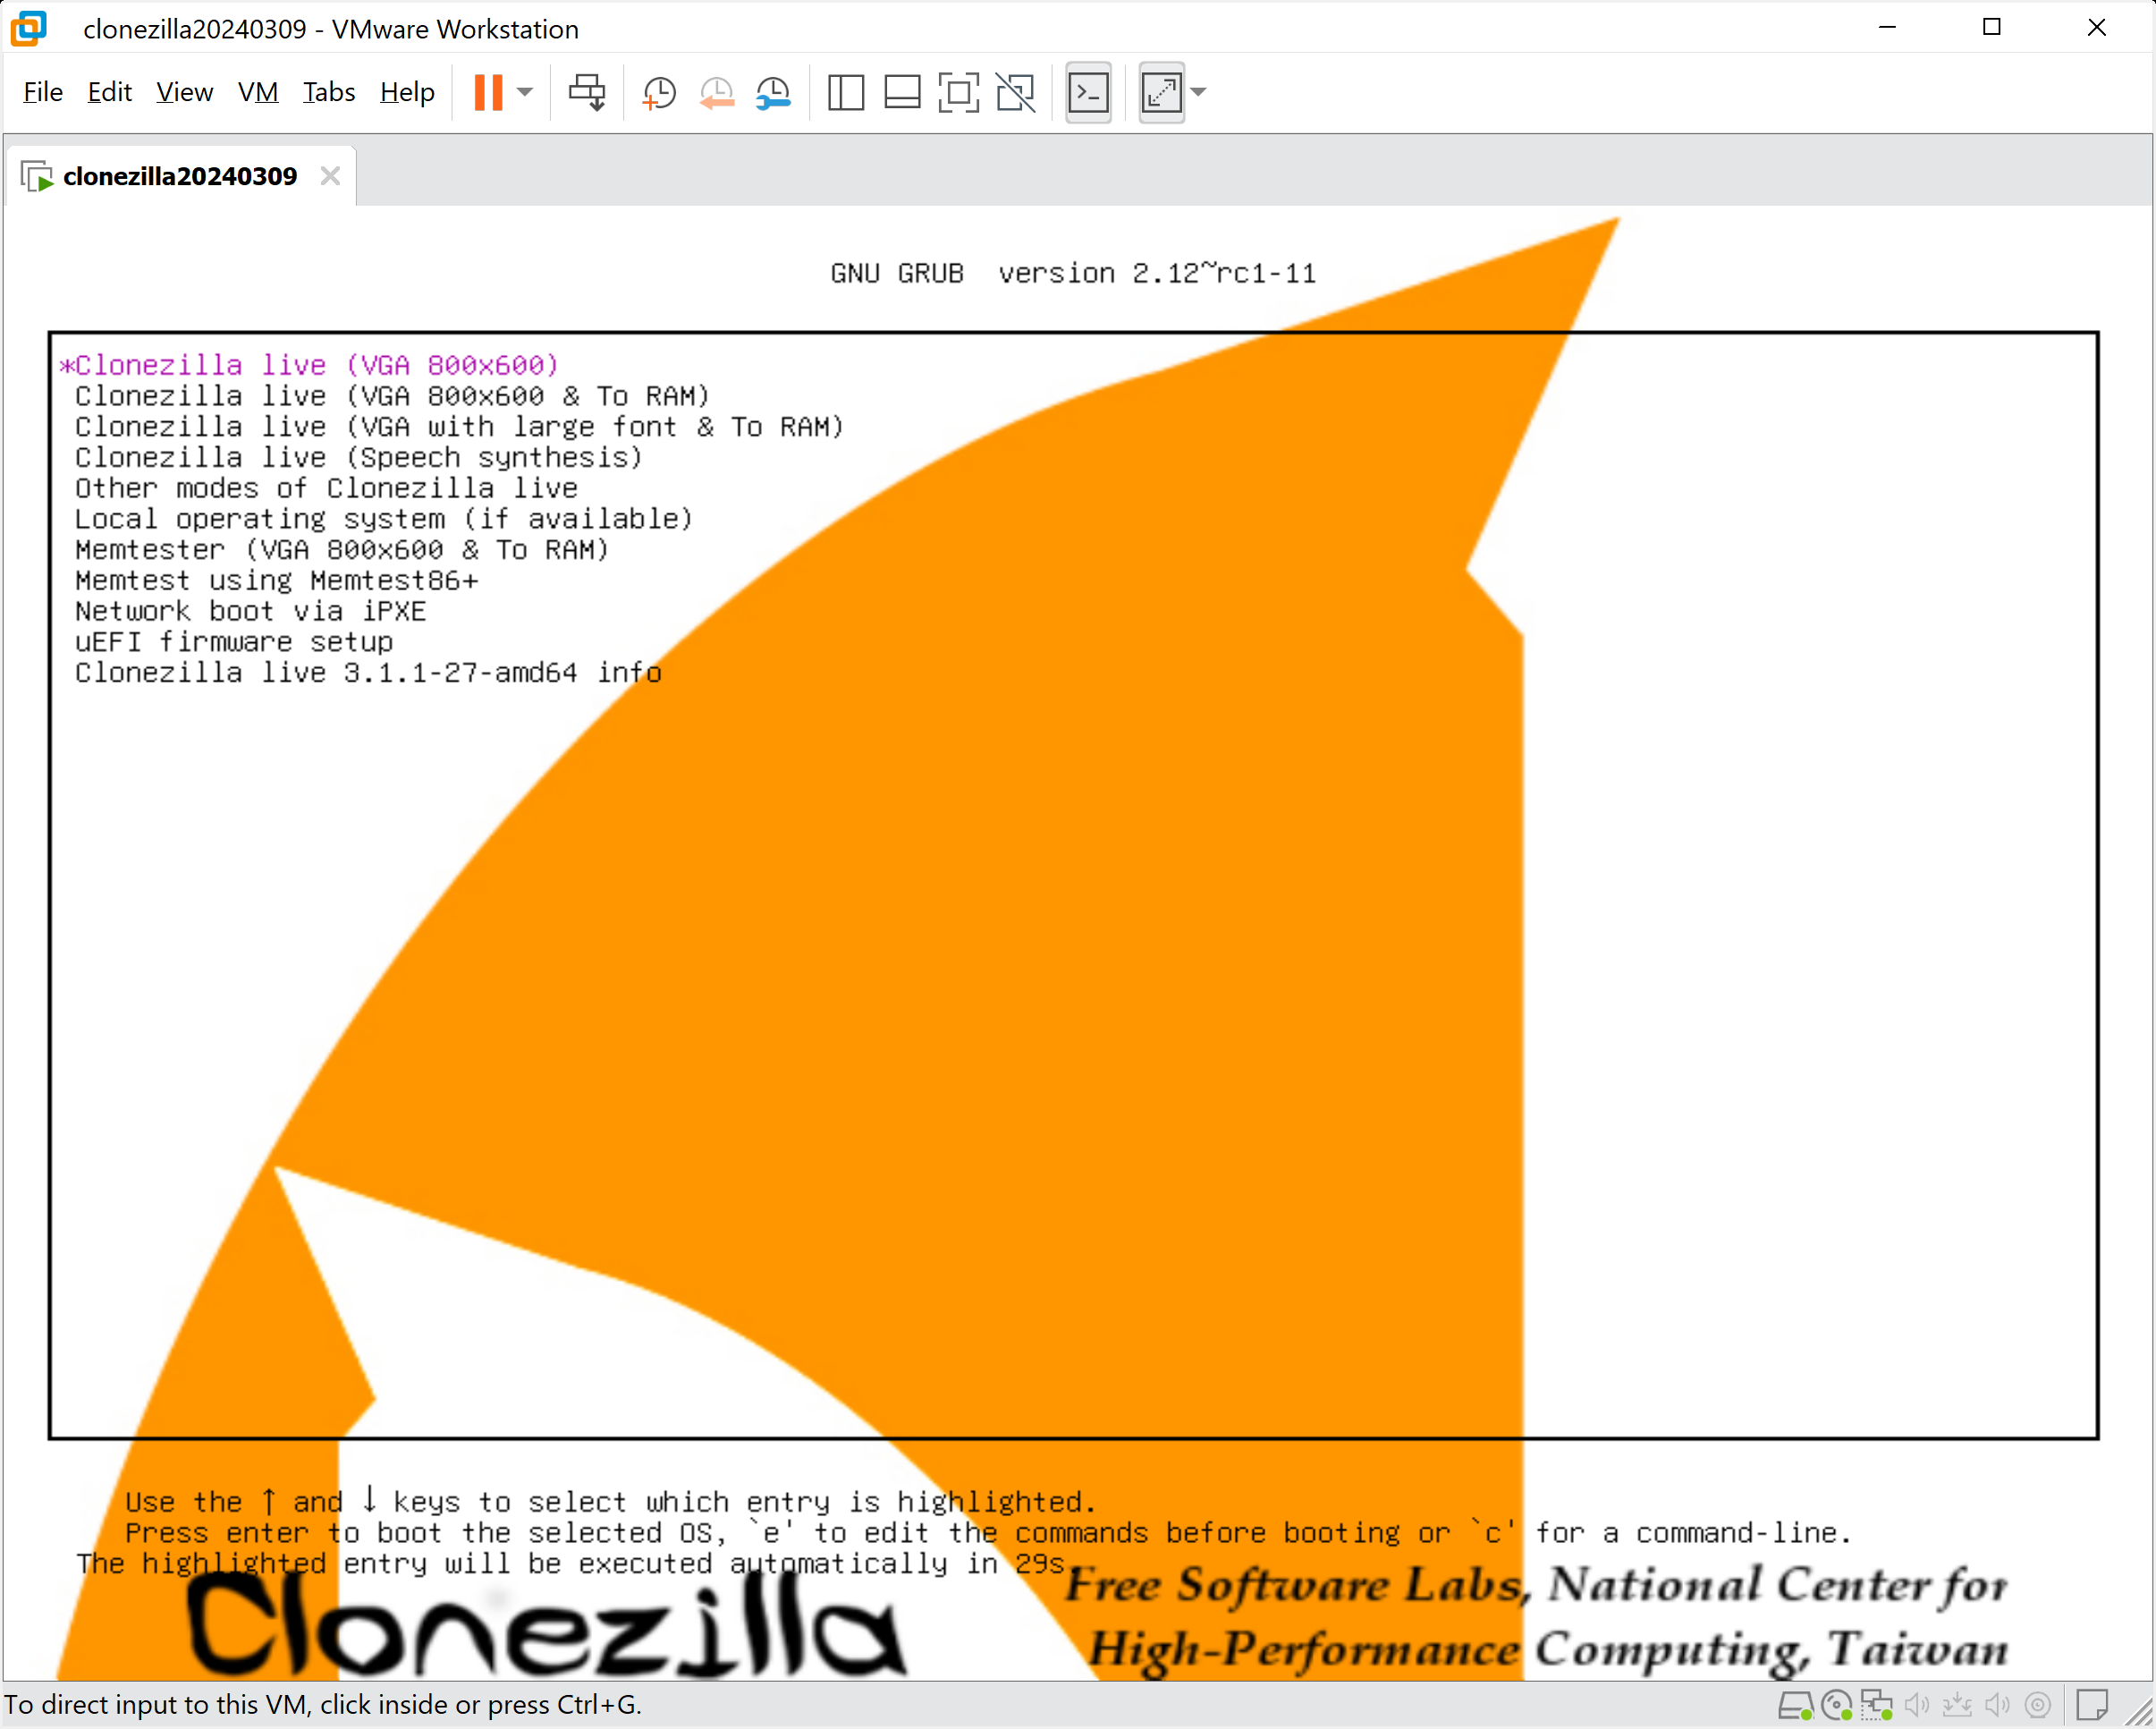
15

Slide 16
16

Slide 17
17

Slide 18
USING "CLONEZILLA LIVE" (continued)
Use the up and down arrow keys of the keyboard to select one of the top three options:
18

Slide 19
19

Slide 20
USING "CLONEZILLA LIVE" (continued)
Press the Enter key of the keyboard.
20

Slide 21
USING "CLONEZILLA LIVE" (continued)
You will see a black screen while "CLONEZILLA LIVE" scans the computer for hard drives and solid state drives (SSDs)
21

Slide 22
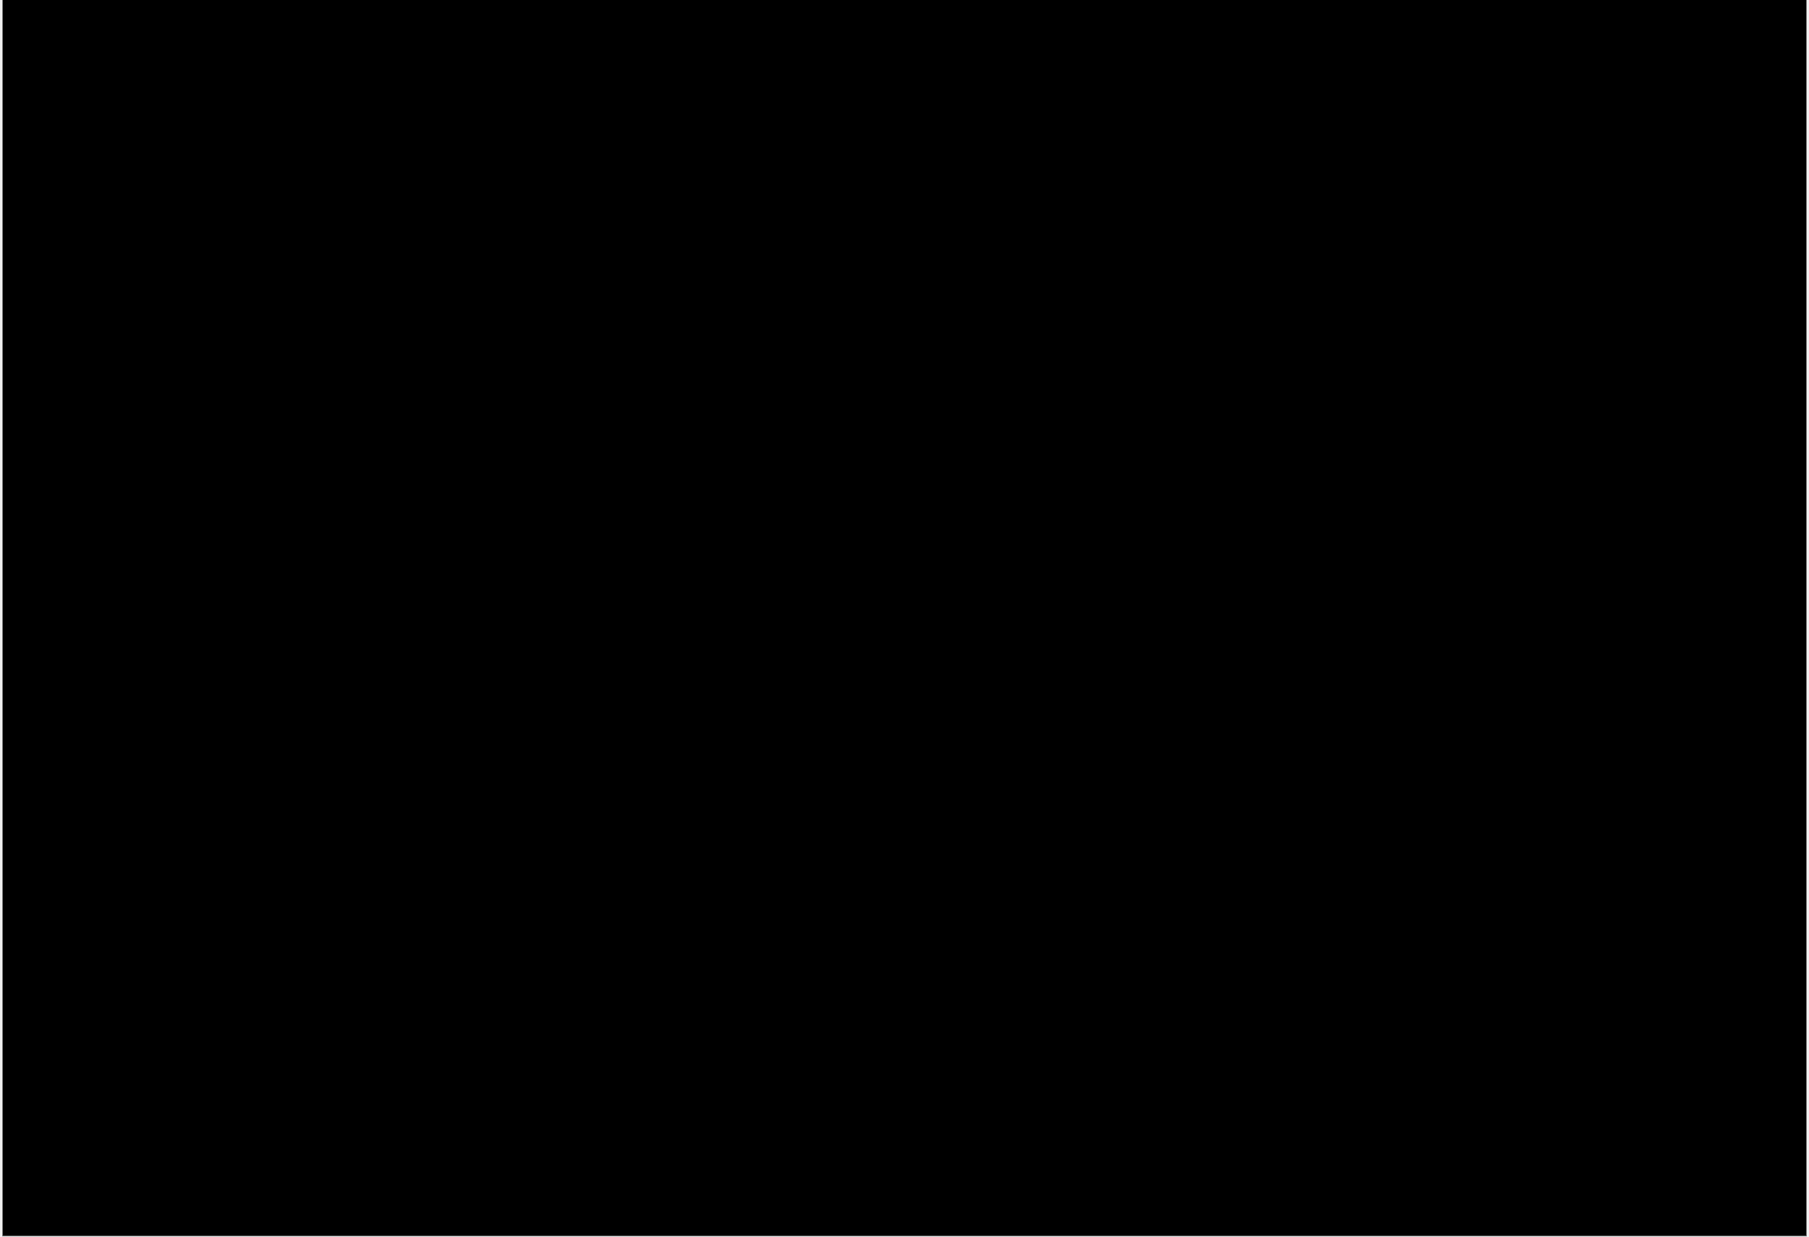
22

Slide 23
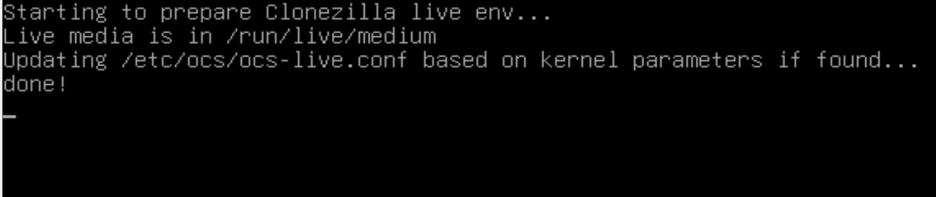
23

Slide 24
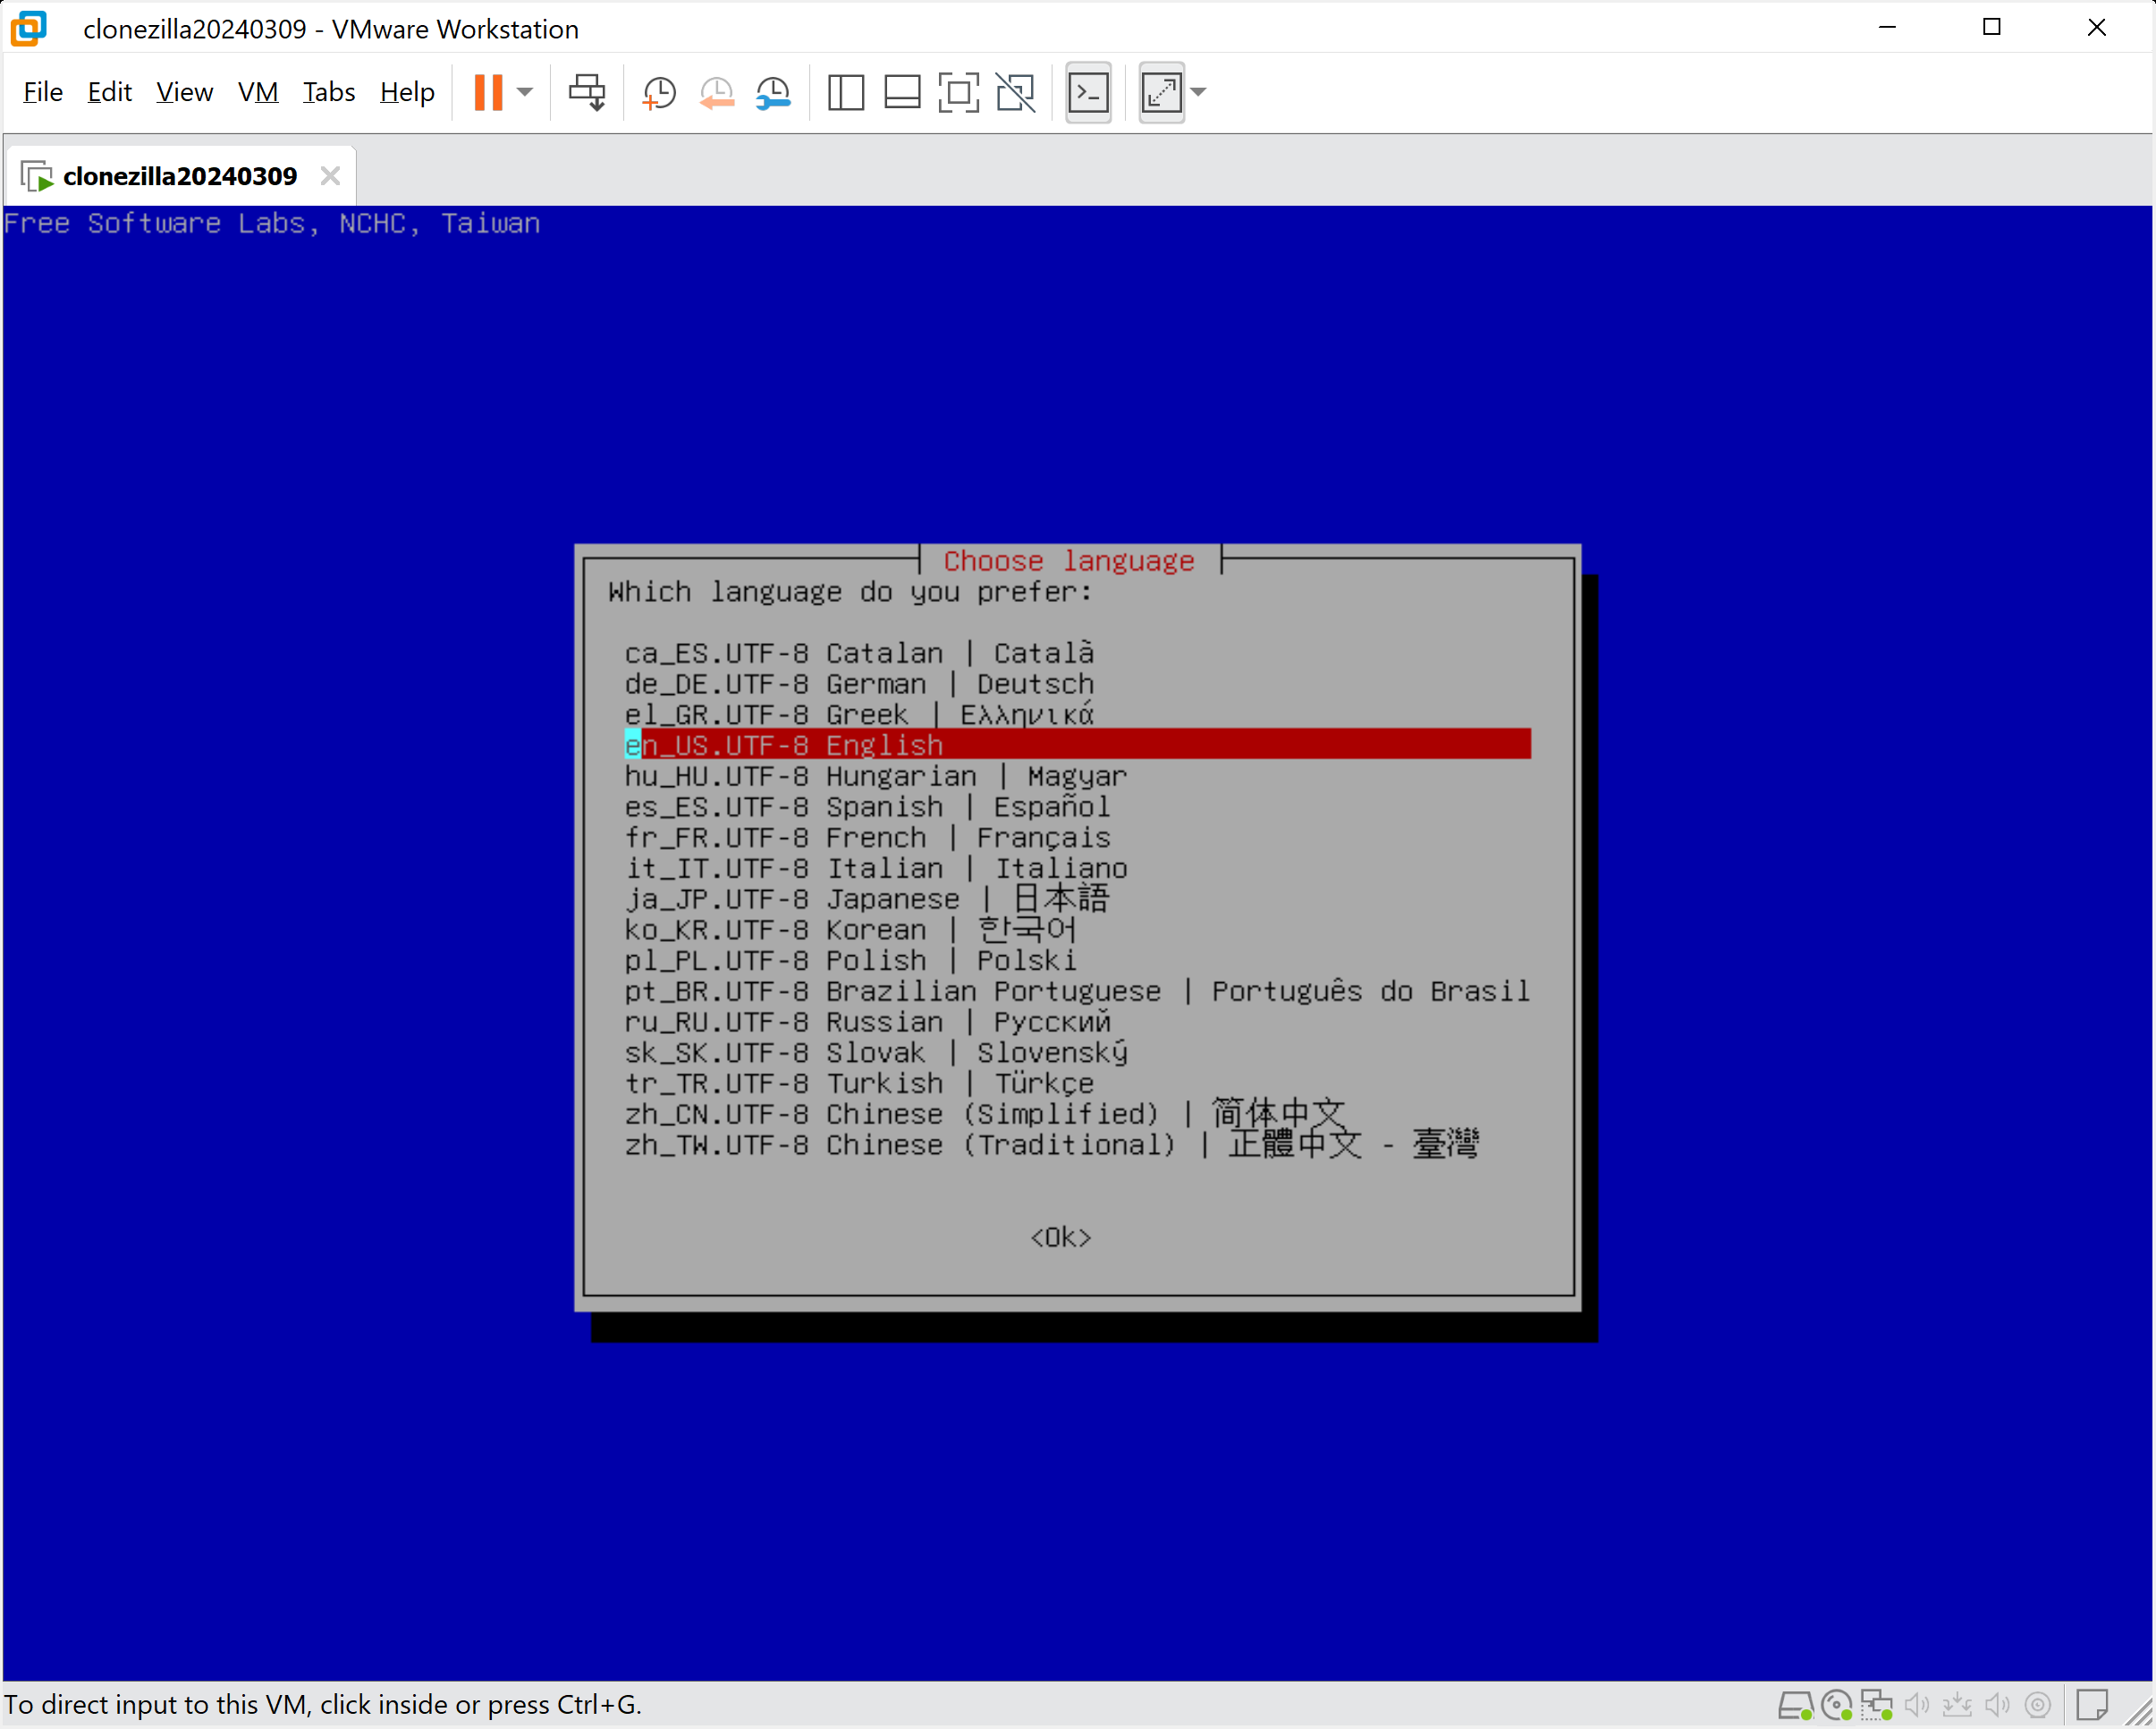
24

Slide 25
25

Slide 26
USING "CLONEZILLA LIVE" (continued)
Press the Tab button of the keyboard to make the "OK" highlight in red:
26

Slide 27
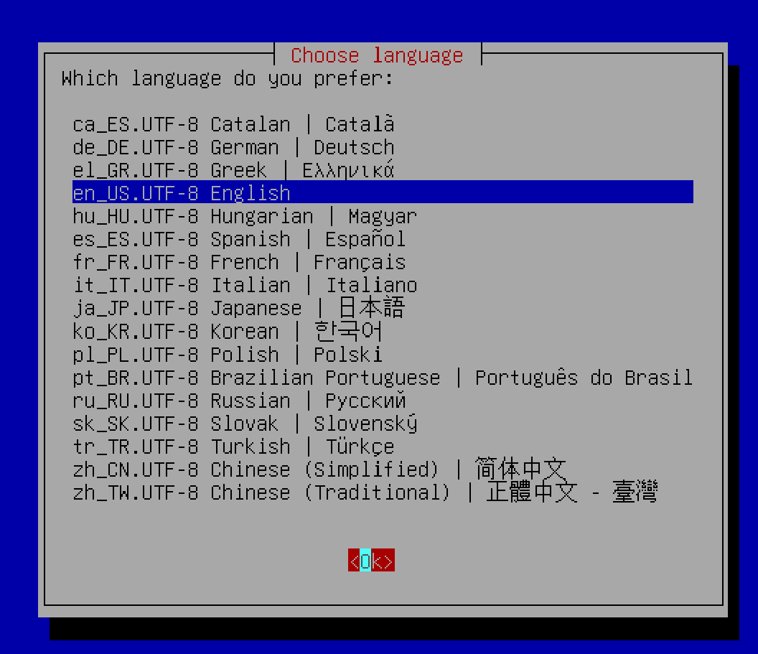
27

Slide 28
USING "CLONEZILLA LIVE" (continued)
Press the Enter key of the keyboard:
28

Slide 29
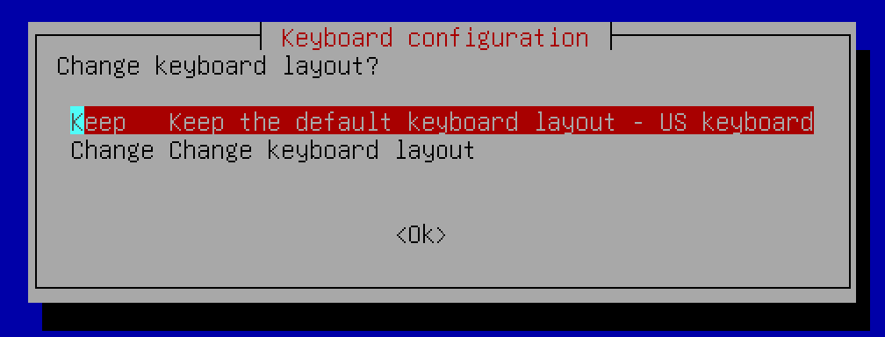
29

Slide 30
USING "CLONEZILLA LIVE" (continued)
Press the Tab key of the keyboard to make the OK turn red:
30

Slide 31
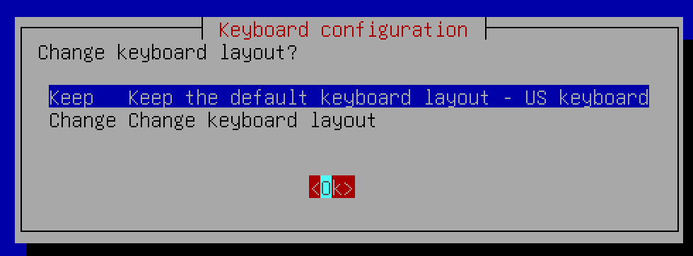
31

Slide 32
USING "CLONEZILLA LIVE" (continued)
Press the Enter key of the keyboard:
32

Slide 33
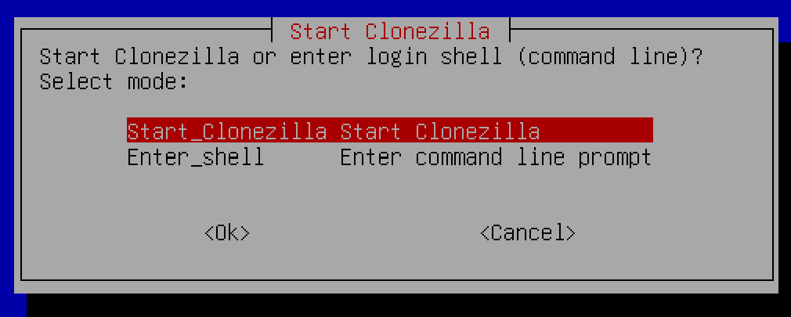
33

Slide 34
USING "CLONEZILLA LIVE" (continued)
Press the Tab key of the keyboard to make the OK turn red:
34

Slide 35
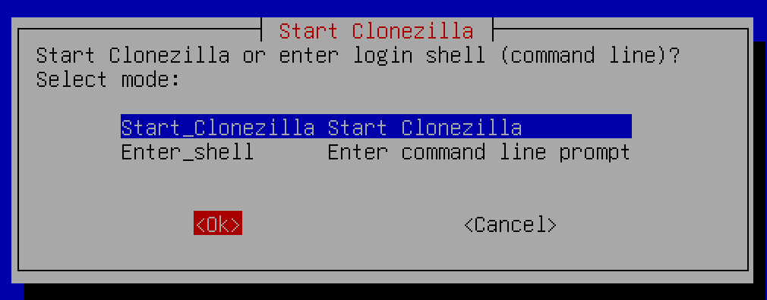
35

Slide 36
USING "CLONEZILLA LIVE" (continued)
Press the Enter key of the keyboard:
36

Slide 37
USING "CLONEZILLA LIVE" (continued)
At this point, the top option is for making a "clone" of a drive or a drive partition and the second option is for making an "image" or restoring from a previously-made "image" of a drive or a drive partition:
37

Slide 38
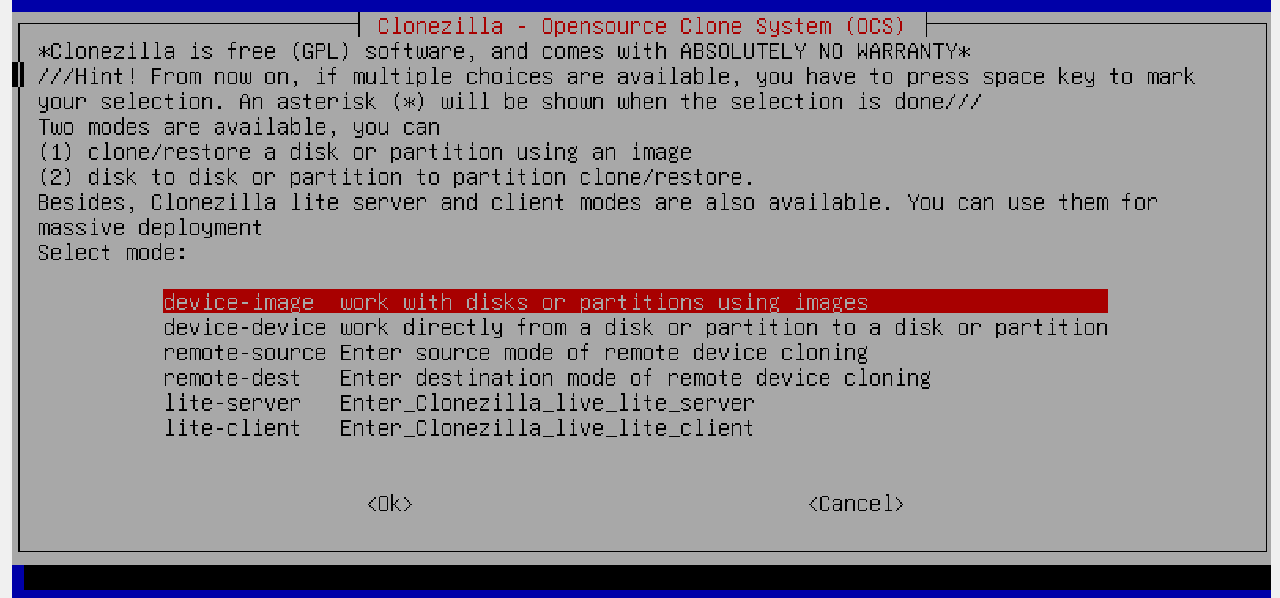
38

Slide 39
USING "CLONEZILLA LIVE" (continued)
If you wish to clone a drive or a drive partition, press the Down Arrow key of the keyboard once to select "device-device work directly.." and to turn it red. (F.y.i. the top default option is for device-image which would let you either create a compressed image file or use a use a previously-made compressed image file to restore to a drive or a drive partition.
39

Slide 40
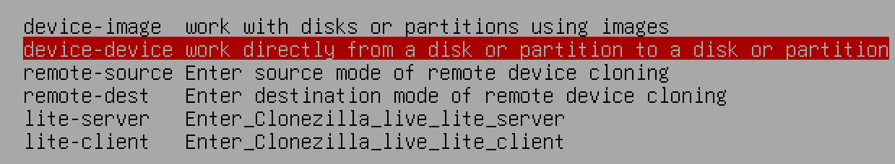
40

Slide 41
USING "CLONEZILLA LIVE" (continued)
Press the Tab key of the keyboard to turn the "OK" to red:
41

Slide 42
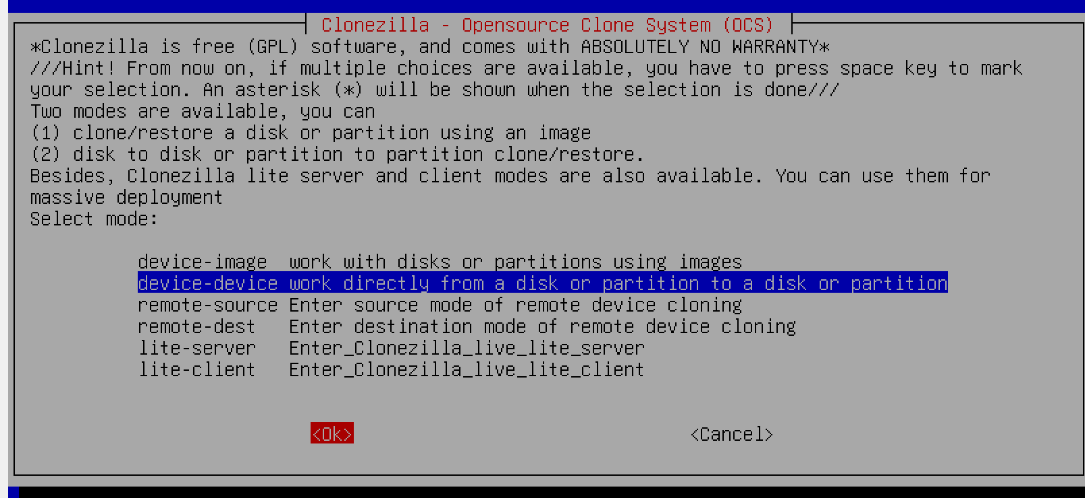
42

Slide 43
USING "CLONEZILLA LIVE" (continued)
Press the Enter key of the keyboard:
43

Slide 44
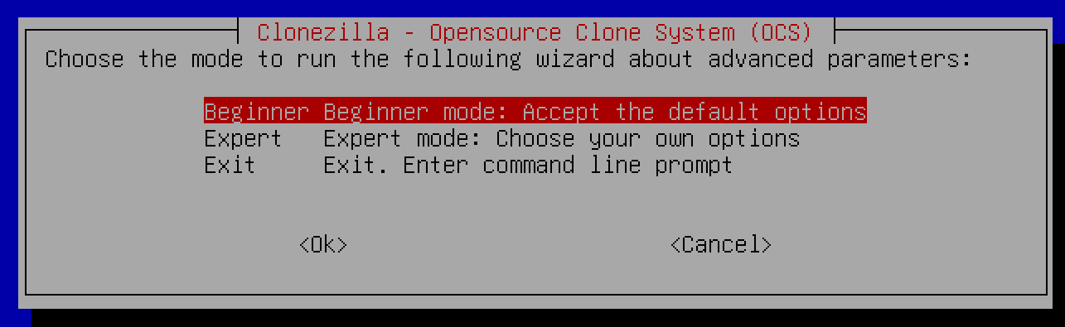
44

Slide 45
45

Slide 46
USING "CLONEZILLA LIVE" (continued)
Press the Tab key of the keyboard to turn the OK red:
46

Slide 47
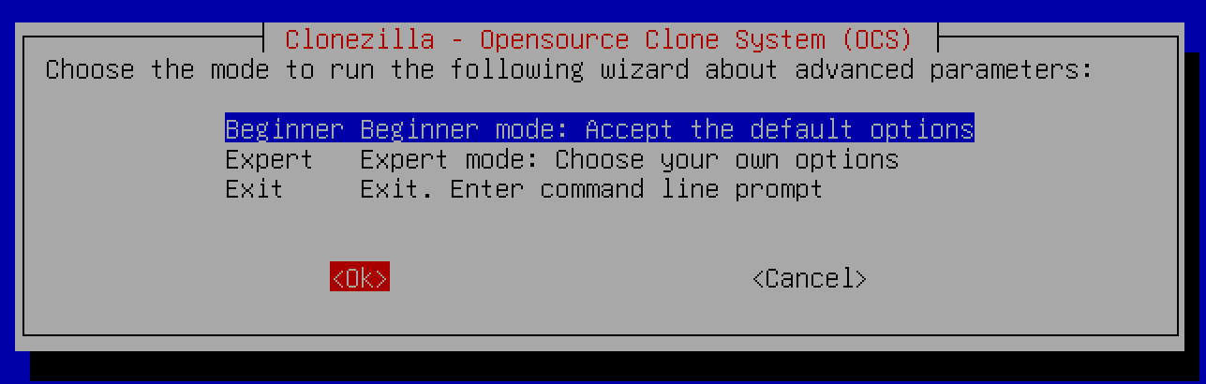
47

Slide 48
USING "CLONEZILLA LIVE" (continued)
Press the Enter key of the keyboard:
48

Slide 49
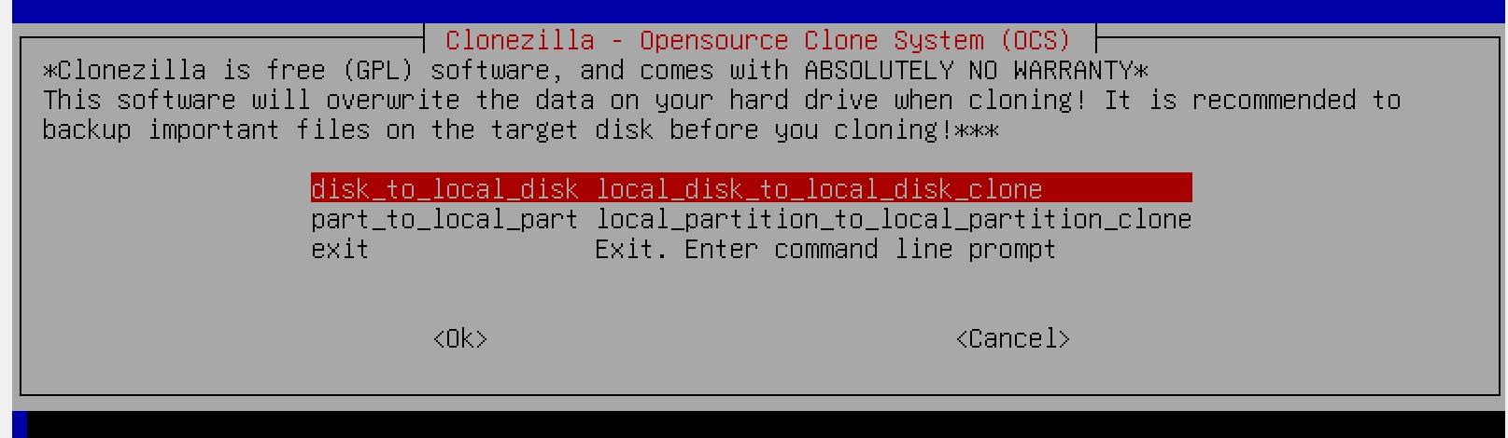
49

Slide 50
50

Slide 51
USING "CLONEZILLA LIVE" (continued)
Press the Tab key of the keyboard to make the OK red:
51

Slide 52
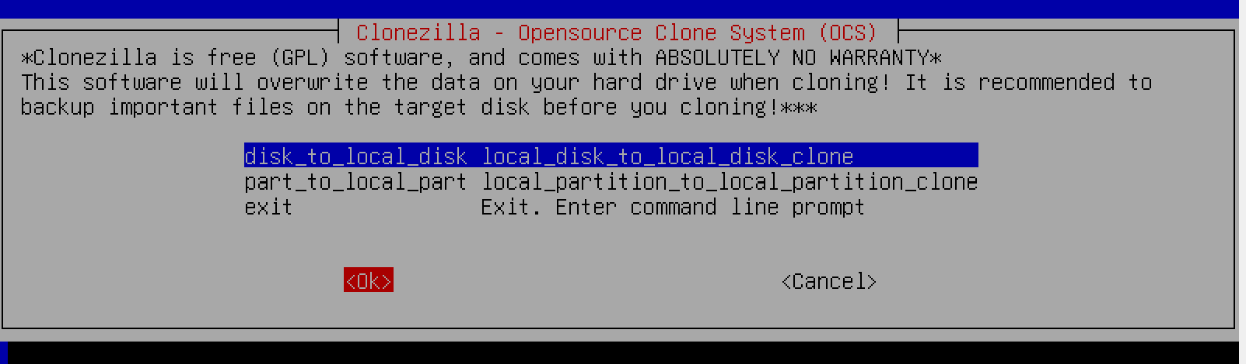
52

Slide 53
USING "CLONEZILLA LIVE" (continued)
Press the Enter key of the keyboard:
53

Slide 54
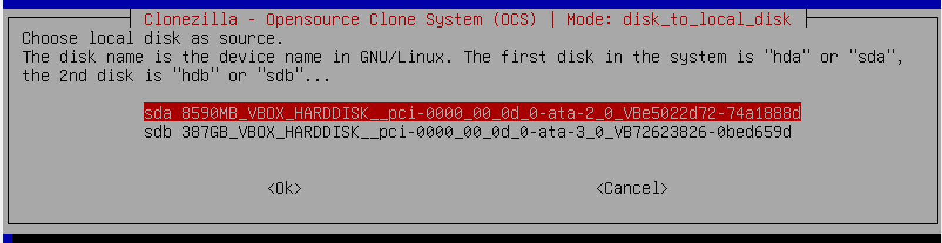
54

Slide 55
USING "CLONEZILLA LIVE" (continued)
Use the up and down arrow keys of the keyboard to highlight in red the "source" hard drive or "source" SSD that has the data and photo files that you wish to clone to the other hard drive or SSD. The "source" hard drive or SSD has to be equal or smaller than the "target" hard drive or SSD.
55

Slide 56
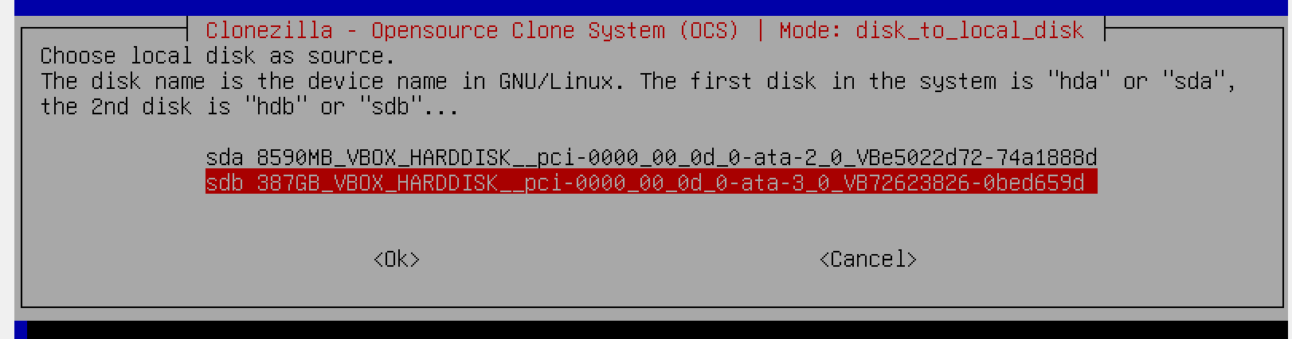
56

Slide 57
USING "CLONEZILLA LIVE" (continued)
Use the Tab key of the keyboard to turn the OK to red:
57

Slide 58
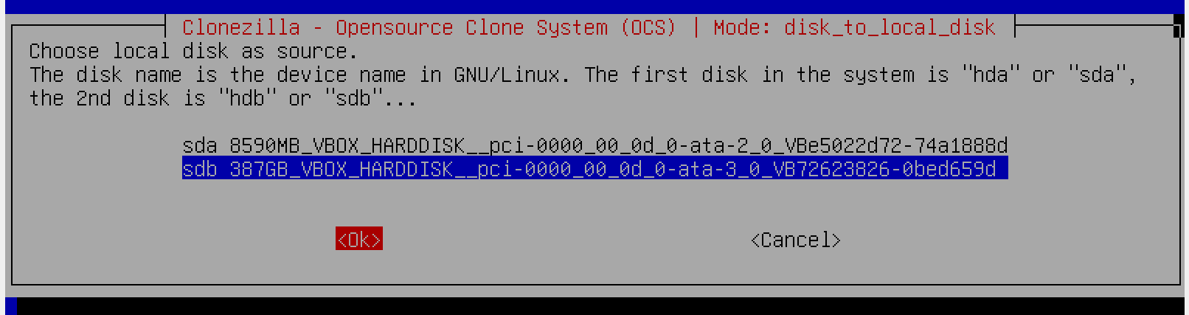
58

Slide 59
USING "CLONEZILLA LIVE" (continued)
Press the Enter key of the keyboard:
59

Slide 60
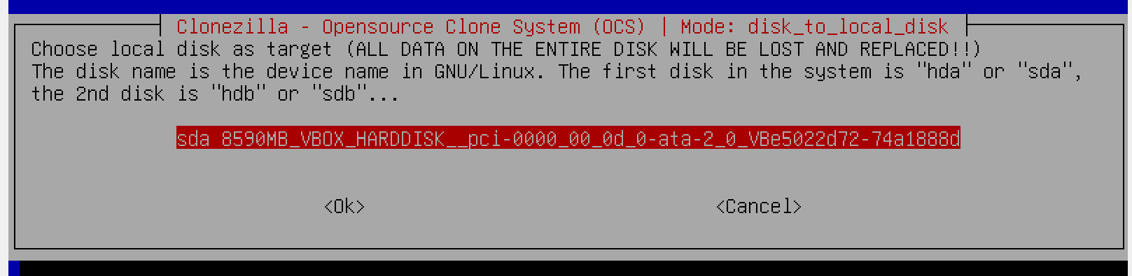
60

Slide 61
USING "CLONEZILLA LIVE" (continued)
If you are given a choice, use the up and down arrow keys of the keyboard to select the target hard drive or SSD where you want the files and folders on the source hard drive or SSD to be copied to:
61

Slide 62
62

Slide 63
USING "CLONEZILLA LIVE" (continued)
Use the Tab key of the keyboard to make the OK turn red:
63

Slide 64
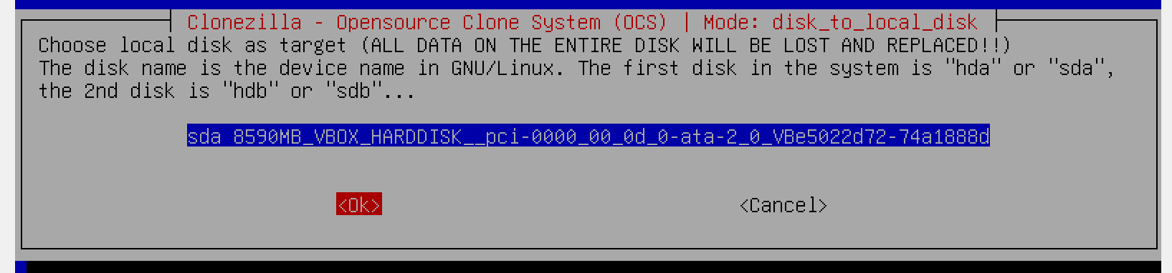
64

Slide 65
USING "CLONEZILLA LIVE" (continued)
Press the "Enter" key of the keyboard:
65

Slide 66
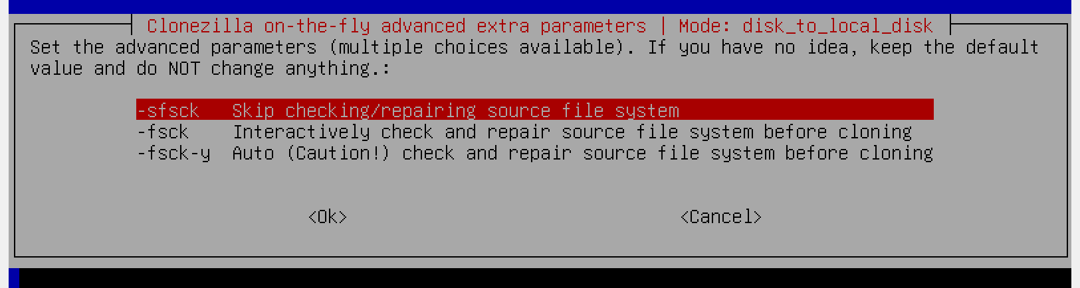
66

Slide 67
67

Slide 68
USING "CLONEZILLA LIVE" (continued)
Use the Tab key of the keyboard turn the "OK" to red:
68

Slide 69
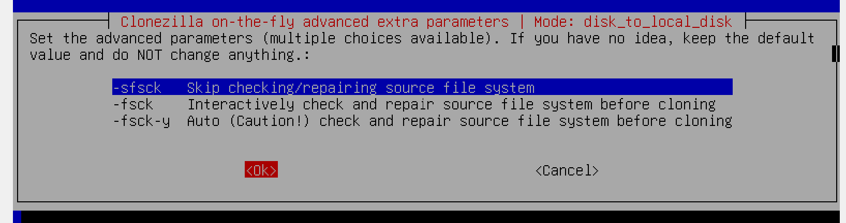
69

Slide 70
USING "CLONEZILLA LIVE" (continued)
Press the Enter key of the keyboard:
70

Slide 71
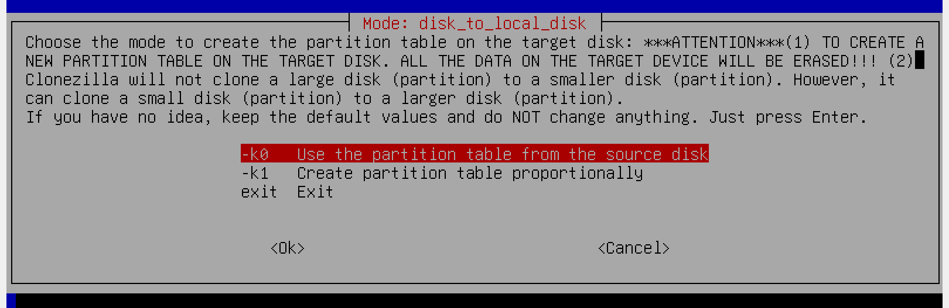
71

Slide 72
72

Slide 73
USING "CLONEZILLA LIVE" (continued)
Use the Tab key of the keyboard to turn the OK to red:
73

Slide 74
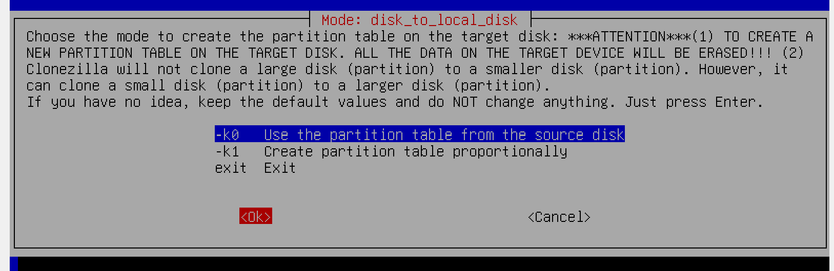
74

Slide 75
USING "CLONEZILLA LIVE" (continued)
Press the Enter key of the keyboard:
75

Slide 76
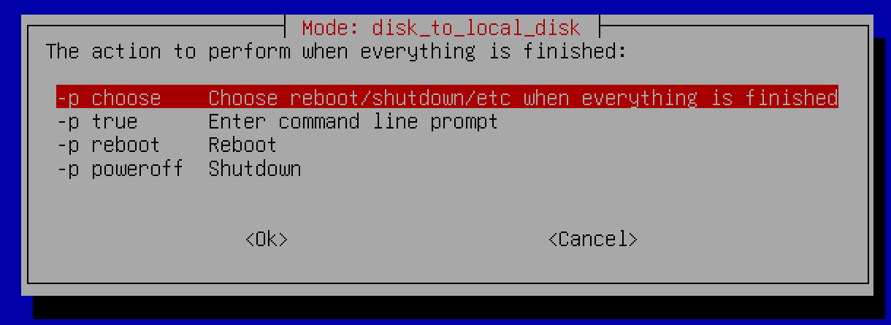
76

Slide 77
USING "CLONEZILLA LIVE" (continued)
Use the Tab key of the keyboard to turn the OK to red:
77

Slide 78
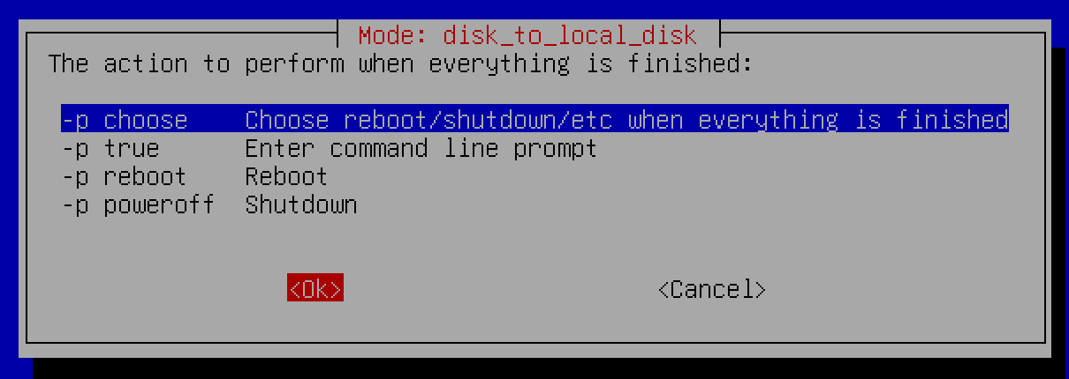
78

Slide 79
USING "CLONEZILLA LIVE" (continued)
Press the Enter key of the keyboard:
79

Slide 80
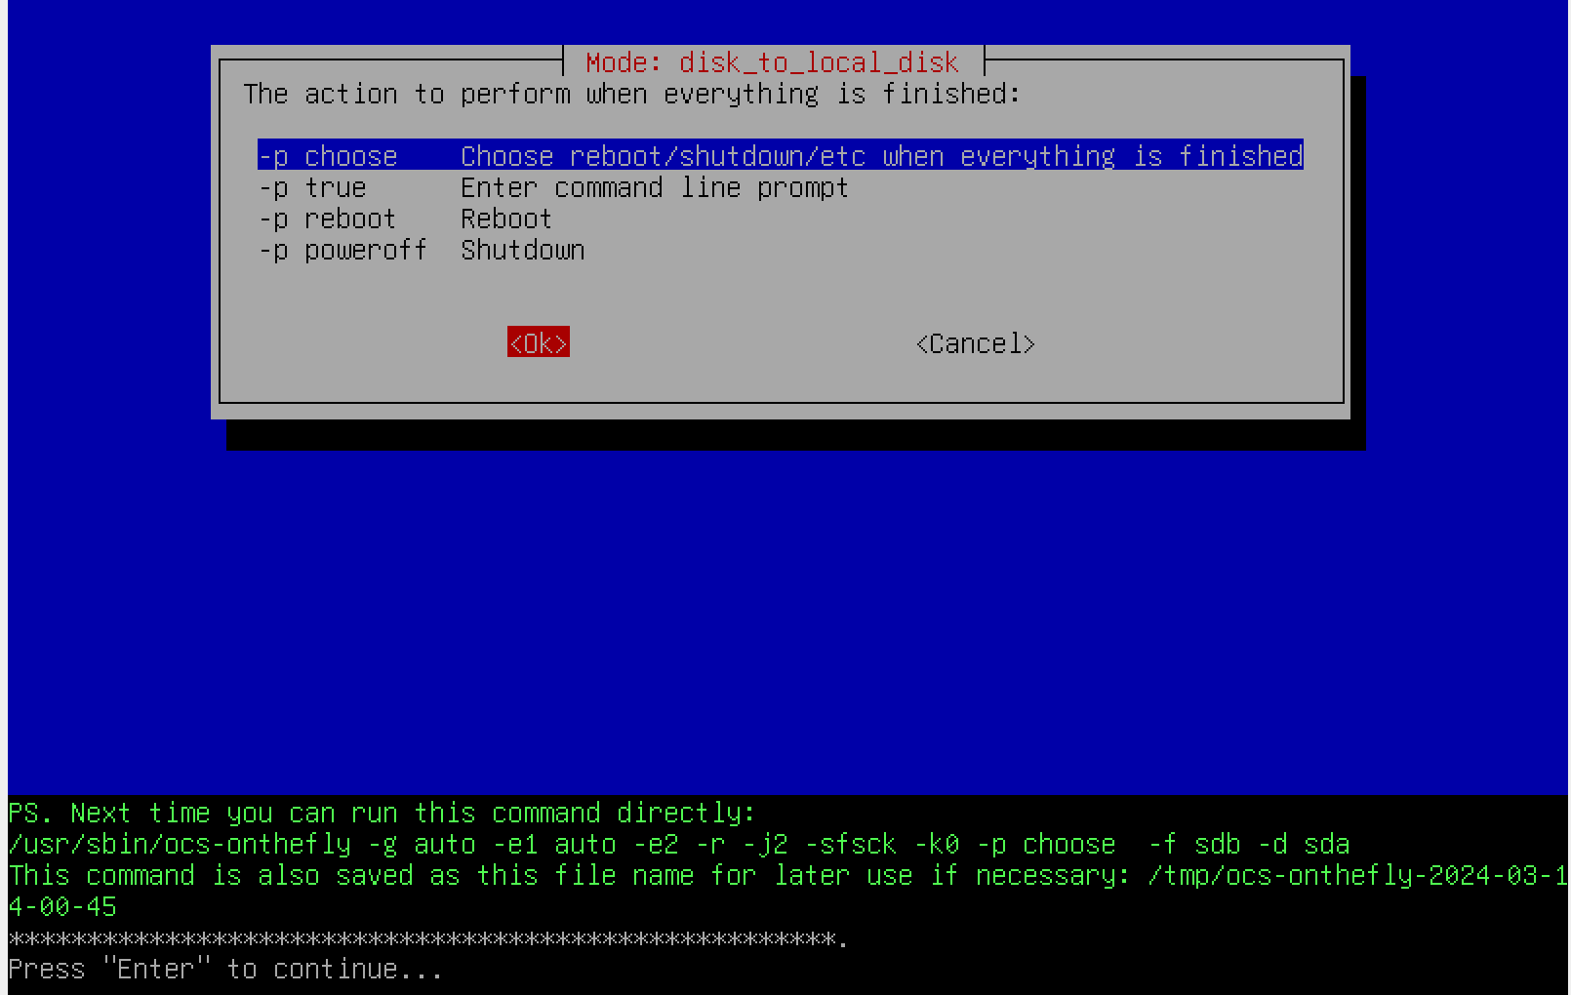
80

Slide 81
USING "CLONEZILLA LIVE" (continued)
Press the Enter key of the keyboard:
81

Slide 82
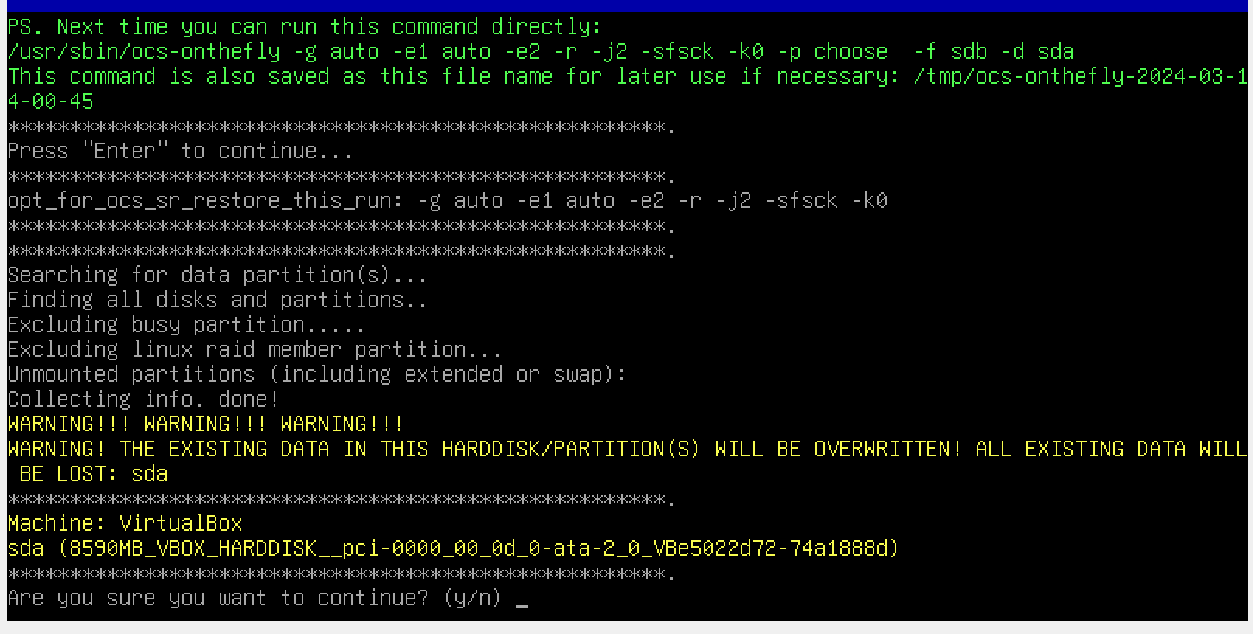
82

Slide 83
83

Slide 84
USING "CLONEZILLA LIVE" (continued)
Use the keyboard to type in a lower case y:
84

Slide 85
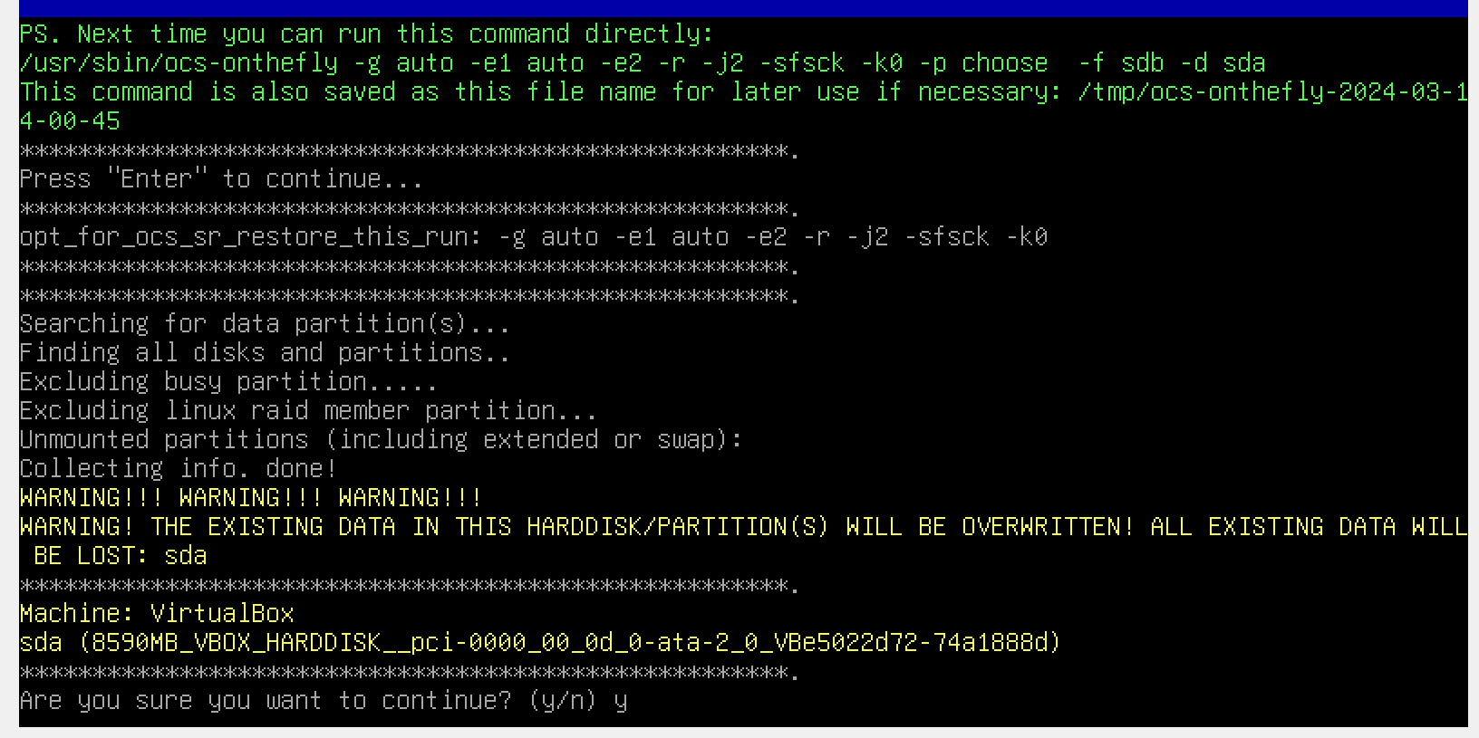
85

Slide 86
86

Slide 87
USING "CLONEZILLA LIVE" (continued)
Press the Enter key of the keyboard:
87

Slide 88
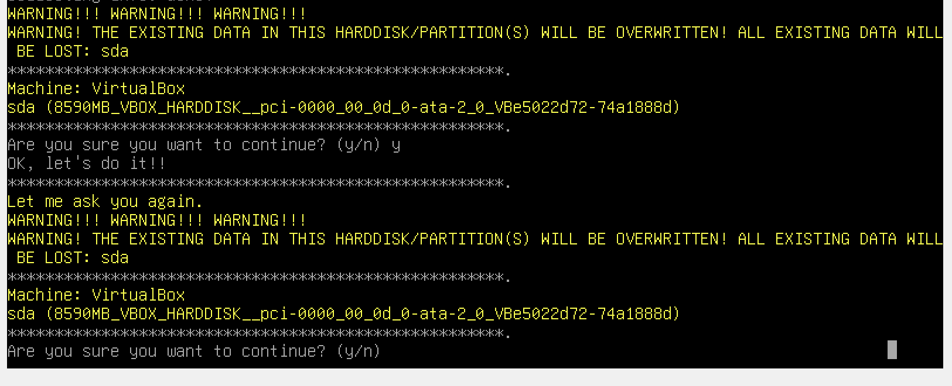
88

Slide 89
USING "CLONEZILLA LIVE" (continued)
Use the keyboard to type a lower case y
89

Slide 90
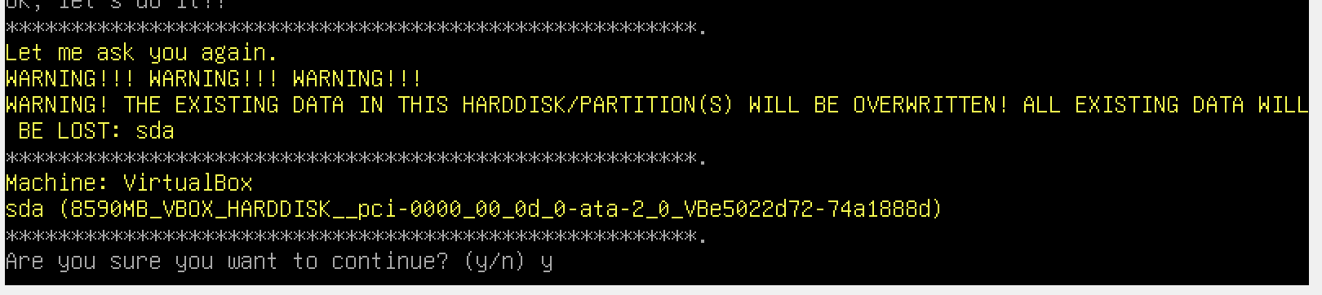
90

Slide 91
91

Slide 92
USING "CLONEZILLA LIVE" (continued)
Press the Enter key on the keyboard:
92

Slide 93
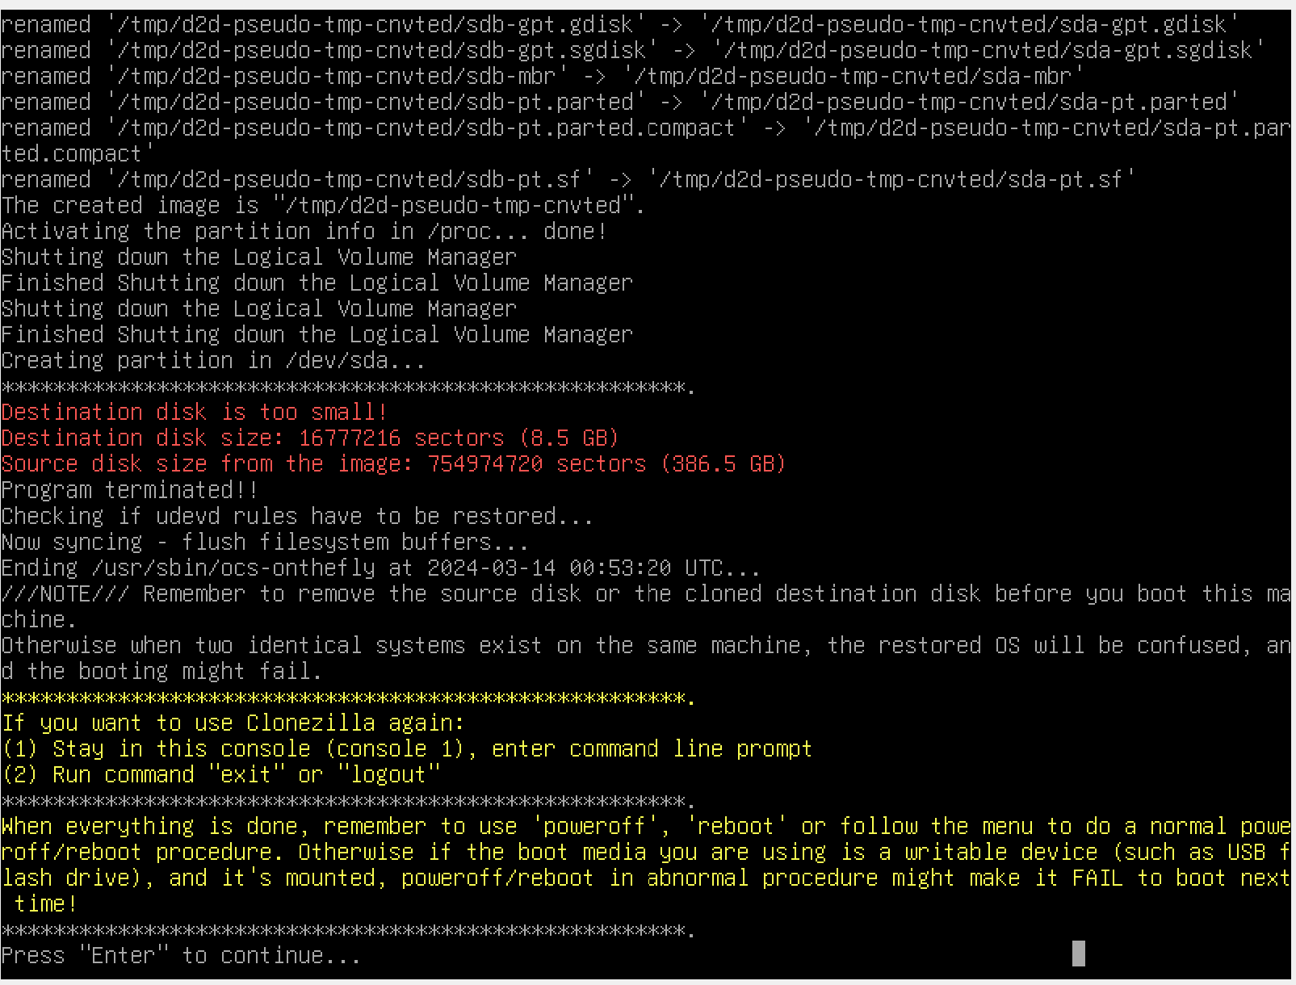
93

Slide 94
94

Slide 95
USING "CLONEZILLA LIVE" (continued)
Select the desired option. Then press the Enter key on the keyboard:
95

Slide 96
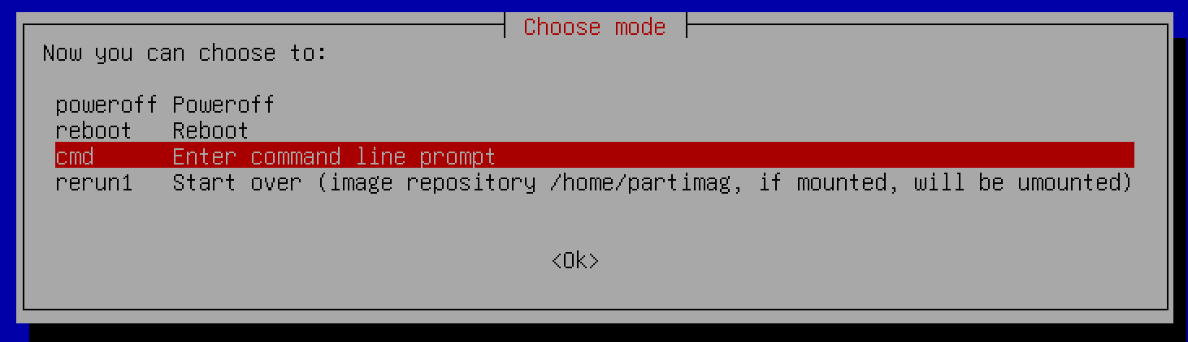
96

Slide 97
ADDITIONAL INFORMATION
https://www.tecmint.com/linux-centos-ubuntu-disk-cloning-backup-using-clonezilla/
97

