Slide 1



6B-"SIGNATURE COLLISIONS" FROM RUNNING BOTH A TARGET DRIVE AND A CLONED DRIVE ON THE SAME "WINDOWS 10" OR "WINDOWS 11" COMPUTER
1

Slide 2
Web location for this presentation:
http://aztcs.apcug.org
Click on "Meeting Notes"
or contact fchao2@yahoo.com
2

Slide 3
SUMMARY
If you clone any hard drive or Solid State Drive (SSD) with either Rescuezilla or Clonezilla and then you boot up any Windows.. computer with both the original source drive and the target clone drive attached, then you will get a "signature collision" with varying results that you have to plan for !
3

Slide 4
KEY INFORMATION
Signature Collisions are "Fatal" for Bootable "Windows 10" or "Windows 11" Drives
Signature Collisions are Recoverable for Non-Bootable Drives in "Windows 10" or "Windows 11" Computers But After You Fix the Signature Collision, "Windows.." Will Reassign The Drive Letter of the Original Data Drive To The Newly-Cloned Target Drive
4

Slide 5
KEY INFORMATION (continued)
Signature Collisions Do Not Occur in "..Linux.." Computers
5

Slide 6
SIGNATURE COLLISION ARE "FATAL" FOR BOOTABLE "WINDOWS.." DRIVES !!
If you use Rescuezilla or Clonezilla to clone a bootable Windows 10 or 11 drive (one that has a C: partition) to a target drive, and then you boot up or reboot the computer with both the original source drive and the target clone drive attached to the computer, then both drives will become corrupted (and you will have to re-install "Windows..")
6

Slide 7
SIGNATURE COLLISIONS ARE "FATAL" FOR BOOTABLE "WINDOWS.." DRIVES !!
If you use Rescuezilla or Clonezilla to clone a bootable Windows 10 or 11 drive (one that has a C: partition) to a target drive, and then you boot up or reboot the computer with both the original source drive and the target clone drive attached to the computer neither the original drive nor the cloned target drive will be able to boot up into Windows 10 or 11 (and you will have to re-install "Windows.." ! )
7

Slide 8
SIGNATURE COLLISIONS ARE "FATAL" FOR BOOTABLE "WINDOWS.." DRIVES !!
When you attach either the original source bootable drive to a computer and then boot up or reboot the computer OR when you attach either the target cloned bootable drive to a computer and then boot up or reboot the computer:
8

Slide 9
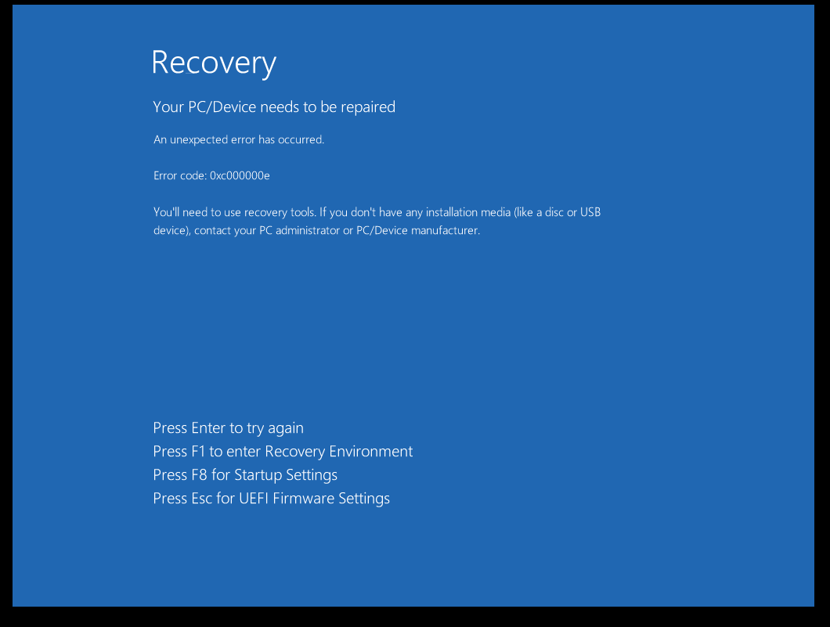
9

Slide 10
10

Slide 11
SIGNATURE COLLISIONS FOR NON-BOOTABLE DATA DRIVES ARE FIXABLE
If you use Rescuezilla or Clonezilla to clone a non-bootable data drive (one that does not have a C: drive partition) that resides in a Windows 10 or 11 to create a to a target drive that is an exact clone of the non-bootable data drive, and then you boot up or reboot the computer with both the original source data-only drive and the target cloned drive, then Windows 10 or 11 will refuse to display the target clone drive as having a signature clash which you can fix.
11

Slide 12
SIGNATURE COLLISIONS FOR NON-BOOTABLE DATA DRIVES ARE FIXABLE
After you fix the signature clash, Windows 10 or Windows 11, will sometimes assign the drive letter of the original data-only drive to the target clone drive.
12

Slide 13
SIGNATURE COLLISIONS FOR NON-BOOTABLE DATA DRIVES ARE FIXABLE (continued)
If you boot up a "Windows.." computer that is attached to both the original source non-bootable data-only hard drive and a target clone drive that has been created by Rescuezilla or "Clonezilla Live", you will see the following in "Disk Management":
13

Slide 14
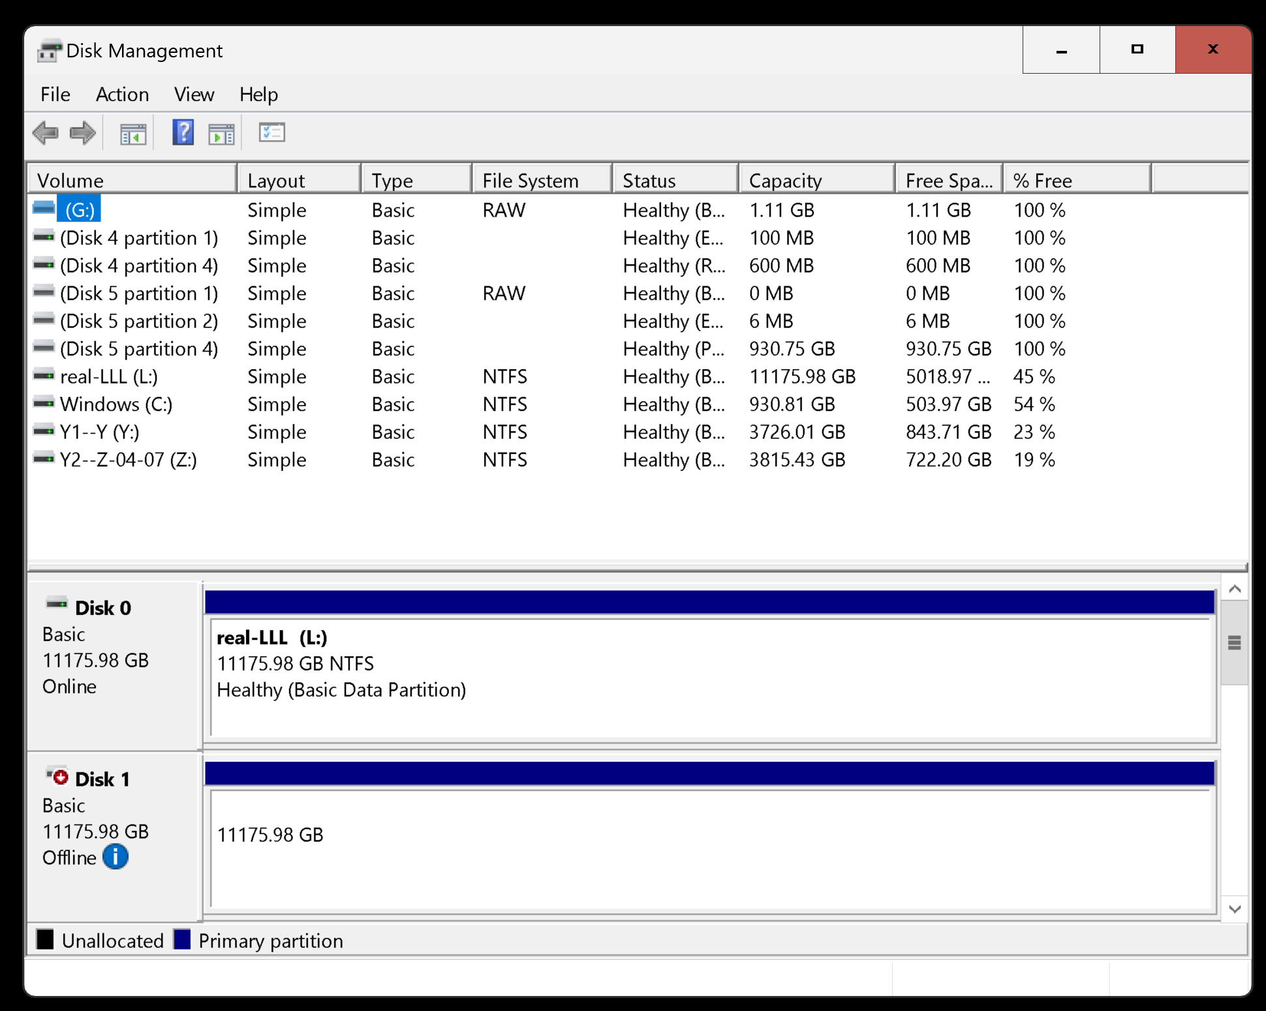
14

Slide 15
15

Slide 16
16

Slide 17
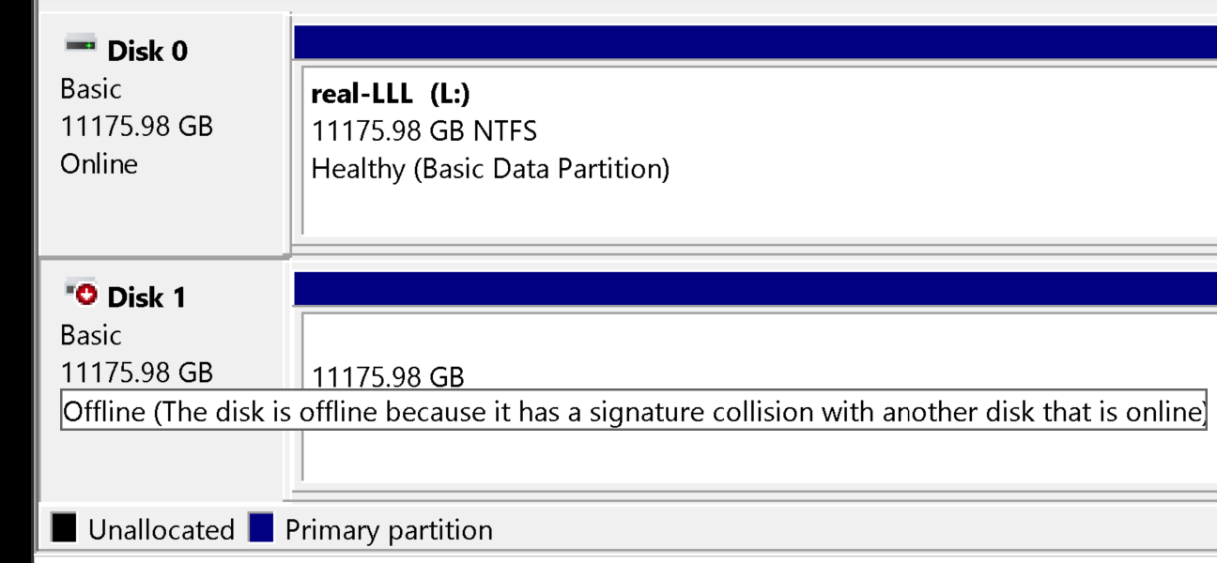
17

Slide 18
SIGNATURE COLLISIONS FOR NON-BOOTABLE DATA DRIVES ARE FIXABLE (continued)
To fix a drive that is offline, use the RIGHT mouse button to click on it. Then click on "..online" in the pop-up menu. This will assign a new "Signature" to the drive and put it online with a drive letter:
18

Slide 19
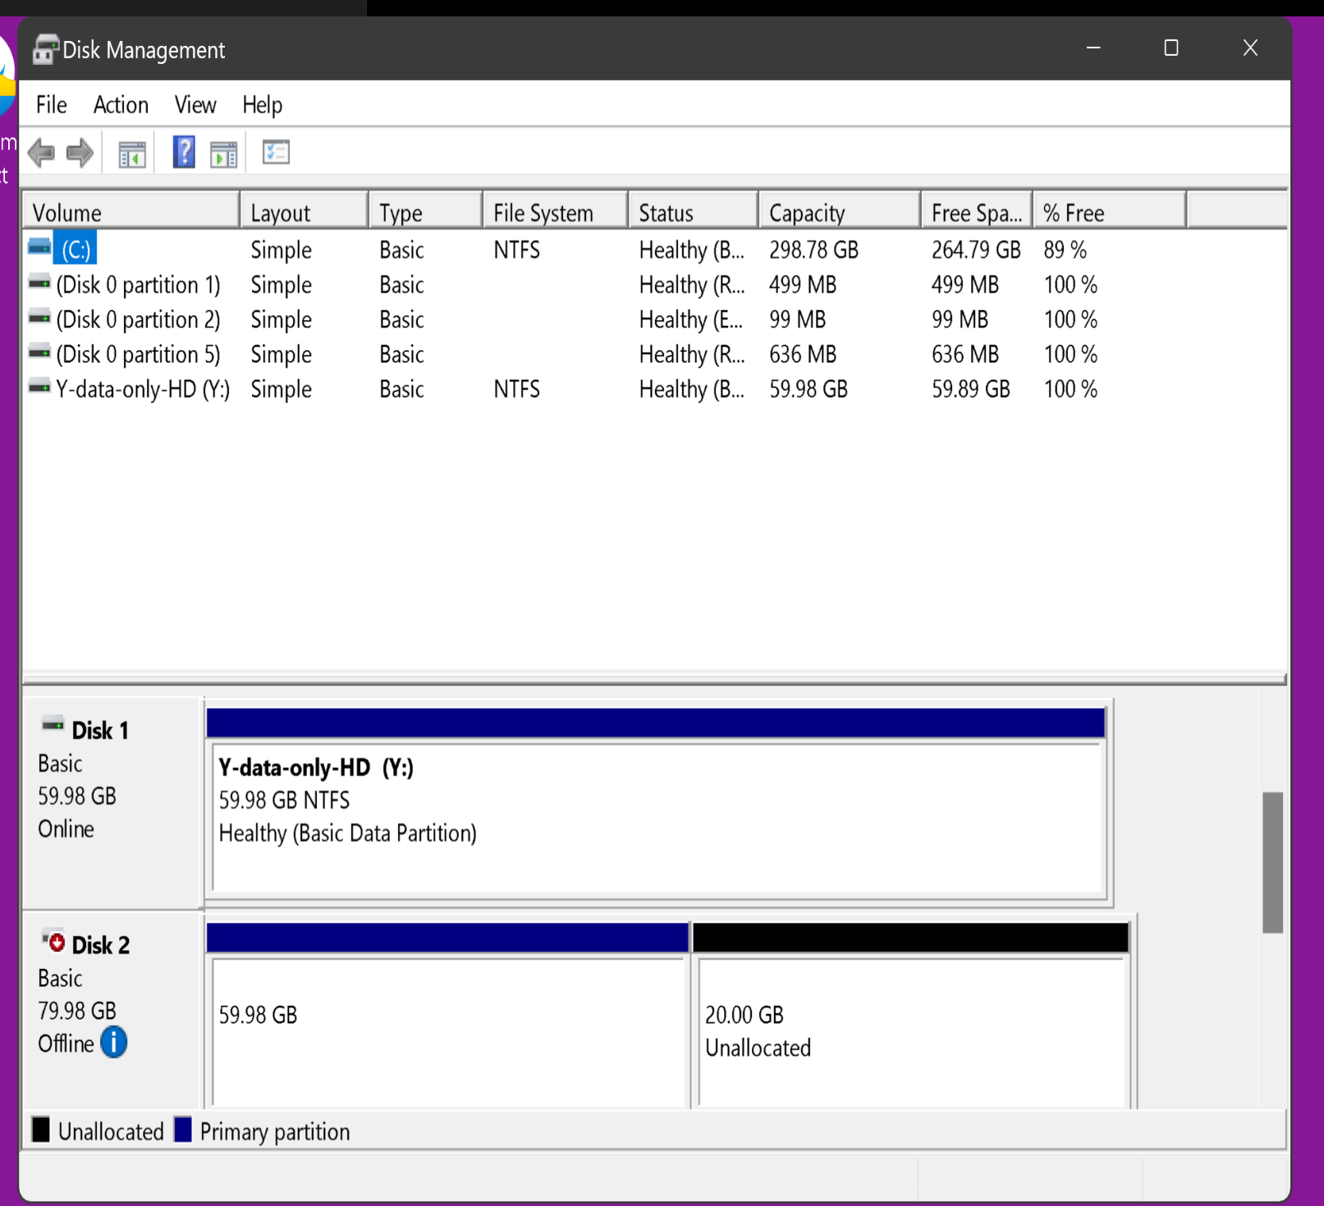
19

Slide 20
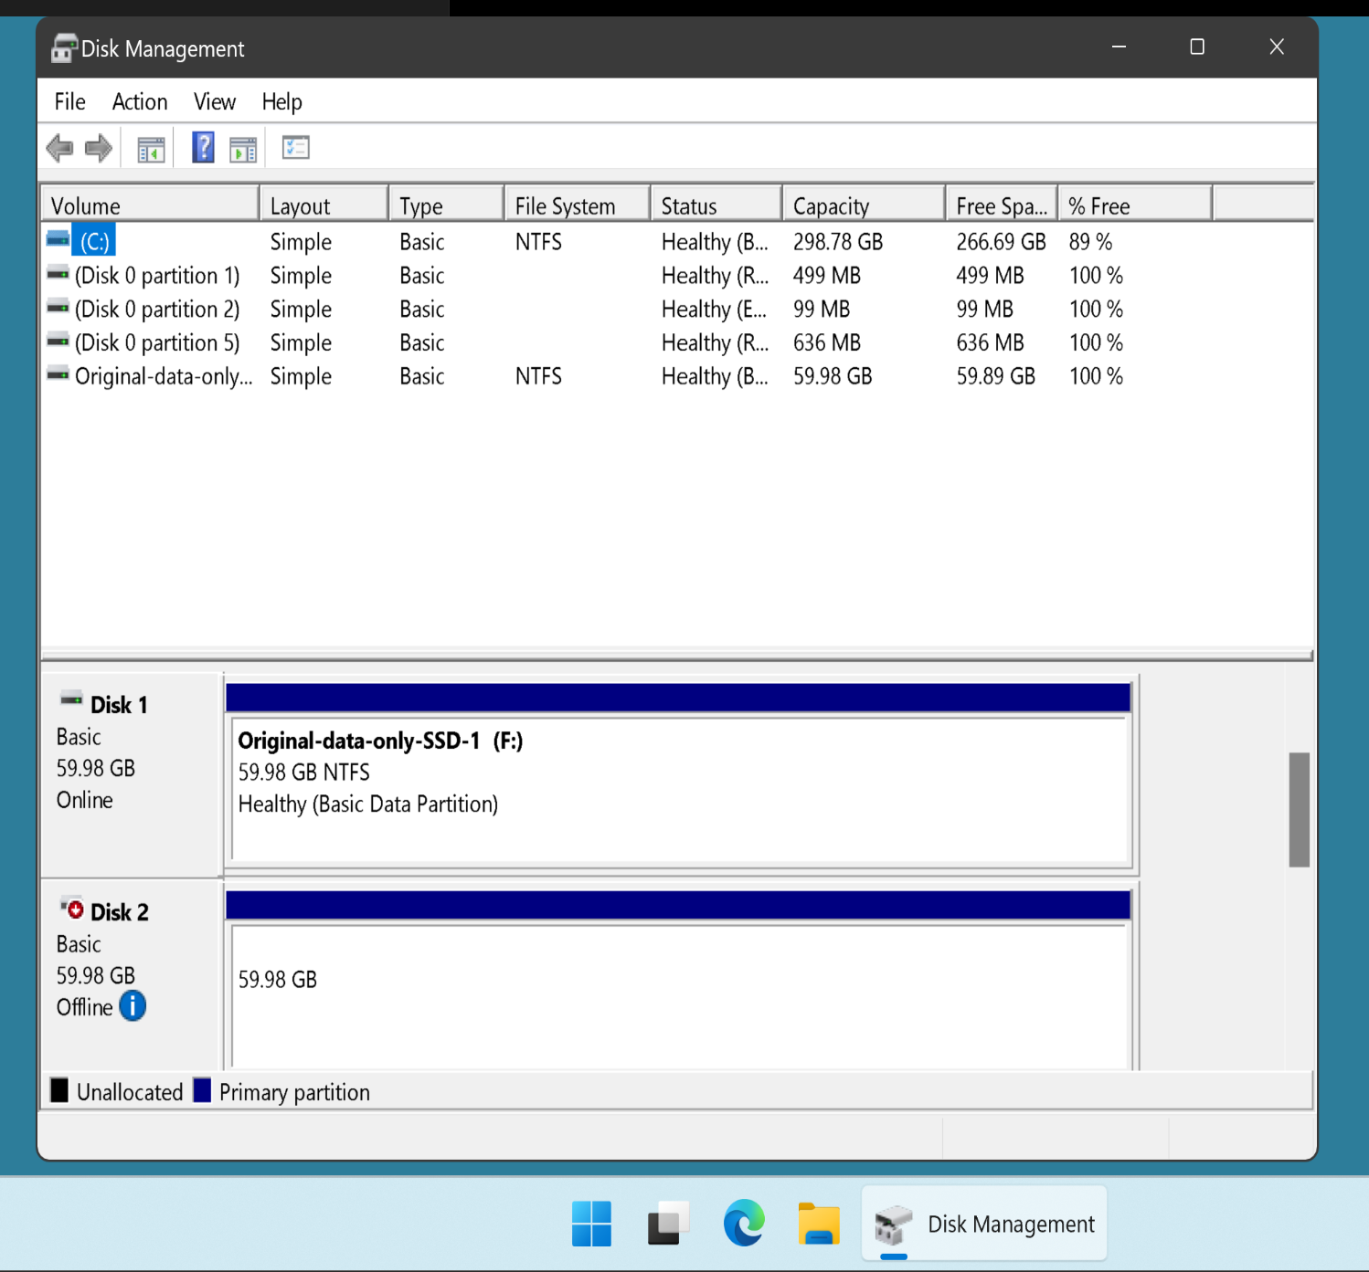
20

Slide 21
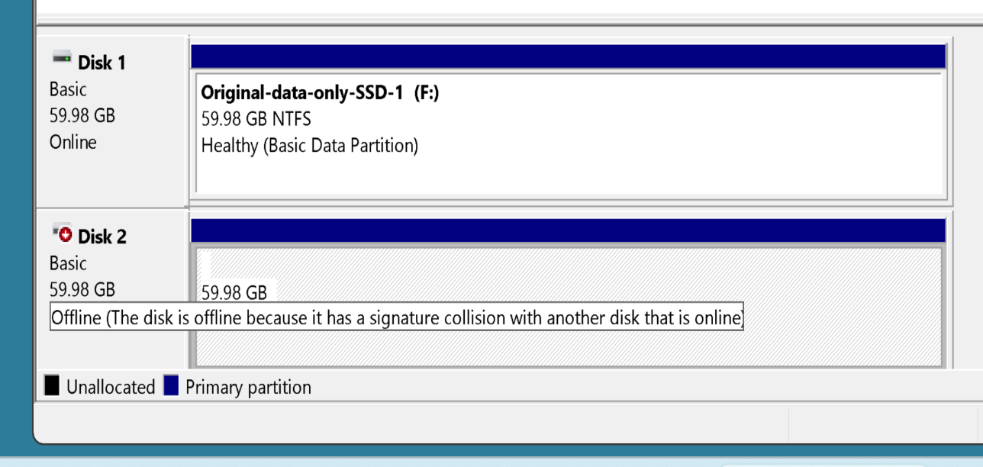
21

Slide 22
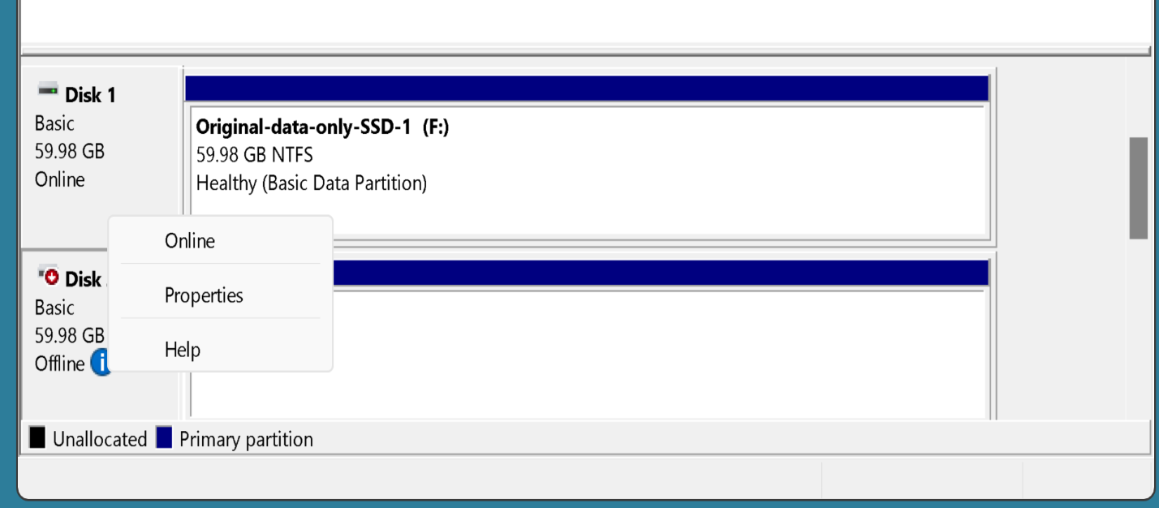
22

Slide 23
23

Slide 24
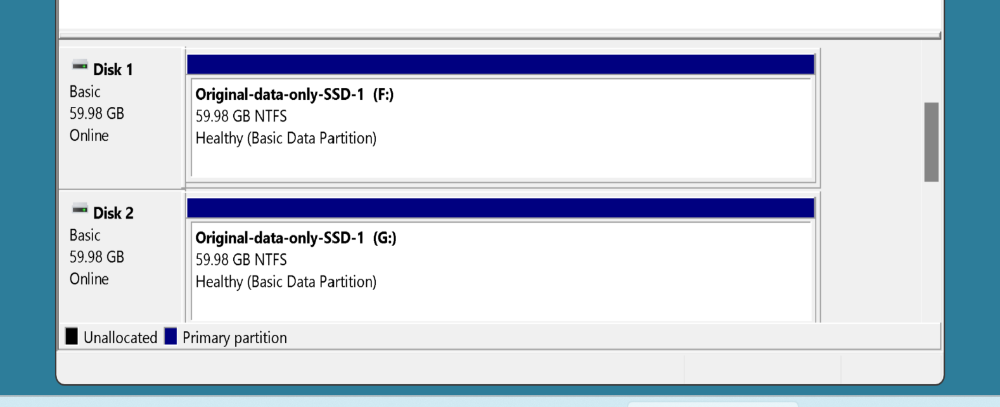
24

Slide 25
25

Slide 26
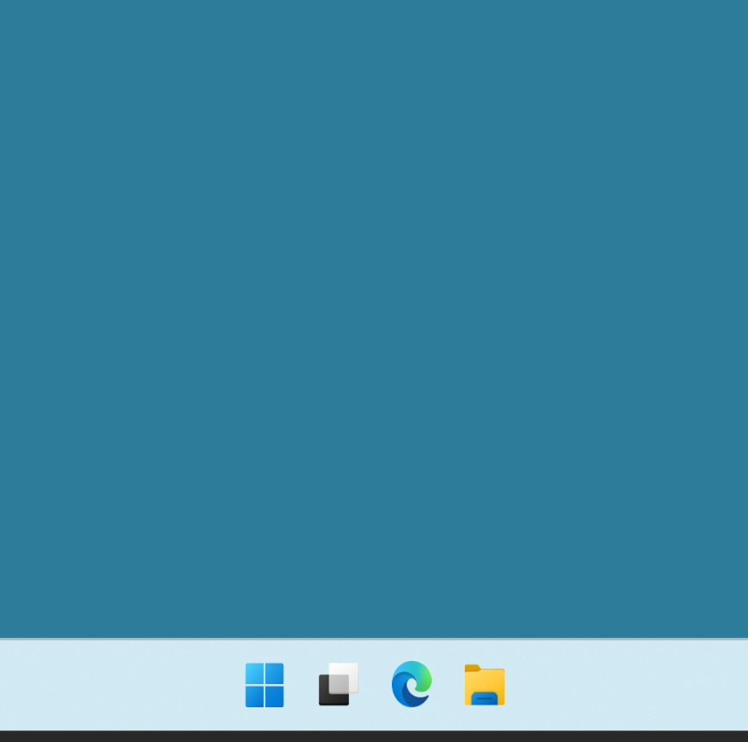
26

Slide 27
27

Slide 28
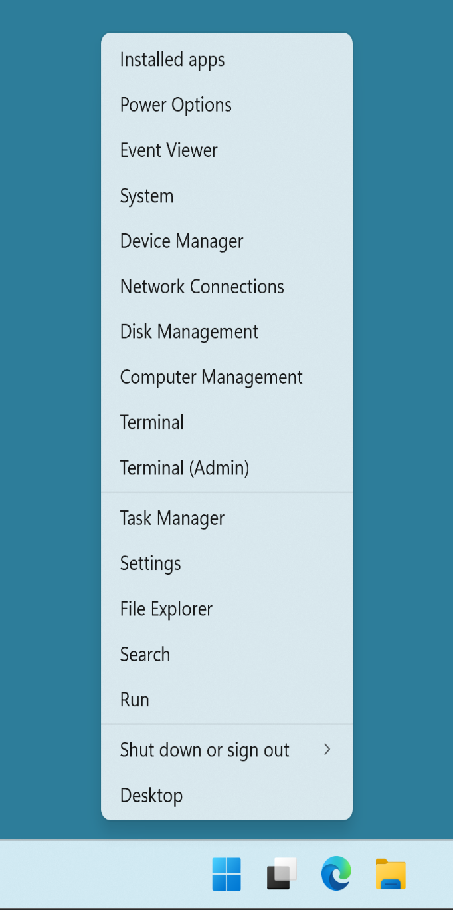
28

Slide 29
29

Slide 30
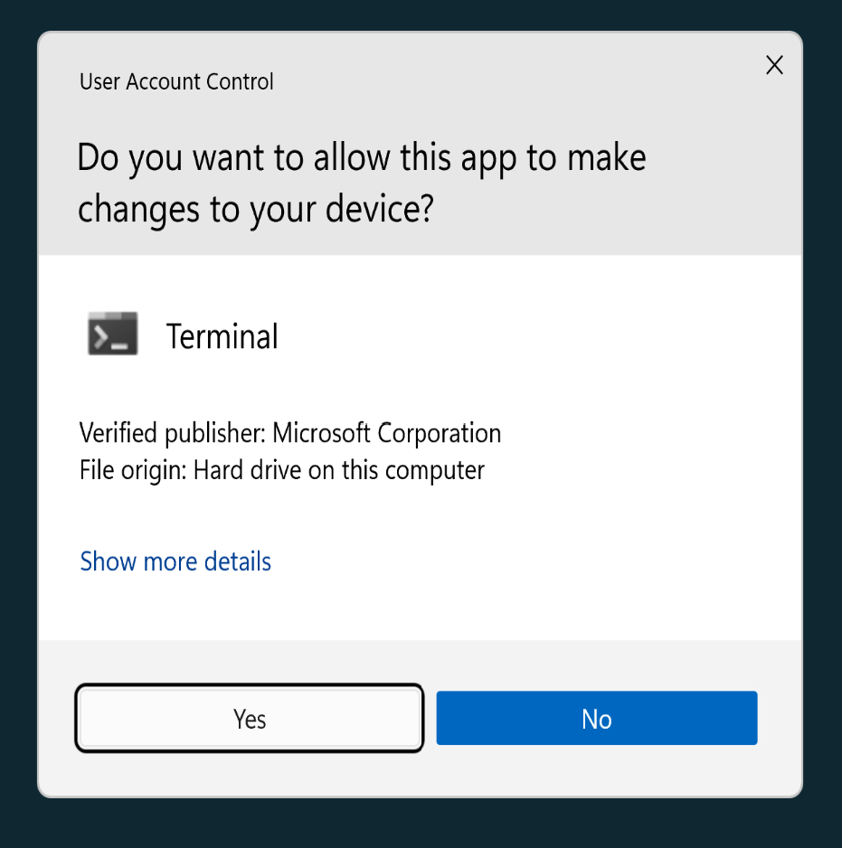
30

Slide 31
31

Slide 32
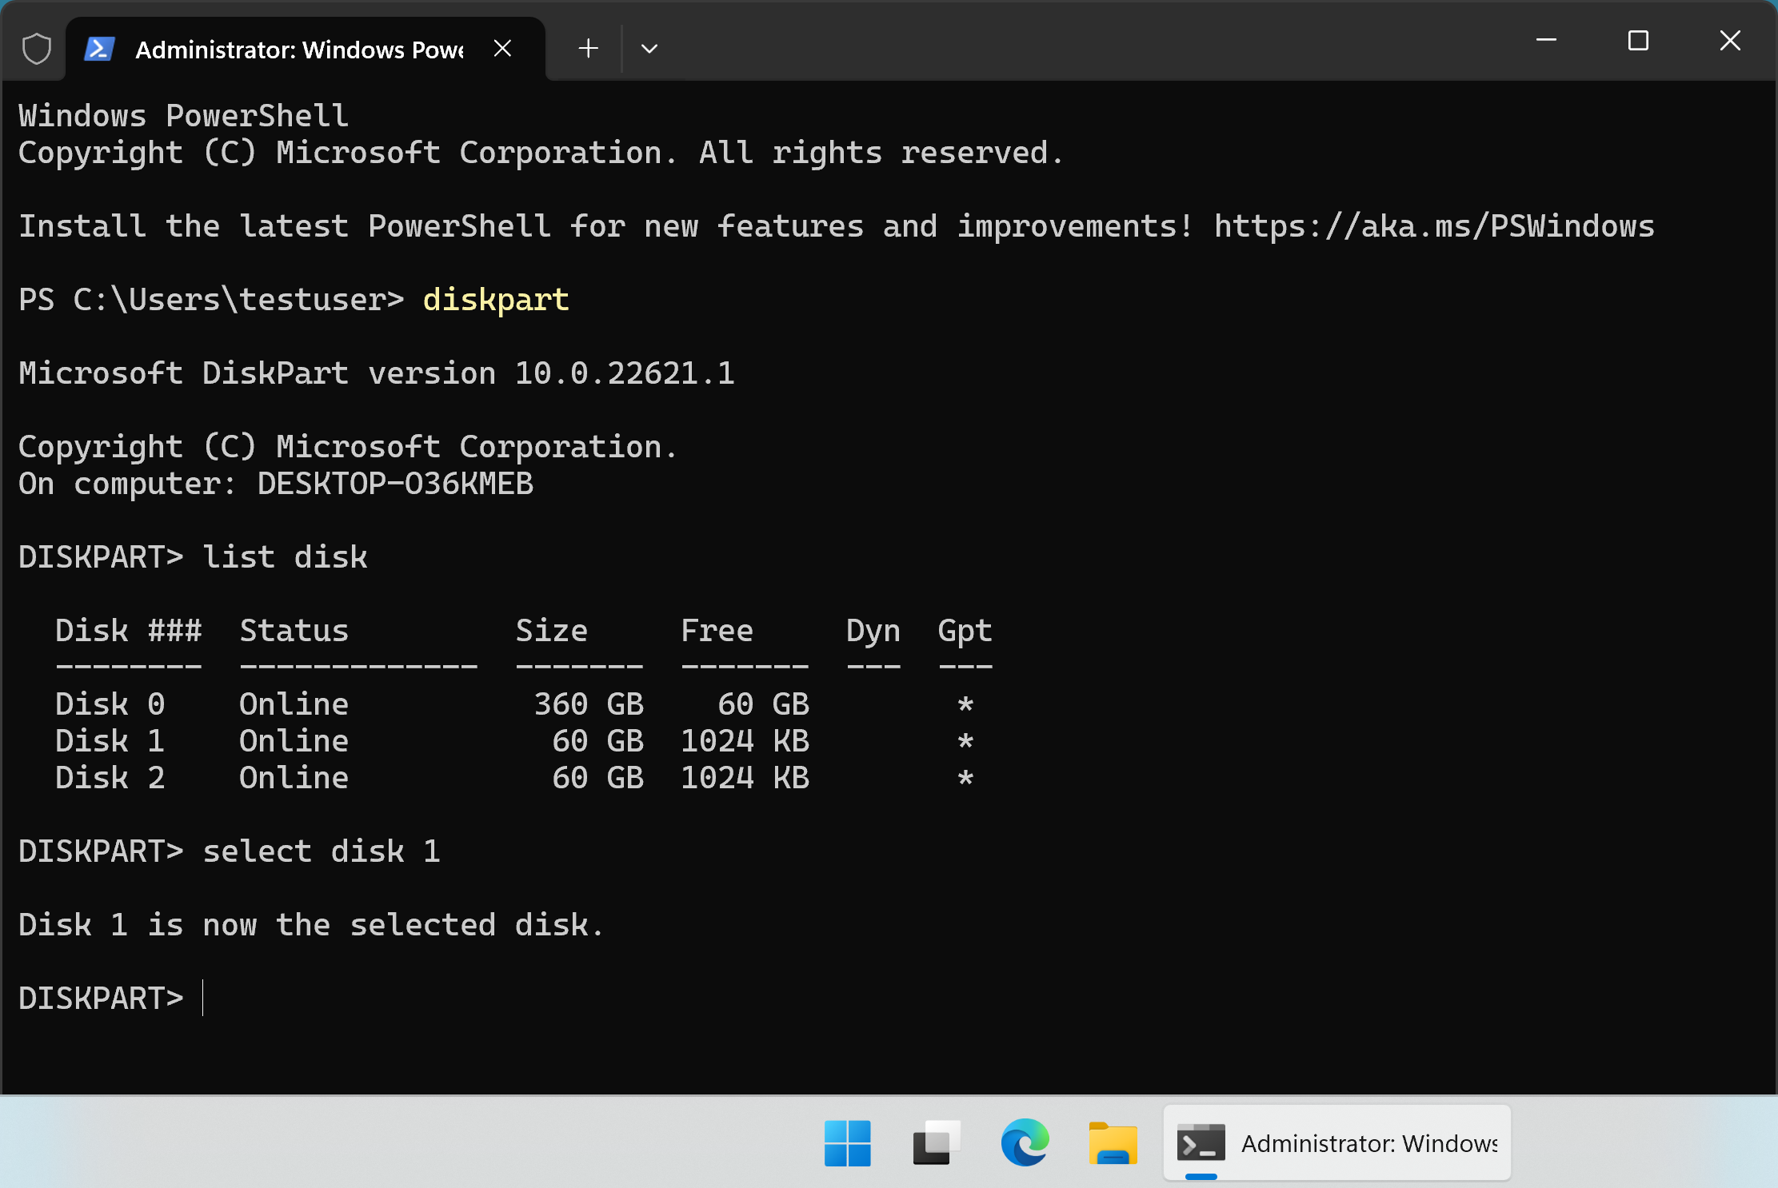
32

Slide 33
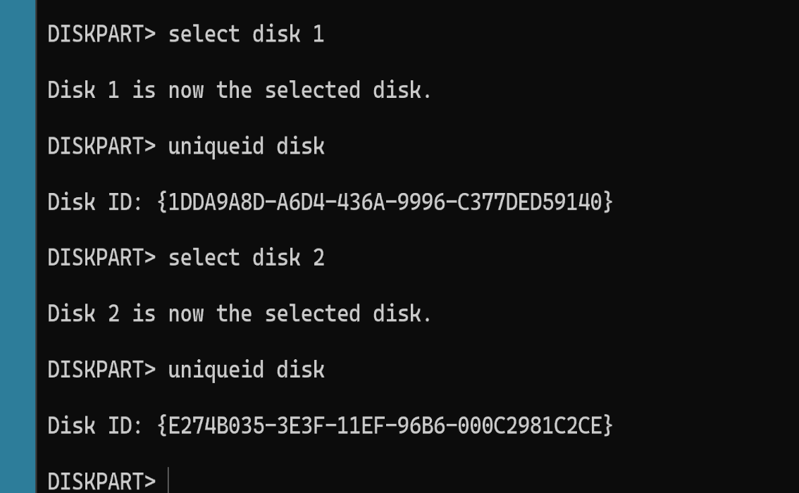
33

Slide 34
SIGNATURE COLLISION SOMETIMES RESULTS IN A SWITCH OF THE DRIVE LETTER FOR DATA-ONLY HARD DRIVES
Sometimes but not, after you use "Rescuezilla" to clone a non-bootable data-only hard drive and you get the previously-mentioned "signature clash", and you fix it as mentioned previously, the target clone drive will take on the original drive letter(s) of the original source clone drive, after the cloning process:
34

Slide 35
SIGNATURE COLLISION SOMETIMES RESULTS IN A SWITCH OF THE DRIVE LETTERS FOR DATA-ONLY HARD DRIVES (continued)
This only happens in "Windows.." computers since Linux computers do not use drive letters.
35

Slide 36
SIGNATURE COLLISION SOMETIMES RESULTS IN A SWITCH OF THE DRIVE LETTERS FOR DATA-ONLY HARD DRIVES (continued)
This only happens in "Windows.." computers randomly and not consistently: Sometimes the cloned target drive gets a different drive letter after you bring it online from a signature collision and sometimes the cloned target drive gets the drive letter of the original data-only drive.
36

Slide 37
SIGNATURE COLLISION SOMETIMES RESULTS IN A SWITCH OF THE DRIVE LETTER FOR DATA-ONLY HARD DRIVES (continued)
Sometimes the cloned target drive gets a different drive letter after you bring it online from a signature collision and sometimes the cloned target drive gets as the drive letter of the original data-only drive.
37

Slide 38
SIGNATURE COLLISION SOMETIMES RESULTS IN A SWITCH OF THE DRIVE LETTER FOR DATA-ONLY HARD DRIVES (continued)
This is what happens when the cloned target drive the same drive letter of the original data-only drive:
38

Slide 39
SIGNATURE COLLISION SOMETIMES RESULTS IN A SWITCH OF THE DRIVE LETTER FOR DATA-ONLY HARD DRIVES (continued)
PRIOR TO CLONING OF A DATA-ONLY DRIVE: SATA PORT #1 --> DATA-ONLY DRIVE 1 HAS DRIVE LETTER L: IN "WINDOWS 10" OR "WINDOWS 11" SATA PORT #2 --> FUTURE CLONE TARGET DATA-ONLY DRIVE EITHER HAS NO DRIVE LETTER OR HAS SOME OTHER DRIVE LETTER
39

Slide 40
SIGNATURE COLLISION SOMETIMES RESULTS IN A SWITCH OF THE DRIVE LETTER FOR DATA-ONLY HARD DRIVES (continued)
AFTER CLONING OF A DATA-ONLY DRIVE: SATA PORT #1 --> ORIGINAL DATA-ONLY DRIVE 1 IS NOW OFFLINE WITH A DIFFERENT DRIVE LETTER AFTER YOU FIX THE SIGNATURE COLLISION SATA PORT #2 --> NEWLY CLONED DATA-ONLY DRIVE IS NOW ONLINE AS DRIVE L: IN "WINDOWS 10" OR "WINDOWS 11"
40

Slide 41
41

