Slide 1



6A-USING "RESCUEZILLA"
1

Slide 2
Web location for this presentation:
http://aztcs.apcug.org
Click on "Meeting Notes"
or contact fchao2@yahoo.com
2

Slide 3
SUMMARY
Here are the actual steps for using the free "Rescuezilla" to clone or image an existing hard drive or solid state drive (SSD).
3

Slide 4
BASIC CONFIGURATION FOR RESCUEZILLA OR CLONEZILLA
1) Source hard drive or SSD (for the clone or image process) is attached to the computer by means of M.2, USB, or SATA
2) Target hard drive or SSD is attached to the computer by means of USB
3) Bootable Rescuezilla device or Clonezilla device is attached to the computer as a USB flash drive, a USB hard drive, a USB SSD, a DVD-R, or a CD-R
4

Slide 5
USING "RESCUEZILLA"
Determine the manufacturer's serial numbers for the "source drive" and the "target drive"
Attach the bootable "Rescuezilla" USB thumb drive or CD or DVD to the computer (and make sure that the bootable device is operational)
5

Slide 6
USING "RESCUEZILLA" (continued)
Attach the "target" hard drive or Solid State Drive or USB flash drive to the computer (and make sure that this "target" device is operational)
6

Slide 7
USING "RESCUEZILLA" (continued)
If the computer is powered up, shut it down. (Many computers will not boot up to a bootable flash drive or a bootable CD or DVD if you do a restart from an operating system that is running.)
7

Slide 8
USING "RESCUEZILLA" (continued)
Power up the computer
Press the key(s) needed to get into the UEFI/BIOS/firmware setup screen for selecting the bootable device
8

Slide 9
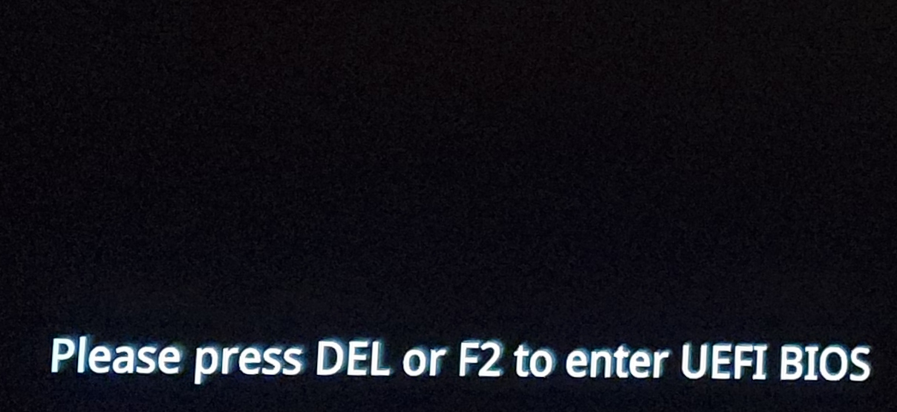
9

Slide 10
USING "RESCUEZILLA" (continued)
Use the mouse or keyboard to highlight the bootable "Rescuezilla" device
Then press the Enter key of the keyboard
10

Slide 11
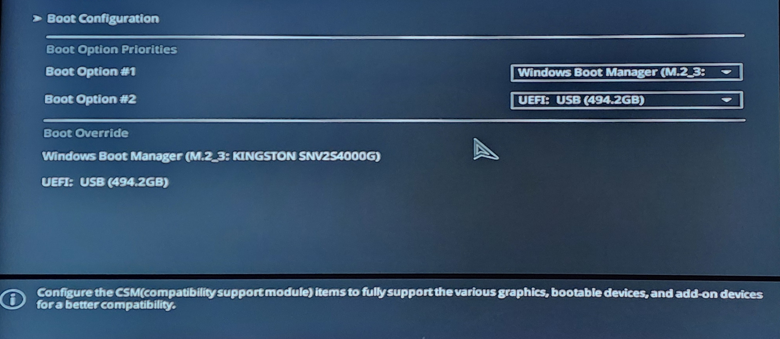
11

Slide 12
12

Slide 13
13

Slide 14
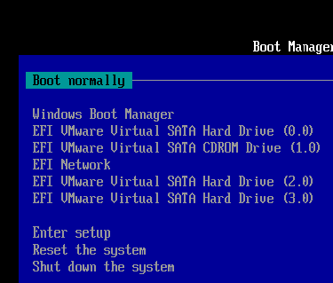
14

Slide 15
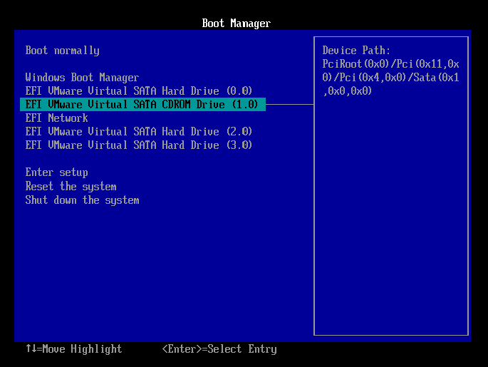
15

Slide 16
16

Slide 17
USING "RESCUEZILLA" (continued)
You will see a black rectangle while "RESCUEZILLA" scans the computer for hard drives and Solid State Drives (SSDs)
17

Slide 18
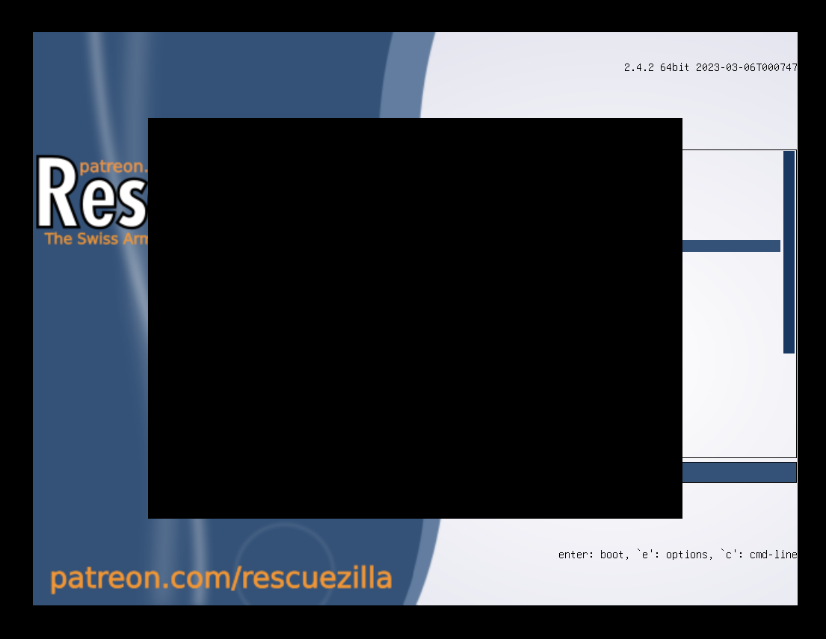
18

Slide 19
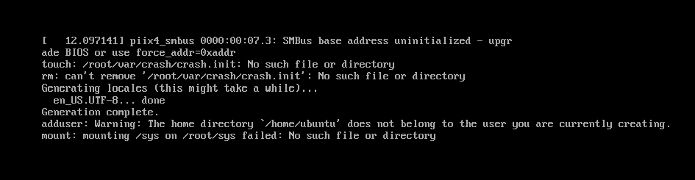
19

Slide 20
20

Slide 21
21

Slide 22
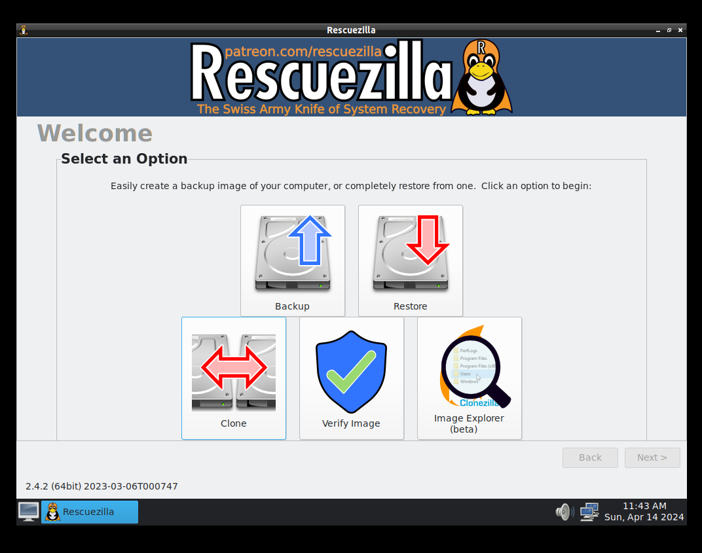
22

Slide 23
USING "RESCUEZILLA" (continued)
The "Backup" button is for creating an "image" of a drive or a drive partition:
23

Slide 24
24

Slide 25
USING "RESCUEZILLA" (continued)
The "Clone" button is for cloning an existing drive to make an exact copy of it:
25

Slide 26
26

Slide 27
USING "RESCUEZILLA" (continued)
The "Restore" button is for restoring from an existing, previously-made "image" of a drive or a drive partition:
27

Slide 28
28

Slide 29
USING "RESCUEZILLA" (continued)
After you click on one of the three options, "Rescuezilla" will scan the computer to make a list of all of the hard drives, Solid State Drives, and USB thumb drives that are connected to the computer:
29

Slide 30
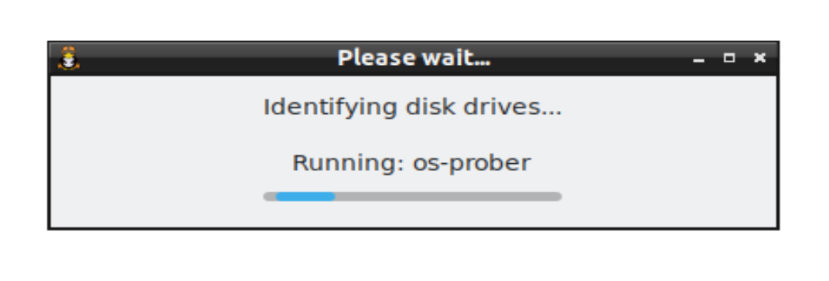
30

Slide 31
USING "RESCUEZILLA" (continued)
Let's assume that you clicked on "Clone":
31

Slide 32
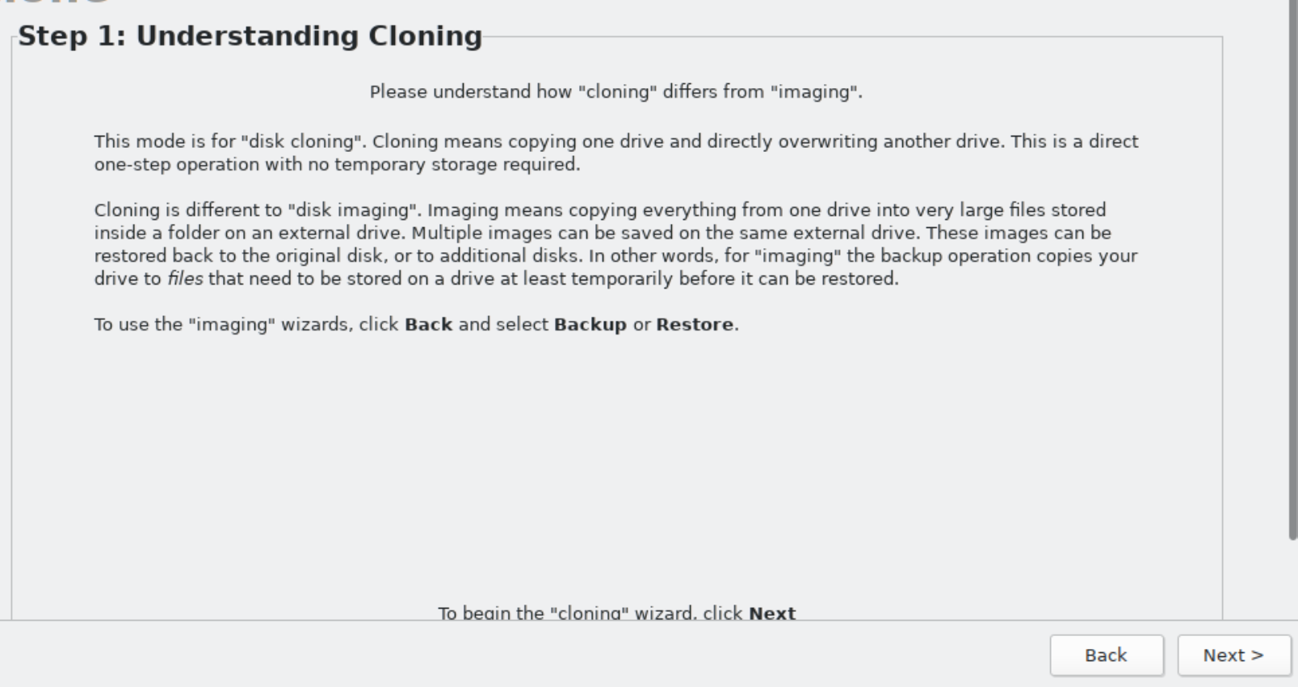
32

Slide 33
33

Slide 34
USING "RESCUEZILLA" (continued)
Click on the "Next" button:
34

Slide 35
35

Slide 36
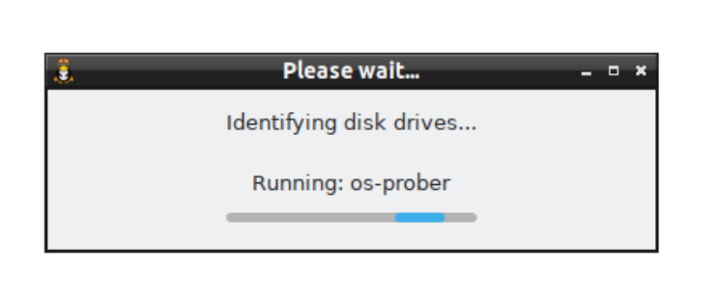
36

Slide 37
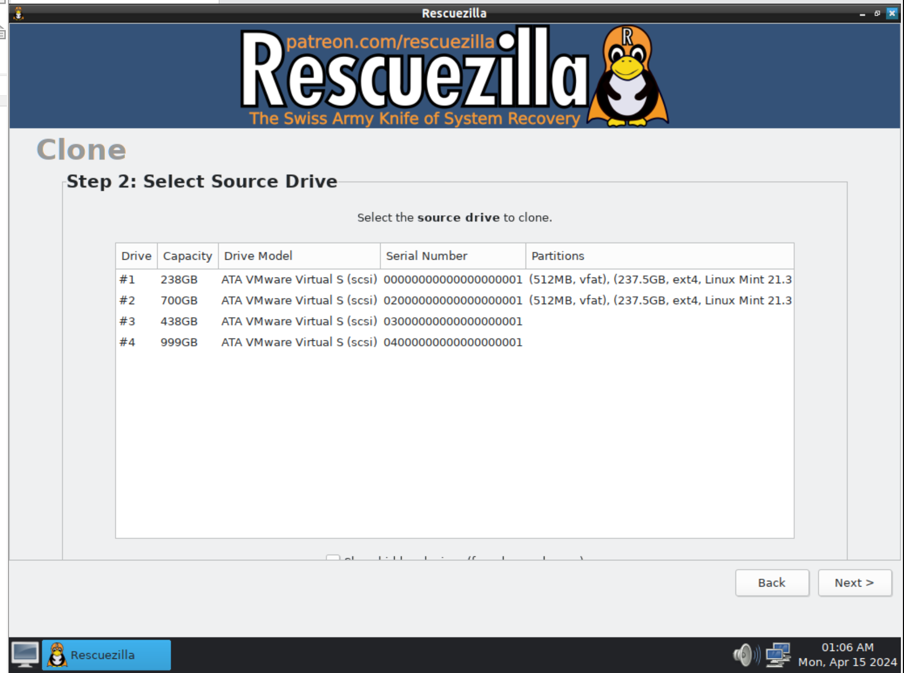
37

Slide 38
USING "RESCUEZILLA" (continued)
Click on the "source drive", = the hard drive, or Solid State Drive, or the flash drive that you wish to make a clone of. Locate the manufacturer's serial number of the "source drive" that wish to clone and check the size of the "source drive". Do not guess !!
38

Slide 39
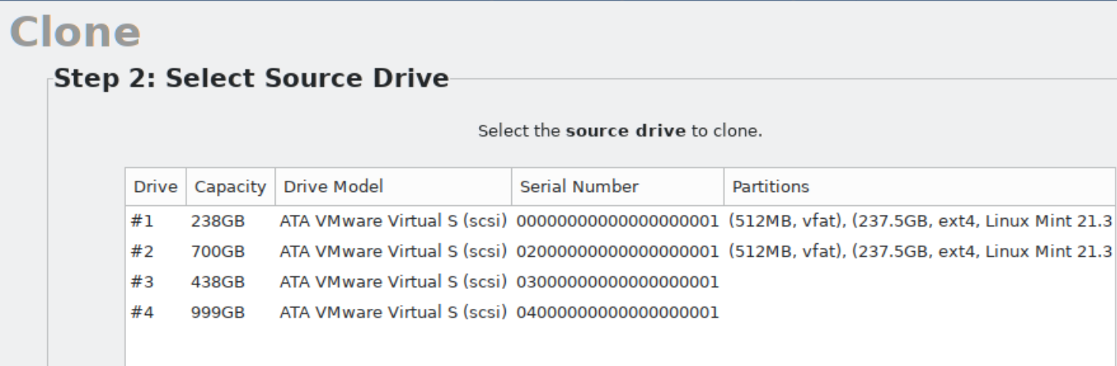
39

Slide 40
40

Slide 41
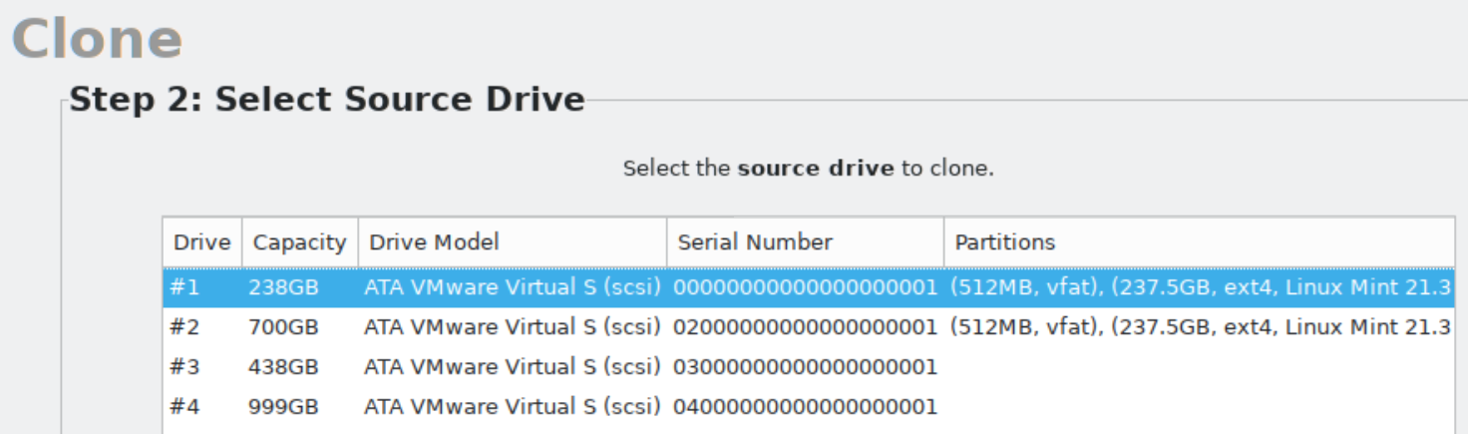
41

Slide 42
USING "RESCUEZILLA" (continued)
Click on the "Next" button in the lower right corner of the window:
42

Slide 43
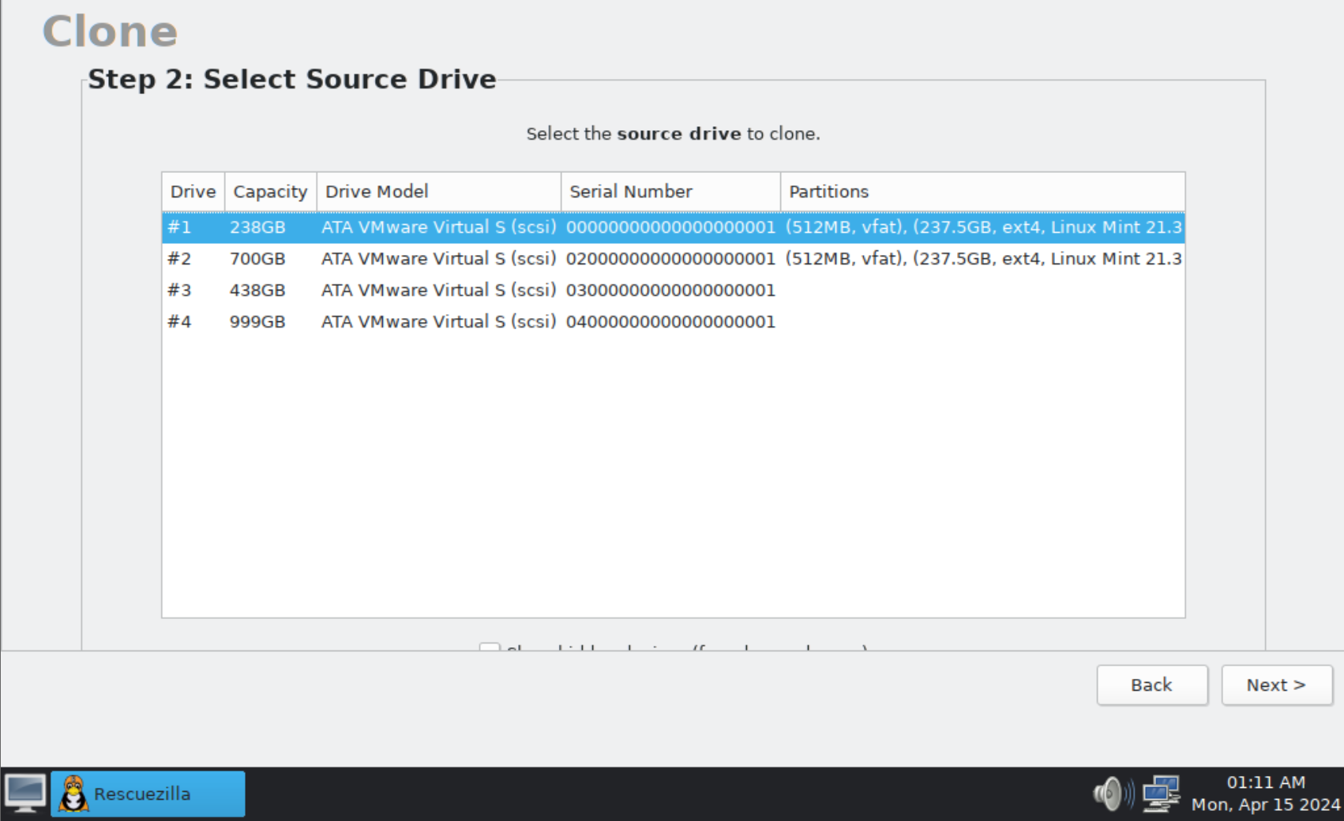
43

Slide 44
USING "RESCUEZILLA" (continued)
Click on the "destination drive", = the hard drive, or Solid State Drive, or the flash drive that you wish to make into a clone of the source disk. Locate the manufacturer's serial number of the "destination drive" that you wish to clone and check the size of the "destination drive". Do not guess !!
44

Slide 45
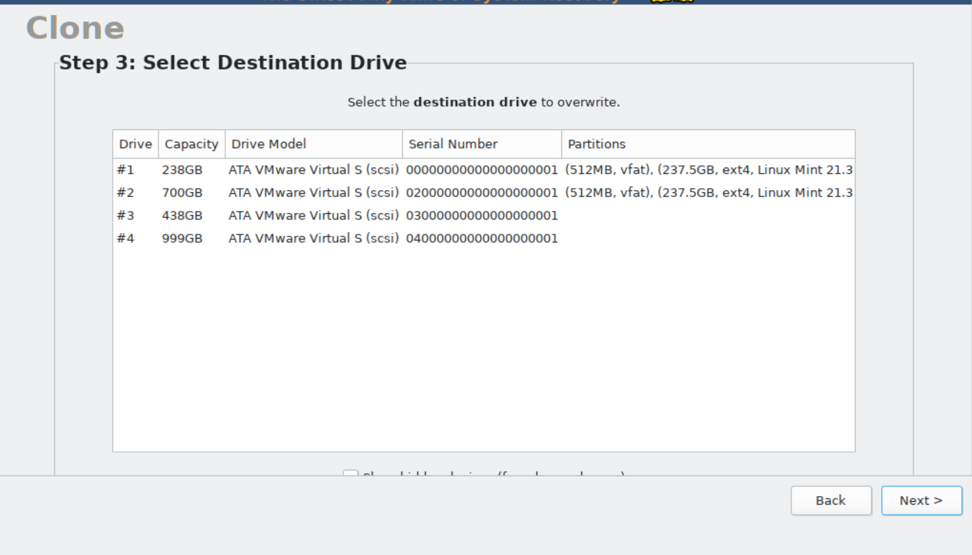
45

Slide 46

46

Slide 47
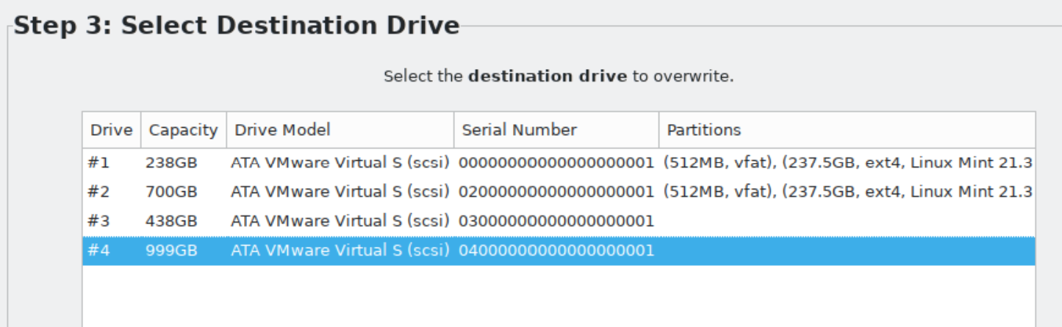
47

Slide 48
USING "RESCUEZILLA" (continued)
Click on the "Next" button in the lower right corner of the window:
48

Slide 49
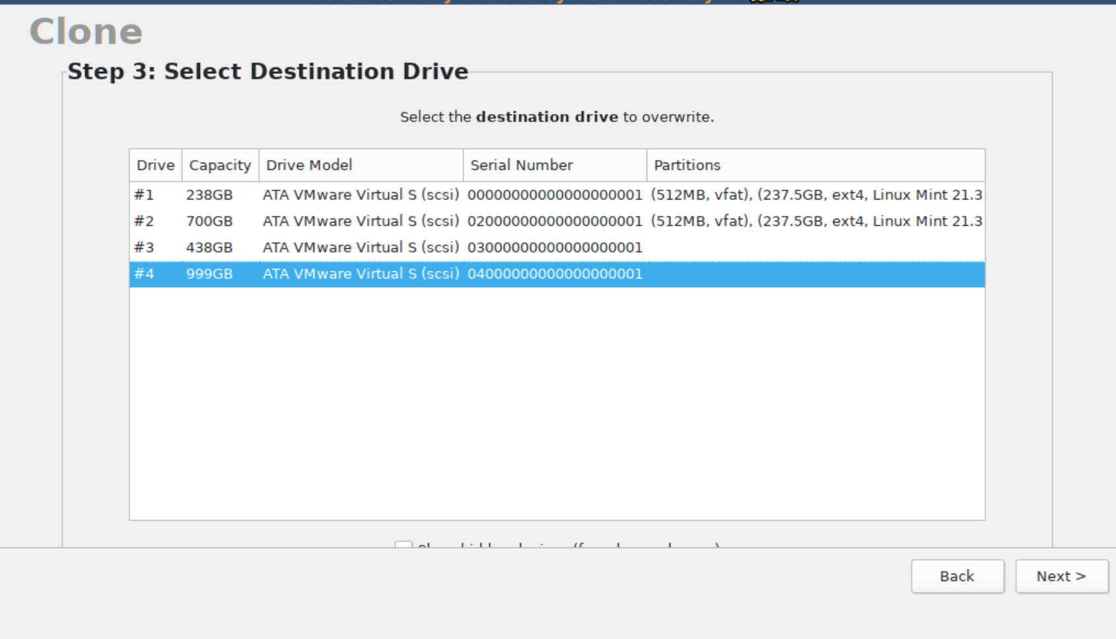
49

Slide 50
USING "RESCUEZILLA" (continued)
Click on the "Next" button in the lower right corner of the window:
50

Slide 51
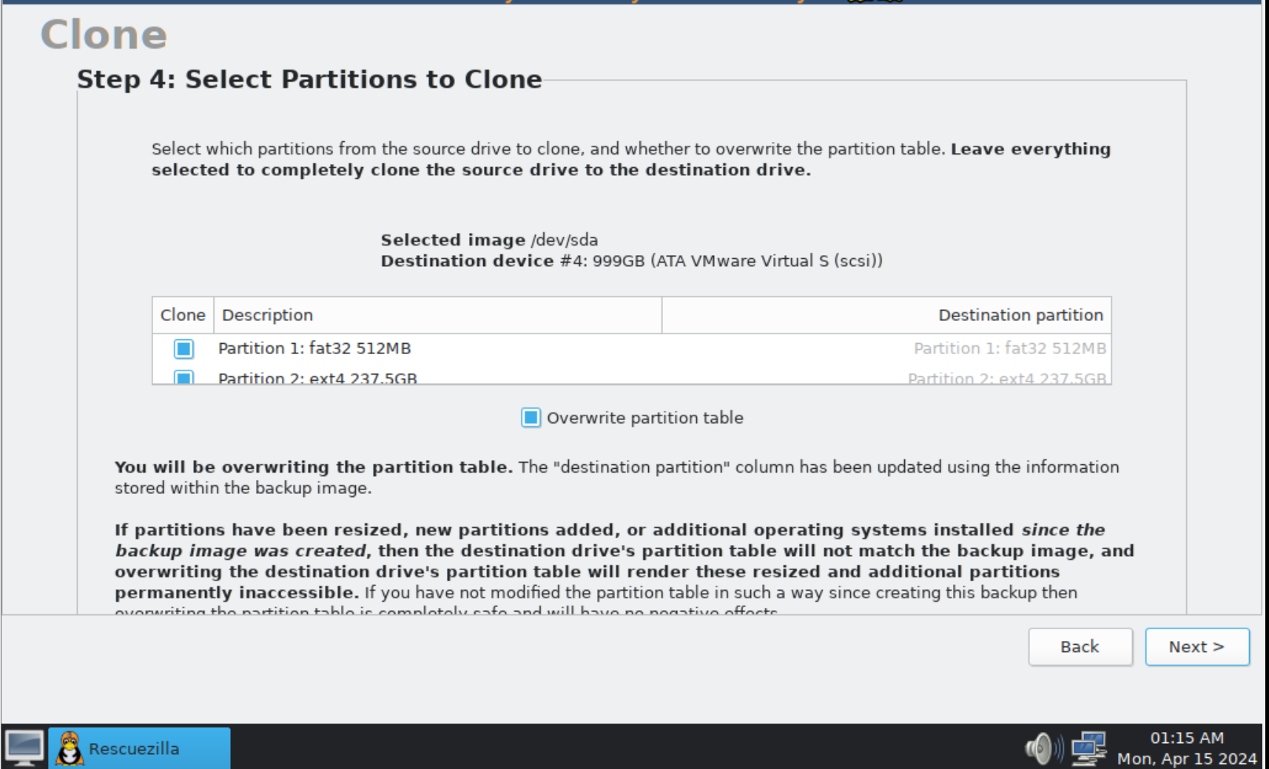
51

Slide 52
USING "RESCUEZILLA" (continued)
Click on the "Next" button in the lower right corner of the window:
52

Slide 53
USING "RESCUEZILLA" (continued)
Click on the "Next" button in the lower right corner of the window:
53

Slide 54
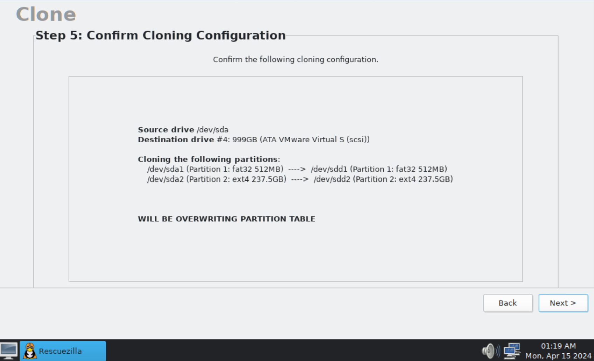
54

Slide 55
USING "RESCUEZILLA" (continued)
Click on the "Yes" button in the dialog box:
55

Slide 56
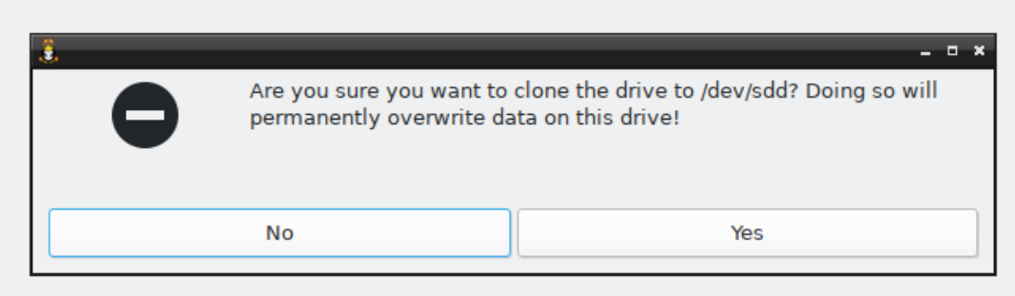
56

Slide 57
57

Slide 58
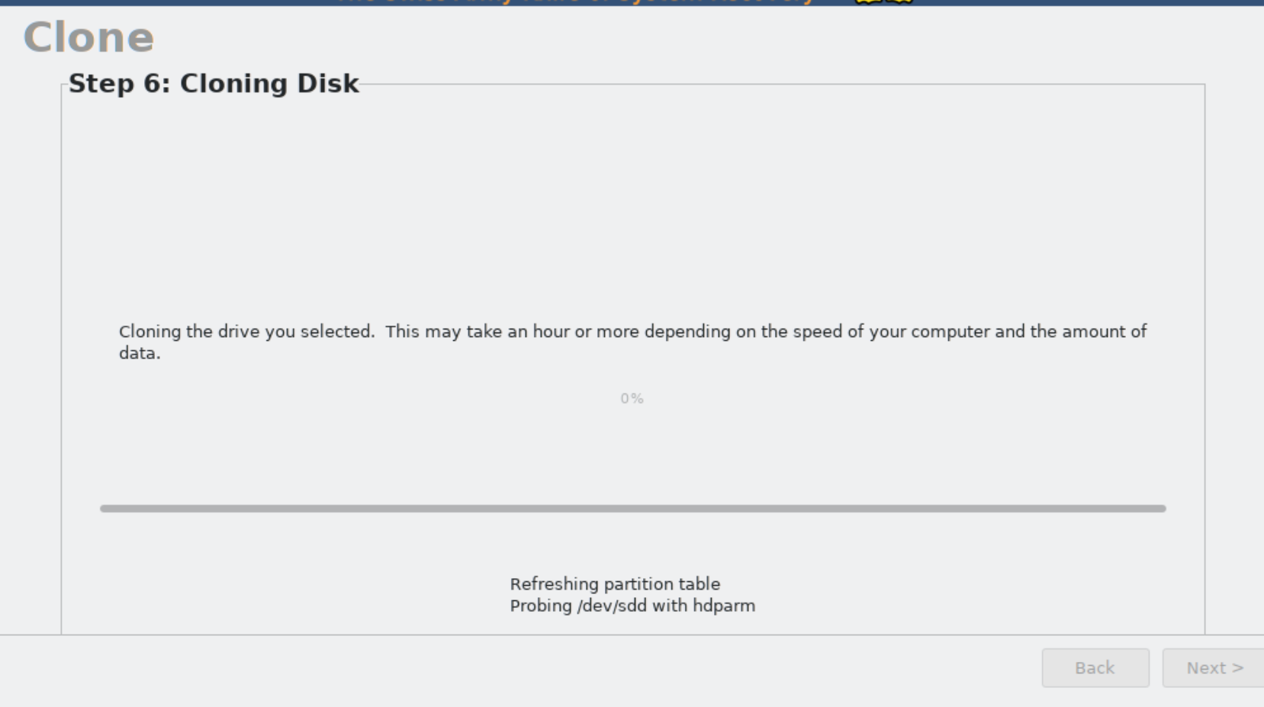
58

Slide 59
59

Slide 60
60

Slide 61
USING "RESCUEZILLA" (continued)
If the monitor screen goes to solid black, please press one of the Ctrl or Shift keys on the keyboard to continue to view the progress of the cloning process.
61

Slide 62
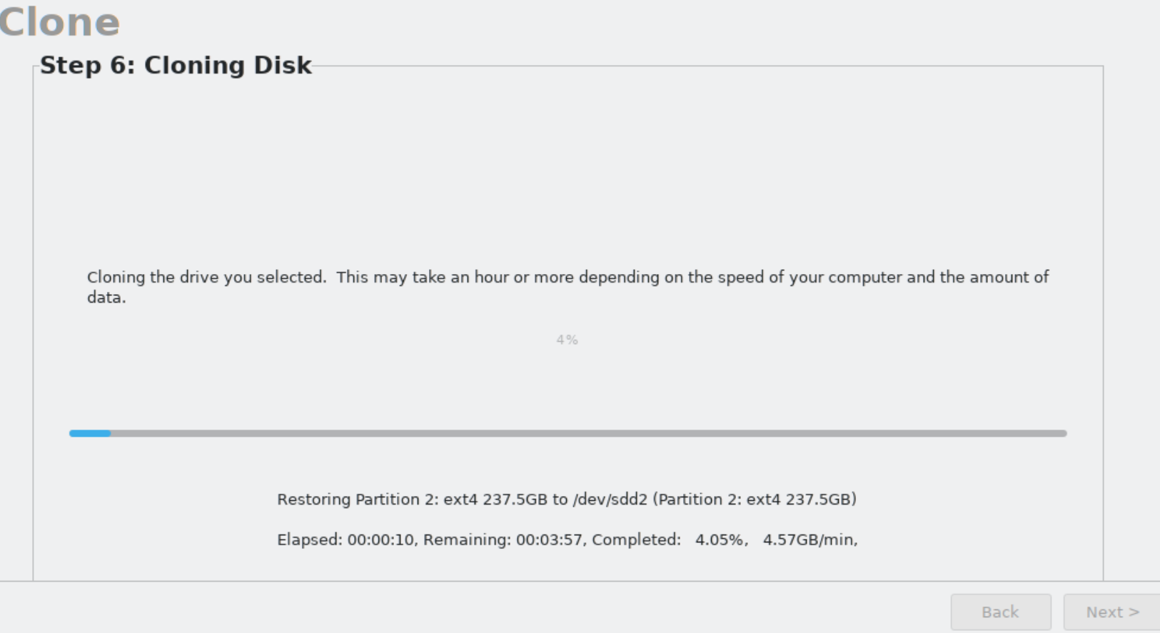
62

Slide 63
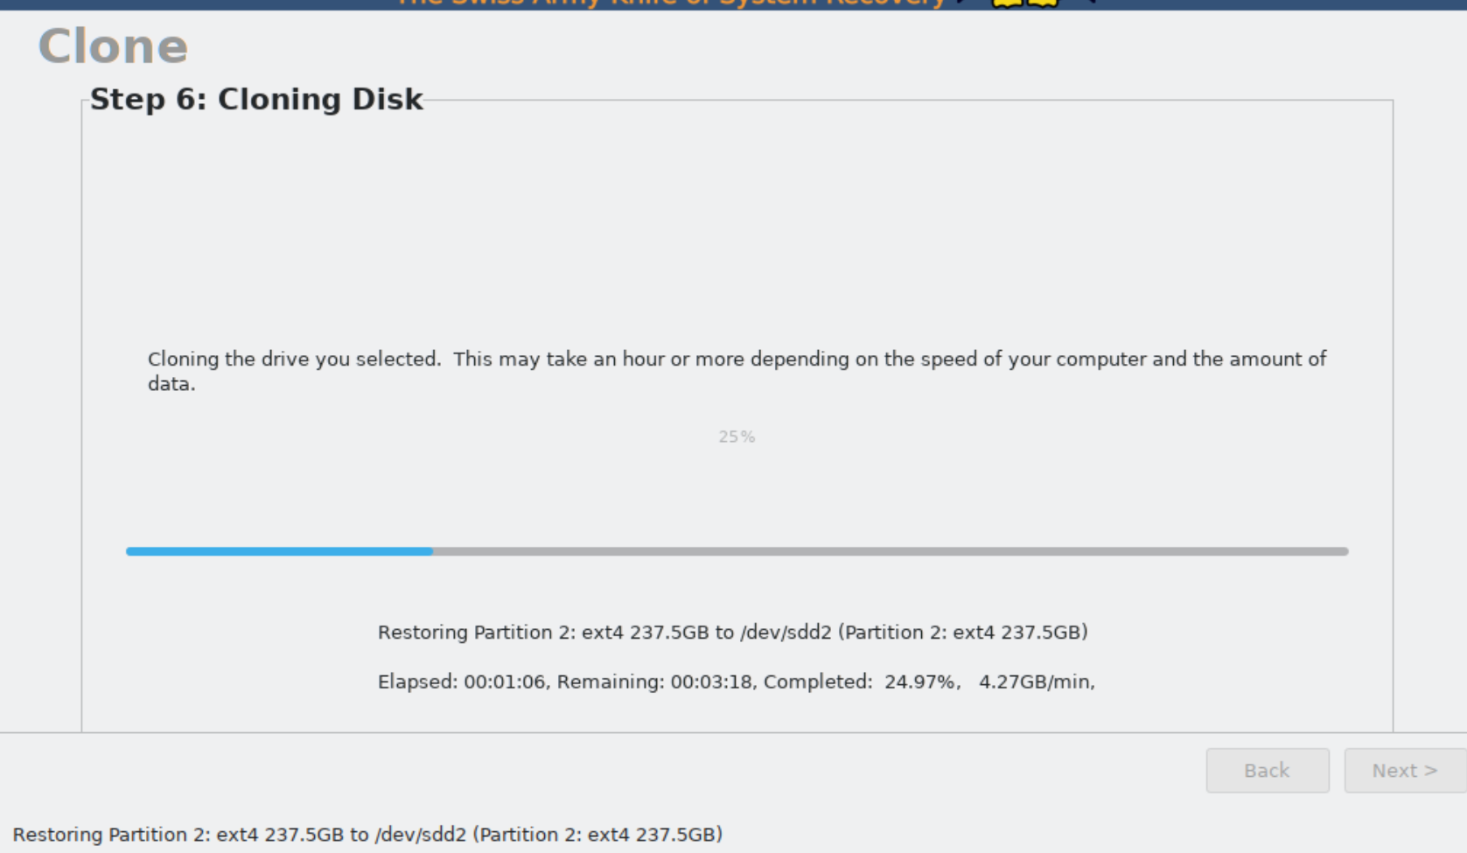
63

Slide 64
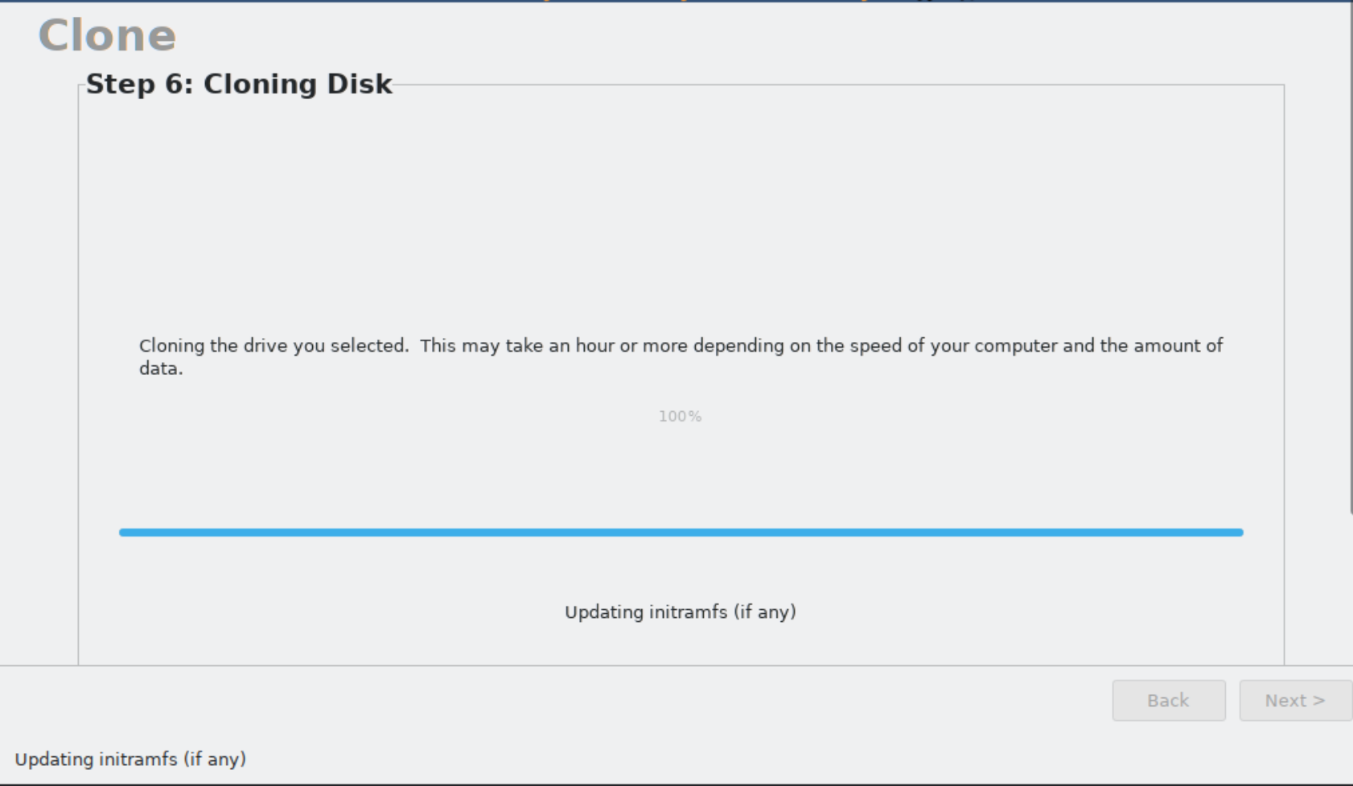
64

Slide 65
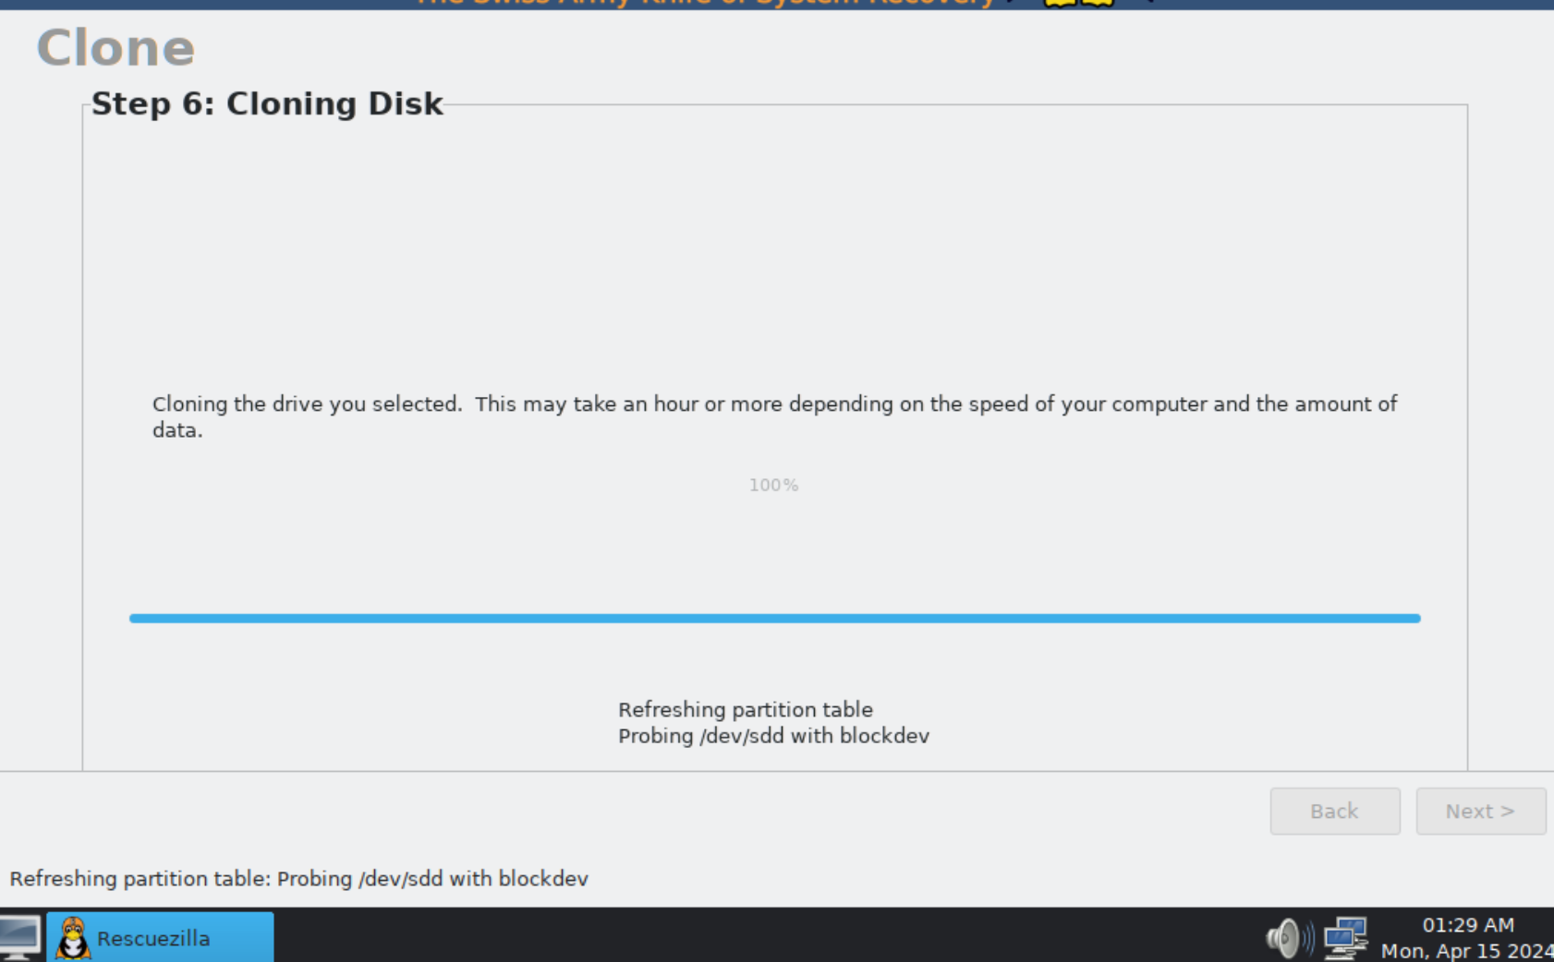
65

Slide 66
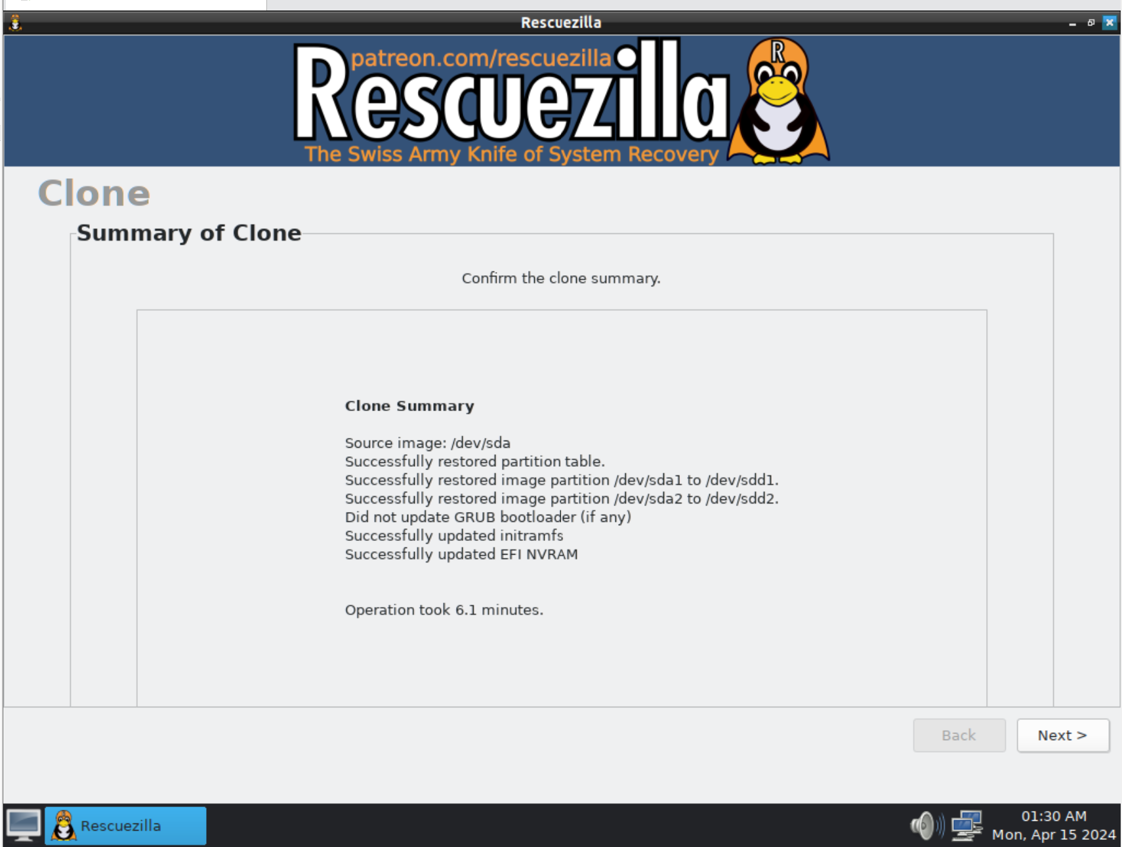
66

Slide 67
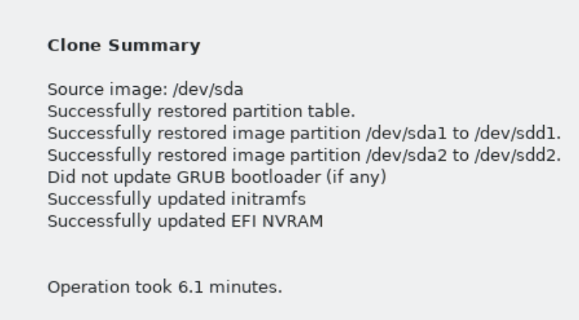
67

Slide 68
USING "RESCUEZILLA" (continued)
Click on the "Next" button in the lower-right corner of the "Rescuezilla" window:
68

Slide 69
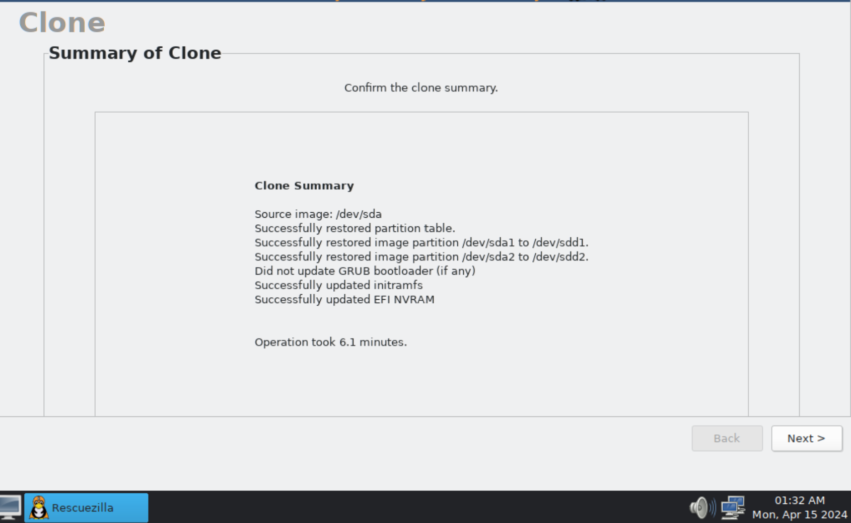
69

Slide 70
70

Slide 71
USING "RESCUEZILLA" (continued)
Use the LEFT mouse button to click on the "Menu" button in the lower-left corner of the computer monitor:
71

Slide 72
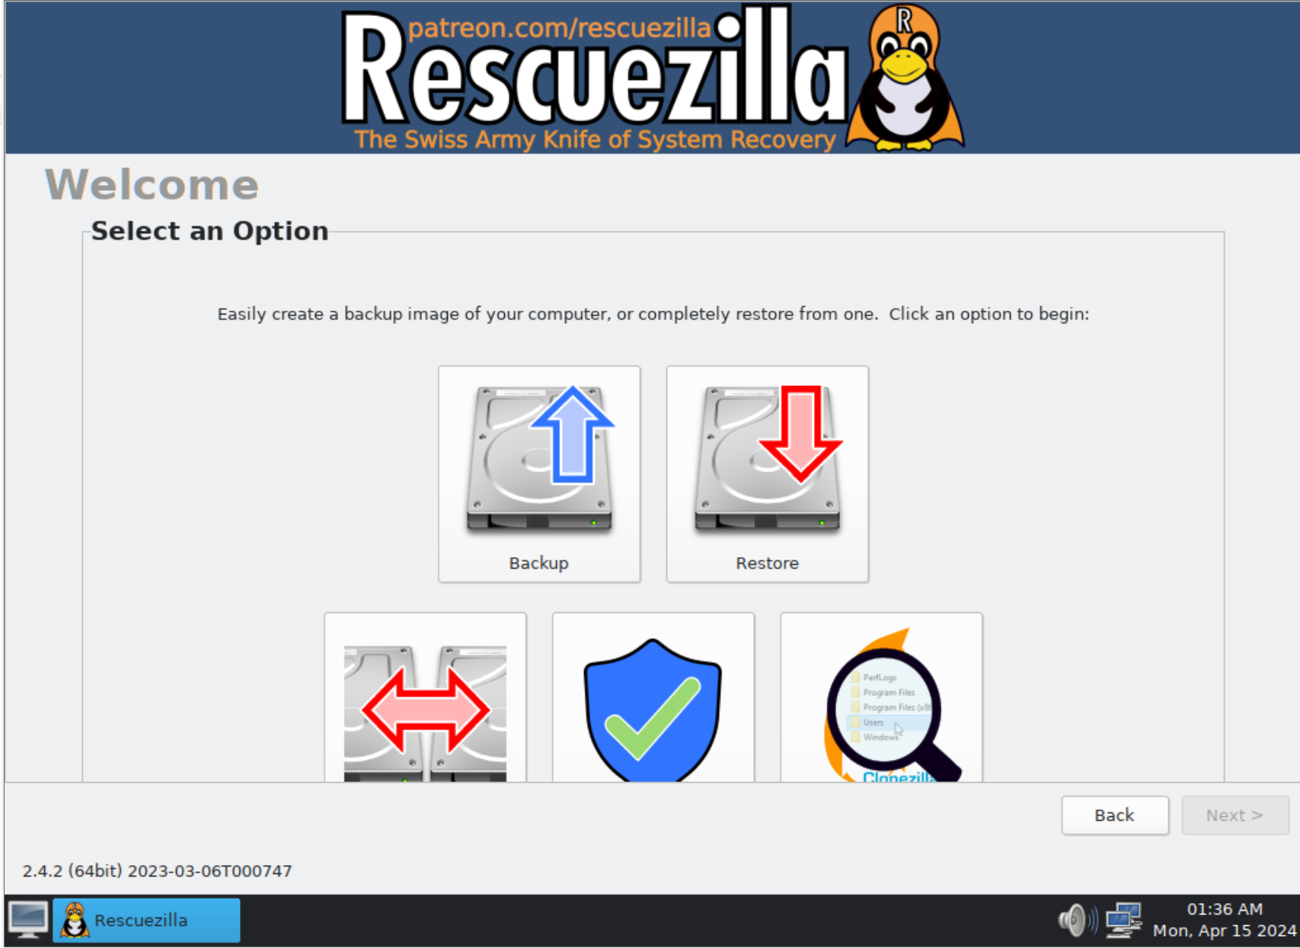
72

Slide 73
73

Slide 74
USING "RESCUEZILLA" (continued)
Use the LEFT mouse button to click on "Shutdown" button:
74

Slide 75
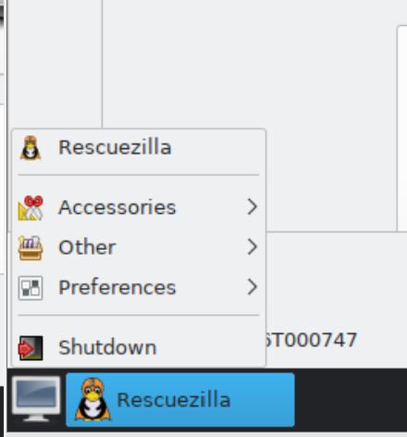
75

Slide 76
76

Slide 77
USING "RESCUEZILLA" (continued)
Click on "Shutdown" in the dialog box:
(Do not click on "Reboot" to avoid a "Signature Collision" which will occur if you accidentally boot up both the original source drive and the target cloned drive with the "Windows.." operating system.
77

Slide 78
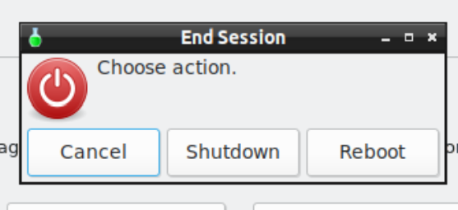
78

Slide 79
USING "RESCUEZILLA" (continued)
After the computer is powered down, disconnect the "destination drive" and store it in a static-proof container".
Do not boot up any computer with both the "source drive" and the "destination drive" connected because it will cause a "signature collision" and other undesired effects (as explained in the next "PowerPoint" slide deck).
79

Slide 80
80

Slide 81
81

