Slide 1



5-DRIVE IDENTIFICATION PRIOR TO WORKING IN RESCUEZILLA AND CLONEZILLA
1

Slide 2
Web location for this presentation:
http://aztcs.apcug.org
Click on "Meeting Notes"
or contact fchao2@yahoo.com
2

Slide 3
SUMMARY
When you are running Rescuezilla or Clonezilla inside a computer, the hard drives and solid state drives that are attached to the computer can be identified by their serial numbers, manufacturer names, and manufacturer model numbers. Here is how you can determine the manufacturers' serial numbers of the various drives inside your computer.
3

Slide 4
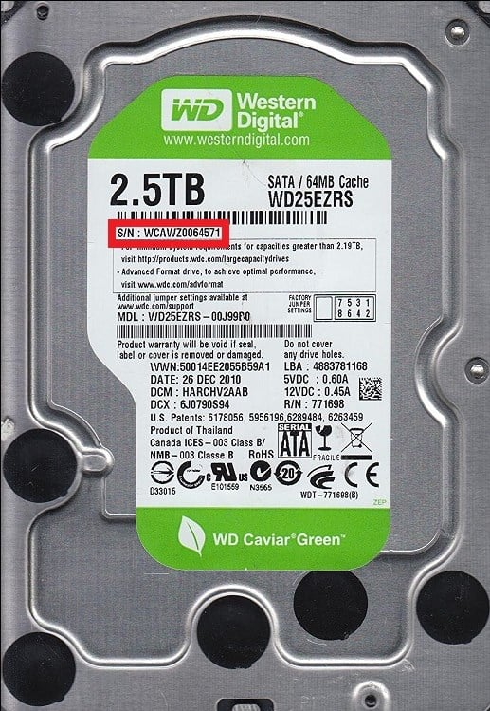
4

Slide 5
5

Slide 6
6

Slide 7
7

Slide 8
HARD DRIVE AND SOLID STATE DRIVE SERIAL NUMBERS
From inside "Terminal (Admin)" in "Windows 10.." or "Windows 11..", if "Terminal (Admin)" defaults to "PowerShell" ("PS"), type in or copy in
Get-WMIObject win32_physicalmedia | Format-List Tag,SerialNumber
Then press the Enter key
according to https://www.tenforums.com/tutorials/87131-find-serial-number-hard-drive-windows.html
8

Slide 9
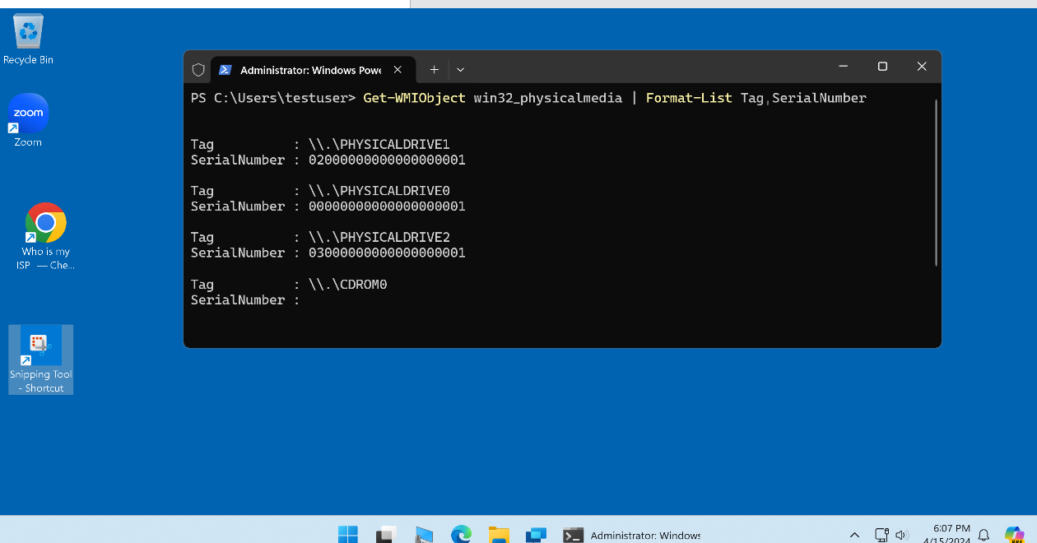
9

Slide 10
10

Slide 11
HARD DRIVE AND SOLID STATE DRIVE SERIAL NUMBERS (continued)
From inside "Terminal (Admin)" in "Windows 10.." or "Windows 11..", if "Terminal (Admin)" defaults to "PowerShell" ("PS"), another way to get drive serial number is to type in or copy in Get-PhysicalDisk -Verbose
Then press the Enter key
according to https://answers.microsoft.com/en-us/windows/forum/all/getting-serial-numbers-of-installed-physical-ssds/b44440ff-93fa-4baa-8602-238033688d83
11

Slide 12
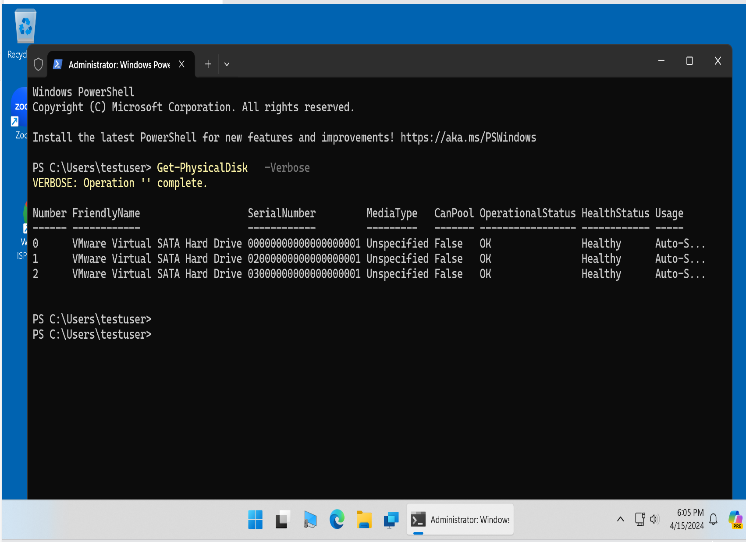
12

Slide 13
13

Slide 14
HARD DRIVE AND SOLID STATE DRIVE SERIAL NUMBERS (continued)
From inside "Terminal (Admin)" in "Windows 10.." or "Windows 11..", type in
or copy in
wmic diskdrive get model,name,serialnumber
Then press the Enter key
according to https://www.tenforums.com/tutorials/87131-find-serial-number-hard-drive-windows.html
14

Slide 15
HARD DRIVE AND SOLID STATE DRIVE SERIAL NUMBERS (continued)
To get the get the drive letters (such as D: and E:) that correspond to the "Physical Drive" numbers in "Windows 10.." or "Windows 11..", use the RIGHT mouse button to click on the "Start" button. Then use the LEFT mouse button to click on "Disk Management".
15

Slide 16
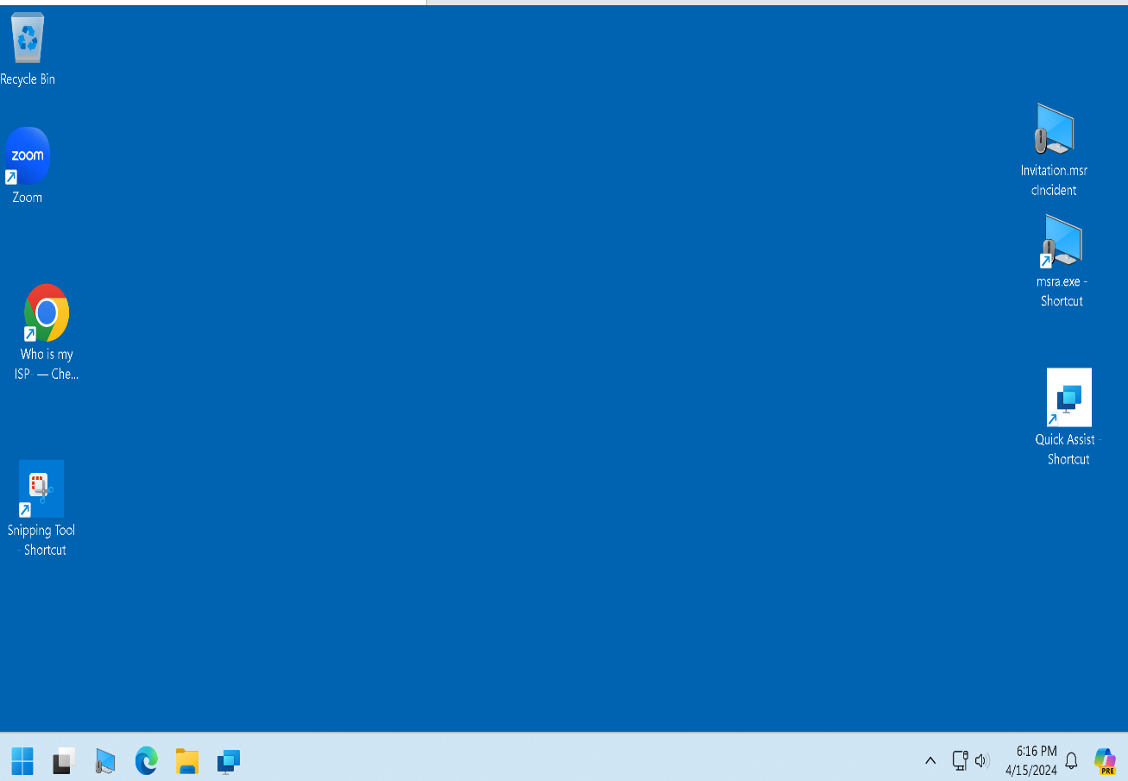
16

Slide 17
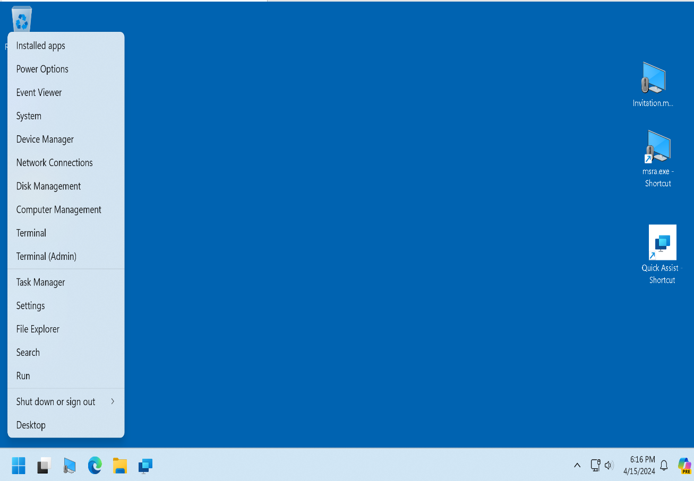
17

Slide 18

18

Slide 19
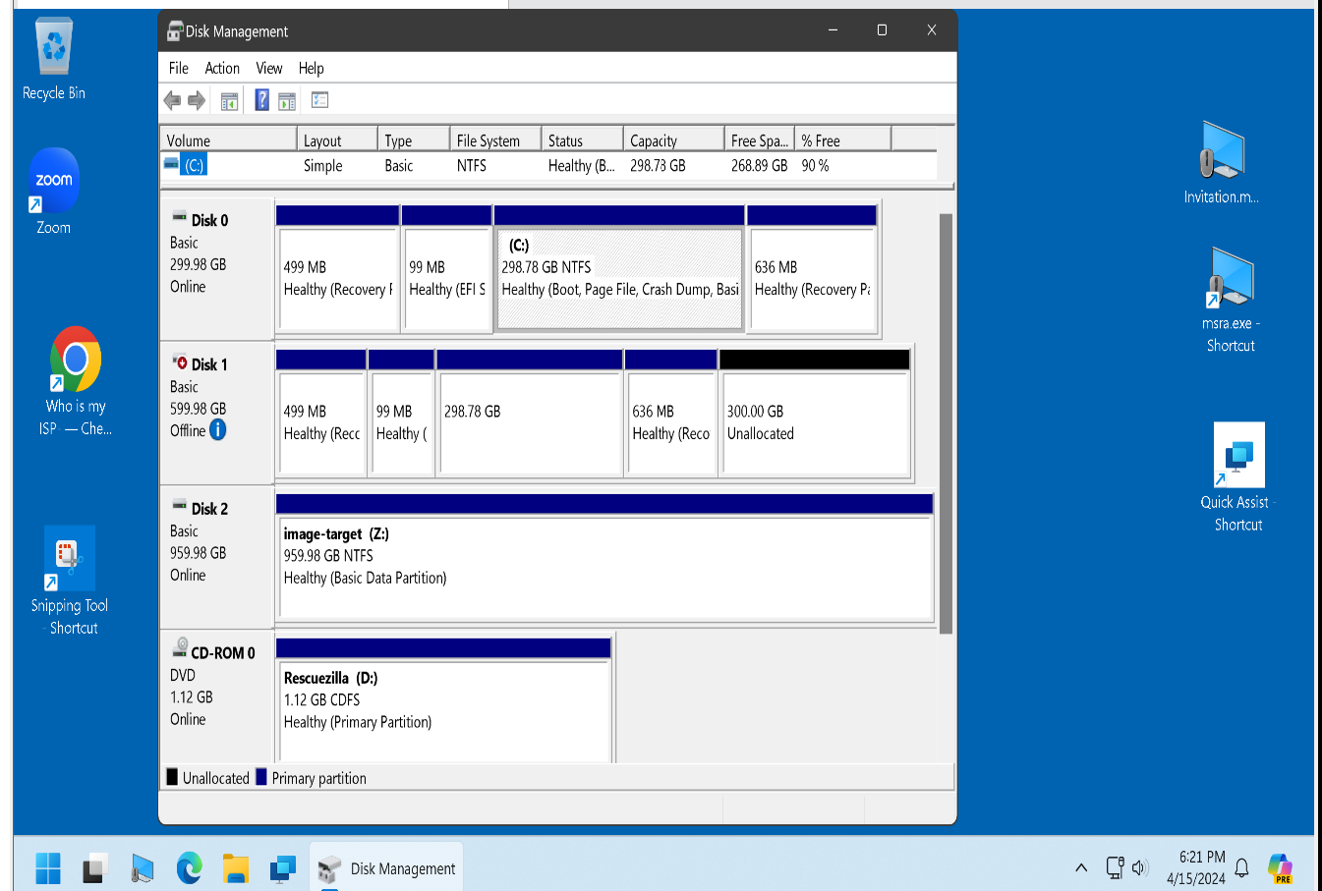
19

Slide 20
20

Slide 21
HARD DRIVE AND SOLID STATE DRIVE SERIAL NUMBERS (continued)
Additional hard drive and Solid State Drive information can be found in "Windows 10.." and "Windows 11.." per the instructions at https://www.makeuseof.com/find-hard-disk-model-serial-number-windows-10/
21

Slide 22
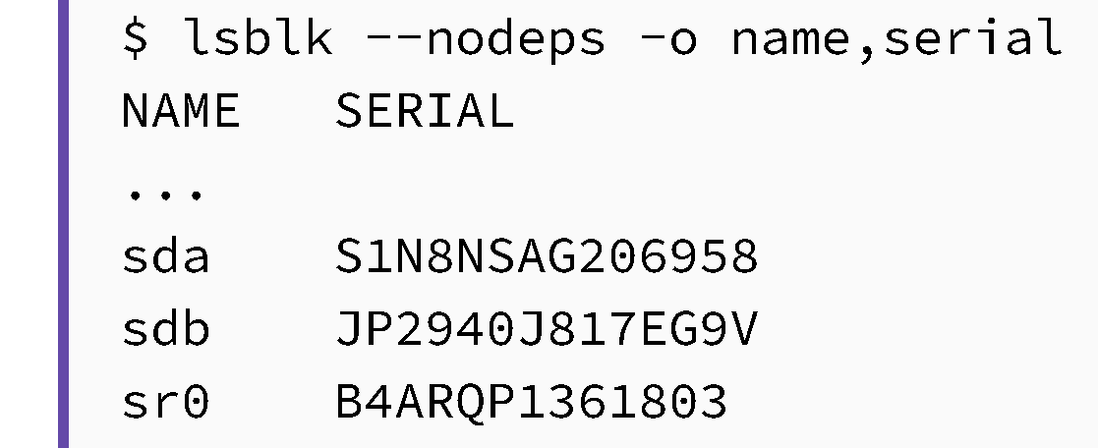
HARD DRIVE AND SOLID STATE DRIVE SERIAL NUMBERS (continued)
From inside "Terminal" in a Linux distribution, type in:
lsblk --nodeps -o name,serial
Then press the Enter key
according to https://www.baeldung.com/linux/storage-ssd-hdd-serial-number
22

