Slide 1



3C-EXTERNAL M.2 SSD ENCLOSURES
1

Slide 2
Web location for this presentation:
http://aztcs.apcug.org
Click on "Meeting Notes"
or contact fchao2@yahoo.com
2

Slide 3
SUMMARY
To clone an internal M.2 SSD, you need to buy and attach the following to your computer: 1) a M.2 SSD drive which inserts into 2) a M.2 SSD enclosure that can connect to an USB port on your computer
3

Slide 4
TOPICS
M.2 SSDs
SSD enclosures
4

Slide 5
M.2 SSDs
M.2 is pronounced "M dot 2"
"SSD" stands for "solid state drive"
M.2 solid state drives are about the size and shape of a stick of chewing gum
5

Slide 6
M.2 SSDs (continued)
Older computers use SATA M.2 SSDs (SATA = "Serial AT Attachment")
Newer computers use NVME M.2 SSD (NVME = "Non-Volatile Memory Express")
6

Slide 7
M.2 SSDs (continued)
M.2 NVMe SSDs range in size from 500 Megabytes to 4 Terabytes
At the 500 Megabyte size, you will experience the space limitations of a crowded closet !
7

Slide 8
M.2 SSDs (continued)
One popular example of a 4 Terabyte NVMe M.2 SSD: https://www.amazon.com/Crucial-PCIe-NAND-NVMe-3500MB/dp/B0B25P44CL/
8

Slide 9
M.2 SSDs (continued)
The following 2TB Kingston M.2 SSD is typical of the ones that are inside most of the medium and low-end "Windows.." computers
https://www.amazon.com/Kingston-2280-Internal-SNVS-2000G/dp/B091BG4HDW/
9

Slide 10
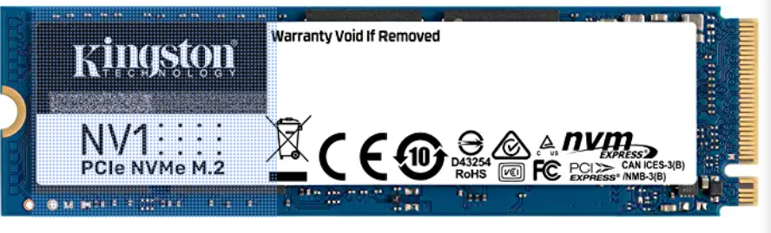

Slide 11
M.2 SSDs ENCLOSURES
To connect an M.2 SSD that is outside of a computer to a computer, you need an M.2 SSD enclosure that connects to one of the USB ports of the computer:
11

Slide 12
"LENTION" M.2 ENCLOSURE
The low-cost Lention enclosure has no fan or cooling fins but, if you leave it open so that it does not overheat, you can insert a separately-purchased M.2 drive into it and use it as a clone target for Rescuezilla or Clonezilla: Do not use it as a permanent USB drive !
12

Slide 13
"LENTION" M.2 ENCLOSURE (continued)
On a warm day, you might have use a small electric fan to keep this enclosure from overheating: https://www.amazon.com/gp/product/B08GR2NJT2/
13

Slide 14
"ANYOYO" M.2 ENCLOSURE
The "ANYOYO" M.2 enclosure has a small fan and it can be used as a permanent M.2 enclosure after you insert a M.2 SSD: https://www.amazon.com/ANYOYO-Enclosure-10Gbps-Cooling-Support/dp/B0D1K85DLG/
14

Slide 15
"INEO" M.2 ENCLOSURE
The "Ineo" M.2 enclosure has a powerful fan and it can be used as a permanent M.2 enclosure after you insert a M.2 SSD https://www.amazon.com/gp/product/B0CMZJM6TH/
15

Slide 16
"ACASIS" M.2 ENCLOSURE
The "Acasis" enclosure also has a powerful fan and it can also be used as a permanent M.2 enclosure after you insert a M.2 SSD: https://www.amazon.com/gp/product/B0C8CZB5S7/
16

Slide 17
"IDMEM" M.2 ENCLOSURE
The "IDMEM" enclosure also has a powerful fan: https://www.amazon.com/dp/B0CZHJSM7P/
17

Slide 18
18

