Slide 1



2B- MAKING A BOOTABLE "RESCUEZILLA" DVD
1

Slide 2
Web location for this presentation:
http://aztcs.apcug.org
Click on "Meeting Notes"
or contact fchao2@yahoo.com
2

Slide 3
SUMMARY
Here are step-by-step instructions on how you can create aor a "RESCUEZILLA" bootable DVD.
3

Slide 4
TOPICS
Downloading the "rescuezilla**.iso file
Making a Bootable DVD from the "rescuezilla**.iso file
4

Slide 5

5

Slide 6
DOWNLOAD THE rescuezilla**. iso FILE (continued)
Use a Web browser to go to rescuezilla.com
6

Slide 7
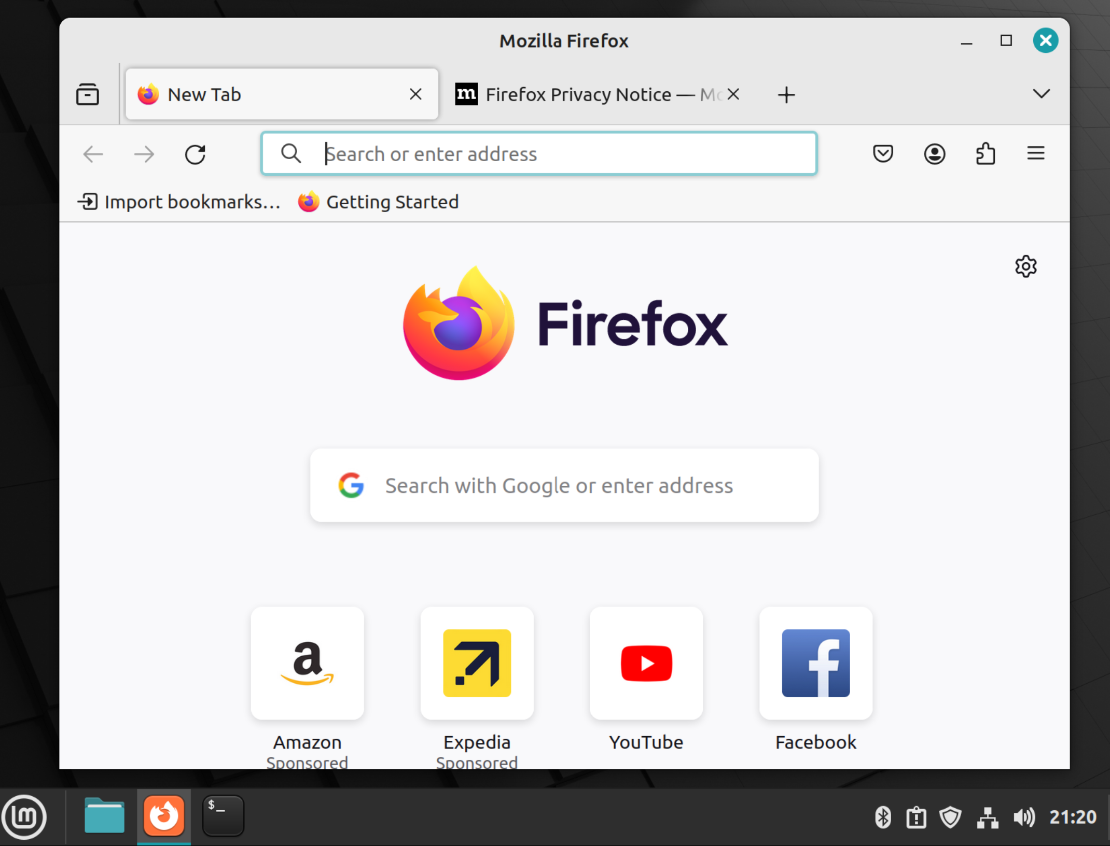
7

Slide 8
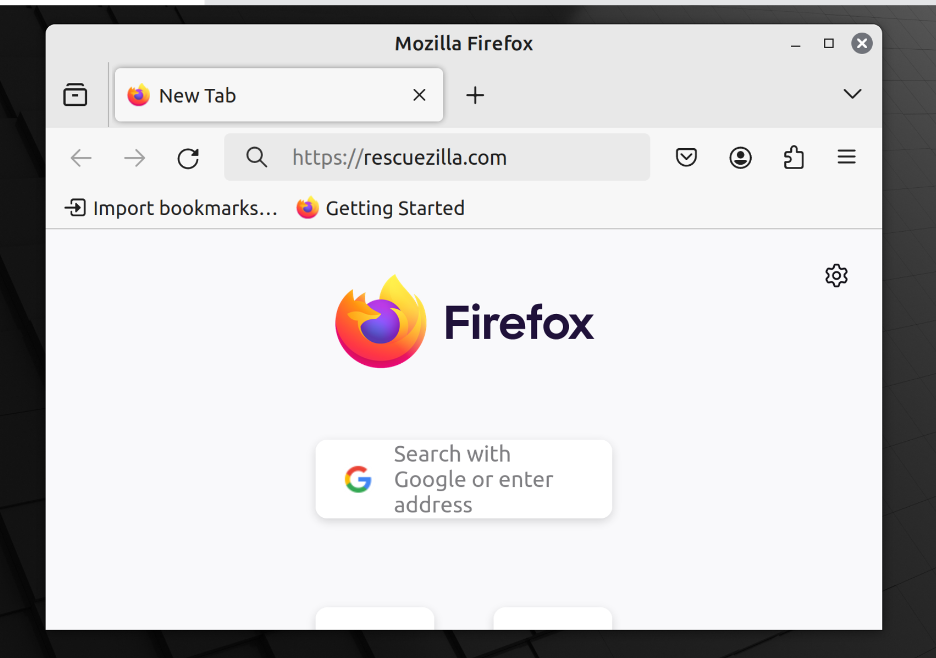
8

Slide 9

9

Slide 10
DOWNLOAD THE rescuezilla**.iso FILE (continued)
Press once on the Enter key of the keyboard:
10

Slide 11
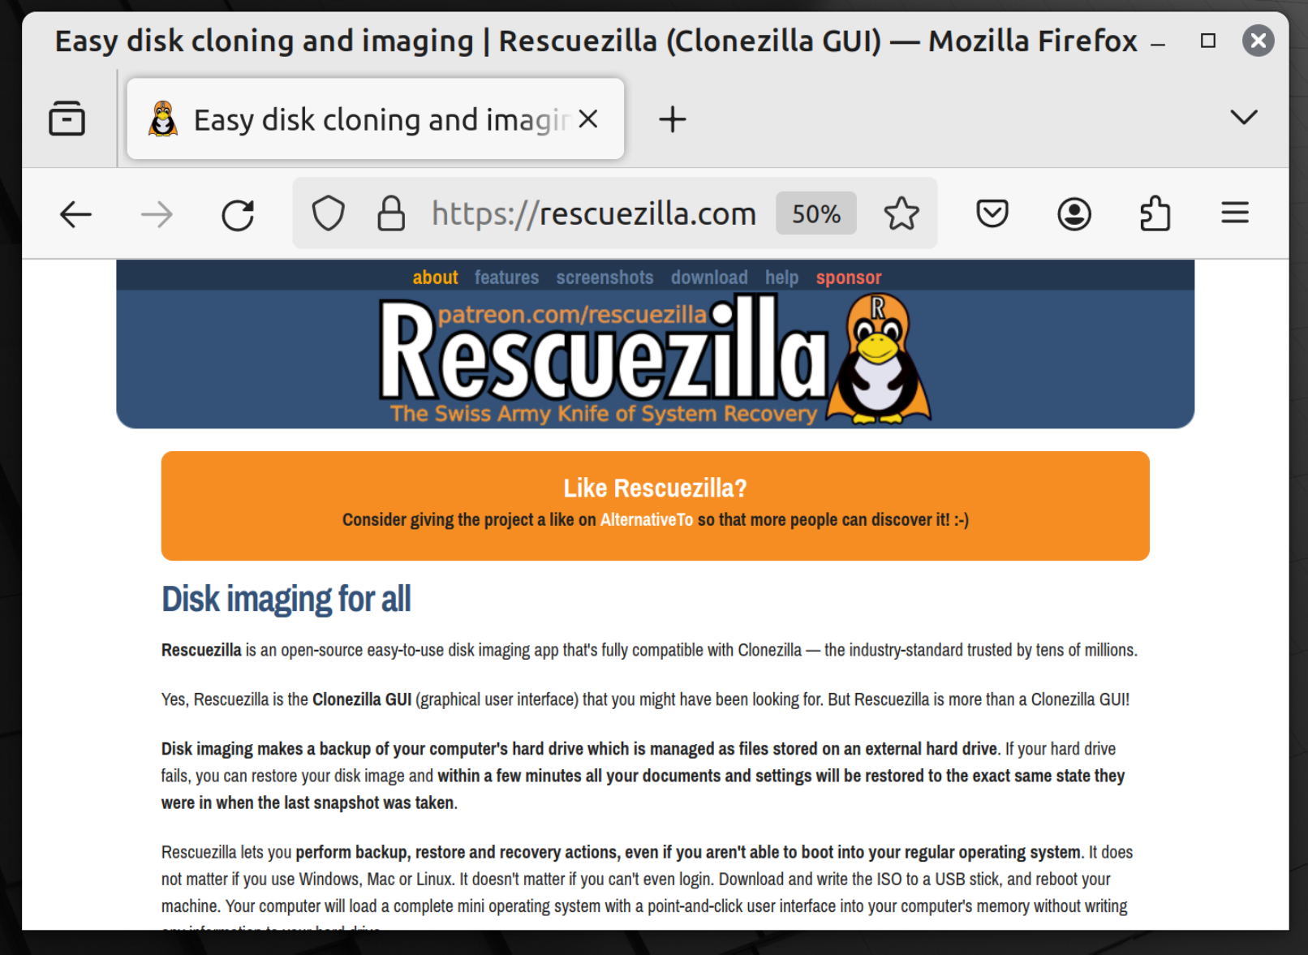
11

Slide 12
DOWNLOAD THE rescuezilla**.iso FILE (continued)
Click on "Download":
12

Slide 13
13

Slide 14
14

Slide 15
DOWNLOAD THE rescuezilla**.iso FILE (continued)
Click on the rescuezilla***.iso file:
15

Slide 16
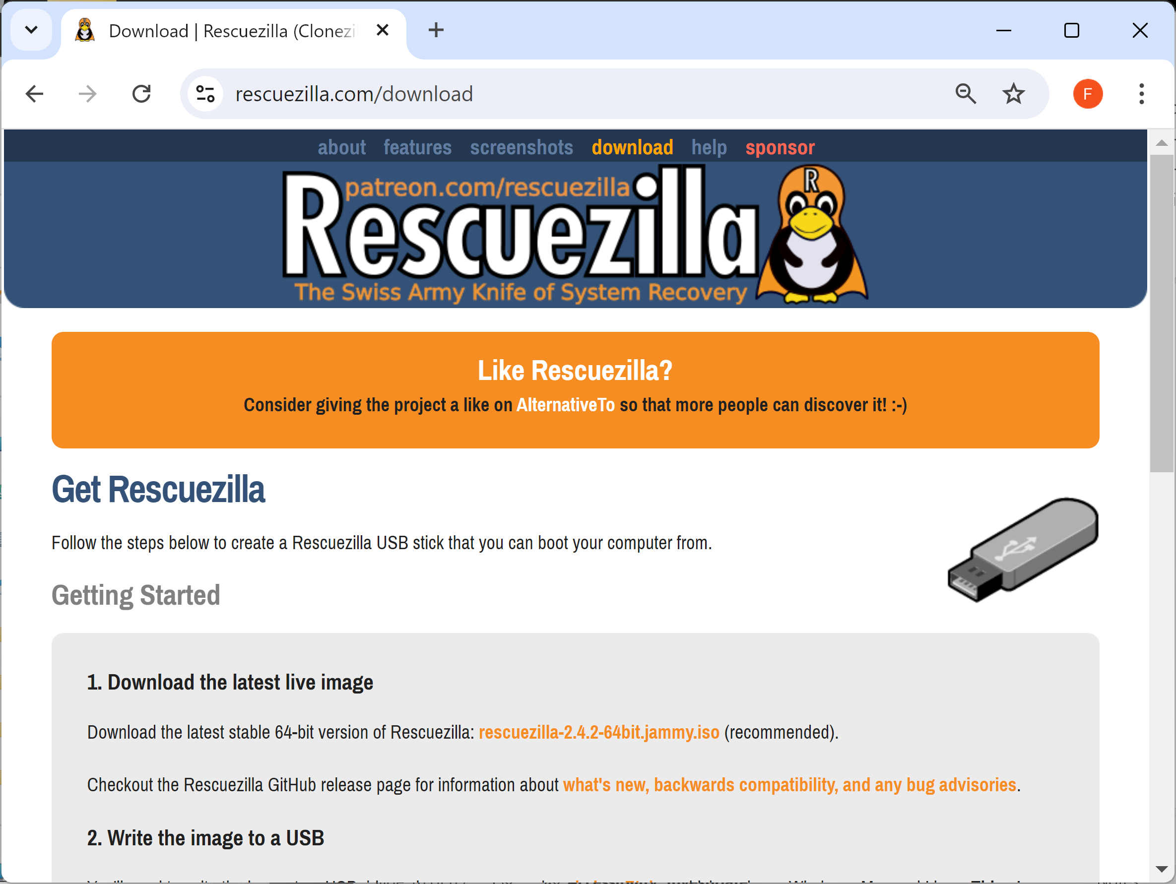
16

Slide 17
DOWNLOAD THE rescuezilla**.iso FILE (continued)
After a minute or two, the rescuezilla**.iso file will reside in the "Downloads" folder of your Windows.. "Users" folder:
17

Slide 18
DOWNLOAD THE rescuezilla**.iso FILE (continued)
The rescuezilla**.iso file will now reside in the "Downloads" folder of your Users folder:
18

Slide 19
CREATE A BOOTABLE "RESCUEZILLA" DVD
From inside the Web browser or from inside the file management app of your Linux or Windows computer, use the RIGHT mouse button to click on the rescuezilla**.iso file:
19

Slide 20
CREATE A BOOTABLE "RESCUEZILLA" DVD (continued)
Click on "Burn disk image" in the pop-up utility menu.
If "Burn disk image" is not shown, click on "Show more options". Then click on "Burn disk image"
20

Slide 21
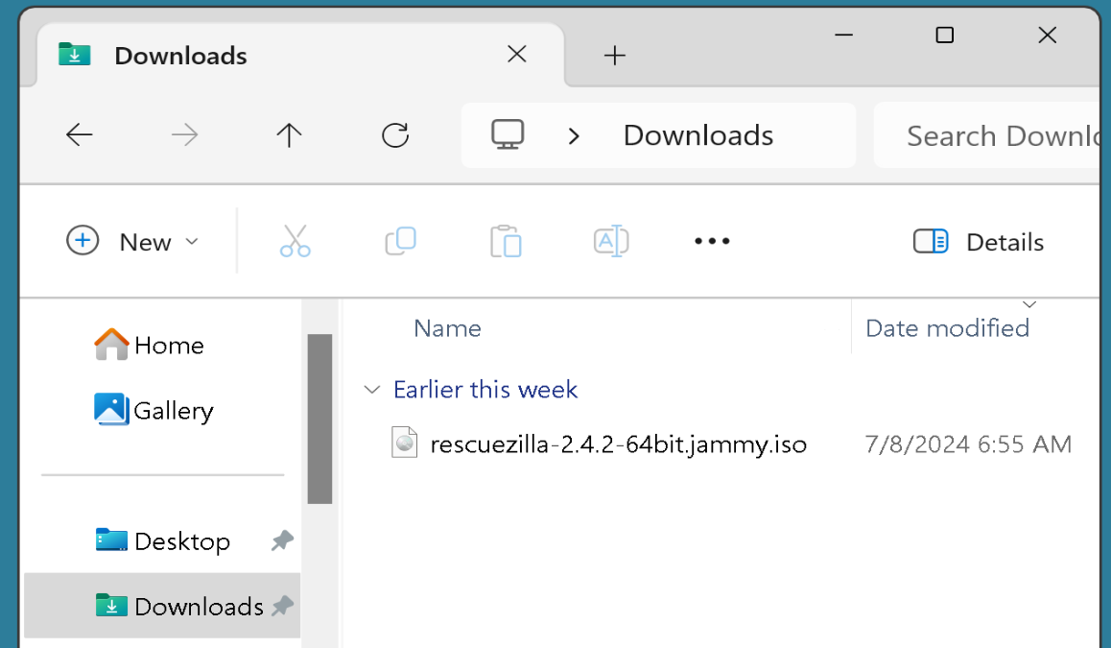
21

Slide 22
22

Slide 23
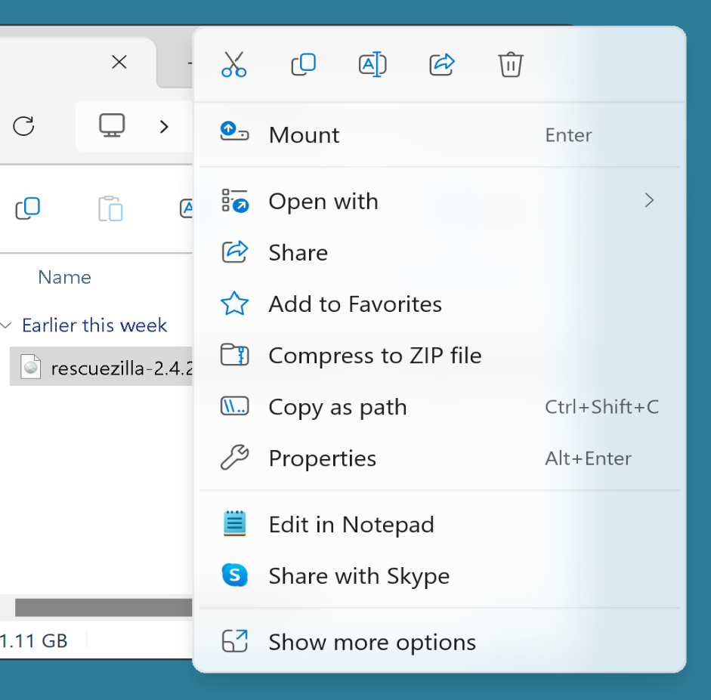
23

Slide 24
24

Slide 25
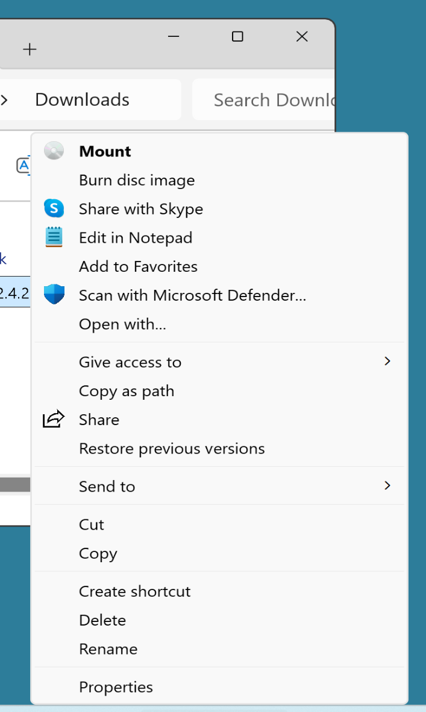
25

Slide 26
26

Slide 27
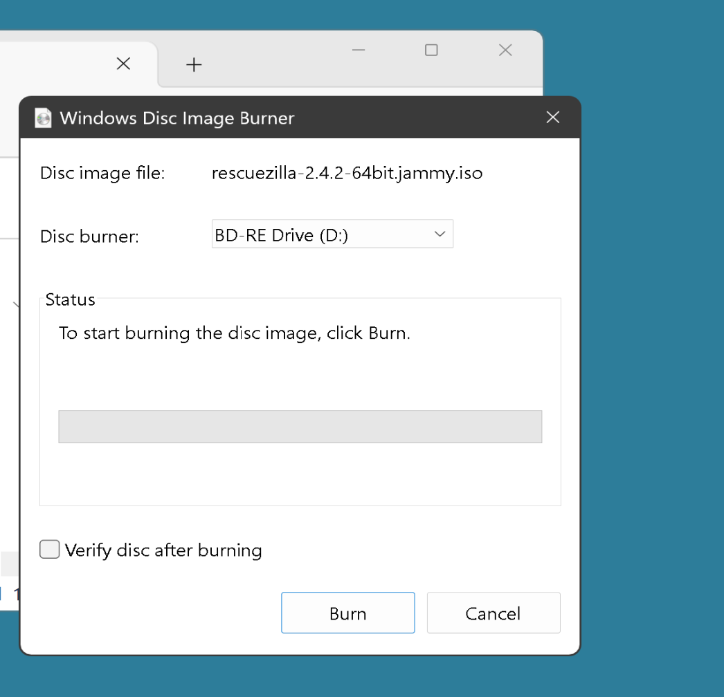
27

Slide 28
CREATE A BOOTABLE "RESCUEZILLA" DVD (continued)
Insert a blank DVD-R or DVD-RW disc into the DVD drive.
Follow the instructions to burn the rescuezilla-***.iso file to the DVD-R or DVD-RW
28

Slide 29
29

Slide 30
30

