Slide 1



2A- MAKING A BOOTABLE "RESCUEZILLA" USB THUMB DRIVE
1

Slide 2
Web location for this presentation:
http://aztcs.apcug.org
Click on "Meeting Notes"
or contact me at fchao2@yahoo.com
2

Slide 3
SUMMARY
Here are step-by-step instructions on how you can create aor a "RESCUEZILLA" bootable USB thumb drive.
3

Slide 4
TOPICS
Download the "rescuezilla**.iso file
Download "balenEtcher Portable" into a "Windows.." computer
Use "balenEtcher Portable" to making a bootable USB Thumb drive from the "rescuezilla**.iso file
4

Slide 5
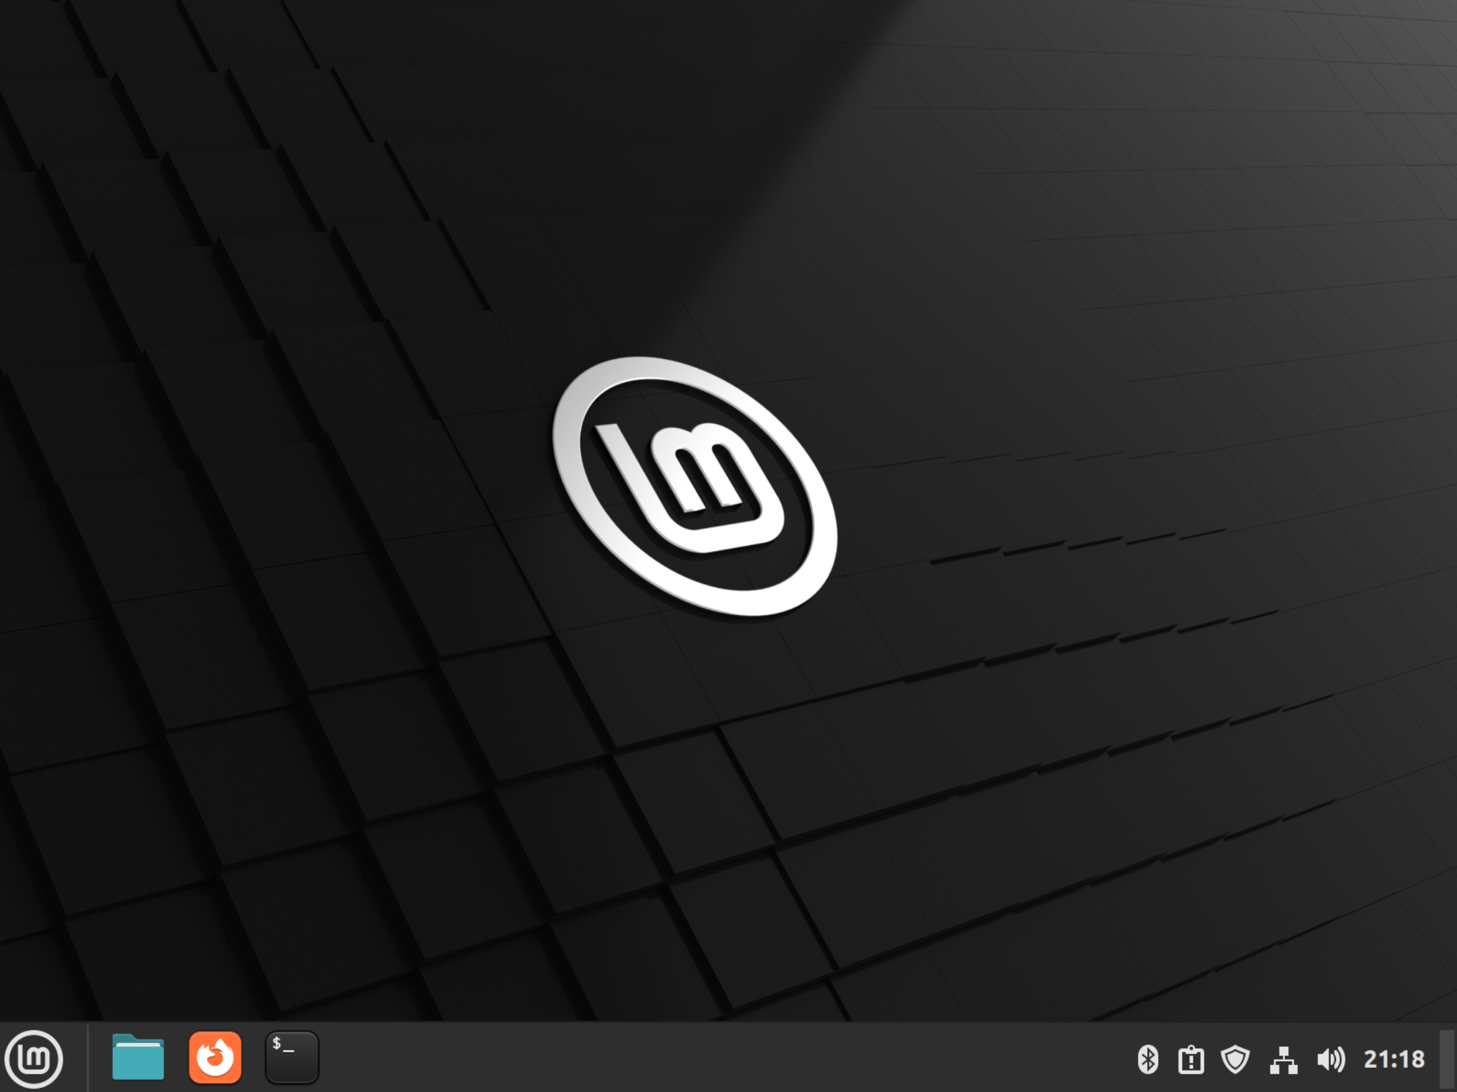
5

Slide 6
DOWNLOAD THE rescuezilla**. iso FILE (continued)
Use a Web browser to go to rescuezilla.com
6

Slide 7
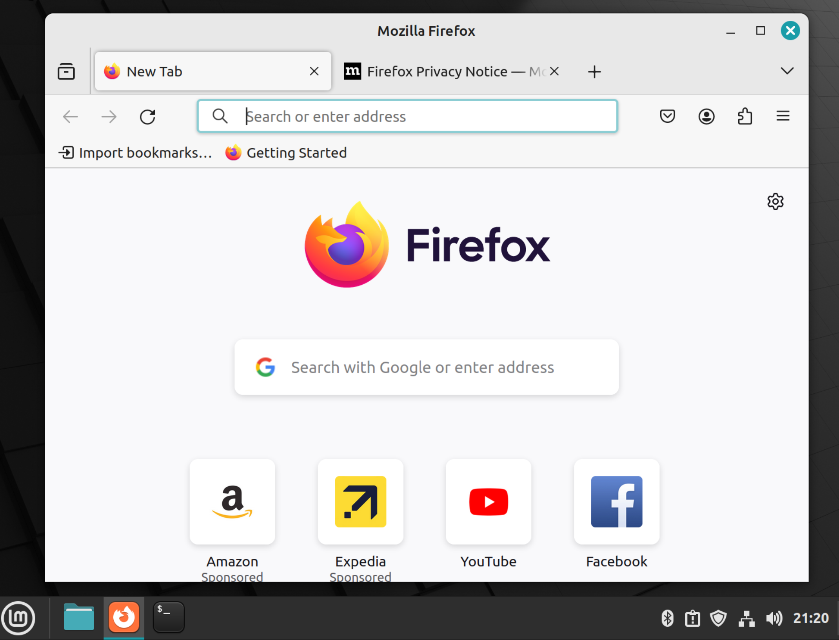
7

Slide 8
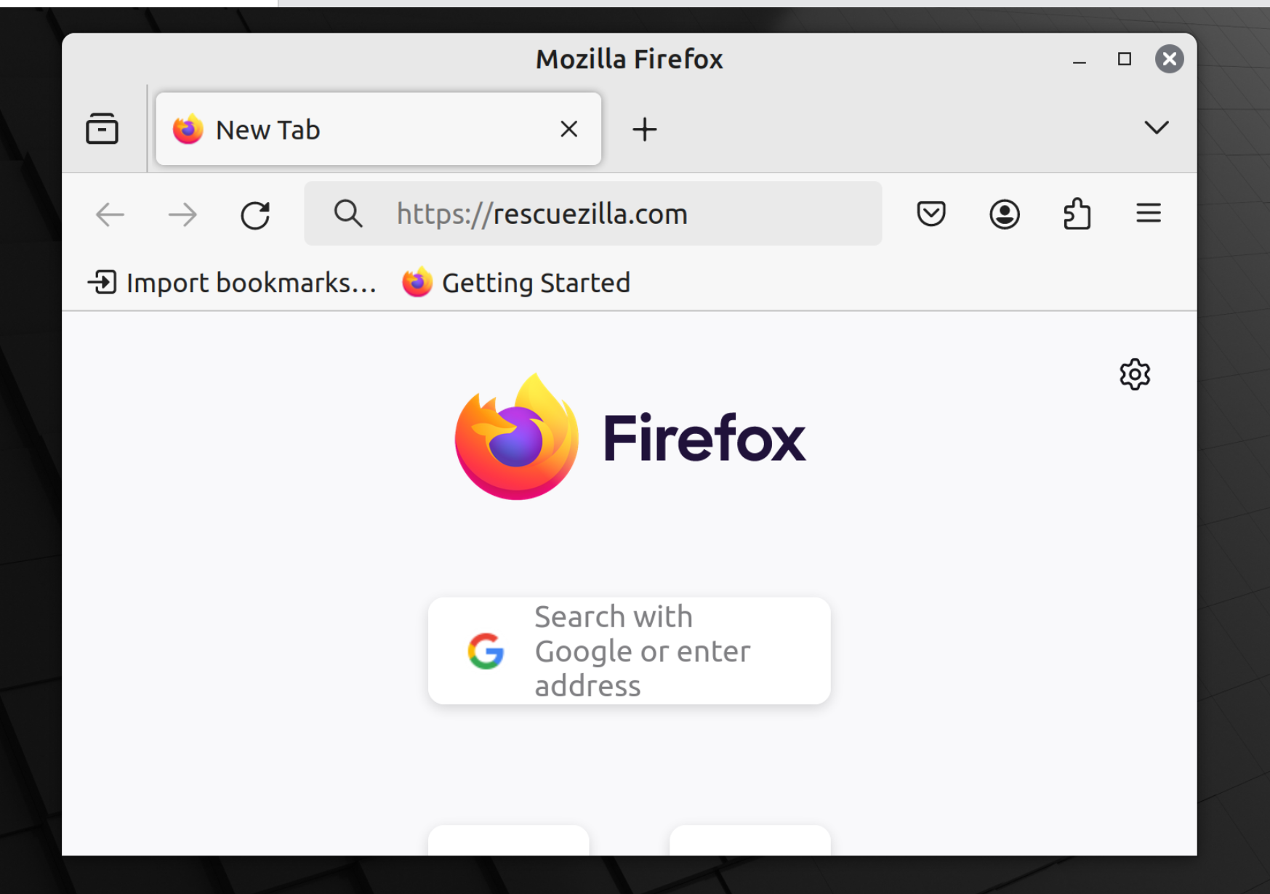
8

Slide 9

9

Slide 10
DOWNLOAD THE rescuezilla**.iso FILE (continued)
Press once on the Enter key of the keyboard:
10

Slide 11
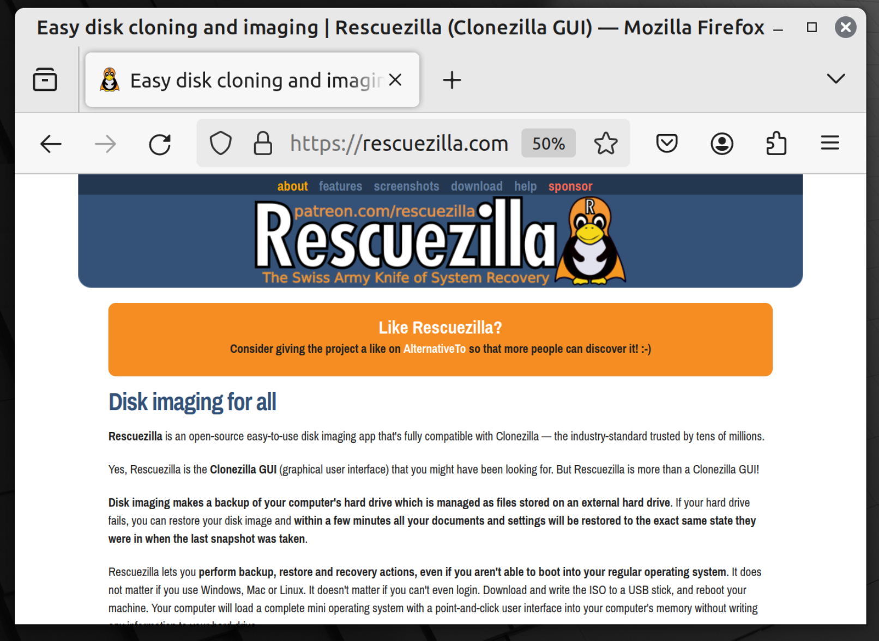
11

Slide 12
DOWNLOAD THE rescuezilla**.iso FILE (continued)
Click on "Download":
12

Slide 13
13

Slide 14
14

Slide 15
DOWNLOAD THE rescuezilla**.iso FILE (continued)
Click on the rescuezilla***.iso file:
15

Slide 16
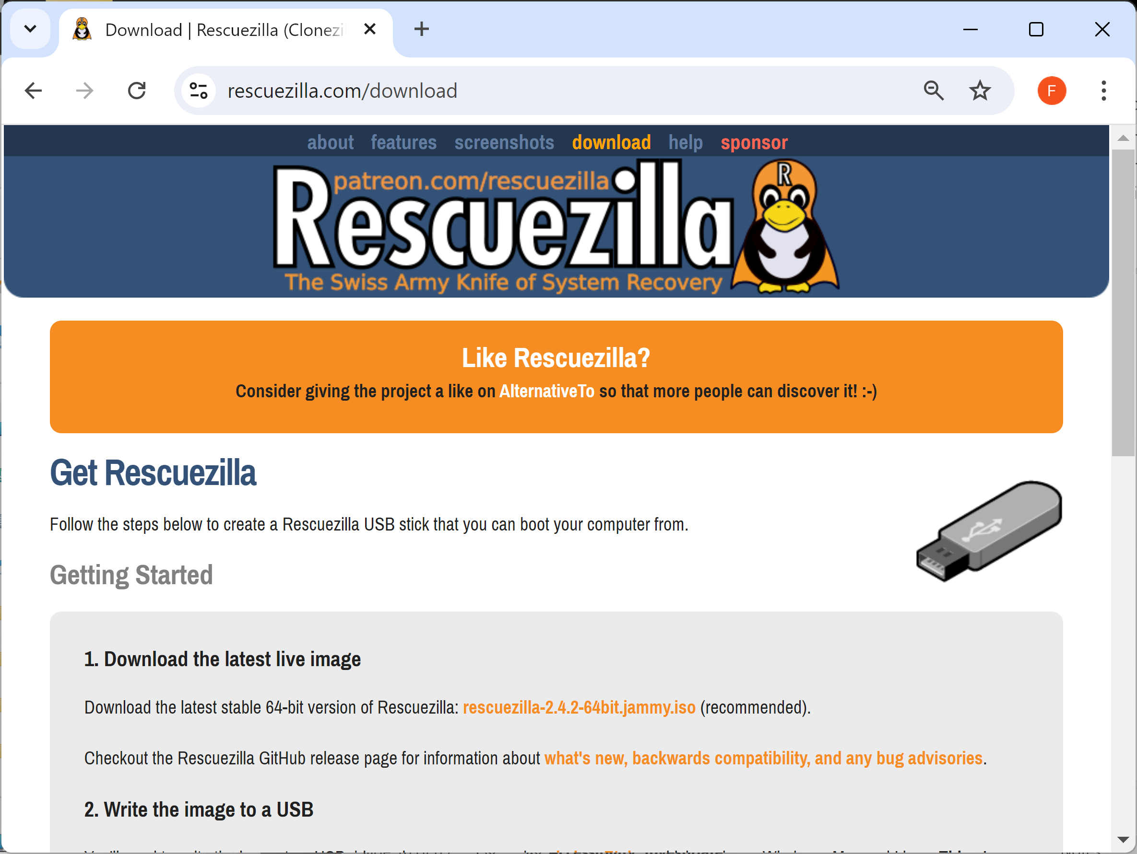
16

Slide 17
DOWNLOAD THE rescuezilla**.iso FILE (continued)
After a minute or two, the rescuezilla**.iso file will reside in the "Downloads" folder of your Windows.. "Users" folder:
17

Slide 18
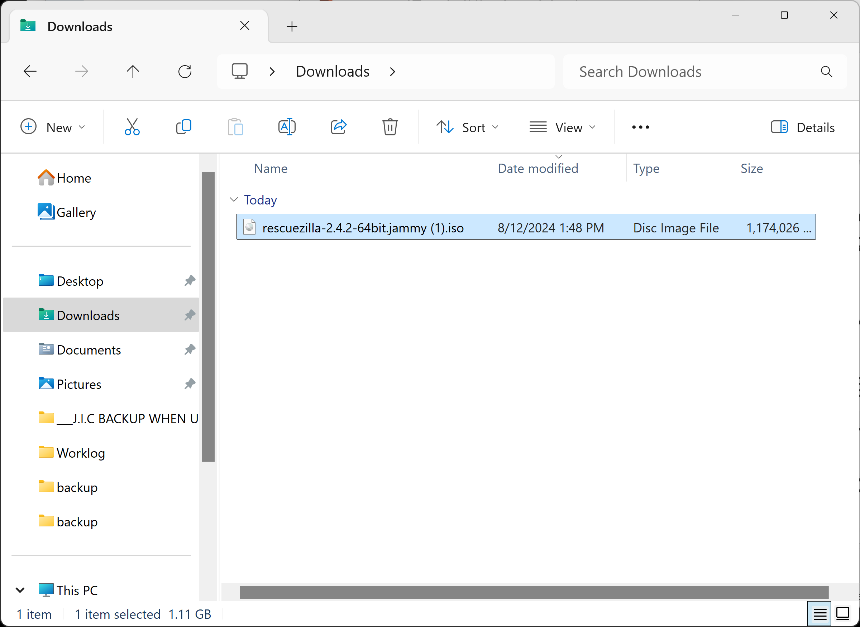
18

Slide 19
DOWNLOAD "balenEtcher PORTABLE"
From inside a "Windows.." computer, use a Web browser to go to https://portableapps.com/apps/utilities/balenaetcher-portable
19

Slide 20
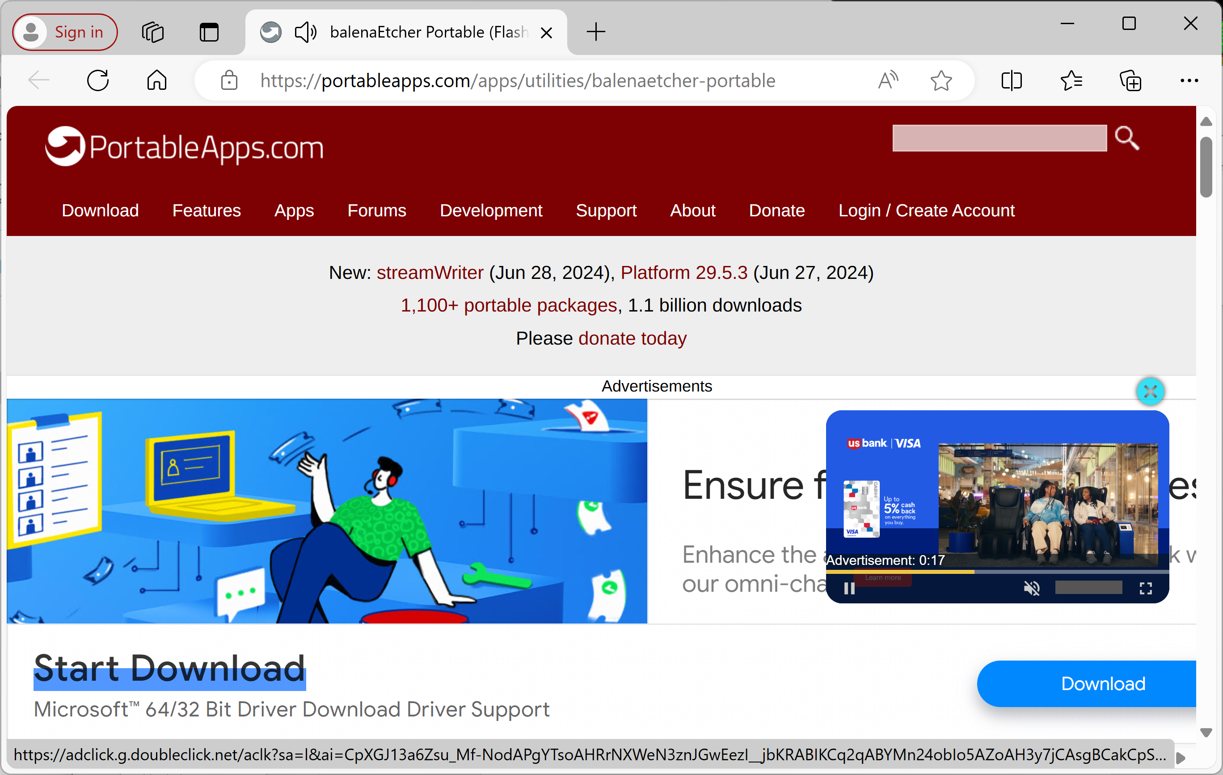
20

Slide 21
DOWNLOAD "balenEtcher PORTABLE"
Scroll or page vertically downward to get past the ads
21

Slide 22
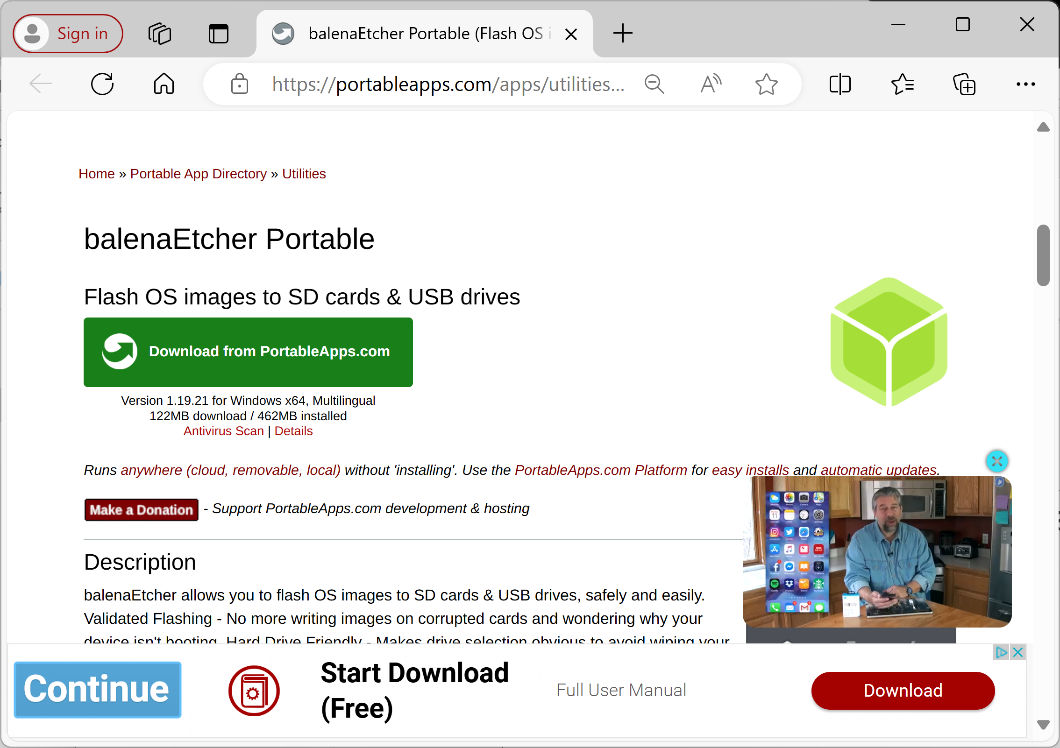
22

Slide 23
DOWNLOAD "balenEtcher PORTABLE"
Double-click on "Download from PortableApps.com" under "balenEtcher Portable":
23

Slide 24
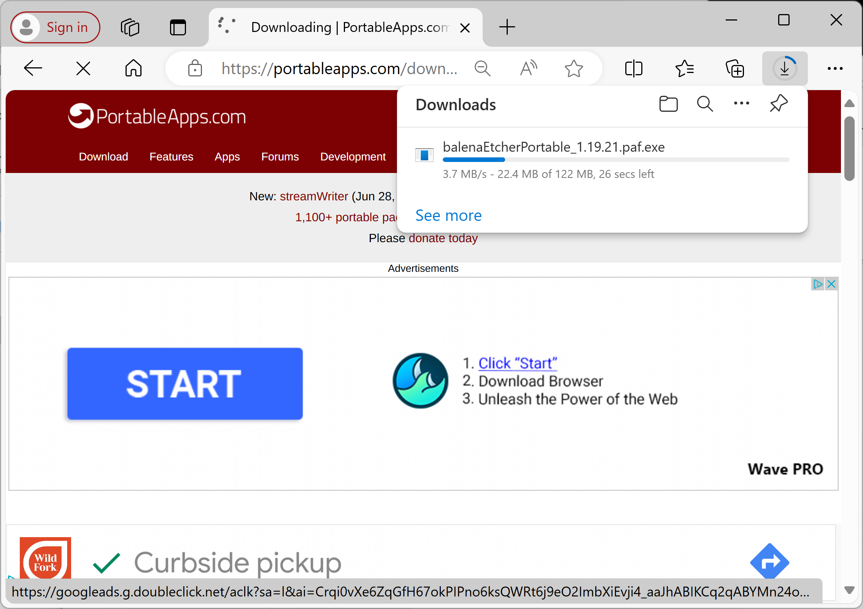
24

Slide 25
DOWNLOAD "balenEtcher PORTABLE"
balenaEtcherPortable_1.19.21.paf.exe will download into the "Downloads" folder of your Windows.. computer:
25

Slide 26
DOWNLOAD "balenEtcher PORTABLE"
Go to the "Downloads" folder inside "File Explorer" and use the LEFT mouse button to double-click on balenaEtcherPortable_1.19.21.paf.exe
26

Slide 27
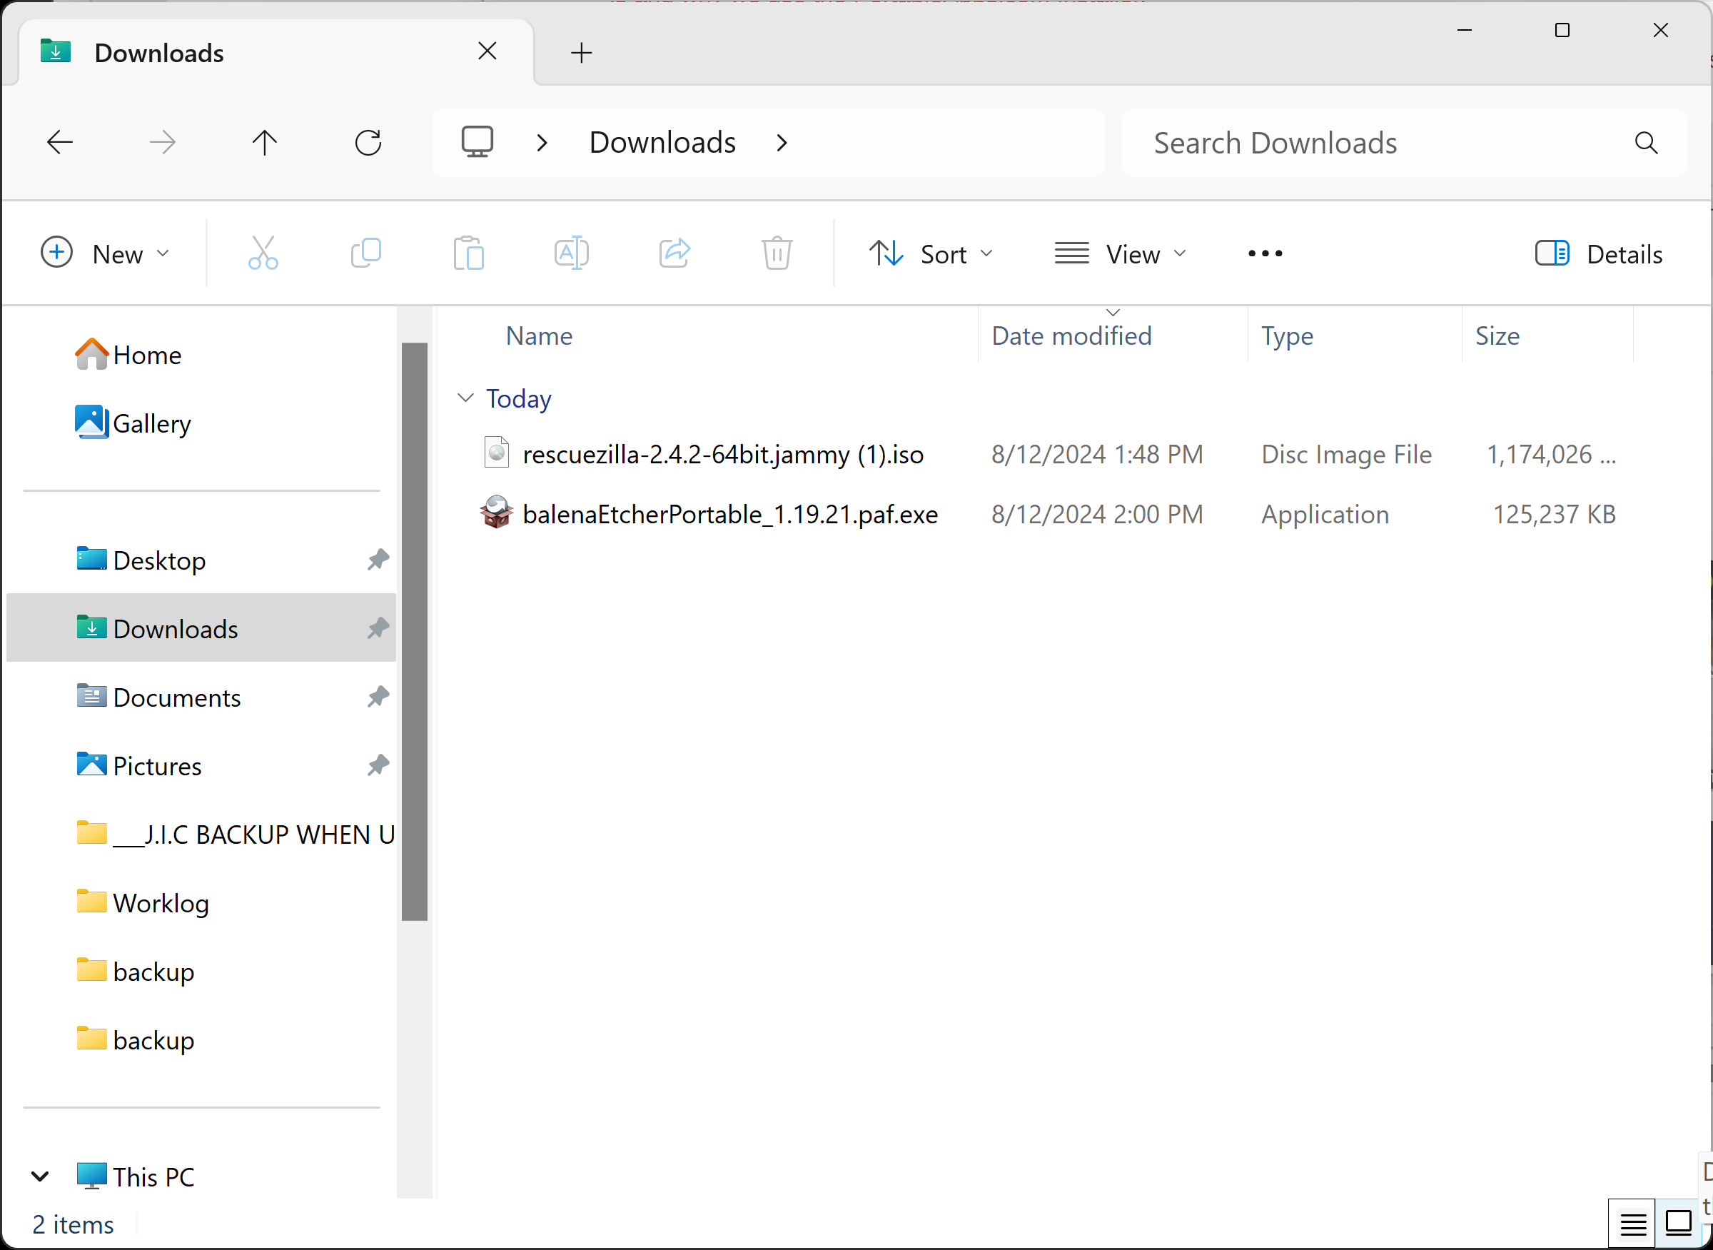
27

Slide 28
DOWNLOAD "balenEtcher PORTABLE"
Click on the "Okay" button:
28

Slide 29
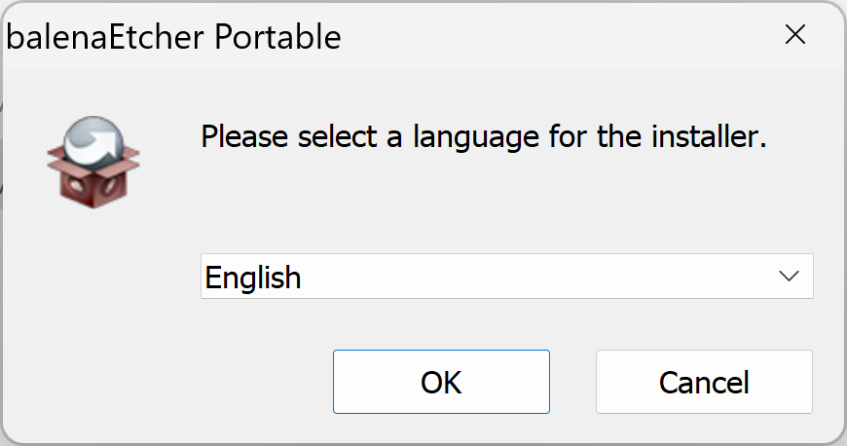
29

Slide 30
DOWNLOAD "balenEtcher PORTABLE"
Click on the "Next" button:
30

Slide 31
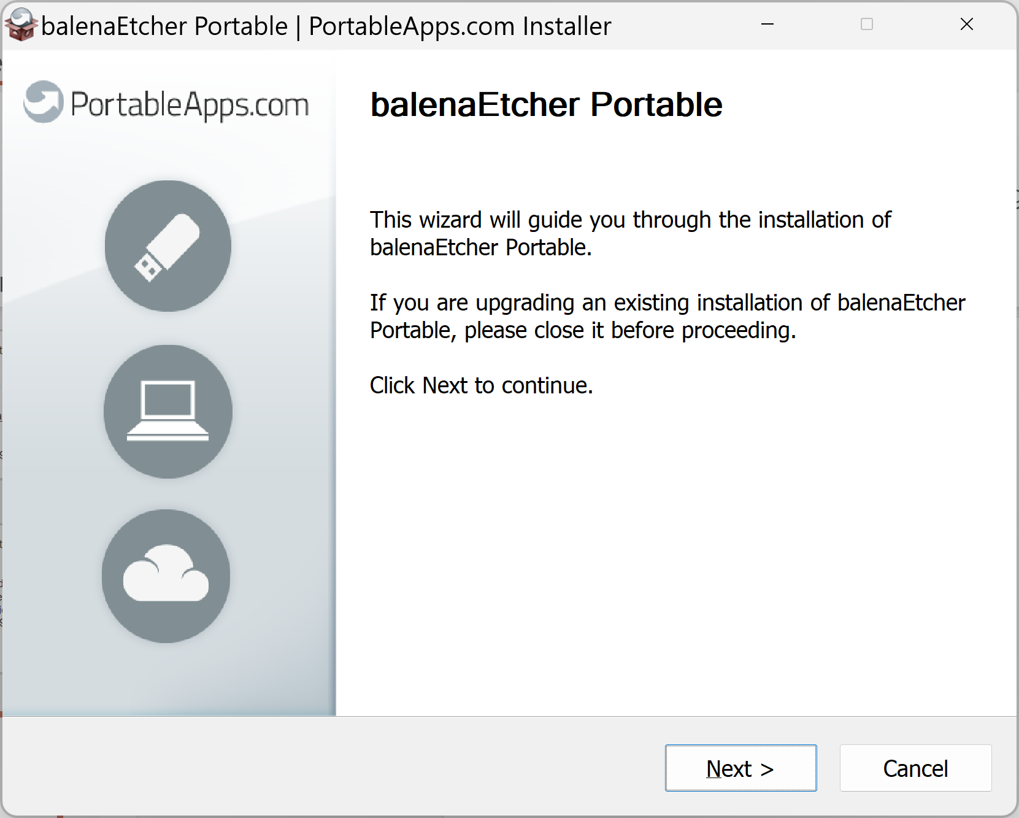
31

Slide 32
DOWNLOAD "balenEtcher PORTABLE"
Click on the "Install" button:
32

Slide 33
33

Slide 34
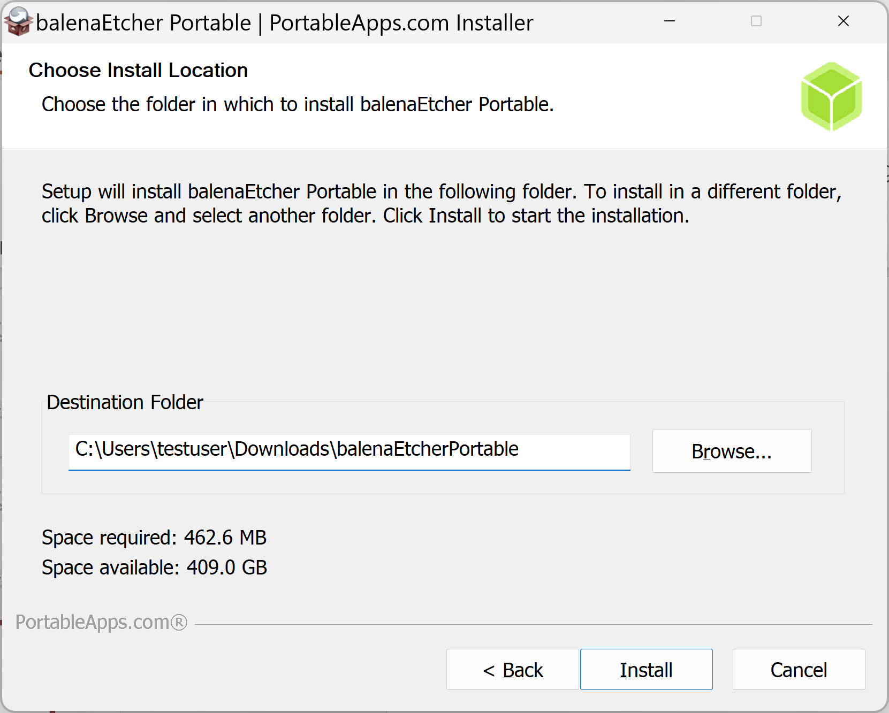
34

Slide 35
35

Slide 36
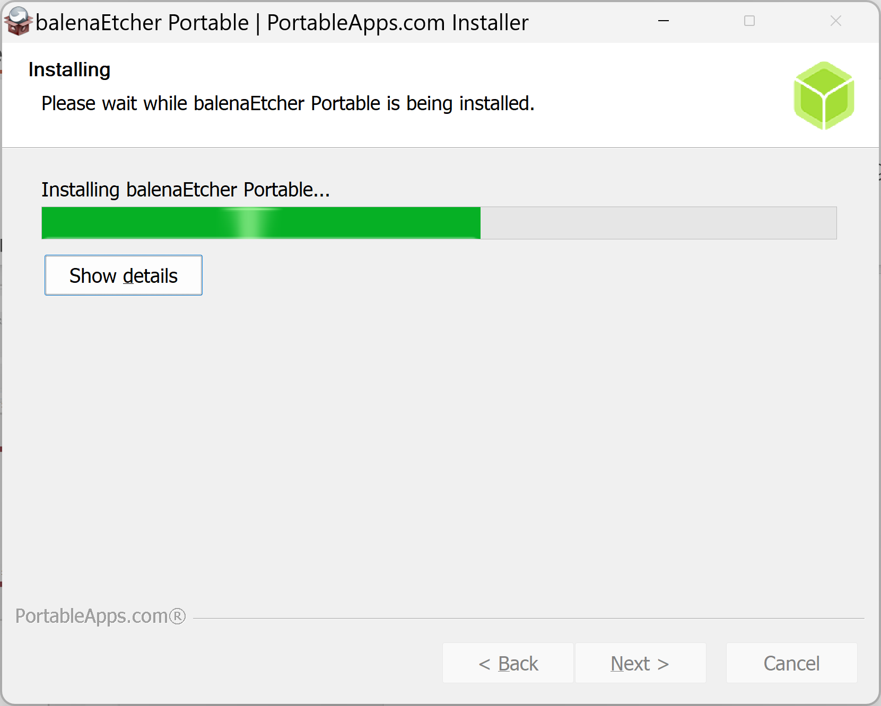
36

Slide 37
37

Slide 38
USE "balenEtcher PORTABLE"
Click on the "Finish" button:
38

Slide 39
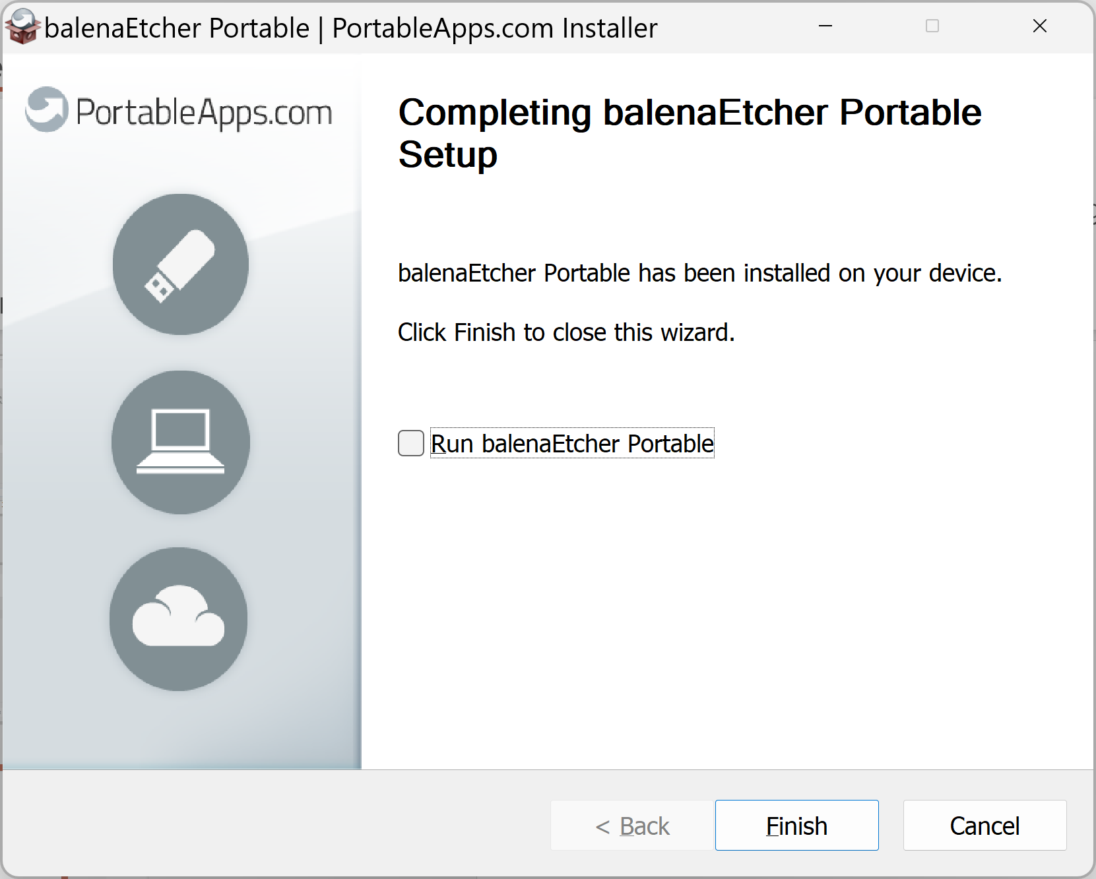
39

Slide 40
USE "balenEtcher PORTABLE"
Use the LEFT mouse button to double-click and open the balenEtcherPortable folder inside the "Downloads" folder:
40

Slide 41
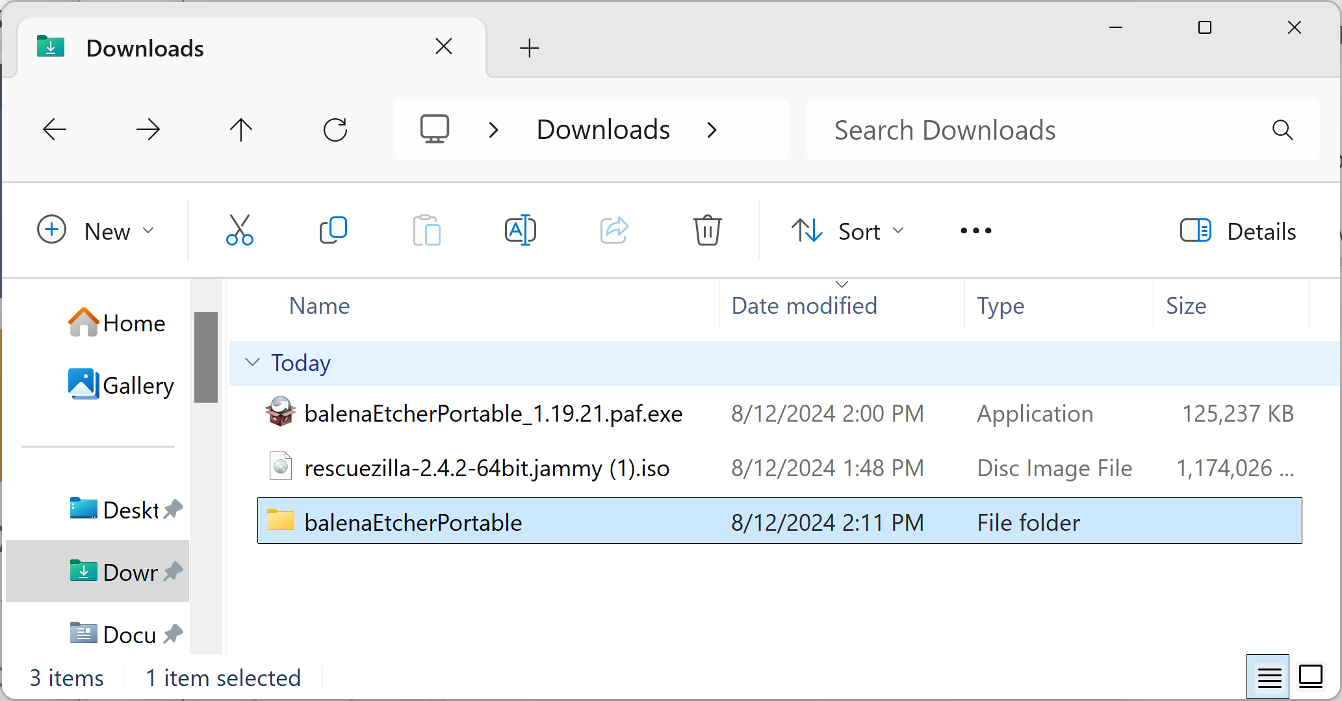
41

Slide 42
USE "balenEtcher PORTABLE" (continued)
Use the LEFT mouse button to double-click and open the App folder inside the balenEtcherPortable folder :
42

Slide 43
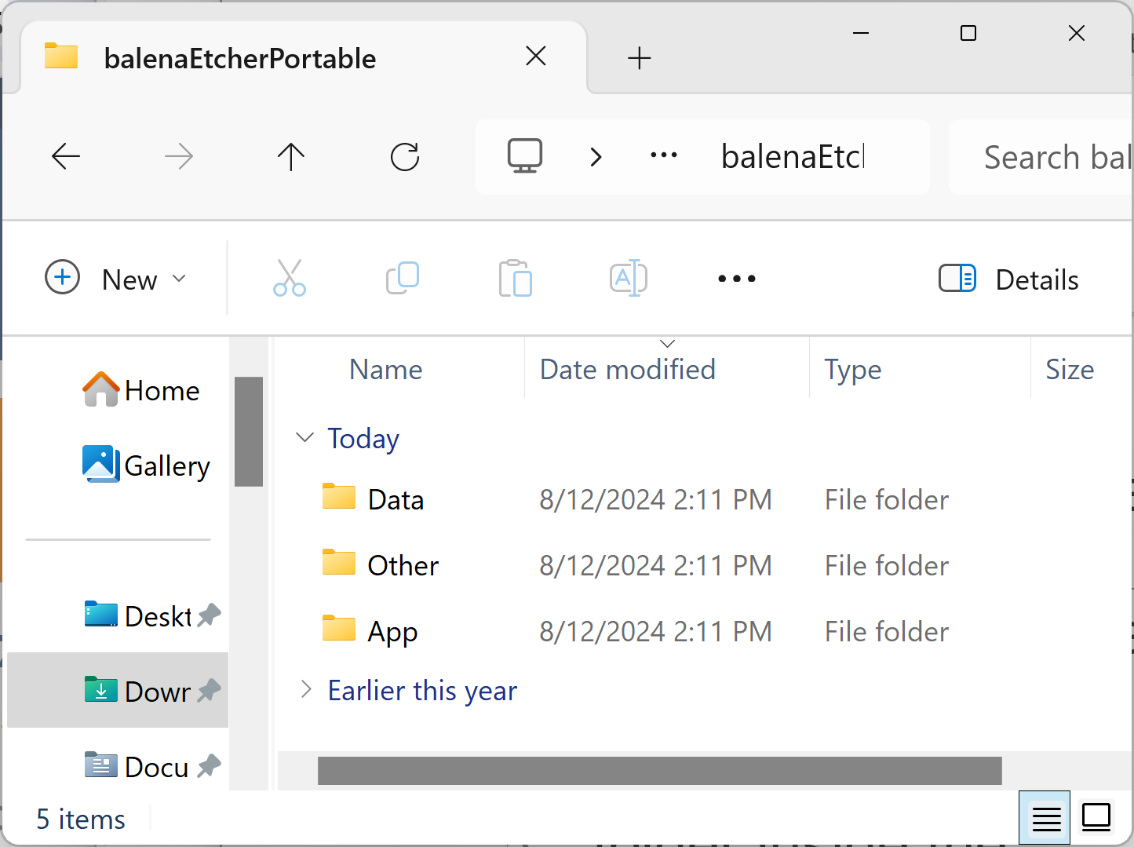
43

Slide 44
USE "balenEtcher PORTABLE" (continued)
Use the LEFT mouse button to double-click and open balenEtcher64 folder inside the App folder :
44

Slide 45
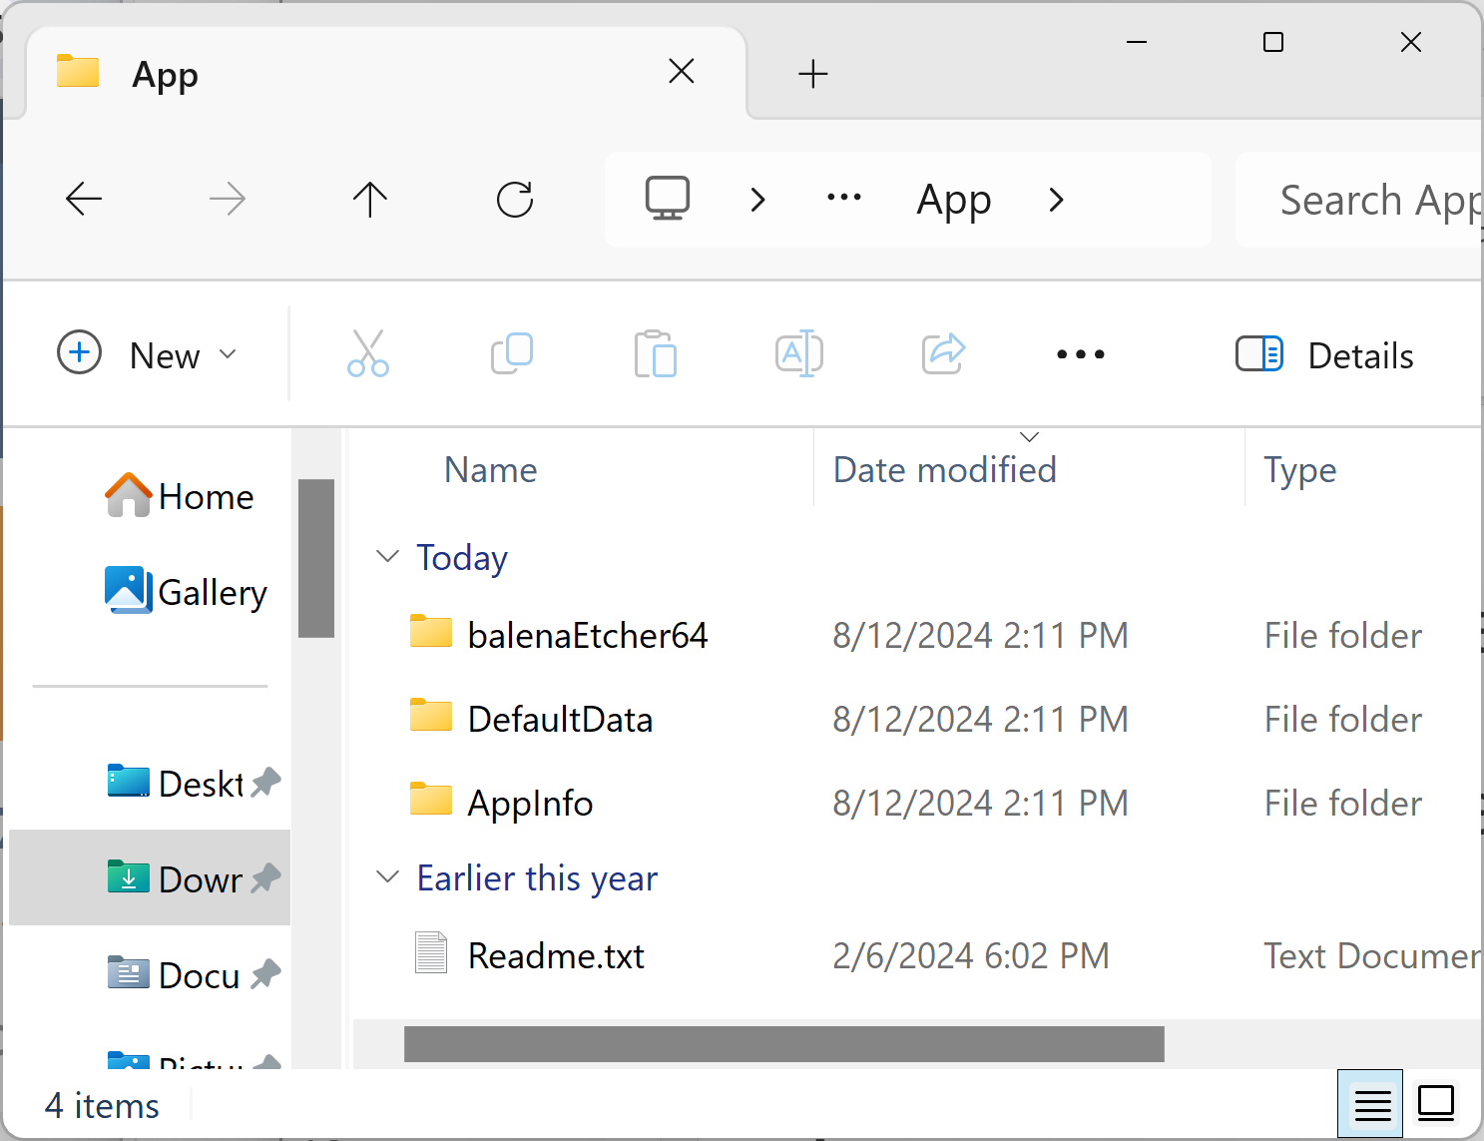
45

Slide 46
USE "balenEtcher PORTABLE" (continued)
Use the LEFT mouse button to double-click on balenEtcher.exe inside the balenEtcher64 folder :
46

Slide 47
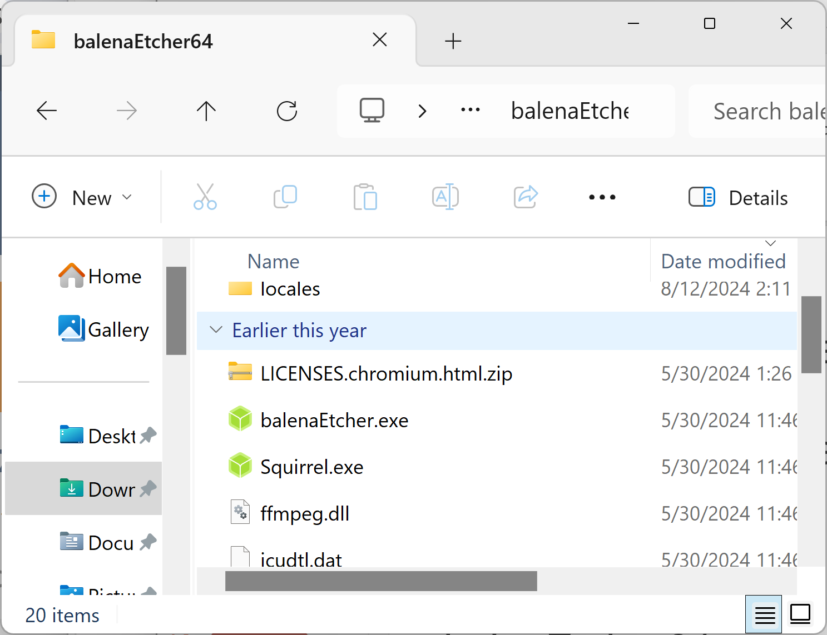
47

Slide 48
USE "balenEtcher PORTABLE" (continued)
The app window for balenEtcher64 will finally be displayed:
48

Slide 49
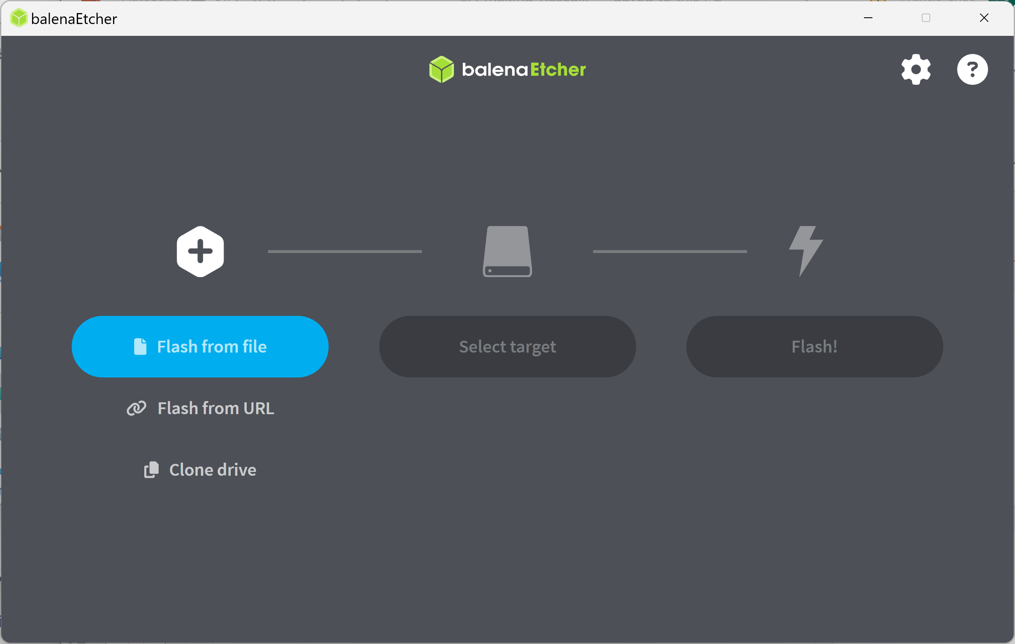
49

Slide 50
USE "balenEtcher PORTABLE" (continued)
Use the LEFT mouse button to click on "Flash from file":
50

Slide 51
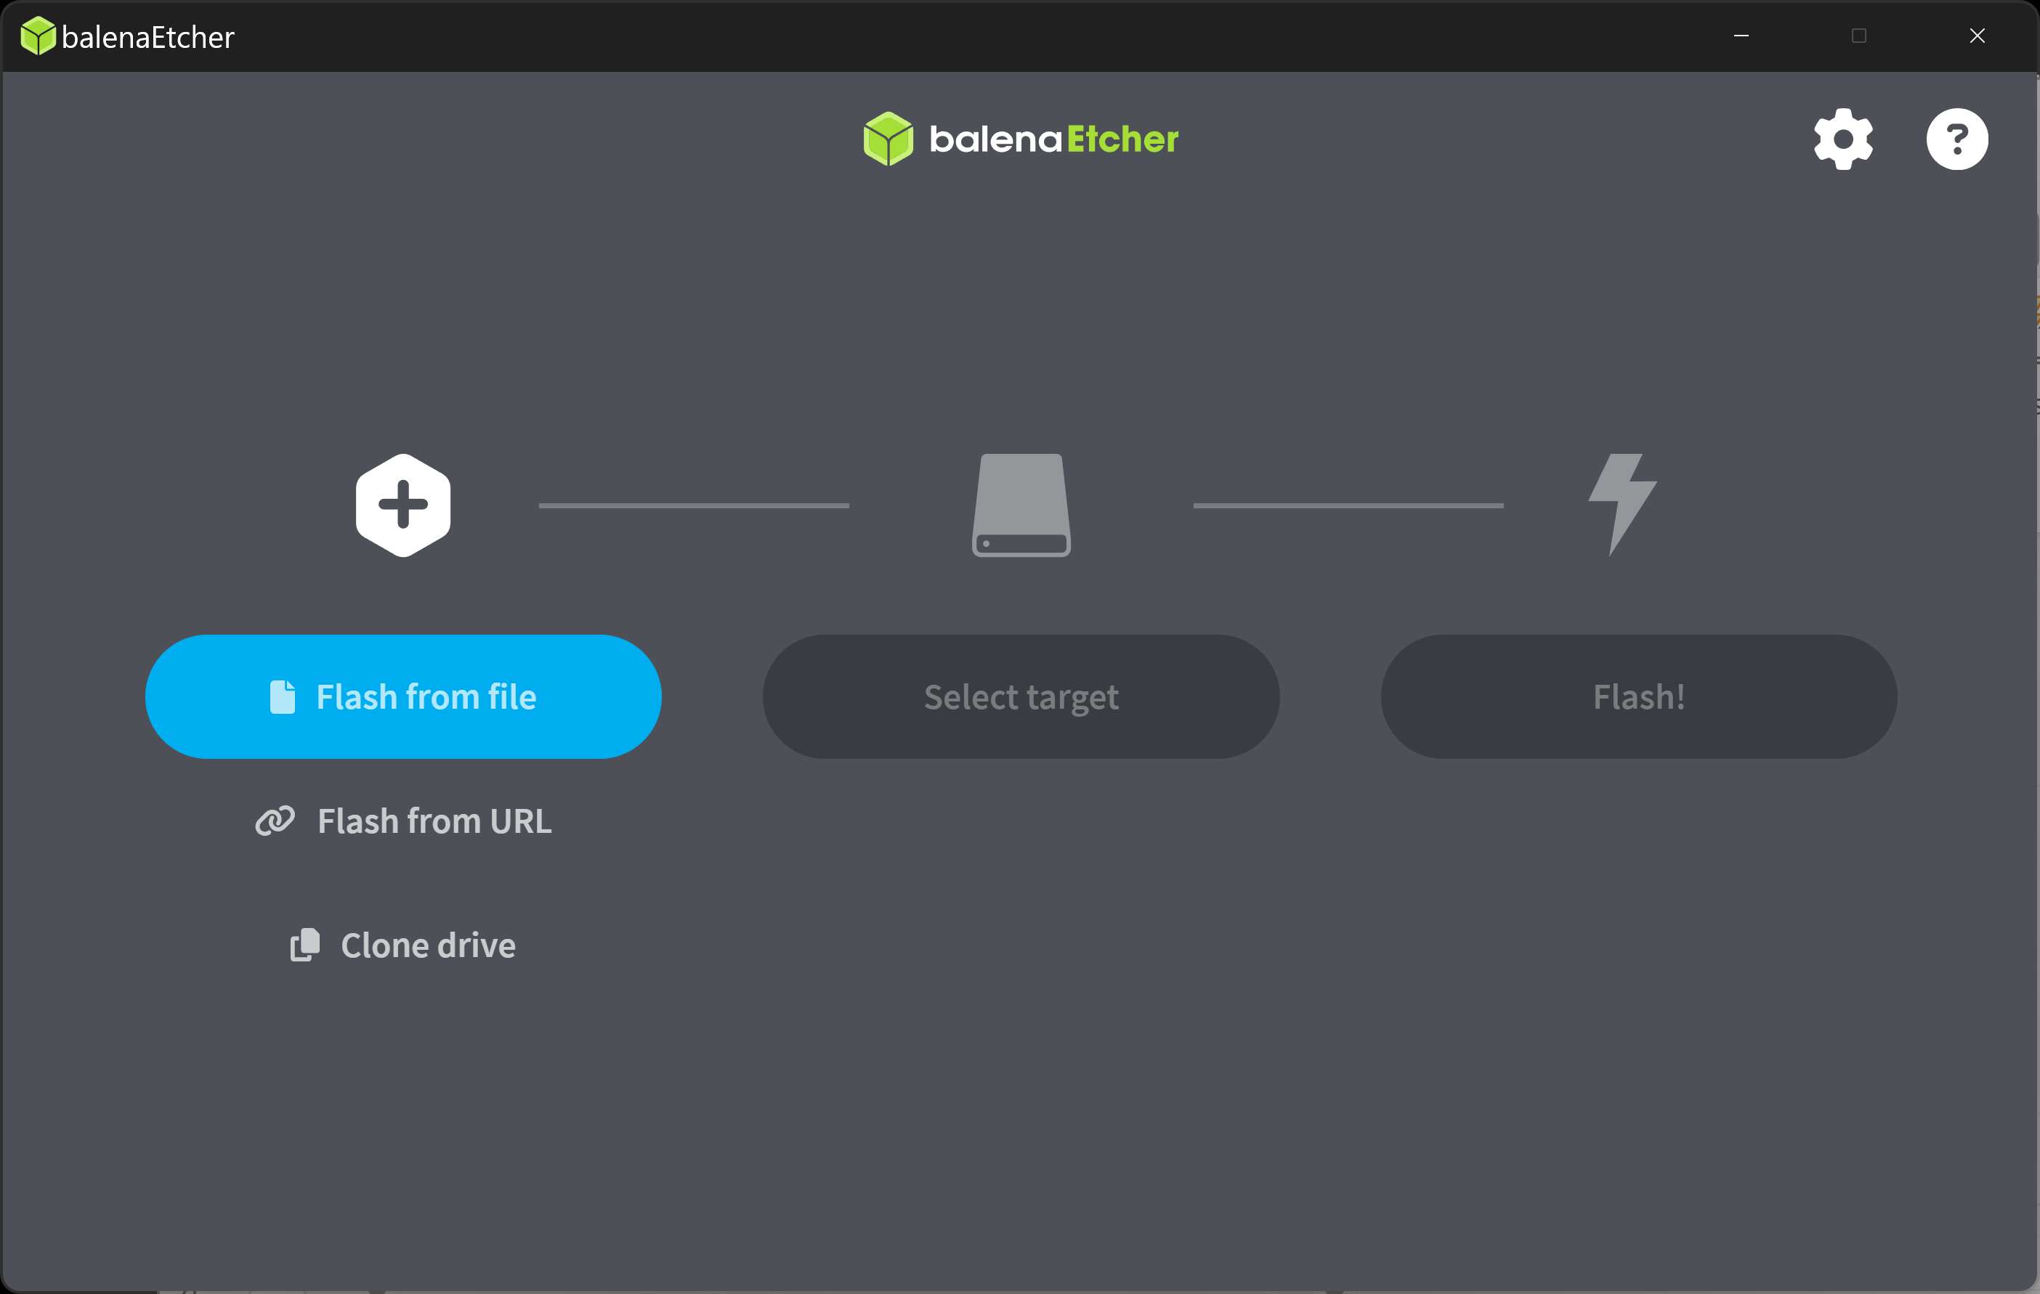
51

Slide 52
USE "balenEtcher PORTABLE" (continued)
An "Open" dialog box will be displayed:
52

Slide 53
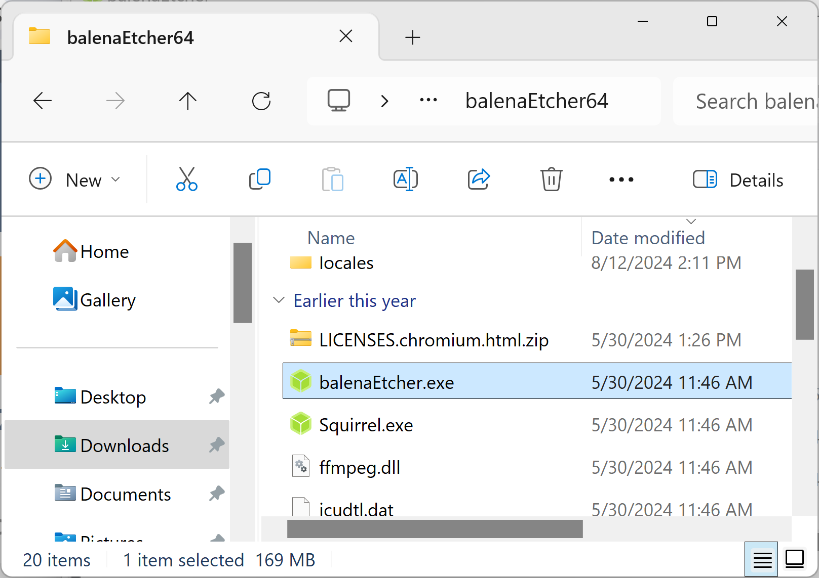
53

Slide 54
USE "balenEtcher PORTABLE" (continued)
From inside the "Open" dialog box locate the "Downloads" folder and double-click on it:
54

Slide 55
55

Slide 56
USE "balenEtcher PORTABLE" (continued)
Double-click on the rescuezilla-********.jammy.iso file that you downloaded earlier
56

Slide 57
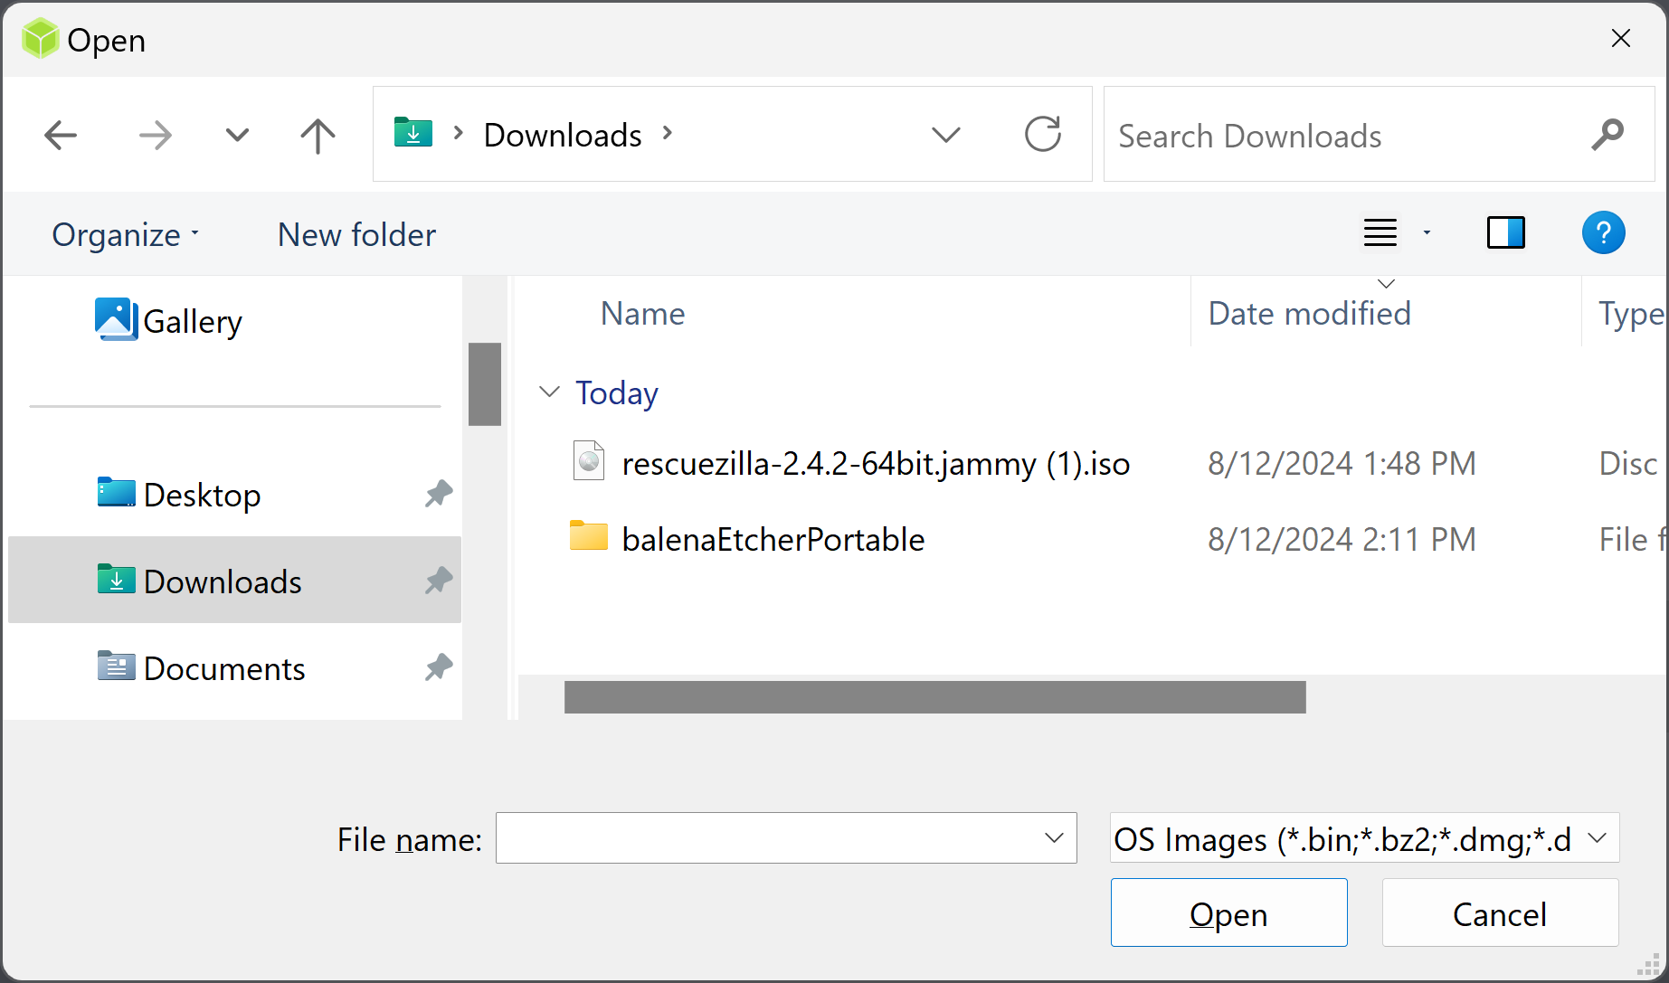
57

Slide 58
USE "balenEtcher PORTABLE" (continued)
You will now be back at the balenEtcher main window:
58

Slide 59
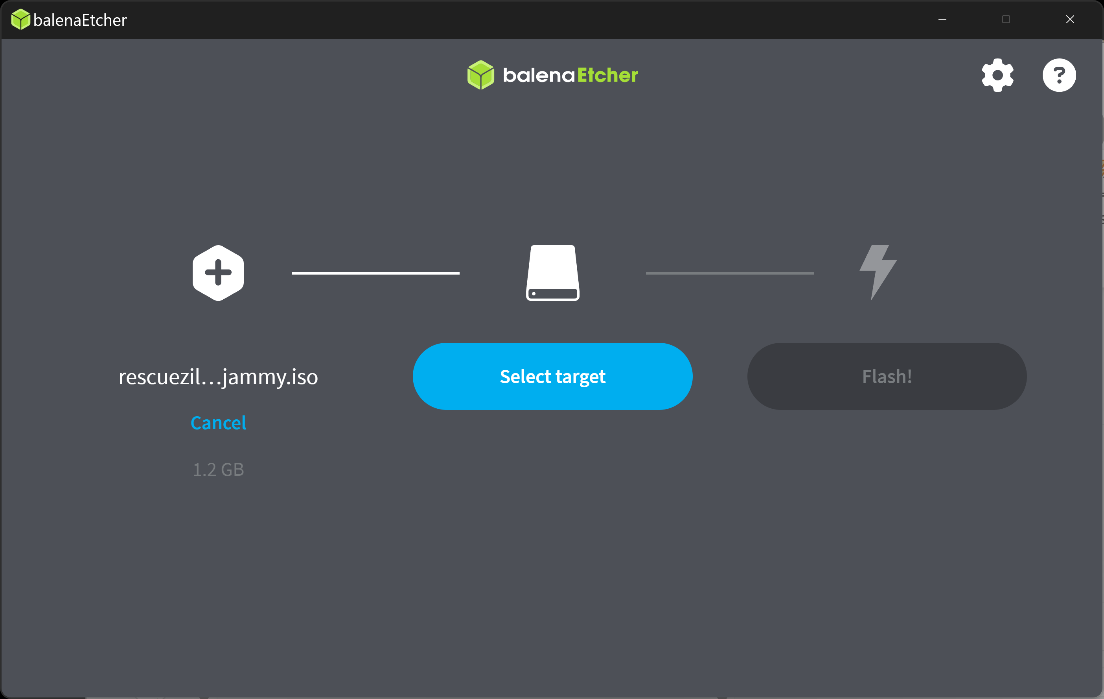
59

Slide 60
USE "balenEtcher PORTABLE" (continued)
Use the LEFT mouse button to click on the "Select target" button:
60

Slide 61
61

Slide 62
USE "balenEtcher PORTABLE" (continued)
Click on the USB drive or USB flash drive that you wish to make into a bootable flash drive:
62

Slide 63
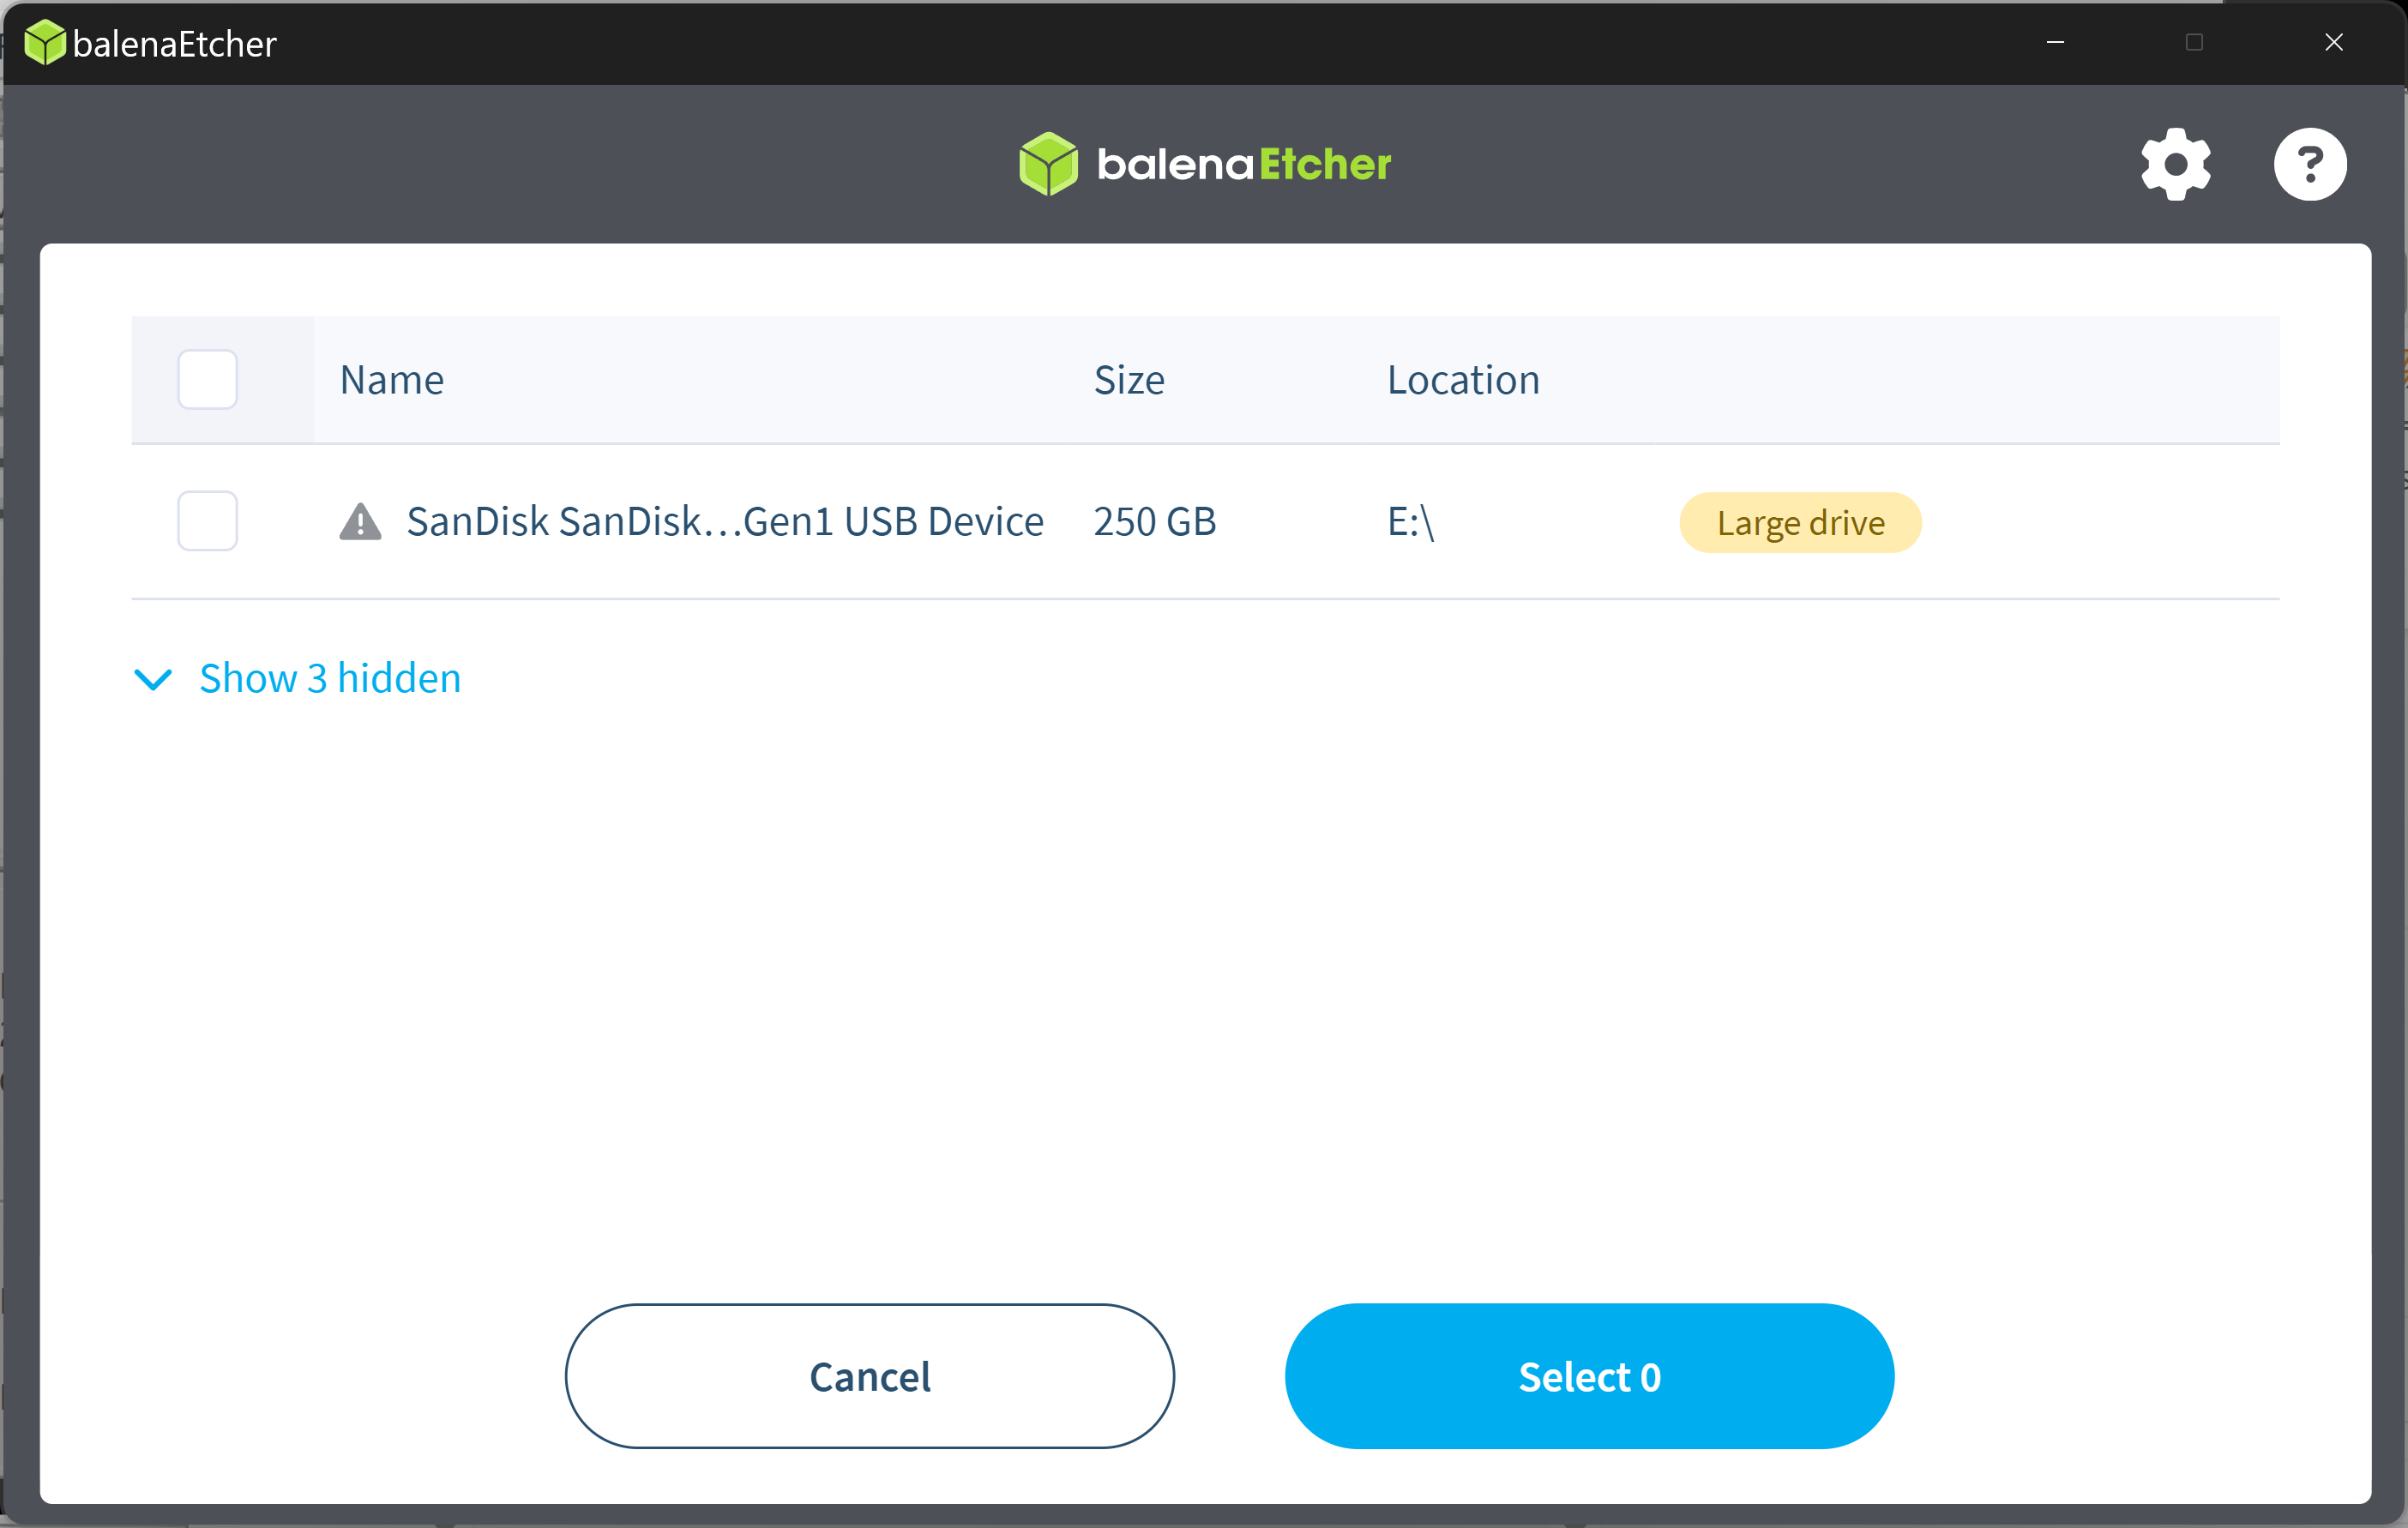
63

Slide 64
64

Slide 65
USE "balenEtcher PORTABLE" (continued)
The USB drive or USB flash drive that you clicked on will become highlighted:
65

Slide 66

66

Slide 67
USE "balenEtcher PORTABLE" (continued)
Click on the "Select 1" button:
67

Slide 68
68

Slide 69
USE "balenEtcher PORTABLE" (continued)
You will be returned to the main balenEtcher window:
69

Slide 70
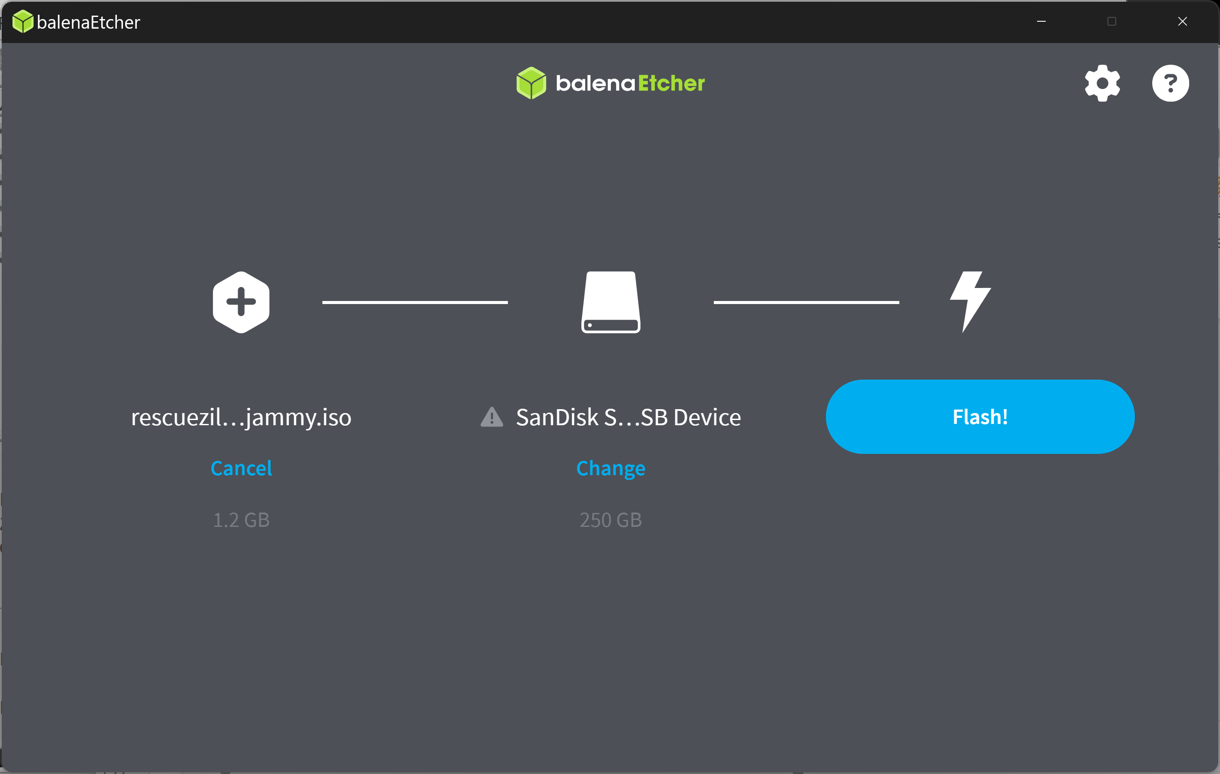
70

Slide 71
USE "balenEtcher PORTABLE" (continued)
Click on the "Flash!" button in the main balenEtcher window:
71

Slide 72
72

Slide 73
USE "balenEtcher PORTABLE" (continued)
Click on the "Yes, I'm sure" button:
73

Slide 74
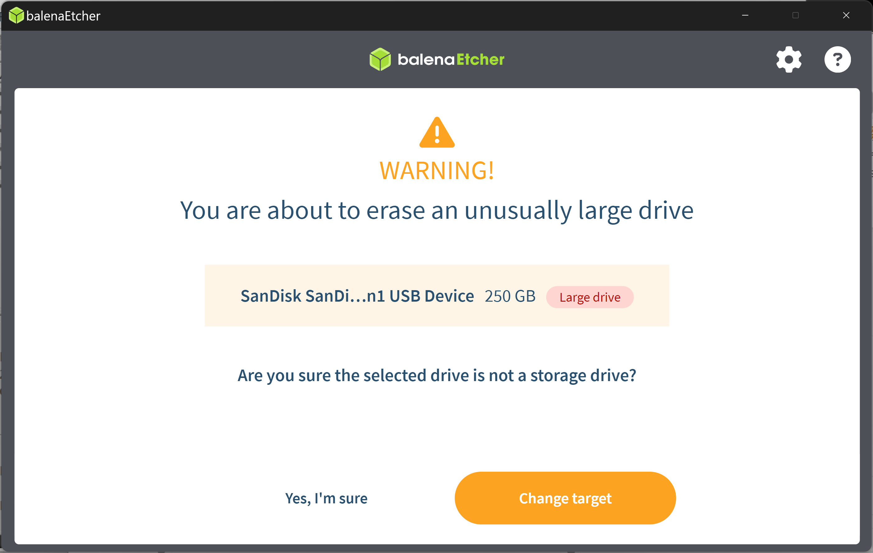
74

Slide 75
75

Slide 76
USE "balenEtcher PORTABLE" (continued)
If a "User Account Control" dialog box is displayed, click on it's "Yes" button
76

Slide 77
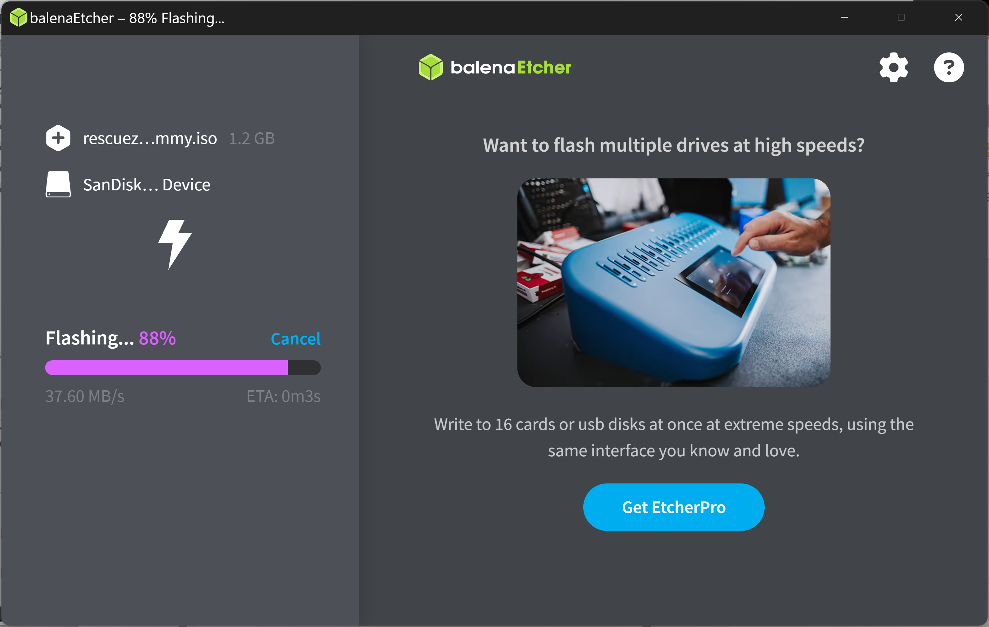
77

Slide 78
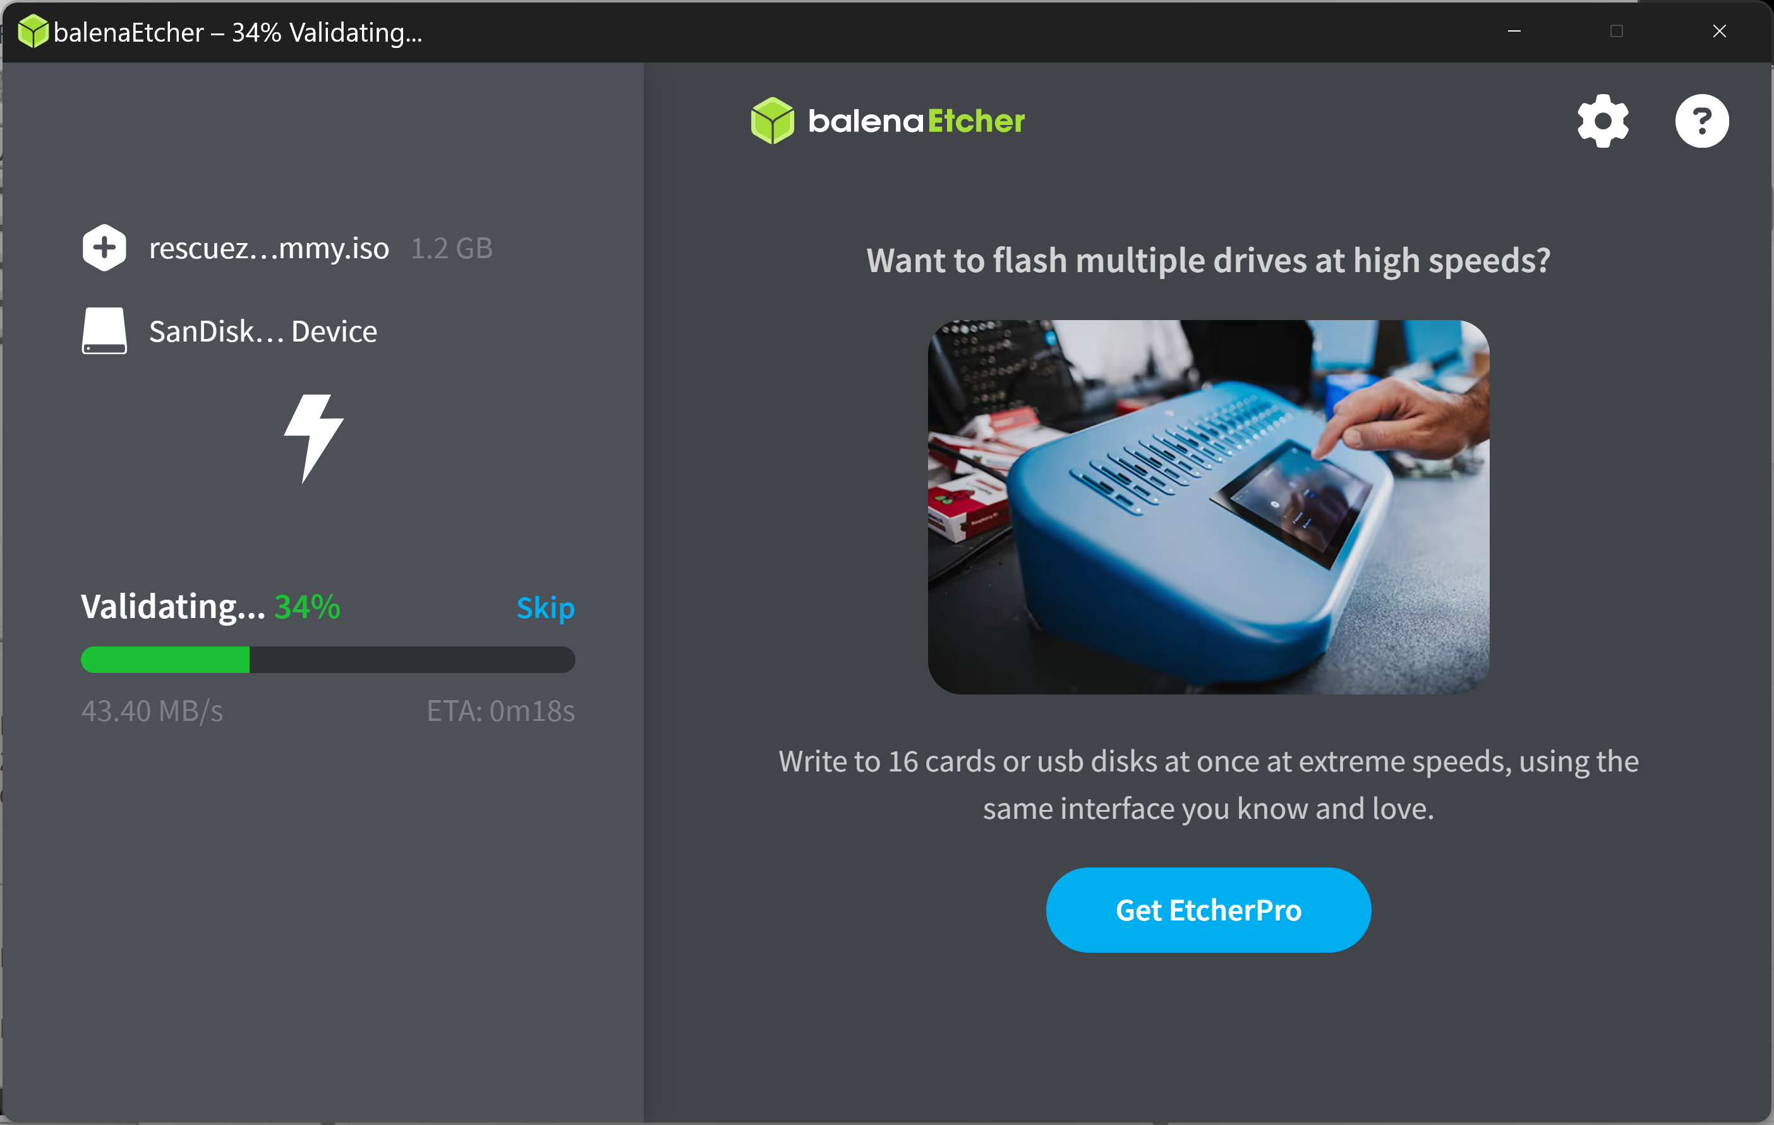
78

Slide 79
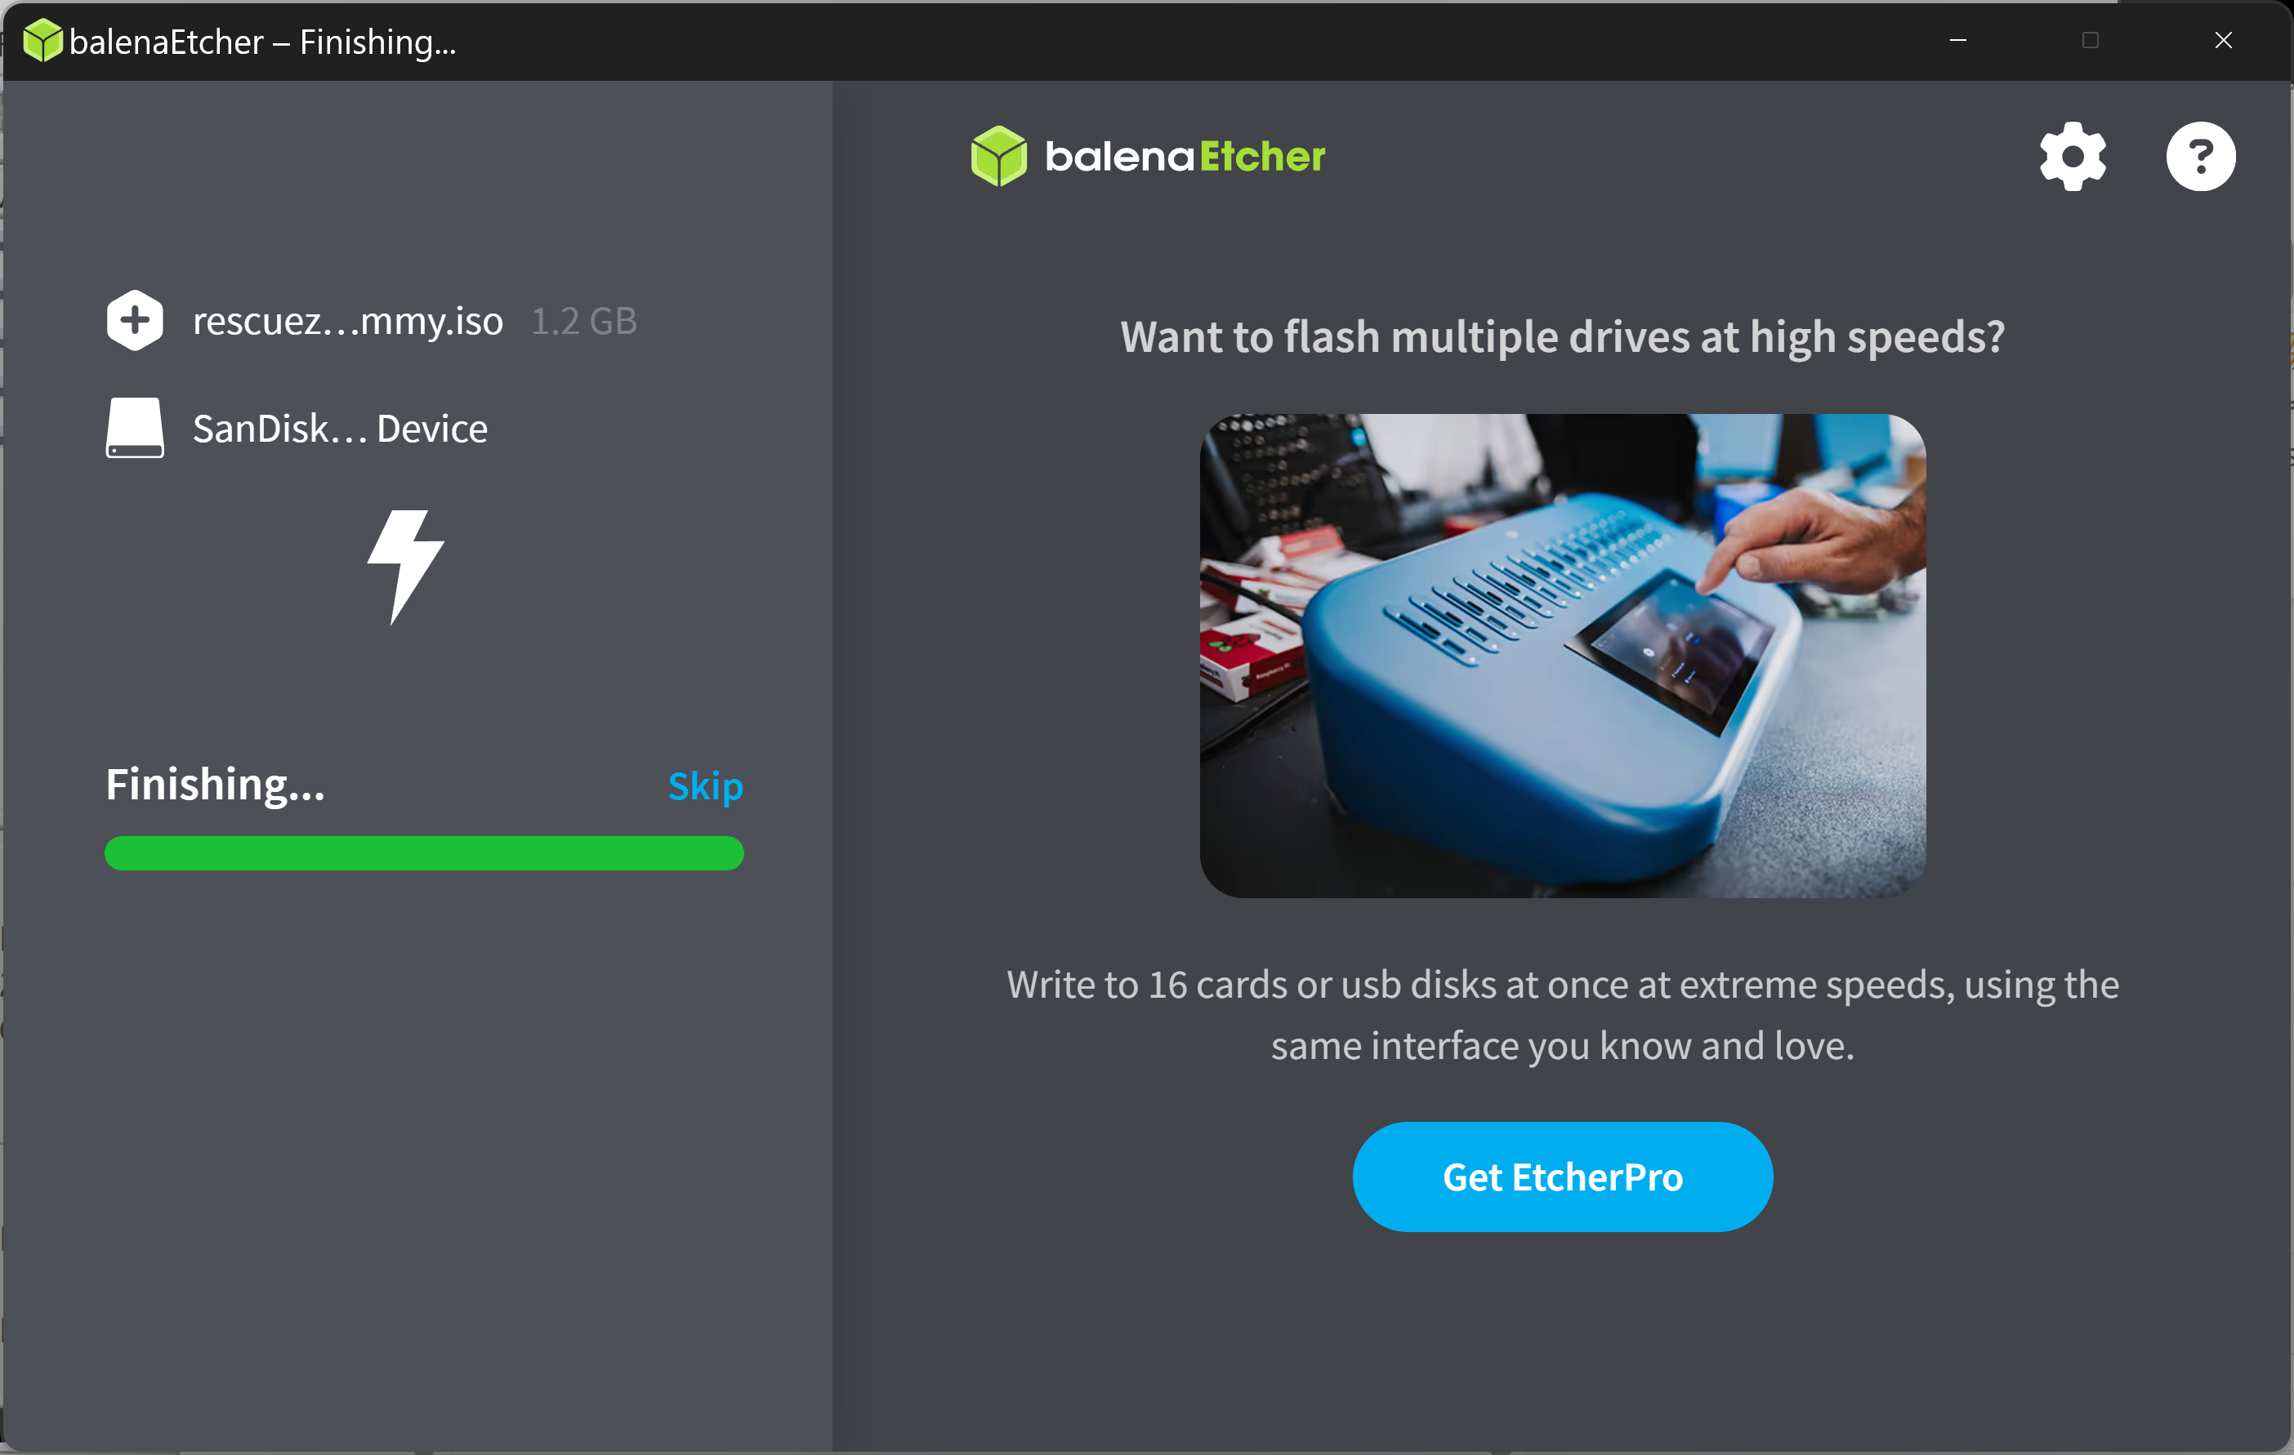
79

Slide 80
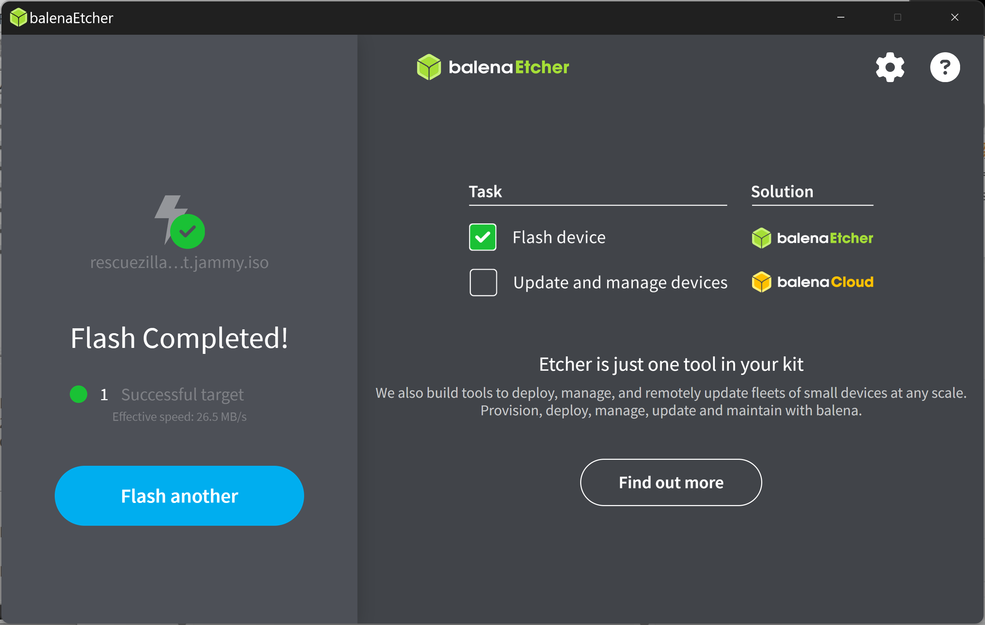
80

Slide 81
USE "balenEtcher PORTABLE" (continued)
Close the "balenEtcher" Window by clicking on the "X" button in it's upper-right corner.
81

Slide 82
82

Slide 83
USE "balenEtcher PORTABLE" (continued)
The USB thumb drive or USB hard drive that you selected is now a bootable device for running "Rescuezilla". Since "Rescuezilla" is a distribution of Linux, do not expect to see much of it's details if you use "File Explorer" or "Disk Management" in a Windows.. computer.
83

Slide 84
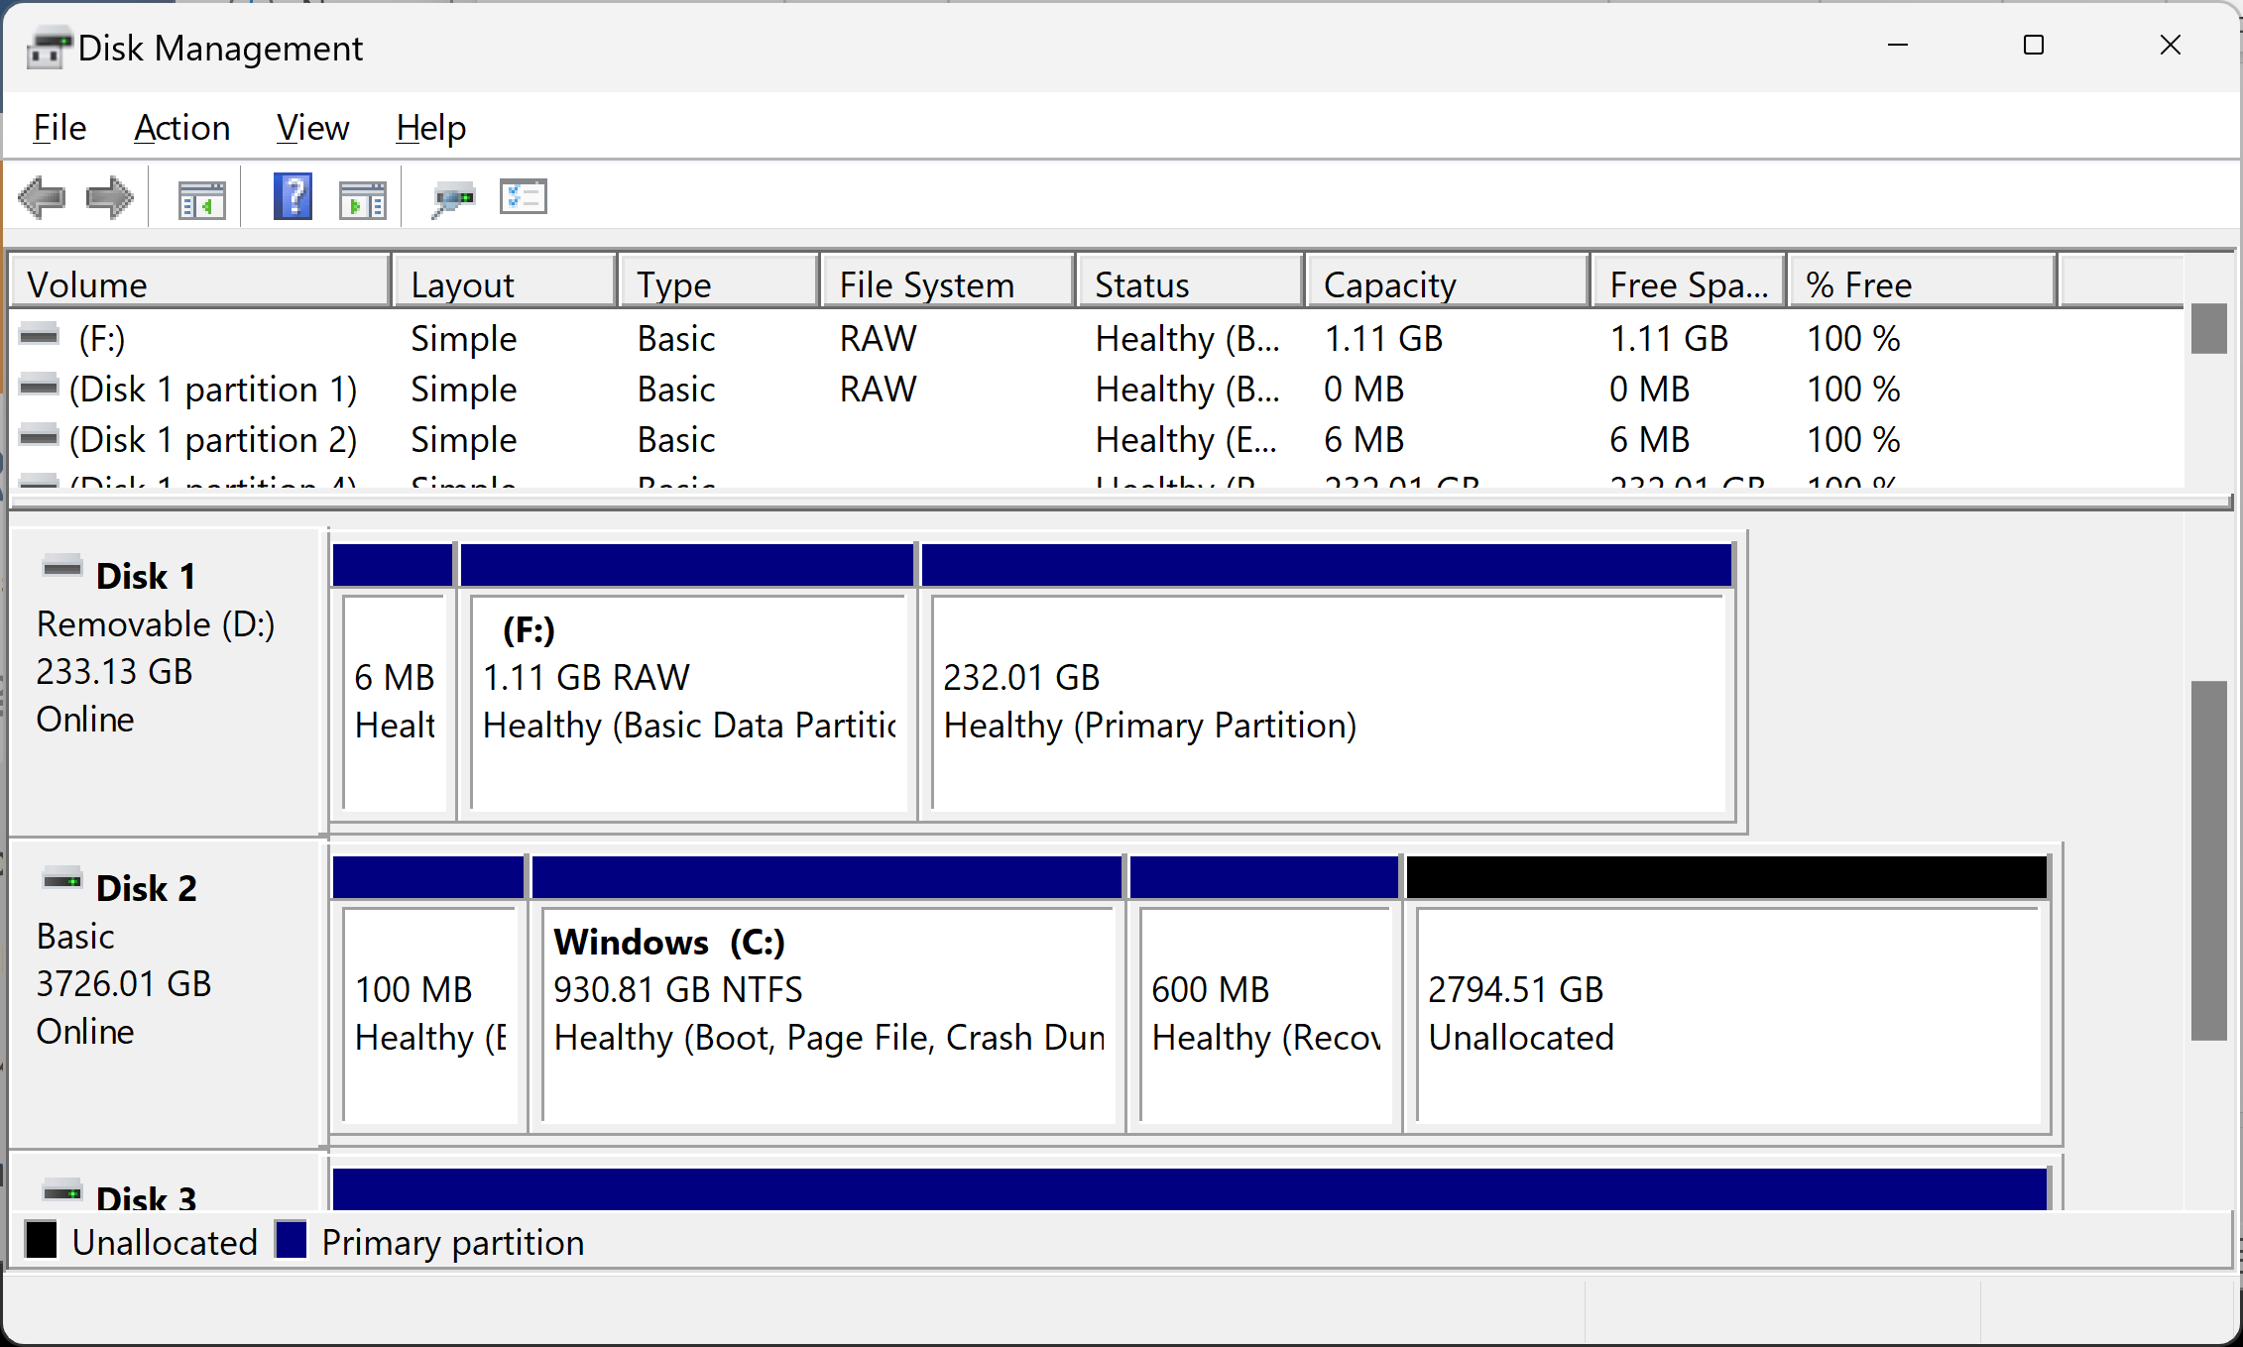
84

