Slide 1



AN INTRODUCTION TO "LINUX MINT" FOR "WINDOWS.." USERS

Slide 2
Web location for this presentation:
http://aztcs.apcug.org
Then click on "Meeting Notes"
email: fchao2@yahoo.com
2

Slide 3
TOPICS
Taskbar versus Panel
Applications Menu
"Task View" versus "Workspaces Switcher"
File Management
Keyboard Combinations
File Extensions
File Format Identification
Device Manager
3

Slide 4
TASKBAR
The "Panel" in Linux Mint serves the same function as the "Taskbar" in Windows 11 and Windows 10.
4

Slide 5
APPLICATIONS MENU
Windows: Use the LEFT mouse button to click on the "Start" button OR press on one of the "Windows" keys of the keyboard. The menu that pops up is often called the "Start Menu".
5

Slide 6
APPLICATIONS MENU (continued)
Linux Mint: Use the LEFT mouse button to click on the "LM" menu button at the end of the "Panel" OR press on one of the "Super" keys of the keyboard.
The big three column menu that pops up is called either the "Application Menu" or the "Cinnamon Menu".
6

Slide 7
"TASK VIEW" VS. "WORKSPACES SWITCHER"
"Task View" in "Windows" and
"Workspaces Switcher" in "Linux Mint":
Use "Task View" in "Windows" to manage multiple active app windows across multiple virtual desktops
Use "Workspaces Switcher" in "Linux int" to manage multiple active apps across multiple virtual desktops
7

Slide 8
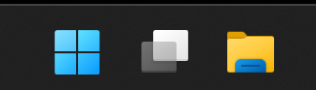
"TASK VIEW" VS. "WORKSPACES SWITCHER" (continued)
Windows:
To start "Task View", use the LEFT mouse button to click on the Task View button
or press Alt + Tab on the keyboard
8

Slide 9
"TASK VIEW" VS. "WORKSPACES SWITCHER" (continued)
Linux Mint:
Two Steps: Step 1: Enable "Workspaces Switcher" (Step 1 only needs to be done once) Step 2: Add, remove, and modify "Workspaces" (Needs to be done as needed.)
9

Slide 10
"TASK VIEW" VS. "WORKSPACES SWITCHER" (continued)
Linux Mint: STEP ONE: ENABLE "WORKSPACES SWITCHER"
Use RIGHT mouse button to click on unused space on any Panel.
Use the LEFT mouse button to click on "Applets" on the pop-up menu
Use the LEFT mouse button to s croll or page downward vertically.
Use the LEFT mouse button to click on "Workplace Switcher" to highlight it
10

Slide 11
"TASK VIEW" VS. "WORKSPACES SWITCHER" (continued)
Linux Mint: STEP ONE: ENABLE "WORKSPACES SWITCHER" (continued)
Then use the LEFT mouse button to click on the "+" button
Use the LEFT mouse button to close the "Applets" box
11

Slide 12
"TASK VIEW" VS. "WORKSPACES SWITCHER" (continued)
Linux Mint: (continued) STEP ONE: ENABLE "WORKSPACES SWITCHER" (continued)
At least four "Workspace" rectangles will now appear on the right side of the middle third of the Panel:
12

Slide 13
"TASK VIEW" VS. "WORKSPACES" (continued)
Linux Mint (continued)
STEP TWO-- Add, remove, and modify "Workspaces"
METHOD 1:
Press Ctrl + Alt + Up on the keyboard to open the Workspace overview.
Click the + symbol on the right side of the screen to add a new workspace.
Add, remove, or modify any existing workspace
Press Escape on the keyboard to return to your active desktop.
13

Slide 14
"TASK VIEW" VS. "WORKSPACES" (continued)
Linux Mint (continued)
STEP 2-- Add, remove, and modify "Workspaces"
METHOD 2:
Use the RIGHT mouse button to click on any of the Workspace rectangles.
Use the LEFT mouse button to select from the pop-up menu
Add, remove, or modify any existing workspace
Press Escape on the keyboard to return to your active desktop.
14

Slide 15
FILE MANAGEMENT
Windows:
Standard privileges:
Use the LEFT mouse button to click on the File Explorer button in the Taskbar or the Start menu. The File Explorer button looks like a folder.
OR
Use the keyboard to press on Windows key + e
15

Slide 16
FILE MANAGEMENT (continued)
Windows (continued):
Administrative privileges:
Use the LEFT mouse button to click on the File Explorer button in the Taskbar or the Start menu or use the keyboard to press "Windows Key" + e
Go to the C: drive.
Scroll or page vertically downword
Go to the "Windows" folder
Use the RIGHT mouse button to click on explorer.exe A pop-up menu will be displayed.
Use the LEFT mouse button to click on "Run as administrator"
16

Slide 17
FILE MANAGEMENT (continued)
Linux Mint:
Standard privileges:
The file management app in Linux Mint is called "Nemo":
Use the LEFT mouse button to click on the "Files" button on the "Panel". It looks like a folder. OR press the Super Key + e on the keyboard
17

Slide 18
FILE MANAGEMENT (continued)
Linux Mint:
Standard privileges (continued):
If the "Files" button is missing from the Panel: Use the LEFT mouse button to click on the "LM" "menu" button.
Use the LEFT mouse button to click on "Accessories" in the center column.
Use the RIGHT mouse button to click on "Files" in the right-most column.
Use the LEFT mouse button to click on "+ Add to panel"
18

Slide 19
FILE MANAGEMENT (continued)
Linux Mint (continued):
Administrative privileges: Use the LEFT mouse button to start "Terminal" Type in sudo nemo Press the Enter key of the keyboard. Enter in your password for "Linux Mint" Press the Enter key of the keyboard.
19

Slide 20
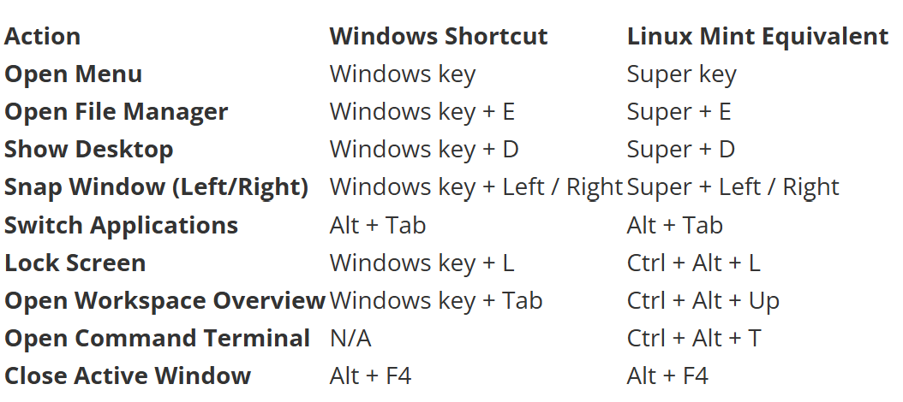
KEYBOARD COMBINATIONS
20

Slide 21
FILE EXTENSIONS
Windows:
The "File Explorer" app in Windows.. defaults to hiding file extensions. This default configuration is often confusing so we recommend removing the checkmark in the View tab of "File Explorer Options"
Linux Mint:
The Nemo "Files" app in Linux Mint does not hide file extensions
21

Slide 22
FILE FORMAT IDENTIFICATION
Windows: File formats are identified by the 3 or 4 digit file extension of a file name.
22

Slide 23
FILE FORMAT IDENTIFICATION (continued)
Windows (continued):
To identify a file that does not have a file extension or a file that has the incorrect file extension, please see
https://tecnobits.com/en/discover-file-format-without-extension/ and
https://www.thewindowsclub.com/open-unknown-file-type-windows
23

Slide 24
FILE FORMAT IDENTIFICATION (continued)
Linux Mint:
File formats are identified by both the 3 or 4 digit file extension AND the first few binary characters at the start of a file. The binary metadata at the start of a file is called a "header".
24

Slide 25
FILE FORMAT IDENTIFICATION (continued)
Linux Mint (continued): To identify the format of a file that either has no file extension or an incorrect fie extension, see
https://linuxvox.com/blog/check-filetype-linux/#using-file-extensions
for information on using the "file" command and the "xxd" command to identify file formats in Linux Mint.
25

Slide 26
DEVICE MANAGER
WINDOWS:
Use the RIGHT mouse button to click on the Start button.
Use the LEFT mouse button to click on "Device Manager"
Or type "control" in the Run box and then go to "Network Connections" or "Sound" to look for the pertinent devices.
26

Slide 27
DEVICE MANAGER (continued)
Linux Mint:
lsusb in Terminal
lspci in Terminal
or go the "Sound" or "Network Connections" in "Settings" or in the "Notification Area" to look for the pertinent device
27

Slide 28
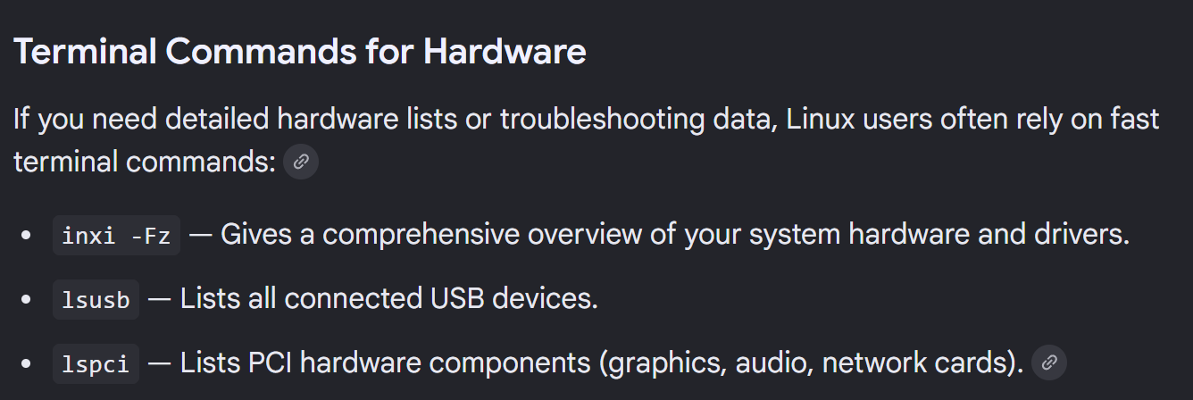
28

Slide 29
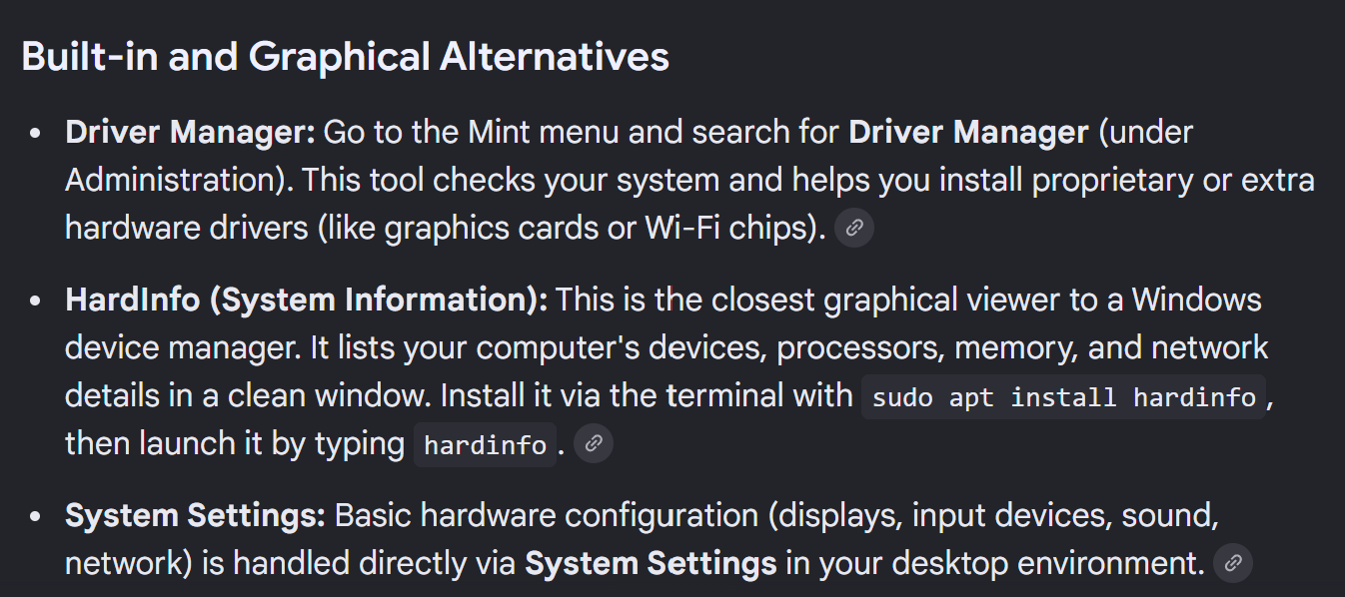
29

Slide 30
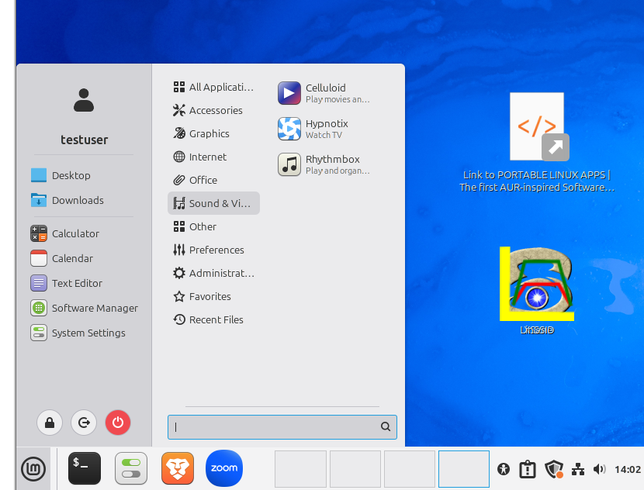
30

Slide 31
31

Slide 32
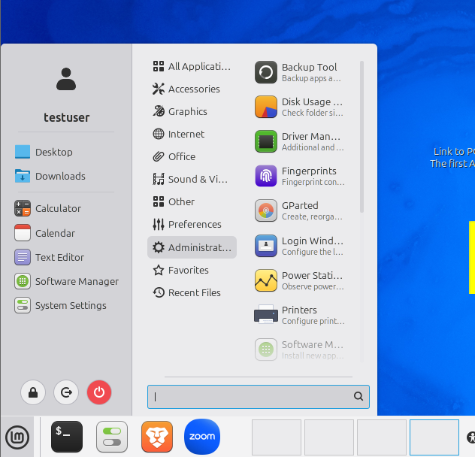
32

Slide 33
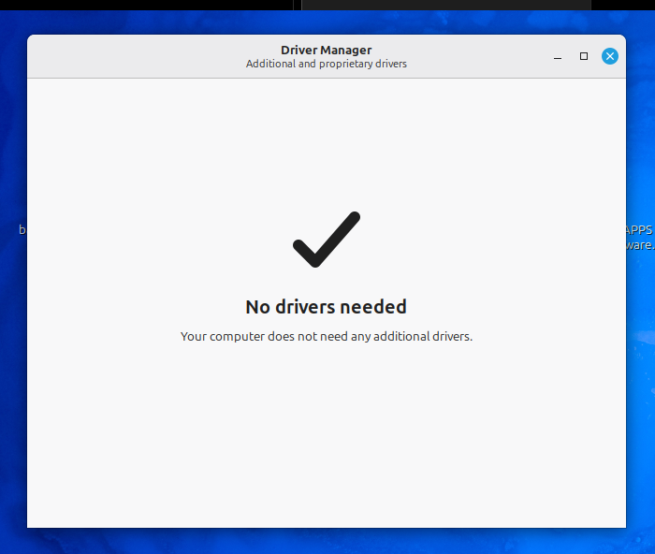
33

Slide 34
34

Slide 35
35

Slide 36
36

Slide 37
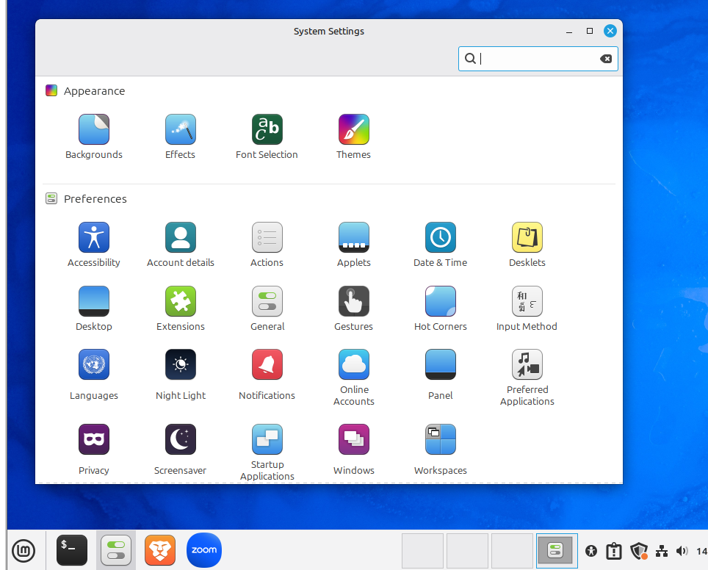
37

Slide 38
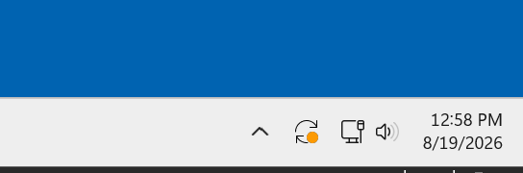
SYSTEM UPDATES
Windows:
When Windows has updates for you to install, it will give you this symbol in the Notification Area:
Use the LEFT mouse button to click on it to start the update process.
38

Slide 39
SYSTEM UPDATES
Windows (continued):
To check for updates when the symbol is not shown:
Use the RIGHT or LEFT mouse button to click on the Start button
Use the LEFT mouse button to click on Settings in the pop-up menu
Use the LEFT mouse button to click on "Windows Update"
Use the LEFT mouse button to click on "Check for updates"
39

Slide 40
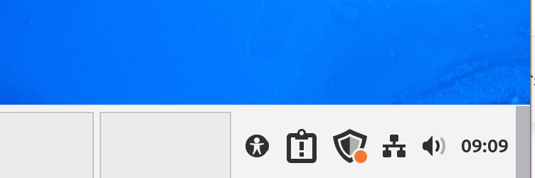
SYSTEM UPDATES (continued)
Linux Mint:
When the "Update Manager" applet detects that updates are available for download and installation, the Update shield icon will look like this:
40

Slide 41
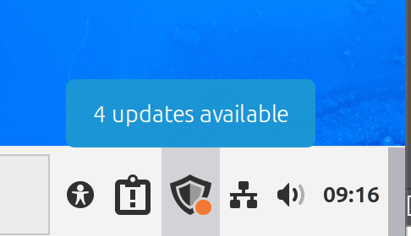
SYSTEM UPDATES (continued)
Linux Mint (continued):
Then you can use the mouse pointer to hover over on the Update shield icon:
41

Slide 42
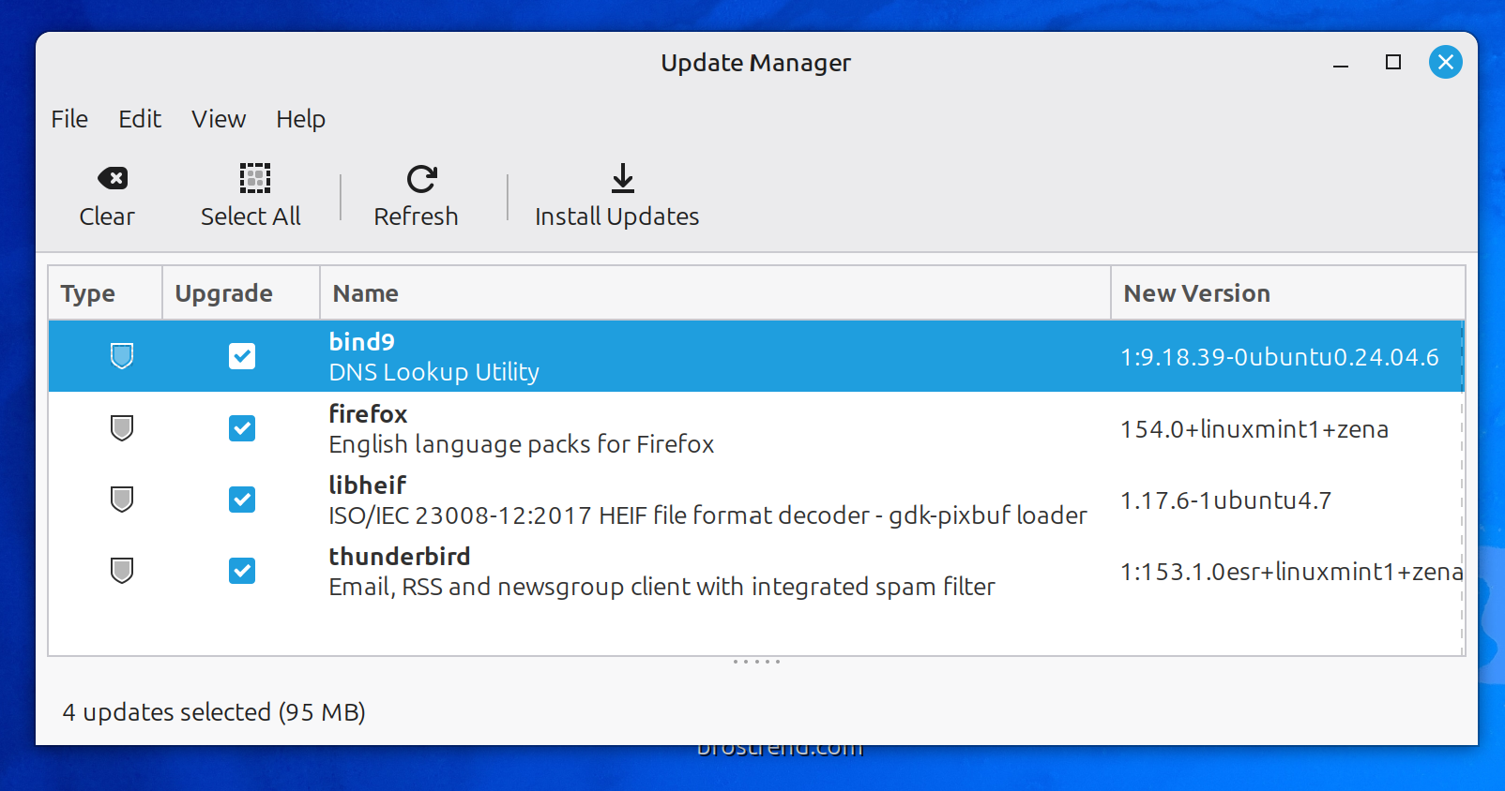
SYSTEM UPDATES (continued)
Linux Mint (continued):
Use the LEFT mouse button to click on "Install Updates":
42

Slide 43
SYSTEM UPDATES (continued)
Linux Mint (continued):
Use the LEFT mouse button to click on "Install Updates":
43

Slide 44
SYSTEM UPDATES (continued)
Linux Mint (continued):
Use the LEFT mouse button to click on "Install Updates":
44

Slide 45
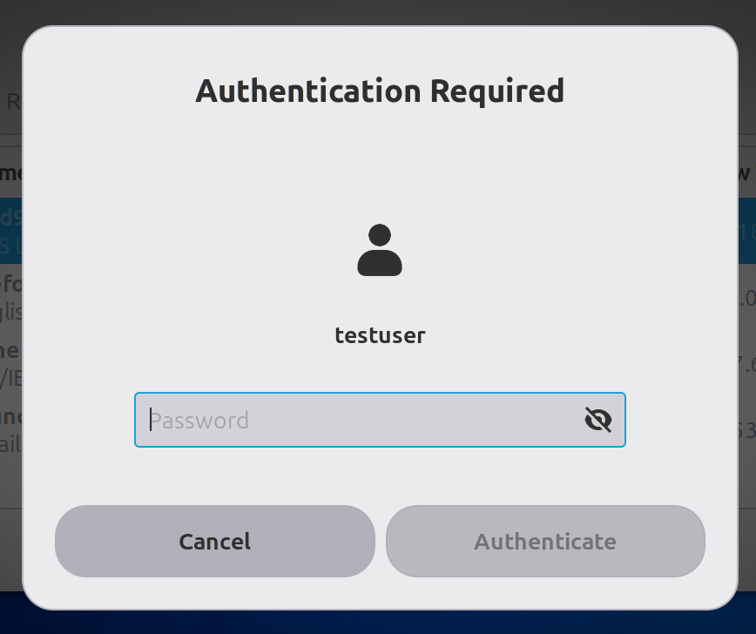
SYSTEM UPDATES (continued)
Linux Mint (continued):
An "Authentication Required" dialog box will be displayed:
45

Slide 46
SYSTEM UPDATES (continued)
Linux Mint (continued):
Type in your password for Linux Mint:
46

Slide 47
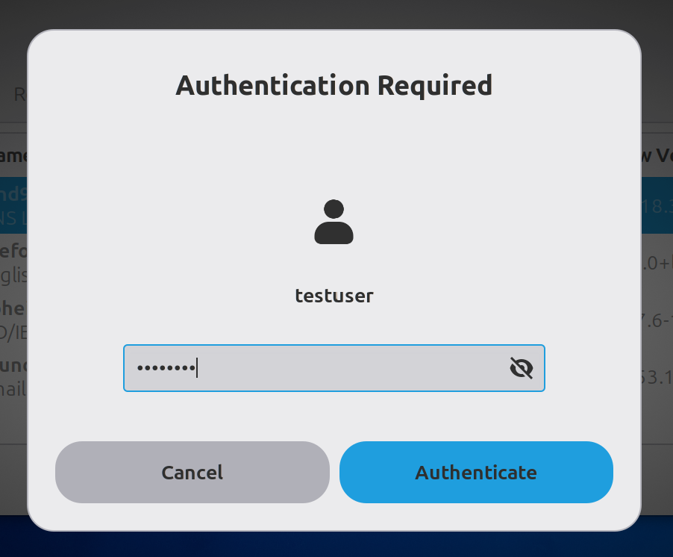
SYSTEM UPDATES (continued)
Linux Mint (continued):
Type in your password for Linux Mint:
47

Slide 48
SYSTEM UPDATES (continued)
Linux Mint (continued):
Use the LEFT mouse button to click on the Authenticate button
48

Slide 49
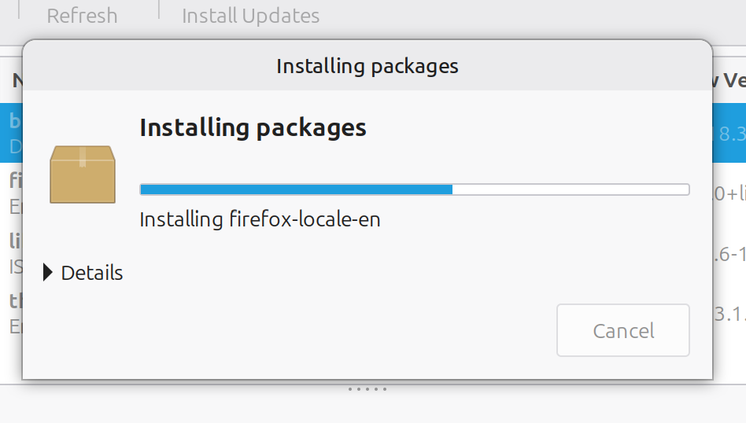
SYSTEM UPDATES (continued)
Linux Mint (continued):
The updates will download and install:
49

Slide 50
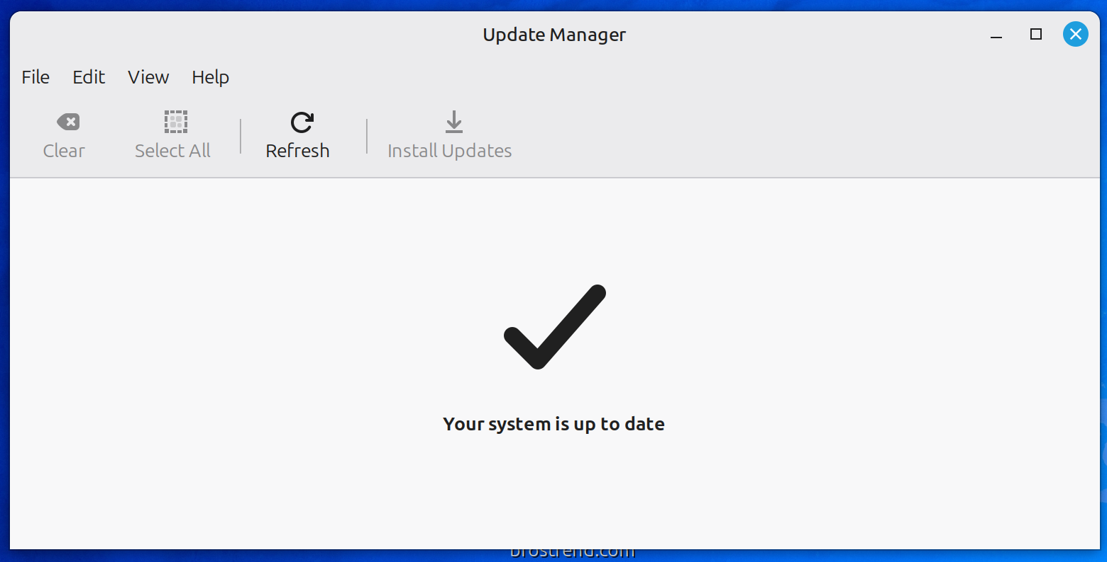
SYSTEM UPDATES (continued)
Linux Mint (continued):
Close the Update Manager dialog box:
50

Slide 51
SFC /SCANNOW VS. BUNDLED UTILITIES
Windows:
SFC scans your system files and confirms they have not been compromised or replaced with unofficial versions.
51

Slide 52
SFC /SCANNOW VS. BUNDLED UTILITIES(continued)
Windows (continued):
Use the RIGHT mouse button to click on the Start button
Use the LEFT mouse button to click on "Terminal (Admin)"
SFC /SCANNOW AND THEN USE dism.exe /online /cleanup-image /scanhealth if SFC /SCANNOW finds probllems
52

Slide 53
SFC /SCANNOW (continued)
Linux Mint:
Linux Mint does not have a single command for fixing the operating system:
See https://linuxvox.com/blog/chkdsk-on-linux/
53

Slide 54
ADVANCED SYSTEM SETTINGS
Windows:
Use the LEFT mouse button to go to Settings, System, About, Related Links, Advanced Systems Settings", "Performance" section, "Settings", "Adjust for best performance, OK
Linux Mint: No equivalent procedure but Linux Mint does not have the "cute stuff" slowdown (= RAM hog) that Windows has
54

Slide 55
STARTUP APPLICATIONS
Windows:
RIGHT click on Start button.
LEFT click on Task Manager.
LEFT click on Startup Apps.
Disable any applications that you do not need to have running all the time.
55

Slide 56
STARTUP APPLICATIONS (continued)
Linux Mint:
LEFT click on Menu button.
LEFT click on Preferrences.
LEFT click on Startup Applications.
Disable any unneeded applications that you do not have starting up during the bootup of Linux Mint.
56

Slide 57
SCREEN SAVER & POWER MANAGEMENT
Windows:
Use the LEFT mouse button to go to: Settings, System, Power, and then "Screen, sleep, & hibernate timeouts"
or go to the "Control Panel". Then use the LEFT mouse button to go to Power Management.
57

Slide 58
SCREEN SAVER & POWER MANAGEMENT (continued)
Linux Mint:
LEFT mouse button to click on "LM" "Menu" button LEFT mouse button to click on Preferences (in the middle column),
LEFT mouse button to click on "Power Management" (in the right- most column),
etc., etc.
58

Slide 59
DISK MANAGEMENT
Windows:
Use the RIGHT mouse button to click on the Start button
Use the LEFT mouse button to click on
"Disk Management"
59

Slide 60
DISK MANAGEMENT (continued)
Linux Mint:
Use the LEFT mouse button to click on the "LM" "Menu" button
Use the LEFT mouse button to click on
"Preferences" in the middle column.
Use the LEFT mouse button to pull downward in the right-most column
Use the LEFT mouse button to click on "Disks"
60

Slide 61
DEFAULT SOFTWARE STORE
Windows:
Use the LEFT mouse button to click on the Start button.
Use the LEFT mouse button pull downward on the vertical scroll bar.
Use the LEFT mouse button to click on "Microsoft Store
61

Slide 62
DEFAULT SOFTWARE STORE (continued)
Linux Mint:
Use the LEFT mouse button to click on the "LM" "Menu" button.
Use the LEFT mouse button to click on "Preferences" in the middle column.
Use the LEFT mouse button to pull downward with the vertical scroll bar in the right-most column.
Use the LEFT mouse button to click on "Software Manager".
62

Slide 63
BUNDLED TEXT EDITING APP
Windows:
In November 2023, the monthly update for Windows 11 caused the bundled "Notepad" text editing app to open all previously edited text files to open as permanent but removable tabs. To stop this annoyance, you can start Notepad. Then click on "Settings". Then click on "Start new session and discard unsaved changes.
63

Slide 64
BUNDLED TEXT EDITING APP (continued)
Windows (continued):
In November 2023, the monthly update for Windows 11 caused the bundled "Notepad" text editing app to open all previously edited text files to open as permanent but removable tabs. To stop this annoyance, you can start Notepad. Then click on "Settings". Then click on "Start new session and discard unsaved changes.
64

Slide 65
BUNDLED TEXT EDITING APP (continued)
Linux Mint:
The "Text Editor" in Linux Mint does not have the annoyances that Microsoft has in "Notepad:
Use the LEFT mouse button to click on the "LM" "menu" button.
Use the LEFT mouse button to click on "Accessories" in the middle column of the pop-up menu.
65

Slide 66
BUNDLED TEXT EDITING APP (continued)
Linux Mint (continued):
Use the LEFT mouse button drag downward on the vertical scroll bar.
Use the LEFT mouse button to drag downward in the vertical scroll bar.
Use the LEFT mouse button to click on "Text Editor".
66

Slide 67
TIME ZONE SETTINGS
Windows:
By default, Windows.. configures the hardware clock on the motherboard to run on the time zone of where the computer is physically located.
67

Slide 68
TIME ZONE SETTINGS (continued)
Linux Mint:
Whenever you start up Linux Mint it will automatically configure the hardware clock on the motherboard to run on Coordinated Universal Time (UTC) rather than local time.
Linux then adds or subtracts the correct number of hours for your specific time zone when it displays the time to you in the "clock" in the "Panel".
68

Slide 69
TIME ZONE SETTINGS (continued)
If you boot up a computer with Windows.. after booting the same computer with Linux Mint: Use the RIGHT mouse button to click on the time display in the Notification Area of the Taskbar.
Then use the LEFT mouse button to click on "Adjust date and time".
Then use the LEFT mouse button to turn OFF "Set time automatically".
Then use the LEFT mouse button to turn ON "Set time automatically".
Then use the LEFT mouse button to close the "Settings" dialog box.
69

Slide 70
TIME ZONE SETTINGS (continued)
This simple procedure will set the clock on the motherboard of the computer back to displaying the time in the time zone that the computer resides. If you wish to set Windows to use the Universal Time Coordinates that Linux sets the motherboard to, you can do so by following the instructions at https://www.xahertz.com/blog/windows-utc/
70

Slide 71
DISPLAY THE RECYCLE BIN ON THE DESKTOP
Windows:
If the Recycle Bin icon is missing from your desktop, you can restore it through the Desktop Icon Settings in Windows.
Right-click on an empty area of the desktop and select Personalize.
In the Personalization window, click Themes.
71

Slide 72
DISPLAY THE RECYCLE BIN ON THE DESKTOP (continued)
Windows (continued):
Scroll down to Related Settings and click Desktop icon settings.
In the Desktop Icon Settings window, check the box for Recycle Bin.
Click Apply, then OK to save changes.
72

Slide 73
DISPLAY THE RECYCLE BIN ON THE DESKTOP (continued)
Windows (continued):
If no icons are visible at all, right-click the desktop, select View, and ensure Show desktop icons is checked.
73

Slide 74
DISPLAY THE RECYCLE BIN ON THE DESKTOP (continued)
Linux Mint:
Open Desktop Settings
Right-click on an empty area of your desktop.
Select Customize or Desktop Settings (wording may vary slightly by Mint version).
Enable the Trash Icon
In the Desktop Icons section, look for a checkbox labeled Trash or Show Trash on desktop.
Check the box.
3. Close the Settings Window
The Trash icon should now appear on your desktop immediately.
74

Slide 75
CLONING & IMAGING DISKS
Windows:
"Macrium Reflect Home" is the best disk imaging and cloning app for "Windows.." but it is not free.
For both Windows.. and Linux Mint, the free "Rescuezilla" distro of Linux can be used to boot up, clone, and image both Windows.. and Linux Mint disks. See https://rescuezilla.com/
75

Slide 76
CLONING & IMAGING DISKS (continued)
2A- Making A "Rescuezilla" Bootable USB Thumb Drive
is described at
http://aztcs.apcug.org/meeting_notes/linuxsig/backup/2A-making-Rescuezilla-thumbdrive.pdf
and is also explained at
http://aztcs.apcug.org/meeting_notes/linuxsig/backup/2A-making-Rescuezilla-thumbdrive.pptx
2B- Making a "Rescuezilla" Bootable DVD Disc
is described at
http://aztcs.apcug.org/meeting_notes/linuxsig/backup/2B-making-Rescuezilla-DVD.pdf
and is also explained at
http://aztcs.apcug.org/meeting_notes/linuxsig/backup/2B-making-Rescuezilla-DVD.pptx
4-Using a Bootable CD or DVD or a Bootable USB Thumb Drive
to Start Up
"Rescuezilla" or "CLONEZILLA LIVE"
is available at
http://aztcs.apcug.org/meeting_notes/linuxsig/backup/4-computer-boot-up-procedure.pdf
and is also explained at http://aztcs.apcug.org/meeting_notes/linuxsig/backup/4-computer-boot-up-procedure.pptx
5-Determining Drive Serial Numbers For Using "Rescuezilla" or "CLONEZILLA LIVE"
is available at
- http://aztcs.apcug.org/meeting_notes/linuxsig/backup/5-drive-identification.pdf
and is also explained at
http://aztcs.apcug.org/meeting_notes/linuxsig/backup/5-drive-identification.pptx
6A-Using "Rescuezilla" To Create A Clone Or An Image Backup
Of A Drive In Your Computer
is available at
http://aztcs.apcug.org/meeting_notes/linuxsig/backup/6A-using-Rescuezilla.pdf
and is also available at
http://aztcs.apcug.org/meeting_notes/linuxsig/backup/6A-using-Rescuezilla.pptx
6B-If You Use Rescuezilla To Clone A Drive In A "Windows 10.."
Or A "Windows 11.." computer
And Connect Both Drives Connected By Means of SATA or M.2,
And You Then Boot Up or Reboot the "Windows.." Computer,
You Will Get A "Signature Collision"
as explained in
http://aztcs.apcug.org/meeting_notes/linuxsig/backup/6B-signature-collisions.pdf
and is also explained at
http://aztcs.apcug.org/meeting_notes/linuxsig/backup/6B-signature-collisions.pptx
("Signature collisions" are "fatal" for bootable "Windows.." drives
but fixable for non-bootable drives.)
8-How the cloning operations of "Rescuezilla" (free) and "Clonezilla" (free)
differ from the cloning operations of "Macrium Reflect" (not free) and EaseUS "Partition Magic" (not free)
is explained at
http://aztcs.apcug.org/meeting_notes/linuxsig/backup/8-free-versus-not-free-cloning-apps.pdf
and is also explained at
http://aztcs.apcug.org/meeting_notes/linuxsig/backup/8-free-versus-not-free-cloning-apps.pptx
7-Using "CLONEZILLA LIVE" To Create Backups of Data and Digital Photo Files
is available at
http://aztcs.apcug.org/meeting_notes/linuxsig/backup/7-using-Clonezilla-Live.pdf
and is also available at
http://aztcs.apcug.org/meeting_notes/linuxsig/backup/7-using-Clonezilla-Live.pptx
Unlike "Rescuezilla", "Clonezilla" has a text-based user interface.
"Clonezilla" can be used if you need to have more control
over the settings of the cloning or imaging process
than than those available in "Rescuezilla".
76

Slide 77
CLONING & IMAGING DISKS (continued)
2B- Making a "Rescuezilla" Bootable DVD Disc
is described at
http://aztcs.apcug.org/meeting_notes/linuxsig/backup/2B-making-Rescuezilla-DVD.pdf
and is also explained at
http://aztcs.apcug.org/meeting_notes/linuxsig/backup/2B-making-Rescuezilla-DVD.pptx
77

Slide 78
CLONING & IMAGING DISKS (continued)
4-Using a Bootable CD or DVD or a Bootable USB Thumb Drive
to Start Up
"Rescuezilla" or "CLONEZILLA LIVE"
is available at
http://aztcs.apcug.org/meeting_notes/linuxsig/backup/4-computer-boot-up-procedure.pdf
and is also explained at http://aztcs.apcug.org/meeting_notes/linuxsig/backup/4-computer-boot-up-procedure.pptx
78

Slide 79
CLONING & IMAGING DISKS (continued)
5-Determining Drive Serial Numbers For Using "Rescuezilla" or "CLONEZILLA LIVE"
is available at
http://aztcs.apcug.org/meeting_notes/linuxsig/backup/5-drive-identification.pdf
and is also explained at
http://aztcs.apcug.org/meeting_notes/linuxsig/backup/5-drive-identification.pptx
6A-Using "Rescuezilla" To Create A Clone Or An Image Backup
Of A Drive In Your Computer
is available at
http://aztcs.apcug.org/meeting_notes/linuxsig/backup/6A-using-Rescuezilla.pdf
and is also available at
http://aztcs.apcug.org/meeting_notes/linuxsig/backup/6A-using-Rescuezilla.pptx
6B-If You Use Rescuezilla To Clone A Drive In A "Windows 10.."
Or A "Windows 11.." computer
And Connect Both Drives Connected By Means of SATA or M.2,
And You Then Boot Up or Reboot the "Windows.." Computer,
You Will Get A "Signature Collision"
as explained in
http://aztcs.apcug.org/meeting_notes/linuxsig/backup/6B-signature-collisions.pdf
and is also explained at
http://aztcs.apcug.org/meeting_notes/linuxsig/backup/6B-signature-collisions.pptx
("Signature collisions" are "fatal" for bootable "Windows.." drives
but fixable for non-bootable drives.)
8-How the cloning operations of "Rescuezilla" (free) and "Clonezilla" (free)
differ from the cloning operations of "Macrium Reflect" (not free) and EaseUS "Partition Magic" (not free)
is explained at
http://aztcs.apcug.org/meeting_notes/linuxsig/backup/8-free-versus-not-free-cloning-apps.pdf
and is also explained at
http://aztcs.apcug.org/meeting_notes/linuxsig/backup/8-free-versus-not-free-cloning-apps.pptx
7-Using "CLONEZILLA LIVE" To Create Backups of Data and Digital Photo Files
is available at
http://aztcs.apcug.org/meeting_notes/linuxsig/backup/7-using-Clonezilla-Live.pdf
and is also available at
http://aztcs.apcug.org/meeting_notes/linuxsig/backup/7-using-Clonezilla-Live.pptx
Unlike "Rescuezilla", "Clonezilla" has a text-based user interface.
"Clonezilla" can be used if you need to have more control
over the settings of the cloning or imaging process
than than those available in "Rescuezilla".
79

Slide 80
CLONING & IMAGING DISKS (continued)
6A-Using "Rescuezilla" To Create A Clone Or An Image Backup
Of A Drive In Your Computer
is available at
http://aztcs.apcug.org/meeting_notes/linuxsig/backup/6A-using-Rescuezilla.pdf
and is also available at
http://aztcs.apcug.org/meeting_notes/linuxsig/backup/6A-using-Rescuezilla.pptx
6B-If You Use Rescuezilla To Clone A Drive In A "Windows 10.."
Or A "Windows 11.." computer
And Connect Both Drives Connected By Means of SATA or M.2,
And You Then Boot Up or Reboot the "Windows.." Computer,
You Will Get A "Signature Collision"
as explained in
http://aztcs.apcug.org/meeting_notes/linuxsig/backup/6B-signature-collisions.pdf
and is also explained at
http://aztcs.apcug.org/meeting_notes/linuxsig/backup/6B-signature-collisions.pptx
("Signature collisions" are "fatal" for bootable "Windows.." drives
but fixable for non-bootable drives.)
8-How the cloning operations of "Rescuezilla" (free) and "Clonezilla" (free)
differ from the cloning operations of "Macrium Reflect" (not free) and EaseUS "Partition Magic" (not free)
is explained at
http://aztcs.apcug.org/meeting_notes/linuxsig/backup/8-free-versus-not-free-cloning-apps.pdf
and is also explained at
http://aztcs.apcug.org/meeting_notes/linuxsig/backup/8-free-versus-not-free-cloning-apps.pptx
7-Using "CLONEZILLA LIVE" To Create Backups of Data and Digital Photo Files
is available at
http://aztcs.apcug.org/meeting_notes/linuxsig/backup/7-using-Clonezilla-Live.pdf
and is also available at
http://aztcs.apcug.org/meeting_notes/linuxsig/backup/7-using-Clonezilla-Live.pptx
Unlike "Rescuezilla", "Clonezilla" has a text-based user interface.
"Clonezilla" can be used if you need to have more control
over the settings of the cloning or imaging process
than than those available in "Rescuezilla".
80

Slide 81
CLONING & IMAGING DISKS (continued)
6B-If You Use Rescuezilla To Clone A Drive In A "Windows 10.." Or A "Windows 11.." computer
and the connect Both Drives to the sae computer by means of SATA or M.2,
and You Then Boot Up or Reboot the "Windows.." Computer,
You Will Get A "Signature Collision"
as explained in
http://aztcs.apcug.org/meeting_notes/linuxsig/backup/6B-signature-collisions.pdf
and is also explained at
http://aztcs.apcug.org/meeting_notes/linuxsig/backup/6B-signature-collisions.pptx
81

Slide 82
CLONING & IMAGING DISKS (continued)
("Signature collisions" are "fatal" for bootable "Windows.." drives
but fixable for non-bootable drives.)
8-How the cloning operations of "Rescuezilla" (free) and "Clonezilla" (free)
differ from the cloning operations of "Macrium Reflect" (not free) and EaseUS "Partition Magic" (not free)
is explained at
http://aztcs.apcug.org/meeting_notes/linuxsig/backup/8-free-versus-not-free-cloning-apps.pdf
and is also explained at
http://aztcs.apcug.org/meeting_notes/linuxsig/backup/8-free-versus-not-free-cloning-apps.pptx
82

Slide 83
CLONING & IMAGING DISKS (continued)
6B-If You Use Rescuezilla To Clone A Drive In A "Windows 10.." Or A "Windows 11.." computer
and the connect Both Drives to the sae computer by means of SATA or M.2,
and You Then Boot Up or Reboot the "Windows.." Computer,
You Will Get A "Signature Collision"
as explained in
http://aztcs.apcug.org/meeting_notes/linuxsig/backup/6B-signature-collisions.pdf
and is also explained at
http://aztcs.apcug.org/meeting_notes/linuxsig/backup/6B-signature-collisions.pptx
("Signature collisions" are "fatal" for bootable "Windows.." drives
but fixable for non-bootable drives.)
8-How the cloning operations of "Rescuezilla" (free) and "Clonezilla" (free)
differ from the cloning operations of "Macrium Reflect" (not free) and EaseUS "Partition Magic" (not free)
is explained at
http://aztcs.apcug.org/meeting_notes/linuxsig/backup/8-free-versus-not-free-cloning-apps.pdf
and is also explained at
http://aztcs.apcug.org/meeting_notes/linuxsig/backup/8-free-versus-not-free-cloning-apps.pptx
7-Using "CLONEZILLA LIVE" To Create Backups of Data and Digital Photo Files
is available at
http://aztcs.apcug.org/meeting_notes/linuxsig/backup/7-using-Clonezilla-Live.pdf
and is also available at
http://aztcs.apcug.org/meeting_notes/linuxsig/backup/7-using-Clonezilla-Live.pptx
Unlike "Rescuezilla", "Clonezilla" has a text-based user interface.
"Clonezilla" can be used if you need to have more control
over the settings of the cloning or imaging process
than than those available in "Rescuezilla".
83

