Slide 1



"iCloud"
CLOUD STORAGE
1

Slide 2
Web location for this presentation:
http://aztcs.apcug.org
Click on
“Meeting Notes”

Slide 3
SUMMARY
You can use Apple's "iCloud" storage to protect yourself from the losing data files.

Slide 4
SUMMARY (continued)
After you get an "iCloud" account, you can use "Windows.." computers or Mac "OS X" computers or "iPads" or "iPhones" to store and download files with "iCloud".

Slide 5
REPORT CARD FOR "iCloud"
AMOUNT OF FREE STORAGE? | 5 GB
RELIABLE UPLOAD AND DOWNLOAD OF ENTIRE FOLDERS CONTAINING DATA FILES? | No, NOT from a Web browser Yes, from the "iCloud Drive" folder created in Apple's "iCloud" app for Windows.. computers
NO KNOWN DATA SECURITY COMPROMISES? | Yes
ONLINE CREATION, VIEWING, AND EDITING OF DOCUMENT FILES AND PHOTOS? | Yes, for Apple office suite formats (*.pages, *.keynote, *.formula) Viewing only for Adobe .PDF files Viewing only for digital photo files
5

Slide 6
"iCloud" CLOUD STORAGE
If you attempt to drag an entire folder into the iCloud.com Web site in the "Safari" Web browser inside a MacOS computer or if you attempt to drag an entire folder into the iCloud.com Web site in any Web browser inside a Windows.." "computer:
6

Slide 7
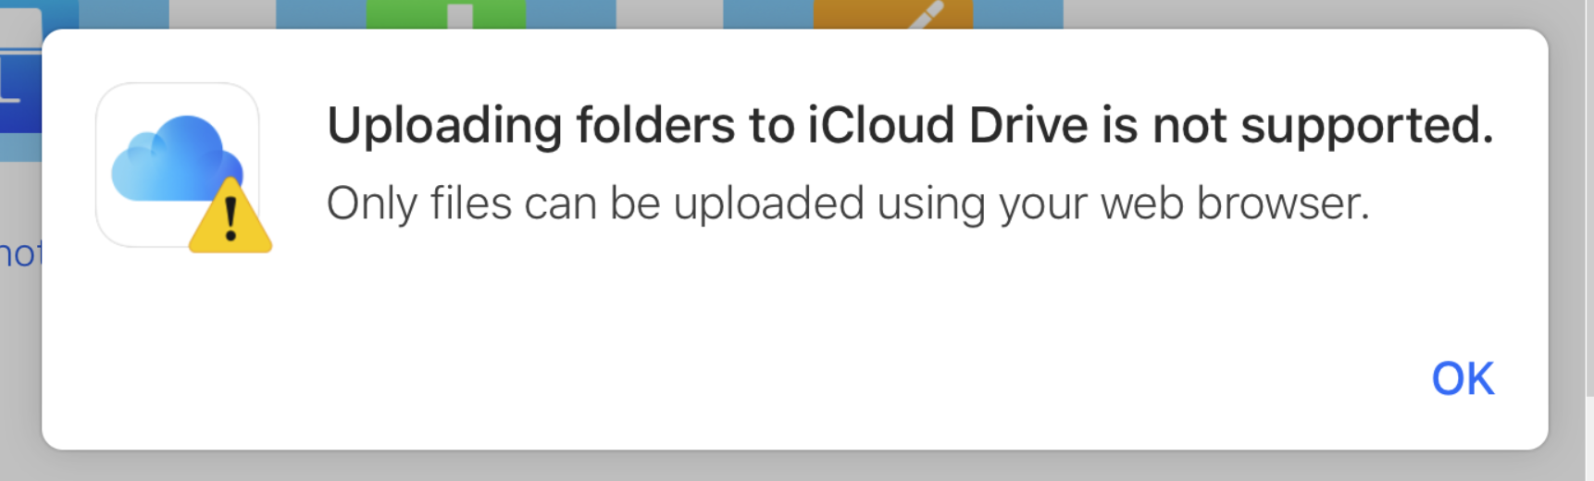
7

Slide 8
8

Slide 9
"iCloud" CLOUD STORAGE (continued)
F.y.i. all other cloud storage services (in this presentation) let you upload entire folders by means of a Web browser: To upload an entire folder up to "iCloud", you have use the "iCloud Drive" folder that is created by the "iCloud" app in "Windows.." or in "MacOS"
9

Slide 10
"iCloud" CLOUD STORAGE (continued)
Unlike all other cloud storage services (in this presentation), you cannot use a Web browser in Windows.. to upload and download files and folders up to "iCloud": The use of the "iCloud" app in Windows.. is mandatory.
10

Slide 11
"iCloud" CLOUD STORAGE (continued)
In most MacOS computers, copies of files in the "Icloud Drive" are stored as actual files on the local hard drive
"iCloud" has an "optimize" option that stores files only in the cloud when the MacOS OS detects that you are running out of hard drive space. However, to let an operating system determine whether to store files on a hard drive is not a good idea.
11

Slide 12
"iCloud" CLOUD STORAGE (continued)
  "iCloud" is free with 5 Gigabytes of storage of when you create a new "iCloud account" or access an existing "iCloud account" from inside an "OS X" 10.7 Lion or higher computer or from inside an iPhone or an iPad running "iOS 17" or higher

Slide 13
"iCloud" CLOUD STORAGE (continued)
  http://icloud.com
  Can use "Google Chrome" browser or "FireFox" from a "Windows.." computer for reliable access to an iCloud account at http://icloud.com (after you create the "iCloud" account from inside an iPhone, an iPad, or a MacOS computer).

Slide 14
"iCloud" CLOUD STORAGE (continued)
  Online viewing and editing using "iWorks for iCloud" feature with "Pages for iCloud", "Formula for iCloud", and "Keynote for iCloud".
  Drag into browser to upload a single file.

Slide 15
"iCloud" CLOUD STORAGE (continued)
  "iCloud" lets you create folders at your account at its server farm.
  "iCloud" does not let you upload or download entire folders when you access icloud.com from a Web browser.

Slide 16
"iCloud" CLOUD STORAGE (continued)
  If you select a group of individual files using Command + a you can upload all of them at the same time by dragging them from your computer into the iCloud browser window.

Slide 17
"iCloud" CLOUD STORAGE (continued)
  If you select a group of individual files up inside "iCloud Drive" using Command + a you can download all of them at the same time by clicking on the "Down from cloud" button.

Slide 18
"iCloud" CLOUD STORAGE (continued)
Perfect integration with Apple's "iWork" office suite in a Mac OS X 10.7 or higher computer: If the "Pages" program is installed and you click on its "iCloud" button, then any .PAGES, .DOC, .DOCX, or .TXT files that you have stored in "iCloud" will be displayed for you to open and edit. Ditto for the "Keynote" program for .KEYNOTE, .PPT, and .PPTX files. Ditto for the "Numbers" program for .NUMBERS, .XLS,.XLSX, or .CSV files.

Slide 19
"iCloud" CLOUD STORAGE (continued)
Perfect integration with Apple's "iWork" office suite in a Mac: (continued) If the "Pages" program is installed and you create a new document, when you "Save", one option will be to save to "iCloud" Ditto for the "Keynote" program. Ditto for the "Numbers" program.

Slide 20
"iCloud" CLOUD STORAGE (continued)
Each unique "iCloud" account that you create (using a unique "Apple ID" that was created on an "Apple device") entitles you to a 5 Gigabytes of storage in the "iCloud" server farm.

Slide 21
DETAILED PROCEDURE FOR CREATING AN "iCloud" ACCOUNT
21

Slide 22
DETAILED PROCEDURE FOR CREATING AN "iCloud" ACCOUNT
Step 1: If you need an "Apple ID" (or if you need an additional "Apple ID" for accessing "iCloud"), use a Web browser in any computer, tablet, or cell phone to go to https://appleid.apple.com/account#!&page=create

Slide 23
DETAILED PROCEDURE FOR CREATING AN "iCloud" ACCOUNT (continued)
Step 2: Follow the guided steps at https://appleid.apple.com/, to create an "Apple ID".

Slide 24
DETAILED PROCEDURE FOR CREATING AN "iCloud" ACCOUNT (continued)
Step 3: From any Mac "OS X" 10.7 Lion or higher computer or from a recent model "iPad" or a recent model "iPhone", use the "Safari" Web browser to go to icloud.com Then use the "Apple ID" that you created in "Step 2" to create an "icloud" account:

Slide 25
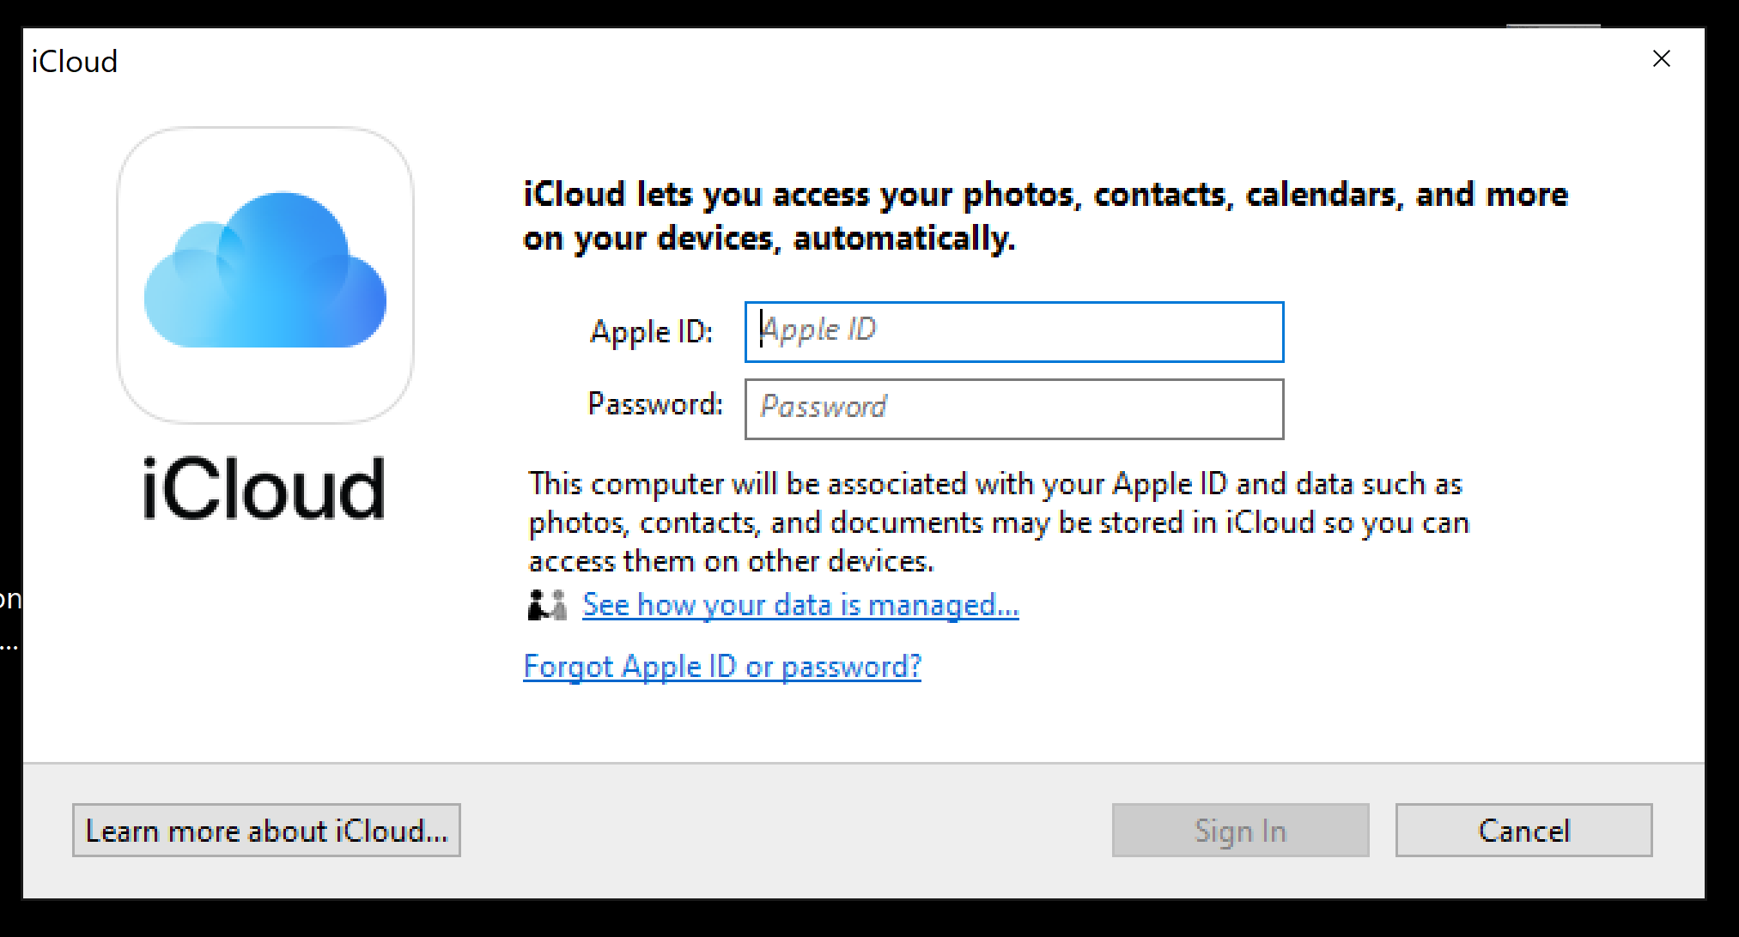
25

Slide 26
26

Slide 27
DETAILED PROCEDURE FOR CREATING AN "iCloud" ACCOUNT (continued)
  Step 3 (continued): Apple does not allow you to create an "iCloud" account from inside a "Windows..", "Linux", or
  "Android" device:

Slide 28
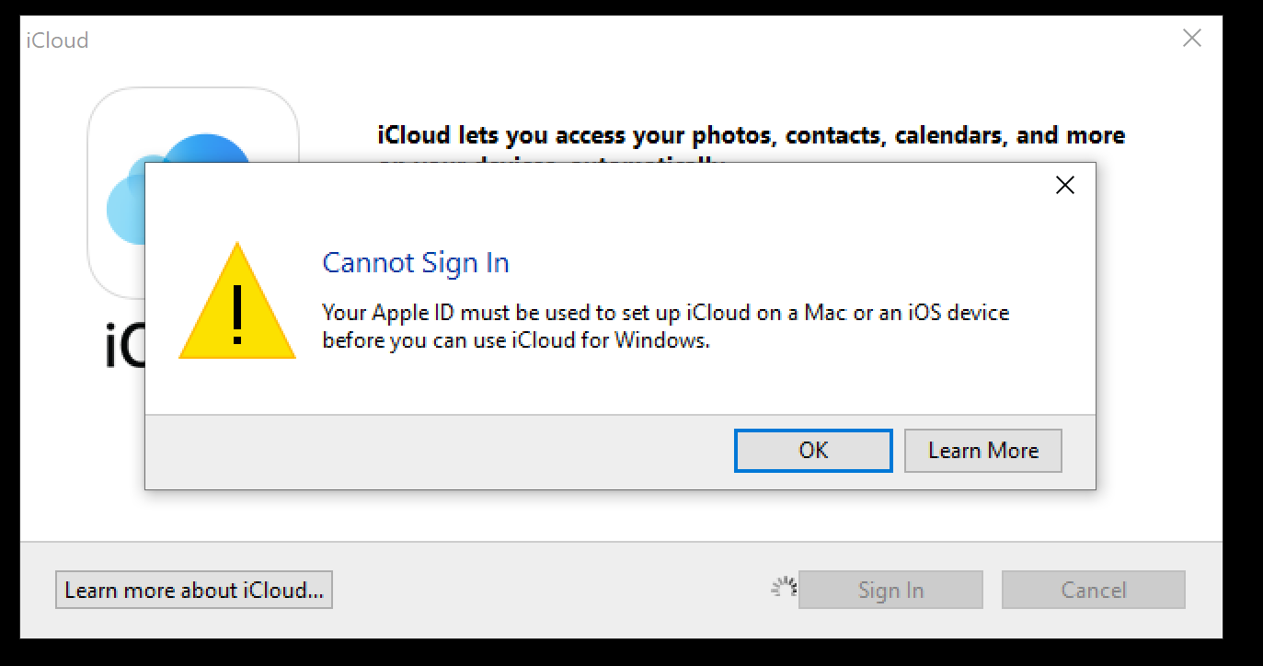

Slide 30
DETAILED PROCEDURE FOR CREATING AN "iCloud" ACCOUNT (continued)
Step 4: After completing this procedure, use any Web browser in any "Windows..", computer, MacOS computer, "Linux.." computer, "iPad", "iPhone", or "Android" phone to access http://icloud.com. and sign in with your "Apple ID" and password.

Slide 31
USING "iCloud":
31

Slide 32
USING "iCloud"
"iCloud" gives you 5 Gigabytes without any monthly charges.
Apple music (formerly called iTunes Music), apps, books and Photo Stream do not count against the 5 Gigabyte total.

Slide 33
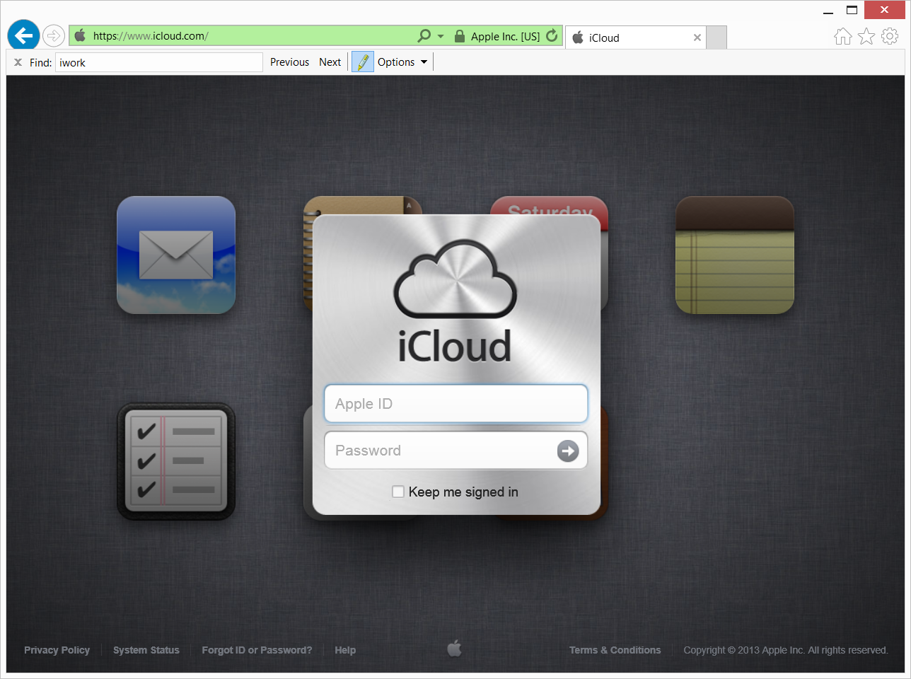

Slide 34
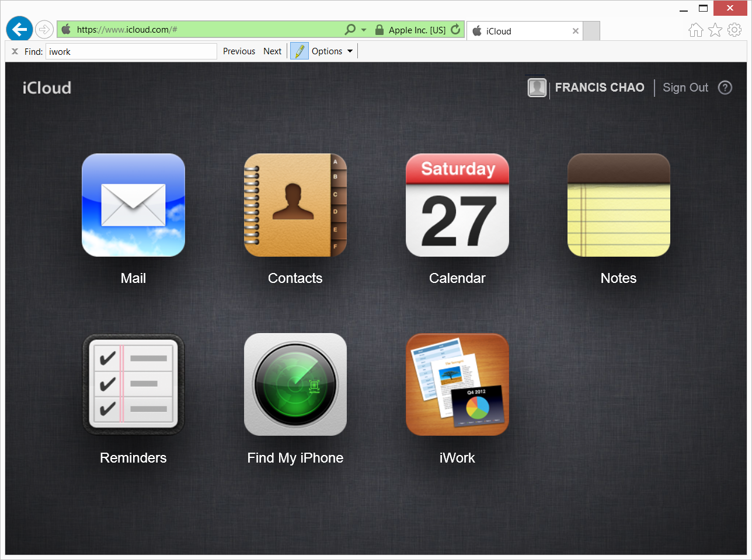

Slide 35
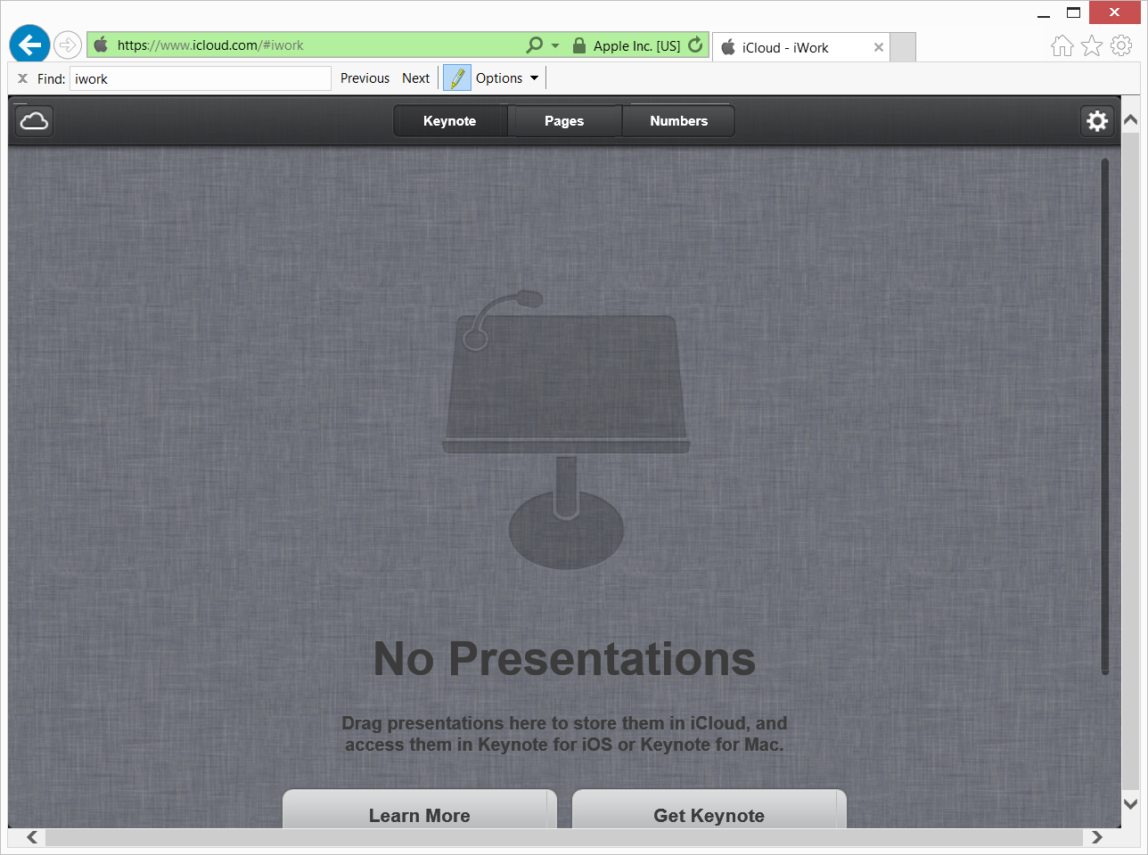

Slide 36
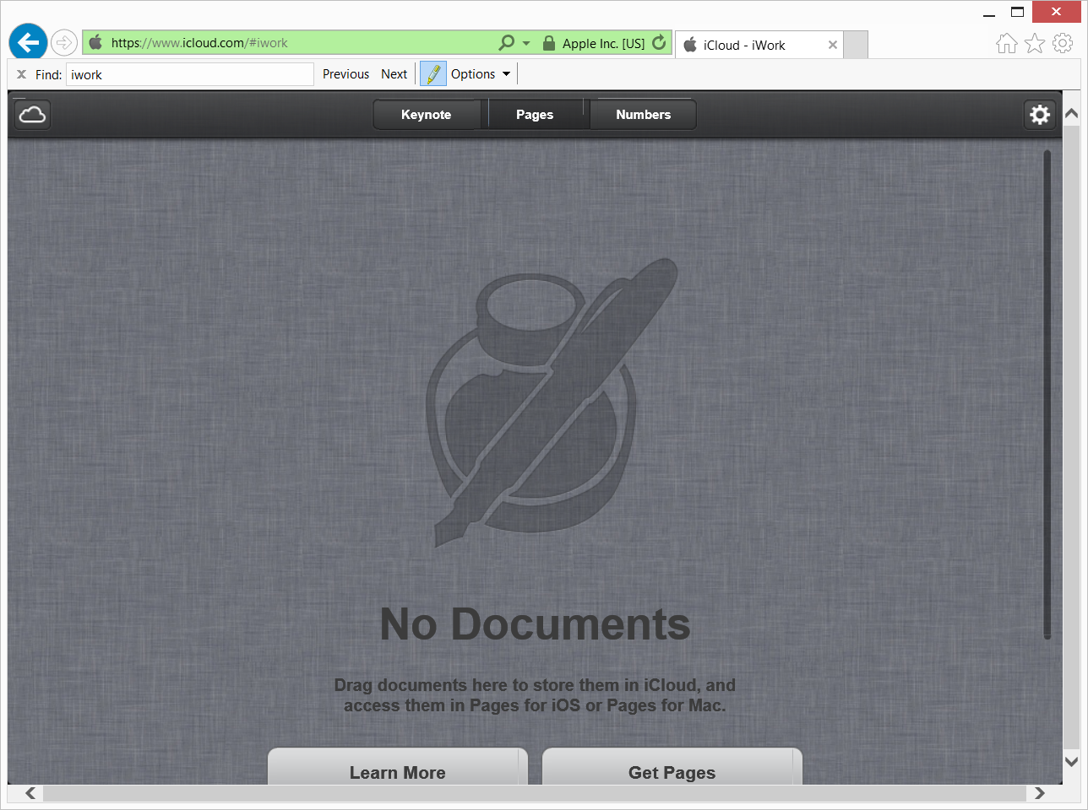

Slide 37
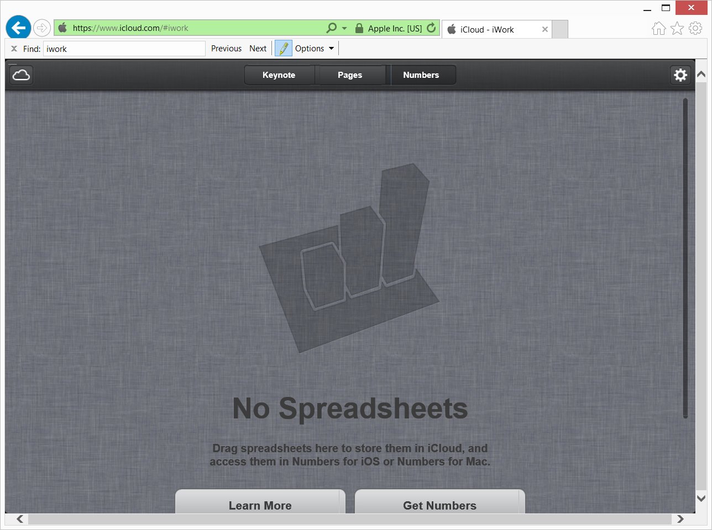

Slide 38
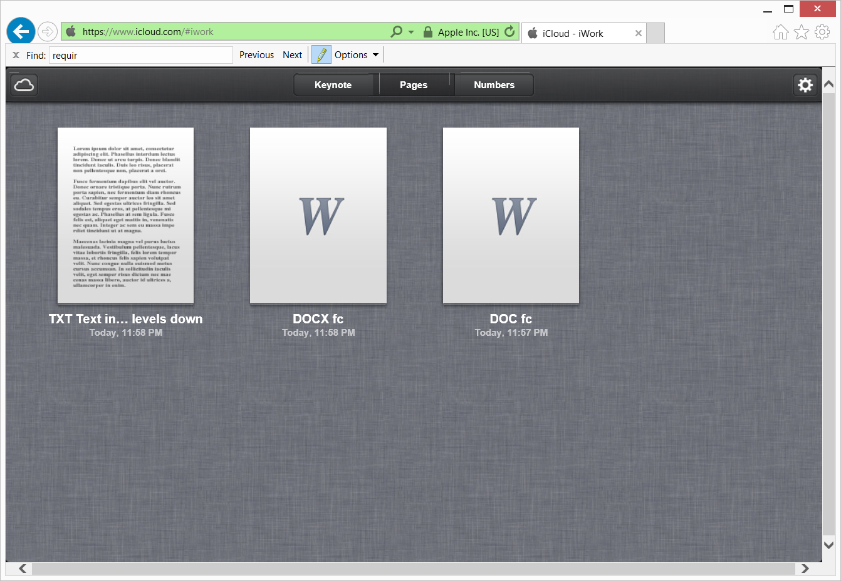

Slide 39
USING "iCloud" (continued)
The icloud.com Web site's failure to display 3-character file extensions (at the "icloud.`com" Web site) can confuse the end-user:

Slide 41
USING "iCloud" (continued)
In contrast, the "iCloud Drive" folder in the "Finder" in macOS or iOS that is created by the "iCloud" app, does show file extensions:

Slide 42
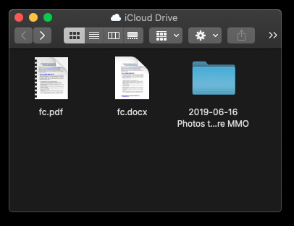

Slide 44
USING "iCloud" (continued)
Officially, the "Pages" storage area of "iCloud" will only accept files in the following four formats:
  "Pages '09" files that are created by the "Pages" app in an Mac, .iPad, or .iPhone (.PAGES file extension)
  "Microsoft Word" files with a .DOC file extension
  Microsoft Word files with a .DOCX file extension
  Text files with a .TXT file extension

Slide 45
USING "iCloud" (continued)
Officially, the "Numbers" storage area of "iCloud" will only accept files in the following four formats:
  "Numbers '09" files that are created by the "Numbers 09" app in an Mac, .iPad, or .iPhone (.NUMBERS file extension)
  "Microsoft Excel" files with a .XLS file extension
  "Microsoft Word" files with a .XLSX file extension
  Comma Delimited files with a .CSV file extension

Slide 46
USING "iCloud" (continued)
Officially, the "Keynote" storage area of "iCloud" will only accept files in the following three formats:
  "Keynote '09" files that are created by the "Keynote 09" app in an Mac, .iPad, or .iPhone (.KEYNOTE file extension or .KEY file extension)
  "Microsoft PowerPoint" files with a .PPT file extension
  "Microsoft PowerPoint" files with a .PPTX file extension

Slide 47
USING "iCloud" (continued)
Unofficially, you can store a file with any format by renaming it with the file extension of an officially supported file format.
  In the "Pages" storage area, you can "force" any file to be stored there by renaming it with a file extension of .PAGES, .DOC, .DOCX, or .TXT

Slide 48
USING "iCloud" (continued)
Unofficially, you can store a file with any format by renaming it with the file extension of an officially supported file format (continued)
  In the "Numbers" storage area, you can "force" any file to be stored there by renaming it with a file extension of .NUMBERS, .XLS, .XLSX, or .CSV

Slide 49
USING "iCloud" (continued)
Unofficially, you can store a file with any format by renaming it with the file extension of an officially supported file format (continued)
  In the "Keynote" storage area, you can "force" any file to be stored there by renaming it with a file extension of .KEY, .KEYNOTE, .PPT, or .PPTX

Slide 50
USING "iCloud" (continued)
Example of storing an unsupported file in "iCloud": Start with a file called "SIG Photo 2013-05-01-1.jpg.". Change the name of the file to "SIG Photo 2013-05-01-1.jpg.docx" Drag the file to the "Pages" tab of "iCloud".

Slide 51
USING "iCloud" (continued)
Unofficially, you can store a folder by zipping the folder and then renaming the .ZIP file with the file extension of an officially supported file format.
  In the "Pages" storage area, you can "force" a folder to be stored there by zipping it and then renaming zip file with a file extension of .PAGES, .DOC, .DOCX, or .TXT

Slide 52
USING "iCloud" (continued)
Unofficially, you can store a folder by zipping the folder and then renaming the .ZIP file with the file extension of an officially supported file format (continued)
  In the "Numbers" storage area, you can "force" any folder to be stored there by zipping it and then renaming the zip file with a file extension of .NUMBERS, .XLS, .XLSX, or .CSV

Slide 53
USING "iCloud" (continued)
Unofficially, you can store a folder by zipping the folder and then renaming the .ZIP file with the file extension of an officially supported file format (continued)
  In the "Keynote" storage area, you can "force" any folder to be stored there by zipping it and then renaming the zip file with a file extension of .KEY, .KEYNOTE, .PPT, or .PPTX

Slide 54
USING "iCloud" (continued)
Example of storing a folder in "iCloud": Start with a folder called "Computer Class Notes". Zip it to create a zip file called "Computer Class Notes.zip" Change the name of the file to "Computer Class Notes.zip.doc" Drag the file to the "Pages" tab of "iCloud".

Slide 55
USING "iCloud" (continued)
In "iCloud", you cannot upload documents, spreadsheets, or presentation files that are bigger than 30 Megabytes into a storage space by dragging from "Windows Explorer", "Desktop", or "Finder" into the "iCloud" storage space in a Web browser. You have to use the "Gear" icon and it's "Upload.." wizard instead:

Slide 56
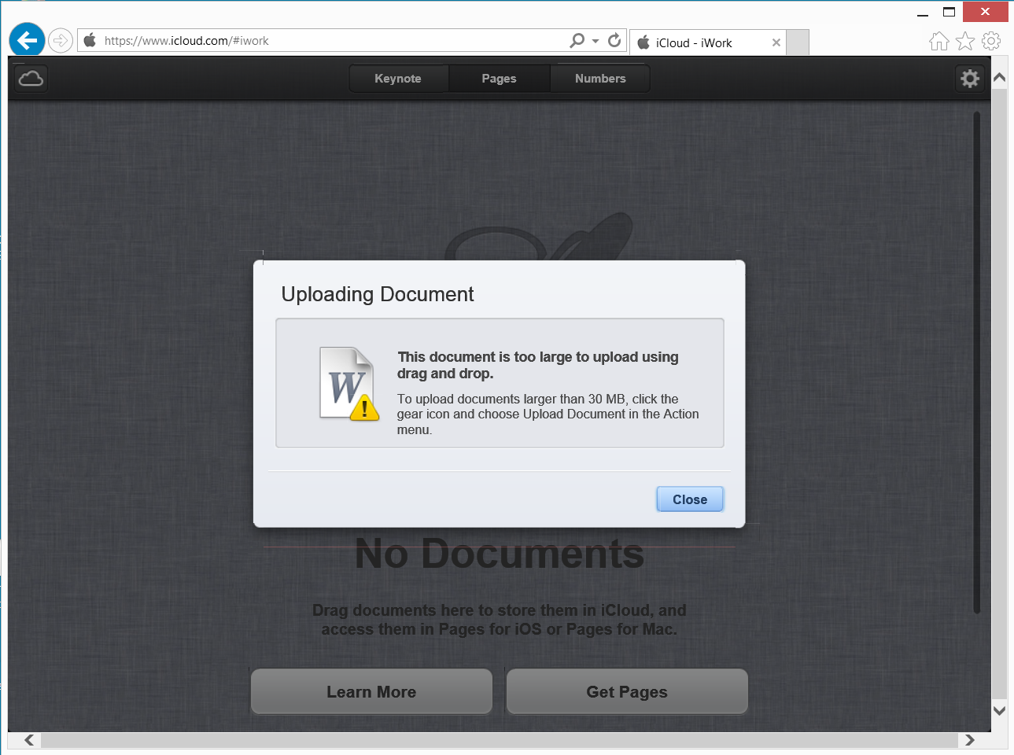

Slide 59
USING "iCloud" (continued)
To turn on iCloud's "Photo Stream" photo storage capabilities, you have to buy and install either the "iPhoto" program or the "Aperture" program. One of these two not-free programs has to be installed into a Mac running "OS X", an "iPad", or an "iPhone".

Slide 60
USING "iCloud" (continued)
Then, to get "Photo Stream" working in a "Windows.." PC, you have to install the free "iCloud Control Panel for Windows" software program. See http://support.apple.com/kb/dl1455 (The character to the right of the "d" is a lower-case "L".) The go the the "iCloud" applet inside the Windows "Control Panel", put a check mark for "Photo Stream" and then click on the "Close" button.

Slide 61
USING "iCloud" (continued)
"Photo Stream" is an iCloud-based file synchronization service for synchronizing .JPG, .TIF, .TIFF, .PNG, and .RAW digital photos between "Mac OS X" computers, "Windows.." computers, iPads, and iPhones.

Slide 62


Internet Connection
Server Farms Operated by Apple for "iCloud"
Your Computer, Tablet, PDA, or Cell Phone
Ethernet or WiFi Adapter
Web Browser to access icloud.com
"iCloud" app for "Windows.." (a desktop program) or Drag and Drop in the Mac "Finder"
Single file upload and download is provided by the Apple's "iCloud Web App Plugin" and HTML

Slide 63
Your Computer, Tablet, PDA, or Cell Phone
accessing iCloud
Ethernet or WiFi Adapter
Upload or download single files
Web Browser to access http://icloud.com
"iCloud Control Panel", a desktop application for "Windows Vista SP2", "Windows 7", or "Windows 8" or Drag and Drop in the Mac "Finder
Automatic download of "Photo Stream" photos, if "Photo Stream" is turned on and manual upload of photos by dragging into "Uploads" folder in "Windows..".
Single file upload by means of the "iCloud Web App Plugin" and single file download by means of HTML.
Cannot log into an account at icloud.com
from Windows 8's new "Start screen"
Internet Explorer 10 ("Windows Store App")

Slide 64
USING "iCloud" (continued)
From inside a Mac "OS X" computer, you have to use either the not-free "iPhoto 9" or "Aperture programs to upload a photo file into your "Photo Stream":

Slide 65
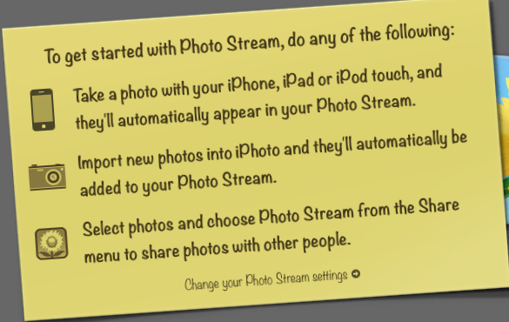

Slide 66
USING "iCloud" (continued)
From inside a "Windows.." computer, you can upload a photo file to your "Photo Stream" by dragging it into the "Uploads" folder that is created when you install the "iCloud Control Panel":

Slide 67
USING "iCloud" (continued)
If you drag a photo file into C:\Users\<your Windows user profile>\My Pictures\Photo Stream\ Uploads\, the "Photo Stream" system will download the file into 1) the "Photo Stream" folder of the "Web" section and the "<Month><Year> Photo Stream" section of the Photos section in the "Library" of "iPhoto 9" or "Aperture" in all Macs running "OS X 10.7 or 10.8 and 2)the "My Photo Stream" folder in your "Pictures" folder in all "Windows.." computers which have the "iCloud Control Panel" installed including the originating "Windows.." computer.

Slide 68
USING "iCloud" (continued)
Once you do the above two steps, all photos that are uploaded to Apple iCloud's "Photo Stream" service (from any device that is participating in your Apple ID's "Photo Stream") will be immediately downloaded to C:\Users\<your Windows user profile>\My Pictures\Photo Stream\ My Photo Stream\ To upload a photo to "Photo Stream" in a "Windows.." computer, drag it into C:\Users\<your Windows user profile>\My Pictures\Photo Stream\ Uploads\

Slide 69
USING "iCloud" (continued)
Deleting a photo file from into C:\Users\<your Windows user profile>\My Pictures\Photo Stream\ Uploads\ will not delete it from other devices in your "Photo Stream".
Deleting a photo file from the "Photo Stream" folder in the "Web" section of "iPhoto" or "Aperture" in a Mac running "OS X" will cause the photo to be deleted from all devices in your "Photo Stream".

Slide 70
USING "iCloud" (continued)
From a Mac running "OS X", you can upload a photo into iCloud's "Photo Stream" service by dragging it into the "<Month> <Year> Photo Stream" section of the "Photos" library of either the "iPhoto 9" program or the "Aperture" program. After you do so, a duplicate copy of the photo will download into the "Photo Stream" section of the "Web" section of "iPhoto 9" program or the "Aperture" program (and into all other devices that are part of your Apple ID's "Photo Stream".)

Slide 71
USING "iCloud" (continued)
Even though they are probably stored there, you cannot access the photos that you upload to the "iCloud" server farm by using a Web browser to go to http://icloud.com

Slide 72
USING "iCloud" (continued)
In a Mac "OS X" computer, the photos that you upload to your "Photo Stream" are also stored in a proprietary "container file" that is located on your local hard drive. This "container file" is maintained by your "iPhoto 9" or "Aperature" program.

Slide 73
"iCloud" in a "Windows.." Computer
To set up "iCloud" in a "Windows.." computer, your computer has to be running "Windows Vista SP2", "Windows 7", or "Windows 8" or "Windows 8.1" or "Windows 10" or "Windows 11" . Go to http://support.apple.com/kb/dl1455 and download and install "iCloud Control Panel for Windows":

Slide 74
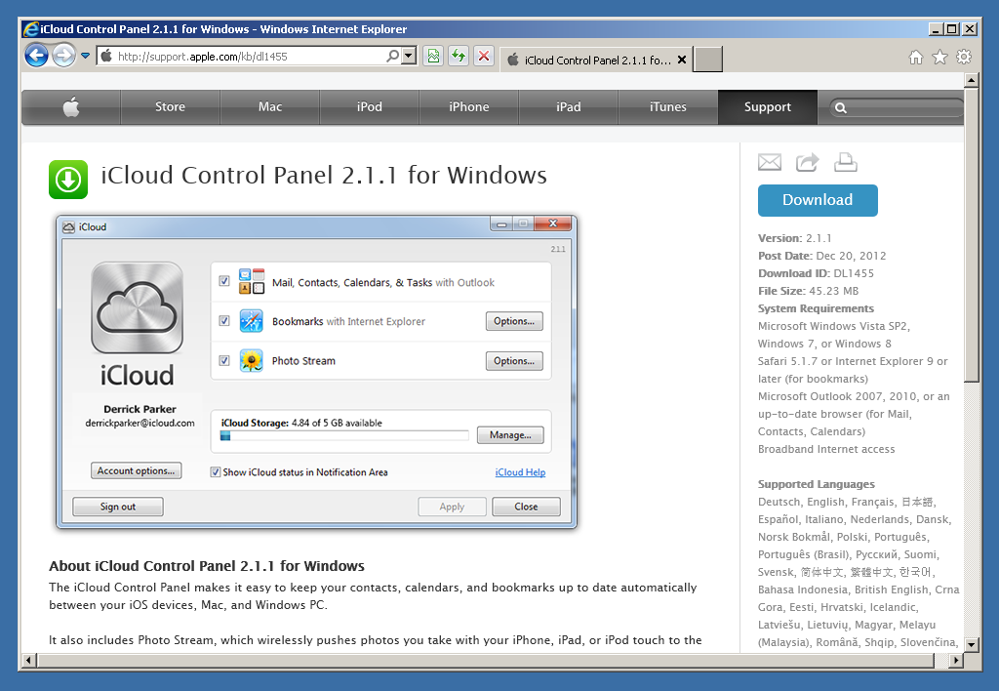

Slide 75
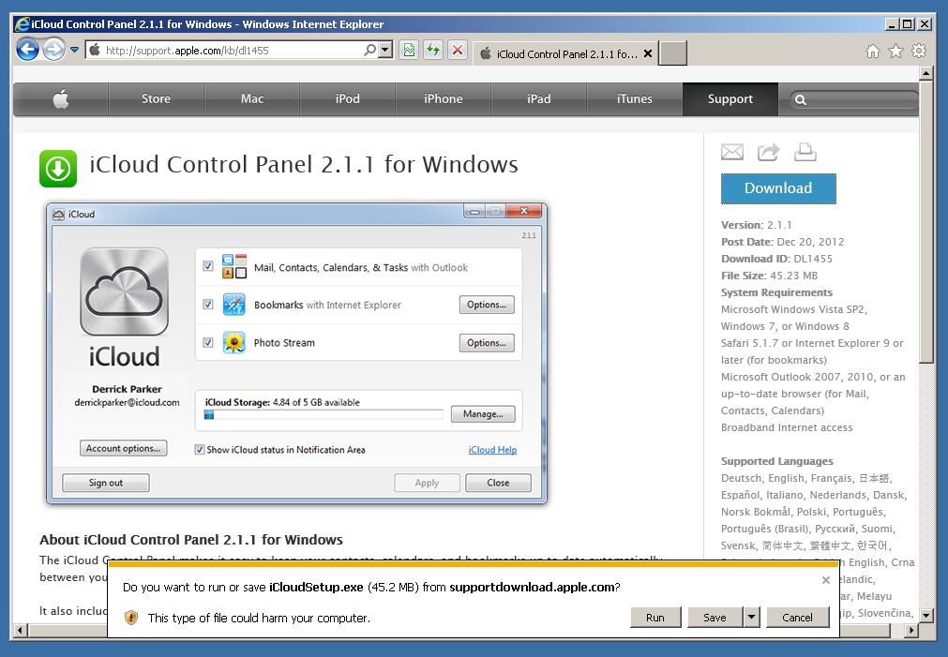

Slide 76
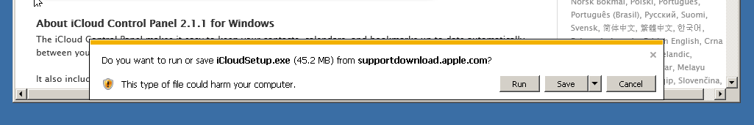

Slide 77
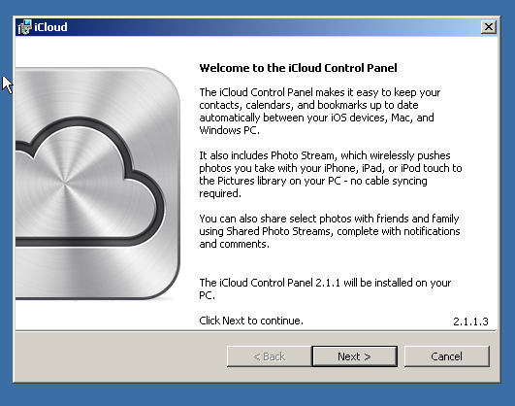

Slide 78
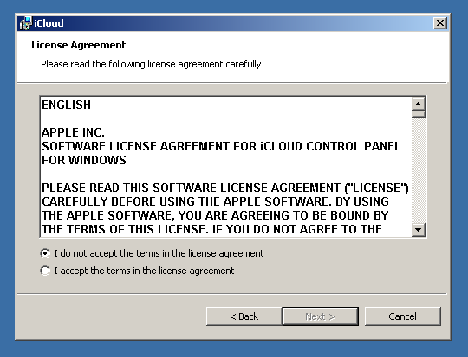

Slide 79
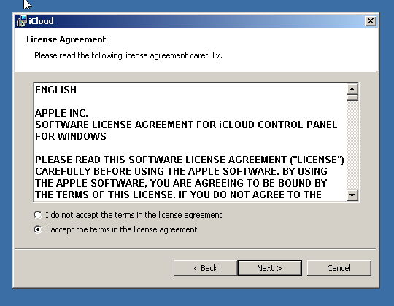

Slide 80
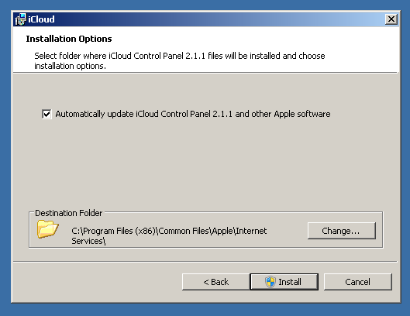

Slide 81
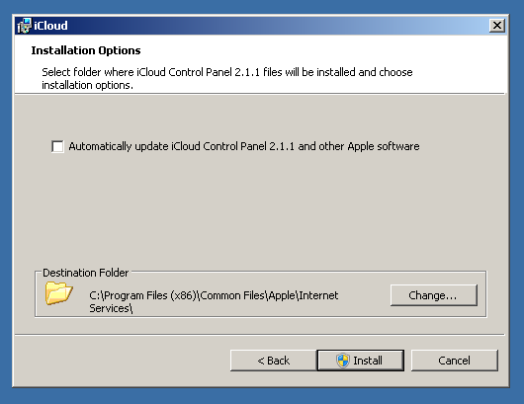

Slide 82
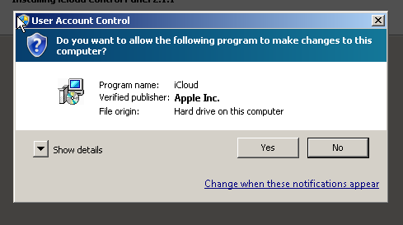

Slide 83
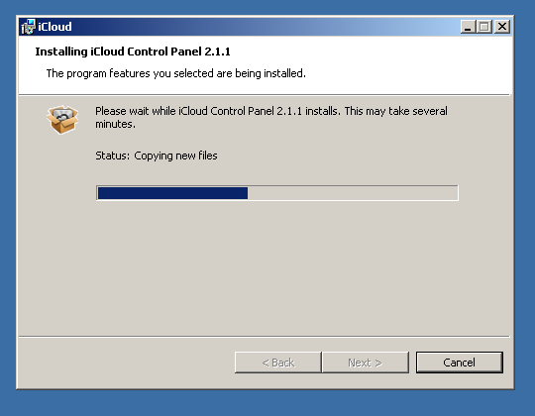

Slide 84
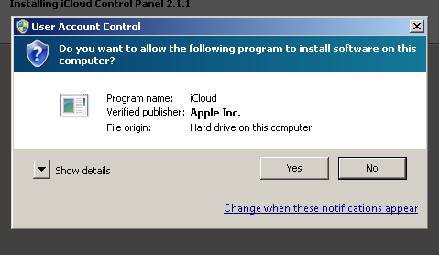

Slide 85
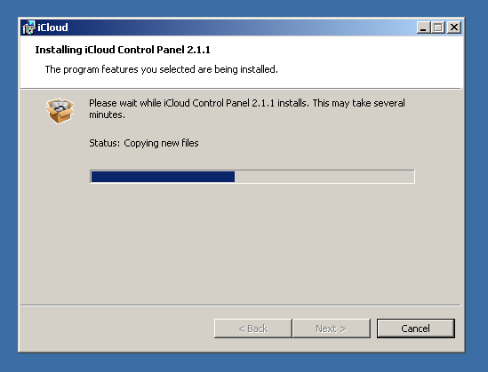

Slide 86
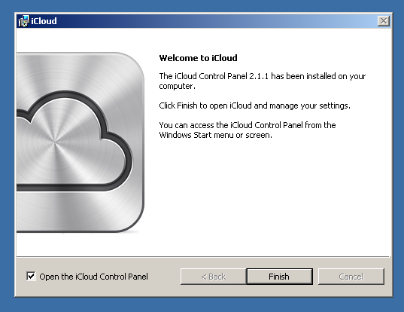

Slide 87
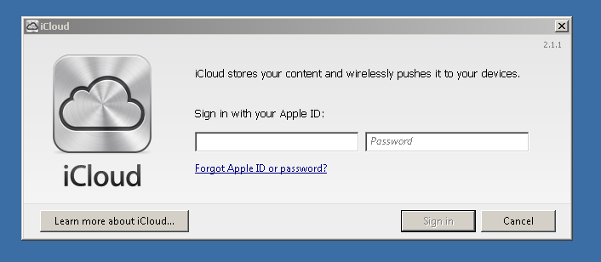

Slide 88
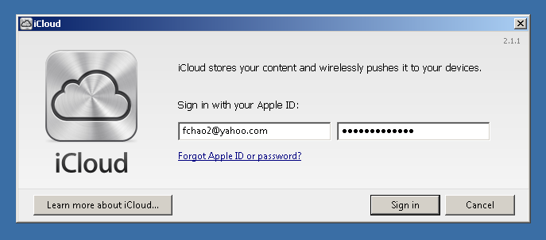

Slide 89
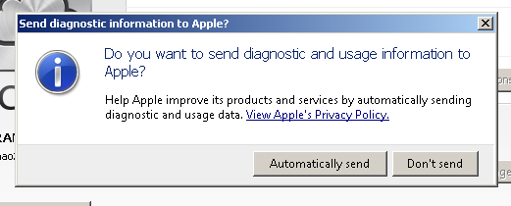

Slide 90
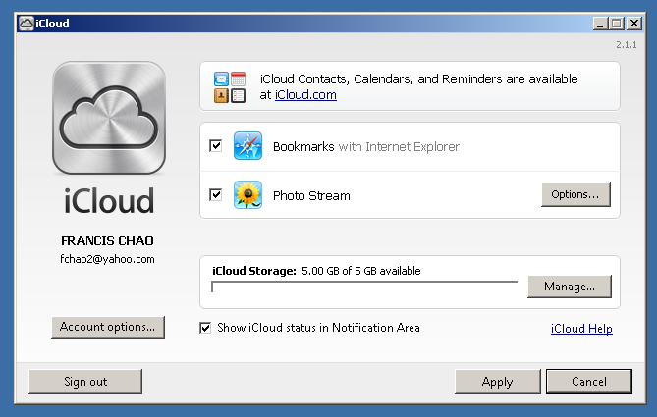

Slide 91
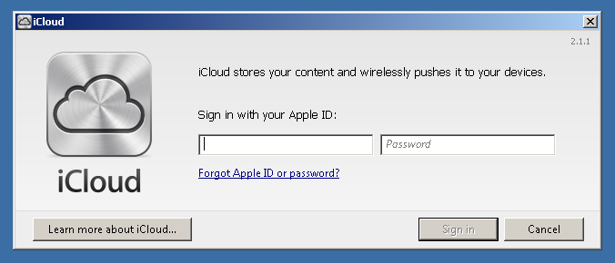

Slide 92
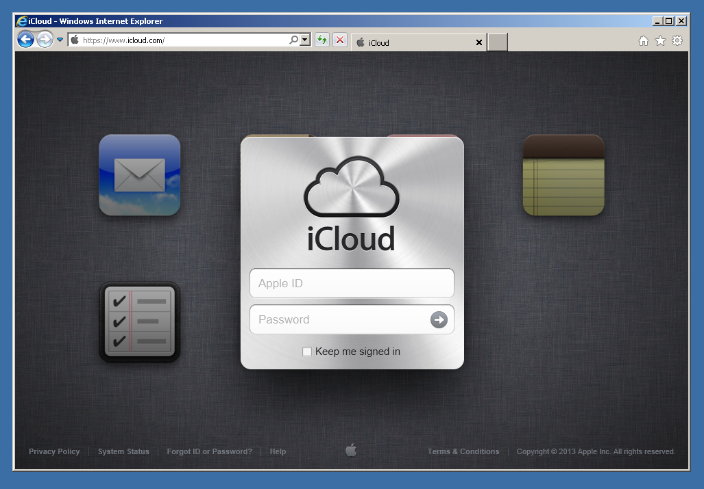

Slide 93
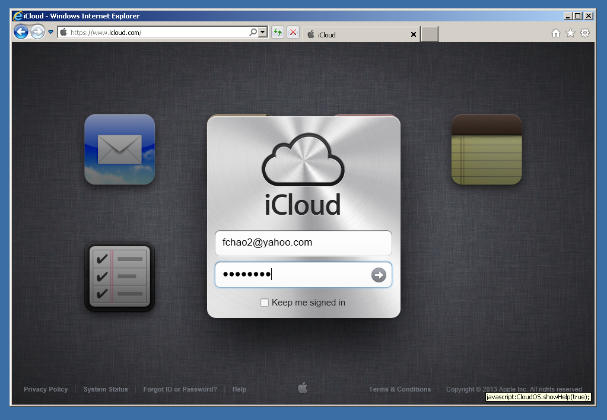

Slide 94
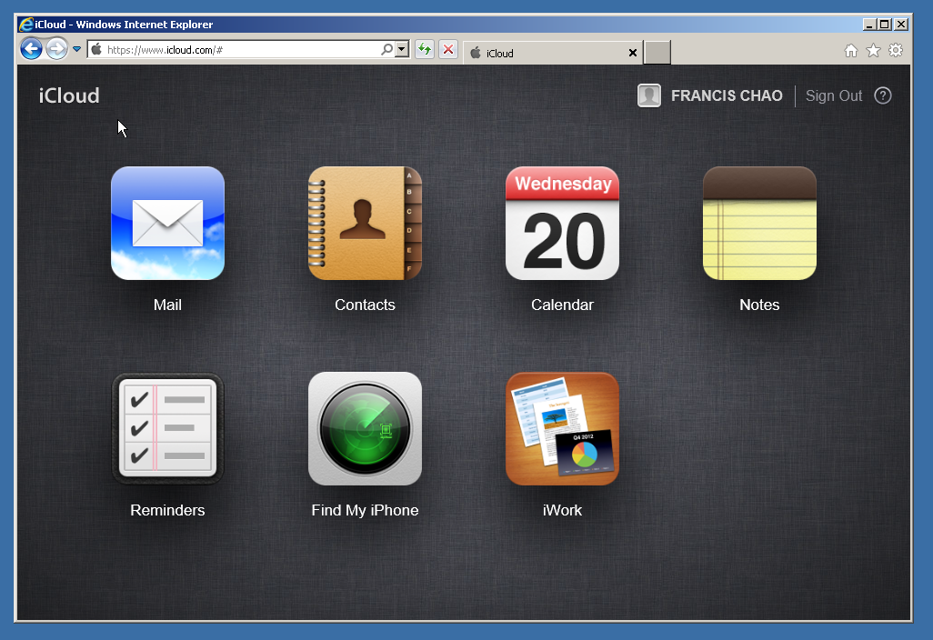

Slide 95
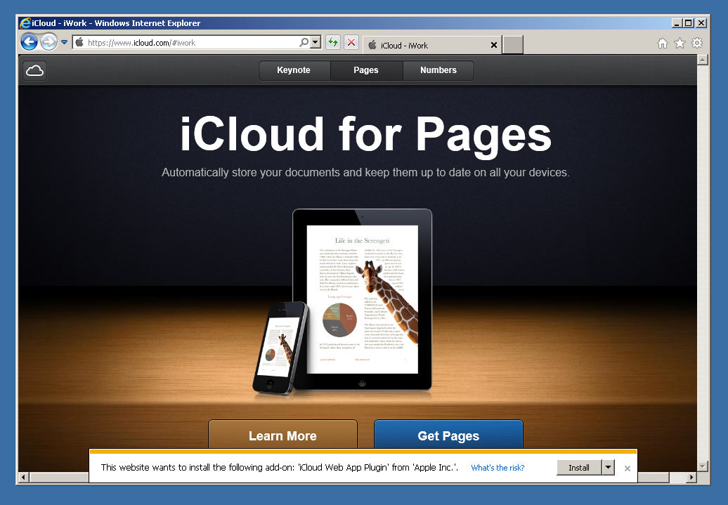

Slide 96
"iCloud" in a "Windows.." Computer
When the pop-up asks you to do so, install the "iCloud Web App Plugin" for "Internet Explorer" or whatever Web browser you are using:

Slide 97
"iCloud" in a "Windows.." Computer
Click on the drop down list button:

Slide 98


Slide 99
"iCloud" in a "Windows.." Computer
Click on "Install for all users" in the drop down list:

Slide 100
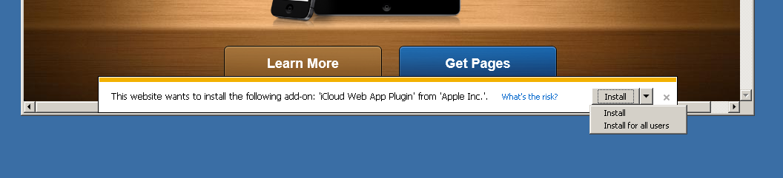

Slide 101
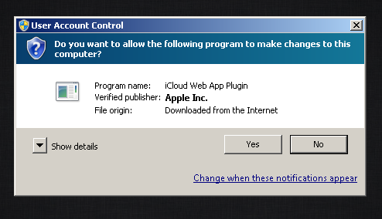

Slide 102
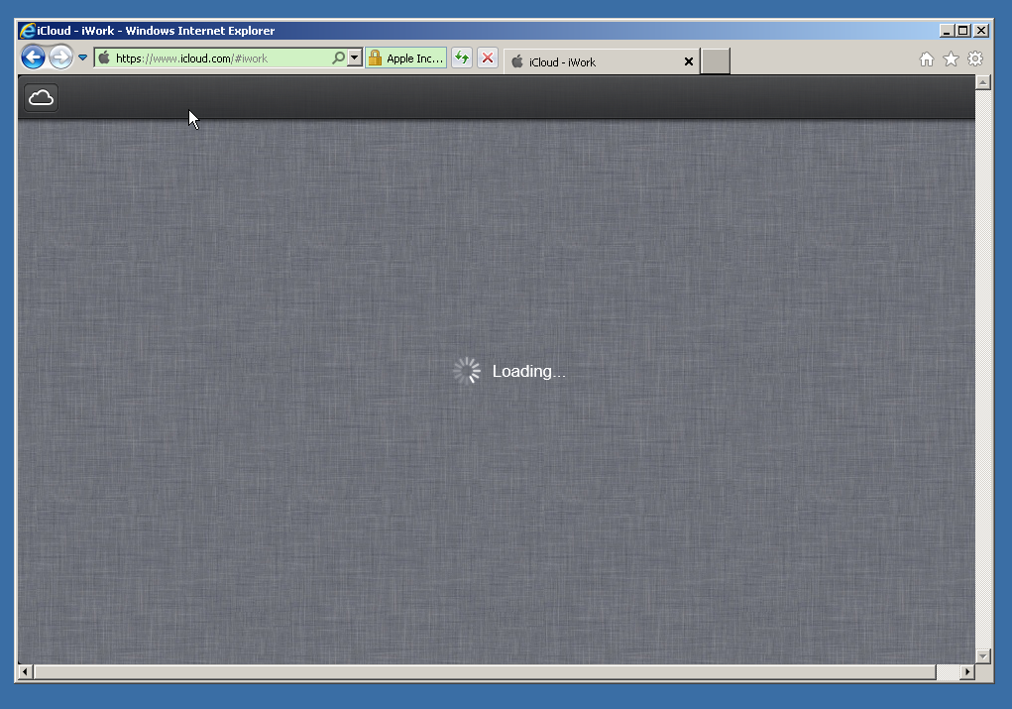

Slide 103
"iCloud" in a "Windows.." computer (continued)
To access the online storage space for documents, double-click on the "iWork" icon:

Slide 105
"iCloud" in a Mac "OS X" computer
  You can click on the "Get Pages" button which will take to take you to "..Store" app that is inside one of these Apple devices:

Slide 106
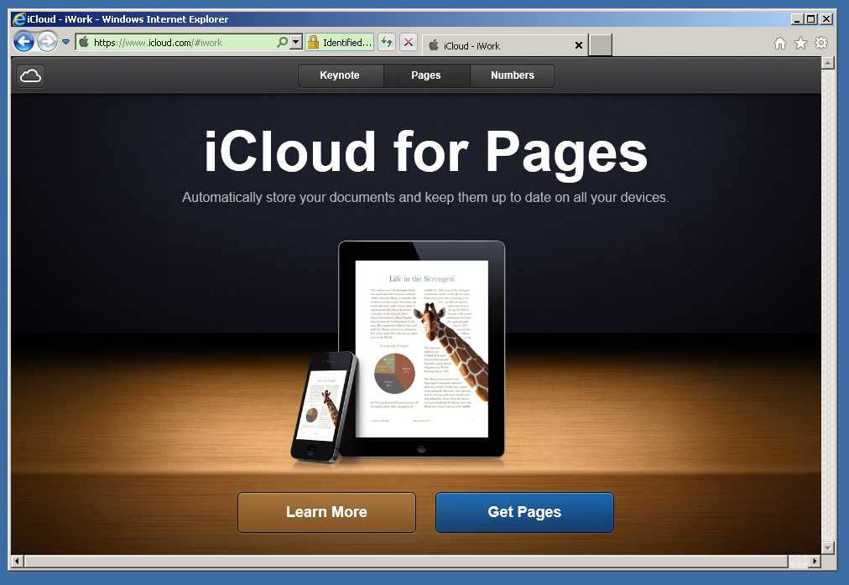

Slide 108
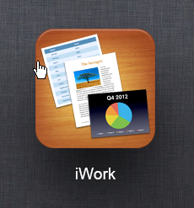

Slide 109
"iCloud" in a Mac "OS X" computer
If you use a Web browser inside a "Windows.." computer to access "icloud.com" and you go to the "iWork" storage area, you should ignore the "Get.." icon because you will not be able to install any of the 3 "iWork" programs into a "Windows.." computer:

Slide 110
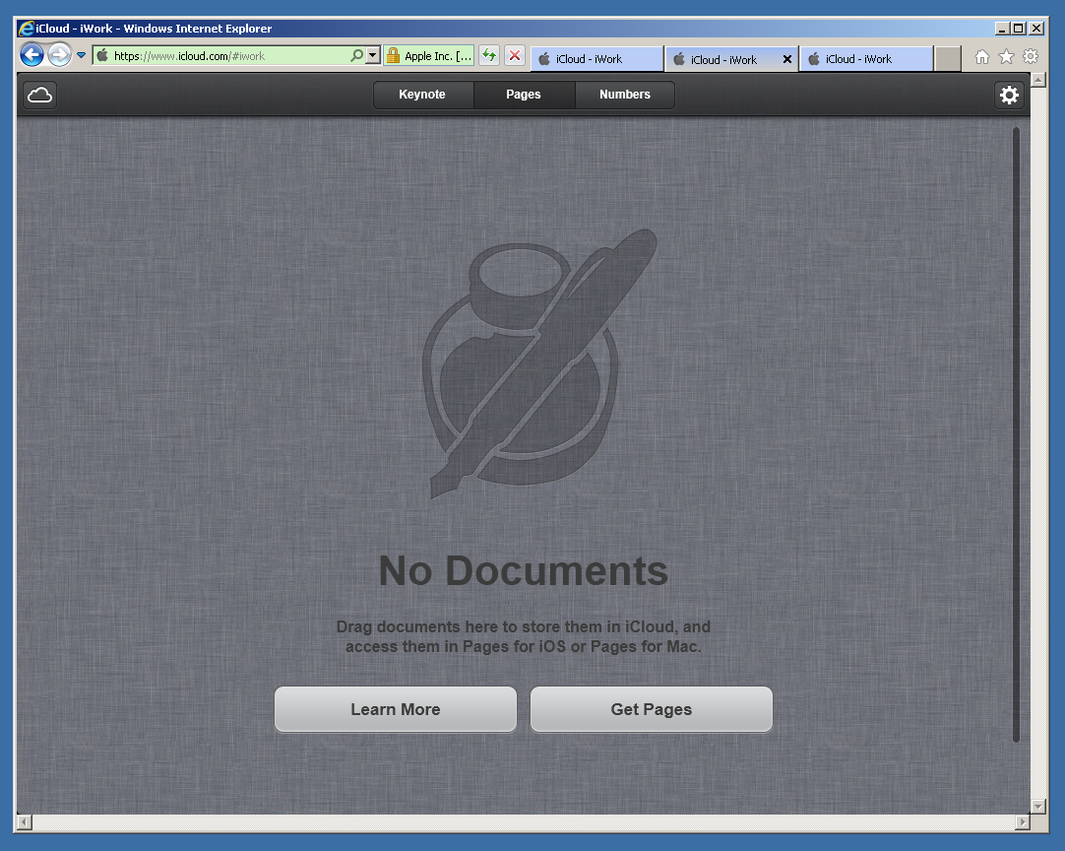

Slide 112


Slide 113
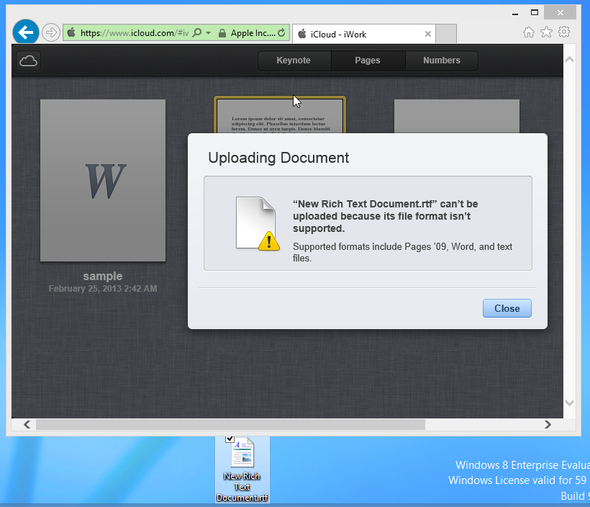

Slide 114
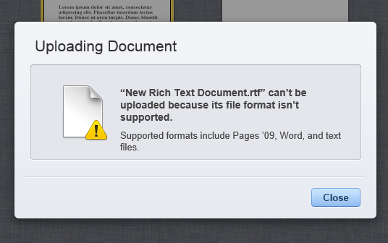

Slide 115
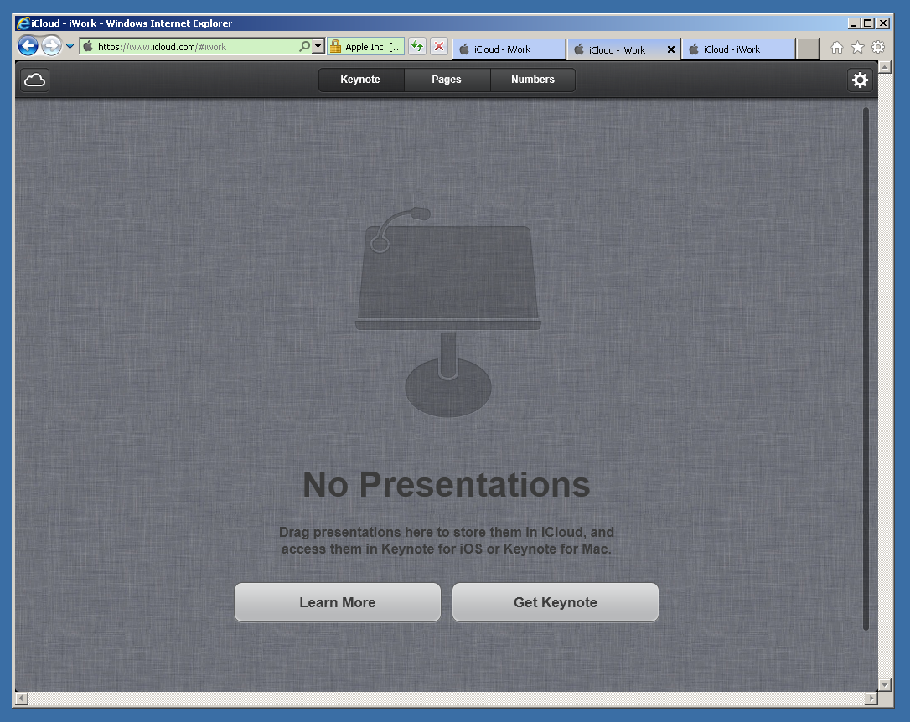

Slide 116


Slide 117
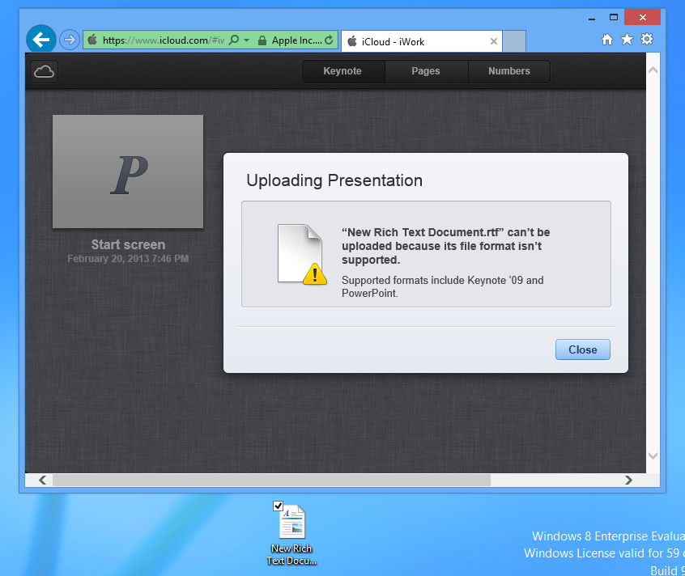

Slide 118
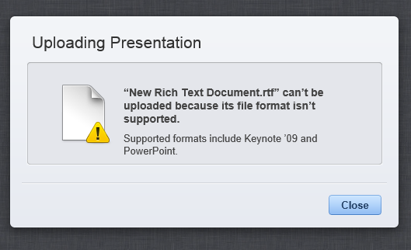

Slide 119
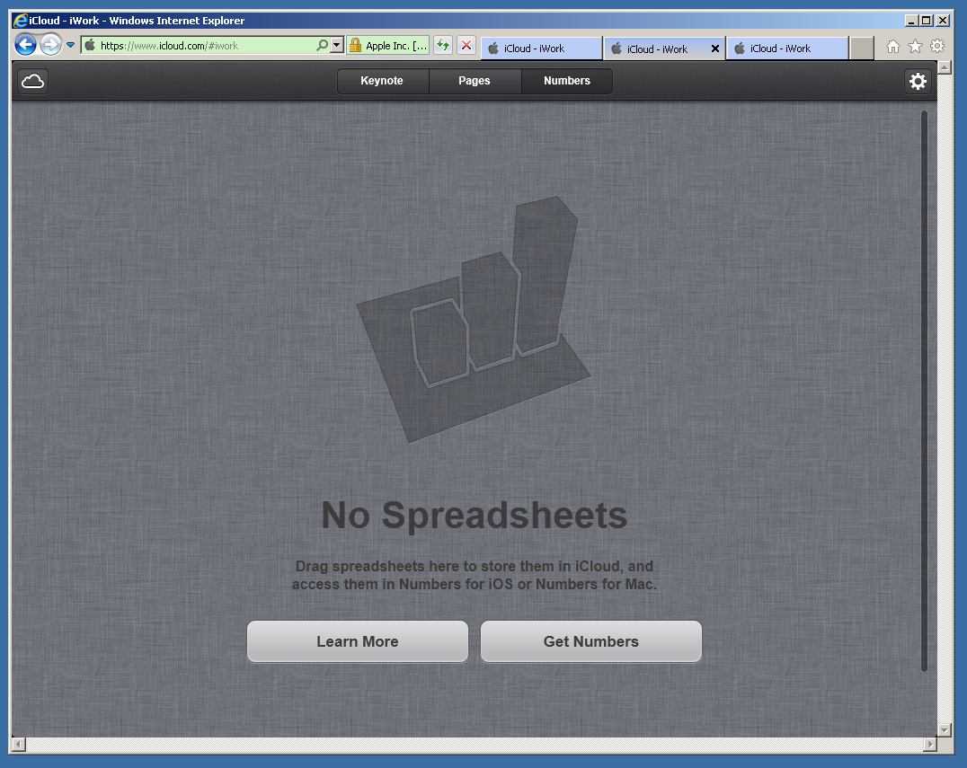

Slide 120


Slide 121
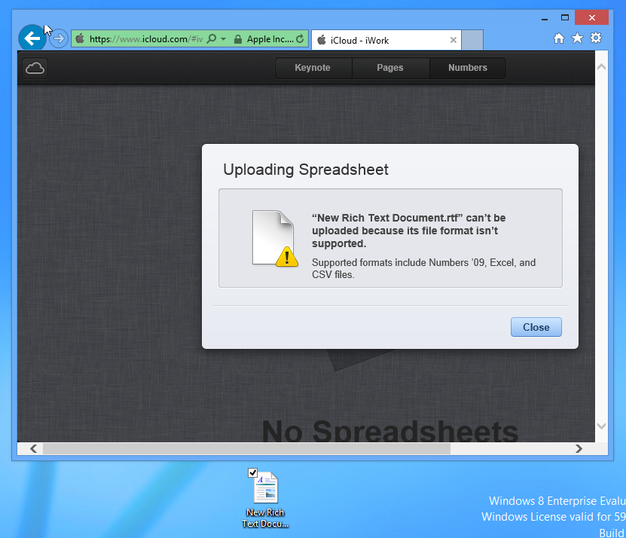

Slide 122
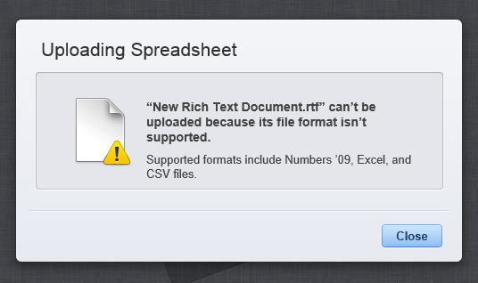

Slide 123
More About iCloud.. (continued)
"iCloud" lets you make folders in the three storage areas for documents: Just drag one or more files on top of another file.

Slide 124
More about "iCloud" (continued)
For a Mac running "OS X" or an iPad or an iPhone running "iOS", you can use "Pages", "Keynote", or "Number" of "iWork" to directly open, view, and edit files that are stored at iCloud by clicking on File, Open, and the "iCloud" button.

Slide 125
More about "iCloud" (continued)
For a Mac running "OS X" or an iPad or an iPhone running "iOS", you can also use a Web browser to access http://icloud.com to upload or download documents to the three storage areas that are related to the "iWork" software application.

Slide 126
More about "iCloud" (continued)
For a "Windows.." computer, you have to use a Web browser at http://icloud.com to download data files from or upload data files to "iCloud".

Slide 127
More about "iCloud" (continued)
If you use a Web browser in a "Windows.." computer, to download documents in the "Pages '09" format from the "Pages" section of the iCloud Web site, you will have a .zip file called <name of document>.pages.zip

Slide 128
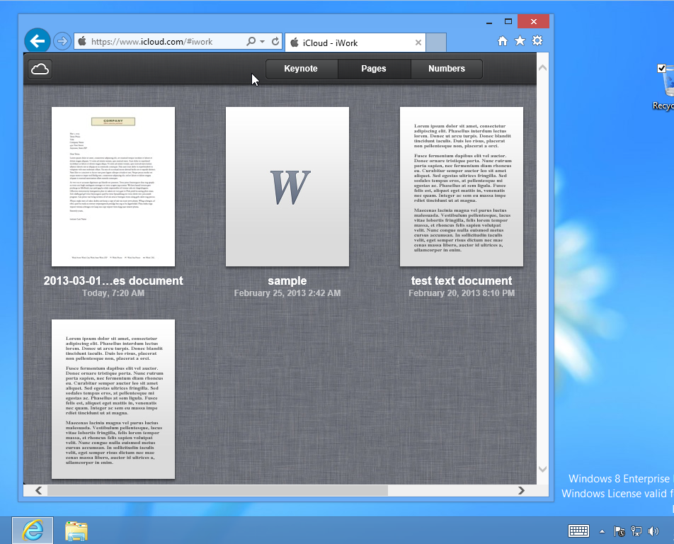

Slide 129
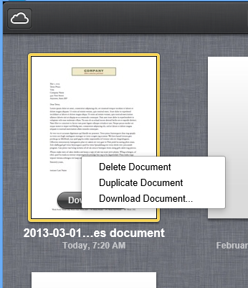

Slide 130


Slide 131


Slide 132


Slide 133


Slide 134


Slide 136


Slide 137


Slide 138


Slide 139


Slide 140


Slide 141


Slide 142


Slide 143


Slide 144


Slide 145


Slide 146


Slide 147


Slide 148
More about "iCloud" (continued)
If you are using "Pages" of "iWork" (in a Mac, an "iPad", or an "iPhone") to edit a .doc or a .docx file, a File and Save will default to saving in "iCloud".

Slide 149
More about "iCloud" (continued)
If you are using "Microsoft Word for Mac.." or "Microsoft Word" (for "Windows..") to edit a .doc or a .docx file, you cannot save directly to "iCloud": You will have to save the file to the Mac or PC desktop or somewhere else on a hard drive. Then, you will have to drag the file to the appropriate "iCloud" location in a Web browser such as "Safari" or "FireFox".

Slide 150
More about "iCloud" (continued)
You cannot use the Mac "Finder" or the Windows "Windows Explorer" to access files that are stored at "iCloud". You have to use a either Web browser such as "Internet Explorer" or "FireFox" in a "Windows.." computer or "Safari" or "FireFox" in a "Mac", or you can use an "iWork" suite app such as "Pages", "Keynote", or "Numbers" in a Mac, an "iPad", or an "iPhone".

Slide 151
More about "iCloud" (continued)
Ubuntu Linux 12.10's "Unity" desktop environment will not let you drag between files from a "Nautilus" file manager window to a Web browser window, so you have to use the "Gear" icon to upload files from the desktop or other hard drive location of a "Ubuntu 12.10" computer into iCloud:

Slide 152


Slide 153


Slide 154


Slide 155


Slide 156


Slide 157


Slide 158


Slide 159
More about "iCloud" (continued)
From inside an Android phone or tablet, you cannot access files that are stored in "iCloud":

Slide 160
More about "iCloud" (continued)
From the "Dolphin Browser" app inside an Android phone or tablet:

Slide 161


Slide 162
More about "iCloud" (continued)
"iCloud" has great integration with Apple's "iWork" programs.
  From inside "Pages", "Keynote", or "Numbers", you can click on the "iCloud" button to access and open existing files that are stored in their corresponding tabs at the "iCloud" server farm:

Slide 163


Slide 165
More about "iCloud" (continued)
"iCloud" has great integration with Apple's "iWork" programs (continued)
  When you click on "File" and "Save", you can select "iCloud" for where to save the file to the corresponding tab up at the "iCloud" server farm.

Slide 166


Slide 168
More about "iCloud" (continued)
In a Mac "OS X" computer, an optional, unofficial way for you to upload files to "iCloud" is to drag and drop in the Mac "Finder"

Slide 169
More about "iCloud" (continued)
Details of this optional, unofficial way for you to upload files in a Mac can be found at http://www.imore.com/icloud-dropbox

Slide 170


Slide 171


Slide 172


Slide 173


Slide 174


Slide 175


Slide 176


Slide 177


Slide 178


Slide 179
More about "iCloud" (continued)
When you drag a file to this "iCloud" folder (from the Mac Desktop or any other "Finder" window), two actions will occur:

Slide 180
More about "iCloud" (continued)
"Action 1": A copy of the file will be created in this hidden folder on your local hard drive and "Action 2": Mac OS X will upload a copy of the file up to the pertinent folder at the "iCloud" server farm

Slide 181
More about "iCloud" (continued)
If you drag a file with an unauthorized file extension, only "Action 1" will occur and "Action 2" will not occur.

Slide 182
More about "iCloud" (continued)
When you remove the file away from this hidden "iCloud" folder on the local hard drive of your Mac) folder, the file will also be deleted in the corresponding tab up at the "iCloud" server farm (if the file was stored there already).

Slide 183


Slide 184


Slide 185


Slide 186


Slide 187


Slide 188


Slide 189


Slide 190


Slide 191


Slide 192


Slide 193


Slide 194


Slide 195


Slide 196


Slide 197


Slide 198


Slide 199
More about "iCloud" (continued)
In an iPhone or an iPad to access "iDrive: tap on files --> tap on "iCloud Drive"

Slide 200


