Slide 1



CLOUD STORAGE SERVICES

Slide 2
Web location for this presentation:
http://aztcs.org
Then click on "Meeting Notes"
2

Slide 3
SUMMARY
You can use free cloud storage to protect yourself from losing data files and to synchronize data files between a server farm and your computers, cell phones, and tablets.
3
33

Slide 4
TOPICS
(Cloud) Storage Versus Backup Versus Synchronization
Cloud Storage Services In General
Apps for Cloud Storage Services
The "OneDrive" App in "Windows 10" Should Probably Be Uninstalled
Some Cloud Storage Services With Free Storage
Security Risks of Cloud Storage Services
4

Slide 5
TOPICS (continued)
Creating An Account At a Cloud Storage Service
Two Ways to Upload and Download Data Files and Photo Files
Services Provided By A Cloud Storage Service
5

Slide 6
TOPICS (continued)
Files Stored Up In the Cloud Versus Files Stored On a Local Hard Drive
Bandwidth and File Size Limitations
Outages of File Storage Services
Report Cards To Compare Cloud Storage Services
6

Slide 7
(CLOUD)
STORAGE VERSUS BACKUP VERSUS SYNCHRONIZATION
7

Slide 8
STORAGE VERSUS BACKUP VERSUS SYNCHRONIZATION
Use of these terms is imprecise
The quotes on the next two slides are taken from https://www.comparitech.com/online-backup/the-difference-between-cloud-backup-cloud-storage-and-synchronization/ :
8

Slide 9
STORAGE VERSUS BACKUP VERSUS SYNCHRONIZATION (continued)
"Cloud storage" is <Start of quote:> like having an external hard drive online that’s accessible anywhere. ... Users typically store things in the cloud manually. That is, they choose when and what files to upload on the cloud on a one-off basis. <End of quote>
9

Slide 10
STORAGE VERSUS BACKUP VERSUS SYNCHRONIZATION (continued)
"Cloud backup" is <Start of quote:> Cloud backup differs in that it’s usually automated. Depending on the service, it can happen continuously or on a set schedule, often hourly or daily. When a file is created or modified, the newest version is uploaded and stored on the cloud. <End of quote>
10

Slide 11
STORAGE VERSUS BACKUP VERSUS SYNCHRONIZATION (continued)
The term "Cloud synchonization".. is used in any or all of three different ways: 1. Storage of files in the cloud for collaboration between multiple people 2. Storage of files in the cloud for making sure that they are exactly the same in multiple devices 3. Storage of files in the cloud to make sure that they are the same as the files in a specific folder(s) in your computer
11

Slide 12
CLOUD STORAGE SERVICES
IN GENERAL
12

Slide 13
A set of interconnected server farms provided by the cloud storage service connects to the Internet which connects to your computer:
13

Slide 14

Server Farm
#1
Server Farm
#2
Server Farm
#3
Your Internet Connection
14

Slide 15
Interconnected Server Farms Operated by a Web-based Cloud Storage Service
Your Internet Connection
15

Slide 16
Your Internet Connection
Computer to Access A Cloud Storage Service
Web Browser (= "Web app") to access the cloud storage service
(Optional) Special Folder Provided by the App and special icon in Notification Area
(Optional) App
Provided by the Cloud Storage Service or a Third-party Software Developer
16

Slide 17

Your Wi-Fi wireless Internet Connection or Your Cell Phone's Data Plan
Cell Phone or Tablet to Access a Cloud Storage Service
Web Browser app ("Safari" in iphone or "Chrome browser" in Android phone)
to access the cloud storage service
(Optional) App
Provided by the Cloud Storage Service or a Third-party Software Developer
17

Slide 18
APPS FOR CLOUD STORAGE SERVICES
You can use as many cloud storage services as you like. Most computer users use more than one cloud storage service because none of the cloud storage services provide very much online storage space for a free account.
18

Slide 19
APPS FOR CLOUD STORAGE SERVICES (continued)
However, you should not use more than one of the apps that are provided by the cloud storage services that you use in a Windows.. or macOS computer:
19

Slide 20
APPS FOR CLOUD STORAGE SERVICES (continued)
The apps that are provided by the various cloud storage services are optional: They cause a noticeable slow-down for your "Windows.." or "macOS" computer. If you do not want to incur this slowing down of your computer, use a Web browser to access all of your cloud storage services instead of there apps.
20

Slide 21
APPS FOR CLOUD STORAGE SERVICES (continued)
In a cell phone or tablet, it is okay to put in the apps for more than one cloud storage service: In a cell phone or tablet, it is hard to use a cloud storage service if you do not install either the app that is provided by a cloud storage service or a third party app for connecting to a cloud storage service.
21

Slide 22
APPS FOR CLOUD STORAGE SERVICES (continued)
In a "Windows.." or "macOS" computer, only install the app for one cloud storage service since the apps for the various cloud storage services will massively slow down your computer, if you put in more than one app.
22

Slide 23
APPS FOR CLOUD STORAGE SERVICES (continued)
Even if you put in only one single app for a single cloud storage service into a computer, you will notice a slow-down in a "Windows.." or "macOS" computer
23

Slide 24
APPS FOR CLOUD STORAGE SERVICES (continued)
If you install a cloud storage service's app into your computer and the slow-down is not acceptable to you, remove by app by using "Revo Uninstaller Portable" as described at http://aztcs.org/meeting_notes/winhardsig/uninstaller/RevoUninstallerPortable.pdf
24

Slide 25
THE "ONEDRIVE" APP IN "WINDOWS 10" SHOULD PROBABLY BE UNINSTALLED
The "Windows 11" and "Windows 10" operating systems are both extremely aggressive about trying to get you to use it's bundled "OneDrive" app Like all cloud storage apps in computers, this app uses lots of RAM and CPU cycles and the "OneDrive" app is optional and you can use your "OneDrive" cloud storage account from any Web browser without using the "OneDrive" app.
25

Slide 26
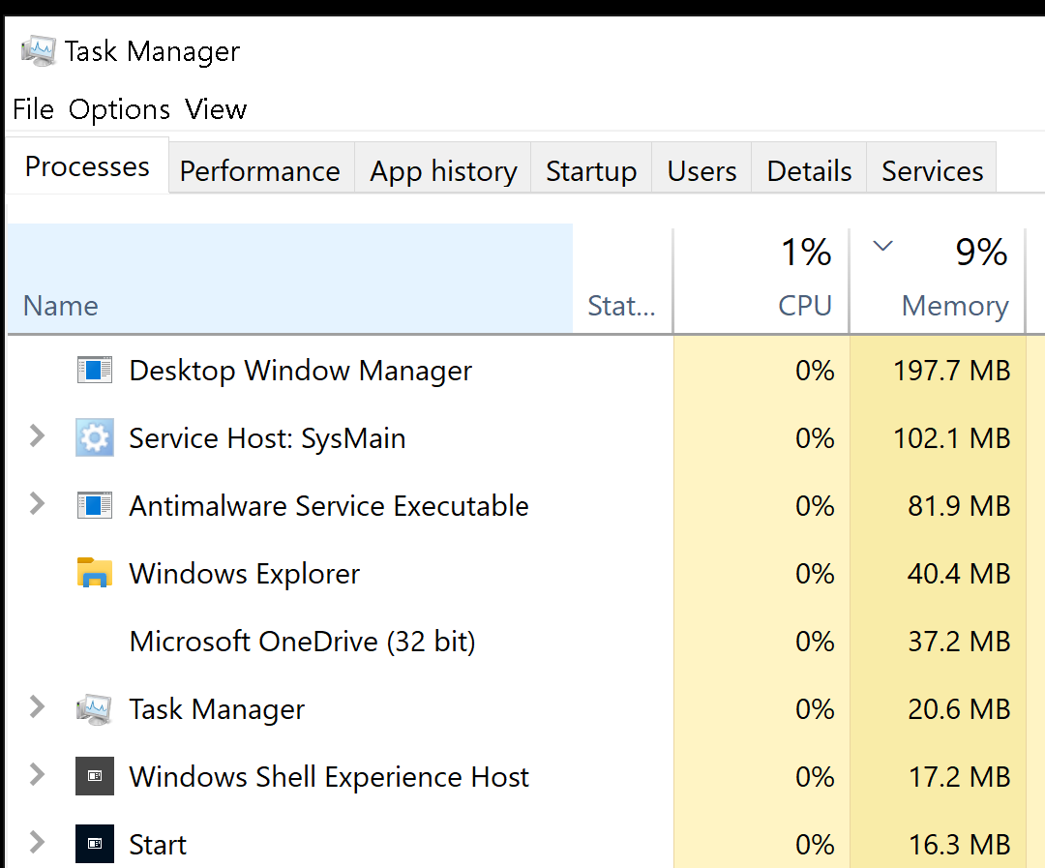
26

Slide 27
27

Slide 28
THE "ONEDRIVE" APP IN "WINDOWS 10" SHOULD PROBABLY BE UNINSTALLED (continued)
To do a clean removal of Microsoft's "OneDrive" app, you can use "Revo Uninstaller Portable" as described at http://aztcs.org/meeting_notes/winhardsig/uninstaller/RevoUninstallerPortable.pdf
28

Slide 29
SOME CLOUD STORAGE SERVICES WITH FREE STORAGE
"Google Drive": 15 Gigabytes shared between "Google Drive", "Gmail", and "Google Photos"
Microsoft's "OneDrive": 5 Gigabytes
"Dropbox": 2 Gigabytes
Apple's "iCloud": 5 Gigabyte for users of MacOS computers or iOS devices
"box.com": 5 Gigabytes if you go to https://www.box.com/pricing/individual
29

Slide 30
SOME CLOUD STORAGE SERVICES WITH FREE STORAGE (continued)
"iDrive": 10 Gigabytes free cloud storage
30

Slide 31
SOME CLOUD STORAGE SERVICES WITH FREE STORAGE (continued)
According to https://www.softwaretestinghelp.com/cloud-storage-providers/
31

Slide 32
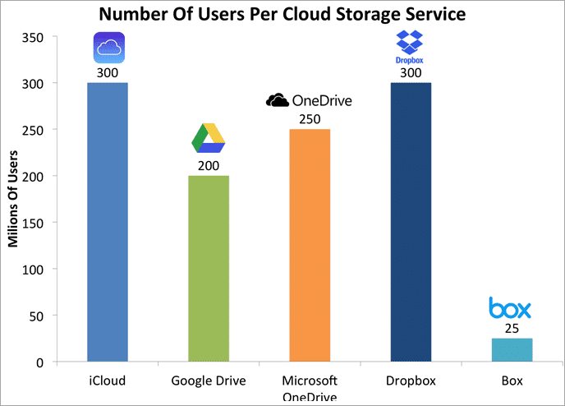
32

Slide 33
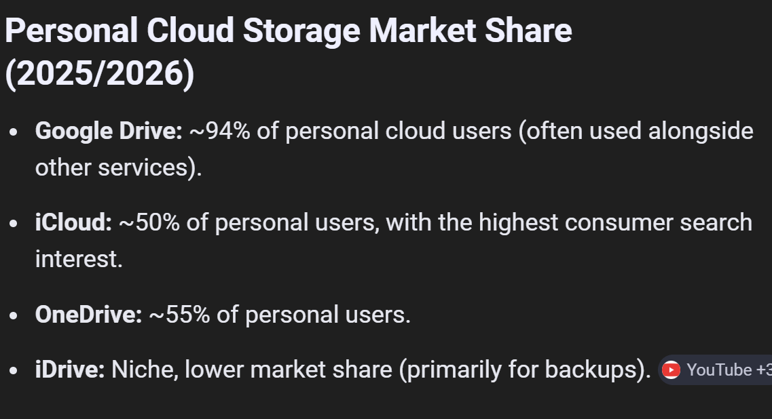
33

Slide 34
SOME CLOUD STORAGE SERVICES WITH FREE STORAGE (continued)
According to https://www.goodcloudstorage.net/cloud-research/google-drive-vs-dropbox-vs-onedrive/#users
34

Slide 35
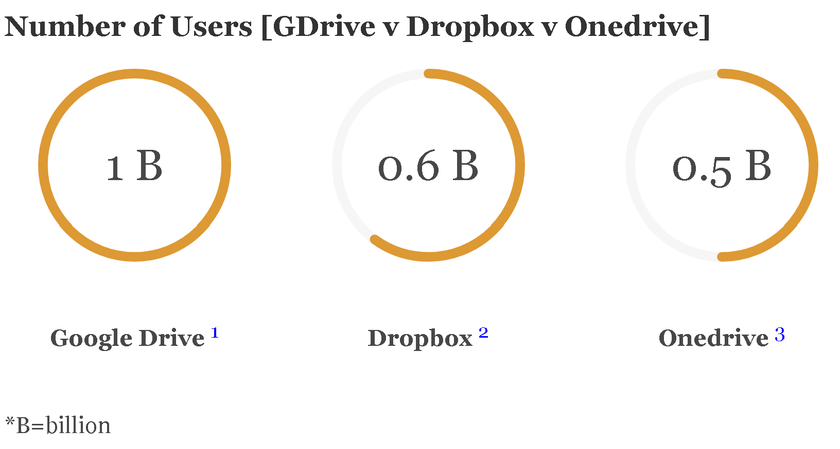
35

Slide 36
SECURITY RISKS OF CLOUD STORAGE SERVICES
36

Slide 37
SECURITY RISKS OF CLOUD STORAGE SERVICES
For each data file or digital photo that you store at a cloud storage service, you have to ask yourself if you accept the risk that an employee or contractor that works for the cloud service might copy or view the data file or digital photo
37

Slide 38
SECURITY RISKS OF STORAGE SERVICE SERVICES (continued)
If an employee or contractor that works for the a cloud service provider viewed or copied your data or photo files, it would be a violation of the employee policies and contractual agreements of the management of the cloud storage service but being in violation of policies and contractual agreements does not prevent such activities (i.e. Eric Snowden and Chelsea Manning).
38

Slide 39
SECURITY RISKS OF STORAGE SERVICE SERVICES (continued)
You have three options to protect yourself from the above-mentioned risks: Option 1: Do not store files that contain "personally important" information at a cloud storage service Option 2: Encrypt the file yourself (such as putting a password on a Microsoft "Word" or "Excel" file)
39

Slide 40
SECURITY RISKS OF STORAGE SERVICE SERVICES (continued)
Option 3: Use a cloud storage service that uses "Zero Knowledge" encryption For more details about "zero knowledge" and the security risks of cloud storage services that do not have "zero knowledge", see https://www.cloudwards.net/what-exactly-is-zero-knowledge-in-the-cloud-and-how-does-it-work/
40

Slide 41
SECURITY RISKS OF STORAGE SERVICE SERVICES (continued)
(Option 3 continued:) "Sync.com" offers 5 Gigabytes for free: They are "zero knowledge" meaning that end-to-end encryption is employed and the employees and contractors of "Sync.com" cannot access or reset the user's passwords. The employees and contractors of "Sync.com" cannot copy or view the user's stored files.
41

Slide 42
CREATING AN ACCOUNT AT A CLOUD STORAGE SERVICE
Which Web browser app should you use? The more popular Web browsers will be easier to use for creating a cloud storage account:
42

Slide 43
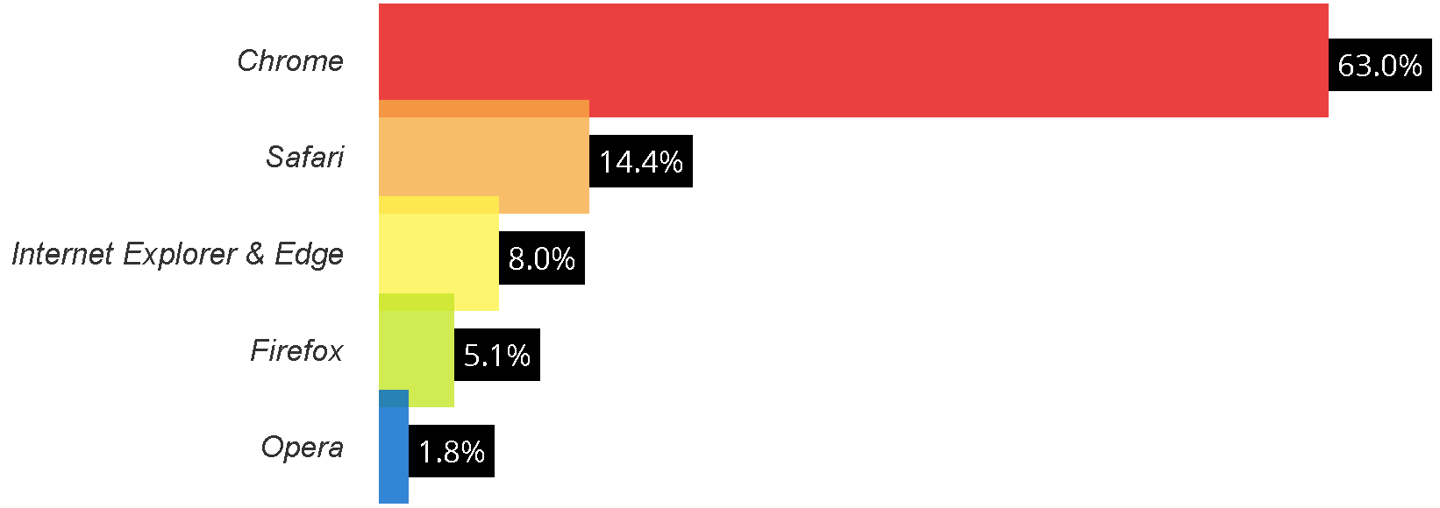
43

Slide 44
CREATING AN ACCOUNT AT A CLOUD STORAGE SERVICE (continued)
Reference for previous slide: https://www.w3counter.com/globalstats.php
44

Slide 45
CREATING AN ACCOUNT AT A CLOUD STORAGE SERVICE
You probably already have a cloud storage account, if you use any of Google's services such as Gmail or if you have an account at one of of Microsoft's services such as "outlook.com" or "live.com", "msn.com", "hotmail.com", "xbox.com", or"Skype"
45

Slide 46
CREATING AN ACCOUNT AT A CLOUD STORAGE SERVICE (continued)
If you have an account at any of the following free "Google" services, you can use the same username and password to get into your existing account at "Google Drive":
46

Slide 47
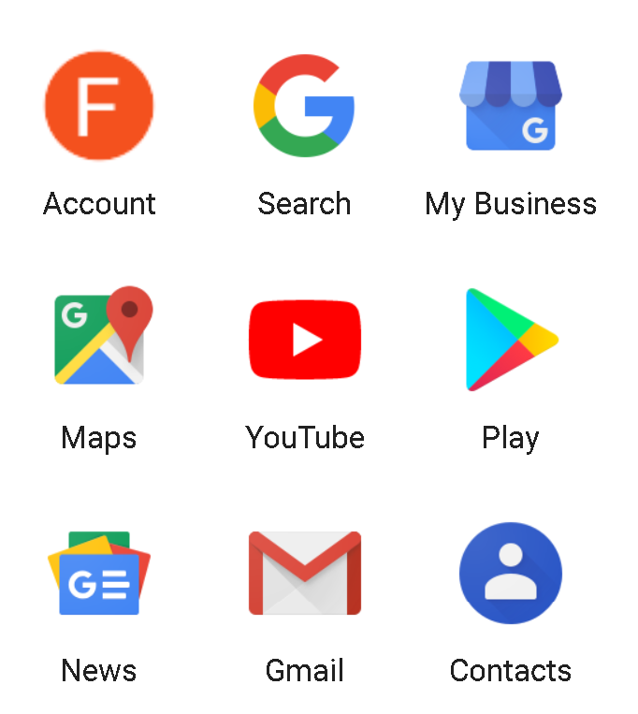

47

Slide 48
CREATING AN ACCOUNT AT A CLOUD STORAGE SERVICE (continued)
If you have an account at any of the Microsoft's services, you can use the same username and password to get into your existing account at Microsoft's "onedrive.com"
When you use a Web browser go to onedrive.com you end up at onedrive.live.com
48

Slide 49
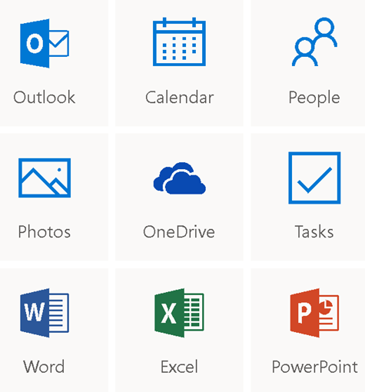

49

Slide 50
CREATING AN ACCOUNT AT A CLOUD STORAGE SERVICE (continued)
If you are signing up for a cloud storage account at a Web site and it asks you for a credit card number or a PayPal log in or a checking account number, then you are signing up for a paid, not-free account: If this happens, quickly close out the Web browser, usually by clicking on the "x" button in the upper-right corner of the browser window.
50

Slide 51
CREATING AN ACCOUNT AT A CLOUD STORAGE SERVICE (continued)
Use a Web browser to go to google.com or drive.google.com
Use a Web browser to go to live.com or onedrive.com
51

Slide 52
CREATING AN ACCOUNT AT A CLOUD STORAGE SERVICE (continued)
Use a Web browser to go to dropbox.com/basic
Use a Web browser to go to apple.com to get an "Apple ID". Then use a Web browser to go to "icloud.com"
52

Slide 53
CREATING AN ACCOUNT AT A CLOUD STORAGE SERVICE (continued)
Use a Web browser to go to https://account.box.com/signup/n/personal#a7vgp (instead of going to box.com)
Use a Web browser to go to https://www.sync.com/free-cloud-storage/ (instead of going to sync.com)
53

Slide 54
TWO WAYS TO UPLOAD AND DOWNLOAD DATA FILES AND PHOTO FILES TO A CLOUD STORAGE SERVICE
Method 1: Use a Web browser to access the Web site of the cloud storage service
Method 2: Use an app that is provided by the cloud storage service or a third-party software developer
54

Slide 55
SERVICES PROVIDED BY A CLOUD STORAGE SERVICE
Storage of data files, photo files, and folders that contain them. All cloud storage services can perform this very basic function.
55

Slide 56
SERVICES PROVIDED BY A CLOUD STORAGE SERVICE (continued)
The rest of the services that are listed differ between the various cloud storage services:
56

Slide 57
SERVICES PROVIDED BY A CLOUD STORAGE SERVICE (continued)
Converting document files and photo files to different formats on demand as a "Software as a Service" Web-based service that does not require any apps on your local computer, tablet, or cell phone
57

Slide 58
SERVICES PROVIDED BY A CLOUD STORAGE SERVICE (continued)
Viewing and editing of data files and digital photos that are stored at the cloud storage service as a "Software as a Service" Web-based service that does not require any apps on your local computer, tablet, or cell phone
58

Slide 59
SERVICES PROVIDED BY A CLOUD STORAGE SERVICE (continued)
Synchronization of files or digital photos between one or more computers, cell phones, or tablets AND the cloud storage service: Synchronization is useful if you need to access or edit a data file or photo on more than one device. However, when a data file get infected by malware on one device, the same gets infected in all devices.
59

Slide 60
SERVICES PROVIDED BY A CLOUD STORAGE SERVICE (continued)
Share a stored folder or file as a link so that others can download or view the stored file or folder:
  Share a file or folder as a password protected link so that you have to give the password to those whom you want to download or view the stored file or folder
  Share a file or folder as a link that is not password-protected
60

Slide 61
BANDWIDTH AND FILE SIZE LIMITATIONS
Different cloud storage services have different maximum file size and bandwidth limitations with their paid accounts having larger file size and bandwidth limitations. See https://en.wikipedia.org/wiki/Comparison_of_file_hosting_services
61

Slide 62
BANDWIDTH AND FILE SIZE LIMITATIONS (continued)
Bandwidth limitations refer to the maximum bytes that you can upload plus download from your local computer, tablet, and cell phone in a given calendar month
See https://en.wikipedia.org/wiki/Comparison_of_file_hosting_services
62

Slide 63
OUTAGES OF CLOUD STORAGE SERVICES
The outages of the more well-known cloud storage services have not exceeded 5 hours per year during the past 5 years
63

Slide 64
OUTAGES OF CLOUD STORAGE SERVICES (continued)
The smaller, less-well-known "boutique" cloud storage services that some professional photographers use have occasionally gone bankrupt without warning, leaving photographers without any way to retrieve their online photos and files
64

Slide 65
OUTAGES OF CLOUD STORAGE SERVICES (continued)
To reduce the possibility of a massive failure at any single cloud storage service, business continuity experts recommend: Store data and photo files both locally on media and/or hard drives AND store data and photo files at more than one cloud storage service
65

Slide 66
OUTAGES OF CLOUD STORAGE SERVICES (continued)
According to https://www.quest.com/community/quest/microsoft-platform-management/b/microsoft-platform-management-blog/posts/the-top-5-benefits-of-using-onedrive :
66

Slide 67
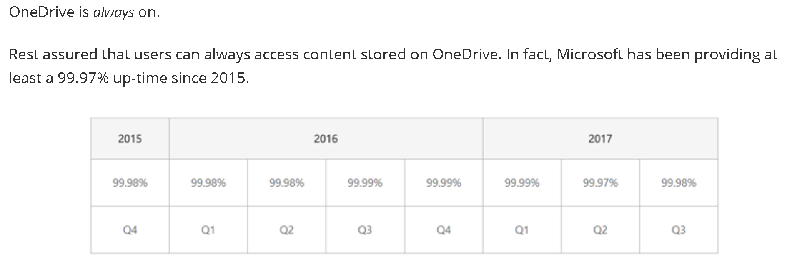
67

Slide 68
68

Slide 69
OUTAGES OF CLOUD STORAGE SERVICES (continued)
100-99.98= 0.02 percent downtime per year
(.02/100)x365x24 = 1.752 hours per year
69

Slide 70
OUTAGES OF CLOUD STORAGE SERVICES (continued)
Some of Google's availability numbers are available at https://cloud.google.com/storage/docs/storage-classes
70

Slide 71
REPORT CARD FOR COMPARING CLOUD STORAGE SERVICES:
71

Slide 72
"<Name of Cloud Storage Service>"
AMOUNT OF FREE STORAGE? | ? GB
RELIABLE UPLOAD AND DOWNLOAD OF ENTIRE FOLDERS CONTAINING DATA FILES? | ?
NO KNOWN DATA SECURITY COMPROMISES? | ?
ONLINE CREATION, VIEWING, AND EDITING OF DOCUMENT FILES AND PHOTOS? | ?
"ZERO KNOWLEDGE" OF YOUR PASSWORD OR YOUR STORED DATA FILES | ?
72

Slide 73
"GOOGLE DRIVE" CLOUD STORAGE
Use "Google Drive" to get 15 GB of free cloud storage. This 15 GB allotment of space must be shared between "Google Drive", Gmail, and uncompressed photo files stored at "Google Photos"
The optional "app" from Google for "Google Drive" is called "Backup and Sync from Google". This name is show in the "Start Menu" of "Windows.."
73

Slide 74
REPORT CARD FOR "GOOGLE DRIVE"
AMOUNT OF FREE STORAGE? | ~ 15 GB
RELIABLE UPLOAD AND DOWNLOAD OF ENTIRE FOLDERS CONTAINING DATA FILES? | Yes
NO KNOWN DATA SECURITY COMPROMISES? | Yes
ONLINE CREATION, VIEWING, AND EDITING OF DOCUMENT FILES AND PHOTOS? | Yes
"ZERO KNOWLEDGE" OF YOUR PASSWORD OR YOUR STORED DATA FILES | No
74

Slide 75
"BOX" CLOUD STORAGE
Use "Box" to get 10 GB of free cloud storage
"Box" gives you more user-configurable options and apps than any of the other cloud storage services (in this presentation).
"Box" is a cloud storage pioneer which a stellar history of secure storage of sensitive data files for the medical and legal professions.
75

Slide 76
REPORT CARD FOR "BOX"
AMOUNT OF FREE STORAGE? | 10 GB
RELIABLE UPLOAD AND DOWNLOAD OF ENTIRE FOLDERS CONTAINING DATA FILES? | Yes
NO KNOWN DATA SECURITY COMPROMISES? | Yes
ONLINE CREATION, VIEWING, AND EDITING OF DOCUMENT FILES AND PHOTOS? | Yes
"ZERO KNOWLEDGE" OF YOUR PASSWORD OR YOUR STORED DATA FILES | No
76

Slide 77
"DROPBOX" CLOUD STORAGE SERVICE
Use Dropbox because they have the fastest uploads and downloads but be aware that they only give you 2 GB of online cloud storage
77

Slide 78
"DROPBOX" CLOUD STORAGE SERVICE (continued)
Historically, "Dropbox" is the least secure and least safe of the popular cloud storage services: See https://en.wikipedia.org/wiki/Criticism_of_Dropbox

Slide 79
REPORT CARD FOR "DROPBOX"
AMOUNT OF FREE STORAGE? | 2 GB
RELIABLE UPLOAD AND DOWNLOAD OF ENTIRE FOLDERS CONTAINING DATA FILES? | Yes
NO KNOWN DATA SECURITY COMPROMISES? | No
ONLINE CREATION, VIEWING, AND EDITING OF DOCUMENT FILES AND PHOTOS? | Yes
"ZERO KNOWLEDGE" OF YOUR PASSWORD OR YOUR STORED DATA FILES | No
79

Slide 80
"ONEDRIVE" CLOUD STORAGE SERVICE
Use Microsoft's "OneDrive" to get 5 GB of free cloud storage
The optional app for "OneDrive" is bundled in with "Windows 10"
Despite's Microsoft's claims to the contrary, the use of the bundled "OneDrive" app is optional and you can use any Web browser to access a "OneDrive" cloud storage account
80

Slide 81
REPORT CARD FOR "ONEDRIVE"
AMOUNT OF FREE STORAGE? | 5 GB
RELIABLE UPLOAD AND DOWNLOAD OF ENTIRE FOLDERS CONTAINING DATA FILES? | Yes
NO KNOWN DATA SECURITY COMPROMISES? | Yes
ONLINE CREATION, VIEWING, AND EDITING OF DOCUMENT FILES AND PHOTOS? | Yes
"ZERO KNOWLEDGE" OF YOUR PASSWORD OR YOUR STORED DATA FILES | No
81

Slide 82
"iCLOUD" CLOUD STORAGE
Use Apple's "iCloud" to get 5 Gigabytes of free storage by following the following procedure at
82

Slide 83
REPORT CARD FOR "iCLOUD"
AMOUNT OF FREE STORAGE? | 5 GB for MacOS & iOS users
RELIABLE UPLOAD AND DOWNLOAD OF ENTIRE FOLDERS CONTAINING DATA FILES? | No, from a Web browser Yes, from the "iCloud Drive" folder created in Apple's "iCloud" app for Windows.. computers
NO KNOWN DATA SECURITY COMPROMISES? | Yes
ONLINE CREATION, VIEWING, AND EDITING OF DOCUMENT FILES AND PHOTOS? | Yes, for Apple office suite formats (*.pages, *.keynote, *.formula) Viewing only for Adobe .PDF files Viewing only for digital photo files
"ZERO KNOWLEDGE" OF YOUR PASSWORD OR YOUR STORED DATA FILES | No
83

Slide 84
"SYNC.COM" CLOUD STORAGE SERVICE
Use "sync.com" to get 5 GB of free cloud storage. they have "zero knowledge" so that their employees and contractors cannot get your password nor can they view or steal your data files and digital photos.
84

Slide 85
REPORT CARD FOR "SYNC.COM"
AMOUNT OF FREE STORAGE? | 5 GB
RELIABLE UPLOAD AND DOWNLOAD OF ENTIRE FOLDERS CONTAINING DATA FILES? | Yes
NO KNOWN DATA SECURITY COMPROMISES? | Yes
ONLINE CREATION, VIEWING, AND EDITING OF DOCUMENT FILES AND PHOTOS? | No
"ZERO KNOWLEDGE" OF YOUR PASSWORD OR YOUR STORED DATA FILES | Yes
85

Slide 86
"SYNC.COM" CLOUD STORAGE SERVICE (continued)
However be aware that "zero knowledge" encryption technology massively slows down uploads and downloads and makes many of the other features such as file viewing and editing unavailable when you log into your account at the Web site of the cloud storage service.
86

Slide 87
"SYNC.COM" CLOUD STORAGE SERVICE (continued)
Your trade-off is between super security, which "sync.com" offers and the lesser security in return for the convenient features that the are offered by the cloud storage services that do not have "zero knowledge" implemented
87

Slide 88
FILES STORED UP IN THE CLOUD VERSUS FILES STORED IN A LOCAL HARD DRIVE
When you use a Web browser to access a cloud storage service, you are viewing the files that you have stored at the cloud storage service
88

Slide 89
FILES STORED UP IN THE CLOUD VERSUS FILES STORED IN A LOCAL HARD DRIVE (continued)
When you use "File Explorer" or any other "file manager" to look at your data files, you are usually looking at files that are stored on a local hard drive or a local hard-drive like device, EXCEPT when you install a app for a cloud storage service, you will have a special folder(s) that can represent what you have stored up in the cloud.
89

Slide 90
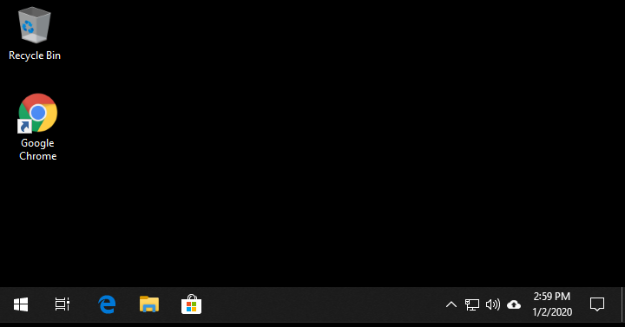
90

Slide 91
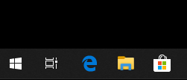
91

Slide 92

92

Slide 93
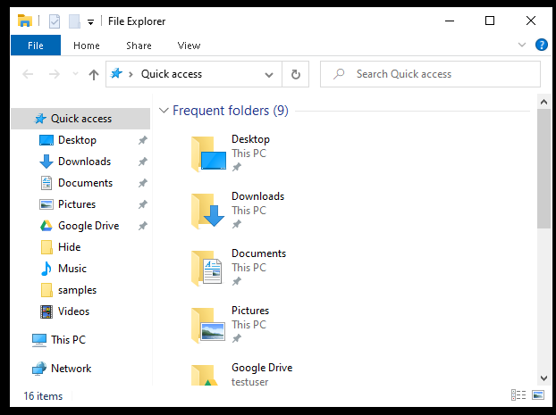
93

Slide 94
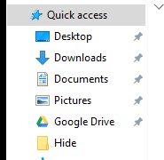
94

Slide 95
95

Slide 96
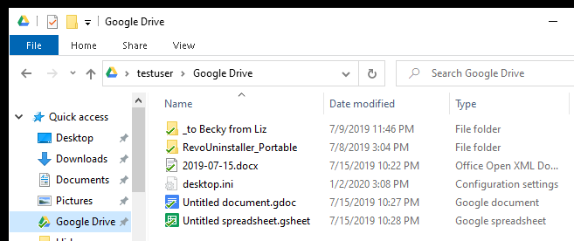
96

Slide 97
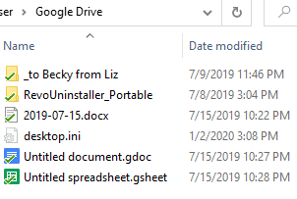
97

Slide 98
FILES STORED UP IN THE CLOUD VERSUS FILES STORED IN A LOCAL HARD DRIVE
The "special folders" that are created by the optional app of a cloud storage service may or may not contain actual copies of your data files or digital photos on a local hard drive of your computer:
98

Slide 99
FILES STORED UP IN THE CLOUD VERSUS FILES STORED IN A LOCAL HARD DRIVE (continued)
For the "Google" "Backup and Sync" app, the "Google Drive" folder will contain local copies of the same exact files that are stored up at the "Google Drive" cloud
99

Slide 100
GRANULARITY OF CONTROL IS THE "ONEDRIVE" APP'S KEY FEATURE
If you log into "Windows 10" with a Microsoft account and you get the bundled OneDrive app working, then you have superior control over how each file or folder that you store in "OneDrive" behaves: Online only, download when needed, synchronized between the server farm and your computer's hard drive, etc.
100

Slide 101
GRANULARITY OF CONTROL IS ONEDRIVE'S KEY FEATURE (continued)
http://techgenix.com/onedrive-features/
https://www.zdnet.com/article/onedrive-tips-and-tricks-how-to-master-microsofts-free-cloud-storage/
https://pureinfotech.com/disable-onedrive-sync-status-icon-file-explorer-windows-10/
101

Slide 102
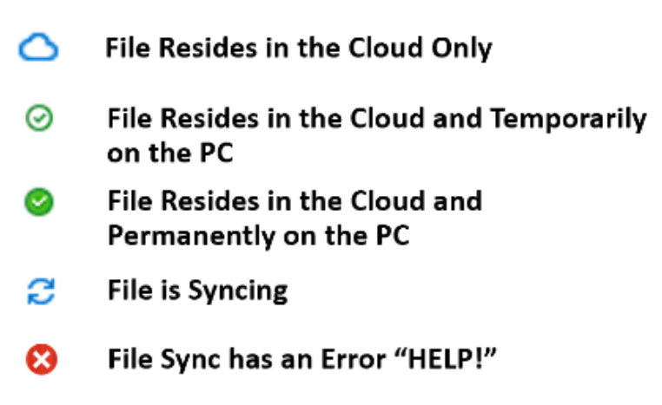
102

Slide 103
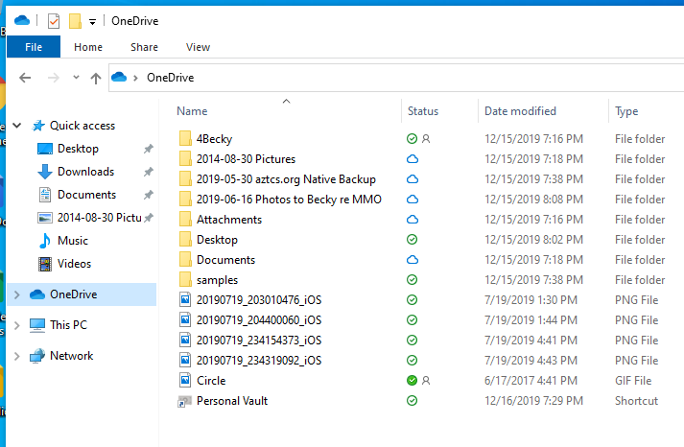
103

Slide 104
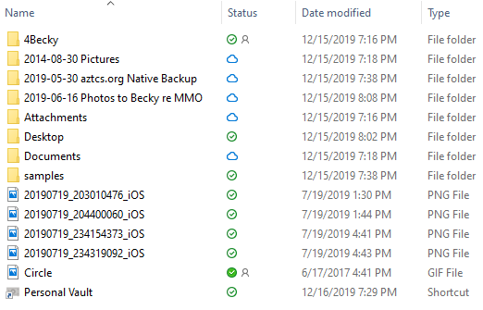
104

Slide 105

105

Slide 106
106

Slide 107
107

Slide 108
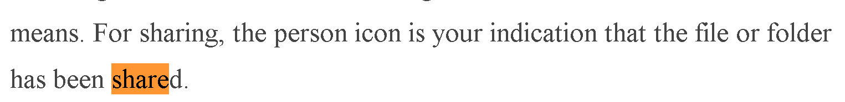
108

Slide 109
A DETAILED COMPARISON OF CLOUD STORAGE SERVICES
https://en.wikipedia.org/wiki/Comparison_of_online_backup_services
109

