Slide 1




CLOUD STORAGE WITH "GOOGLE DRIVE"
1

Slide 2
Web location for this presentation:
http://aztcs.org
Click on
“Meeting Notes”
2

Slide 3
SUMMARY
You can use "Google Drive" cloud storage to protect yourself from the losing data files and to access data files on multiple computers, cell phones, and computing devices.
3

Slide 4
"Google Drive" Server Farms
Approximately 2 million servers for Google services such as "Google Drive", "Gmail", "Google Site", "Google Voice", "Google+", etc.
Server farms are located in 12 places: 1. Council Bluffs, Iowa 2. The Dalles, Oregon 3. Douglas County, Georgia 4. Lenoir, North Carolina 5. Pryor in Mayes County, Oklahoma 6. Berkeley County, South Carolina 7. Quilicure, Chile 8. Hamina, Finland 9. St. Ghislain, Belgium 10. Dublin, Ireland 11. Singapore 12. Changhua County, Taiwan
4

Slide 5
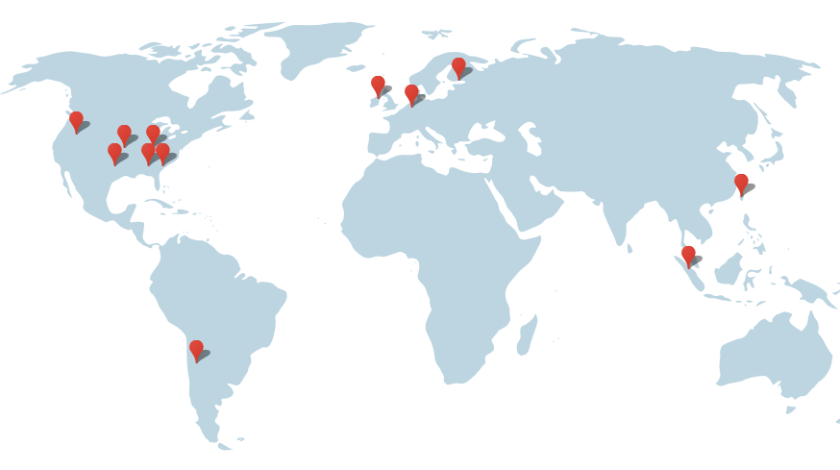
5

Slide 6
The map in the previous page was found at http://www.google.com/about/datacenters/inside/locations/index.html
6

Slide 7
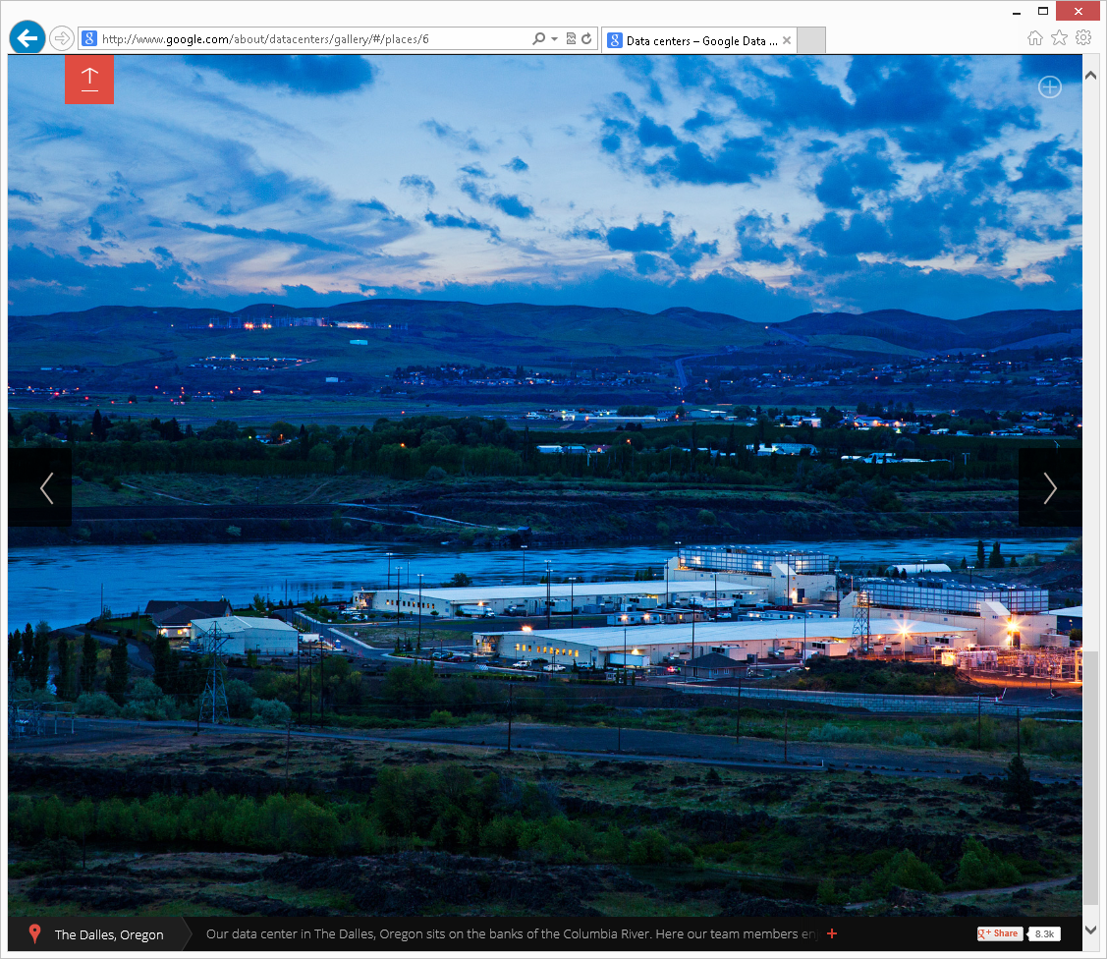
Server Farm at The Dalles, Oregon
7

Slide 8
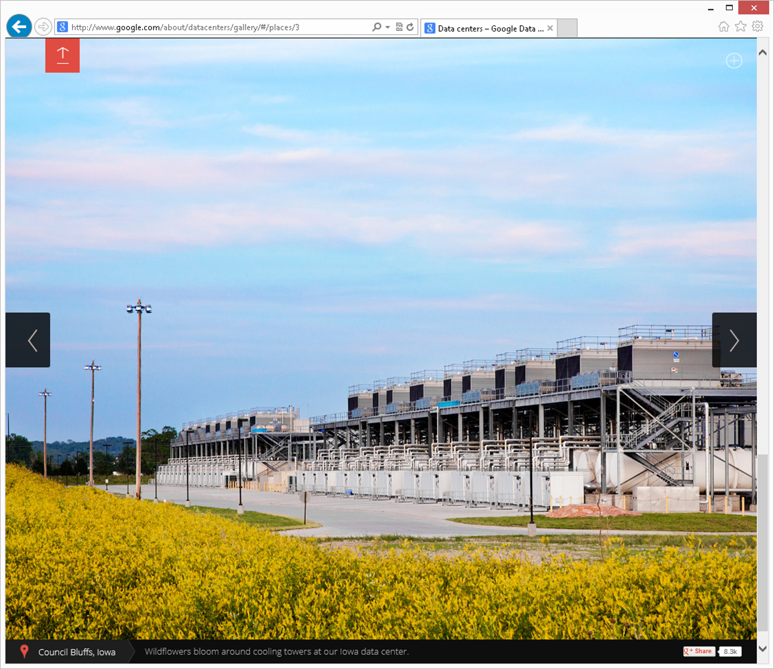
Server Farm at Council Bluffs, Iowa
8

Slide 9
The Iowa server farm cost $1.5 billion to build according to http://www.datacenterknowledge.com/archives/2013/12/02/in-iowa-a-field-becomes-a-huge-google-server-farm/
9

Slide 10
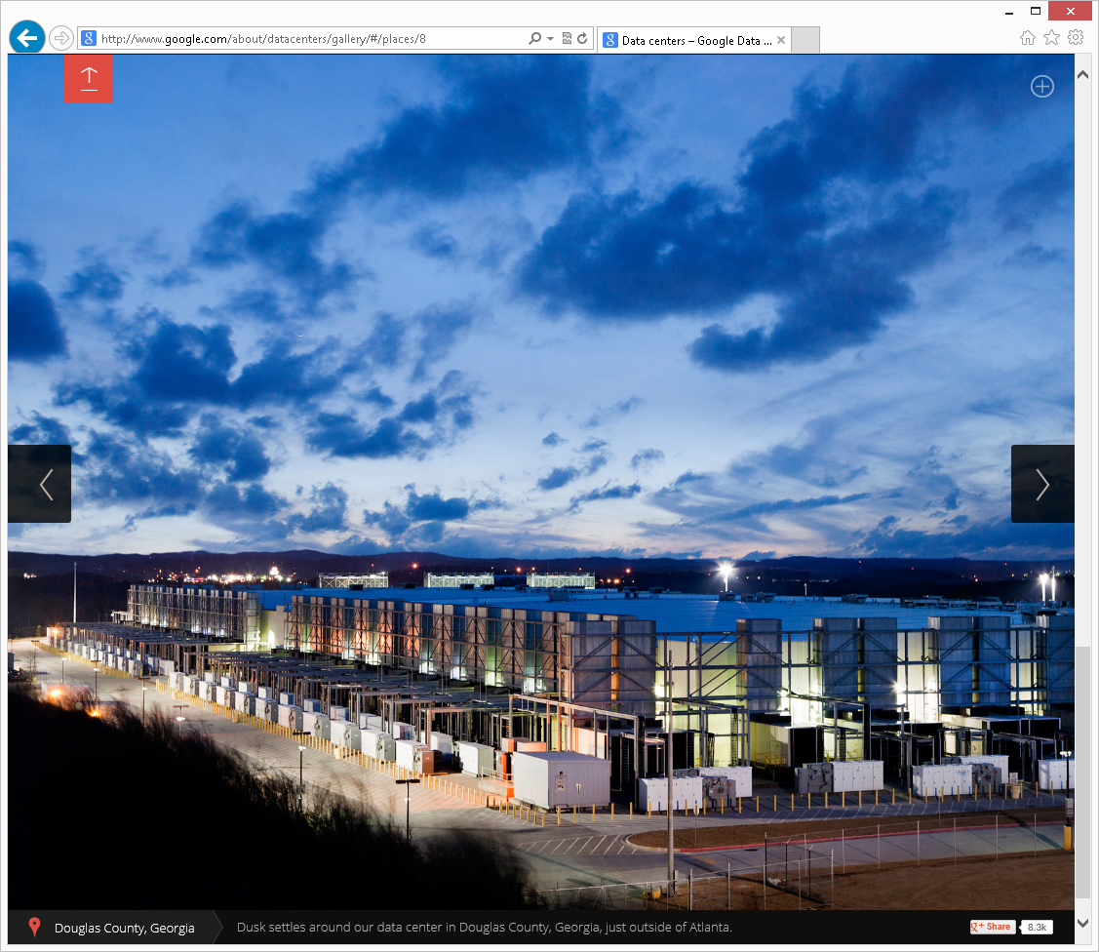
Server Farm at Douglas County, Georgia
10

Slide 11
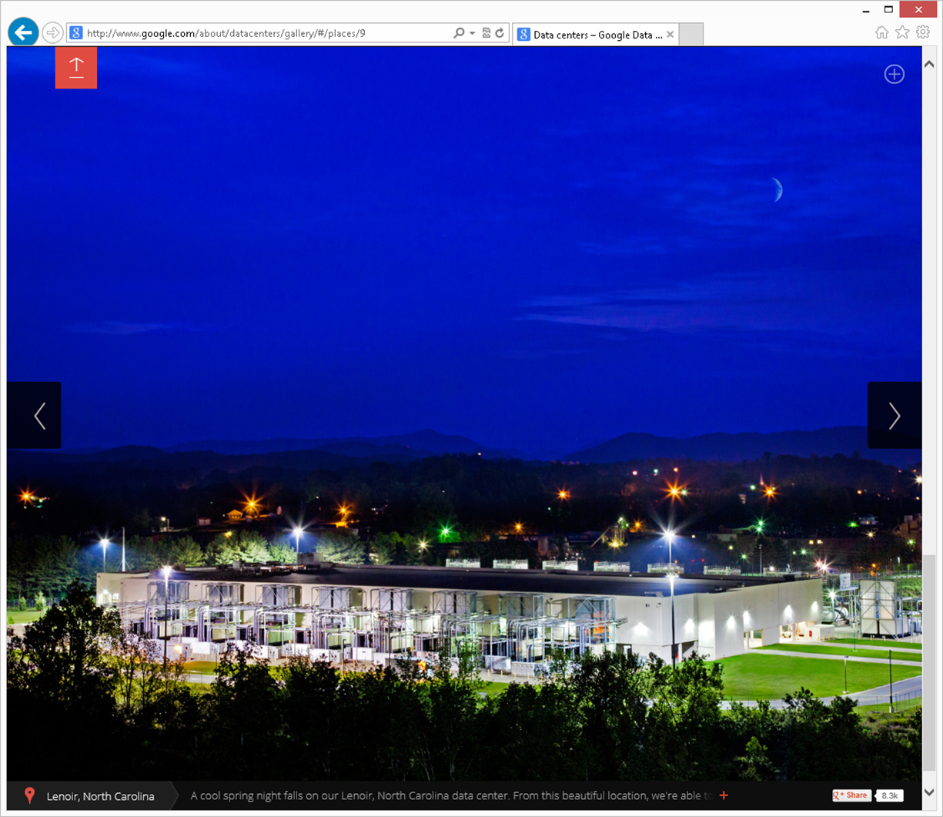
Server Farm at Lenoir, North Carolina
11

Slide 12
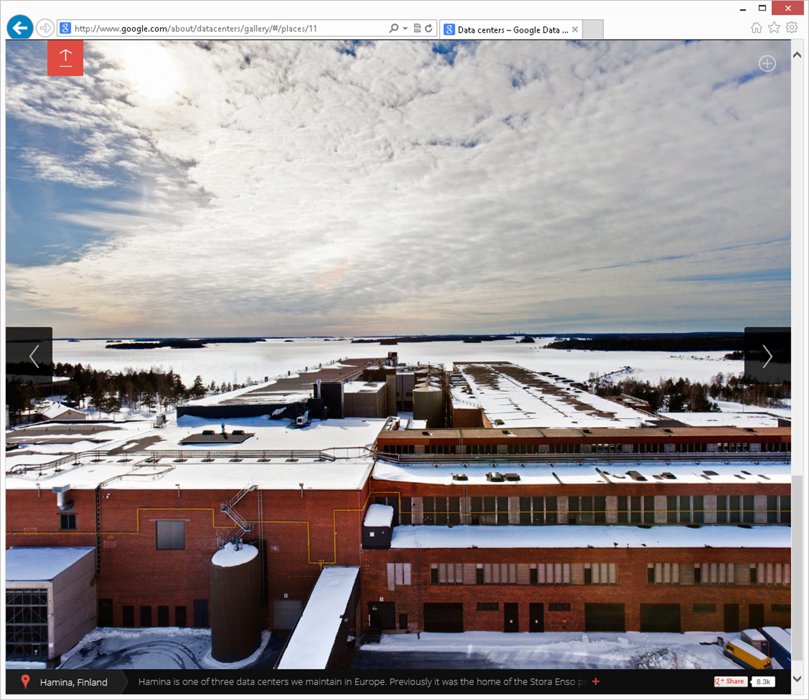
Server Farm at Hamina, Finland
12

Slide 13
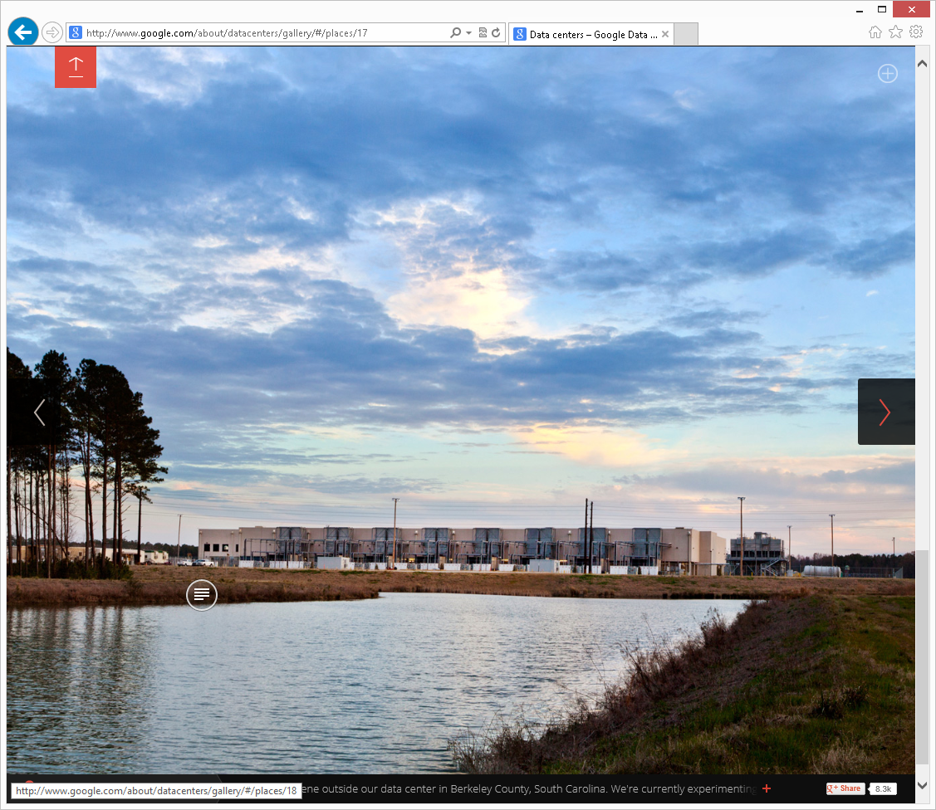
Server Farm at Berkeley County, South Carolina
13

Slide 14
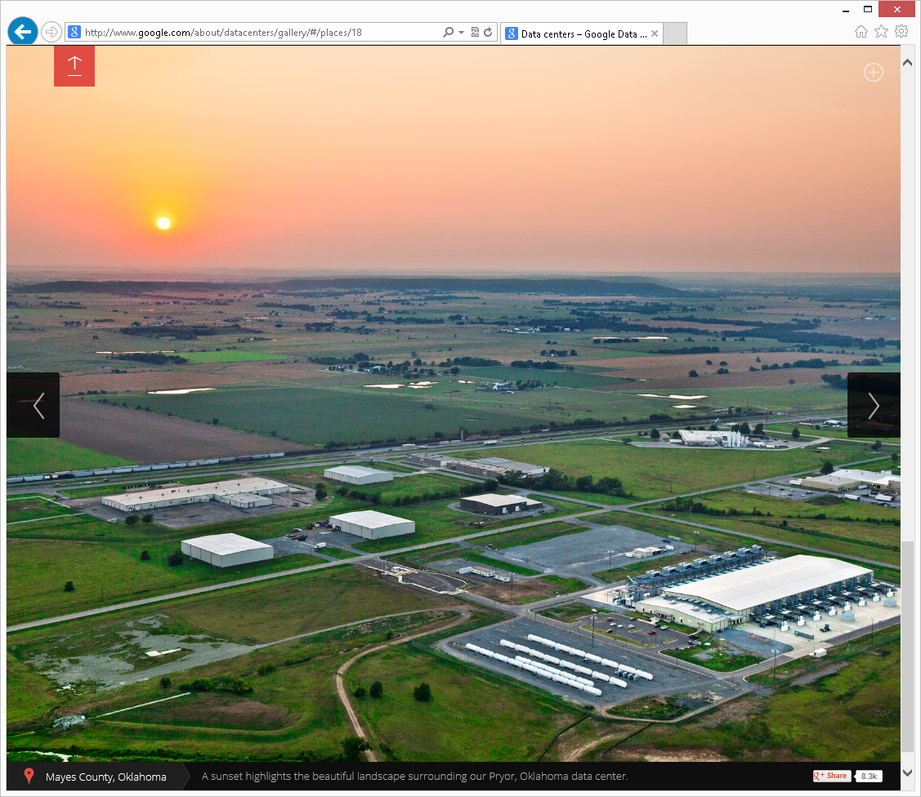
Server Farm at Mayes County, Oklahoma
14

Slide 15
REPORT CARD FOR "GOOGLE DRIVE"
AMOUNT OF FREE STORAGE? | 5 GB
UPLOAD AND DOWNLOAD FOLDERS OF DATA FILES? | Yes, folder uploads and downloads from the Chrome browser or with a Java applet in other Web browsers. Also, folder uploads from the "Google Drive for PC" app's "Google Drive" folder.
STORE PHOTO FILES IN ADDITION TO DOCUMENT FILES? | Yes
ONLINE VIEW AND EDIT OF DOCUMENTS AND PHOTOS? | Yes
"WINDOWS STORE APP" FOR USE IN THE "START" SCREEN OF "WINDOWS 8"? | Yes ("Google Drive Client")
15

Slide 16

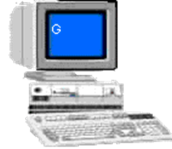
Internet Connection
Server Farms Operated by a Google for "Google Drive"
Your Computer, Tablet, PDA, or Cell Phone
Ethernet or WiFi Adapter
Web Browser
to access drive.google.com
"Google Drive" which is a desktop application for "Windows XP", "Windows Vista" "Windows 7",
"Windows 8", or
"Mac OS X 10.6+"
Native upload/down ability in Chrome Browser and an add-on is provided by Google for browsers other than Chrome
16

Slide 17

Your Computer, Tablet, PDA, or Cell Phone
accessing GOOGLE DRIVE
Ethernet or WiFi Adapter
Upload or download single files
Download entire folders as zip files
Can upload entire folders
Web Browser to access drive.google.com
Native upload/download capability in Chrome browser. A Java applet add-on is provided by Google for folder uploads in other browsers. Single file uploads and downloads with HTML
"Google Drive" which is a desktop application for "Windows XP",
"Windows Vista", "Windows 7", "Windows 8", or "Mac OS X 10.6+"
Upload folders or single files
(No downloads using the "Google Drive" program)
For the Windows 8's "Start screen"-based
"Internet Explorer 10", only the upload and download of single files is possible.
17

Slide 18
Report Card for "Google Drive" (continued)
From the "Google Chrome" Web browser, you can download and upload local folders of data files to the "Google Drive" server farm.
From most other Web browsers, you can install a Google-provided "Java-based folder upload applet" that will enable the upload of local data files to the "Google Drive" server farm.
18

Slide 19
Using the "Google Chrome" browser to upload folders or files from your local computer to the "Google Drive" server farm:
19

Slide 20
Using the "Google Chrome" browser to download folders or files from the "Google Drive" server farm to your local computer:
20

Slide 21
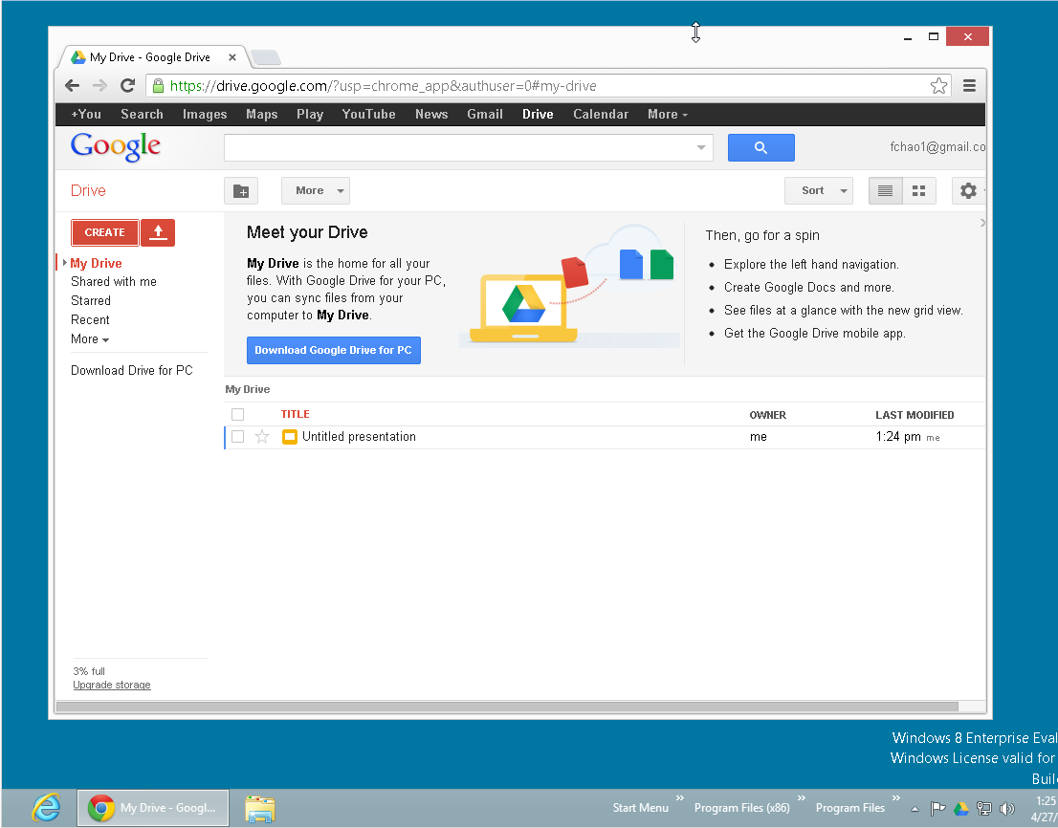
21

Slide 22
22

Slide 23
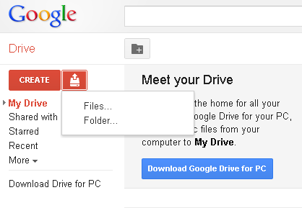
23

Slide 24
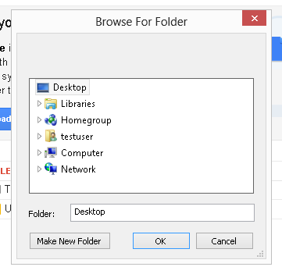
24

Slide 25
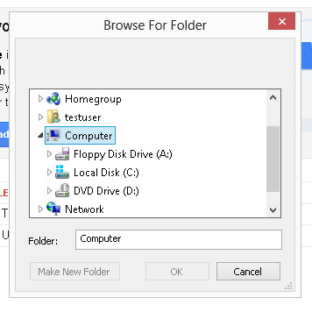
25

Slide 26
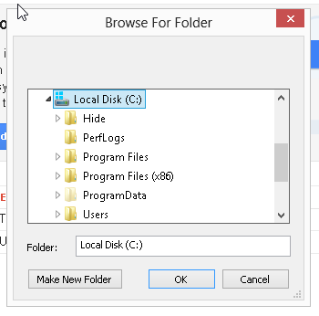
26

Slide 27
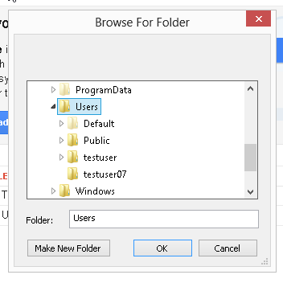
27

Slide 28
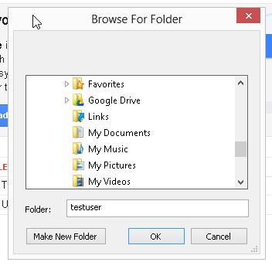
28

Slide 29
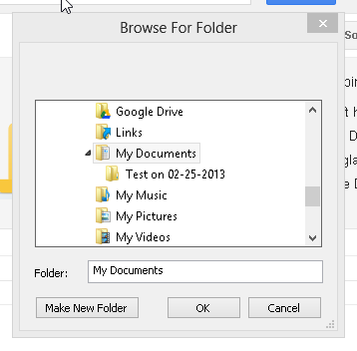
29

Slide 30
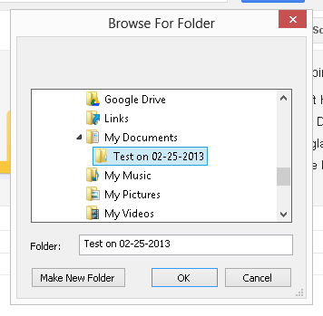
30

Slide 31
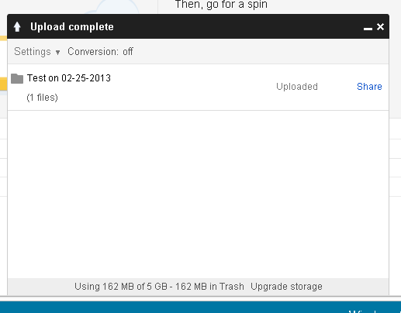
31

Slide 32
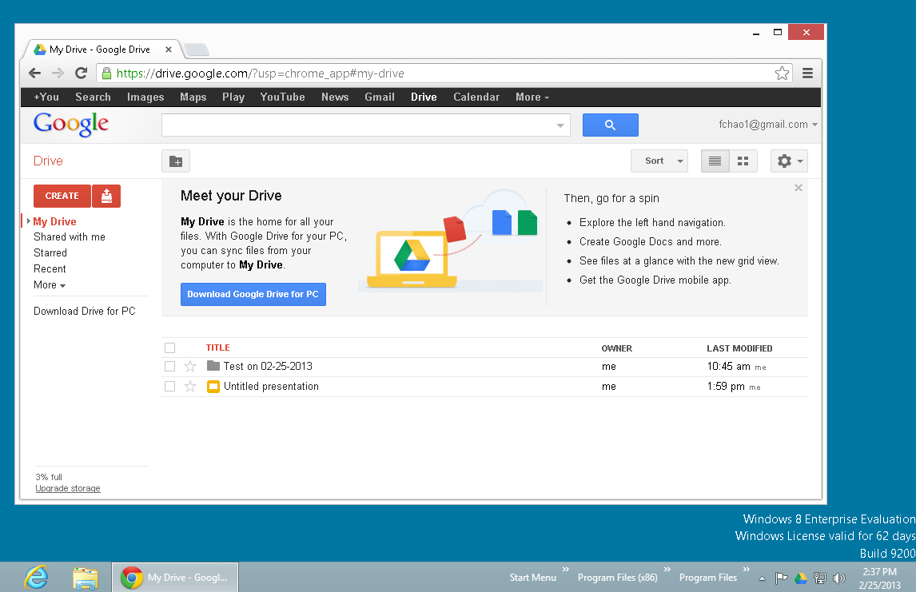
32

Slide 33
33

Slide 34
Report Card for "Google Drive" (continued)
When you use a Web browser to download a file from the "Google Drive" server farm: the "Google Drive" server farm zips the folder before sending it to the "Downloads" folder of your computer.
34

Slide 35
Report Card for "Google Drive" (continued)
The "Google Chrome" browser has the added benefit of allowing offline access to all files stored at the "Google Drive" server farm, even when you do not have an Internet connection. See http://support.google.com/drive/bin/answer.py?hl=en&answer=2375012&topic=2375002&ctx=topic
35

Slide 36
Report Card for "Google Drive" (continued)
The "Start" screen version of Internet Explorer 10 (= "Metro IE10") of "Windows 8" does not allow the upload of a folder with Google Drive's java browser applet: You can only upload a single file at a time.
36

Slide 37
Report Card for "Google Drive" (continued)
The "Start" screen version of Internet Explorer 11 (= "Metro IE11") of "Windows 8.1" does not allow the upload of a folder with Google Drive's Java browser applet: You can only upload a single file at a time.
37

Slide 38
Report Card for "Google Drive" (continued)
"Google Drive" does not have a "Windows Store App" for the new "Start Screen" of "Windows 8" (while "OneDrive" and "Box" both provide free "Windows Store Apps" for the "Start" screen of "Windows 8")
38

Slide 39
Report Card for "Google Drive" (continued)
"Google Drive" displays all 3-character file extensions (unlike "OneDrive" which does not display 3-character file extensions which can confuse the end-user).
39

Slide 40
Using the "Desktop" version of the Internet Explorer 10" browser (in "Windows 7" and "Windows 8") to upload folders or files from your local computer to the "Google Drive" server farm:
40

Slide 41
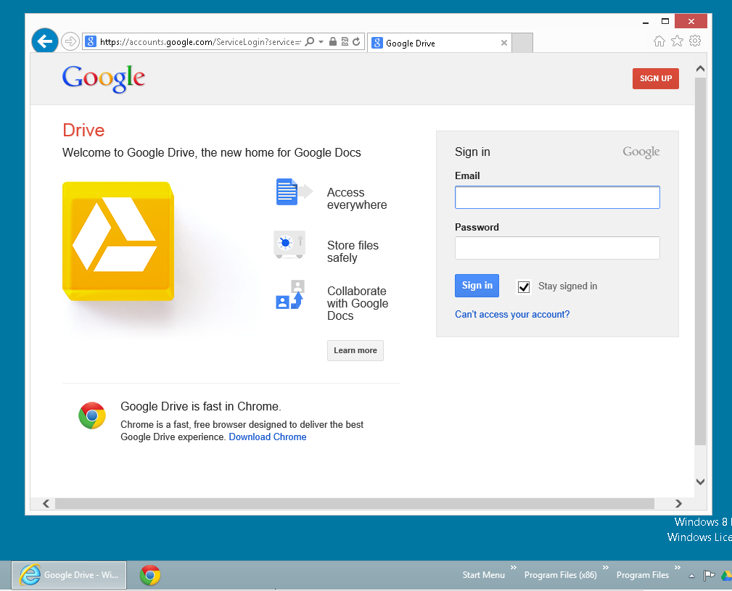
41

Slide 42
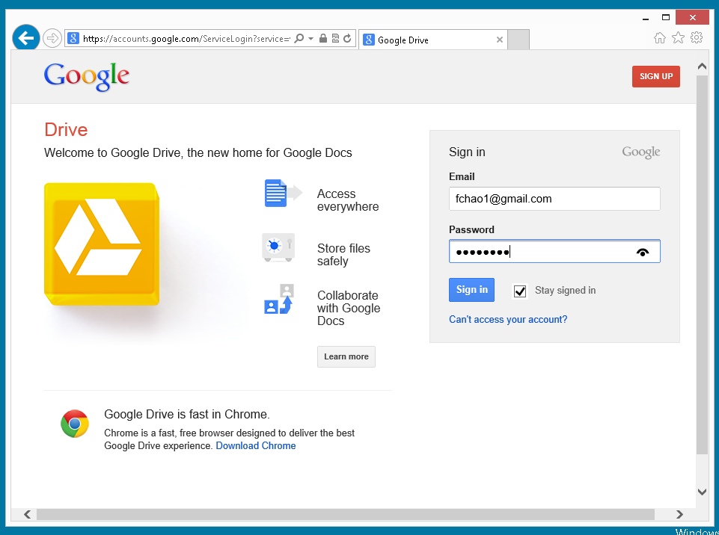
42

Slide 43
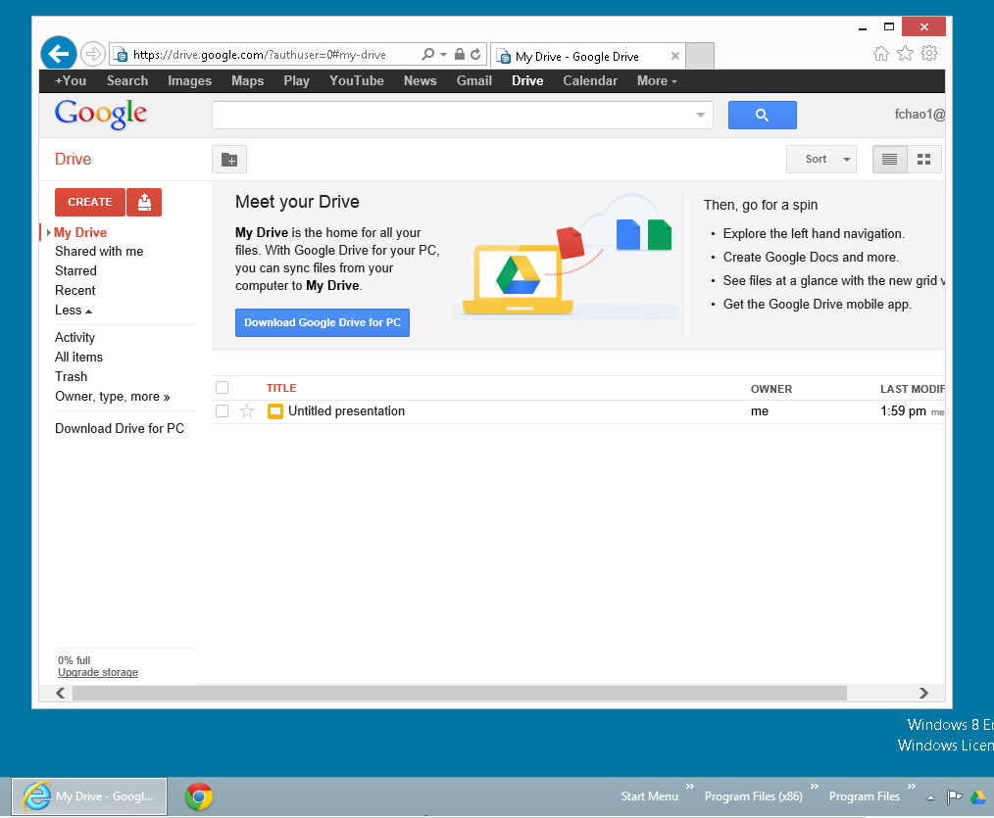
43

Slide 44
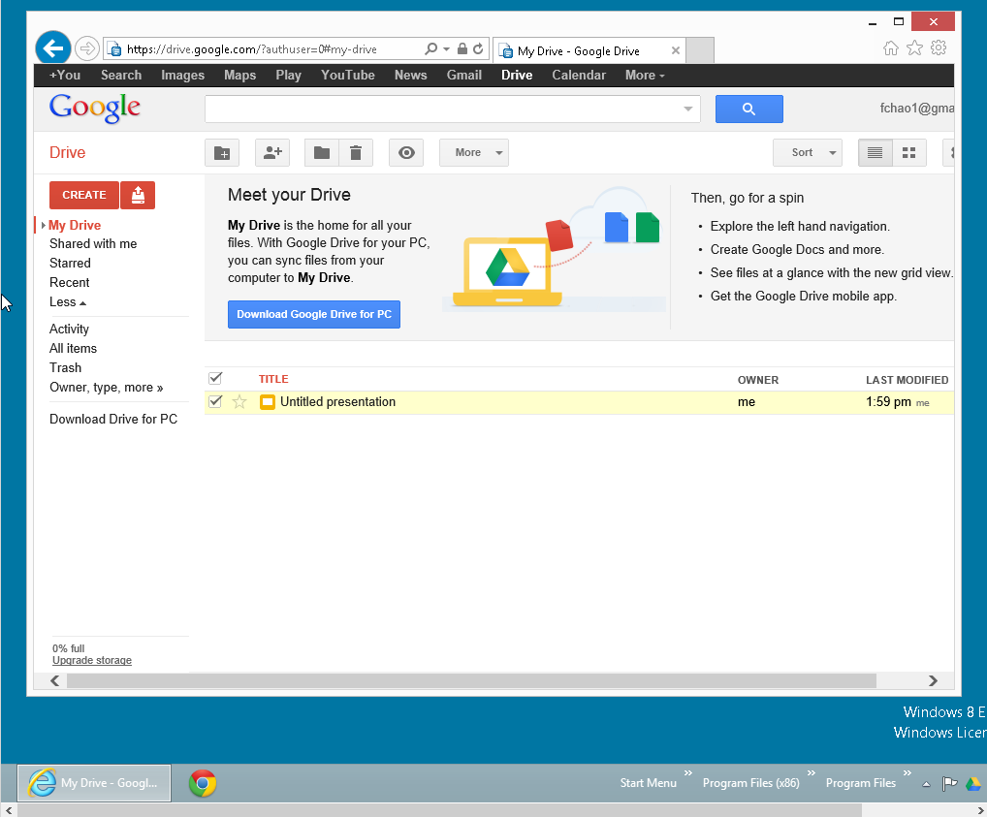
44

Slide 45
45

Slide 46
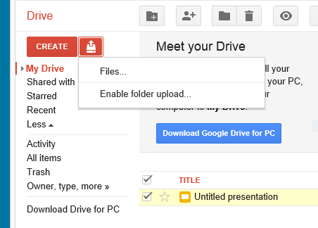
46

Slide 47
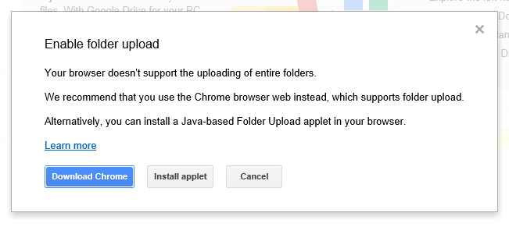
47

Slide 48
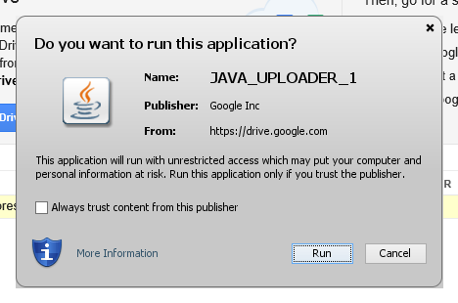
48

Slide 49
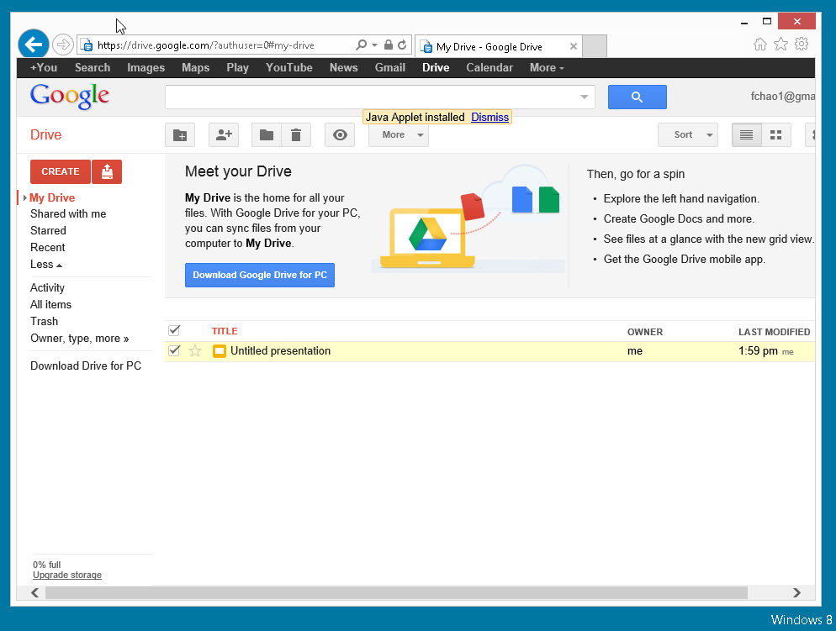
49

Slide 50

50

Slide 51
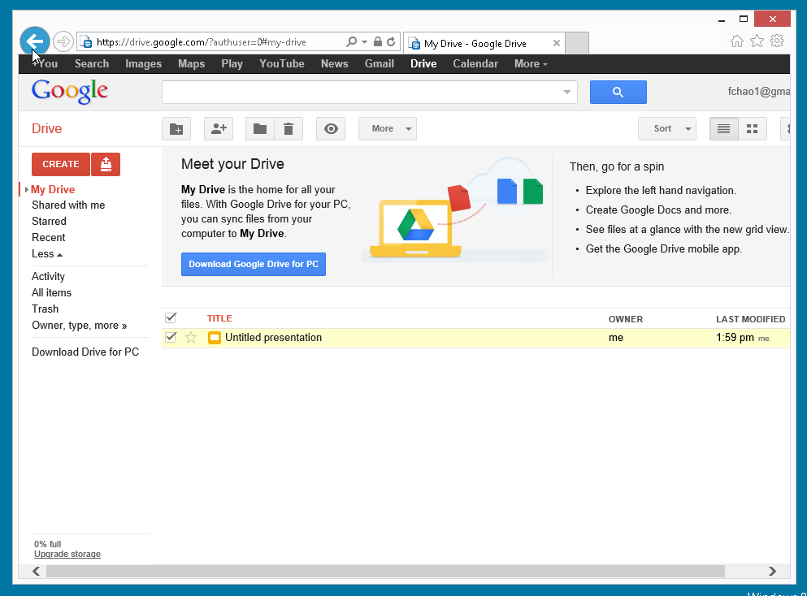
51

Slide 52
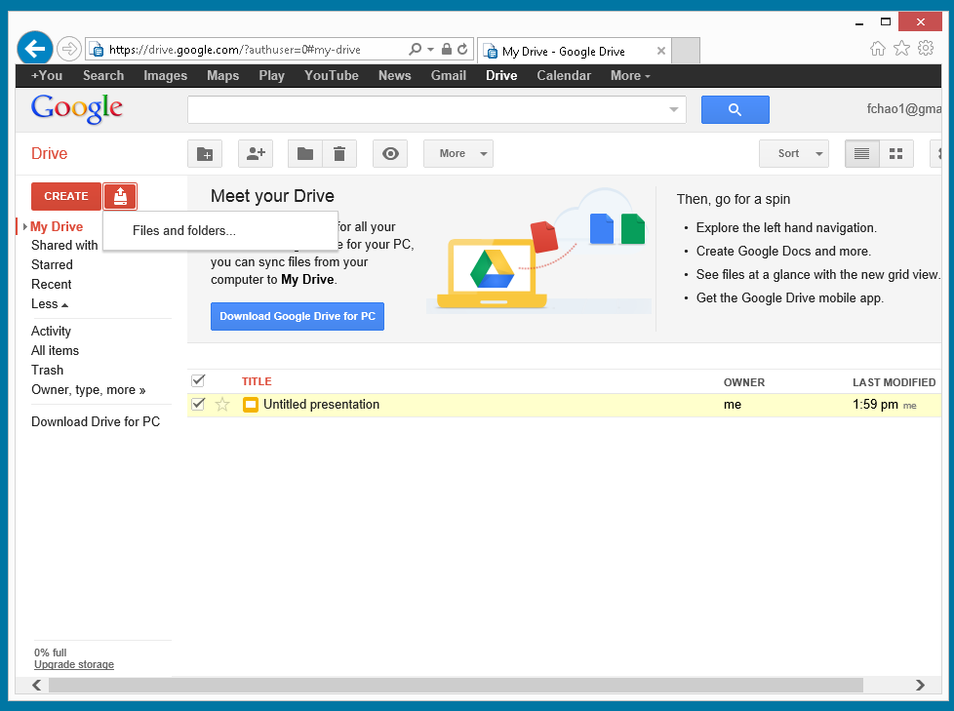
52

Slide 53
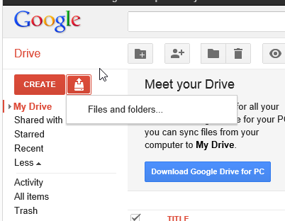
53

Slide 54
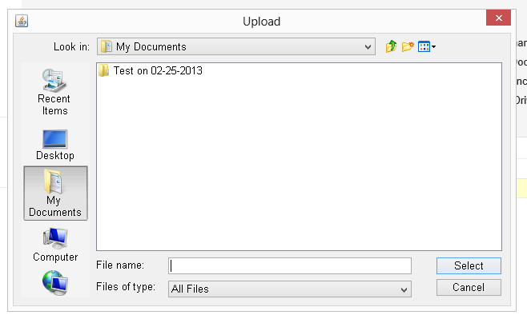
54

Slide 55
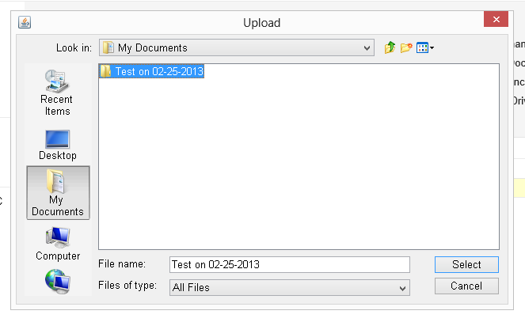
55

Slide 56
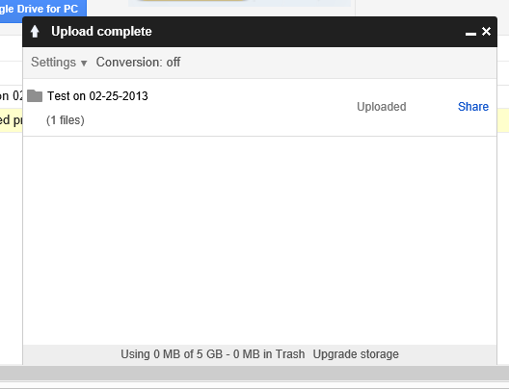
56

Slide 57
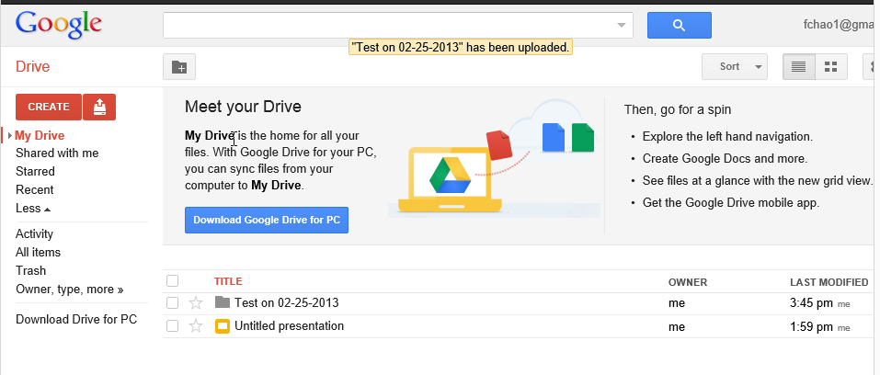
57

Slide 58
At the present time, you cannot use the "Desktop" edition of the Internet Explorer 11" browser (in "Windows 8.1") to upload folders or files from your local computer to the "Google Drive" server farm:
58

Slide 59
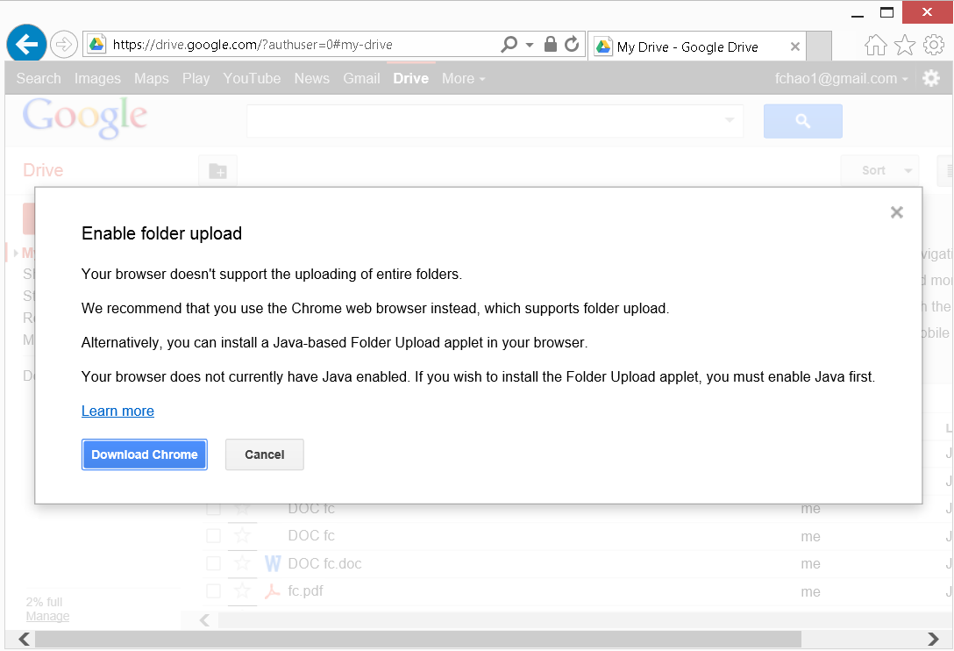
59

Slide 60
Using the "Google Drive for Windows" desktop app to upload folders or files from your local computer to the "Google Drive" server farm:
60

Slide 61
Requirements for "Google Drive" for all platforms: See http://support.google.com/drive/bin/answer.py?hl=en&answer=2375082
61

Slide 62
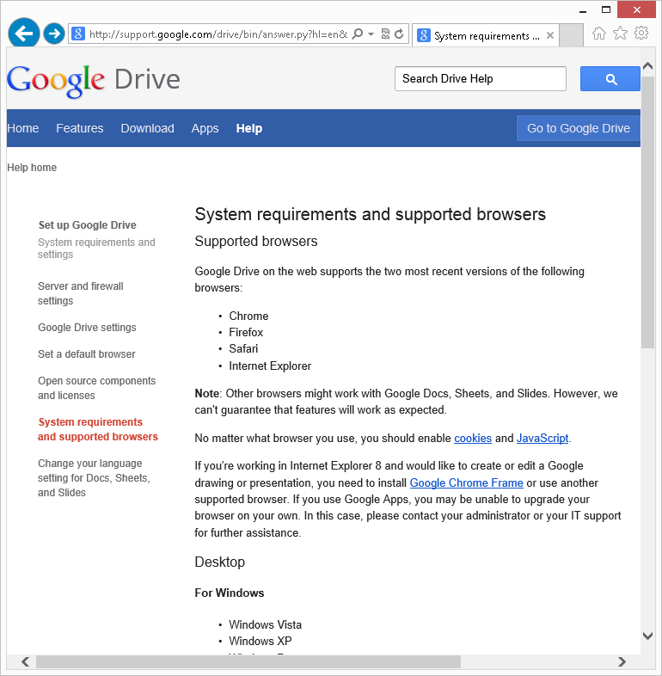
62

Slide 63
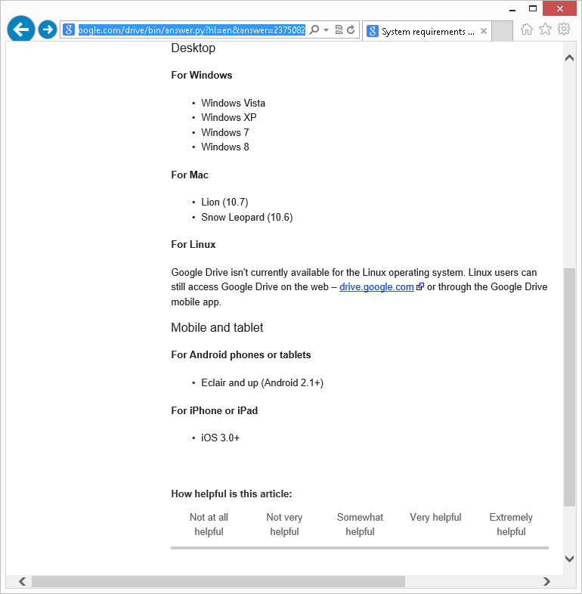
63

Slide 64
Google will not let you download their "Google Drive.." software until you log in with your Google account!:
64

Slide 65
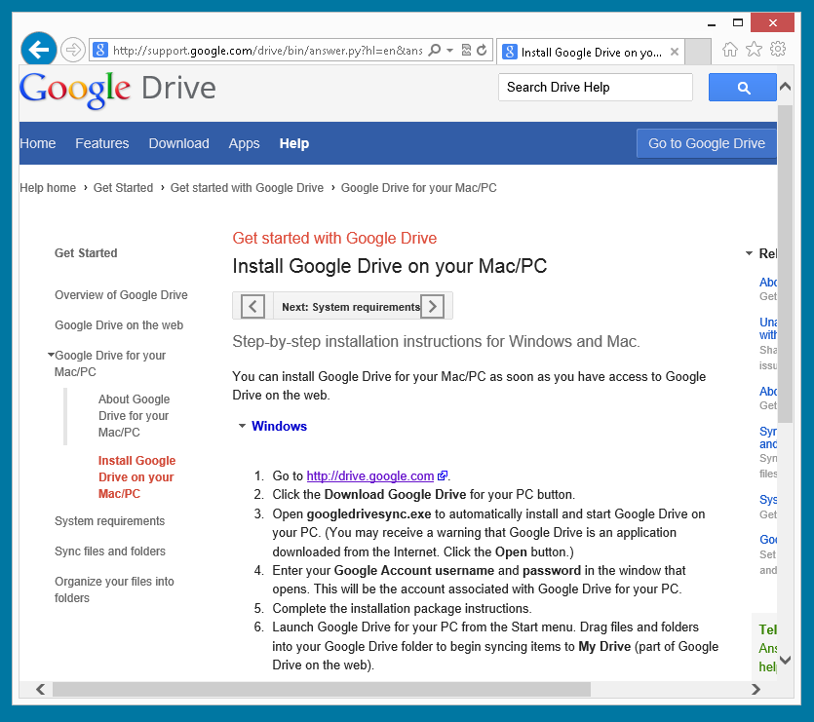
65

Slide 66
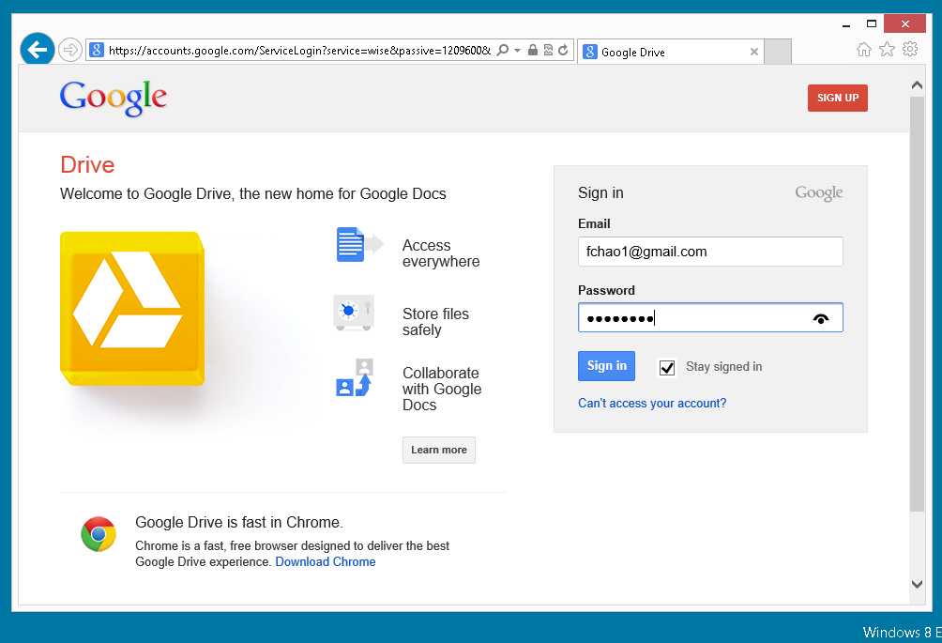
66

Slide 67
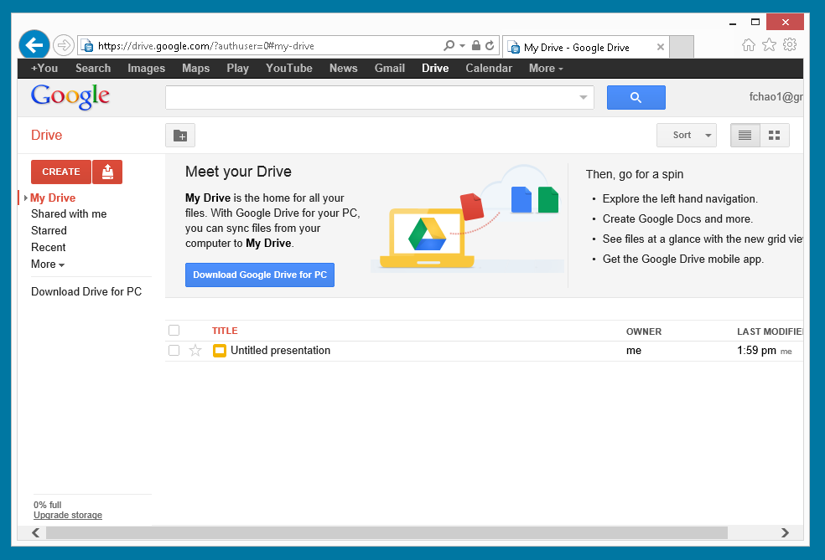
67

Slide 68
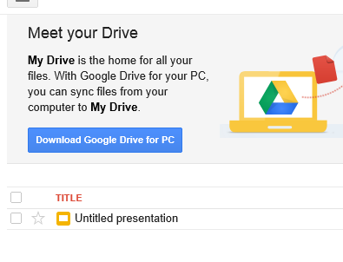
68

Slide 69
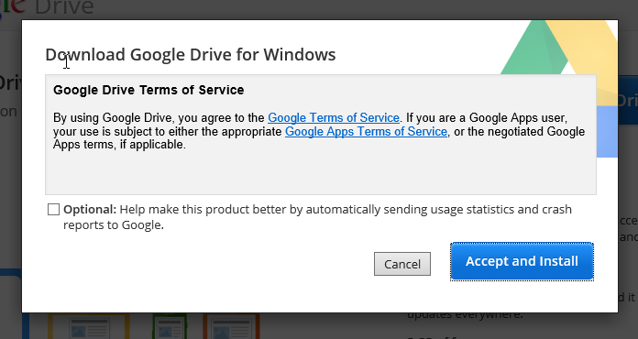
69

Slide 70
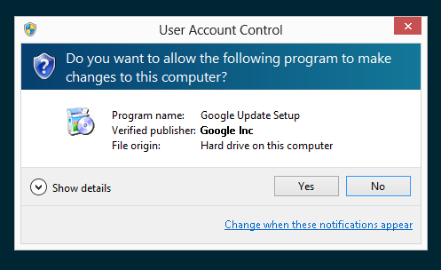
70

Slide 71
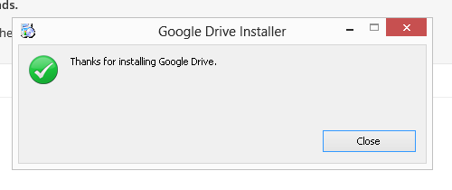
71

Slide 72
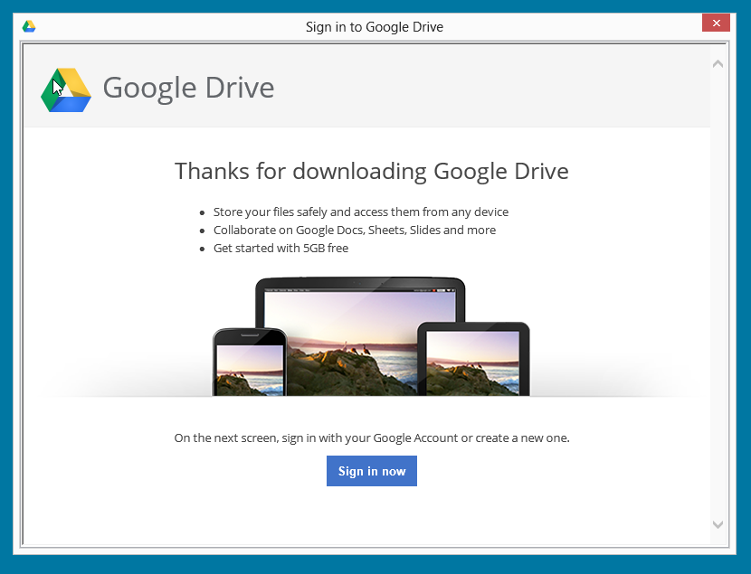
72

Slide 73
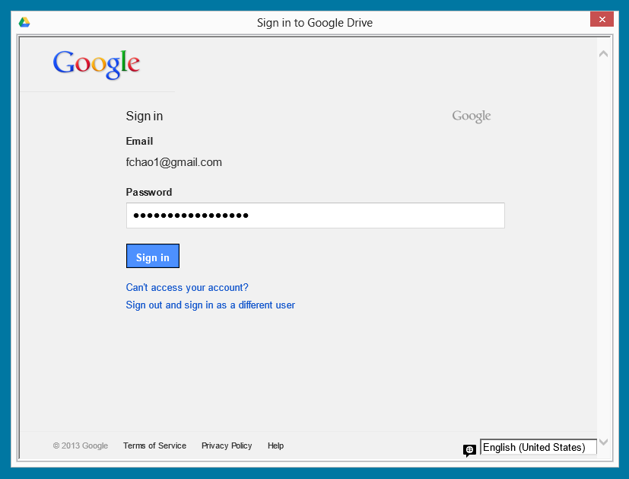
73

Slide 74
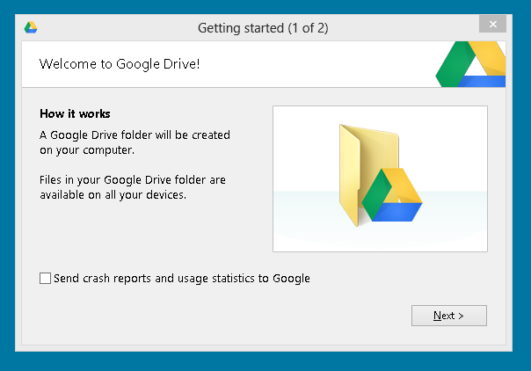
74

Slide 75
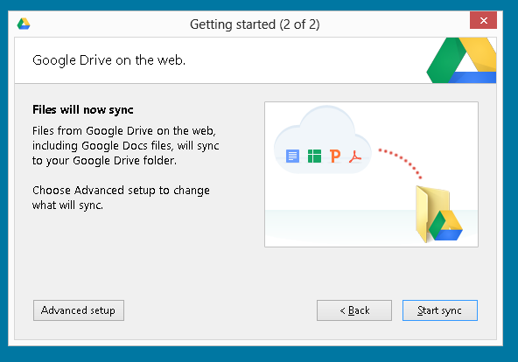
75

Slide 76
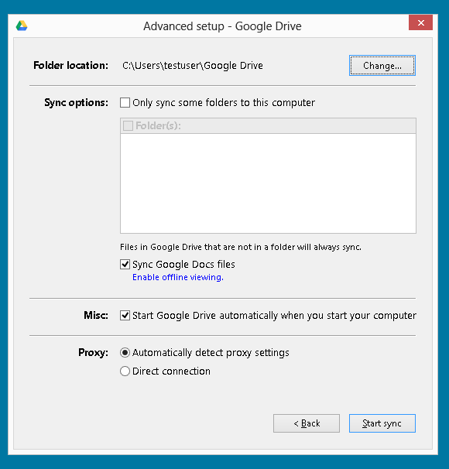
76

Slide 77

77

Slide 78

78

Slide 79
79

Slide 80

80

Slide 81

81

Slide 82

82

Slide 83

83

Slide 84
Report Card for "Google Drive" (continued)
If you delete a data file or folder from your C:\Users\<username>\Google Drive\ folder, the corresponding data file or folder will also be deleted from the "Google Drive" server farm.
84

Slide 85

85

Slide 86

86

Slide 87

87

Slide 88

88

Slide 89

89

Slide 90

90

Slide 91
Report Card for "Google Drive" (continued)
Automatic versus Manual Sync Mode: See http://support.google.com/drive/bin/answer.py?hl=en&answer=1190765&ctx=cb&src=cb&cbid=1le7legfzqat7&cbrank=2
91

Slide 92
WEB-BASED FILE CREATION, VIEWING, AND EDITING IN "GOOGLE DRIVE
92

Slide 93
Web-based File Creation, Editing, and Viewing In "Google Drive"
Google's online file creation and editing services used to be called "Google Docs" and it was accessed by means of http://docs.google.com
These online file creation and editing services are now integrated inside "Google Drive".
93

Slide 94
Web-based File Creation, Editing, and Viewing in "Google Drive" (continued)
To create a new file, click on the "Create" button:
94

Slide 95

95

Slide 96

96

Slide 97

97

Slide 98
Web-based File Creation, Editing, and Viewing in "Google Drive" (continued)
Two ways to perform an operation on an existing file or folder when accessing Google Drive with a Web browser:
Method 1: Use the RIGHT mouse button to click on it and then select from the pop-up context menu
98

Slide 99
Web-based File Creation, Editing, and Viewing in "Google Drive" (continued)
Two ways to perform an operation on an existing file or folder when accessing Google Drive with a Web browser (continued):
Method 2: Place a checkmark for the file or folder and then click on the "More" button
99

Slide 100
Report Card for "Google Drive" (continued)
Details of Method 1: Use the RIGHT mouse button to click on it and then select from the pop-up context menu:
100

Slide 101

101

Slide 102
Report Card for "Google Drive" (continued)
Details of Method 2: Place a checkmark for the file or folder and then click on the "More" button:
102

Slide 103

103

Slide 104
104

Slide 105

105

Slide 106
Report Card for "Google Drive" (continued)
If you right click on a file and do an "Open with.." and select "Google Docs", "Google Sheets", or "Google Slides", you will create a new tab in your Web browser:
106

Slide 107

107

Slide 108

108

Slide 109

109

Slide 110

110

Slide 111

111

Slide 112

112

Slide 113

113

Slide 114
114

Slide 115
Report Card for "Google Drive" (continued)
If you create a new document, spreadsheet, or presentation, Google Drive will store the new file in its own proprietary format.
If you then download this file down to your a local hard drive of your computer, you will have to select the format that you want to file to be downloaded as.
115

Slide 116
Google Drive (continued)
For viewing and editing:
.PDF files open for viewing in the "Google Docs" Web-based service.
.DOC files open for viewing and editing in the "Google Docs" Web-based service.
.XLS files open for viewing and editing at the "Google Sheets" Web-based service.
.PPT files open for viewing and editing in the "Google Slides" Web-based service.
.PPTX files open for viewing and editng at the "Google Sheets" Web-based service..
116

Slide 117
Report Card for "Google Drive" (continued)
If you upload a .doc, .docx, .xls, .xlsx, or a .pptx file to the server farm of "Google Drive" and then you use "Google Docs", "Google Sheets", or "Google Slides" to edit the file, "Google Docs" will create a new file that is minus the file extension.
117

Slide 118
Report Card for "Google Drive" (continued)
Each time that you edit the original .doc, .docx, .xls, .xlsx, or .pptx file, "Google Docs", "Google Sheets", or "Google Slides", you will create another file that is minus the file extension. These files will have the same name but will have a different "Last Modified" date and time.
118

Slide 119
Report Card for "Google Drive" (continued)
The "Google Docs" proprietary format for documents is called .gdoc A .gdoc file (that is located in the "Google Drive" folder in your PC or Mac) is actually a shortcut that points to the location of the actual file up at the "Google Docs" server farm.
119

Slide 120
Report Card for "Google Drive" (continued)
The "Google Docs" proprietary format for spreadsheets is called .gsheet A .gsheet file (that is located in the "Google Drive" folder in your PC or Mac) is actually a shortcut that points to the location of the actual file up at the "Google Docs" server farm.
120

Slide 121
Report Card for "Google Drive" (continued)
The "Google Docs" proprietary format for presentation files is called .gslides A .gslides file (that is located in the "Google Drive" folder in your PC or Mac) is actually a shortcut that points to the location of the actual file up at the "Google Docs" server farm.
121

Slide 122
Report Card for "Google Drive" (continued)
The three "Google Docs" proprietary formats store "revision history" that lets you see how the file looked at a previous point in time. See http://support.google.com/drive/bin/answer.py?hl=en&answer=190843
122

Slide 123
Web-based File Creation, Editing, and Viewing in "Google Drive" (continued)
The "Connect more apps" selection option lets you start up many more online Web-based services for file creation, editing, and viewing:
123

Slide 124
124

Slide 125

125

Slide 126

126

Slide 127

127

Slide 128

128

Slide 129

129

Slide 130

130

Slide 131

131

Slide 132

132

Slide 133

133

Slide 134

134

Slide 135

135

Slide 136

136

Slide 137

137

Slide 138

138

Slide 139

139

Slide 140

140

Slide 141

141

Slide 142

142

Slide 143

143

Slide 144

144

Slide 145

145

Slide 146

146

Slide 147

147

Slide 148

148

Slide 149

149

Slide 150

150

Slide 151

151

Slide 152

152

Slide 153

153

Slide 154

154

Slide 155

155

Slide 156

156

Slide 157

157

Slide 158
Storage plans for "Google Drive":
158

Slide 159


Slide 160

160

Slide 161

161

Slide 162

162

Slide 163

163

Slide 164
Appendix 1 Google's Claim of 15 Gigabytes of Free Storage is Slightly Misleading
Google's Web page at https://tools.google.com/dlpage/drive states you you get 15 Gigabytes of free space. However you actually get 5 Gigabytes of free storage for "Google Drive" 5 Gigabytes of free storage for "Gmail" and 5 Gigabytes of free storage for "Google+ photos".
164

Slide 165
Additional Information about Google Drive
See http://support.google.com/drive/?hl=en and http://www.gcflearnfree.org/googledriveanddocs and http://www.gcflearnfree.org/googledocuments
165

